Slide 1


Slide 2
RoboFish
Supervisor:
Dr. Raed Al-Qadi
Prepared by:
Ayat Salman
Nowwar Kusa

Slide 3
Outline
Introduction.
Hardware Components.
Hardware Development.
Problems.
Future Works.
Demo.

Slide 4
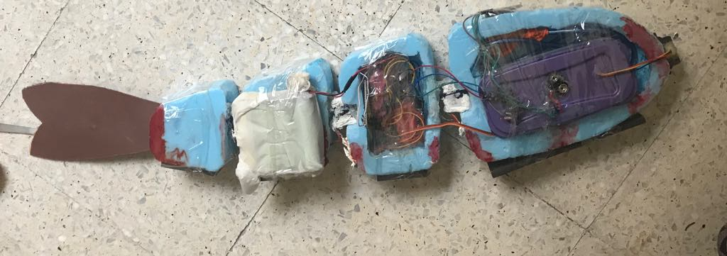
Introduction
What is RoboFish?
RoboFish is a self controlled fish which can swim forward, avoid obstacles then turn around, dive and float easily and can swim in a variable speed.

Slide 5
Introduction
The main features of our RoboFish are:
Forward swimming.
Avoiding obstacles (turn around).
Swimming in a variable speed controlled via Bluetooth.
Dive and float in the water.

Slide 6

Hardware Components
Arduino Uno.
Bluetooth module.
Three Servo Motors.
Submersible DC pump.
Sharp IR sensor.
Four Battery pack.

Slide 7
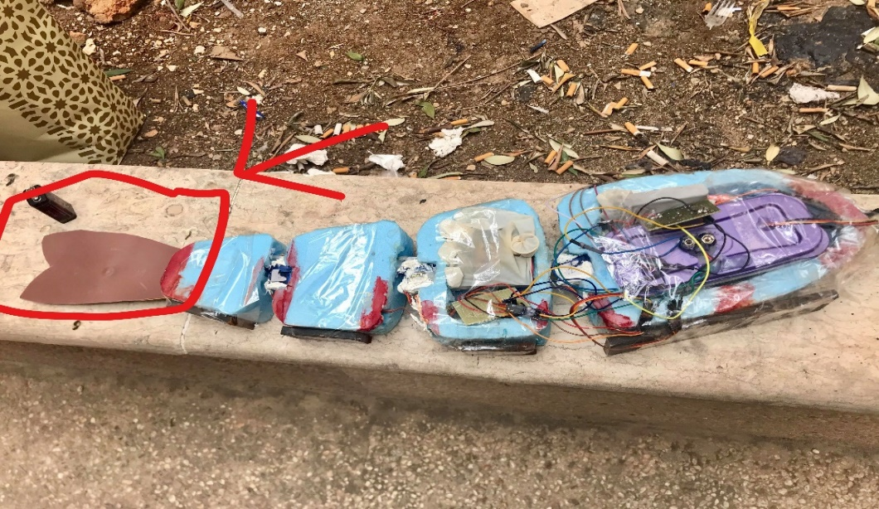
Hardware Development
Shape design:
Common Polystyrene.
Fish face design.
Caudal fin design.
Connecting the Servos.

Slide 8
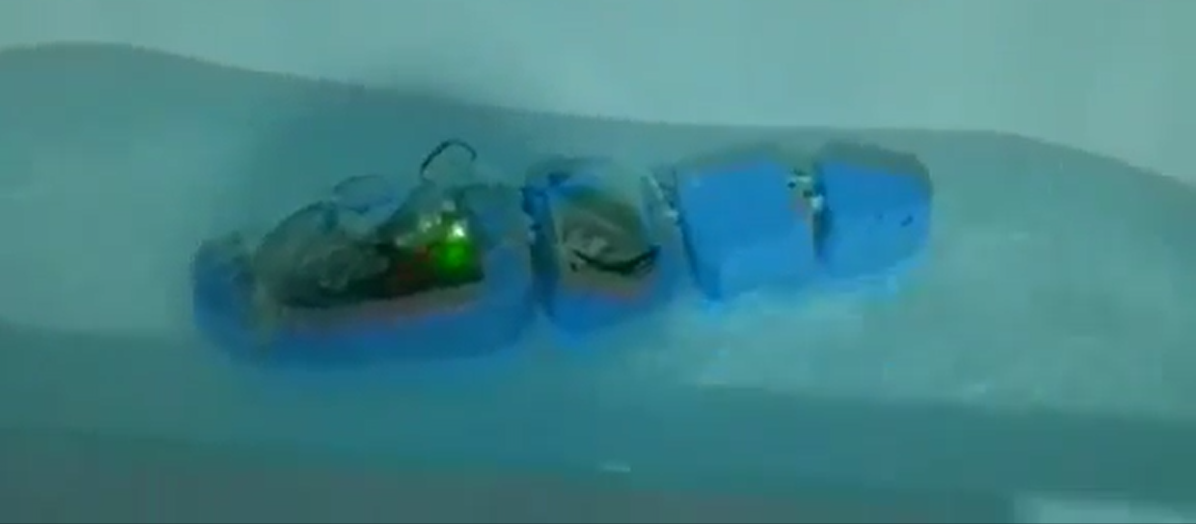
Hardware Development
Putting the fish in water

Slide 9
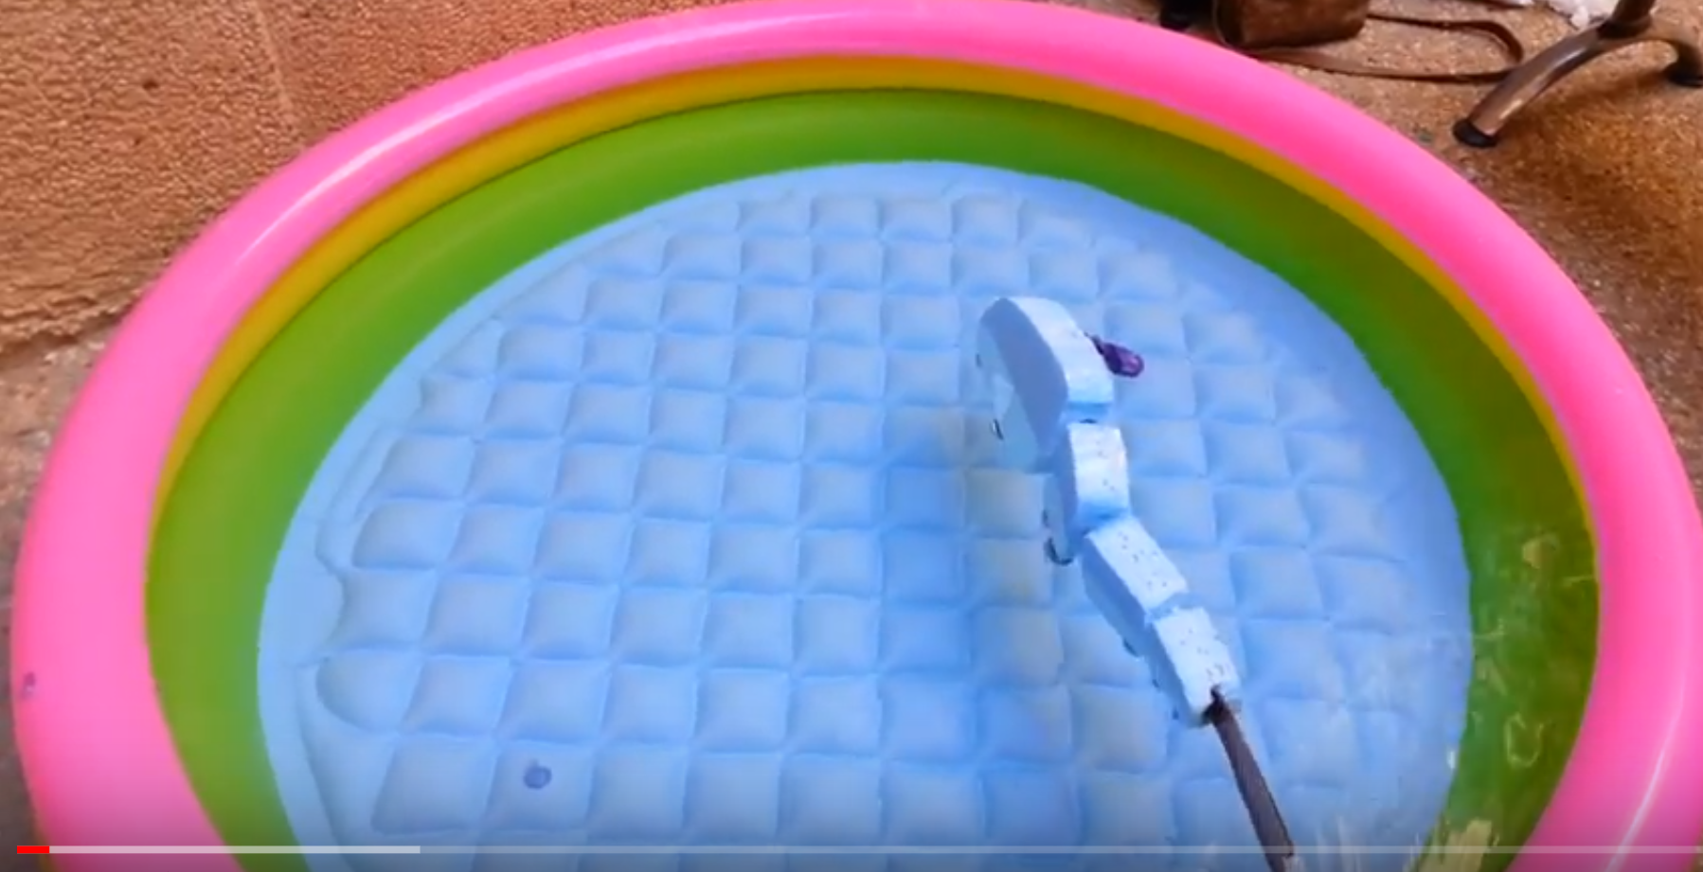
Hardware Development
Fish after adding iron pieces

Slide 10

Hardware Development
Calculations:
To let the fish partially floats in the water (half of it floats )
$$density of obj×v of obj=density offluid ×v of displaced fluid$$
$$?? × v = 1 × 0.5 v$$
$density of obj$ = 0.5 gm/cm3.
The mass of iron required:-
$density of obj\text{ =}$ mass / volume
$mass =0.5 ∗1600 =800 gm of iron$

Slide 11
Fish movement
Small demo

Slide 12
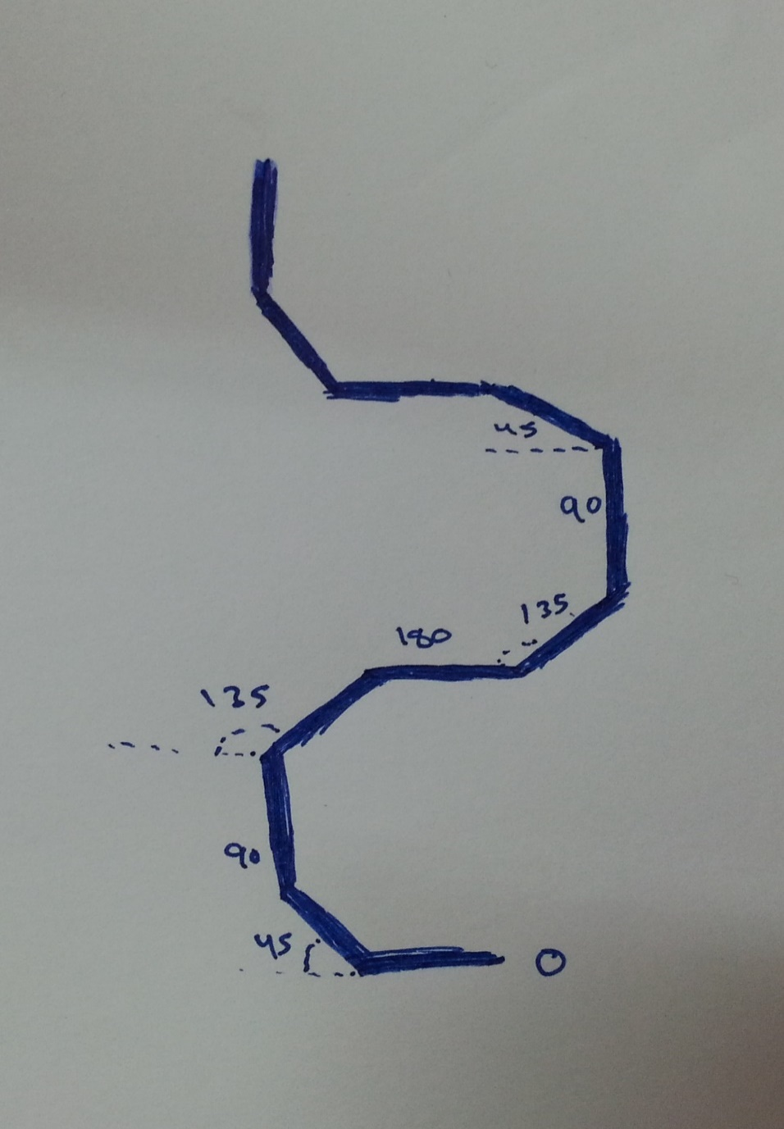
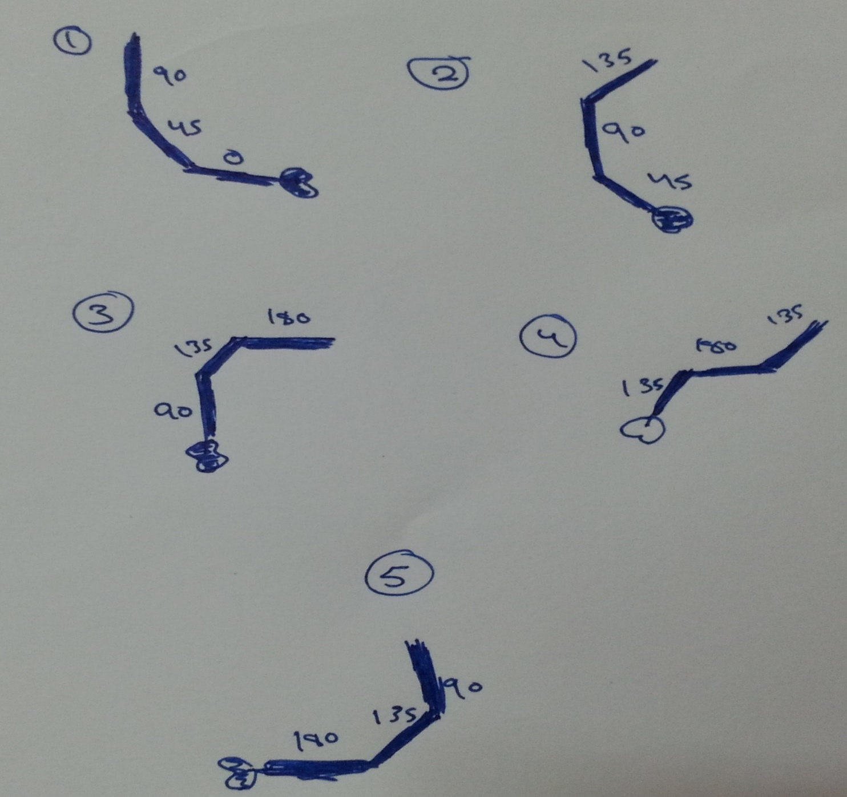
Fish movement

Slide 13
Fish movement
 | Servo 1 | Servo 2 | Servo 3
1 | 90 | 45 | 0
2 | 135 | 90 | 45
3 | 180 | 135 | 90
4 | 135 | 180 | 135
5 | 90 | 135 | 180
Note that :
Servo 1 → 90 – 180
Servo2 → 45 – 180
Servo3 → 0 - 180
Every time the difference between the values of the motors is 45

Slide 14
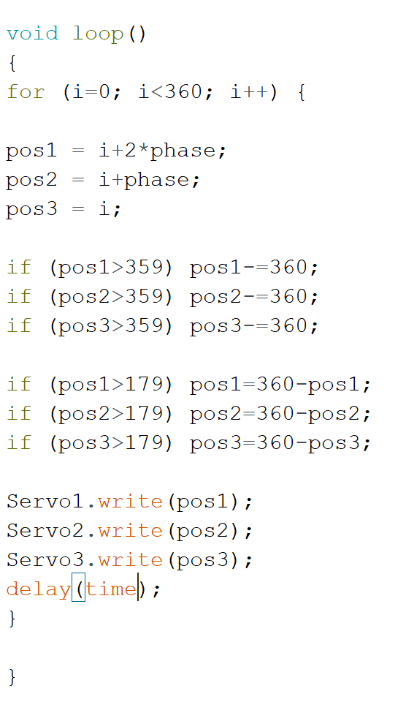
Fish movement

Slide 15
Fish movement
Small demo

Slide 16
Controlling fish
Bluetooth module.
Sharp IR sensor.
Rotation.
Speed controlling.

Slide 17
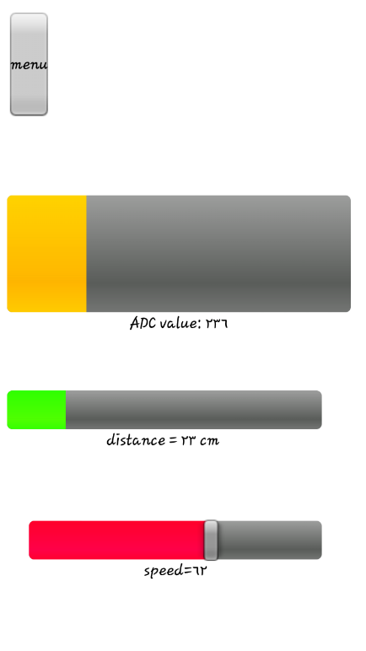
Hardware Development
User Interface App:
Make our own app.
RoboRemo – Customizable.

Slide 18
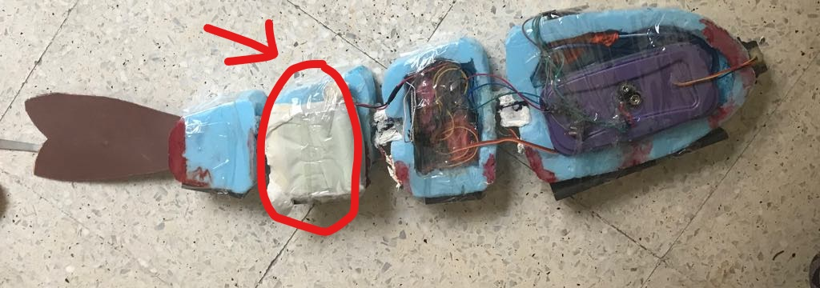
Hardware Development
(powering the fish)
Power supply:
Using 4 batteries
All the problems we faced here

Slide 19

Going up & down
Calculations:
If we added 1400 ml of water :-
$$density of obj\text{ =}$$
3000 /2625= 0.875 gm/cm3
$$density of obj×v of obj=density offluid ×v of displaced fluid$$
$0.875 × \left(1600+1400\right) = 1 × ??$ $v of displaced fluid$= 2625cm3.
Ratio = 2625 /3000 = 7/8

Slide 20
Going up & down
Small demo

Slide 21
Constrains and Difficulties
Dealing with water.
Electric Danger.
Waterproofing.
Choosing the pool.
Making the fish neutrally buoyant.

Slide 22
Future Work
Mechanical design.
Using more Sensors.
Neutral Buoyancy.
Battery saving.

Slide 23
Thank you

