Slide 1

Simulation Of A Cooperative Protocol For Common Control Channel Implementation
Prepared by:
Aishah Thaher
Shymaa Khalaf
Supervisor:
Dr.Ahmed Al-Masri

Slide 2
Out Line
What is “TV White Space”?
Spectrum Sensing Methods
Cognitive channel models
Network Setup Problem
Algorithm for the cooperative protocol
Simulation Results
Conclusion

Slide 3
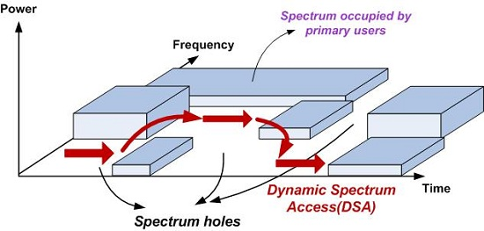
What is “TV White Space”?

Slide 4
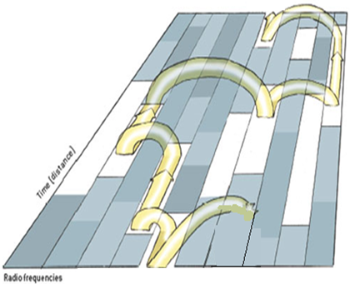
Benefits Of TV White Space Usage
higher bandwidth
widely available network access

Slide 5
Spectrum Sensing Methods

Slide 6
1. Matched Filtering

Slide 7
2. Energy Detection
Optimal way to detect primary signals when
information of the primary signal is unknown
to secondary users
Measures the energy of the received waveform over a specified observation time
Can be implemented both in time
and also frequency domain

Slide 8
3. Cyclostationary Feature Detection
having a drawback of high computationally complexity
performs satisfyingly well under low SNR regimes due to its robustness against unknown level of noise
it is not susceptible to noise levels as energy detection

Slide 9
4. Higher Order Statistics
Motivated for the need of more efficient and flexible
communication system
very useful in problems where non-gaussian,
colored noise have to be considered
applicable in non-Gaussian or non-linear processes

Slide 10
5. Waveform Based Sensing
only applicable to systems with known signal patterns
the performance of the sensing algorithms increases as the length of the known signal pattern increases

Slide 11
Cognitive channel models

Slide 12
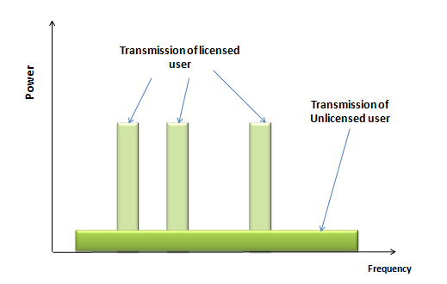
1. Underlay paradigm

Slide 13
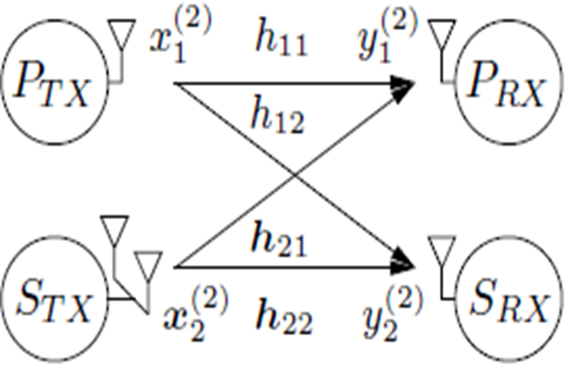
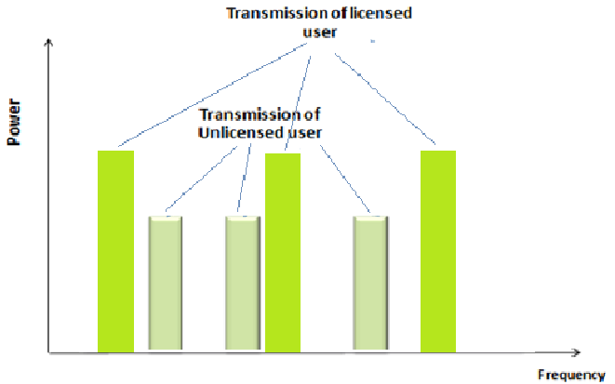
2. Overlay paradigm

Slide 14
3. Interweave paradigm
the cognitive users are required to not interfere with the primary users
requires the cognitive users to collect side information about the primary users' activity

Slide 15
Network Setup Problem

Slide 16
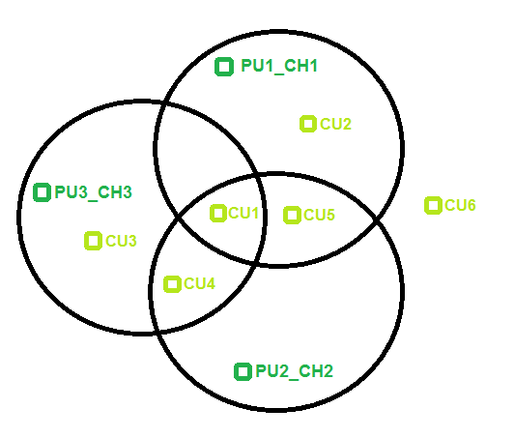

Slide 17
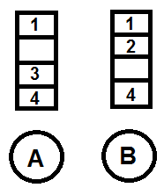
Common Control Channel Problem

Slide 18
Algorithm for the cooperative protocol

Slide 19
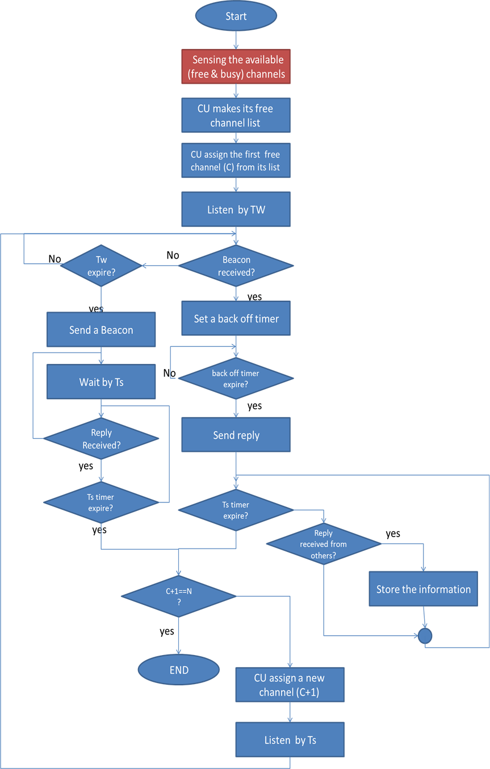

Slide 20
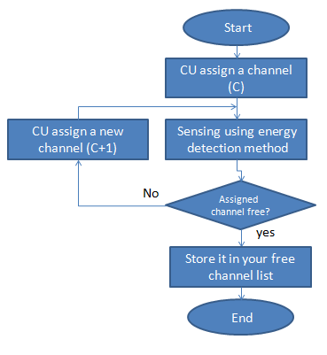
sensing flowchart

Slide 21
Simulation Results

Slide 22
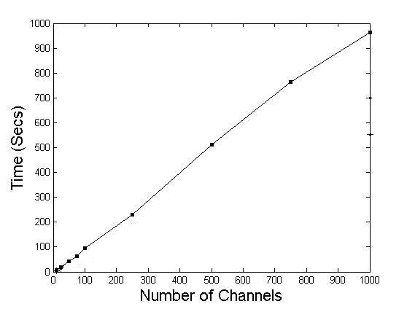
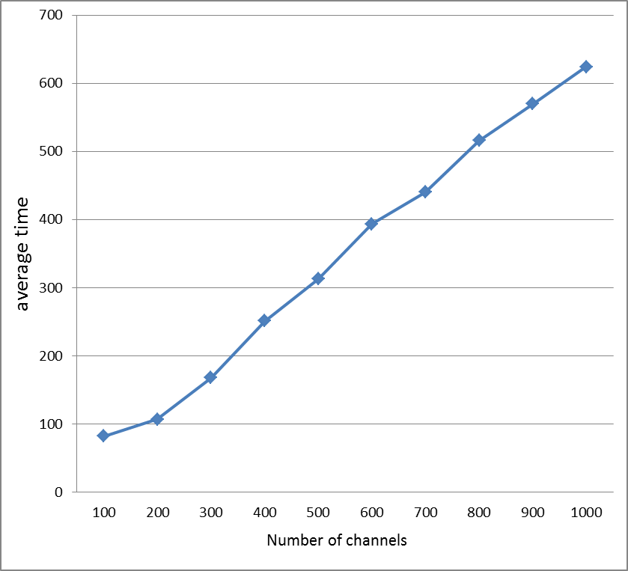
average Time with varied number of channels
cooperative protocol
sequential protocol

Slide 23
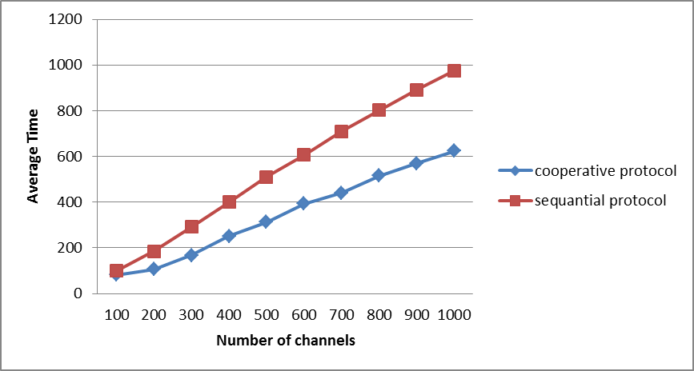
comparison between sequential and cooperative protocols

Slide 24
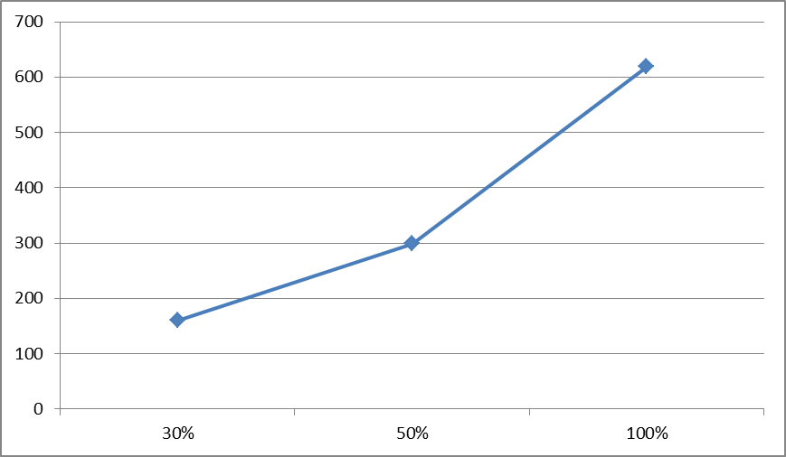
Average time which is needed to have information about
30% , 50% and 100% of the system information

Slide 25
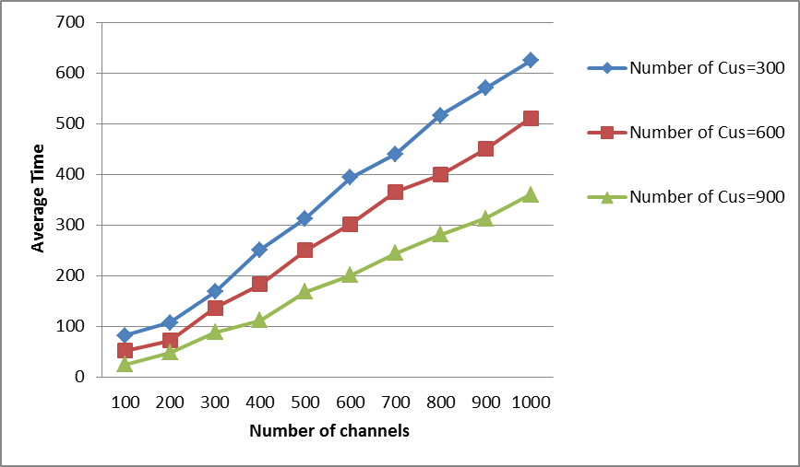
Response of the cooperative system for different number of users

Slide 26
Conclusion
The Network Setup Problem (NSP) is discussed and our protocol is proposed to set up a Multi-hop CRN (MHCRN), it was observed that our cooperative protocol can Exploits the resources at the best and fastest ways and allowing the users the opportunity to meet and communicate as soon as possible compared to the SEQ-protocol that proposed in " Cognitive Radio Network Setup without a Common Control Channel " paper.

Slide 27
Thank you…

