Slide 1

Developing Water Demand and Losses Forecasting and Losses Reduction Models for Water Management System in the
Municipality of Nablus
An-Najah National University
Faculty of Engineering and Information Technology
Industrial Engineering Department
Graduation Project II
Wednesday, December 29, 2021

Slide 2






Meet The Team
Supervisor: Dr. Yahya Saleh
Prepared By:
Adnan Seddeh Hala Ratrout Lana Lahham
Osama Hijawi Aya Abu-Rajab

Slide 3
TABLE OF CONTENTS
01
02
03
04
06
INTRODUCTION
METHODOLOGY
07
PROBLEM STATMENT
DATA ANALYSIS AND RESULTS
OBJECTIVES
FORECASTING
MANAGMENT
08
CONSTRAINTS & DIFFICULTIES
CONCLUSION
05
09
LITERATURE REVIEW
RECOMMENDATIONS

Slide 4

INTRODUCTION
About municipality of Nablus
Water and Sanitation Department in Nablus Municipality
Major idea of our project
related to the importance of water and reduce the losses to achieve the best.

Slide 5
PROBLEM STATMENT
The current water network in Nablus is considered unqualified, as there are several types of losses that lead to losses in the amount of water sent to citizens as well as financial losses.
water losses causes:
-physical ➔ leakage of tanks, leakage of pipes.
-commercial➔ inaccurate measurements, water theft.

Slide 6
OBLECTIVES
The project aims to reach two main points, namely, building an effective prediction model to predict the state of the water network in Nablus, which specifically detects water losses for each pressure zone (PZ) and transition lines (TL). Which helps in evaluating the future water consumption of the city to meet the demand of customers at the lowest possible cost. And the second trend is to provide an initial administrative system that helps manage and reduce waste to reach the same goal.

Slide 7
CONSTRAINTS & DIFFICULTIES
The difficulty of taking times for meeting with people in municipality because of the afraid from corona
The lack in time because of the current situation and the procedure of taking data form water department
Missing data for some pressure zones, periods, and meters that needs calibration.
The difficulty of collecting data and finding sources or references about the problem, which took a lot of time and effort to achieve accurate and reliable results.

Slide 8
LITERATURE REVIEW
Forecasting
Anticipating the occurrence of an expectation of the company's ability to derive its next moves from predicting what will happen if this occurs, as the study of current events is a tool for decision-making and dealing with future uncertainty.
The importance of forecasting lies in giving the ability to make data-driven decisions, as forecasting provides information related to past, present, and potential future events. Especially in the process of water forecasting, managers are able to estimate future demand and enable them to understand spatial and temporal patterns of future water use to improve the system or plan for future water purchase in addition to future revenues and expenditures.

Slide 9
LITERATURE REVIEW
Management system
For a management system, the four phrases (plan, do, verify and implement) are the key aspects of any management system in addition to continuous system improvement.
water management system :
Water Management is important since it helps determine future Irrigation expectations. water management is the control and movement of water resources to minimize the loses under set policies and regulations.

Slide 10
MRTHODOLOGY
Study tool
01
02
Collecting data
follow mechanisms, read studies and articles
collect accurate data to help in building the models that In conjunction with field visits and follow up with engineers
Data forecasting and management
Analysis data
03
04
after analyze data we will put a work frame aims to Improve water distribution and management after get suitable forecasting model in terms of reduce losses
use a statistical software’s in terms of know the weakness and the trends of data in way to improve it to do the necessary processes to build and improve models

Slide 11
DATA ANALYSIS AND RESULYS
Nablus city divided into 28 areas doe to water department distribution
Have a population about 155K people with growth rate about 2.5%

Slide 12
SCATTER PLOT CHARTS

Slide 13
SCATTER PLOT CHARTS

Slide 14
COEFFICIENT OF VARIATION CHARTS

Slide 15
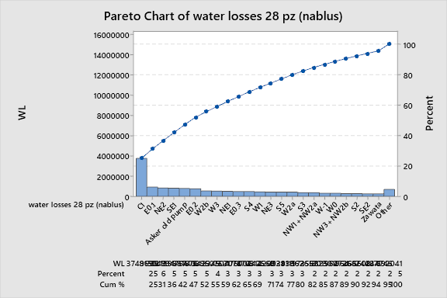
PARETO CHARTS

Slide 16
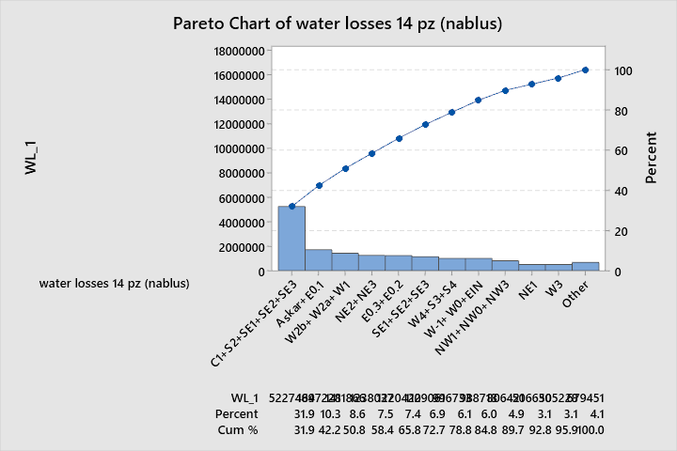
PARETO CHARTS

Slide 17
DATA NOTE
WL=WP-WC
Miss data points rate is 0.0327%. it’s common to have a 5% miss data points rate in data.
Using R language libraries (import TS).
The output of this procedure is fitting N/A data points. Uses na_Kalman fuc Smoothing on structural time series models (or on the state space representation of an ARIMA model) for imputation.
Calendar effect.
Why Cube root?
Data Note: Bagging
Some of PZ’s called “Isolated PZ”. That means NM sure that these PZ’s impossible have -ve (-ve value means WC > WP and that’s impossible) values. So, we assume Isolated PZ is an anchor PZ to stand on it.

Slide 18
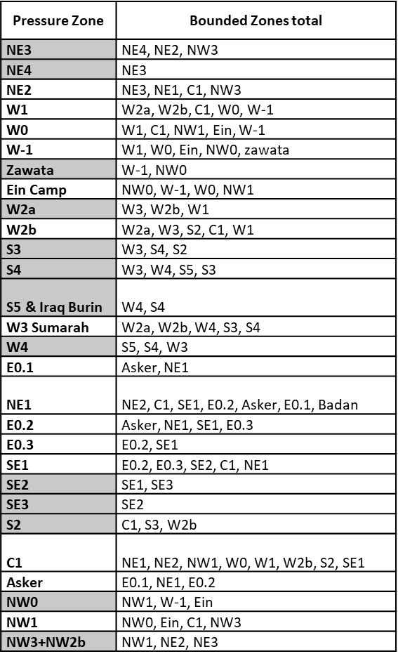
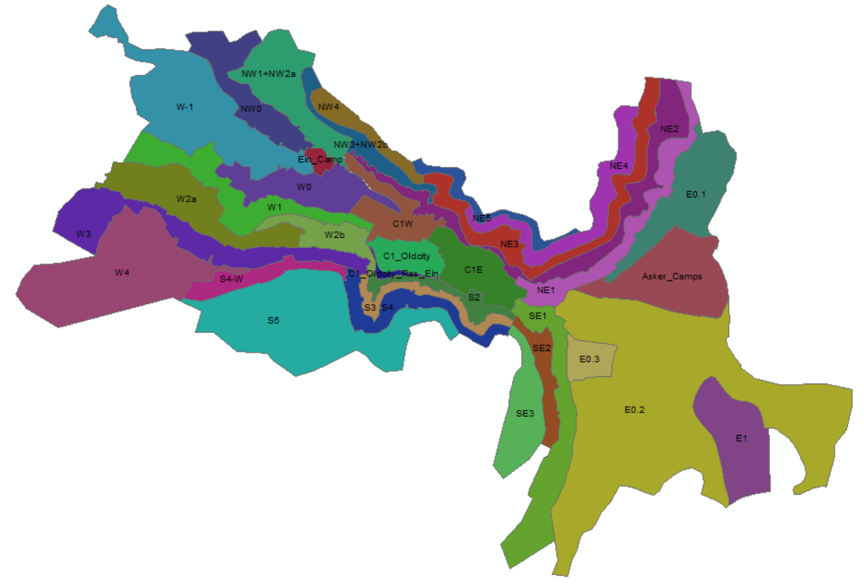
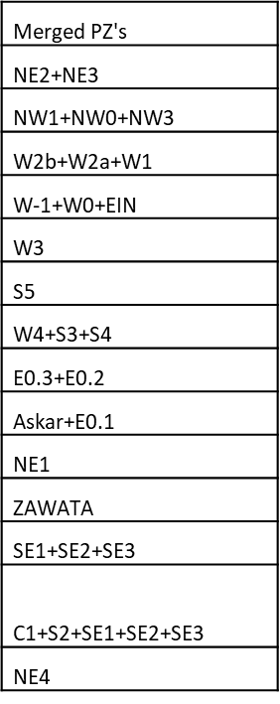

Slide 19
METHODS
Time Plot.
Time Series Decomposition
Trend Analysis
Forecasting Models
  Moving Average (MA)
  Single Exponential Smoothing (SES)
  Double Exponential Smoothing (DEA)
  Triple Exponential Smoothing (HW)
  Autoregressive Integrated Moving Average (ARIMA)

Slide 20
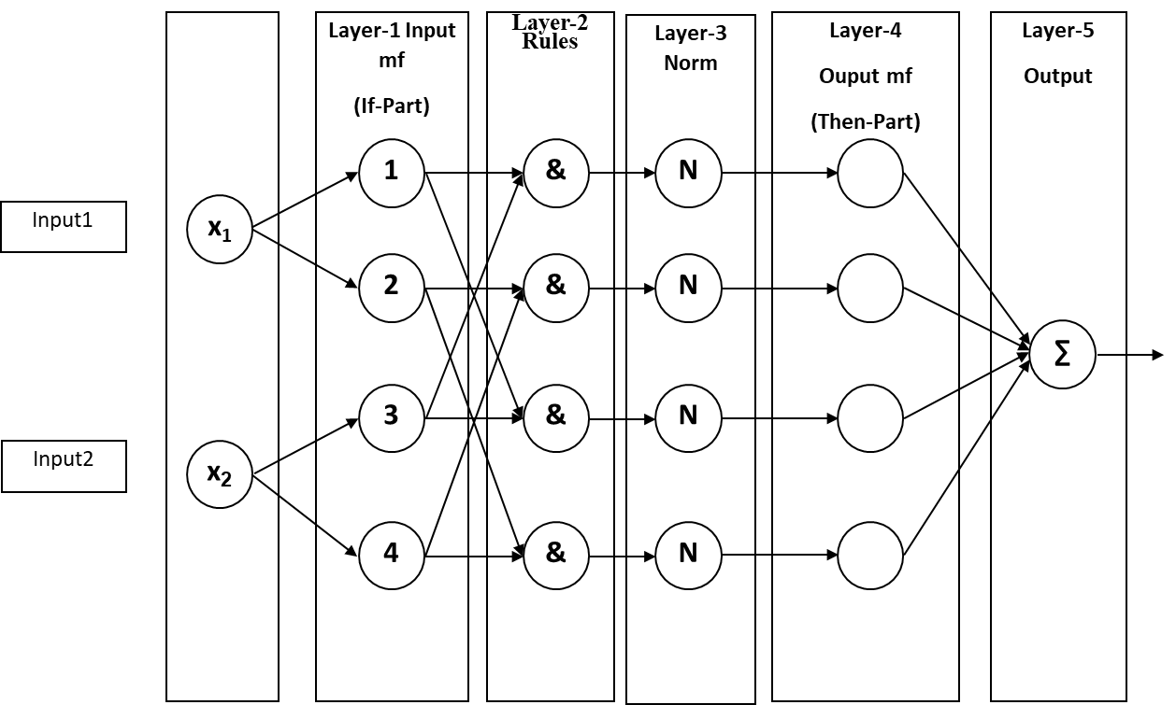



ADAPTIVE NEURO FUZZY INFERENCE SYSTEM (ANFIS)
Takagi-Sugeno function f_{j} Where, p_{j}, q_{j}, and r_{j} are the consequent (then-part) parameters.
In our case we use rules as (and). mtf = 3

Slide 21
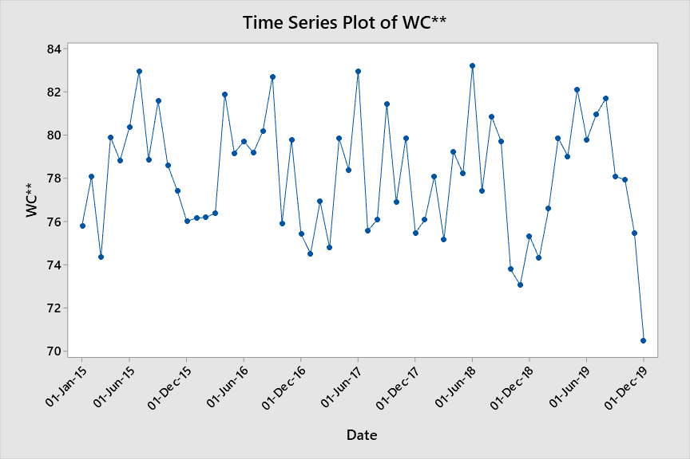
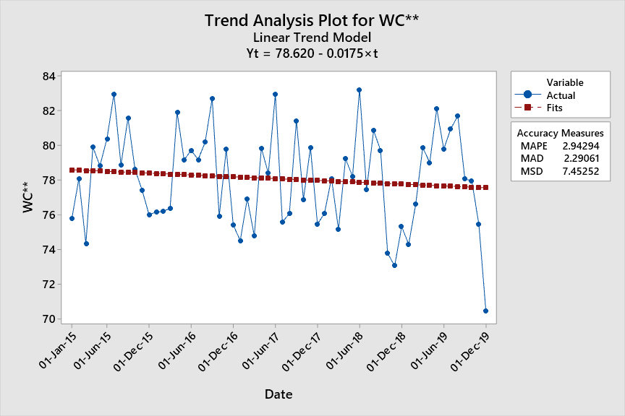
NABLUS WC FORECASTING RESULTS

Slide 22
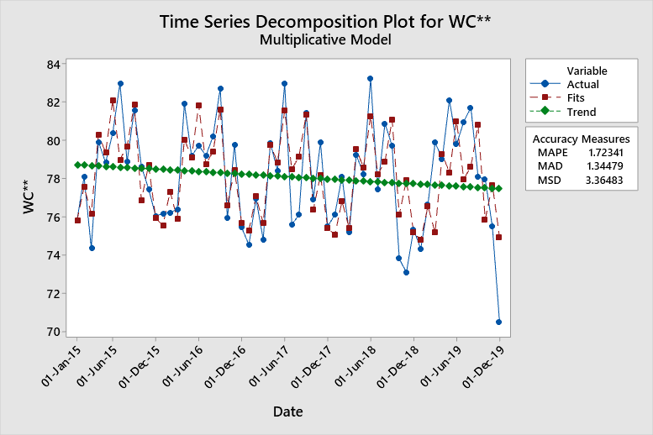
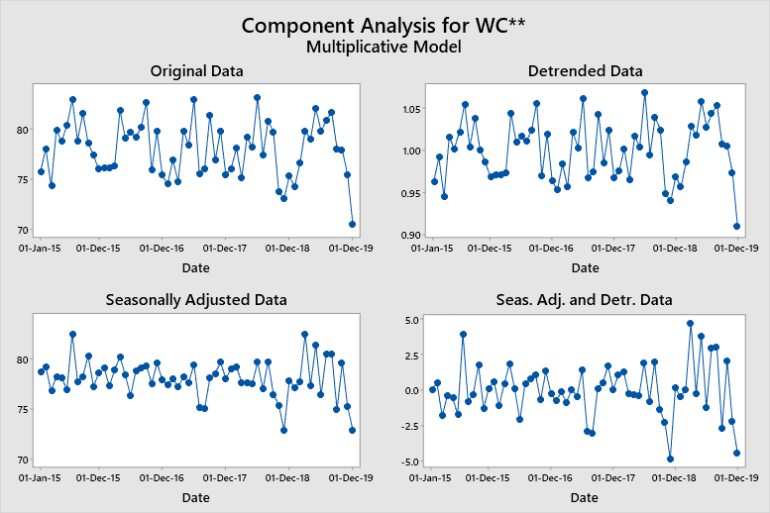
NABLUS WC FORECASTING RESULTS

Slide 23
NABLUS WC FORECASTING RESULTS
 | MAPE | MSE | MAE
MA 2 | 2.93493 | 2.28116 | 8.01494
MA 4 | 3.37018 | 2.62007 | 9.91726
MA 6 | 3.6574 | 2.8436 | 11.2444
MA 2 C | 2.25435 | 1.75486 | 4.7142
MA 4 C | 2.11173 | 1.6432 | 4.33629
MA 6 C | 2.38412 | 1.85372 | 5.34023
MA 1 | 3.4716 | 2.7108 | 10.7719
MA 3 | 3.05072 | 2.37637 | 8.59035
MA 5 | 3.4422 | 2.6754 | 10.3269
MA 7 | 3.5662 | 2.7656 | 10.6524
MA 1 C | 3.4716 | 2.7108 | 10.7719
MA 3 C | 1.95662 | 1.52077 | 3.56219
MA 5 C | 2.21967 | 1.73043 | 4.69421
MA 7 C | 2.4573 | 1.91173 | 5.4528
SES | 3.02918 | 2.35772 | 8.23512
DEMA | 3.07946 | 2.4039 | 8.81254
HW 0.2 | 2.25882 | 1.75778 | 4.78173
HW (0.8, 0.005, 0.1) | 2.41757 | 1.88867 | 5.35394

Slide 24
NABLUS WC FORECASTING RESULTS
Final Estimates of Parameters
Type | Coef | SE Coef | T-Value | P-Value
AR 1 | -0.798 | 0.152 | -5.24 | 0.000
AR 2 | -0.396 | 0.156 | -2.53 | 0.015
SMA 12 | 0.769 | 0.176 | 4.36 | 0.000
Modified Box-Pierce (Ljung-Box) Chi-Square Statistic
Lag | 12 | 24 | 36 | 48
Chi-Square | 12.76 | 29.52 | 42.74 | *
DF | 9 | 21 | 33 | *
P-Value | 0.174 | 0.102 | 0.119 | *
Residual Sums of Squares
DF | SS | MS
44 | 259.209 | 5.89111

Slide 25
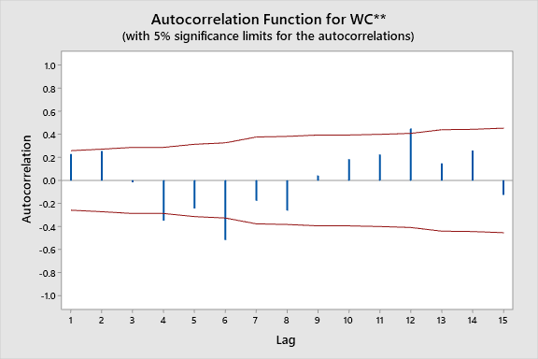
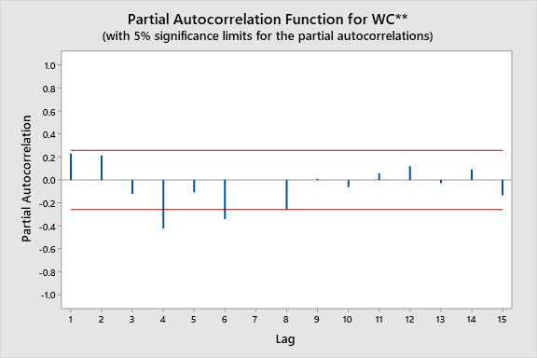
NABLUS WC FORECASTING RESULTS ARIMA(2,1,0) (0,1, 1)12

Slide 26
NABLUS WC FORECASTING RESULTS ARIMA(2,1,0) (0,1, 1)12

Slide 27
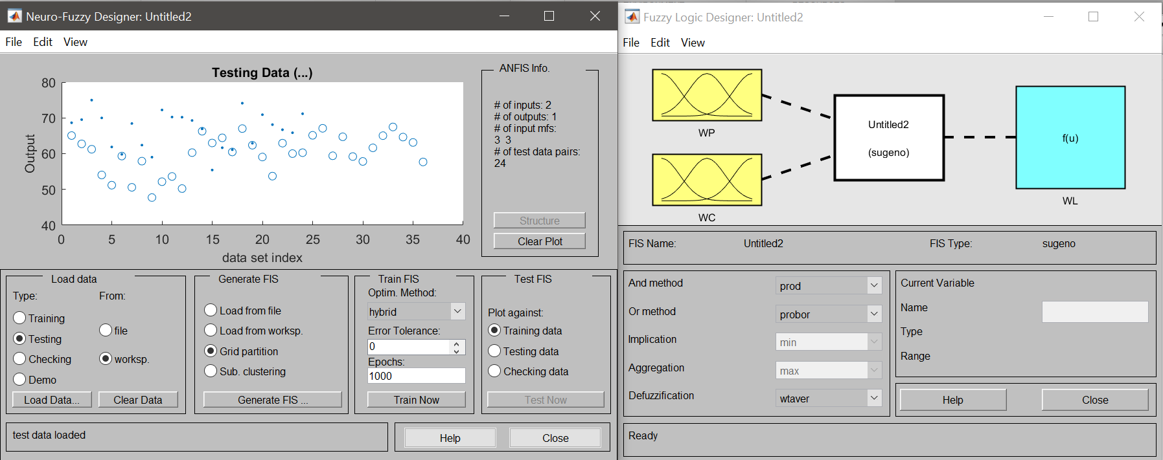
NABLUS WL FORECASTING RESULTS

Slide 28
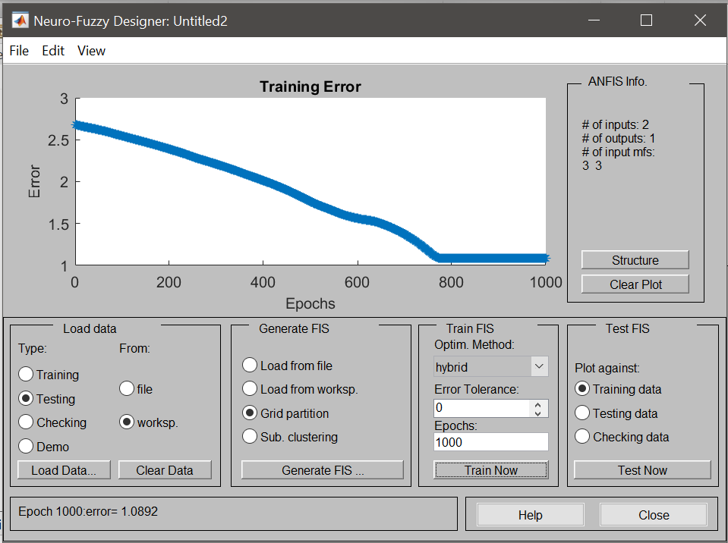
NABLUS WL FORECASTING RESULTS

Slide 29
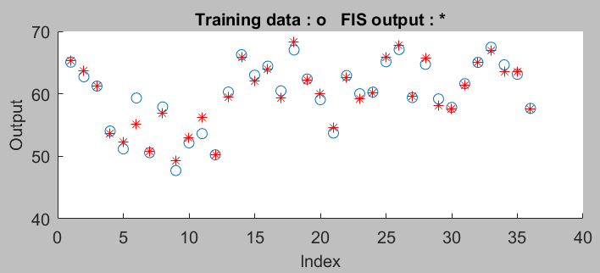
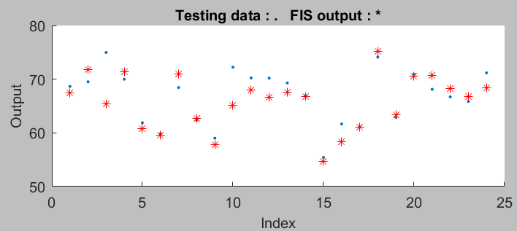
NABLUS WL FORECASTING RESULTS

Slide 30
NABLUS WL FORECASTING RESULTS

Slide 31
NABLUS WL FORECASTING RESULTS
Models | WL** |  |  | WL***
 | MAPE | MAE | MSE | MAPE | MAE | MSE
MA 1 | 7.9764 | 4.9254 | 35.6963 | 7.9625 | 4.9113 | 35.3132
MA 3 | 7.439 | 4.6135 | 32.8422 | 6.9158 | 4.2594 | 29.8254
MA 5 | 7.2962 | 4.579 | 32.1289 | 7.0312 | 4.38 | 28.6599
MA 7 | 7.2454 | 4.565 | 30.2256 | 6.7928 | 4.2685 | 27.4152
MA 1 C | 7.9764 | 4.9254 | 35.6963 | 7.9625 | 4.9113 | 35.3132
MA 3 C | 4.9403 | 3.058 | 13.6568 | 4.892 | 3.0231 | 13.7205
MA 5 C | 5.3369 | 3.2813 | 16.8561 | 5.1134 | 3.1492 | 15.8976
MA 7 C | 5.9127 | 3.6562 | 18.4335 | 5.6797 | 3.5072 | 17.8884
SES | 6.933 | 4.2855 | 27.6758 | 6.6954 | 4.1297 | 26.1671
DEMA | 7.727 | 4.7905 | 33.2116 | 7.8783 | 4.8869 | 33.6204
HW (0.8, 0.1 ,5) | 6.8742 | 4.3271 | 27.8908 | 6.8059 | 4.2584 | 24.9593

Slide 32
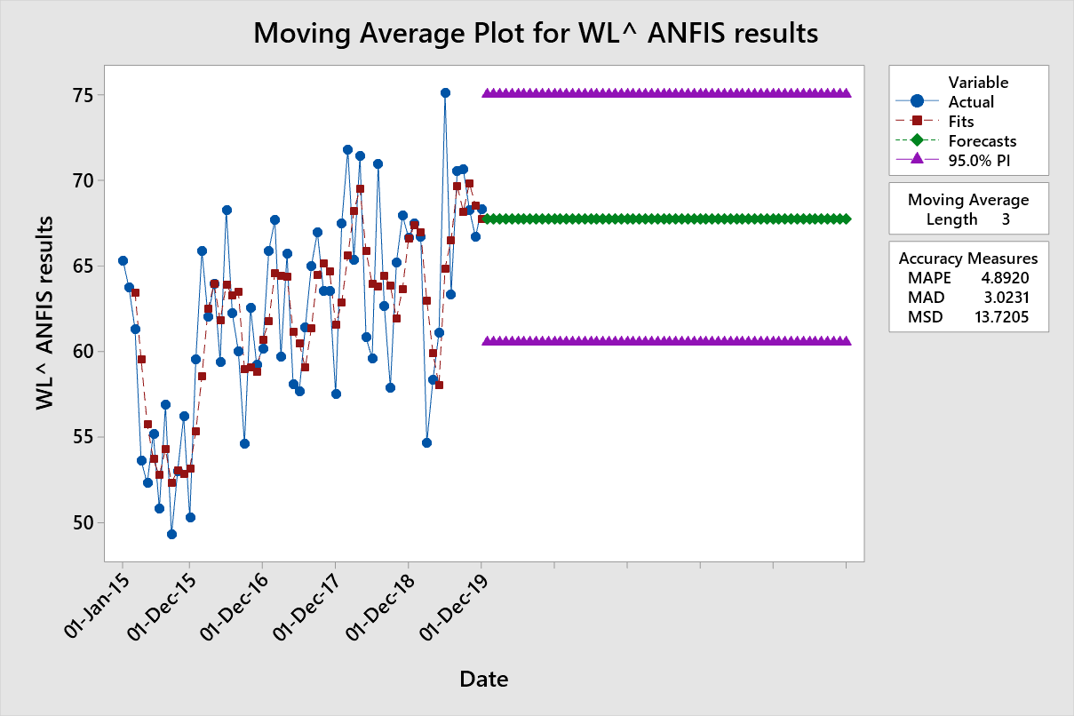
NABLUS WL FORECASTING RESULTS

Slide 33
NABLUS WL FORECASTING RESULTS

Slide 34
NABLUS WL FORECASTING RESULTS ARIMA(2,1,0) (0,1, 1)12

Slide 35
NABLUS WL FORECASTING RESULTS
NM Losses for (2015-2019) = 14,885,168 m³
NM Losses for (2020-2024) = 18,682,243 m³ with PI=95%
WL will increase by 29.4%

Slide 36
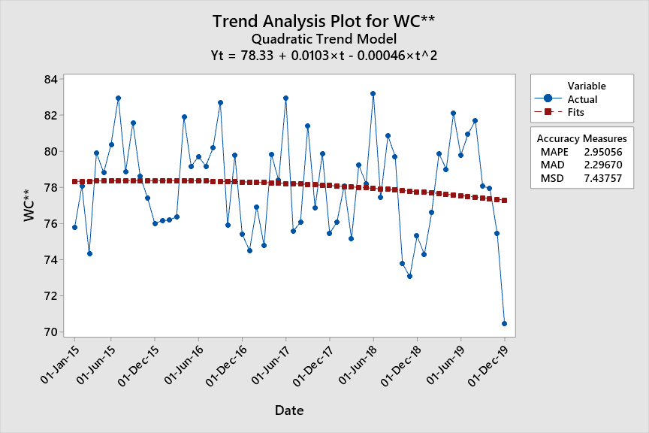
NE2+NE3 WC FORECASTING RESULTS

Slide 37
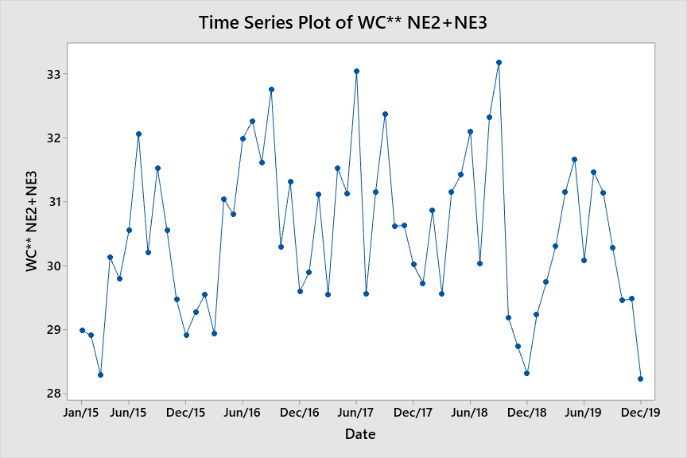
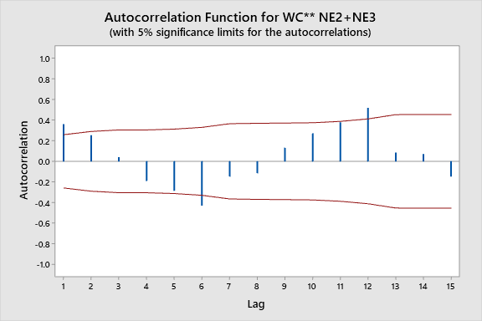
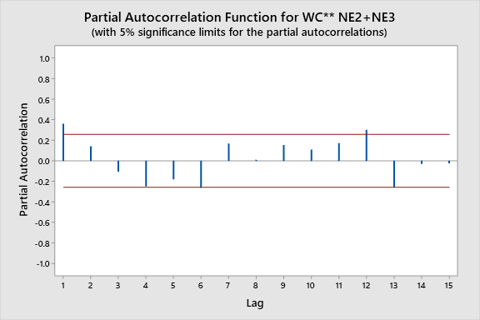
NE2+NE3 WC FORECASTING RESULTS
 | MAPE | MAD | MSD
TA Linear | 3.37765 | 1.02998 | 1.48685
TA Quadratic | 3.06424 | 0.93527 | 1.2708
TA Growth | 3.37231 | 1.02917 | 1.48746
TA S-Cycle
TS Decomp. | 2.20053 | 0.66961 | 0.67636
MA 2 | 3.46284 | 1.05571 | 1.52401
MA 4 | 3.8239 | 1.16566 | 1.77072
MA 6 | 4.10684 | 1.25465 | 2.08414
MA 2 C | 2.56818 | 0.78323 | 0.86036
MA 4 C | 2.44477 | 0.74597 | 0.75571
MA 6 C | 2.59651 | 0.7931 | 0.89308
MA 1 | 3.55608 | 1.08585 | 1.81212
MA 3 | 3.57152 | 1.08744 | 1.59581
MA 5 | 3.95898 | 1.20823 | 1.92907
MA 7 | 3.9932 | 1.21762 | 1.95502
MA 1 C | 3.55608 | 1.08585 | 1.81212
MA 3 C | 2.30856 | 0.7038 | 0.67734
MA 5 C | 2.52225 | 0.77033 | 0.82258
MA 7 C | 2.67004 | 0.81621 | 0.93198
SES | 3.36651 | 1.02648 | 1.45217
DEMA | 3.50009 | 1.0649 | 1.55611
HW (0.2, 0.2, 0.2) | 1.97701 | 0.60086 | 0.66776

Slide 38
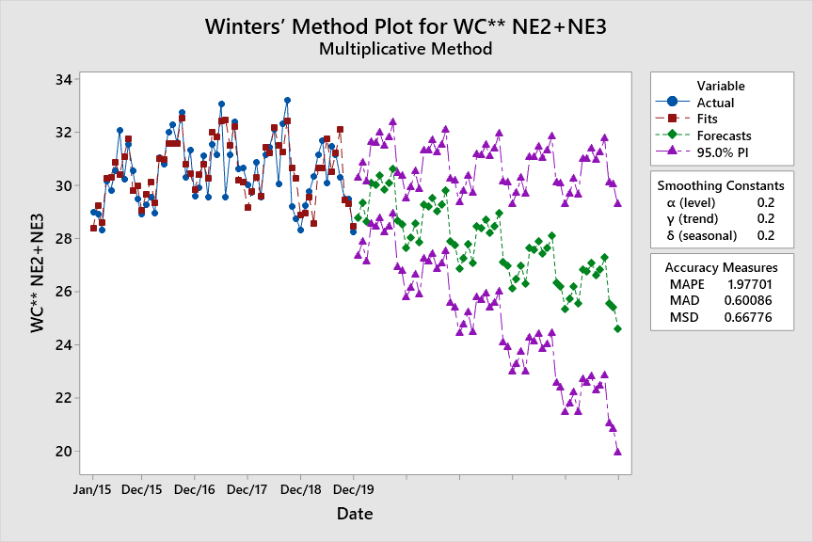
NE2+NE3 WC FORECASTING RESULTS

Slide 39
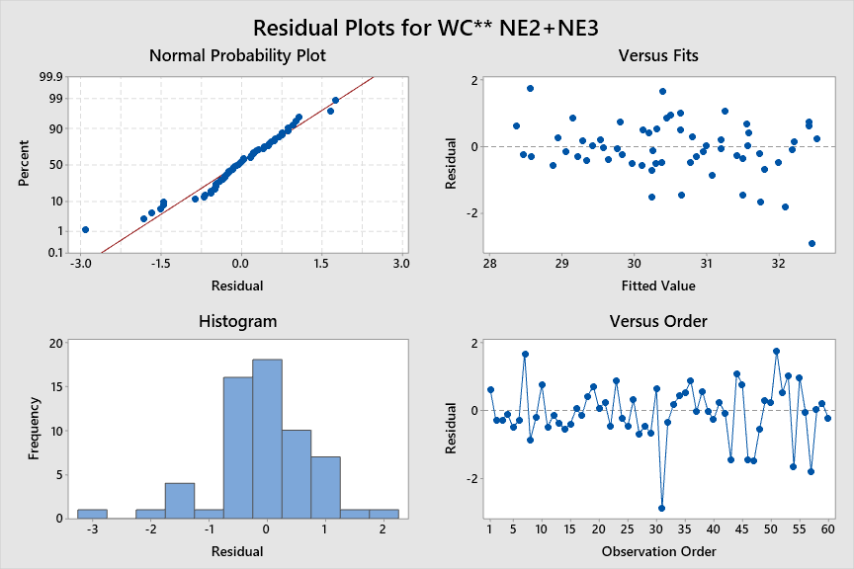
NE2+NE3 WC FORECASTING RESULTS

Slide 40
NE2+NE3 WC FORECASTING RESULTS

Slide 41
NE2+NE3 WL FORECASTING RESULTS
 | MAPE | MAD | MSD
TA Linear | 7.64432 | 2.05169 | 6.97838
TA Quadratic | 7.61519 | 2.0368 | 6.75764
TA Growth | 7.39469 | 1.99589 | 6.65502
TA S-Cycle | 7.55453 | 2.03642 | 6.93543
TS Decomp. | 7.94777 | 2.17202 | 7.196
MA 2 | 7.83239 | 2.12045 | 7.16009
MA 4 | 8.03805 | 2.1937 | 8.35275
MA 6 | 8.42989 | 2.30292 | 8.95838
MA 2 C | 5.79496 | 1.57068 | 4.02074
MA 4 C | 5.25337 | 1.42326 | 3.51112
MA 6 C | 5.62239 | 1.52439 | 4.14568
 | MAPE | MAD | MSD
MA 1 | 8.26483 | 2.24334 | 8.42993
MA 3 | 7.87246 | 2.13328 | 7.77255
MA 5 | 8.35415 | 2.27984 | 8.99425
MA 7 | 8.58709 | 2.35081 | 8.69985
MA 1 C | 8.26483 | 2.24334 | 8.42993
MA 3 C | 5.2216 | 1.41363 | 3.18226
MA 5 C | 5.53014 | 1.49637 | 3.91215
MA 7 C | 5.83597 | 1.58319 | 4.44594
SES opt. | 7.39227 | 1.99974 | 6.73086
DEMA opt. | 7.7911 | 2.1067 | 7.56455
HW (0.2, 0.2, 0.2) | 7.79782 | 2.11106 | 7.5298
HW (0.9, 0.2, 0.5) | 8.17926 | 2.23078 | 7.93164
HW (0.8, 0.1, 0.5) | 7.99699 | 2.17714 | 7.30972

Slide 42
NE2+NE3 FORECASTING RESULTS
This model estimates that NE2+NE3 will loss 1,994,174 m³ between (2020-2024).
Results says that WL m³ ’s will be more than the WC m³ ’s for these PZ’s.
These results should push NM to improve its performance.

Slide 43
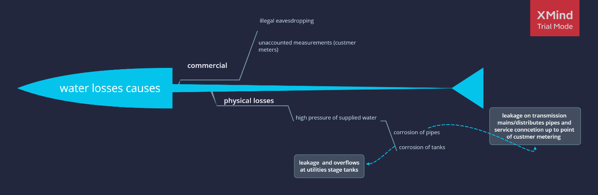
TYPE OF LOSSES

Slide 44
FEMA ANALYSIS
Detection Rate
Rank | Description
1-2 | Very high probability that the defect will be detected. Verification and/or controls will almost certainly detect the existence of a deficiency or defect
3-4 | High probability that the defect will be detected. Verification and/or controls have a good chance of detecting the existence of a deficiency/defect
5-7 | Moderate probability that the defect will be detected. Verification and/or controls are likely to detect the existence of a deficiency or defect
8-9 | Low probability that the defect will be detected. Verification and/or control not likely to detect the existence of a deficiency or defect.
10 | Very low (or zero) probability that the defect will be detected. Verification and/or controls will not or cannot detect the existence of a deficiency/defect.
Losses Type | Rank
Customer meters | 4
Water theft | 7
Leakage of pipes between tanks house connection | 6
Leakage and overflow of tanks | 1

Slide 45
FEMA ANALYSIS
Failure Rate
rate | Description
1 | Very unlikely
2 | Remote
3 | occasional
4 | probable
5 | frequent
Losses Type | Rank
Customer meters | 4
Water theft | 2
Leakage of pipes | 3
Leakage and overflow of tanks | 1

Slide 46
FEMA ANALYSIS
Severity Ranking
Rank | Severity class
10 | catastrophic
7-9 | critical
4-6 | major
1-3 | minor
Losses Type | Rank | Note
Customer meters | 9 | cost
Water theft | 9 | cost
Leakage of pipes | 10 | Quality& cost
Leakage and overflow of tanks | 10 | Quality&cost

Slide 47
FEMA ANALYSIS

Slide 48
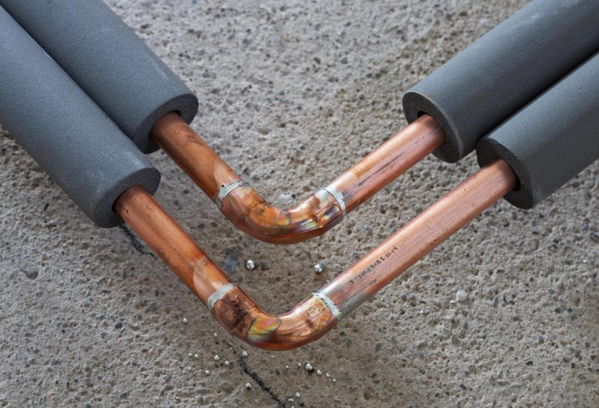
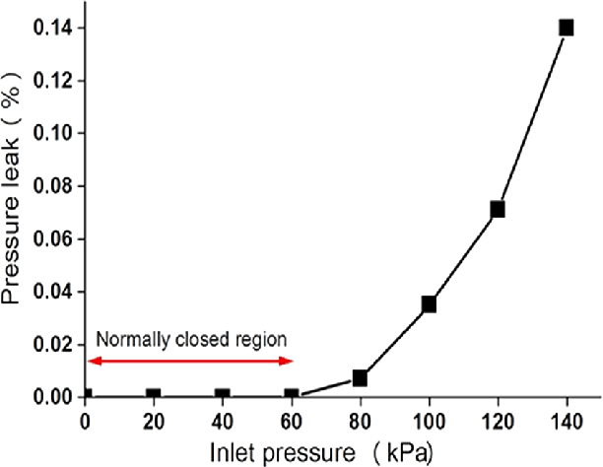
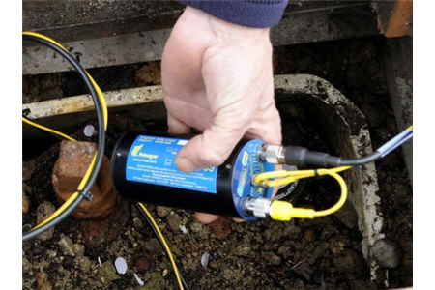
RECOMMENDED ACTIONS FOR PIPES LEAKAGE REDUCTION
Pipes Isolation
Pressure control
pipe size
PRVs
3. Monitor network activities

Slide 49
RECOMMENDED ACTIONS FOR PIPES LEAKAGE REDUCTION
4. wireless sensor networks
5. Increase metering
6. educational campaign
7. Rehabilitation of pipes and connections

Slide 50
LEAKAGE MANAGEMENT STRATEGY OF WATER NETWORK
PROMETHEE Method: Preference Ranking Organization Method for Enrichment Evaluations

Slide 51
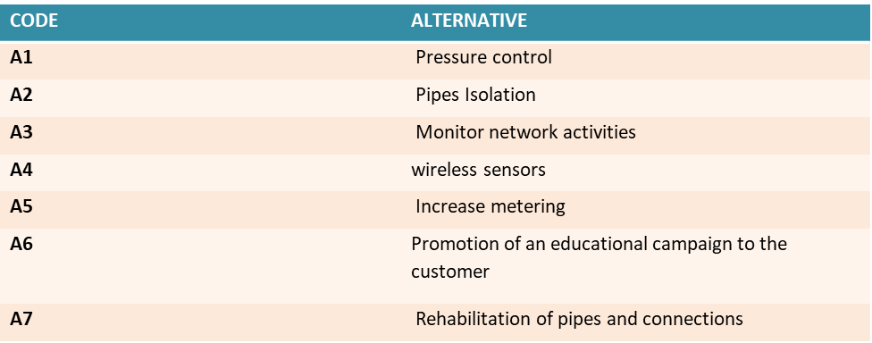
PROCEDURE OF PROMETHEE METHOD
1. Identification of alternative

Slide 52
PROCEDURE OF PROMETHEE METHOD
2. Identification of decision-makers
CODE | Decision-makers
DM1 | Nablus Municipality representative
DM2 | Consultant—Engineer (technician who assesses the system’s hydraulic situation)
DM3 | Environment Agency (professional with twofold interest, to guarantee suitable conditions, being the reduction of leakage itself beneficial for the environment, and to avoid environmental impacts, because the way in which leakage reduction is achieved can provoke impacts).
DM4 | Community representative (represents the citizens’ interests—wanting to receive water under normal pressure and to avoid a price increase)

Slide 53
PROCEDURE OF PROMETHEE METHOD
3. Identification and assessment of relevant criteria
Criterion | Description
Cr1 | Cost (minimize) The cost to implement the alternative. The lower cost, the most preferable the alternative. The values are expressed in dollar currency ($)
Cr2 | Benefit period (maximize) Useful life-span of the alternative. This time is measured in months. The higher the time, the more preferable the alternative
Cr3 | Economic-financial balance (maximize) Criterion reflecting the measurement of improvement of the company’s financial health by the potential of the alternative to increase revenue and to have as consequence a significant increase on the profit
Cr4 | Effects in reduction of waste (maximize) Reflects the potential of the alternative to reduce the water waste (inducing water conservation)
Cr5 | Environmental benefits (maximize) Reflects the influence of the alternative in protecting the environment, favoring those activities that degrade the water resources less
Cr6 | Maintenance and operation conditions (maximize) Seeks the more efficient identification of leaks, as well as the decrease in time needed to repair a leak. It also treats the reduction of the high pressure in the networks
Cr7 | Social acceptability (maximize) Seeks to represent the repercussion of the establishment of each alternative inside communities, understanding the importance of the rational use of water

Slide 54
PROCEDURE OF PROMETHEE METHOD
4. Judgment of the alternatives in relation to the criteria
5. Aggregation of results

Slide 55
CONCLUSION

Slide 56
RECOMMENDATION

Slide 57


Slide 58


Slide 59


