Slide 1


CoffeeLine
By: Karam Zaidan & Ameed Salameh
supervisor: Dr. Muhannad Al-Jabi

Slide 2

Table of contents
Main Idea
Features
Hardware Modules
Constraints
Future Work
Notes:
‹#›

Slide 3
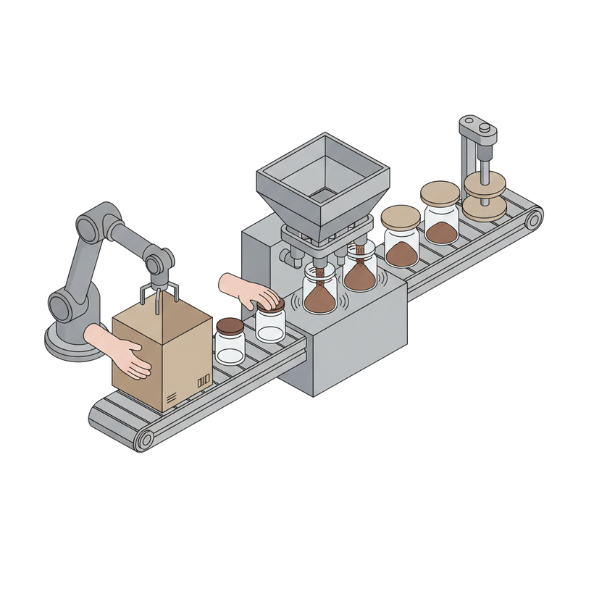
Main Idea
The main goal of this project is to design a small automated production line for filling and packaging powdered products.
It can handle coffee, tea, cappuccino, and cardamom with selectable weights.
The machine automatically fills containers and seals them with a built-in lid pressing system.
The project demonstrates efficient, accurate automation without human intervention.

Slide 4
Features
1- Supports multiple products.
2- Selectable weight options.
3- Automatic filling process.
4- Automatic lid placement and pressing.
5- Microcontroller-based control.
Notes:
‹#›

Slide 5
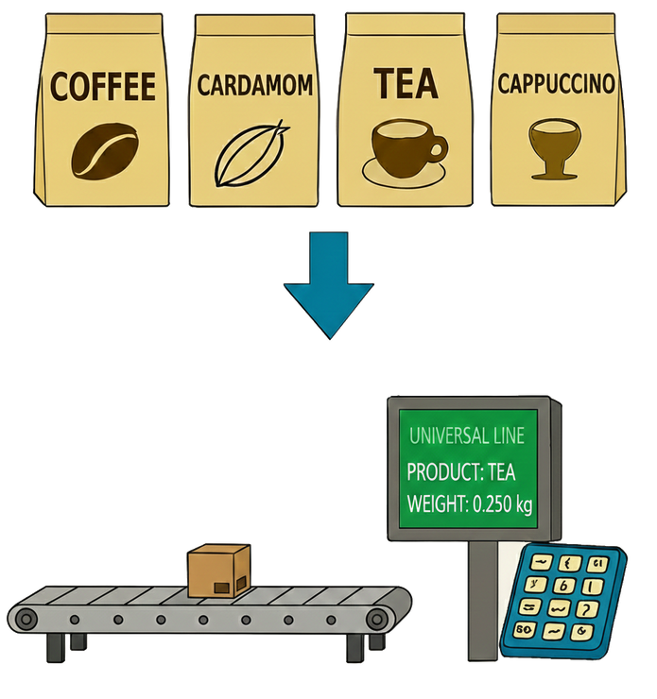
Supports multiple products
This feature allows the machine to handle different types of powdered products using the same line. It eliminates the need for separate equipment for each product, saving time and space in the production process.
Notes:
‹#›

Slide 6
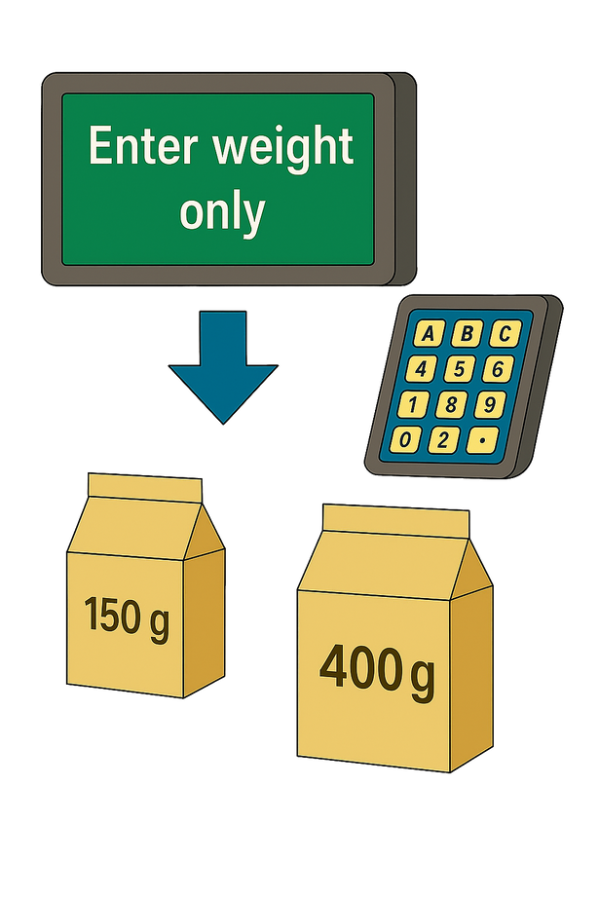
Selectable weight options
This feature allows the machine to fill containers with precise amounts according to the selected weight. It ensures accuracy and consistency, reducing product waste.
Notes:
‹#›

Slide 7
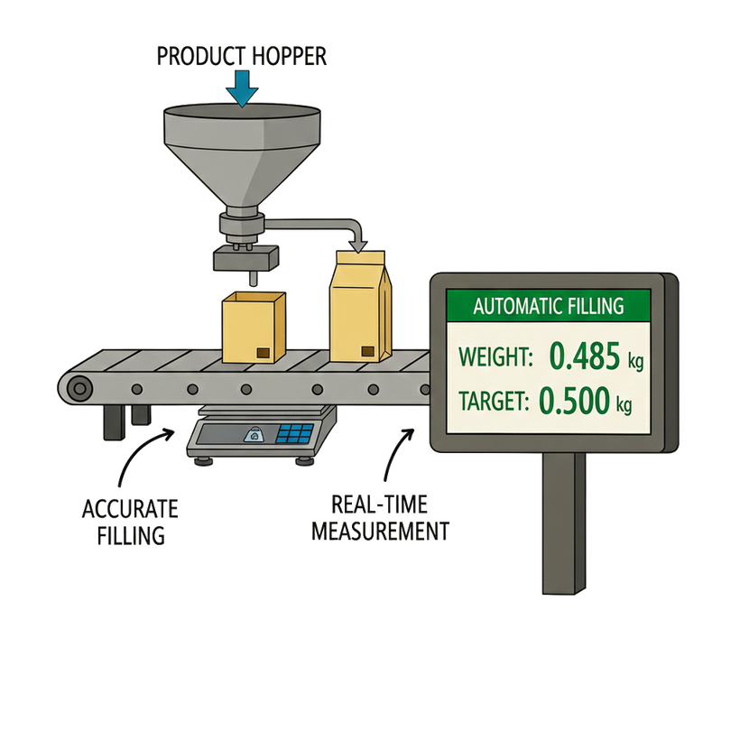
Automatic filling process with weight measurement
The automatic filling system fills containers accurately while measuring their weight in real-time. This ensures that each container reaches the selected weight, reducing errors and product waste.
Notes:
‹#›

Slide 8
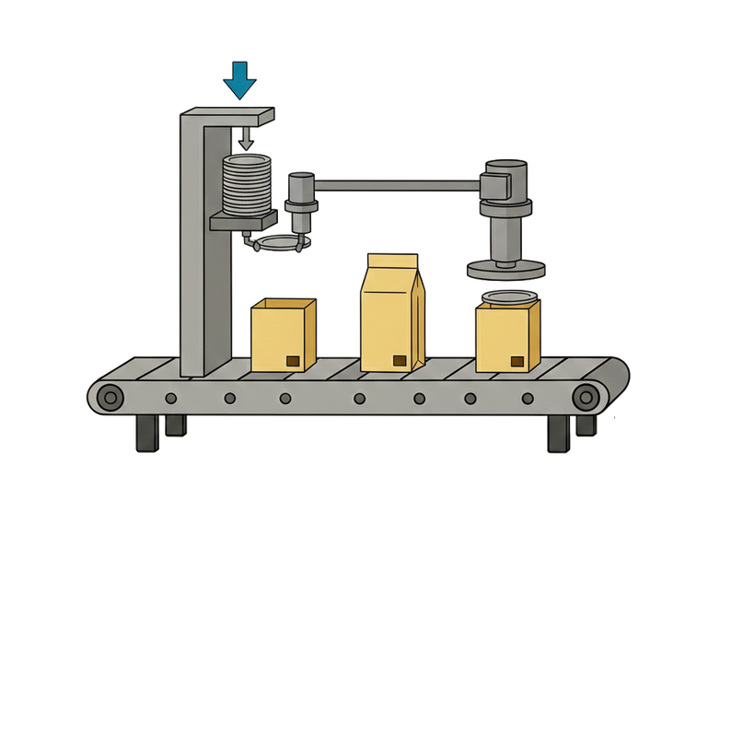
Automatic lid placement and pressing
This feature ensures that every container is properly sealed without manual intervention. It improves product safety and maintains quality during storage and transport.
Notes:
‹#›

Slide 9
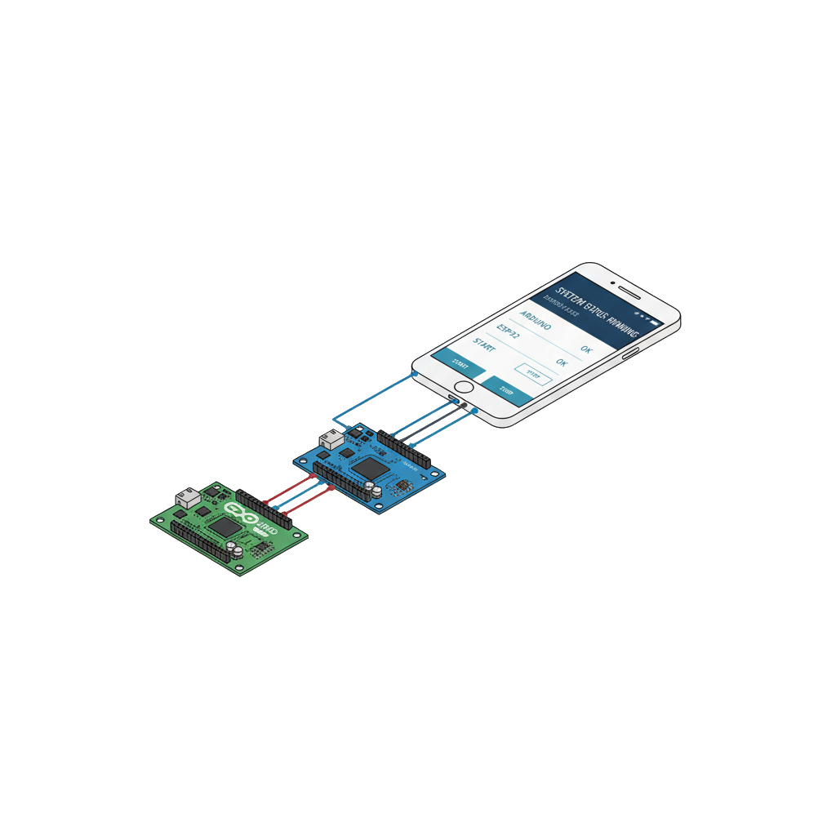
Microcontroller-based control
uses microcontrollers to manage the production line Arduino controls the motors and sensors, while ESP32 allows user input via the app or keypad and coordinates all operations, This ensures a smooth and reliable workflow throughout the system.
Notes:
‹#›

Slide 10
Hardware Modules

Slide 11
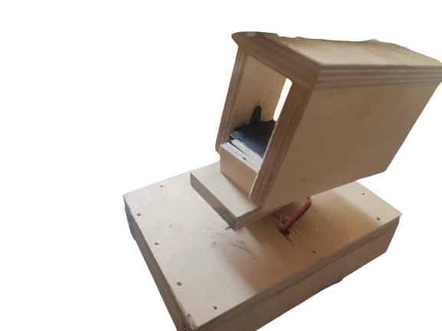
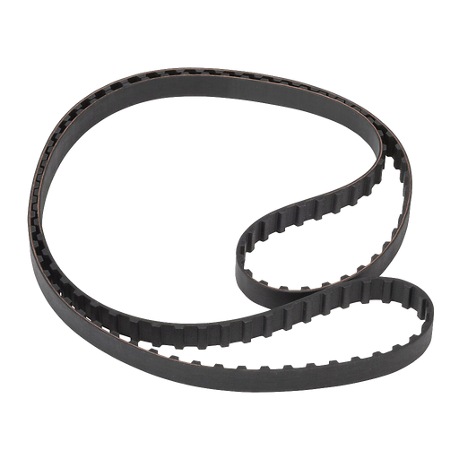
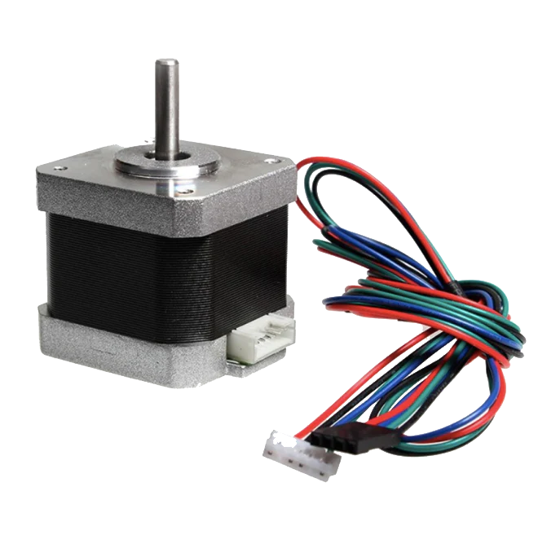
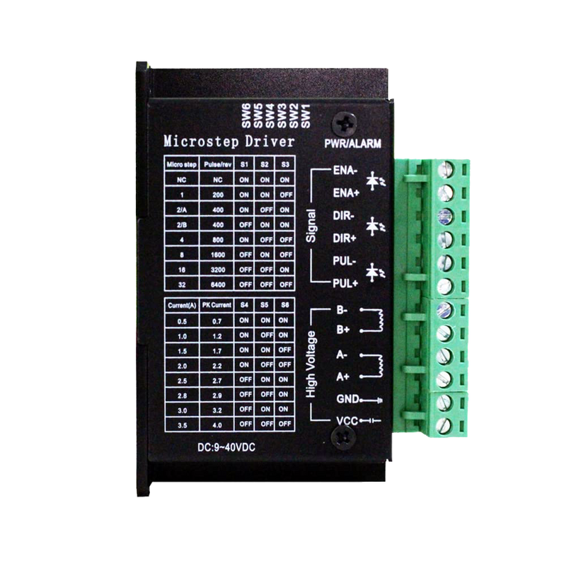
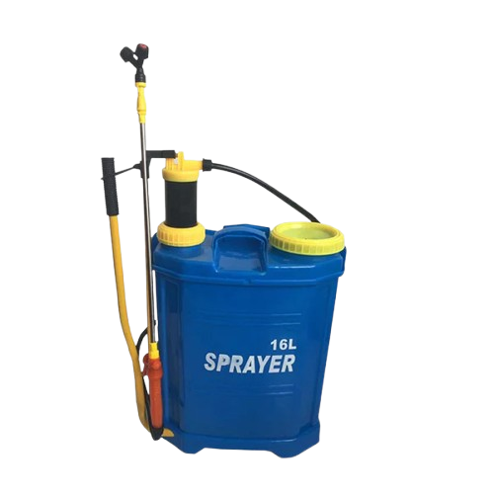

Slide 12
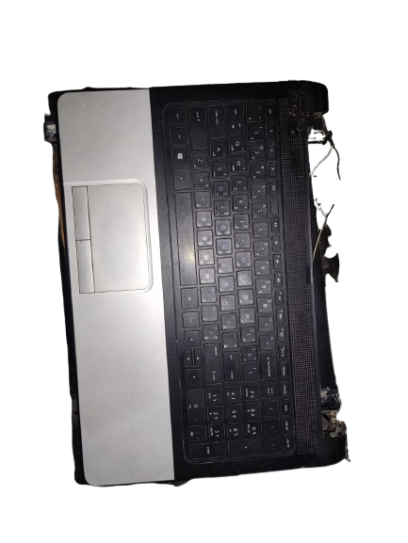
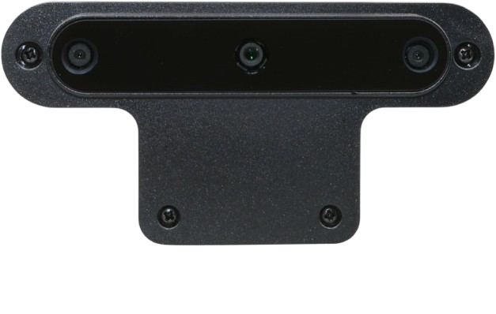
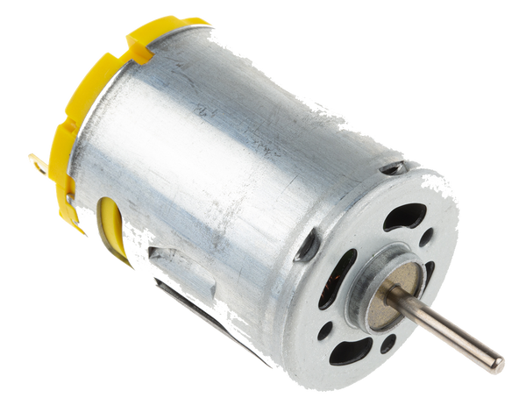
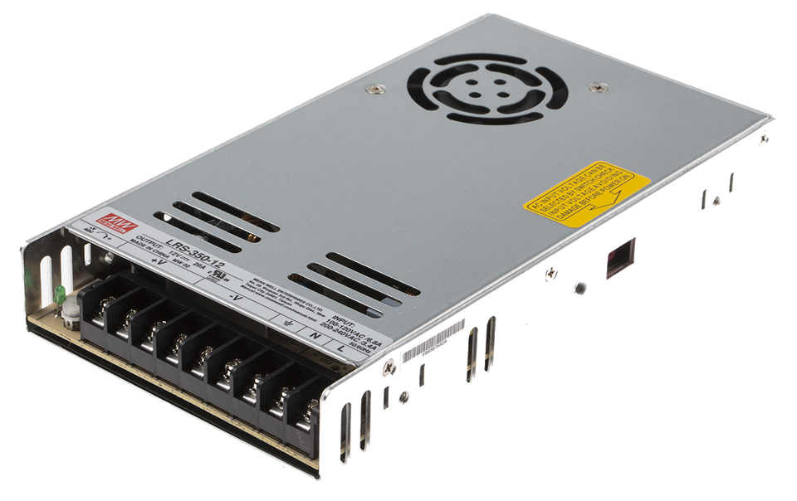
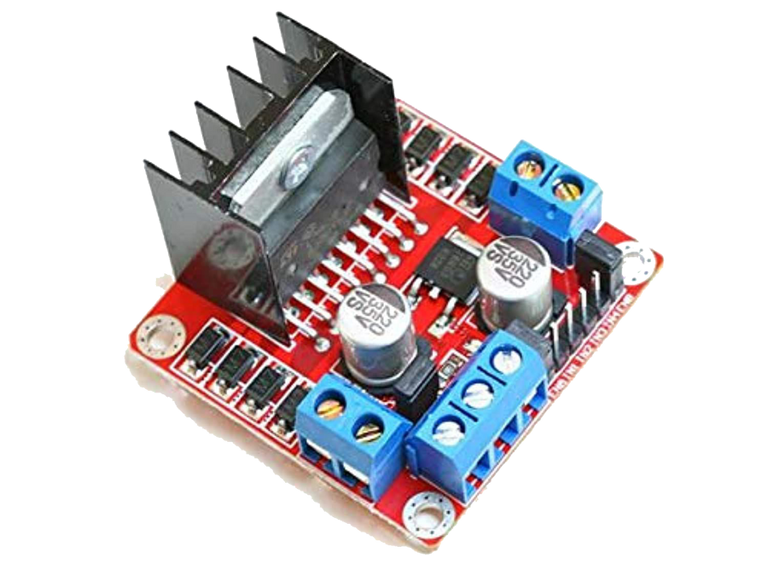

Slide 13
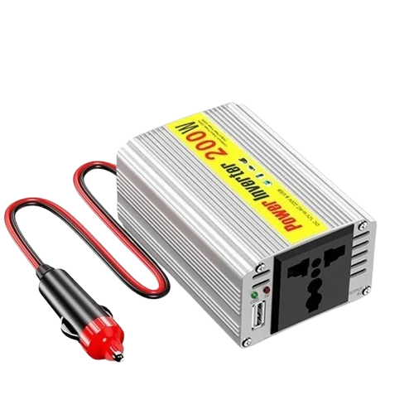
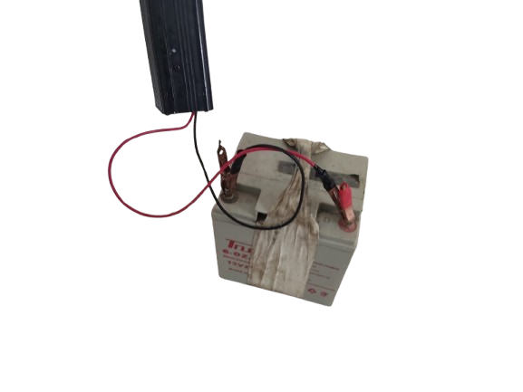
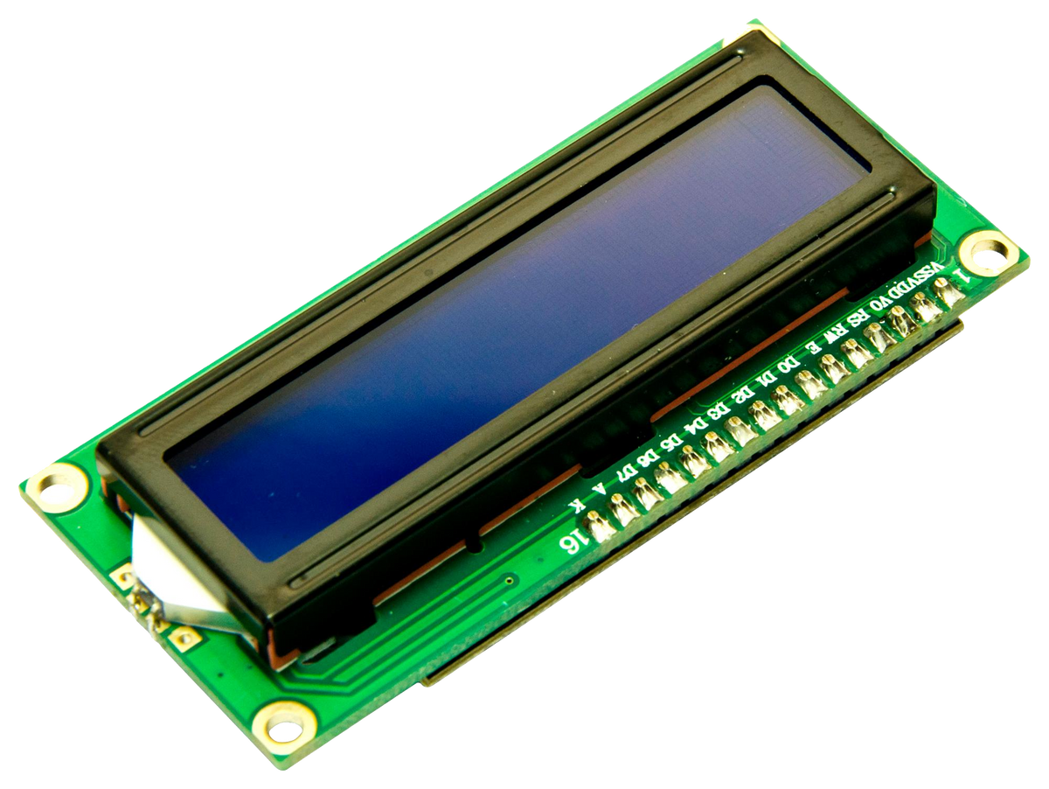
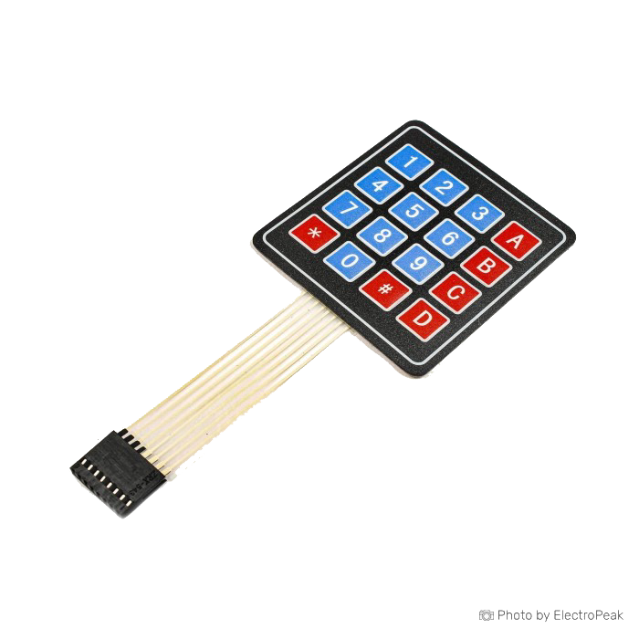

Slide 14
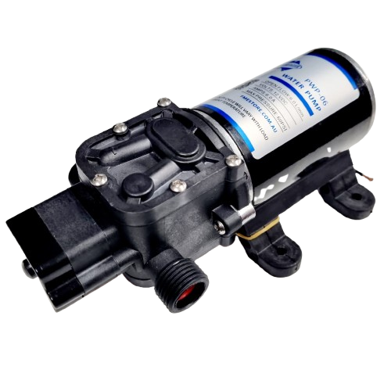
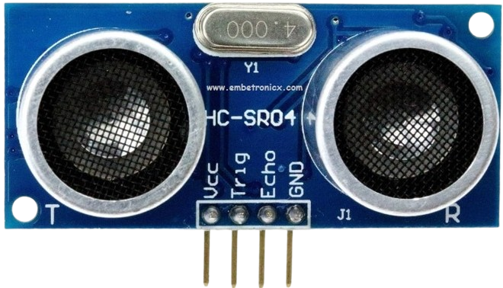
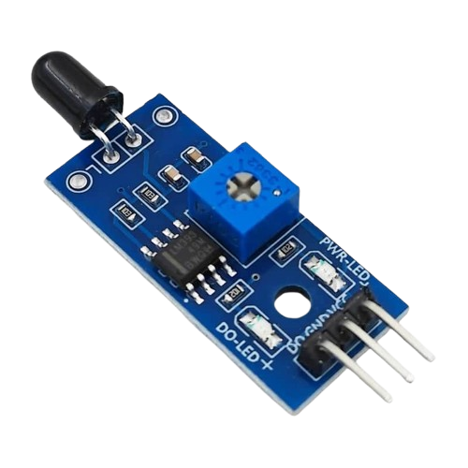
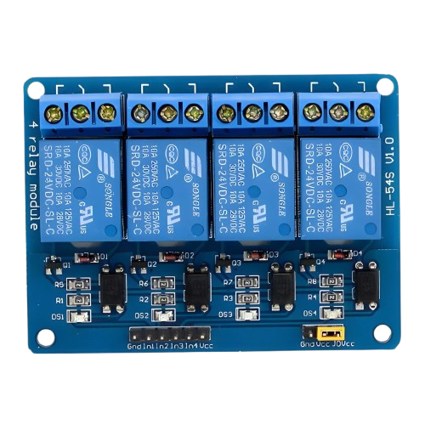
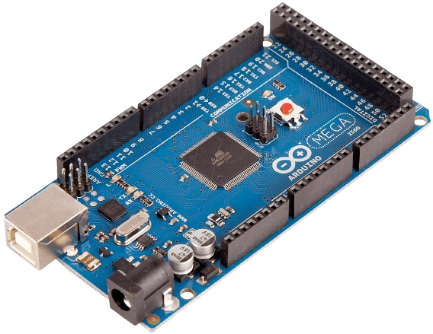
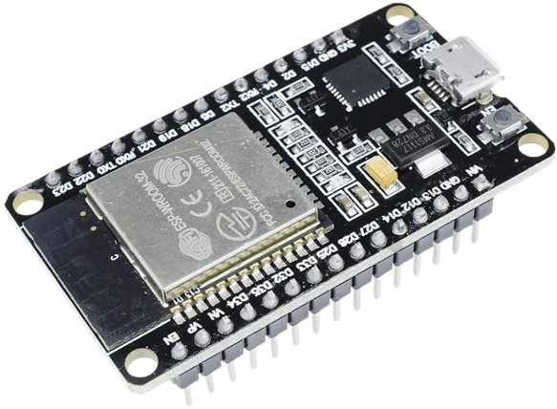
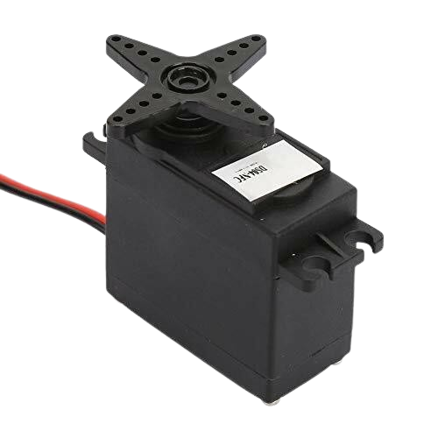
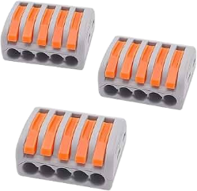
<#>

Slide 16
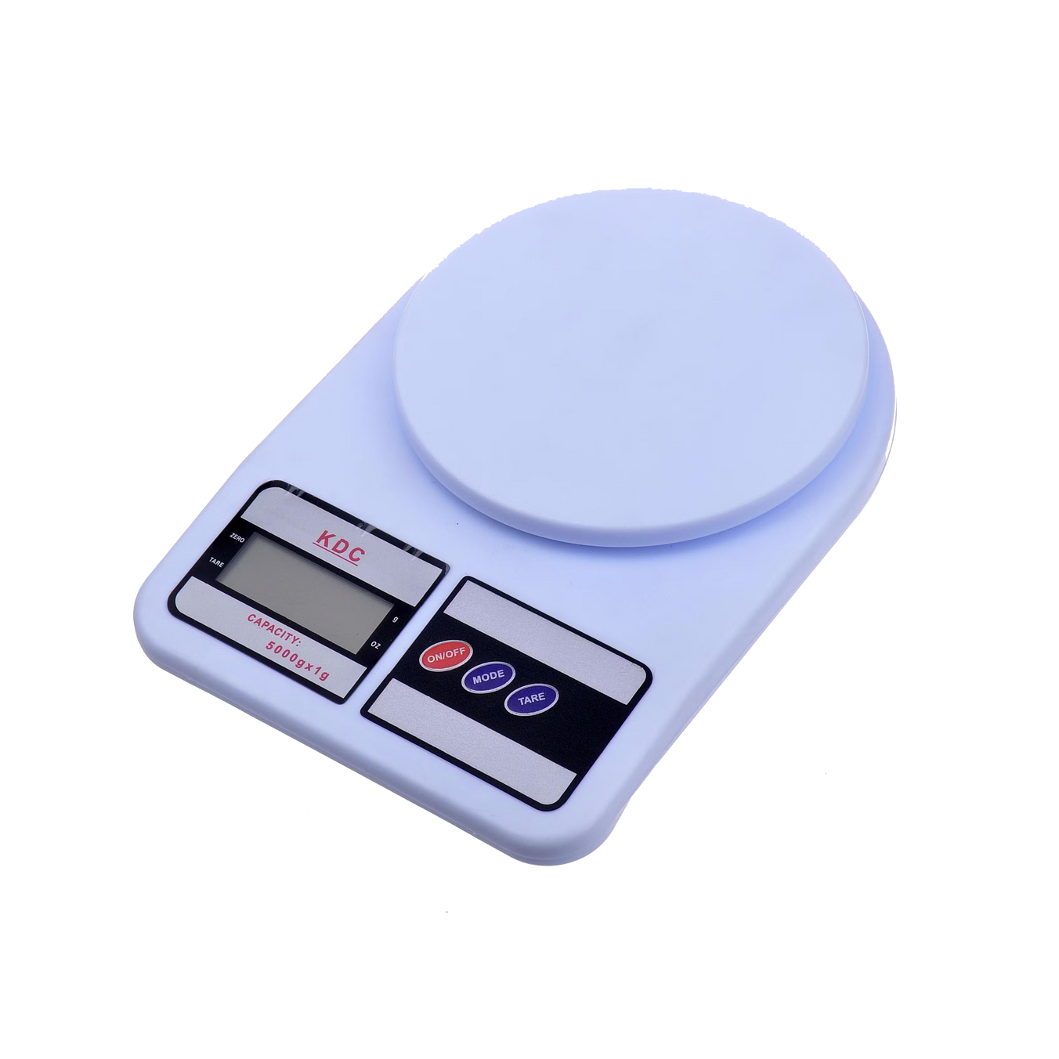
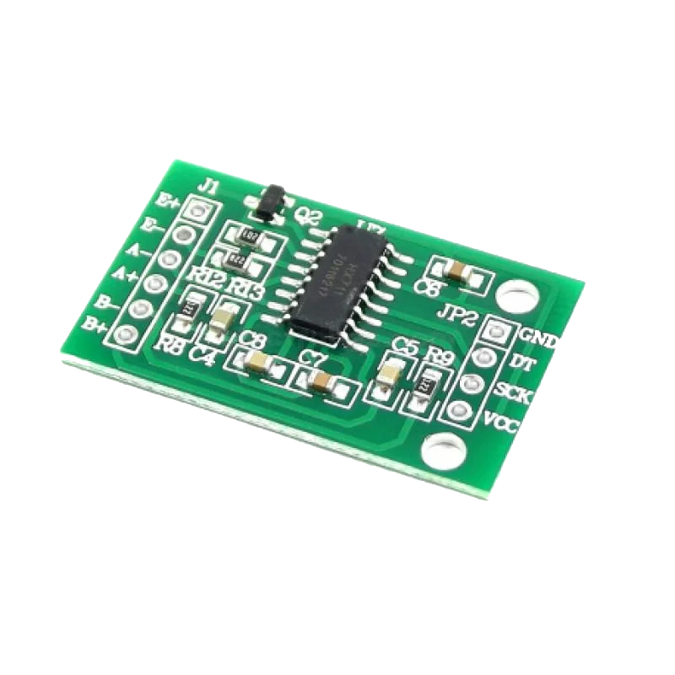

Slide 17
Constraints

Slide 18

Accuracy:
One of the main challenges in this project was the accuracy of the weighing system.
Despite calibration attempts, the load cell readings were not fully stable, which affected the precision of the final weight.
Electrical:
Electrical leakage caused system instability and affected the overall performance of the project.
Experience:
Limited prior experience increased development time and trial-and-error during implementation.

Slide 19

Budget:
The limited budget affected the selection and quality of components used in the project.
Material Flow:
When a large quantity was added, the material became compacted and stopped flowing properly, With smaller quantities, the flow worked normally

Slide 20
Future Work

Slide 21
Automated Feeding System:
Design a fully automated feeding mechanism for small containers and lids to eliminate manual handling and improve system efficiency.
Vibration:
Add a vibration mechanism to evenly distribute the coffee inside the container and prevent material piling during the filling process.
Scalability:
Upgrade the system to handle larger production volumes and more container sizes, ensuring flexibility for future expansion.

Slide 22
Thanks For Watching
Any Questions ?

