Slide 1
An-Najah National University
Faculty of Engineering & Information Technology
Industrial Engineering Department
Applying Lean Tools and Developing Improvements at Palkarm Factory
Supervisor: Eng. Tamer Haddad

Slide 2
Our Team
George Duaibis
Khaled Abu-Odeh
Maen Daraghma
Rami Al-Ahmad

Slide 3
Outline
Introduction
The production Process
The Methodology
The existing production system
Results
Conclusion and Discussion
Recommendations

Slide 4
Introduction
Background
Palkarm
Since 1988
Eastern Industrial Zone, Nablus, Palestine
Pharmaceutical and chemical industry
7 product families
60 employees, females mostly
One of 12 factories in Palestine
Markets: Local & international markets
Notes:
international markets: Iraq , Algeria, Saudi Arabia, Italy
GMB:

Slide 5
Introduction
Palkarm problems
Unorganized work areas
No clear job description for the employees
non-added value activities consumes worker's time
Notes:
the primary one is unorganized working area which causes waste of motion and high waiting time, as a result increase the lead time.
The other main problem that there is no clear job description for the employees, which increase variation in performing work, mistakes rate and cost of production.
Finally, as a result of absence of lean culture, non-added value activities consumes worker's time, which also decreased productivity and negatively affect lead time

Slide 6
Introduction
Our Objectives
More organized workplace
Eliminating/reducing non-value added activities
Reduction or elimination of errors & mistakes
By using:
Lean Manufacturing tools
Notes:
Sec. 1.3: Project Objectives

Slide 7
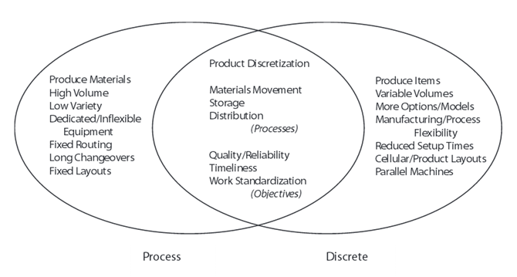
The Production Process
Process Industry
Cosmetics is a process industry
Notes:
1- The difference between discrete and process industry:Process manufacturing is defined as “production that adds value by mixing, separating, forming, and/or performing chemical reactions, It may be done in either batch or continuous mode"
2- Dedicated: مخصصة/ Routing: مسار / Changeovers: التغيير من نظام معين لآخر
3- Types of industries:1- Discrete 2- Continuous 3- Process industries (Discrete + Continuous) (Start as Continuous and then Discrete with activities like shaping, assembling, ﬁnishing, and packing operations)

Slide 8
The Production Process
Process Industry Classification
Product characteristics
Process characteristics
When the product eventually becomes discrete in the process?

Slide 9
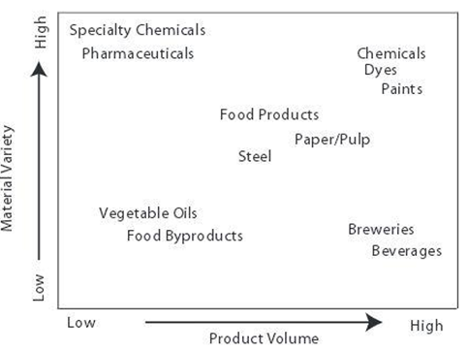
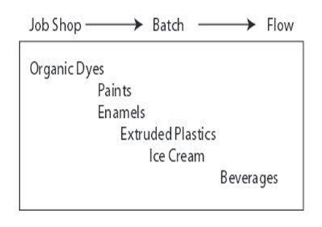
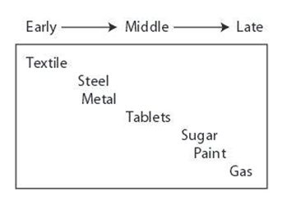
The Production Process
Process Industry Classification

Slide 10
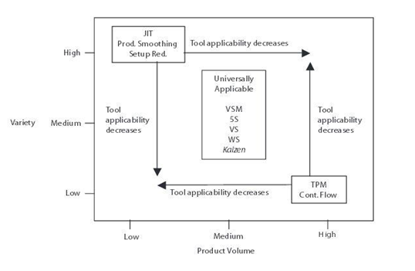
The Production Process
The Effects Of The Classification On Lean
The product characteristics

Slide 11
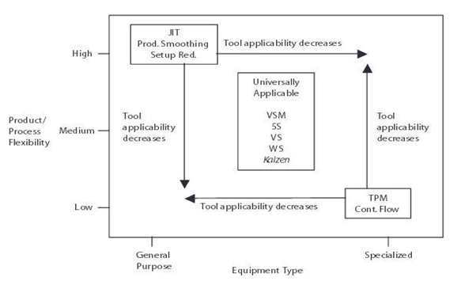
The Production Process
The Effects Of The Classification On Lean
The process characteristics

Slide 12
The Production Process
The Suitable Lean Tools
Universally applicable tools
Value Stream Mapping
5 S
Work Standardization
Visual systems
Kaizen
These tools offer the potential for significant gains with relatively low investment

Slide 13
The Methodology
Data Collection
Visit the factory
Interviews with the workers
Historical data
Cosmetics standards
Process flow chart
To identify the several stages and their sequence in the industrial process

Slide 14
The Methodology
Value Stream Mapping (VSM)
Value-added & Non-value added activities
To: Visualize an entire production processes
Helps in:
Identifying waste and its sources
Creates a common language about a production process
Current state
Notes:
A value stream is defined as all the value-added and non-value added actions required to bring a specific product, service, or combination of products and services, to a customer, including those in the overall supply chain as well as those in internal operations. VSM is an enterprise improvement technique to visualize an entire production processes, representing information and material flow, to improve the production process by identifying waste and its sources. A VSM, both current and future state, is created using a pre-defined set of icons .VSM creates a common language about a production process, enabling more purposeful decisions to improve the value stream

Slide 15
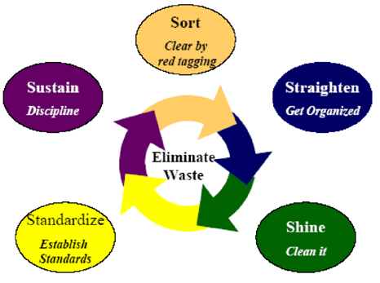
The Methodology
Workplace organization “5s”
Notes:
. 5S reduces wastes by eliminating the searching for tools because everything is in the right place. Preventive maintenance assures that the tools are ready to use, reducing setup time, and the equipment’s and machines will be running effectively, avoiding unplanned downtime or breakdowns.5s comes from the Japanese words Seiri (Sort), Seiton (Straighten), Seiso (Shine and Sweep), Shitsuke (Standardize), and Seiketsu (Sustain).
The 5S.s are some rules for work place organization which aim to organize each worker’s work area for maximum efficiency
Use PDCA (plan, do, check, act), or “Deming cycle” to implement 5S. This is a never-ending process and has to follow a process approach: Establish program plan for each phase from 5S(Sort, Set in order, Shine, Stabilize, Sustain).Start of the program,The expected result of 5S is evaluated.Corrective and preventive actions taken.

Slide 16
The Methodology
Sorting
work area assessment for all items (equipment ,tools, materials).
developing Criteria for removing un necessary items.
take photos for current state.
tags all un necessary item.
Choosing holding area for the tagged items.

Slide 17
The Methodology
Set In Order
Assist all items had already passed the sort step by usage frequency criteria.
Determine the best place for each item.
Decide the needed amount.
Decide who is responsible for each item.
use color coding system to outlines areas and labels to identify these areas.

Slide 18
The Methodology
Shining
Prepare a list of “Visual Sweeping” activities that need to occur in the work area.
Post the finished “Visual Sweeping” list in obvious area.
Prepare a list of “Physical Sweeping” activities.
Post finished “Physical Sweeping” list in obvious communication area.

Slide 19
The Methodology
Standardization
Review and document Sorting activity.
Review and document set in order activity.
Review and file Sweeping activity lists.
Establish a schedule for periodic repetition of 5S activities.

Slide 20

The Methodology
Family Products Selection
According to pareto’s 80/20 ,Lipstick has been selected .
Lipstick=20% of production and 80% of revenues

Slide 21
The existing production System
Preorder Production process
Base solution
Adding the base material
Melting the base material
Mixing
Continously adding color dyes until reaching the color level wanted
Adding perfume and vitamn E
Solidfy
Pouring the mixture in large molds
Wait for the mixture to solidify
Store the solidified mixture until needed

Slide 22
The existing production System postorder production process
Preparing
Apply pressure and heat on the preformed solidified mixture in specific parameters
Pouring the soft mixture in final lipstick molds to solidify
Packaging
Primary packaging of the final shape of lipstick in plastic container
Secondary packaging of the lipsticks carton package

Slide 23
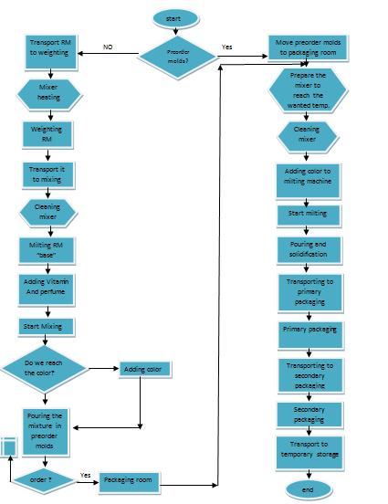
Process flow chart

Slide 24
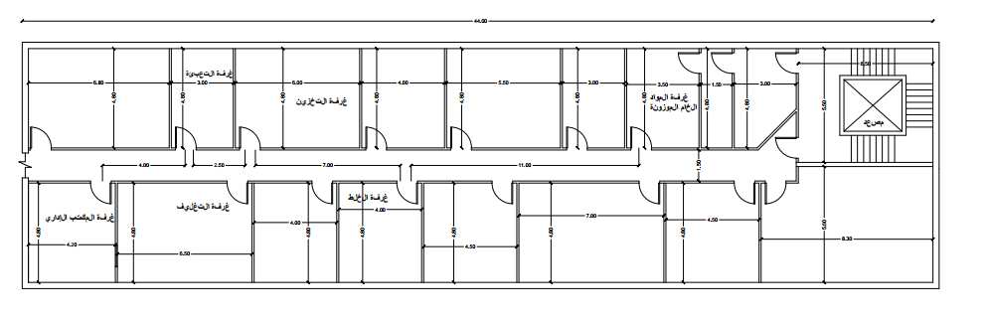
Production Department Layout

Slide 25
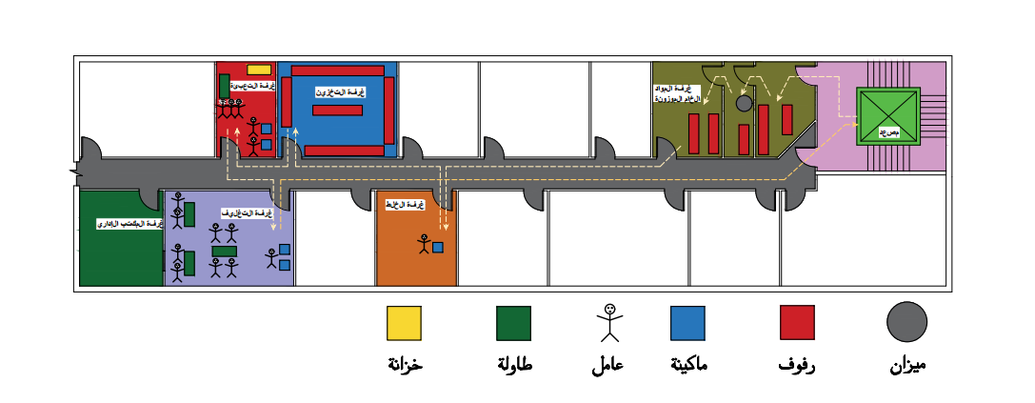
Existing flow pattern between departments

Slide 26
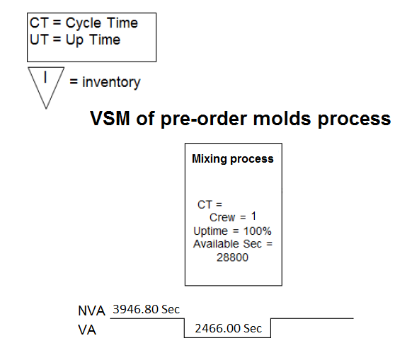
VSM for existing production system
VSM for preorder molds preparing
AV=38%

Slide 27
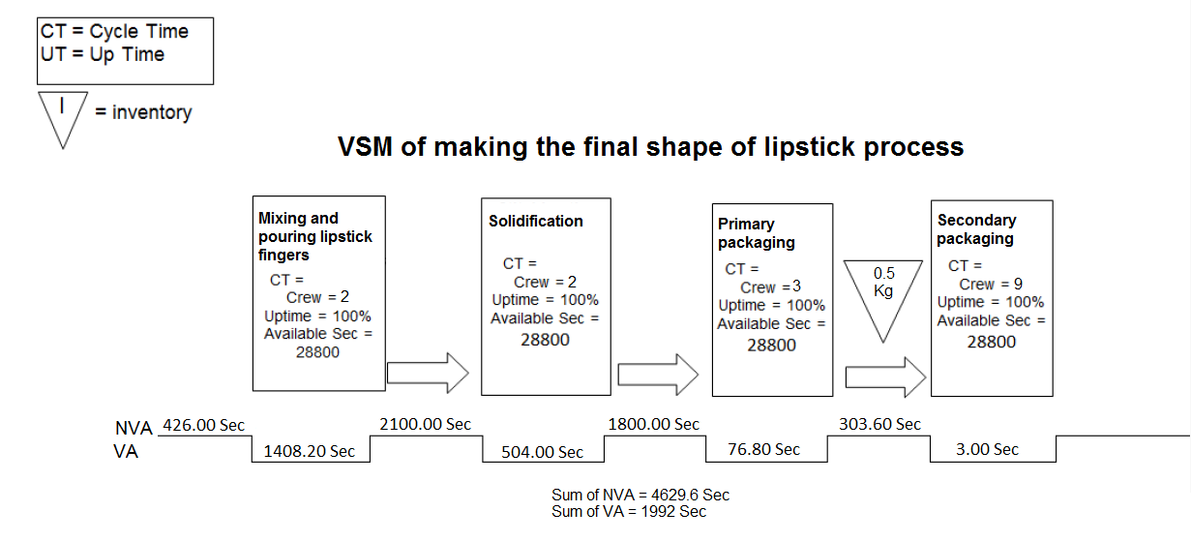
VSM for existing production system
VSM for final shape of lipstick process
AV=30%

Slide 28
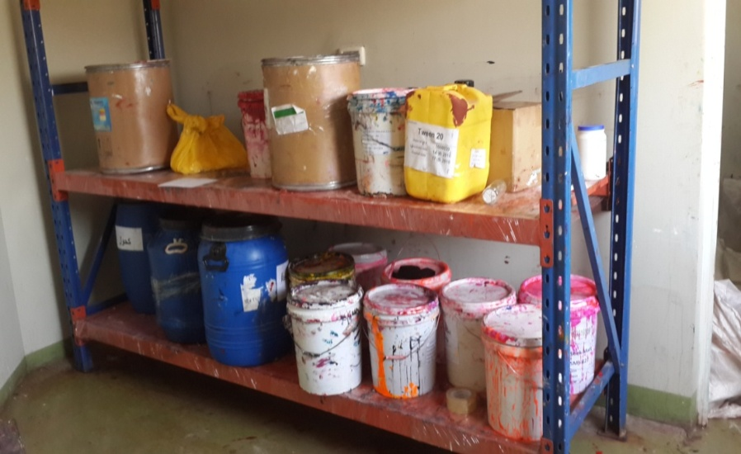
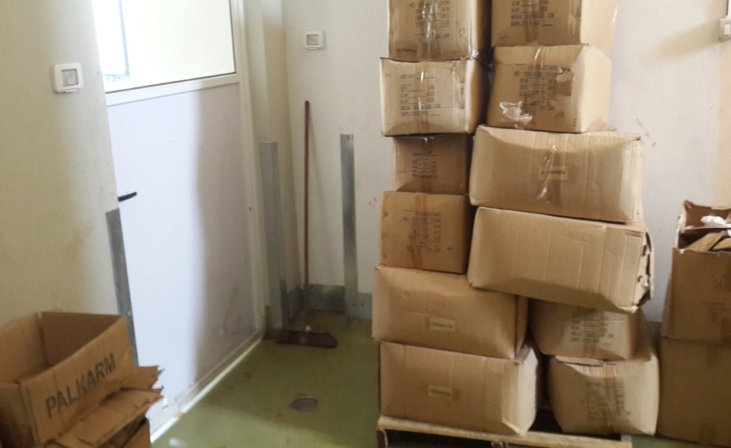
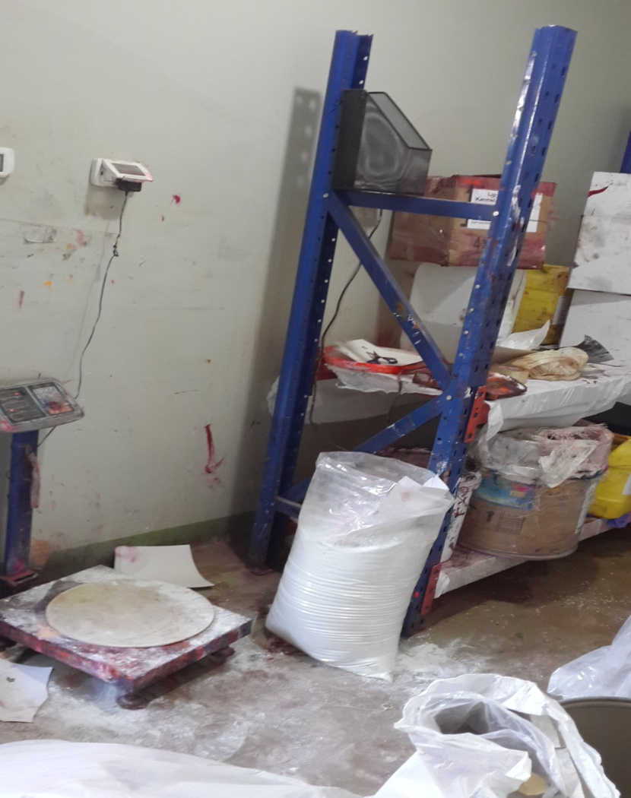
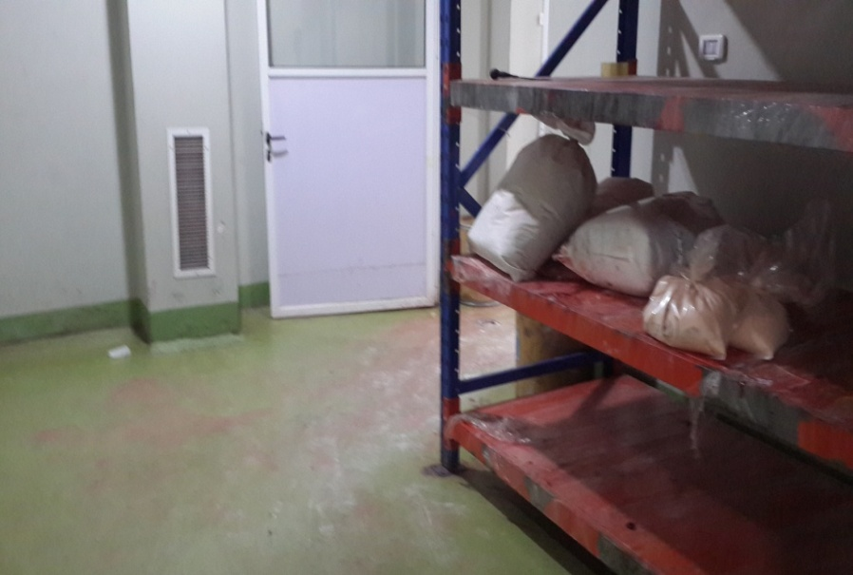
Current state analysis without 5s
The Weighing Room

Slide 29
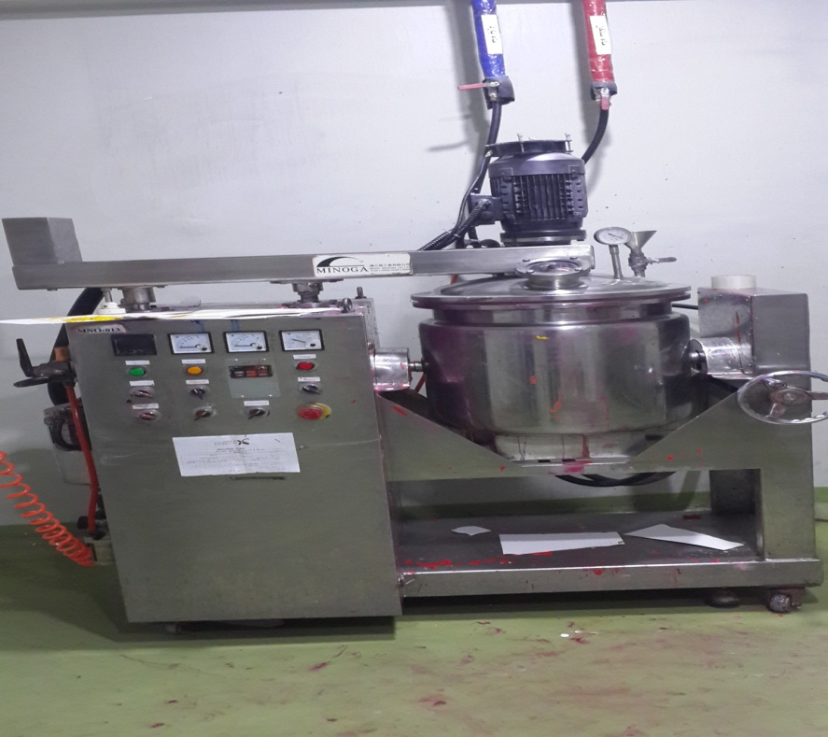
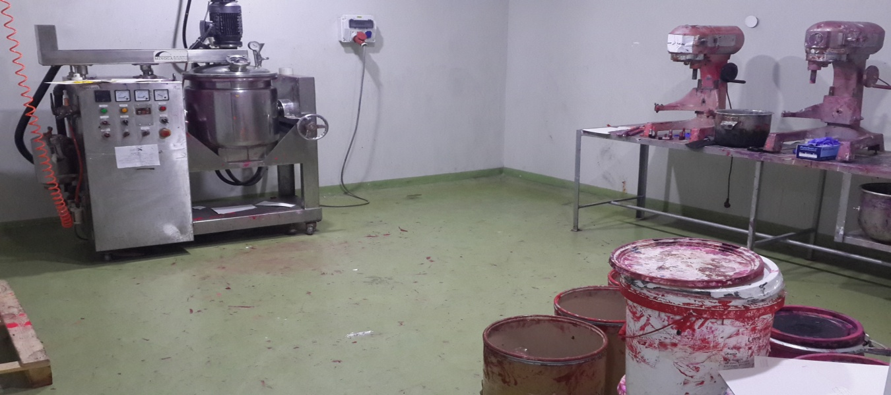
Current state analysis without 5s
Mixing Room

Slide 30
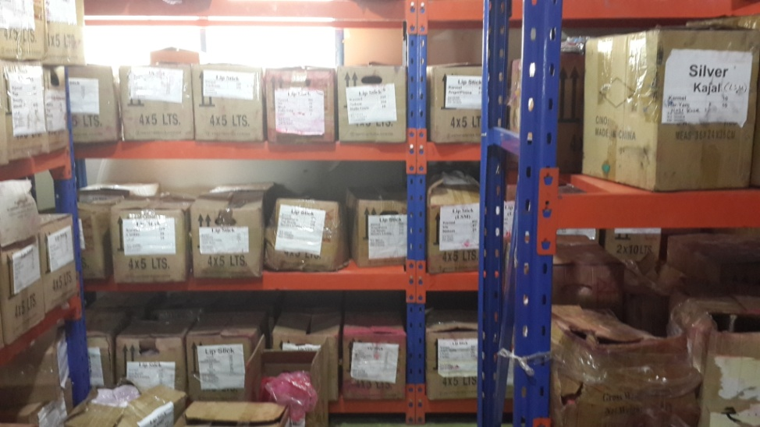
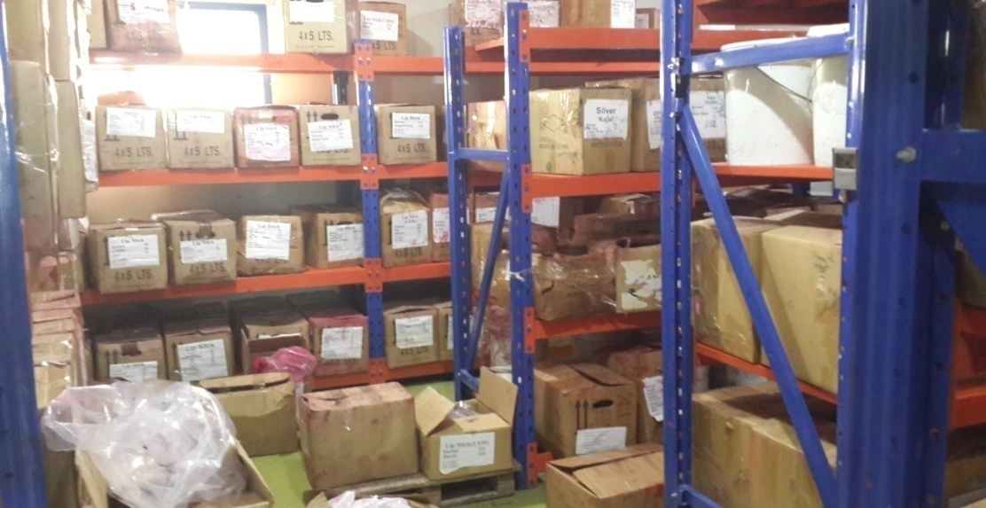
Current state analysis without 5s
Pre-Order Molds Inventory

Slide 31
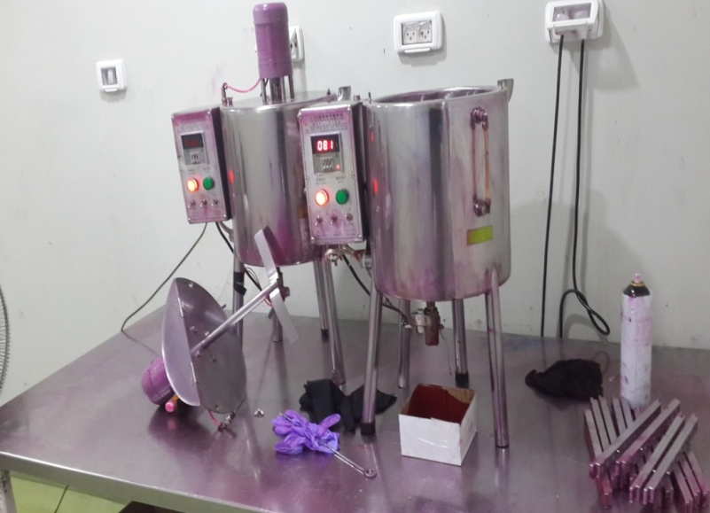
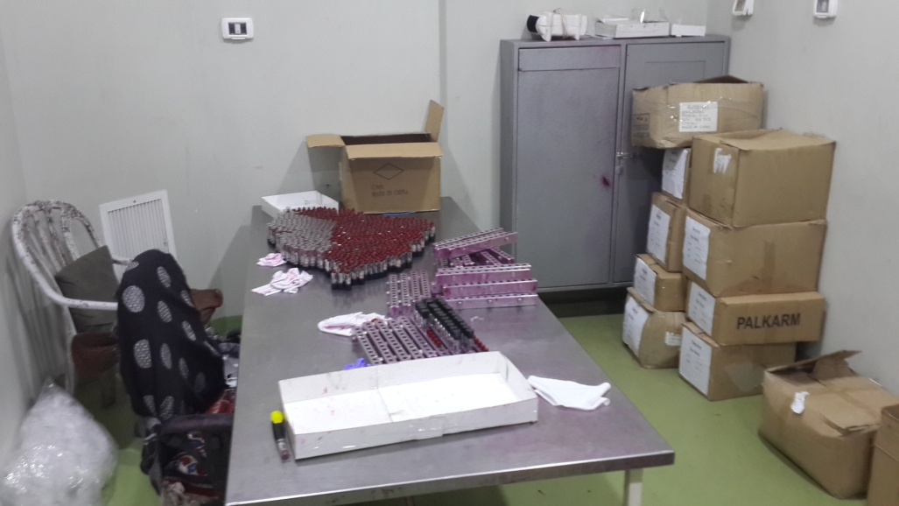
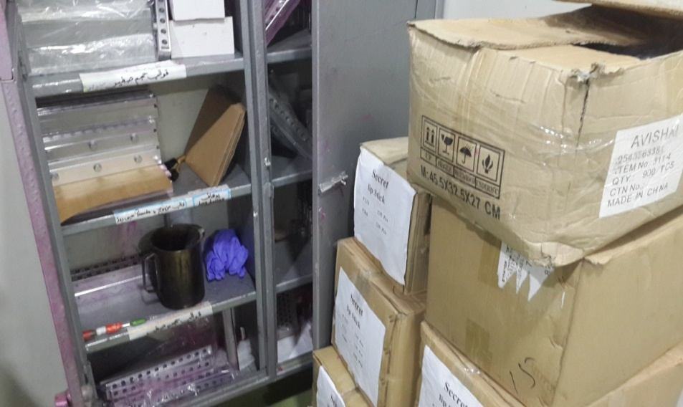
Current state analysis without 5s
The Primary Packaging Room

Slide 32
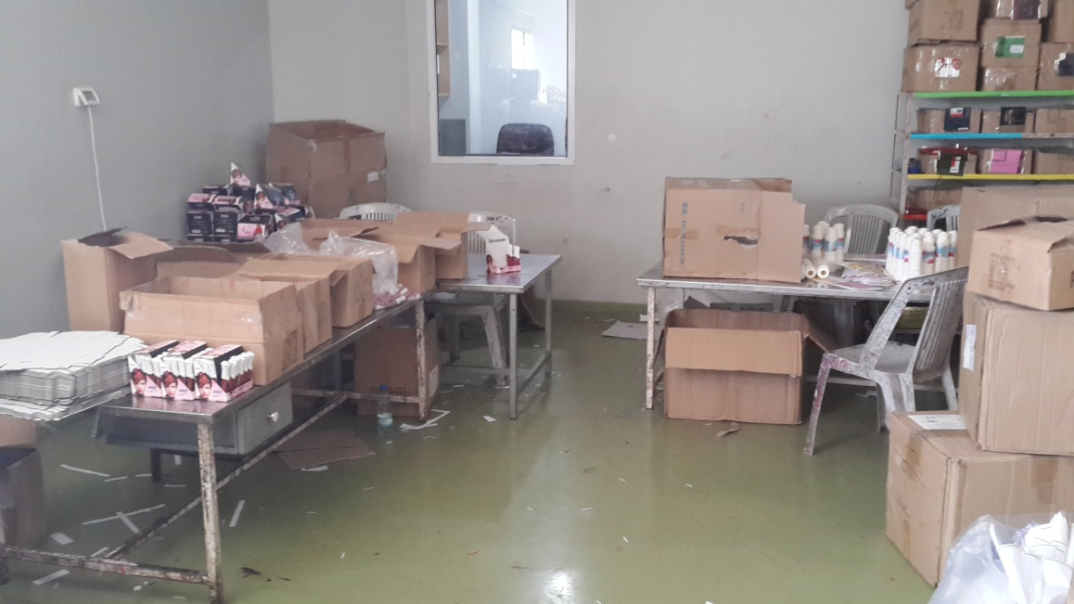
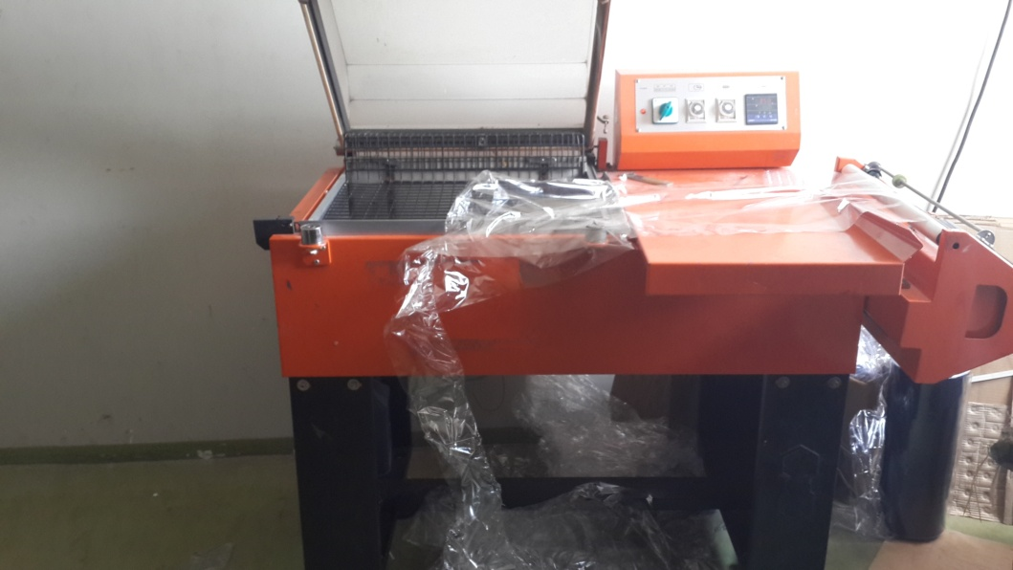
Current state analysis without 5s
The Secondary Packaging Room

Slide 33
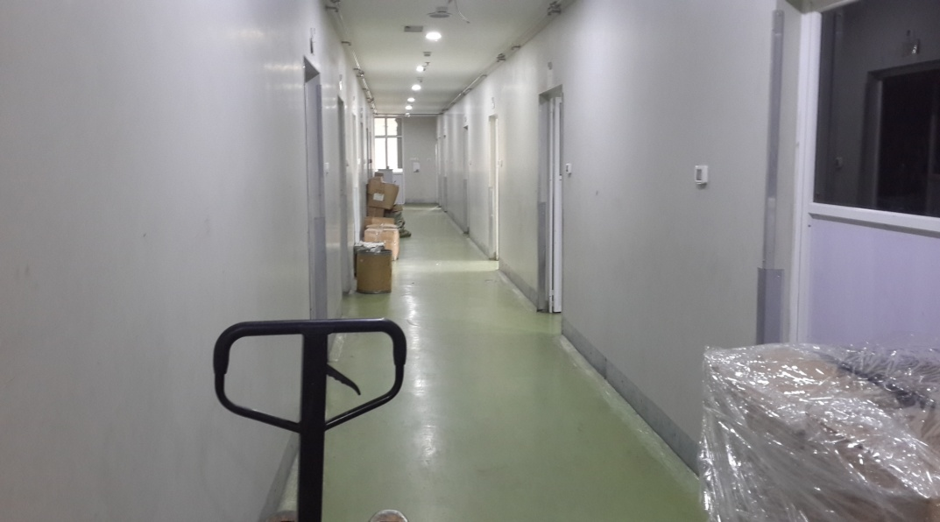
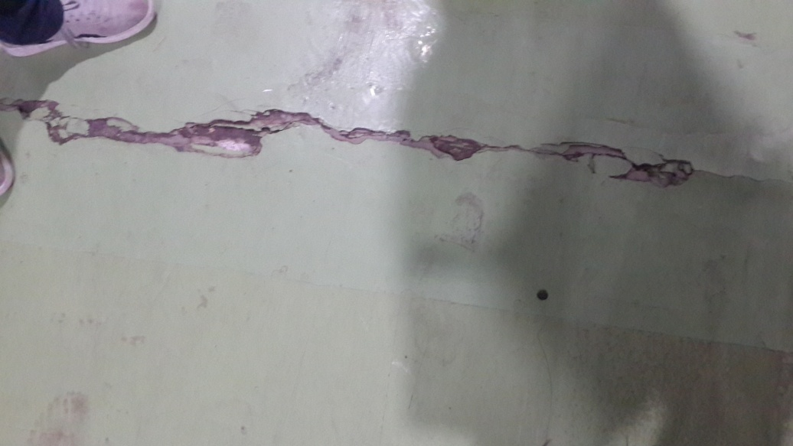
Current state analysis without 5s
The Hallway

Slide 34
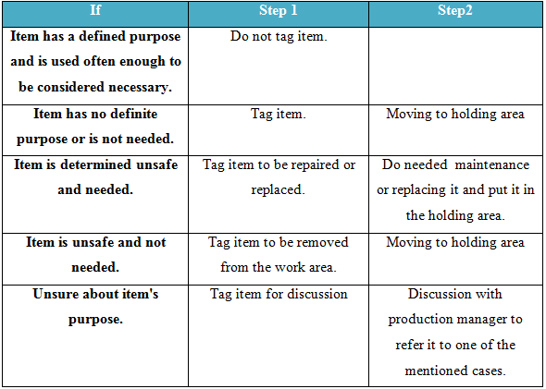
5S Implementation phases
Sorting criteria

Slide 35
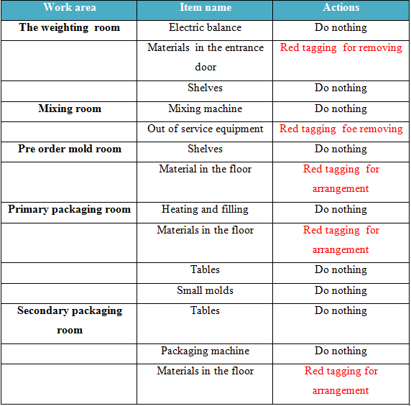
5S Implementation phases
Sorting implementation

Slide 36
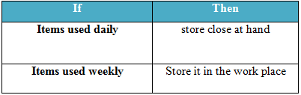
5S Implementation phases
Set In Order criteria

Slide 37
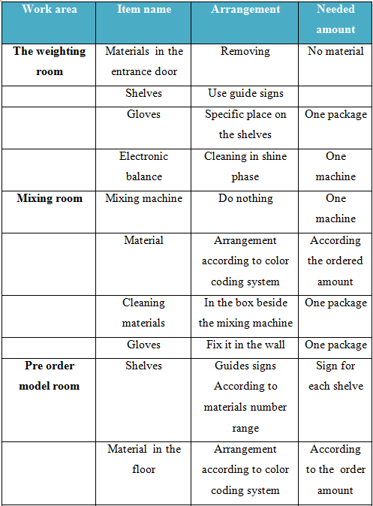
5S Implementation phases
Set In Order implementation (1/2)

Slide 38
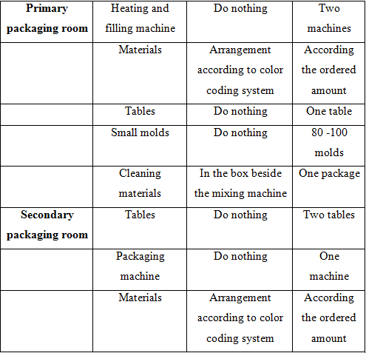
5S Implementation phases
Set In Order implementation (2/2)

Slide 39
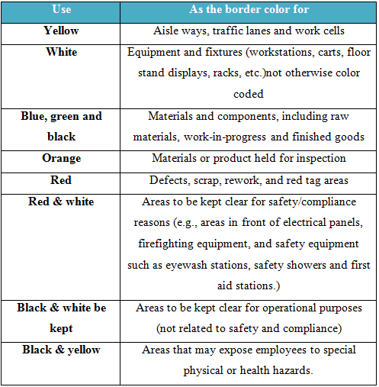
5S Implementation phases
Set In Order – colour coding criteria

Slide 40
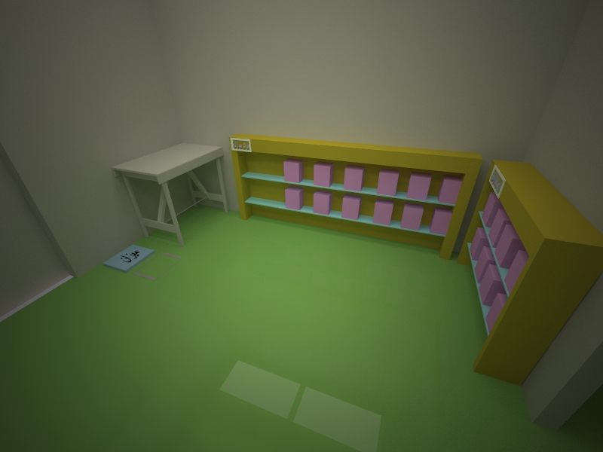
Work areas after implementing color coding
The weighing room

Slide 41
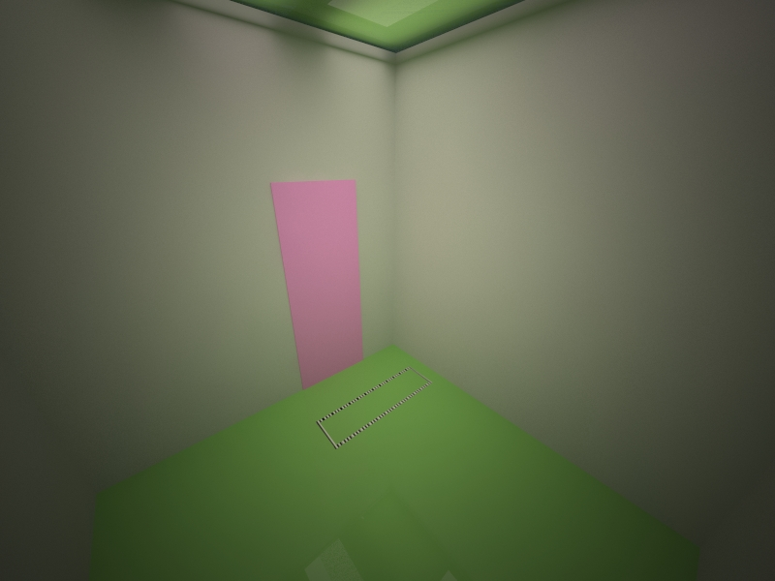
Work areas after implementing color coding
The entrance door to the weighting room

Slide 42
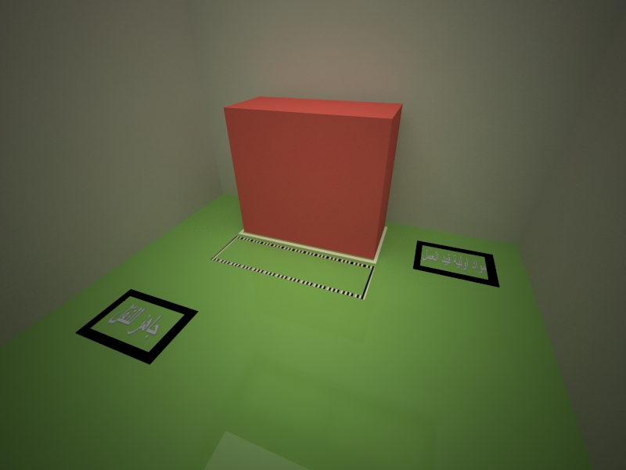
Work areas after implementing color coding
The Mixing room

Slide 43
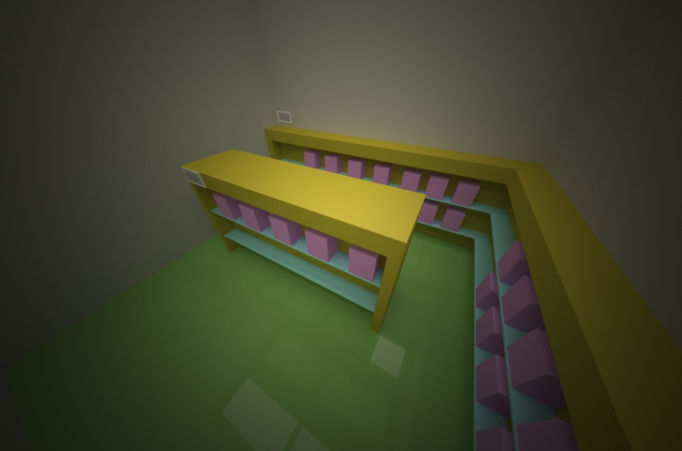
Work areas after implementing color coding
The Pre-Order Molds Inventory

Slide 44

Work areas after implementing color coding
The Primary packaging room

Slide 45
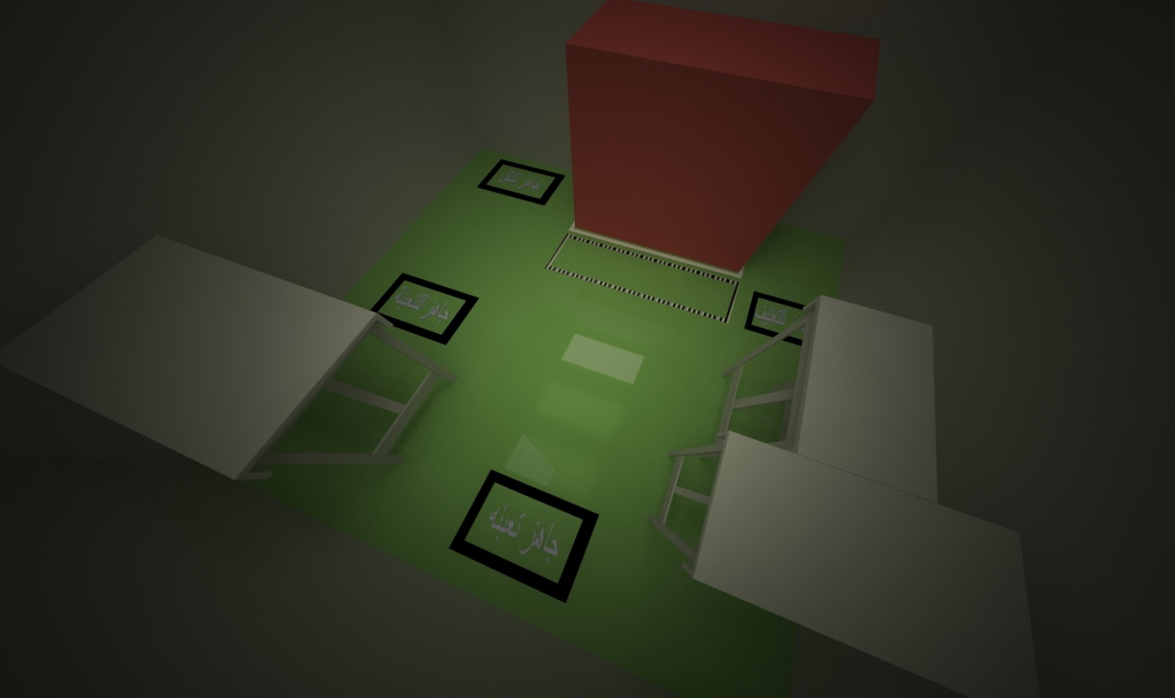
Work areas after implementing color coding
The Secondary packaging room

Slide 46
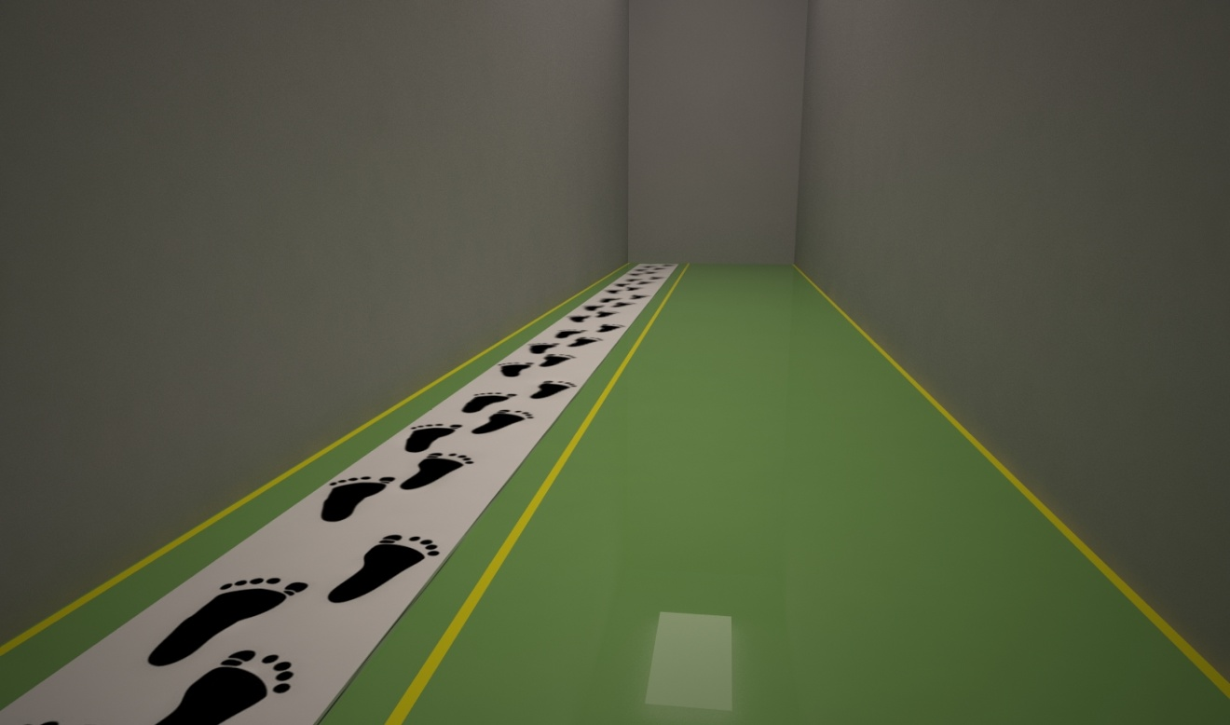
Work areas after implementing color coding
The hallway

Slide 47
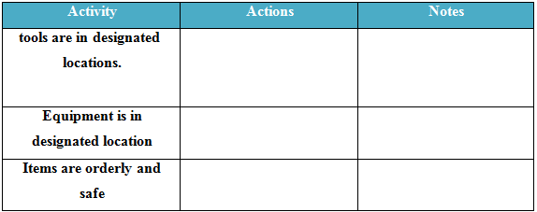
5S Implementation phases
Shining - Visual Sweeping List

Slide 48
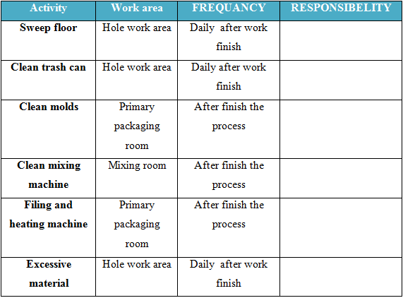
5S Implementation phases
Shining - Physical Sweeping List

Slide 49
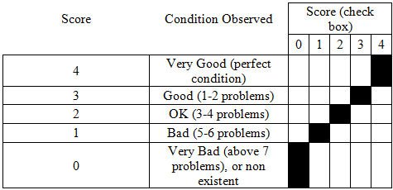
5S Implementation phases
Standardization - Scoring guide

Slide 50
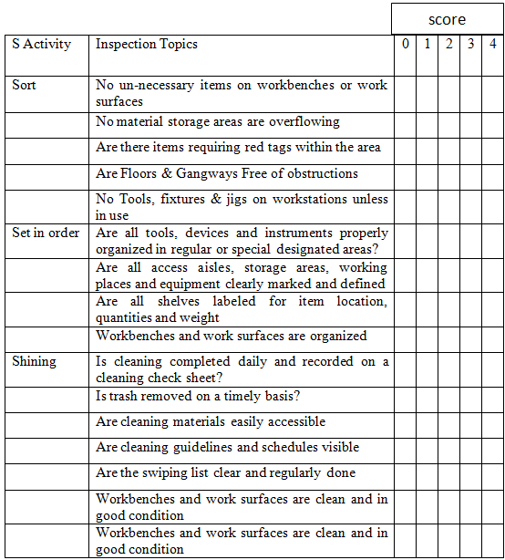
5S Implementation phases
Standardization - A schedule for periodic repetition of 5S activities

Slide 51
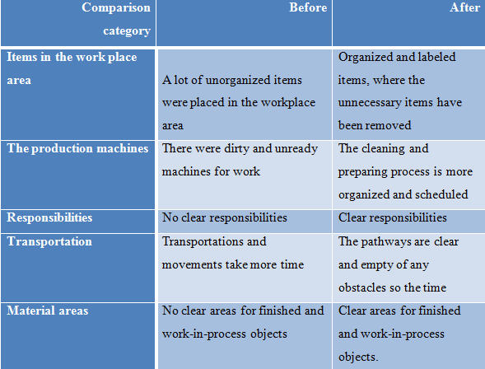
Discussion and Conclusion

Slide 52
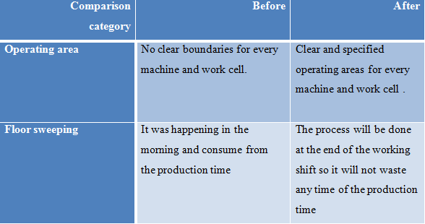
Discussion and Conclusion

Slide 53
Recommendations
the top management are required to fully support this activity all through the factory.
The involvement of all employees in the all departments in the program 5S.
A 5S team should be established to continuously control and monitor the implementation of 5S.
Work standardization lean concept should be created for each process.

Slide 54
Recommendations
using this project as a reference to implement 5s on other production lines in the factory.
hire more experienced employees in lean manufacturing systems.
create clear job discretions and tasks for each employee to facilitate employee management and evaluation.

