Slide 1
Smart Cleaning
Robot
Prepared by:
Mohammad Tariq Abueideh
Yousef Tariq Aslan

Slide 2
Table Of Contents
Introduction
Related Work
Methodology
Results and Analysis
Challenges and Constraints
Conclusion and Future Work

Slide 3
Introduction
1.

Slide 4
Introduction
Problem description
Objectives
Work steps

Slide 5
Related Work
2.

Slide 6
Related Work
Robot sensing its environment
Robot covering the whole area
ROS helps robotics

Slide 7
Methodology
3.

Slide 8
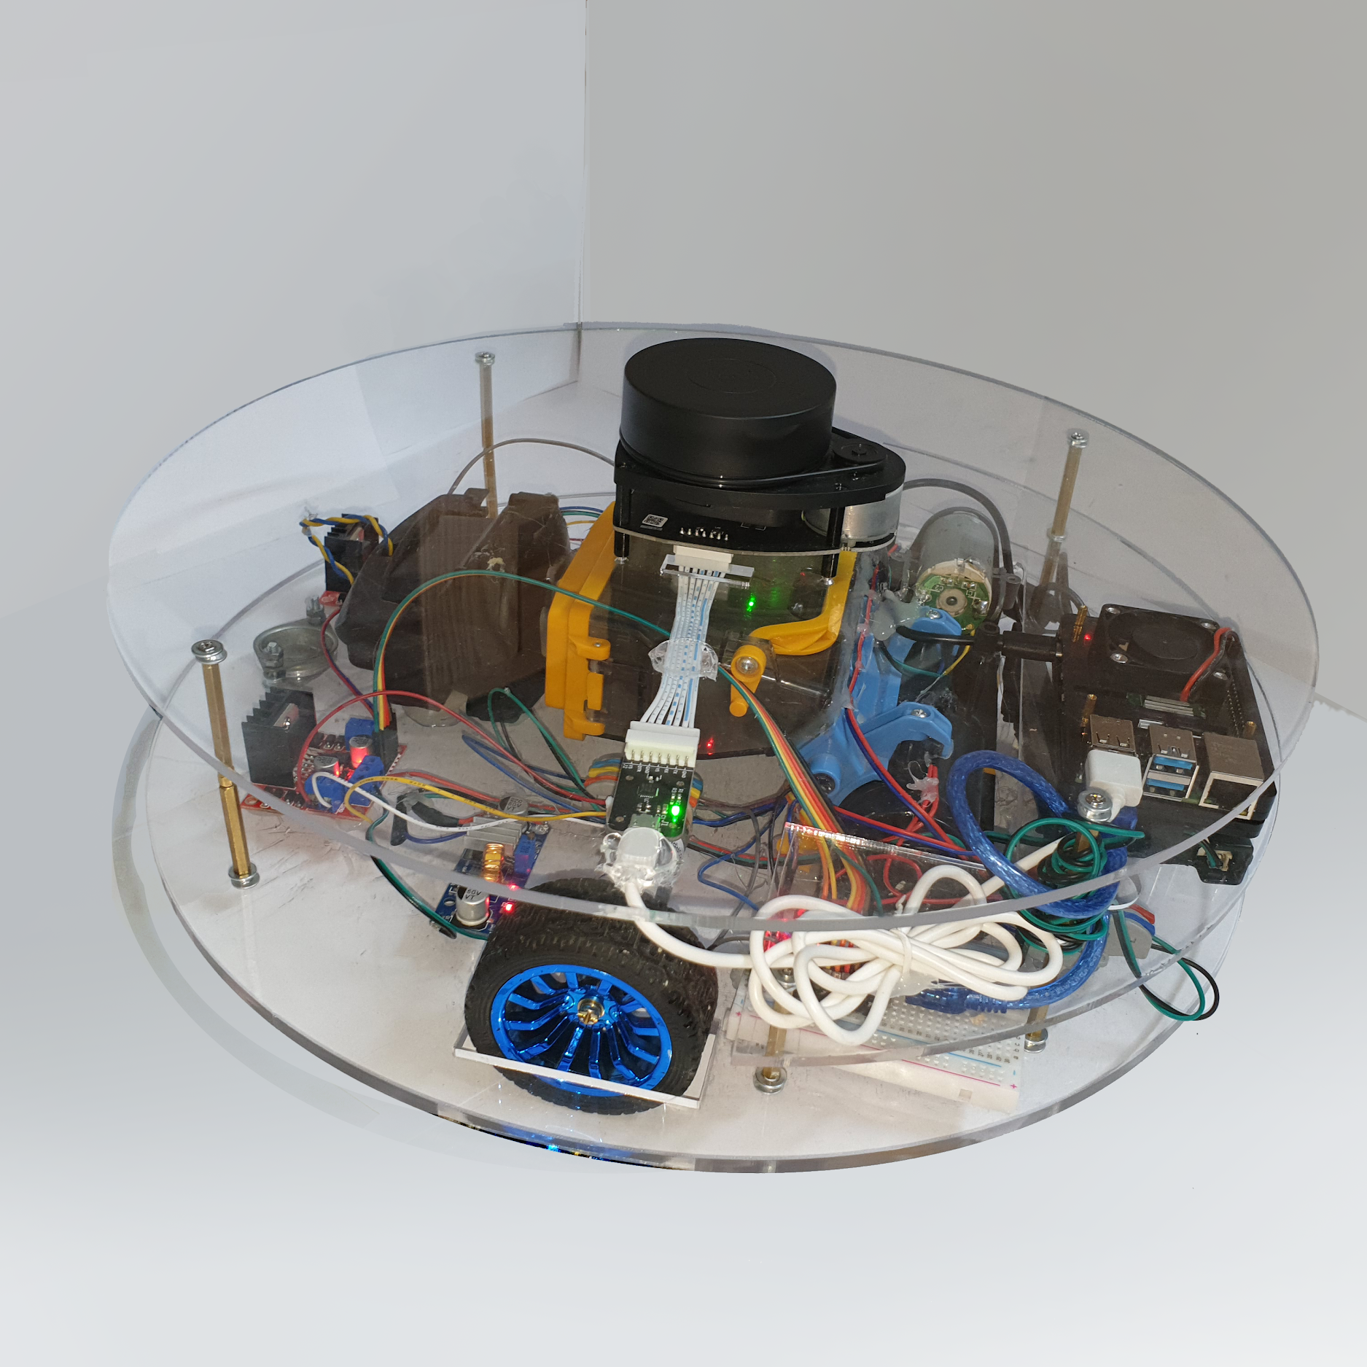
Design specification
Methodology
Material
Dimensions
Assembly

Slide 9
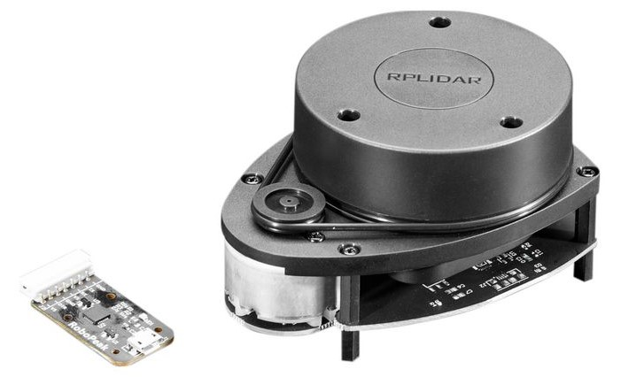
Hardware Components
Methodology (cont.)
RPLiDAR A1
Raspberry Pi 4

Slide 10
Hardware Components
Methodology (cont.)
Arduino Nano
DC Motor
Motor Driver

Slide 11
Hardware Components
Methodology (cont.)
Power Supply Considerations
  Li-ion Battery
  Buck Converter

Slide 12
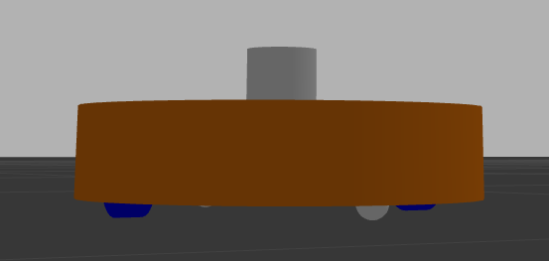
Implementation
Methodology (cont.)
Robot Operating System
Unified Robot Description Format

Slide 13
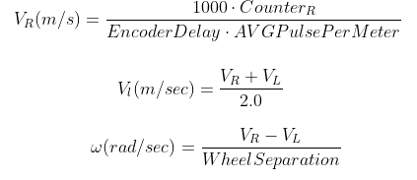
Implementation
Methodology (cont.)
Odometry Implementation

Slide 14
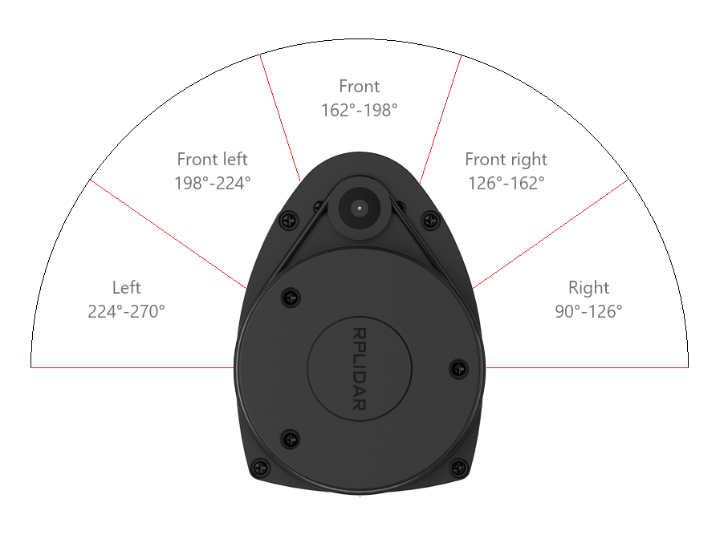
Implementation
Methodology (cont.)
Mapping
  SLAM gmapping
  Autonomous mapping

Slide 15
Implementation
Methodology (cont.)
Localisation
  AMCL
Path Planning
  Global & Local Planners
  Velocity command to wheel velocity

Slide 16
Implementation
Methodology (cont.)
Full Coverage
  Occupancy grid
  Erosion & Dilation
  Spiral filling
Room Cleaning

Slide 17
Results and Analysis
4.

Slide 18
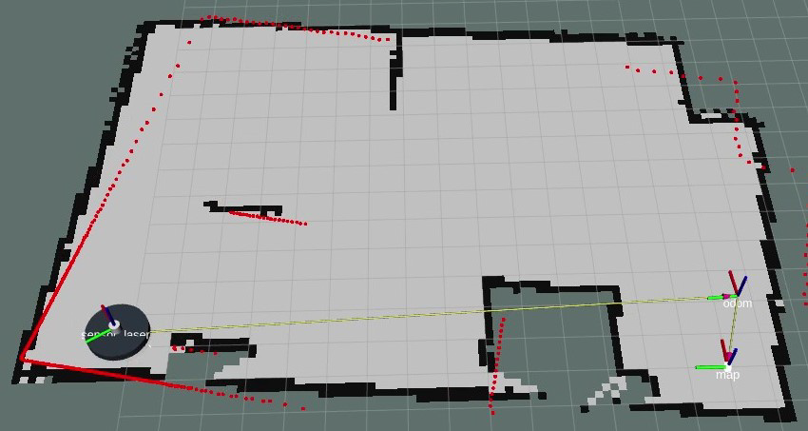
Mapping
Results and Analysis

Slide 19
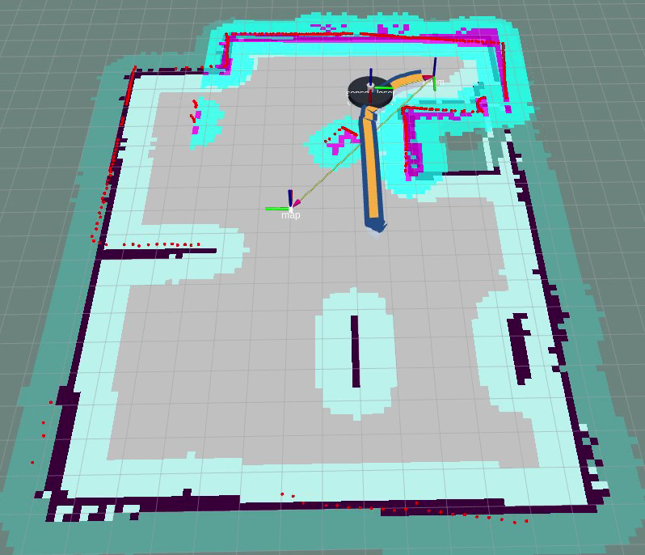
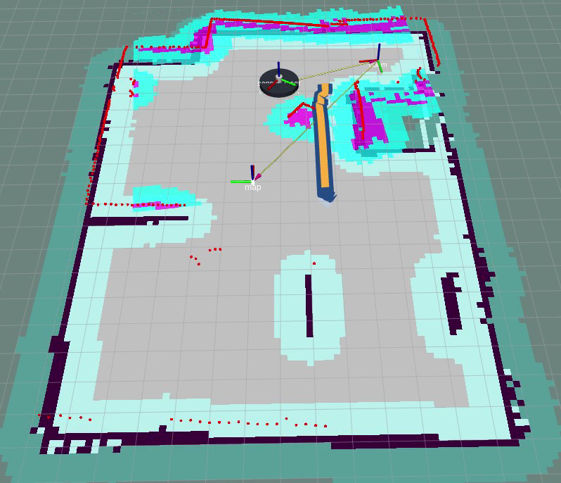
Path Planning & Obstacle avoidance
Results and Analysis

Slide 20
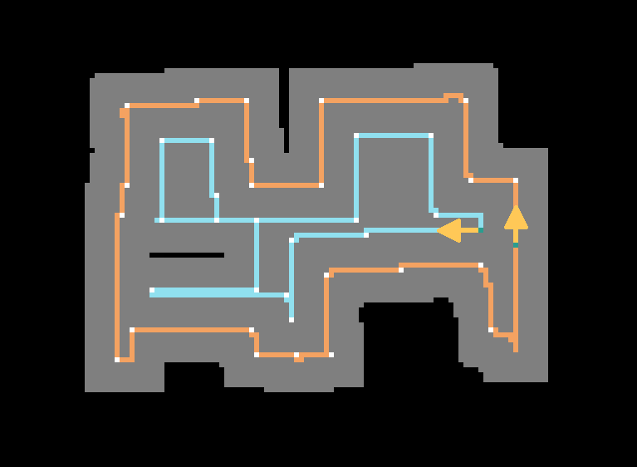
Full Coverage
Results and Analysis

Slide 21
Challenges and Constraints
5.

Slide 22
Challenges and Constraints
Stepper Motor Sound
Non-identical DC motors
Blind Spot of LiDAR

Slide 23
Conclusion and Future Work
6.

Slide 24
Conclusion
We have been able to map out a room with its details
We have been able to introduce a solution on how to fully clean the room
The autonomous navigation process can be integrated into many other projects

Slide 25
Future Work
Charging station
Add IR sensor
IoT integration

Slide 26
THANKS!
Any questions?

