Slide 1


Slide 2
Intelligent recommendation system for
social media content
An-Najah National University
Computer Science
Islam Amer
Supervised by:
Dr.Abdel-razzak Natsheh

Slide 3
Outline
Introduction
Challenges
Features
Work Flow
Show Demo
Future work and conclusion

Slide 4
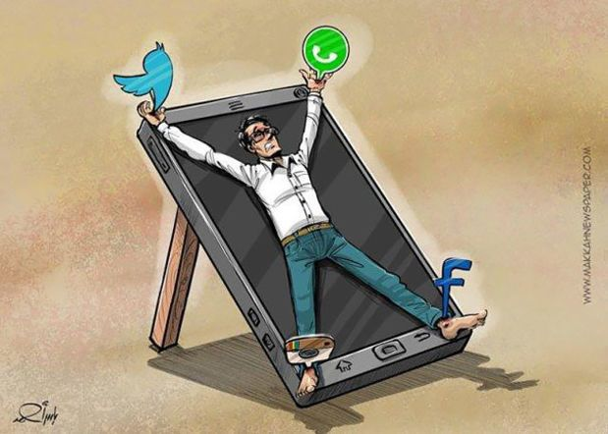
introduction

Slide 5

introduction

Slide 6
Challenges
Arabic Data.
Repeating posts.
time

Slide 7
Features
Searching about new posts every 12 hours by using “cron job”.
Repeating posts has been resolved by using “Levenshtein algorithm”.
The web application has a search engine to make the search easier.
Login via Facebook in order to allow the web application to let you move to original post inside Facebook page.
Accessibility : Is about creating an environment that is friendly to 100 percent of its visitors. On a website, this means that all content can be read, all visuals can be seen, and all media can be viewed.

Slide 8
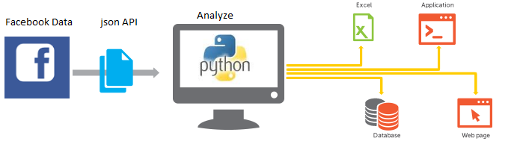
Work Flow
Scraping Data
Analyze Data
Store Data

Slide 9
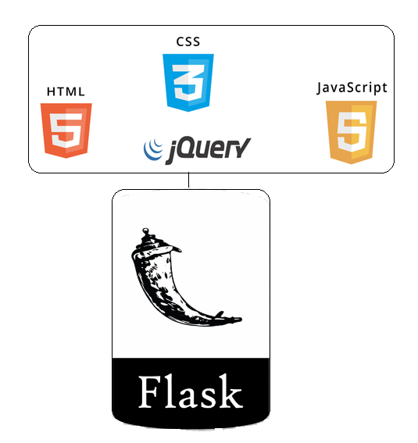

Web application
Front end: HTML, CSS, JavaScript, jQuery, bootstrap
Back end: Flask Framework
bootstrap

Slide 10
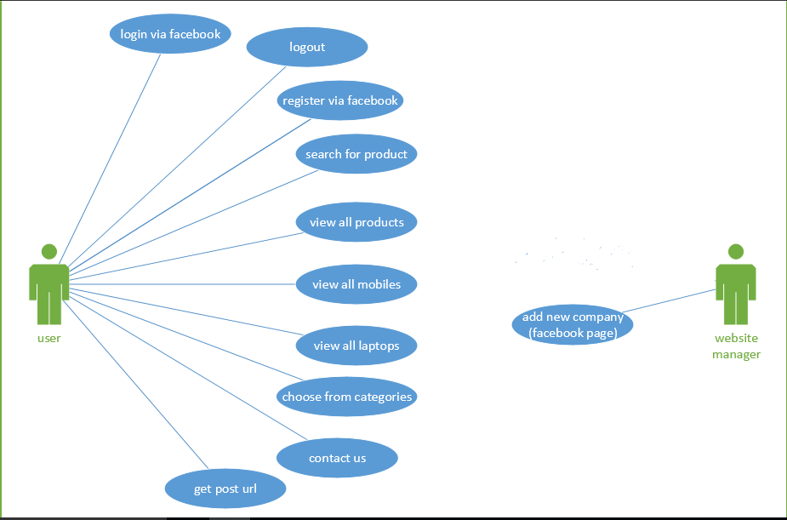
Use case diagram

Slide 11
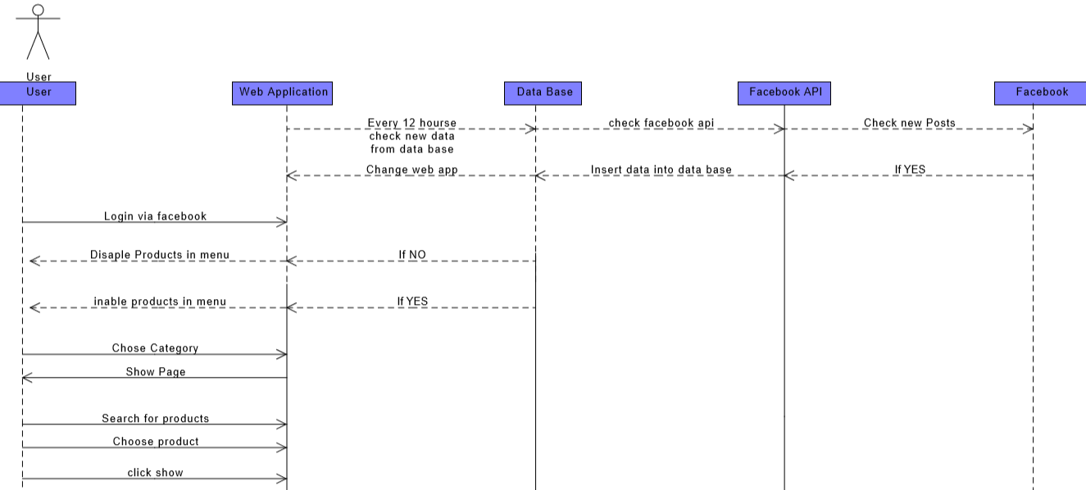
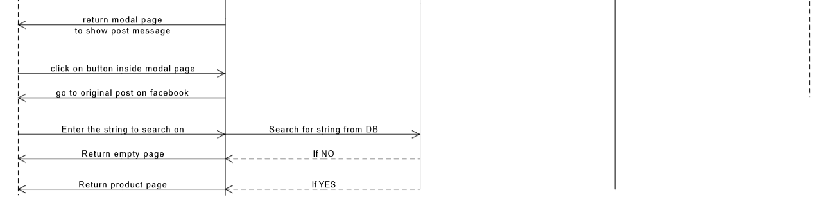

Slide 12
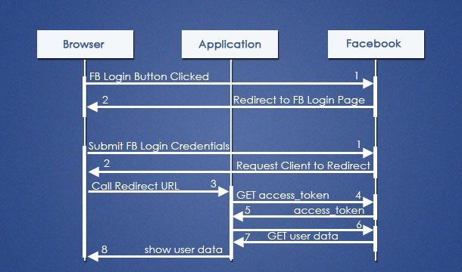

Slide 13
Future work and conclusion
Allow the system to include more products.
Analyze page data and return trusted pages.
Allow the system to focus on trusted pages
Create android and ios application.
Make my web application more accessible
In this project, I built a website that aims to make Facebook shopping process easier.

Slide 14

Any questions ??

