Slide 1
بســـــــــــم الله الرحمن الرحيم
Graduation Project 2 Presentation
New Design of a Multipurpose Building
Prepared By :
Amjad Zidan
Osama Rashad
Ashraf Moshref
Supervised by : Eng. Mo’ayad Salhab

Slide 2
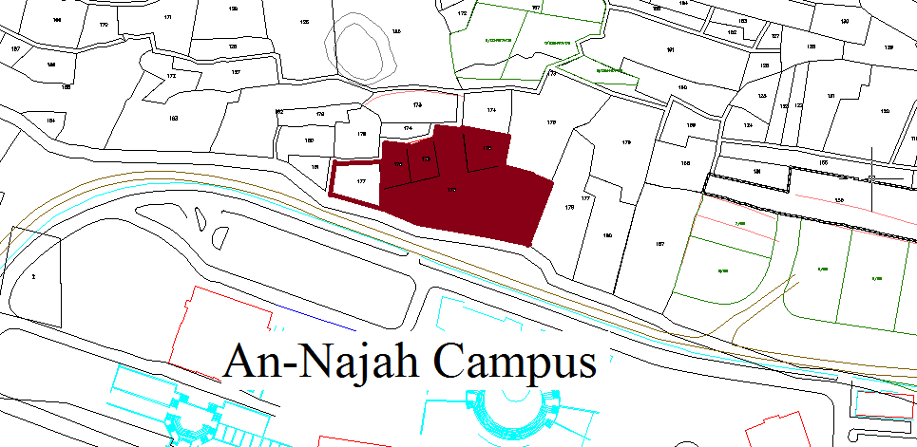
Project Main Idea

Slide 3
Summary :
1- Architectural Design
2- Environmental Design
3-Structural design
4-Mechanical design
5-Electrical design
6-Safety & Fire Design
7-Quantity Surveying & Specifications

Slide 4
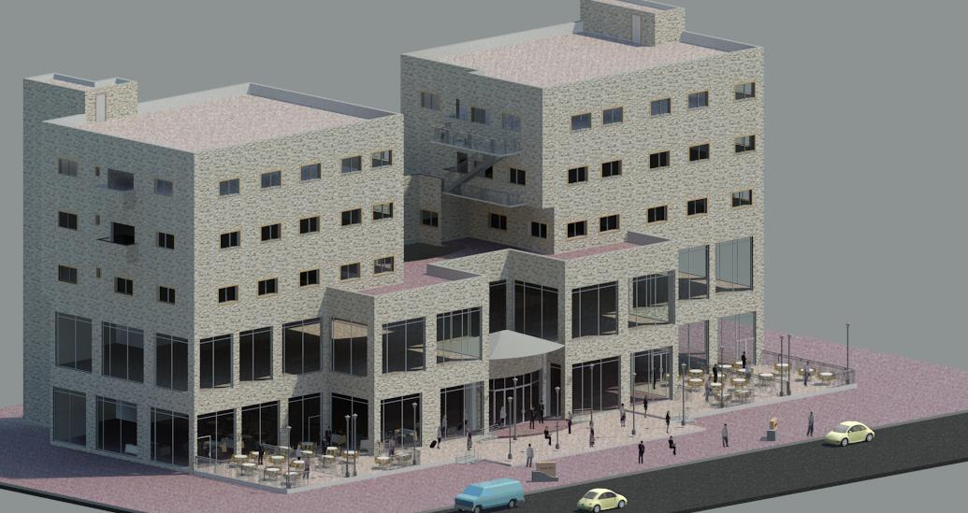

Slide 5
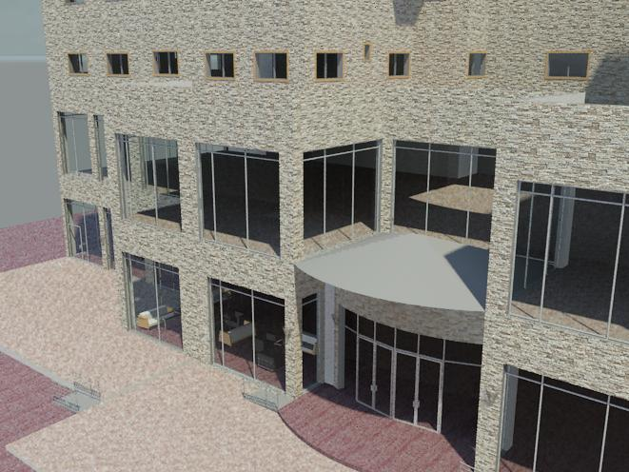

Slide 6
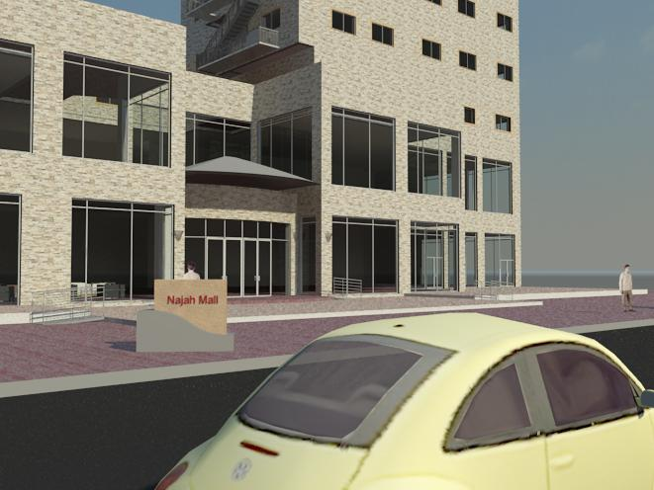

Slide 7
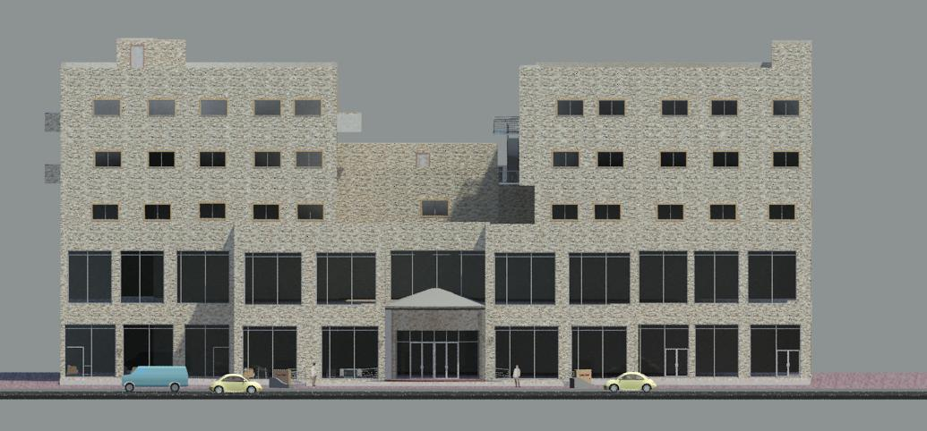

Slide 8
ARCHITECTURAL DESIGN
Basic Elements :
1- The Main Entrance
2- The Main Hall
3- Stairs

Slide 9
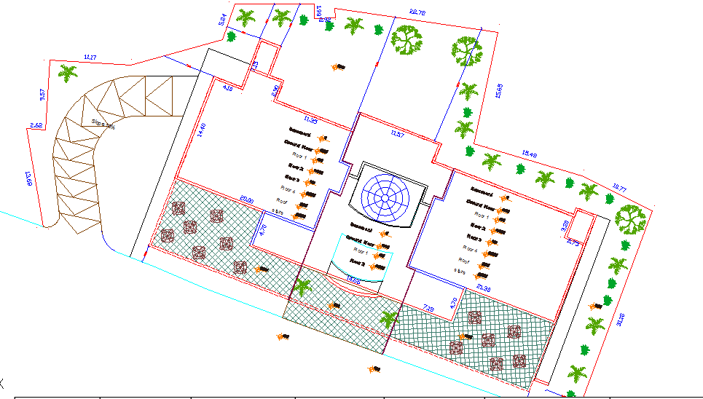
Site Plan

Slide 10
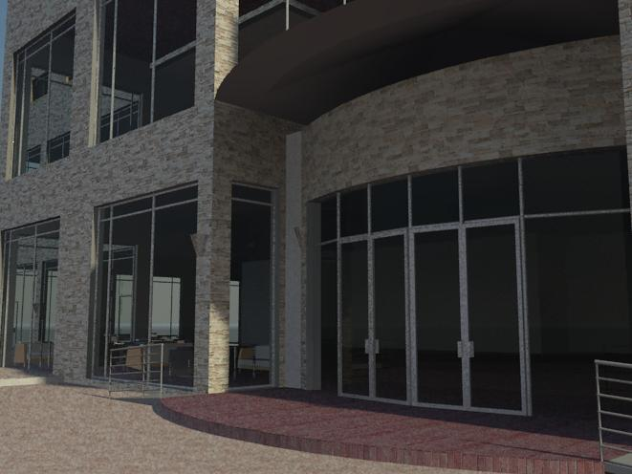

Slide 11
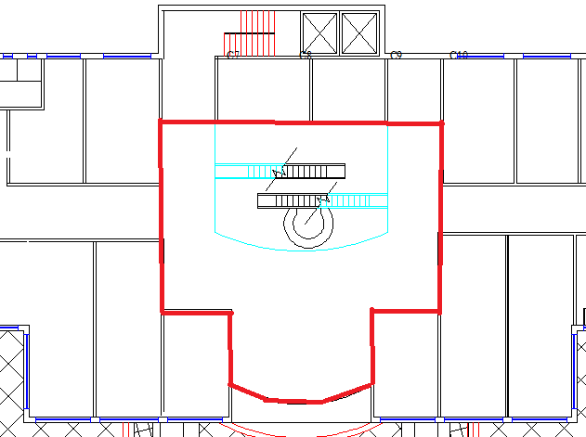
Main Hall

Slide 12
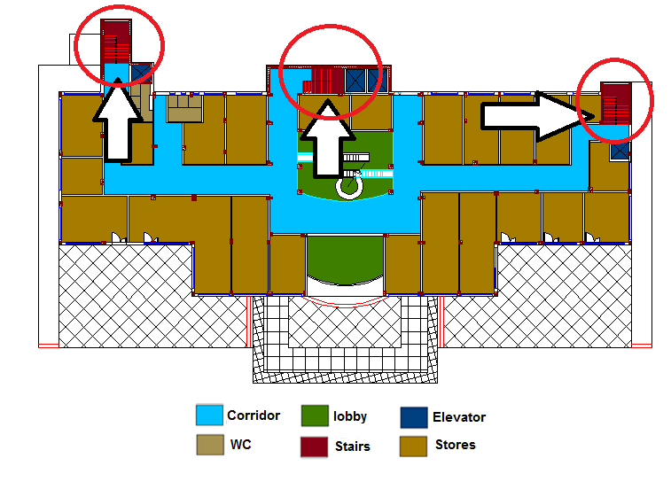
Stairs

Slide 13
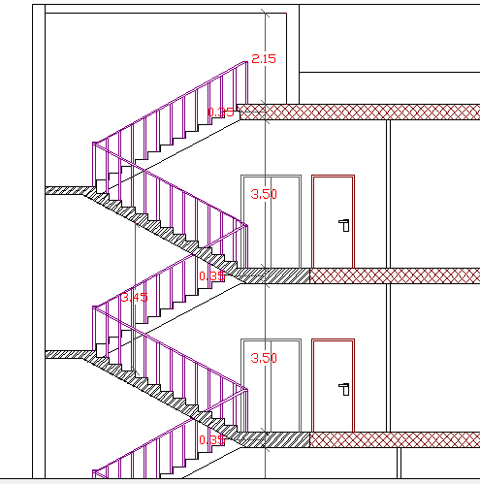
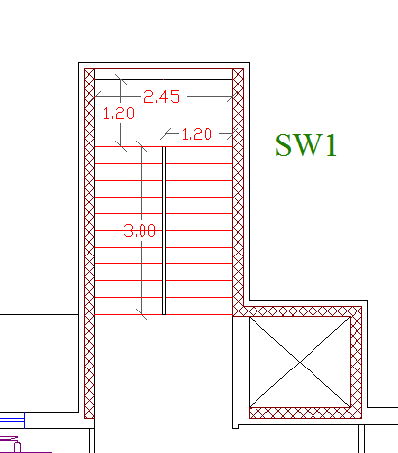
Stairs

Slide 14
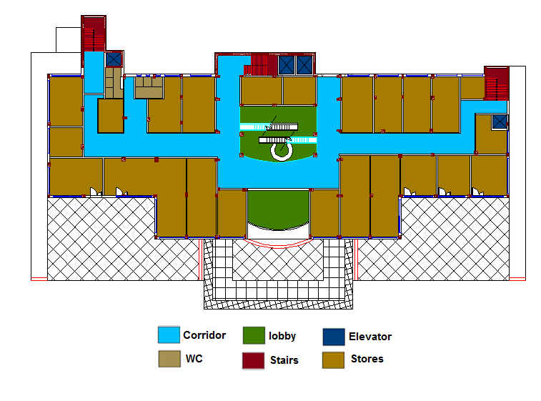
Ground Floor

Slide 15
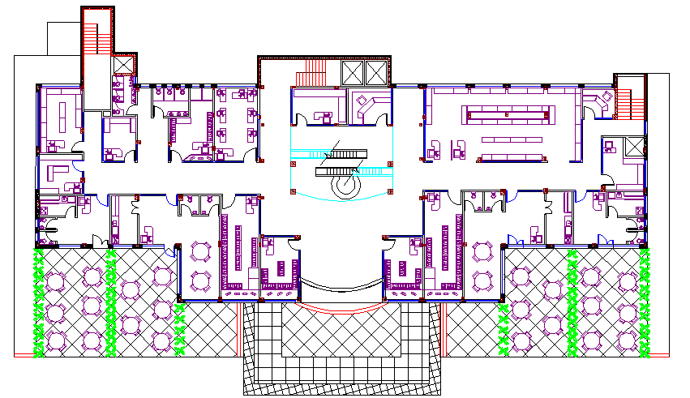
Ground Floor

Slide 16
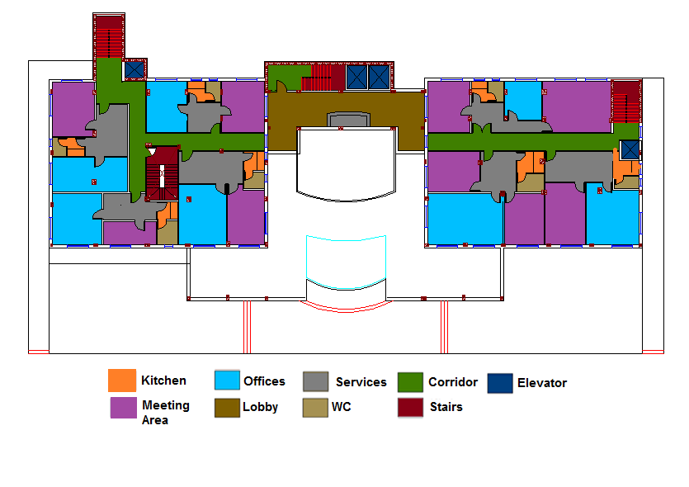
Second Floor
Offices

Slide 17
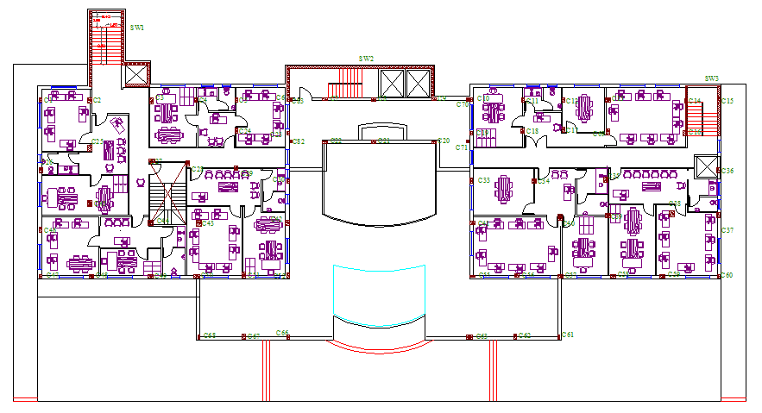
Offices

Slide 18
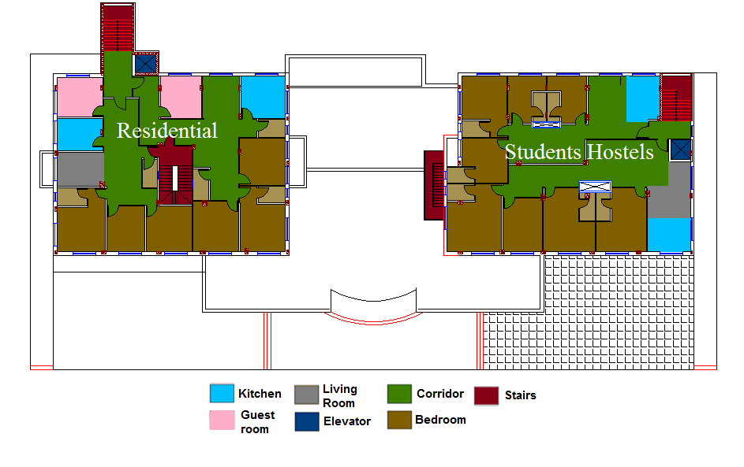
3rd & 4th Floors
Residential

Slide 19
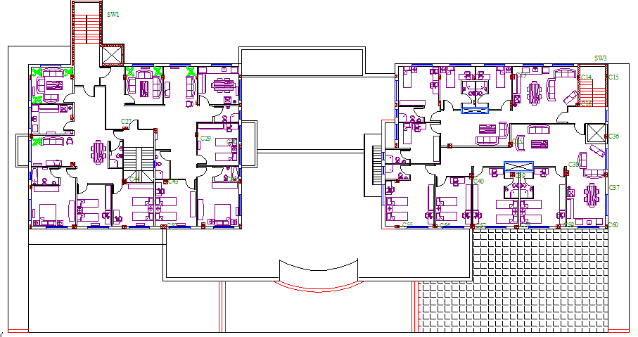
Residential

Slide 20
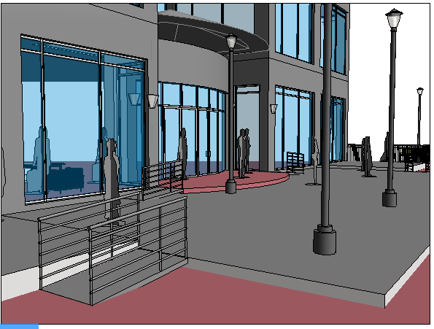
Ramps

Slide 21
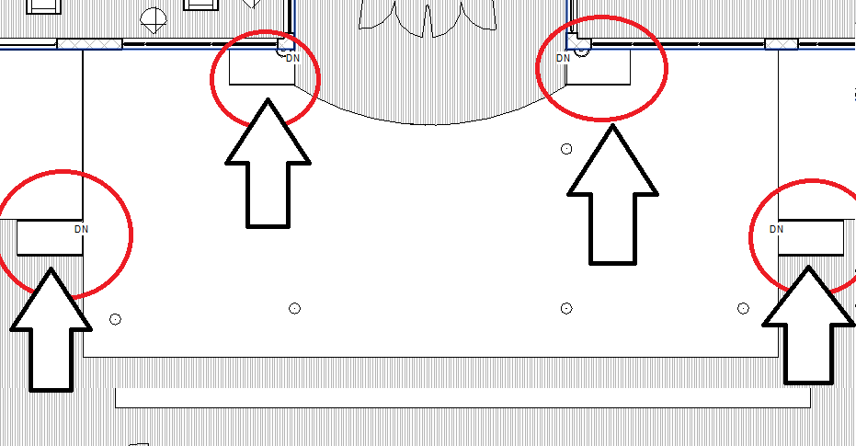
Ramps Location

Slide 22
Environmental Design
1- Acoustical and Thermal Insulation
2-Natural Day Lighting
3-Shading

Slide 23
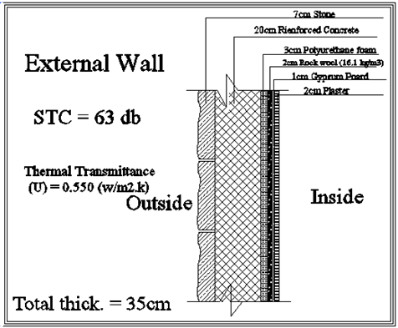
Acoustical and Thermal Insulation
Type of material | Thickness | K ( w/m.k) | R ( m².k/w) | STC (db)
Outside | …………. | …………. | 0.04 | …………
Stone | 0.07 | 2600 | 0.027 | 50
Rei. Concrete | 0.2 | 2100 | 0.095 | 50
Polyurethane foam | 0.03 | 0.03 | 1.000 | 3
Gypsum Board | 0.1 | 0.21 | 0.048 | 2
Cement Plaster with lime | 0.02 | 0.87 | 0.023 | 2
Rock wool | 0.02 | 0.044 | 0.455 | 3
Inside | ………… | ………….. | 0.13 | ………..
 |  | Total R | 1.817 | Total STC
 |  | U(w/m²) | 0.55 | 63

Slide 24
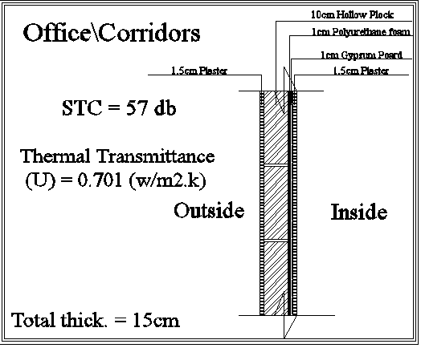
Acoustical and Thermal Insulation
Type of material | Thickness | K ( w/m.k) | R ( m².k/w) | STC (db)
Outside | …………. | …………. | 0.04 | …………
Cement Plaster with lime | 0.015 | 0.87 | 0.017 | 2
Hollow Block | 0.1 | 0.12 | 0.833 | 38
Polyurethane foam | 0.01 | 0.03 | 0.333 | 11
Gypsum Board | 0.01 | 0.179 | 0.056 | 2
Cement Plaster with lime | 0.015 | 0.87 | 0.017 | 2
Inside | ………… | ………….. | 0.13 | ………..
 |  | Total R | 1.427 | Total STC
 |  | U(w/m²) | 0.701 | 57

Slide 25
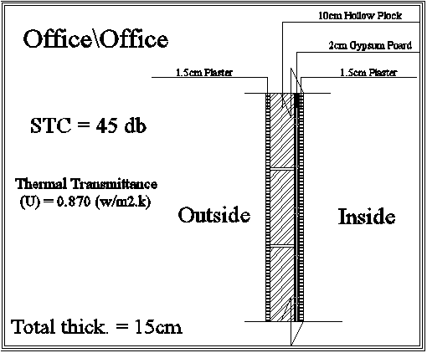
Acoustical and Thermal Insulation
Type of material | Thickness | K ( w/m.k) | R ( m².k/w) | STC (db)
Outside | …………. | …………. | 0.04 | …………
Cement Plaster with lime | 0.015 | 0.87 | 0.017 | 2
Hollow Block | 0.1 | 0.12 | 0.833 | 38
Gypsum Board | 0.02 | 0.179 | 0.112 | 2
Cement Plaster with lime | 0.015 | 0.87 | 0.017 | 2
Inside | ………… | ………….. | 0.13 | ………..
 |  | Total R | 1.15 | Total STC
 |  | U(w/m²) | 0.87 | 45

Slide 26
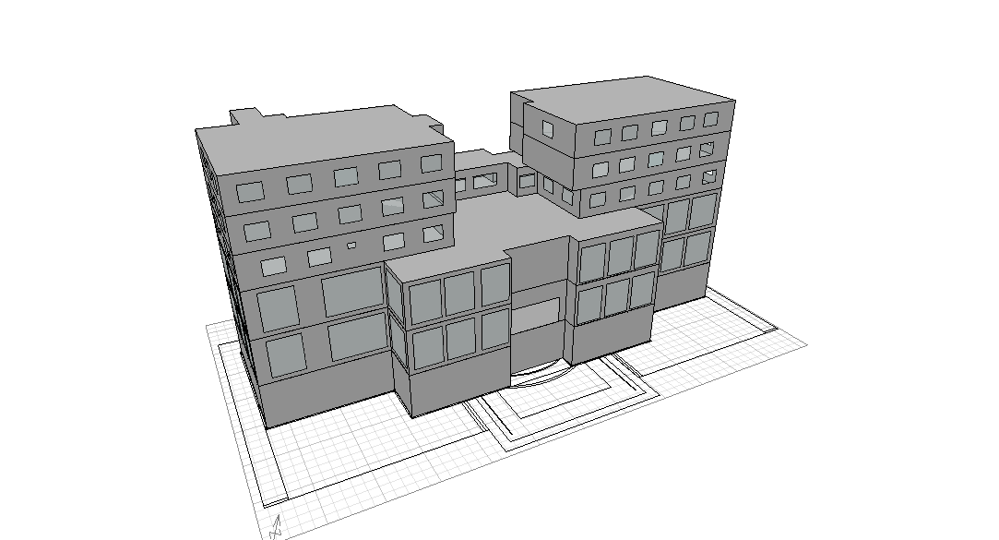
Natural Day Lighting
Shape of building on Ecotect

Slide 27
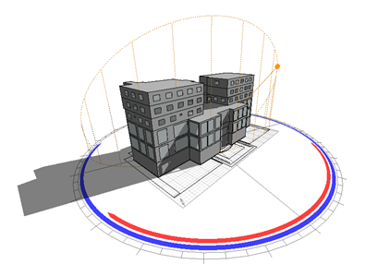
The Shadow of the Building in summer
Building shadow at 8am 15th of May

Slide 28
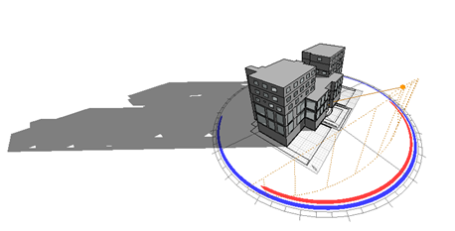
The Shadow of the Building in Winter
Building shadow at 8AM 21st of January

Slide 29
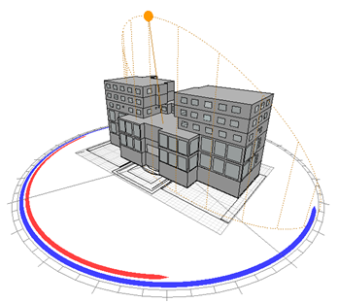
The Sun Path in Summer in May

Slide 30
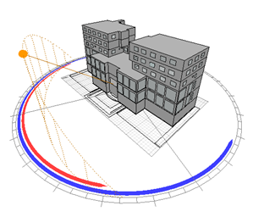
The Sun Path in Winter in January

Slide 31
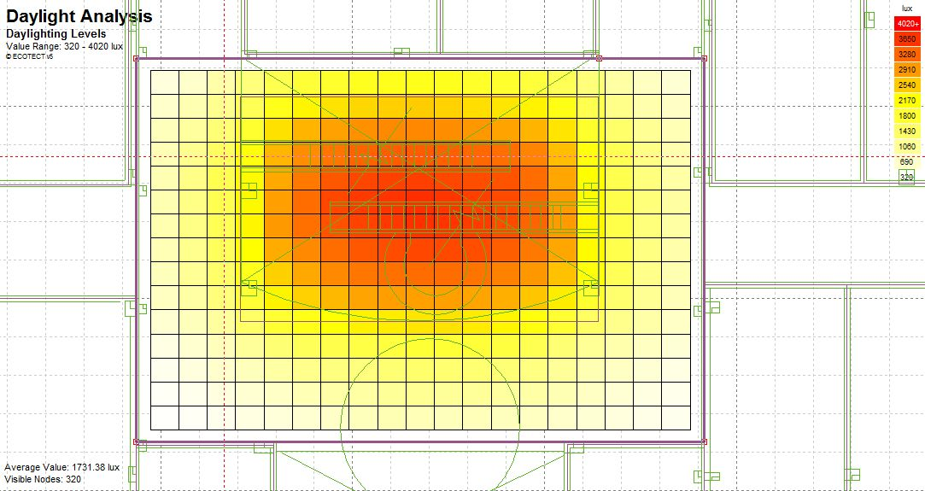

Daylight levels samples of selected areas in the building
Hall in Ground Floor Daylight levels

Slide 32
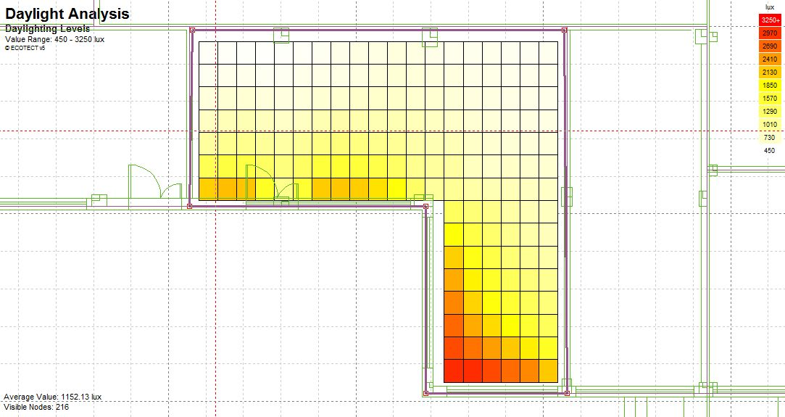

Shop 9(cafeteria) Daylight levels

Slide 33
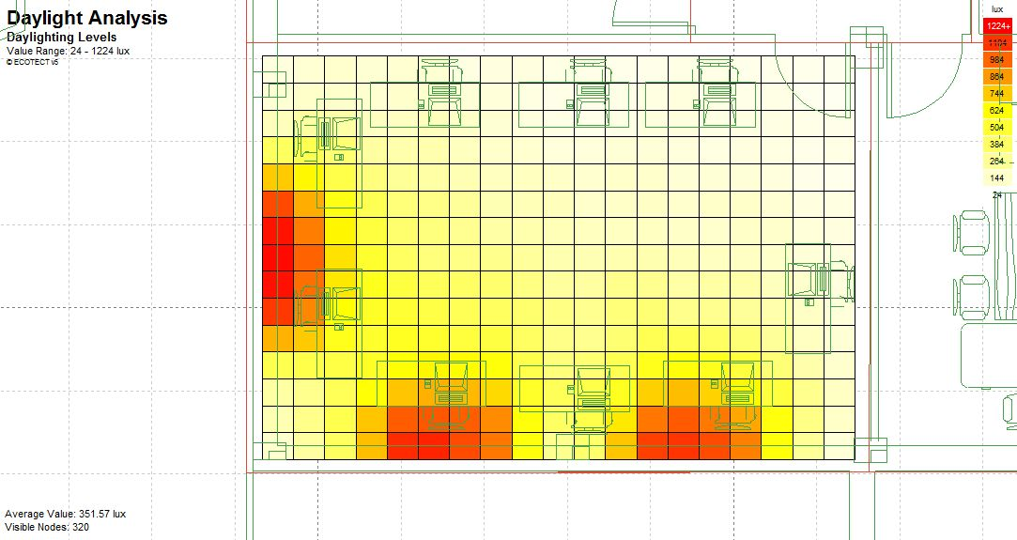

Staff Room office 6 daylight levels

Slide 34
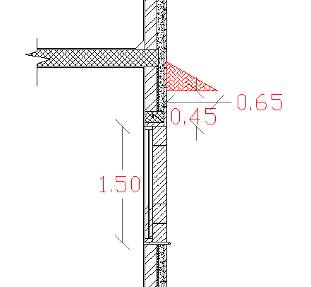
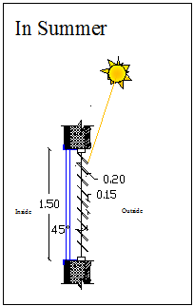
Shading
For south elevation
Cantilever
For East/West elevation
Vertical shutter

Slide 35
Structural Design
The design codes used in the design process in our project :
American Concrete Institute ACI318-09
The seismic design code UBC97

Slide 36
Loads and Specifications
Live Load :
In Mall 0.5ton/m2 (500kg/m2)
In Residential and Offices 0.3ton/m2 (300kg/m2)
Super Imposed Dead Load :
0.35ton/m2 (350kg/m2)
ƒ`c :
B350 for slabs, beams and footings (ƒ`c = 280 kg/cm²)
B400 for columns (ƒ`c = 300 kg/cm²)
fy :
4200kg\ cm²
Bearing Capacity (BC) : 35ton/m2

Slide 37
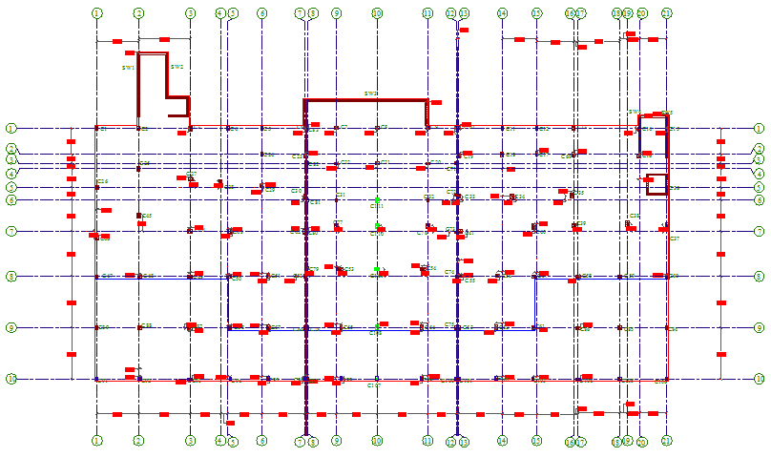
Center of Columns

Slide 38
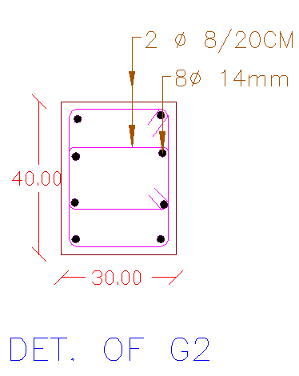
Columns and Reinforcement Details
Steel bars for each group :
Col | b | h | As
G1 | 20 | 40 | 8Ф14
G2 | 30 | 40 | 8Ф14
G3 | 30 | 50 | 8Ф16
G4 | 25 | 40 | 8Ф14
G5 | 20 | 30 | 8Ф14
G6 | 40 | 40 | 8Ф16
G7 | 20 | 30 | 8Ф14

Slide 39
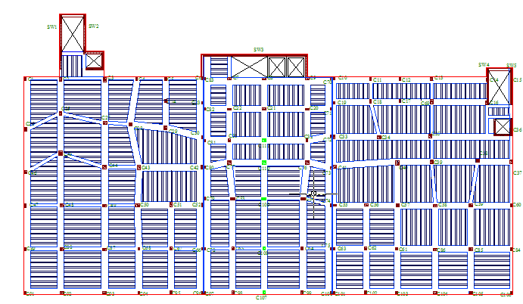
Slabs and Beams
Basement Slab

Slide 40
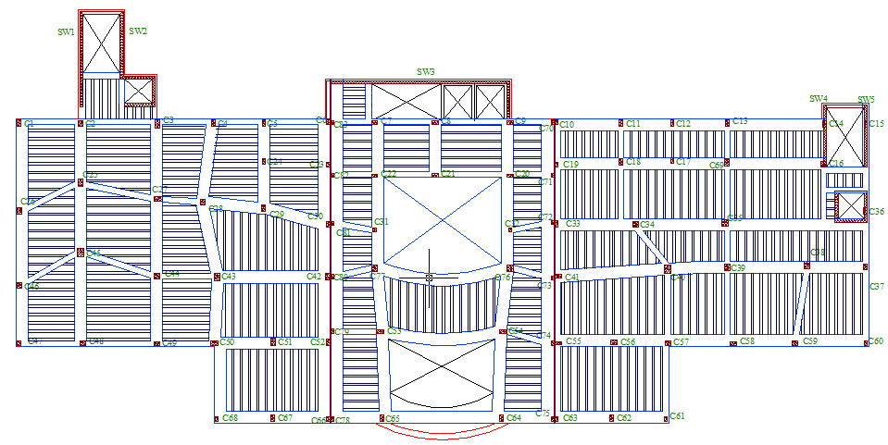
Slabs and Beams
Ground and First Floor Slab

Slide 41
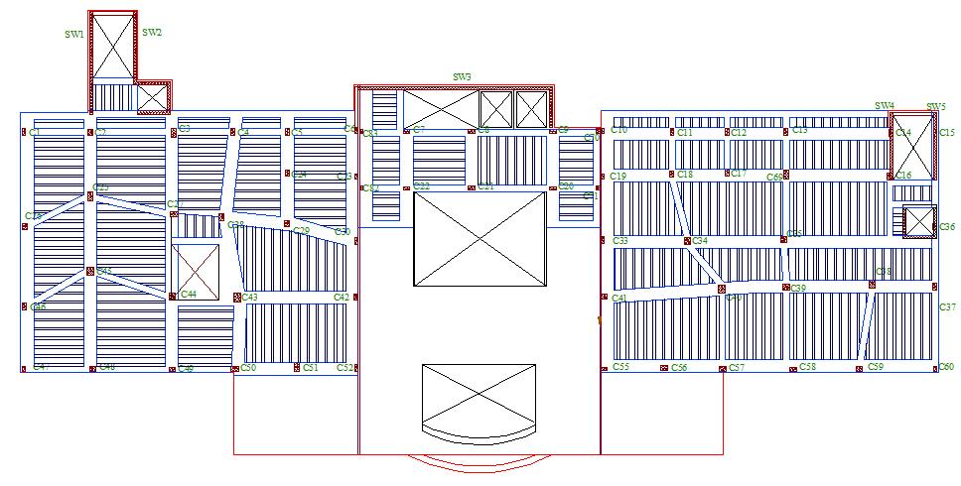
Slabs and Beams
Second Floor Slab

Slide 42
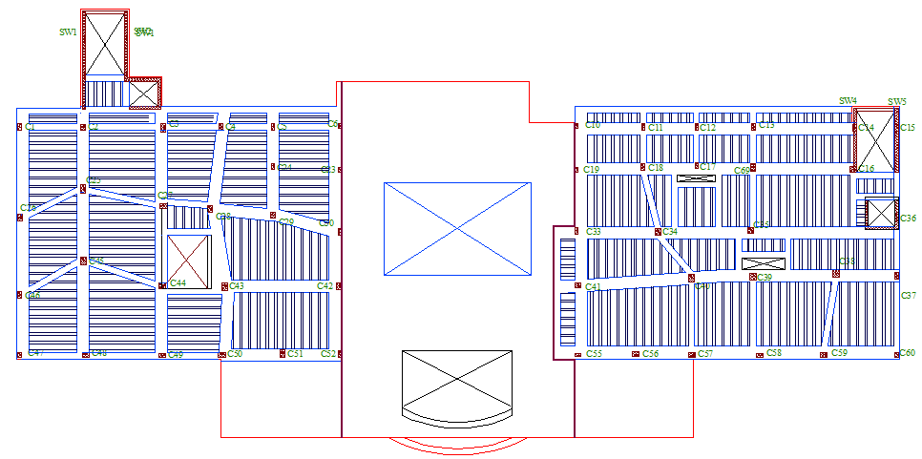
Slabs and Beams
Third and Forth Floor Slab

Slide 43
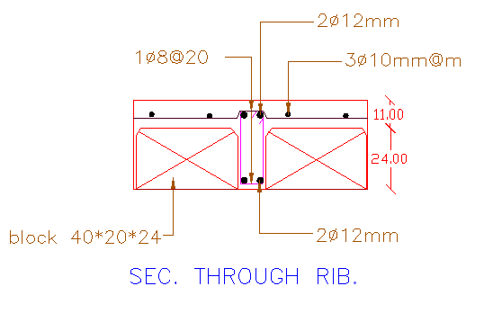
Section Through Ribs

Slide 44
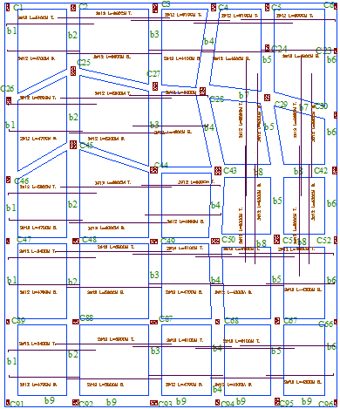
Slabs
Reinforcement Details for Basement Slab

Slide 45
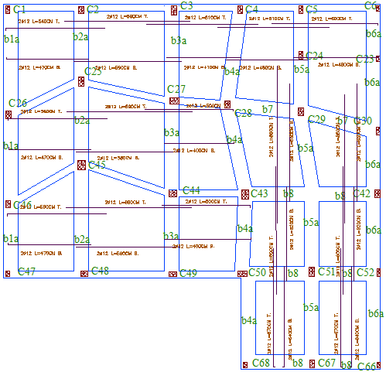
Slabs
Reinforcement Details for Ground and First Floor Slab

Slide 46
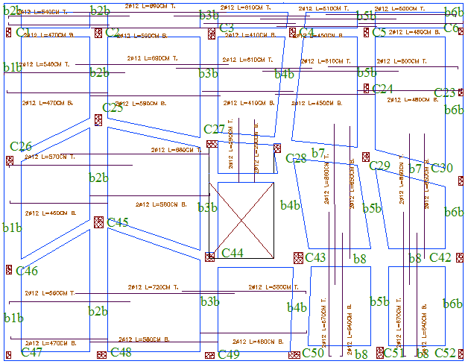
Slabs
Reinforcement Details for Second, Third and forth floor Slab

Slide 47
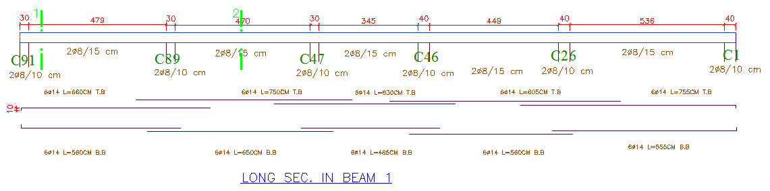
Beams
Long Section in Beam 1 in Basement Slab
Beam | Top reinforcement | Bottom reinforcement
b1 | 6Ø14 | 6Ø14
b2 | 6Ø14 | 6Ø14
b3 | 6Ø14 | 6Ø14
b4 | 6Ø14 | 6Ø14
b5 | 6Ø14 | 6Ø14
b6 | 6Ø14 | 6Ø14
b7 | 6Ø14 | 6Ø14
b8 | 6Ø14 | 6Ø14

Slide 48
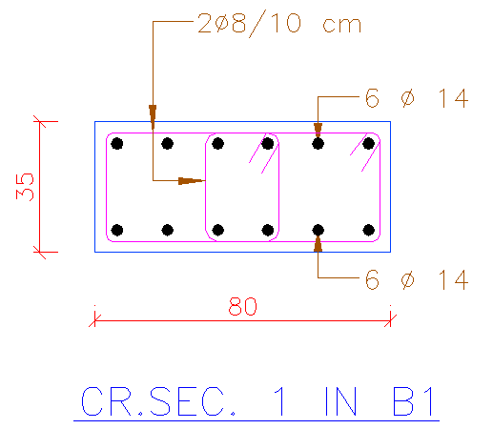
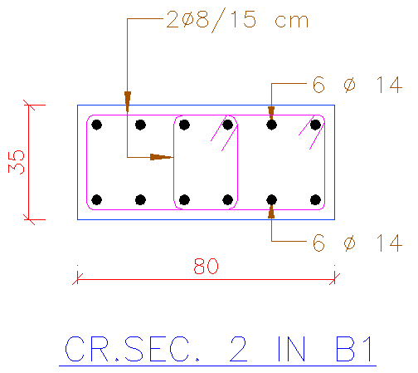
Beams
Cross Section 1 in Beam 1
Cross Section 2 in Beam 1

Slide 49
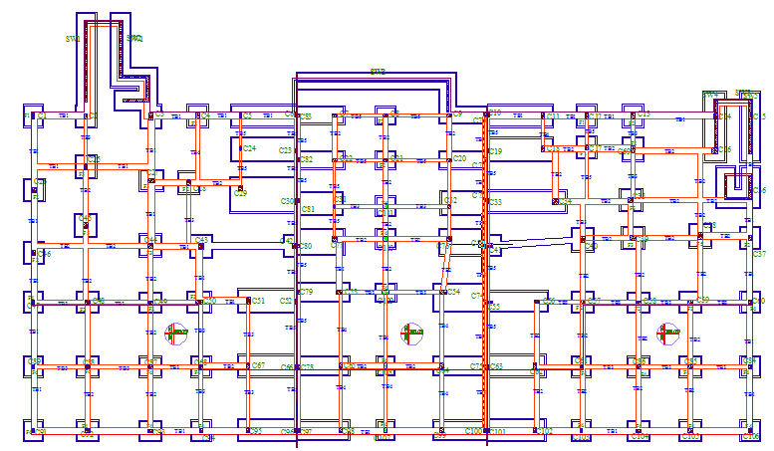
Footings and Tie Beams

Slide 50
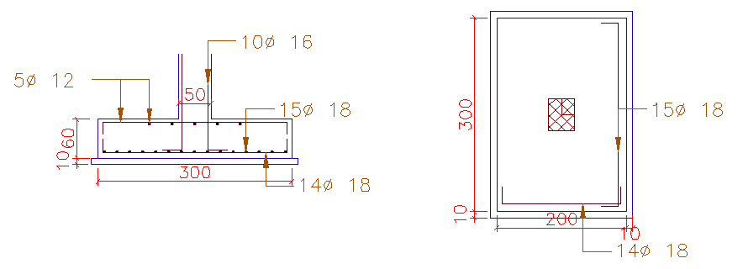
Footings
Single Footing
Footing | length(m) | width(m) | height(m) | As L | As W
F1 | 1.7 | 1.7 | 0.4 | 9Ф16 | 7Ф16
F2 | 2 | 2 | 0.5 | 11Ф16 | 10Ф16
F3 | 2 | 2.5 | 0.55 | 12Ф18 | 10Ф18
F4 | 1.4 | 1.4 | 0.4 | 7Ф14 | 7Ф14
F5 | 3 | 2 | 0.5 | 15Ф18 | 14Ф18

Slide 51
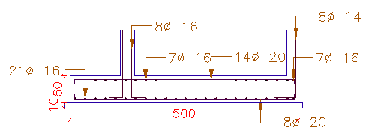
Footings
Combined Footing

Slide 52
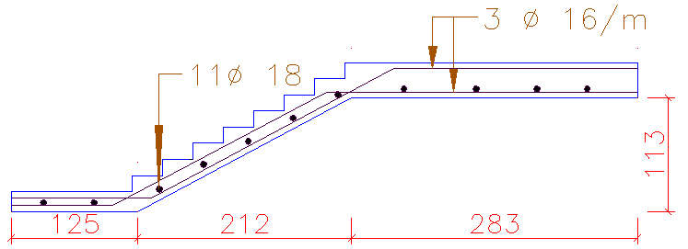
Stairs
Reinforcement Details for Stairs

Slide 53
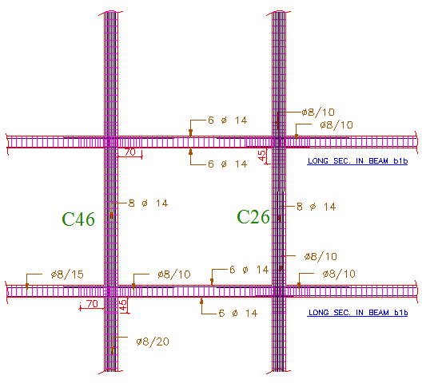
Joints Reinforcement Details

Slide 54

Seismic Design
Seismic Separation

Slide 55
Seismic Design
The Seismic Checks using Sap2000 :
1- Compatibility Check
2- Equilibrium Check
3- Check for Internal Forces

Slide 56
Mechanical Design
The Mechanical Design Consists of four stages
1-Drainage
2-Water Supply
3-HVAC
4-Elevators

Slide 57


Drainage
The Drainage system for third floor

Slide 58

Drainage
Floors | Number of Drainage Fixture units
Ground floor | 40
First floor | 40
Second floor | 63
Third floor | 98
Fourth floor | 98

Slide 59

Water Supply
2'' for Water meter for each Apartment
2.5forMain Vertical Pipe
2'' for Horizontal Pipe
3/4'' for Horizontal(Branch) inside Pipe

Slide 60
HVAC System
1- Heating
2- Cooling

Slide 61
Heating Loss
WE USE | # COLUMS(3C) | M' | # radiators | TOTAL LOSS | ROOM
10 | 9.8 | 0.0408 | 1 | 1999.74 | Zone 1
8 | 7.2 | 0.0257 | 1 | 1249.36 | Zone 2
9 | 8.4 | 0.0258 | 1 | 1289.7 | Zone 3
14 | 13.1 | 0.0500 | 1 | 2632.36 | Zone 4
9 | 8.7 | 0.0262 | 1 | 1294.64 | Zone 5
9 | 8.9 | 0.0367 | 1 | 1437.27 | Zone 6

Slide 62

Heating System

Slide 63
Heating Gain
Q total | QL |  |  | Qs |  |  |  |  | ROOM
 | equipment | occupants | ventilation | equipment | lighting | occupants | ventilation | Q _{WIN+ WALL}
2818.85 | 120 | 88 | 576 | 139 | 130.05 | 119 | 232.8 | 1553.0 | MASTER BEDROOM
2180.3 | 0 | 88 | 576 | 170 | 134.3 | 119 | 232.8 | 860.2 | BEDROOM A
2566.15 | 120 | 88 | 576 | 224 | 123.25 | 119 | 232.8 | 1083.1 | BEDROOM B
6005.8 | 750 | 132 | 1036.8 | 2363 | 139.4 | 178.5 | 419.04 | 987.9 | KITCHIN
2502.4 | 0 | 352 | 1304 | 85 | 374 | 476 | 931.2 | 1213.4 | GUEST RROM
12229.2 | 990 | 748 | 5068.8 | 2981 | 901 | 1011.5 | 2048.64 | 5697.6 | TOTAL

Slide 64

Cooling System

Slide 65
Elevator Design
Average Population : 1300 person
%HC : 14% (Center City type)
After Calculations
N = 5 , 3500/lb 400fpm
But because there's many stairs in the building and to satisfy symmetry to the building for seismic code requirements and for Architectural considerations, it was more practical to use 4 elevators.

Slide 66
Electrical Design
Dialux Sample
Sockets Calculations and samples
Lighting Calculations
Main Distribution Board “MDB”
Branch Calculations

Slide 67


Dialux
Cafeteria Luminaire and Lighting Calculations using Dialux
Surface | ❒ [%] | E avg [lx] | E min [lx] | E max [lx] | u0
Work plane | / | 480 | 58 | 846 | 0.122
Floor | 30 | 334 | 22 | 686 | 0.067
Ceiling | 73 | 137 | 38 | 298 | 0.277
Walls (7) | 75 | 170 | 29 | 527 | /

Slide 68
Socket Calculations
Total current | total number of sockets | number of sockets | Place | No. of floor
500 Amp | 100(5A) | 100 | General(all shops) | Ground Floor
240 Amp | 16(15A) | 16 | Special Loads
20 Amp | 4(5A) | 4 | WC’s
20 Amp | 4(5A) | 4 | Lobby
780 Amp | Total Current in Ground Floor
500 Amp | 100(5A) | 100 | General(all shops) | First Floor
20 Amp | 4(5A) | 4 | WC’s
520 Amp | Total Current in First Floor
65 Amp | 13(5A) | 13 | Office 1 | Second Floor
70 Amp | 14(5A) | 14 | Office 2
70 Amp | 14(5A) | 14 | Office 3
95 Amp | 19(5A) | 19 | Office 4
100 Amp | 20(5A) | 20 | Office 5
105 Amp | 21(5A) | 21 | Office 6
85 Amp | 17(5A) | 17 | Office 7
20 Amp | 4(5A) | 4 | Lobby
610 Amp | Total Current in Second Floor
160 Amp | 32(5A) | 32 | Apartment 1 -West | Third Floor
160 Amp | 32(5A) | 32 | Apartment 2 -West
170 Amp | 34(5A) | 34 | Apartment 3 -East
165 Amp | 33(5A) | 33 | Apartment 4 -East
655 Amp | Total Current in Third Floor
160 Amp | 32(5A) | 32 | Apartment 1 -West | Fourth Floor
160 Amp | 32(5A) | 32 | Apartment 2 -West
170 Amp | 34(5A) | 34 | Apartment 3 -East
165 Amp | 33(5A) | 33 | Apartment 4 –East
655 Amp | Total Current in Fourth Floor
3220 Amp | Total Current in the Building
Sockets Calculations in the entire Commercial Center

Slide 69

Socket Calculations
Socket Calculations Sample and Sockets Distribution for (Apartment 2 F3)
Total current | total number of sockets | number of sockets | Place | No. of floor
160 Amp | 32(5A) | 32 | Apartment 2 -West | Third Floor

Slide 70
Lighting Calculations
A sample of the Ground Floor Calculations for Lighting
Total watt | N | n | Watt | Type of lamp | place
288 | 4 | 2 | 36 | Fluorescent | Shop 1
288 | 4 | 2 | 36 | Fluorescent | Security
576 | 8 | 2 | 36 | Fluorescent | Shop 3
360 | 5 | 2 | 36 | Fluorescent | Shop 4
36 | - | 2 | 18 | PL
144 | 2 | 2 | 36 | Fluorescent | Shop 5
432 | 6 | 2 | 36 | Fluorescent | Shop 6
288 | 4 | 2 | 36 | Fluorescent | Shop 7
576 | 8 | 2 | 36 | Fluorescent | Shop 8
72 | - | 4 | 18 | PL
1296 | 18 | 2 | 36 | Fluorescent | Shop 9
13100 Watt | Total Watt in Ground Floor
45160 Watt | Total Watt in the Building

Slide 71

Lighting Calculations
Lighting Calculations Sample and Distribution of Luminaires for Office 6
2016 | 28 | 2 | 36 | Fluorescent | Office 7
36 | - | 2 | 18 | PL
28 | 1 | 2 | 14 | BEGA T16

Slide 72

MDB(Main Distribution Board)
MDB Details

Slide 73

MDB(Main Distribution Board)

Slide 74
Branch Circuit Calculations
- Diversity Factor for lighting = 0.8
- Diversity Factor for sockets = 0.2
- Safety Factor =1.5
- Power Factor = 0.8
- Current for lighting = 10 Amp
- Current for sockets = 16 Amp

Slide 75

Branch Circuit Calculations
Circuit breaker sample for Apartment 2 F3 :
Lighting load for Apartment 2 F3 = 930Watt
Sockets load for Apartment 2 F3= 160 Amp
N for lighting branches= 5 Circuit breaker for lighting
N for sockets branches= 32/2 = 16 Circuit breaker for sockets.

Slide 76
Safety and Fire Design
Fire System and Details
Fire Exits

Slide 77


Fire System Details
Fire System details in Offices (1)

Slide 78

Fire System Details
Fire System details in Offices (2)

Slide 79
Fire Exits
Fire Exits in the Ground and First Floor

Slide 80

Fire Exits
Fire Exits in the Second Floor

Slide 81

Fire Exits
Fire Exits in the Second Floor

Slide 82

Fire Exits
The Western Fire Exit in the Eastern part of the Third and Forth Floor

Slide 83
Quantity Surveying & Specifications
Total Concrete
 | Volume of concrete | Cost
Walls | 271.1 (m³) | 94885 NIS
Floor and roof | 4925.46 (m³) | 1723911 NIS
Columns | 145.64 (m³) | 50974 NIS
Footing | 99.12 (m³) | 34692 NIS
Total | 5441.32 (m³) | 1904462 NIS

Slide 84
Total Steel
 | Volume of concrete | Cost
Walls | 271.1 (m³) | 94885 NIS
Floor and roof | 4925.46 (m³) | 1723911 NIS
Columns | 145.64 (m³) | 50974 NIS
Footing | 99.12 (m³) | 34692 NIS
Total | 5441.32 (m³) | 1904462 NIS

Slide 85
Total Cost
Earth work | 158960
Concrete | 1904462
steel | 889657.6
block | 96476.1
Stone | 52602.42
Labor | 450000
Total | 3604760.54 NIS

Slide 86
Thank You For Listing
Any Questions ?

