Slide 1

An-Najah National University
Building Engineering Department
Integrated redesign of a Bank of Palestine in Nablus city
Prepared By:
Aseel Sukkar
Hiyam Naffa’a
Sujood Samaneh
Supervisor:
Eng.Fadi A.Fatayer.

Slide 2
Contents
Introduction
Site Analysis
Architectural Aspects
Environmental Aspects
Structural design
BOQ
Electro-mechanical design

Slide 3
Introduction:
Objectives :
Conducting a study of architectural design based on architectural standards
To make some comparisons and modifications with some case studies and to make a better design.
Redesign architectural plans taking into consideration environmental standards that ensure acoustic, thermal and theoretical comfort.
To assign a suitable structural system that integrates with the new design taken into considerations columns, beams, slabs and footings.
Design an electro-mechanical system taking into consideration artificial lighting, HVAC system, electrical calculations and safety system.
To make sure that all of the previous should integrate with all together with no clashes between designs.

Slide 4
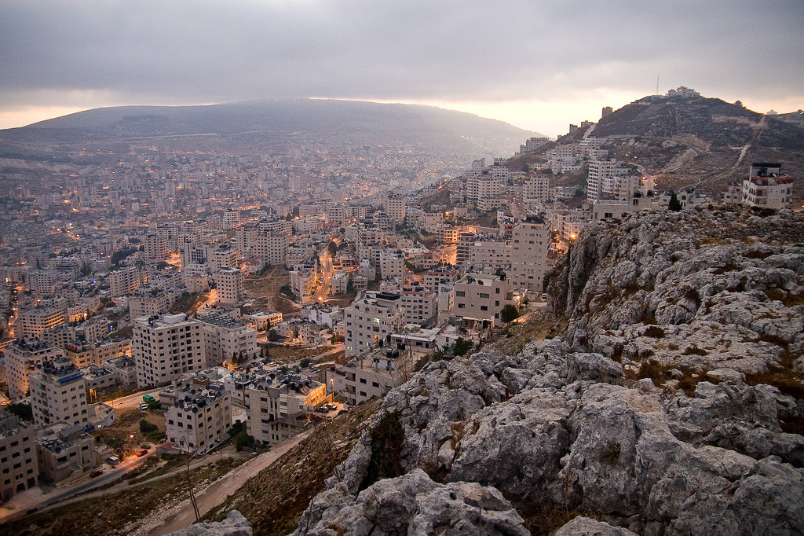
Site Analysis

Slide 5
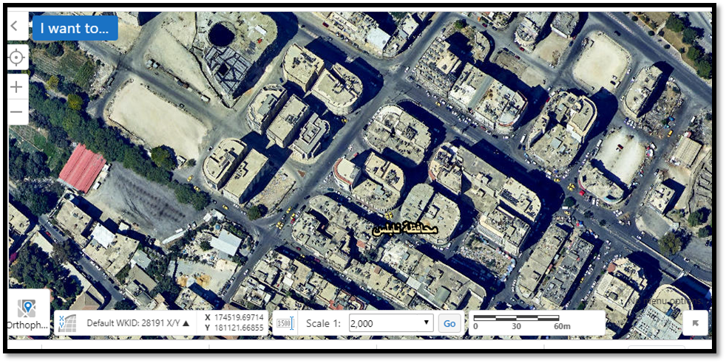
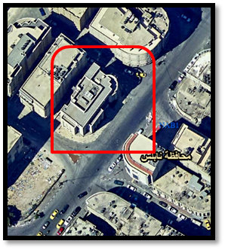
Site location
This Bank shows in the Figure is located in Nablus city, which lies in the north of west bank in Palestine. Nablus is about 569 m above sea level. The site is located in the “Sufian Street “, ‘Basatine Region’, on latitude 32.22° N and longitude 35.25°E
Zoom in

Slide 6
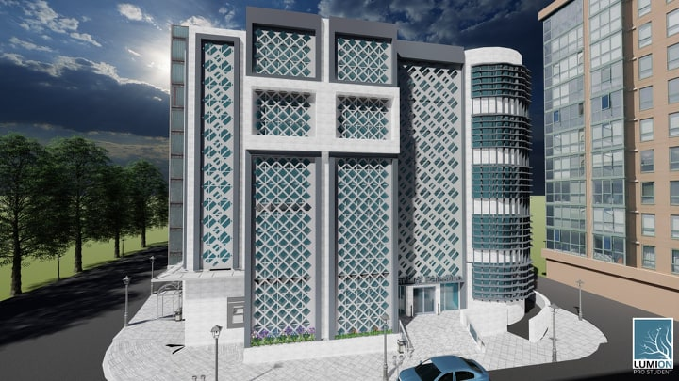
Architectural Aspects

Slide 7
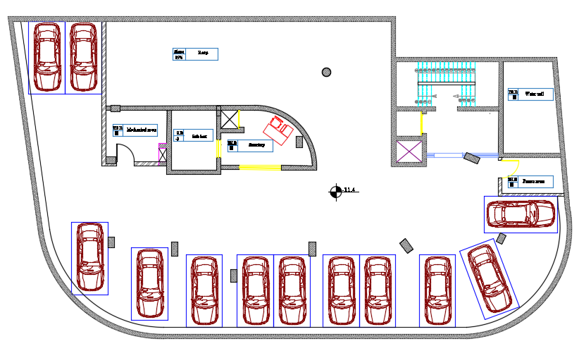
Comparison:
Adding third basement floor

Slide 8
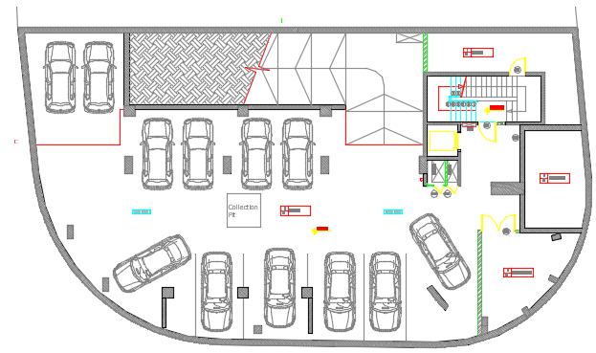
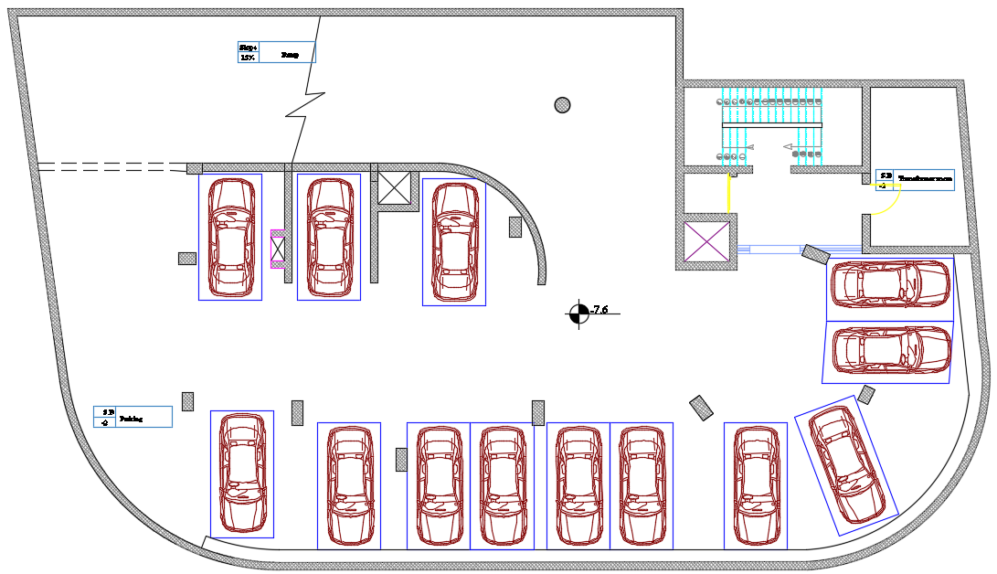
Comparison:
Second basement
Before
After

Slide 9
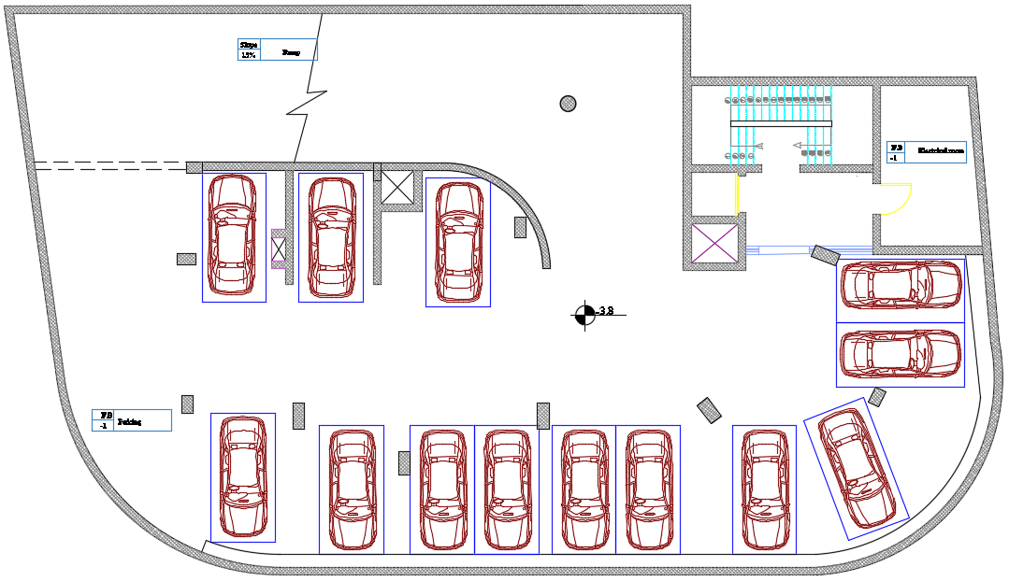
Cont.…
First basement
Before
After

Slide 10
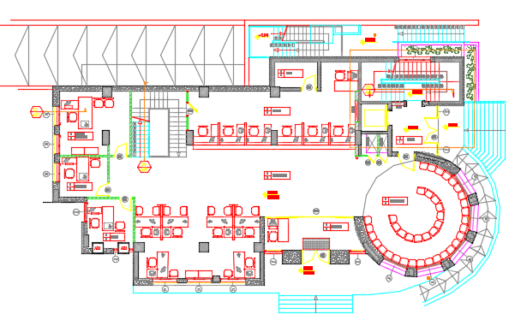
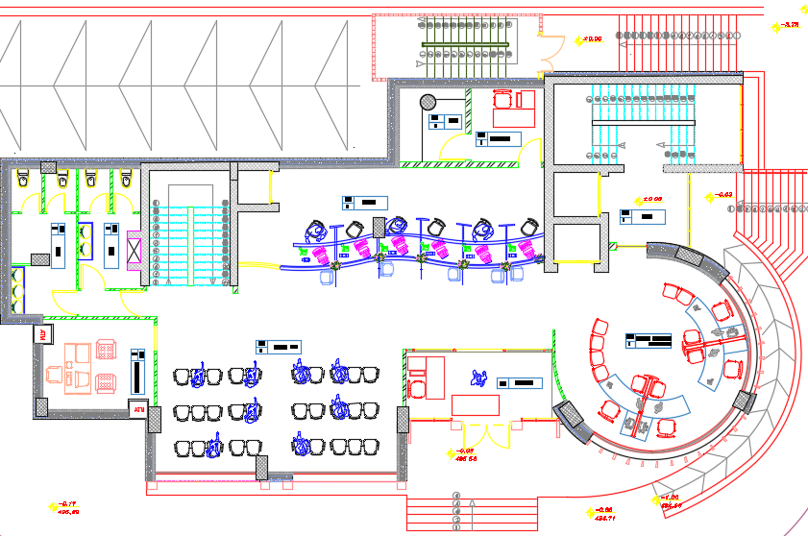
Cont.…
Ground Floor
Before
After

Slide 11
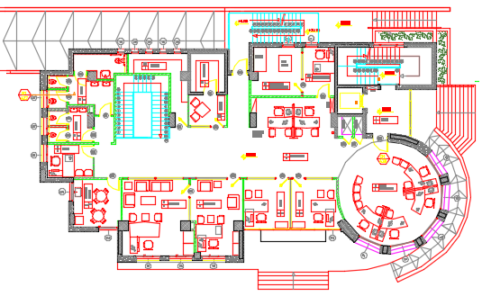
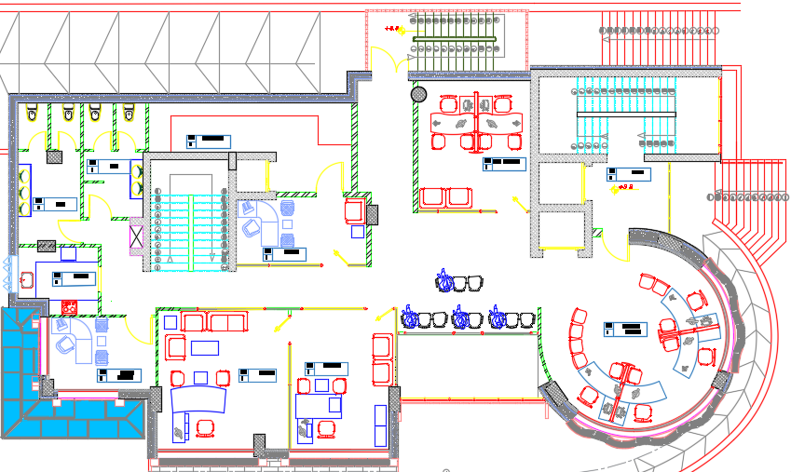
Cont.…
2. First Floor
Before
After

Slide 12
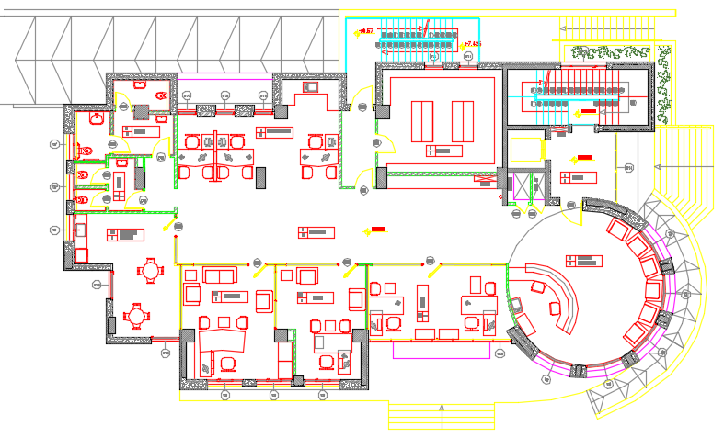
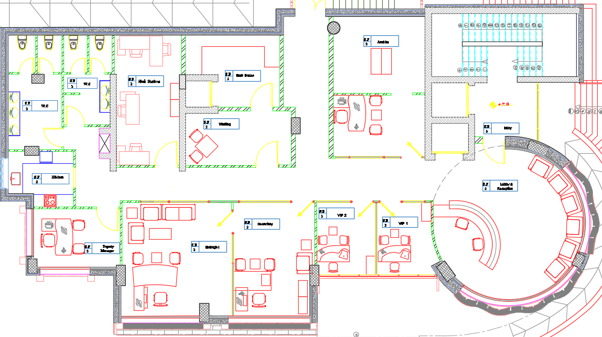
Cont.…
3. Second Floor
Before
After

Slide 13
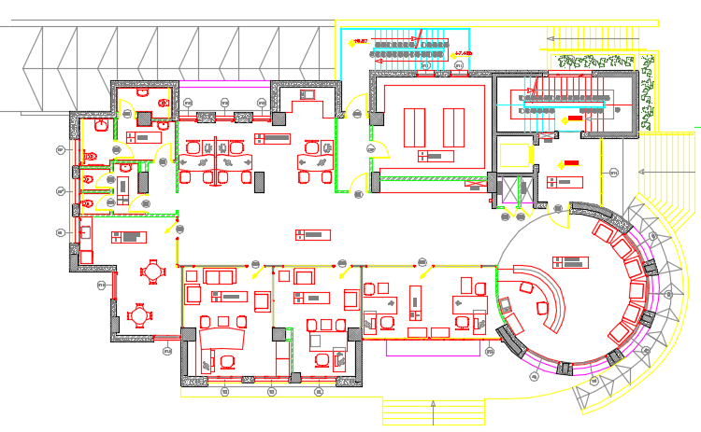
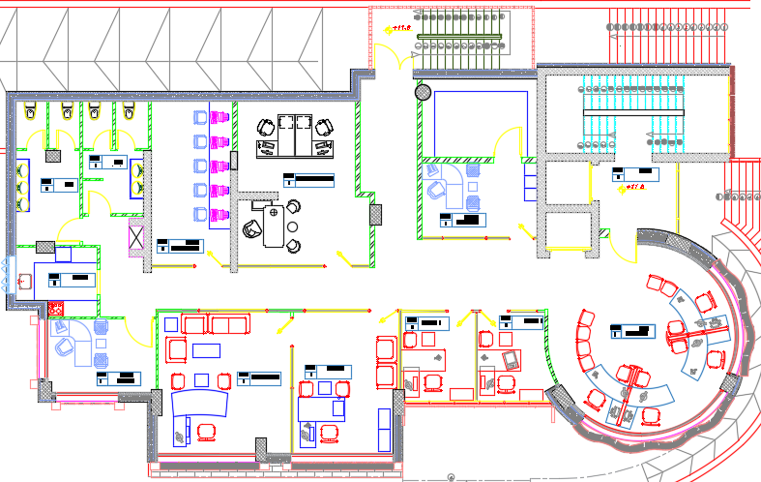
Cont.…
4. Third Floor
Before
After

Slide 14
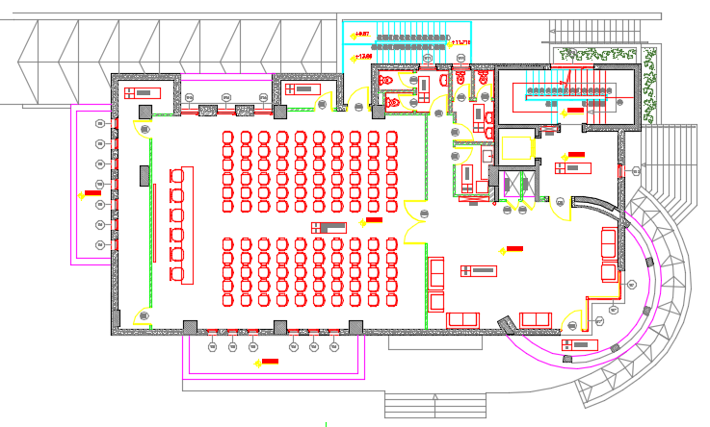
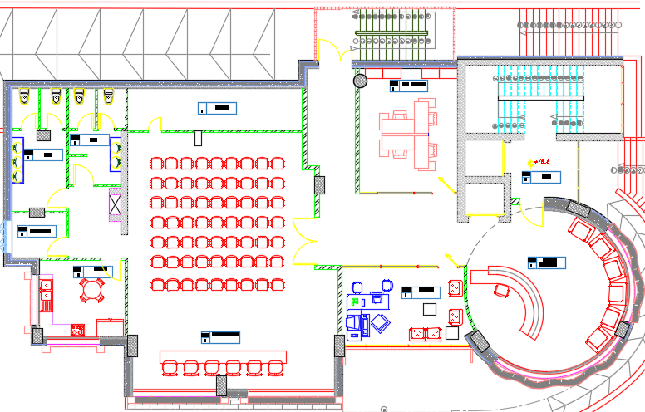
Cont.…
5. Fourth Floor
Before
After

Slide 15
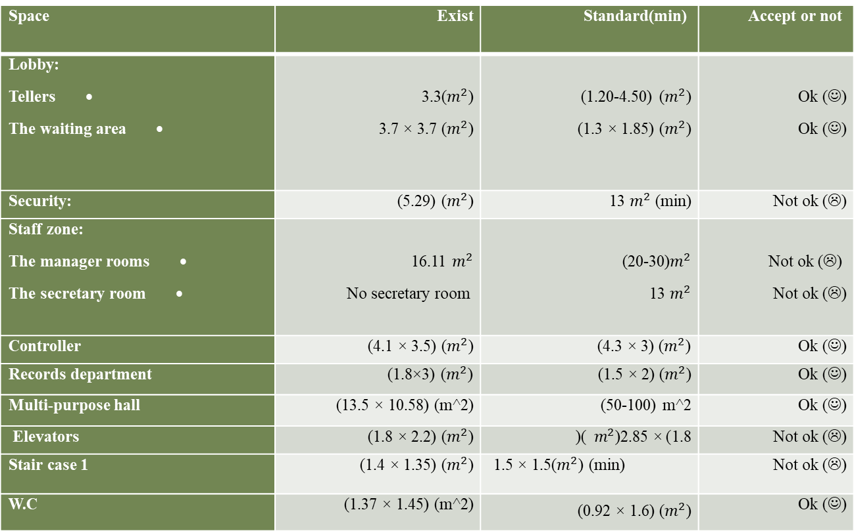
Exist vs standards:

Slide 16
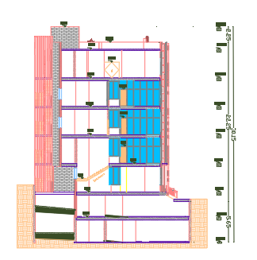
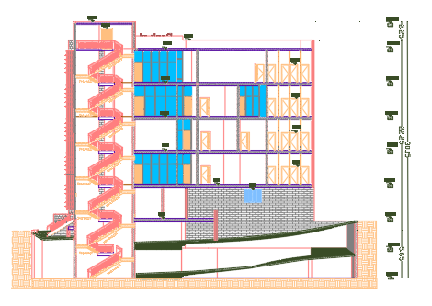
Sections
Section B-B
Section A-A

Slide 17
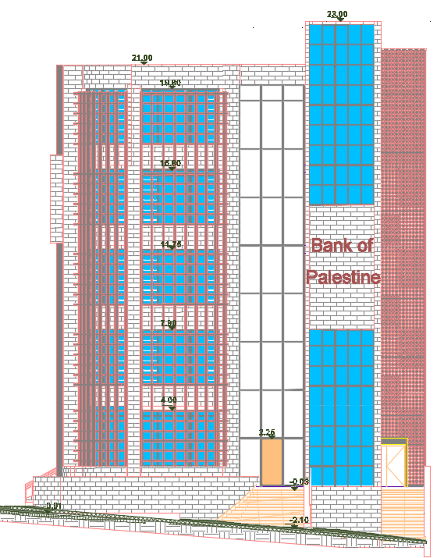
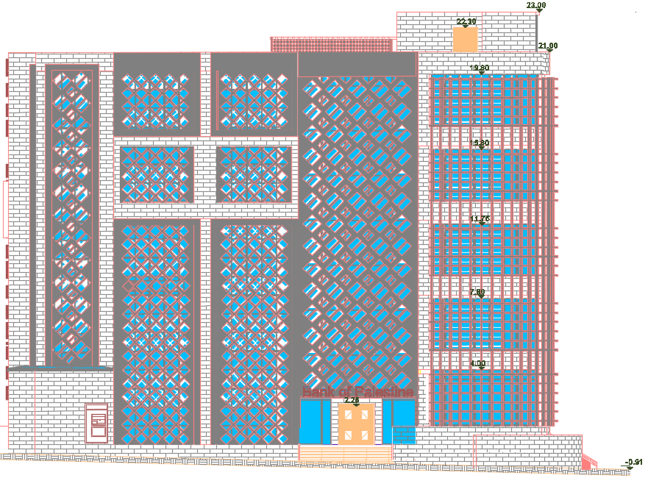
Elevations
East Elevation
South Elevation

Slide 18
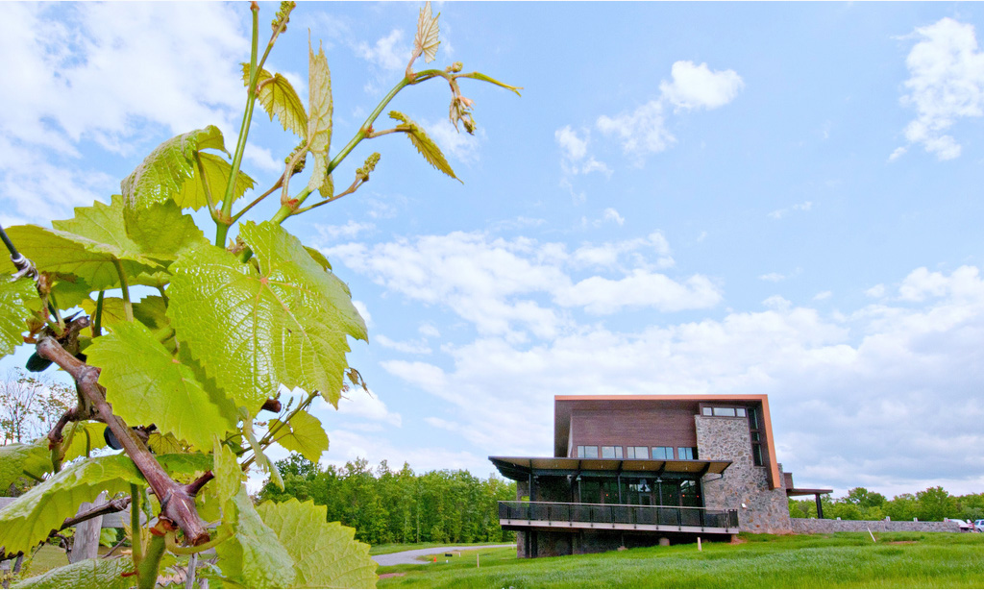
Environmental Design

Slide 19
The important fields in Environmental Analysis
3. Thermal comfort
2. Orientation and Overshadowing Analysis
1. Daylight Analysis

Slide 20
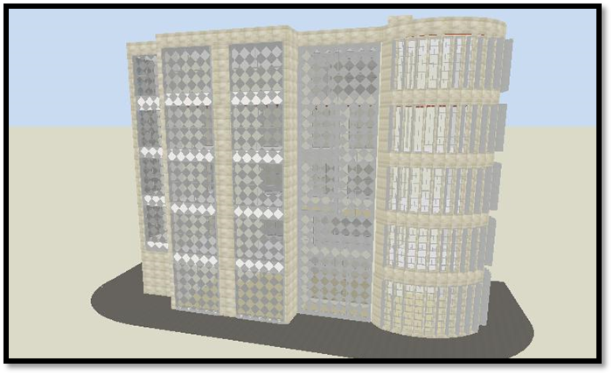
Treatments
Daylighting Analysis
The model of the faculty from Design Builder with the treatments,
Using louvers.
Using shutters.
Using Aluminum frame work as CNC.
Using glass with low light transmission.

Slide 21
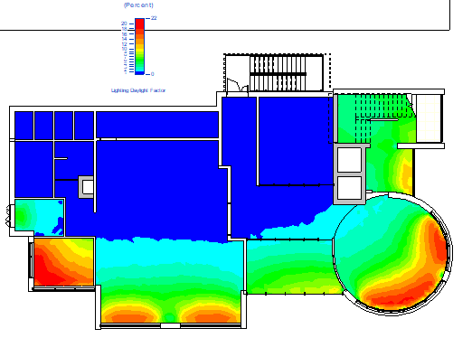
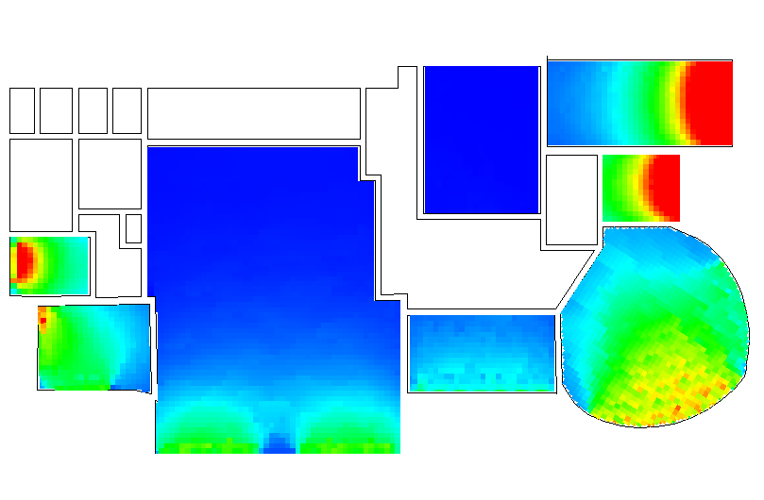
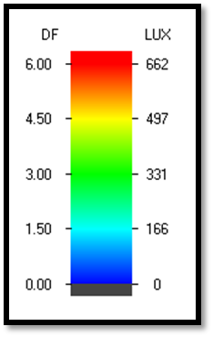
Daylight analysis for the model for the fourth floor before and after modification
Before
After
Day light factor color range

Slide 22
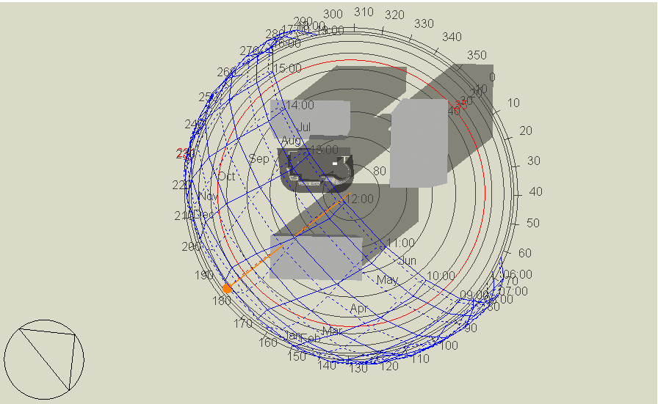
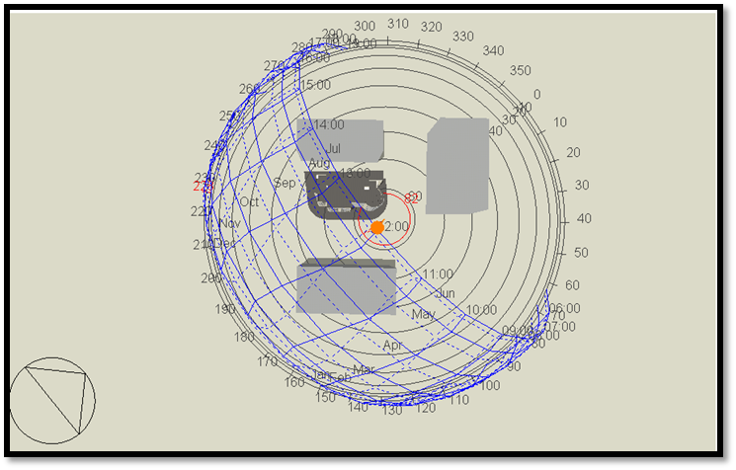
2. Orientation & overshadowing analysis
The building orientation is related to the true north, and the building is in the northwest direction
Overshadowing in winter at 12:00 PM
Overshadowing in summer at 12:00 PM

Slide 23
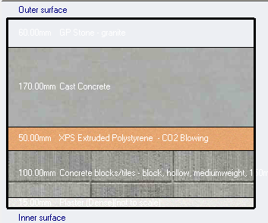
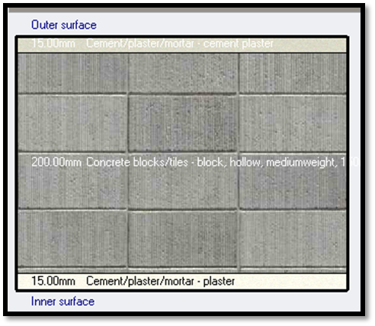
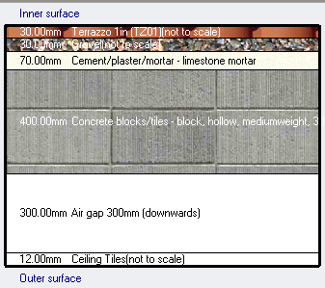
Thermal Comfort
Summary for the materials that were used in the walls and slabs in the faculty
External walls
2. Internal wall
3. Ribbed slab

Slide 24
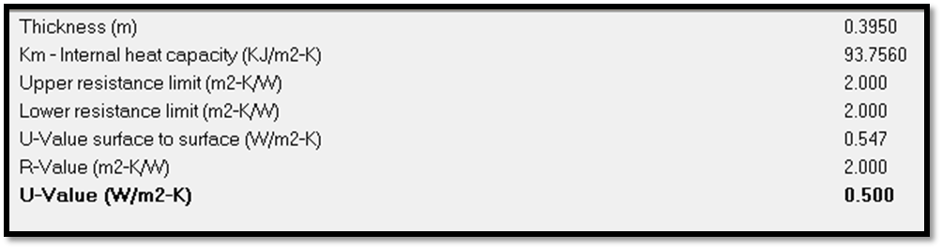
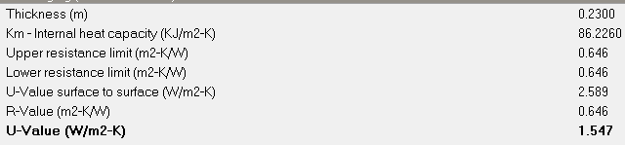
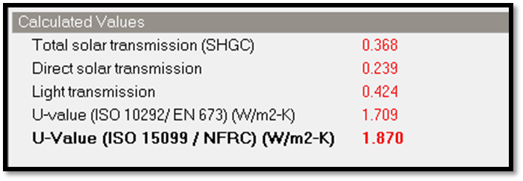
Thermal Comfort
Summary of properties of partition that were used in the faculty
External walls
2. Internal wall
3. Glass

Slide 25
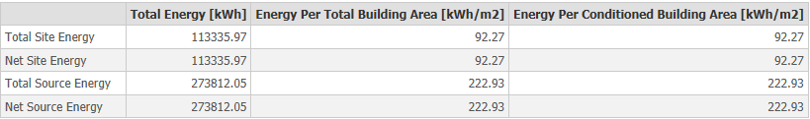
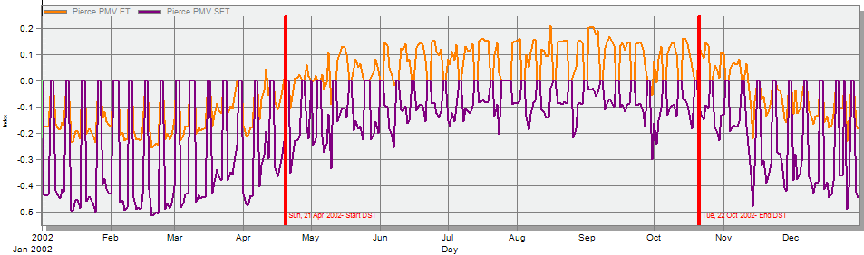
Cont.…
Energy consumption in the bank by Design Builder
The PMV value

Slide 26
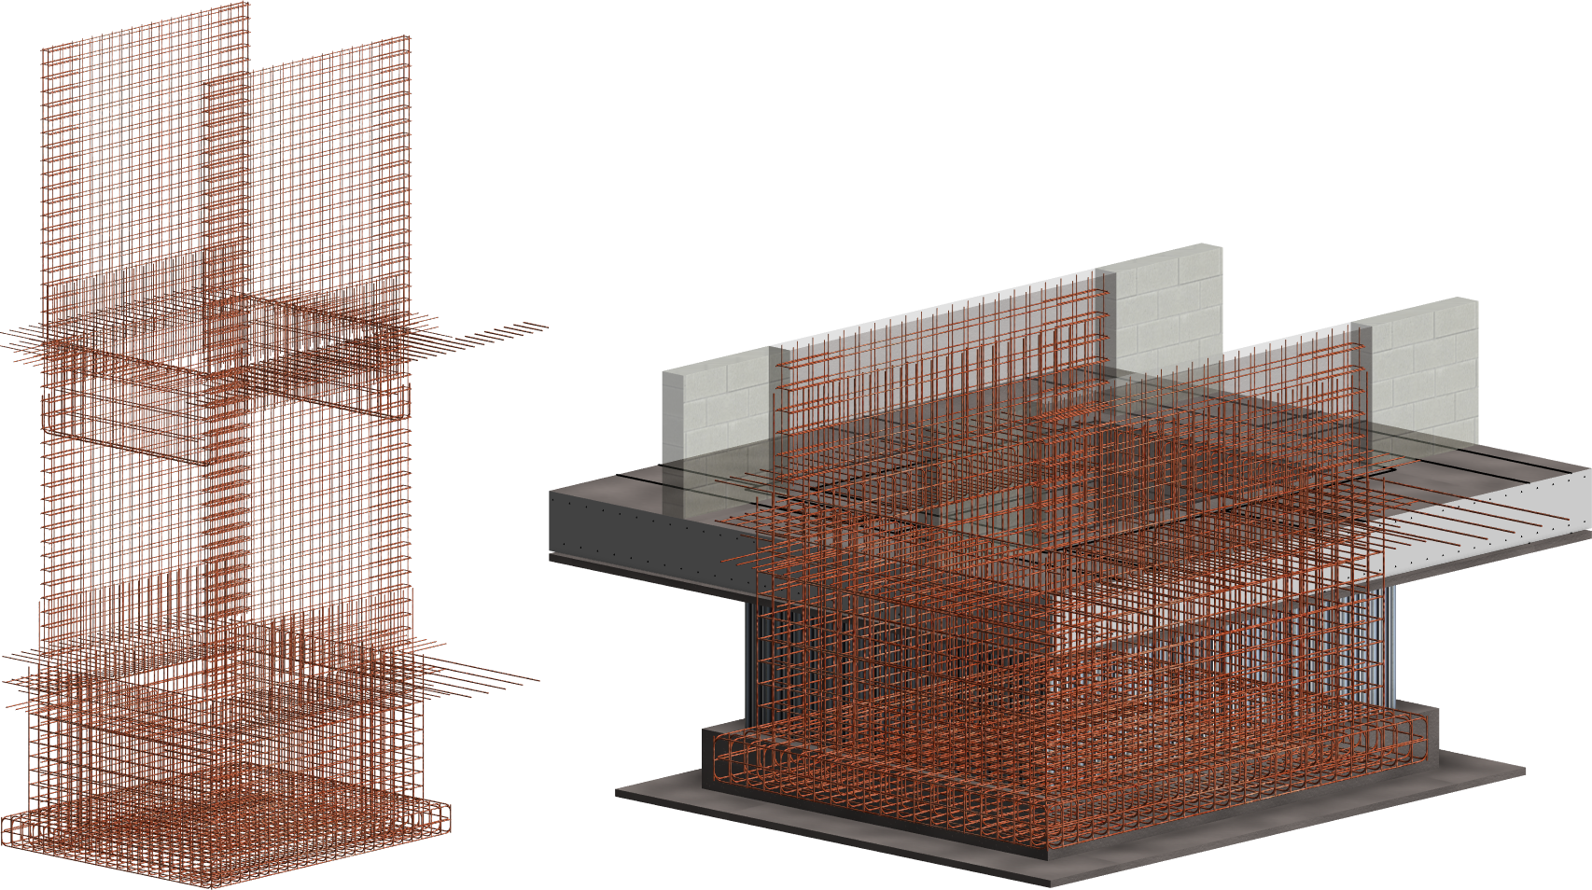
Structural Design

Slide 27
Materials
The parameters for seismic analysis
Concrete (with compressive strength of 28 MPa (B350)
Steel rebar(with yielding strength of (420 MPa)
Concrete (with compressive strength of 32MPa (B400)
Steel with minimum yield stress of 248.1 MPa
Seismic zone; the bank is located in Nablus so the zone is 2B, and the Z value = 0.20
Force Reduction Factor R = 5.5 (Building Frame System - shear wall)
Response spectrum scale factor = $\frac{I×g}{R}$ = $\frac{1∗9810}{5.5}$ = 1783.6
Response spectrum scale factor = (𝑰×𝒈)/𝑹 = (𝟏∗𝟗𝟖𝟏𝟎)/(𝟓.𝟓) = 1783.6
Soil profile; the soil is clay so the soil profile is SD
Importance factor I = 1
Acceleration-Dependent Seismic Coefficient Ca = 0.28
Velocity-Dependent Seismic Coefficient Cv = 0.4
Design codes
ACI 318 - 14
ASCE 7 for load design
UBC 97 for seismic design
ASCE for steel design
Loads
SID = 4 kN/m²
Live Load = 6 kN/m²
External wall = 28 KN/m
Dead Load

Slide 28
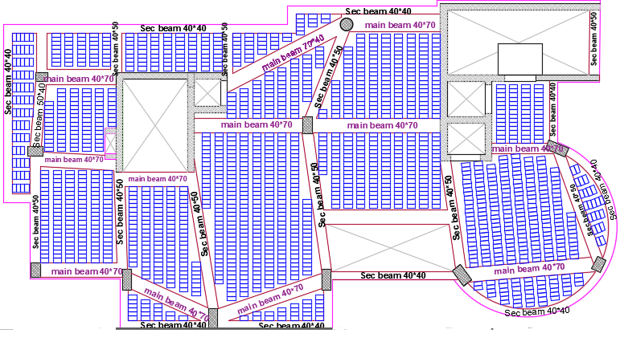
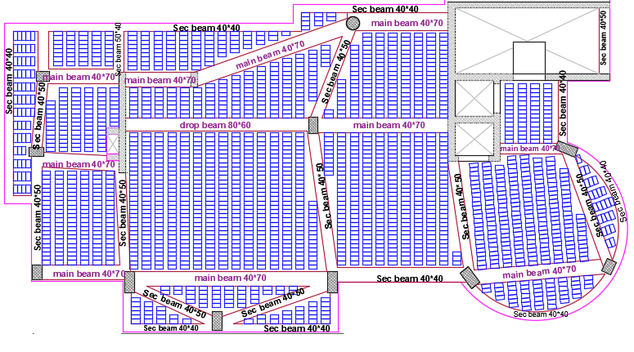
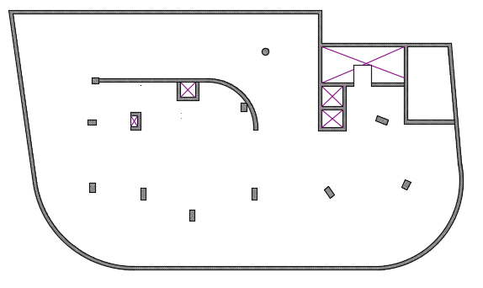
Ground Floor Ribbed Slab
Fourth Floor Ribbed Slab
Third Basement Soild Slab

Slide 29
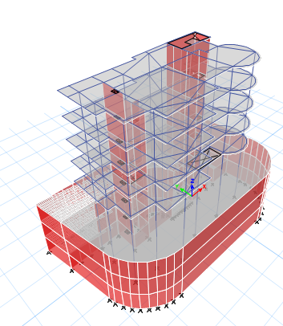
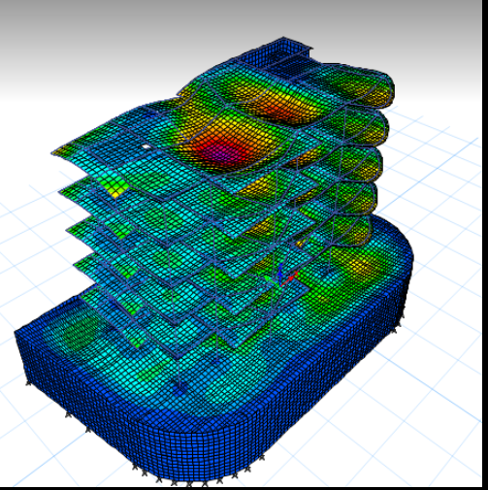
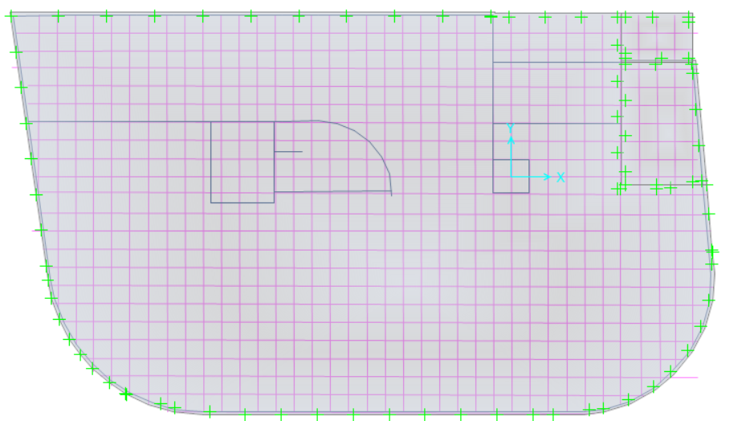
Programs models
ETABS model
Safe model

Slide 30
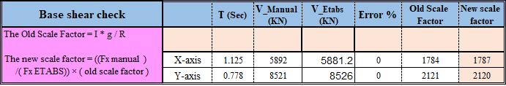
Seismic design checks
Base shear check
shear results from ETABS are greater than manual calculations, so base shear check is ok
Drift check
All drifts in floors < Limit, so the check is ok

Slide 31
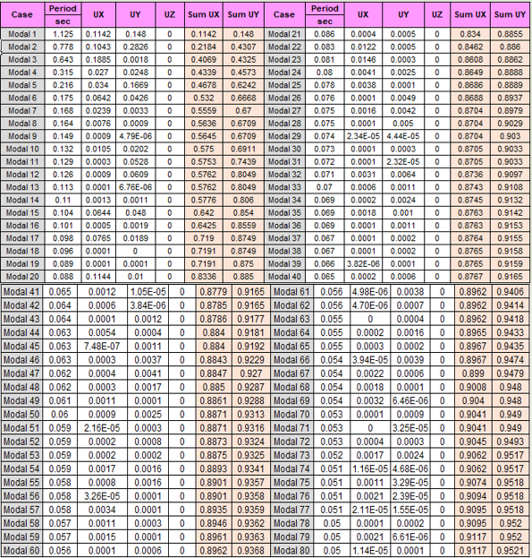
Modal Mass Participating Ratios Check.
The summation of the mass participation ratio > 0.90, so the check is ok

Slide 32
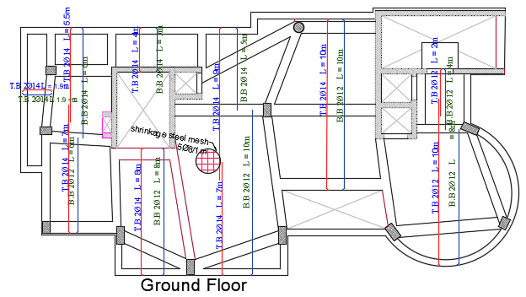
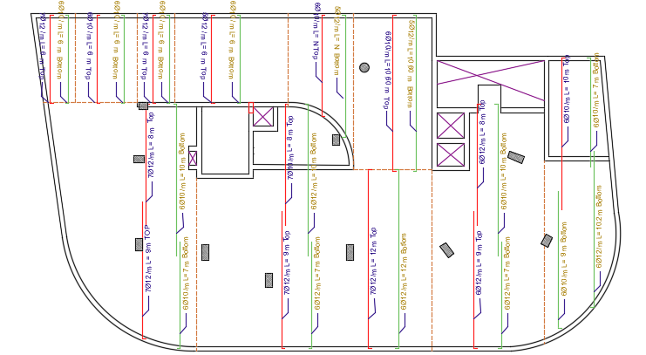
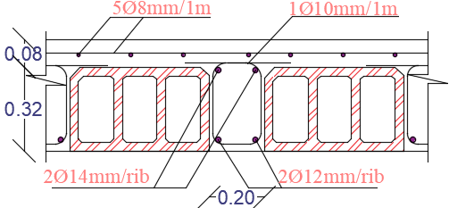
Ribbed Slabs Detailing
Soild Slabs Detailing (Y direction)

Slide 33




Cap Detailing
Soild Slabs Detailing (X direction)

Slide 34





Beams Detailing

Slide 35



Columns Detailing

Slide 36

Mat Foundation Design
The minimum reinforcement = ρ_{min} × b×h= 0.0018× 1000 × 940= 1692 mm²/mm
So, it is need (8Ø16 mm/m) for the minimum reinforcement.( red zone )

Slide 37




Slide 38


Water Tank Design
Water load:
Water pressure on walls (height = 3.8m),
γw = 10kN/m^3
P_{total} = -10Z+10*8 = -10Z + 80
A = Zero, B = Zero, C = -10, D = 80

Slide 39



Excavation shoring
Soil characteristics in AL Basateen region
Friction angle (Ф) = 0
ɣ = 18
Cohesion coefficient = 69
The type of soil in this site is clay
Design of piles
The Propped sheet piles will be used, because the height of the excavation is larger than 7 meter.

Slide 40


Design of propped beam
Which beam support piles at7.6 m from 0.0 m
Width = 700 mm
Depth = 1200 mm
Wu = 200 KN /m.
Thickness of slap1 =250mm
f՝c = 28 Mpa
fy = 420 Mpa
Design of the beam (at the top of piles)
Width = 800 mm
Depth = 800 mm
f՝c = 28 Mpa
fy = 420 Mpa
ρ min =$\frac{1.4}{420}=0.0033$
A_{s} min= ρ min × d × b= 0.0033×740 × 800 = 1953.6 ${mm}^{2}$.
So, use As min = 1953.6 mm² for all face

Slide 41




Design of propped beam
Design of beam at top of piles

Slide 42


Steel Stair Design
Assumptions for materials:
Construction steel: A36
Yielding strength equal Fy = 248MPa
Ultimate strength equal Fu = 400 MPa.
Loads calculations

Slide 43



For steel design
Steel section
Connection
The location of the connections

Slide 44


The detailing for the base plate details - A
The detailing for the base plate details - B

Slide 45



Shows the detailing for column splice
The detailing for the beam-column flange

Slide 46

Electro-Mechanical Design

Slide 47








Artificial lighting
The selected Luminaires
Lighting with switches in Waiting room
The selected Luminaires pictures,

Slide 48





Illuminance result from DIALux evo for the Tellers
Glare Index
The uniformity
Some pictures for the Tellers

Slide 49






Result from DIALux evo for the other spaces in the building,
Offices
Bathroom
stairs
Waiting Room
Meeting Room

Slide 50




Sockets plan for the Waiting Room
The electrical load of power, lighting and loud speaker system in the building
Symbols of the sockets
Main Distribution of circuit breaker in the building

Slide 51



SPU Distribution board
The power calculations, for each distribution board in each floor in the SPU case
UPS distribution board for the ground floor
The two cases, normal and UPS distribution boards

Slide 52


SPU and normal sockets plans
Sockets plan in the ground floor
Sockets plan in the first floor

Slide 53





HVAC system
VRF (Variable Refrigerant Flow) system
The system that was used is VRF system and the maximum cooling load equal 72.35 KW.
The components of this system is from Toshiba company .
Fan coil type (AP0274SPH) from Toshiba company with flow rate 0.3 m3/s
Diffuser type(AM028FNNDEH/EU) with flow rate 0.1 m3/s
Slot diffuser with flow rate o.16m3/s
Cassette unit from Toshiba company with flow rate 0.11 m3/s
Outdoor Units.

Slide 54


The distribution of the fan coil and diffusers in the first floor.
The distribution of the fan coil and diffusers in the ground floor.

Slide 55


Acoustic Design
Material used
Material use in widow
Material use in ceiling

Slide 56

2. Reverberation Time (RT60)
Conference Room

Slide 57
2. Reverberation Time (RT60)
Waiting Area
RT60 value doesn’t exceed RT60 standard limit (0.5-1 sec).
Office
RT60 value doesn’t exceed RT60 standard limit (<1 sec).

Slide 58



3. Sound Transmission Class (STC)
Internal wall STC from Insul program=51 STC
II. Internal glass partition STC from Insul program=44 STC

Slide 59



III. External walls STC was =65
4. Impact Insulation Class (IIC)
For building floor impact insulation class was =55 (IIC)
IV. External glass from Insul program=53 STC

Slide 60




5. Loudspeakers
TS-815 speaker
2) T-770A speaker

Slide 61



Conference Room
The total SPL max= 91.4dB
And Al =4.6%

Slide 62


Elevators assessment
The number of elevators in the building = 2+1(service) elevators. There is a special need for money transparent which will move daily in the faculty and all the elevators are within the standard dimension.
The distribution of the elevators is good and the number is enough for all the customers and the stuff.

Slide 63

Draining system & water supply system

Slide 64


Water Supply System
Water consumption
Number of employee=40
Water consumption =2280L/day
Water Tanks

Slide 65

Water Collector
There is one collector for each floor
Pipe | Diameter (in)
Vertical | 2.5``
Horizontal | 1.25``
Branch | ¾``

Slide 66

2. Draining System
Fixture units in Ground floor
Fixture units in Other floors
Ground Floor
Fixture Type | Number of functions | Weight of fixtures in unit | Total number
W.C | 4 | 4 | 16
Lavatory | 5 | 2 | 10
 | Total |  | 26
Other Floors
Fixture Type | Number of functions | Weight of fixtures in unit | Total number
W.C | 4 | 4 | 16
Lavatory | 5 | 2 | 10
Kitchen sink | 1 | 2 | 2
 | Total |  | 28
The diameter & pipe slope

Slide 67

Drainage pipes and manhole on the site

Slide 68

Fire and Safety

Slide 69




The symbols of the suppression system in the plans
Part of firefighting plan for the ground floor
The symbols for the detection and notification system.
The emergency lights and signs

Slide 70





The different types of sprinkler in the building
The different types of the extinguisher
Spaces | Extinguisher Types
Halls | Water Extinguisher
Offices | Dry Extinguisher
Kitchen | Dry Powder Extinguisher
Chemical and Electrical Rooms | CO2 Extinguisher
Space | Sprinkler Type
Halls | Water Sprinkler
Chemical and Electrical Rooms | Wet Chemical Sprinkler
Offices | Dry Sprinkler
Kitchen | Wet chemical Sprinkler
Safe Boxes | Dry Sprinkler

Slide 71


The evacuation plan for the ground floor
The evacuation plan for the first floor

Slide 72

Reflected false ceiling for ground floor

Slide 73

Quantity Surveying and Cost Estimation

Slide 74
Quantity Surveying
The total cost of the bank is 8442387NIS and the total area of the bank building is 4206 m² which means that the total unit cost per m² is 2007 NIS/ m².
Earth work = 907470 NIS
Foundation Work = 446124 NIS
Super Structure = 2091718 NIS
Finishes Work = 2950610 NIS
Electrical work = 731425 NIS
Safety work = 122100 NIS
Mechanical work = 1154590 NIS
Site Work= 38350 NIS

Slide 75


Slide 76


