Slide 1

An-Najah National University
Faculty of Engineering and Information Technology
Industrial Engineering Department
Implementation of Lean Manufacturing Tools
At Al-Maslamani Factory: Inventory waste reduction
Prepared by:
Ansam Adas Raghad Hakawati
Batoul Thuluth Saly Al Omar
Fareda Al-Abed Lara Takrori
Supervised by: Dr. Yahya Saleh
Date: 3rd, may, 2018

Slide 2
Out line:
Introduction
overview about the company
Problem Statement
Methodology
Calculations
Conclusion

Slide 3
introduction
Food processing industry is considered one of the oldest industries in Palestine.
Developing the food processing industry has essential effects on all related sectors and industries
Especially on the agricultural sector which is the main supplier of inputs.

Slide 4
overview about the company
Al-Maslamani Company was established in 1952.
It is considered as one of the biggest trading companies in Palestine working in the field of roasting, manufacturing and packaging of different kinds of nuts and seeds
In addition to importing luxury chocolates from the most well-known international vendors

Slide 5
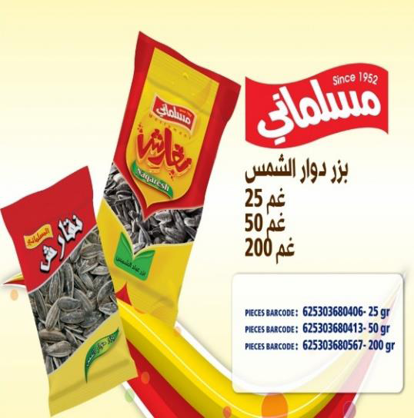
Some of Maslamani products:
Sunflower Seeds

Slide 6
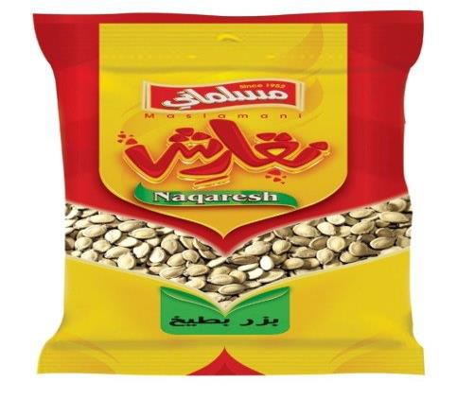
Watermelon Seeds

Slide 7
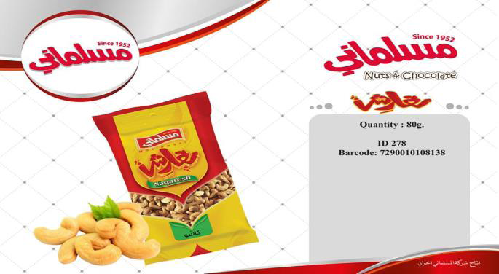
Cacho nuts

Slide 8
Lean Definition
Lean manufacturing is consider as doing more with less. It involves efforts to eliminate or reduce muda (waste)
in other words ,leans’ aims to perform production with :
minimum manpower
minimum production area
consuming minimum resources
holding inventories at the minimum level
making minimum defects
producing products at the shortest time
Improve customer satisfaction

Slide 9
Problem Statement
Al-Maslamai company has been encountering many yield losses in many production processes resulting in significant amounts of wastes in raw materials, work in process and finished products. More specifically, such wastes could be reflected into one or more than the well-known seven wastes-TIMWOOD.
The current project aims are applying a set of lean manufacturing techniques in Al-Maslamani Company for the ultimate goal of reducing and/or eliminating the generated wastes and they don’t have forecasting system. The ordering policy done randomly.

Slide 10
Project Aims
The current project aims are applying a set of lean manufacturing techniques in Al-Maslamani Company for the ultimate goal of reducing and/or eliminating the generated wastes and they don’t have forecasting system. The ordering policy done randomly.

Slide 11
Methodology
After scientific visit of the company ,making a meetings with industrial engineer Waed Bouzia , collecting data and using it in our project by applying a systematic way (DMAIC methodology), which is a data-driven quality strategy used to improve processes.

Slide 12
define
analyze
DMAIC
measure
Improve
control

Slide 13
Description of the wastes
Description | Examples | Type of waste
●Each one of them need special condition like humidity, temperature and ventilation. | ●Same storage place for the raw material such as sun button, pistachio and finished product. | Inventory
●This lead to problem with customer order whether excess or shortage. | ●Bad communication and coordination between the production manager and warehouse management.
●This is possible to restrict the movement of workers, also it may burn easily, so this affect the safety of workers. | ●The carton for packaging stored in the production plane instead of putting them on the warehouses.
●This will generate a problem in extracting and transferring. | ●Miss ordering of the ballets that contains the raw materials “layout problem”.
●This take a space of warehouse instead of exploit it for useful purpose, moreover, this is extra expenses. | ●The long period for storing the sun button.

Slide 14
●Instead of using it as a final product, they throw it away. | ● Transferring the products from the roasting machine to cooling or packaging location manually. | Defects
●This amount of salt is disposed and can't use it again as it affects the quality and surely it's a lost cost. | ●The large amount of salt and spices that they use as a flavour leaks out during roasting.
●This burns the product as a result of that, the best quality is decreased, and they sold it less than what it should. | ●Sometimes the high temperature of the roaster or the existence of that raw material in it for a period long than the allowed.
●Certainly, this make a problem with the retailers, like losing customer trust. In addition, throwing away these bags will cost them. | ●During the packaging process, some of the bags are empty.
●This error makes a problem with the ministry of health and reduce the customer satisfaction. | ●Rarely, the expire and production date sometimes is not clear during the printing process.
●This causes the nuts to fall. | ●The rubber conveyer that transfers the roasted nuts to packaging machine is broken.

Slide 15
●This burns the product as a result of that, the best quality is decreased and they sold it less than what it should. | ●Sometimes the high temperature of the roaster or the existence of that raw material in it for a period long than the allowed. | ●over processing

Slide 16
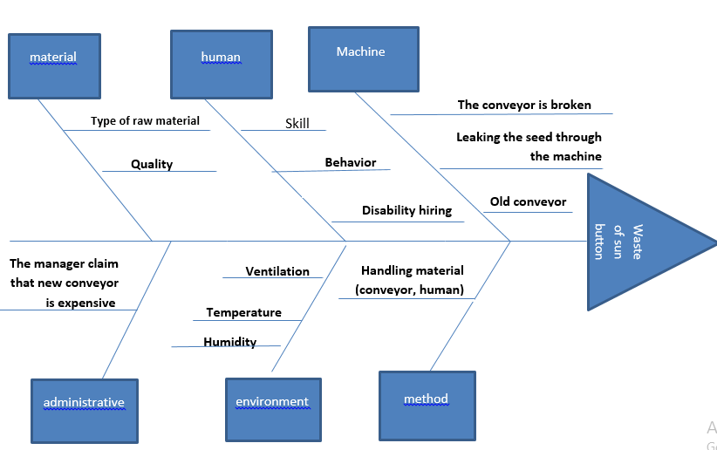
Cause and effect diagram for waste of sum button

Slide 17
ProModel is another tools to analyze and improve the processes
We use the Pro-Model to simulate the operations which the raw sun button passes through it and therefore measure the real and the optimal performance of the operations and compare it with the current situation .
So, through the results we can analyze the problems, explain the causes and the sources
.And finally find the right solutions which can take the company for the highest possible of performance

Slide 18
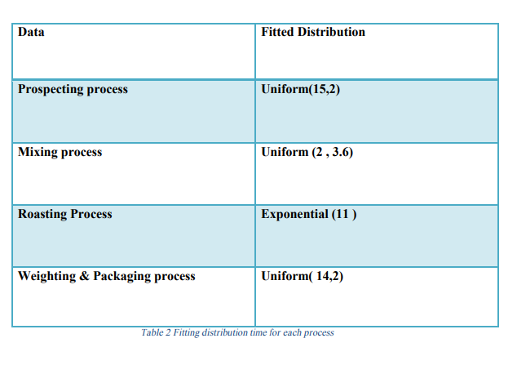

Slide 19
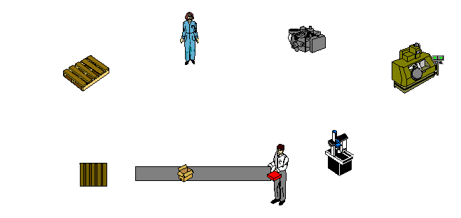

Slide 20
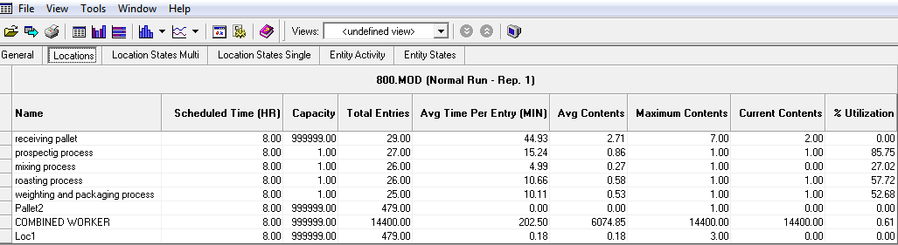
The results which came out from the model

Slide 21
After defining the several types of waste and using simulation model to show the production process. We obtained that some of the wastes are un controllable. Also, we focus on inventory waste to build a forecasting system and in ordering to policy.

Slide 22
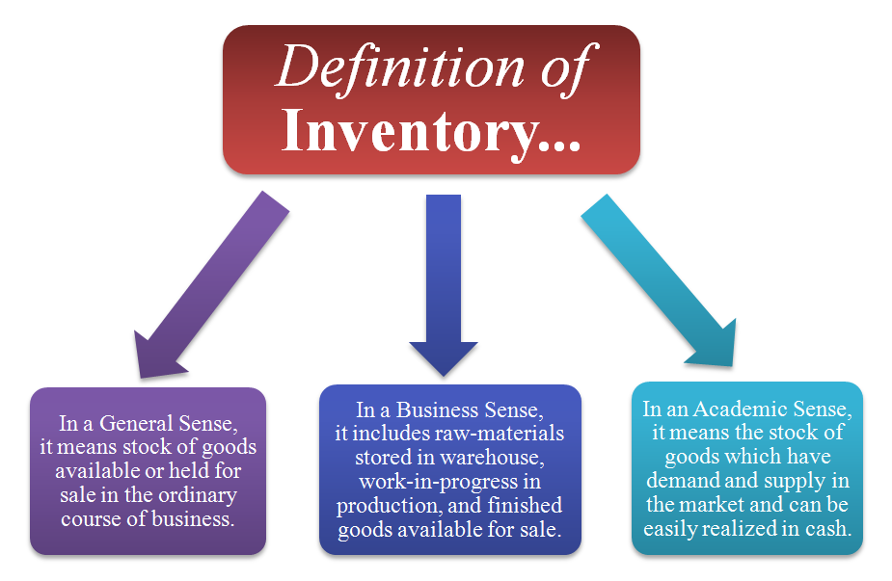
Inventory

Slide 23
Reasons for keeping inventory
leads to a more organized warehouse.
helps save time and money.
increases efficiency and productivity.
keeps your customers coming back for more.
improves the accuracy of inventory orders.
The following table shows the demand and
forecasting for finished sun button.

Slide 24
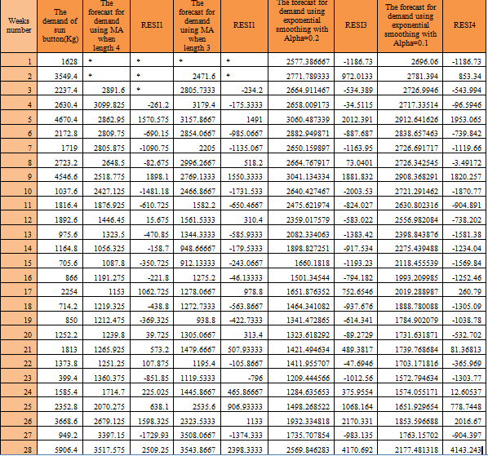

Slide 25
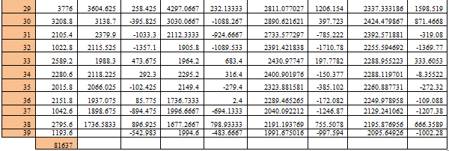

Slide 26
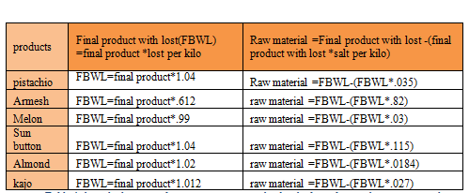
Converting the finished products quantities to raw quantities
The table below shows the ratio of converting

Slide 27
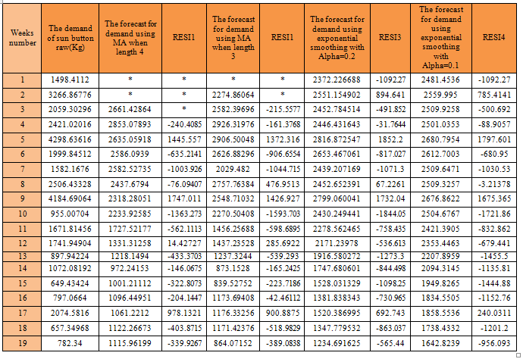
The table below shows the demand and forecasting for raw sun button

Slide 28
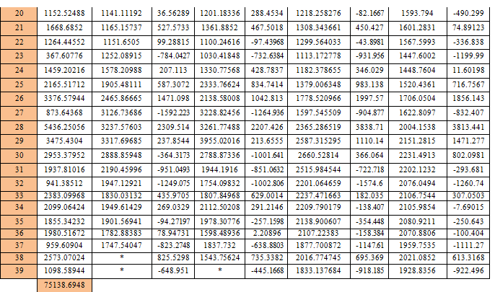

Slide 29
ABC classifications
There are several various type of inventory control analysis techniques such as ABC ,HML , VED …etc. But in our project we shall focus on the ABC analysis techniques.
ABC analysis is an inventory categorization method which dividing item into three categories A,B,C :
A being the most valuable item
B&C being the least valuable item

Slide 30
The ways of classifications parts for the purpose of ABC analysis:
Unit cost.
On hand value.
Lead time.
Extended value of future requirements.
Extended value of past Issues.

Slide 31
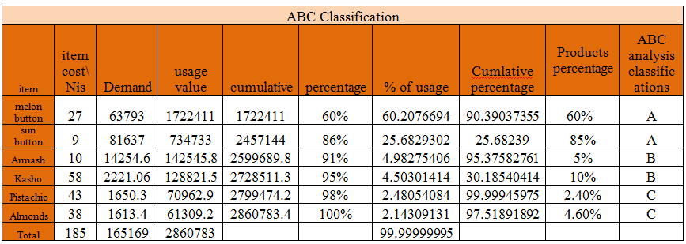
ABC classification for six products by using the steps of the technique

Slide 32
Pareto chart analysis of the ABC classification

Slide 33
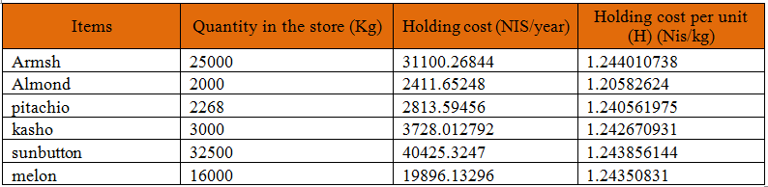
Holding cost

Slide 34
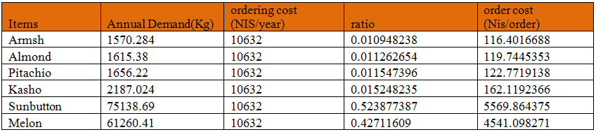
Ordering cost

Slide 35

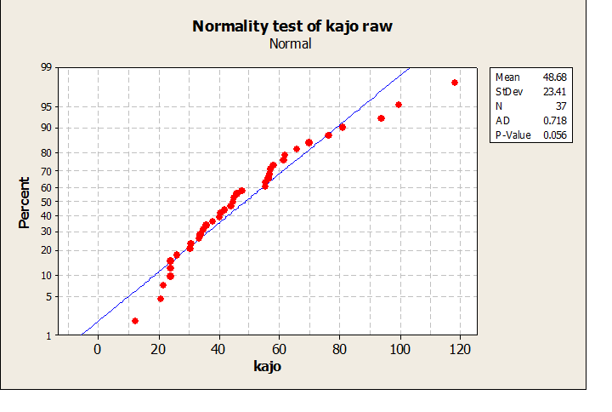
Safety stock
The figure shows the normal probability test

Slide 36
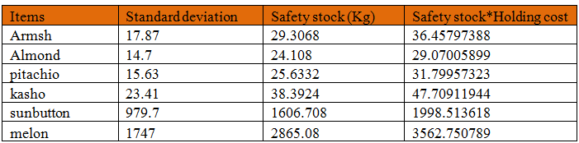
Safety stock

Slide 37
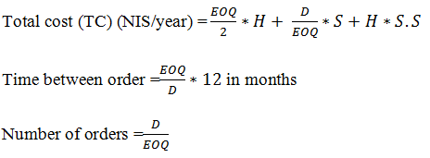
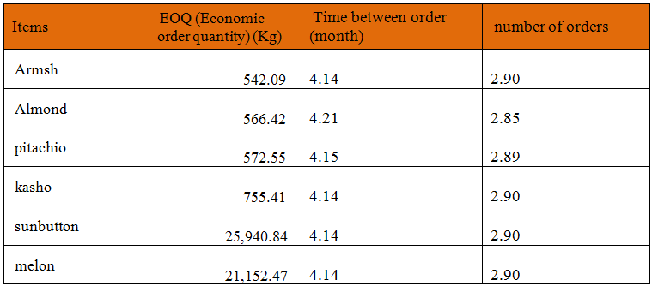
Ordering policy

Slide 38
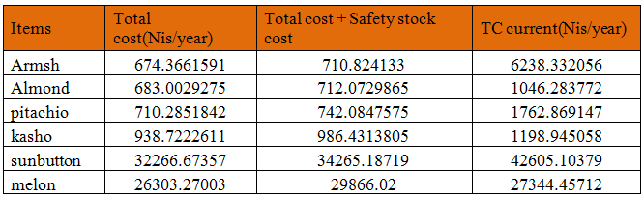
Differences in costs between the improved and the current

Slide 39
Improve and control stages
Improve process performance by addressing and eliminating the root causes
Control the improved process and future process performance.

Slide 40
Conclusion
By implementing an effective inventory management system, Al-Maslamani Company will be able to save a lot of money and keeping their services as it is to their customers.

