Slide 1
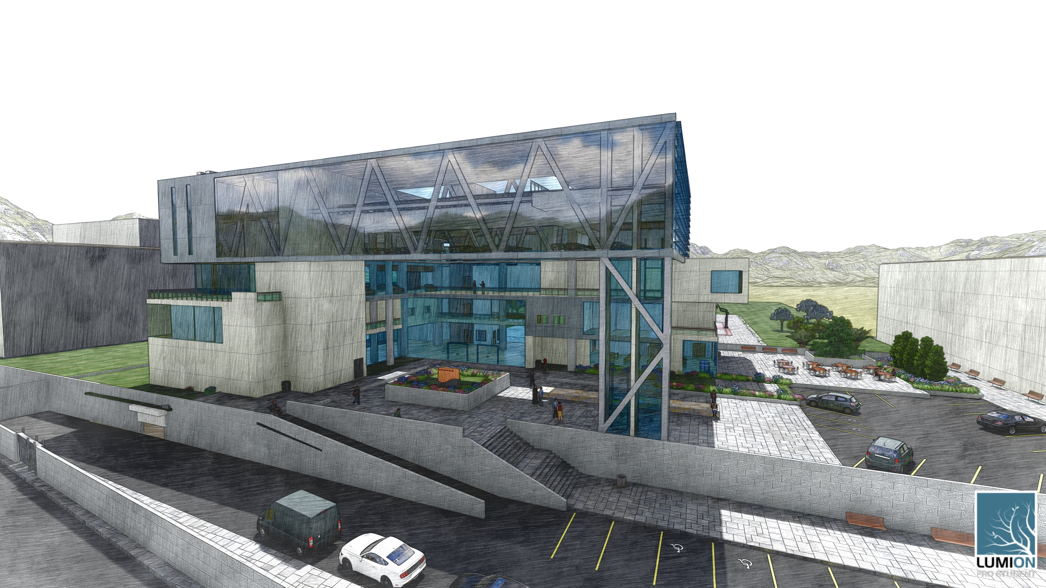

An-Najah National University
Building Engineering Department
Integrated redesign of a faculty of architecture in Nablus city
Prepared By:
Marwan Akhras
Musab Seddeh
Jameel Sabbah
Supervisor:
Eng. Haitham Sawalha

Slide 2
Contents
Architectural
BOQ
Site and location
Fire and safety
Electro- Mechanical Design
Environmental design
Structural Design
Passive design

Slide 3
Site and location

Slide 4
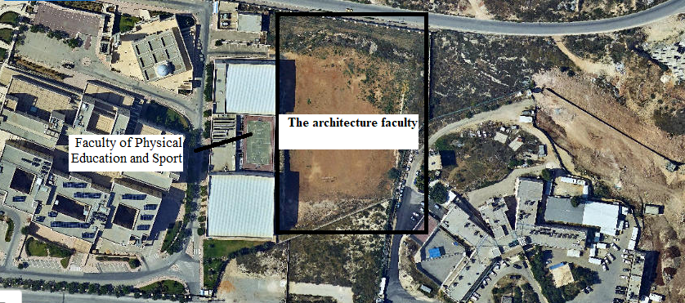

Site location
This faculty is located in Nablus city, which lies in the north of west bank, approximately 30 mile north of Jerusalem; Nablus is about 565 m above sea level. The site is located in Al-Najah University on latitude 32.2$°$N and longitude 35.2$°$ E.

Slide 5
Architectural Plans

Slide 6
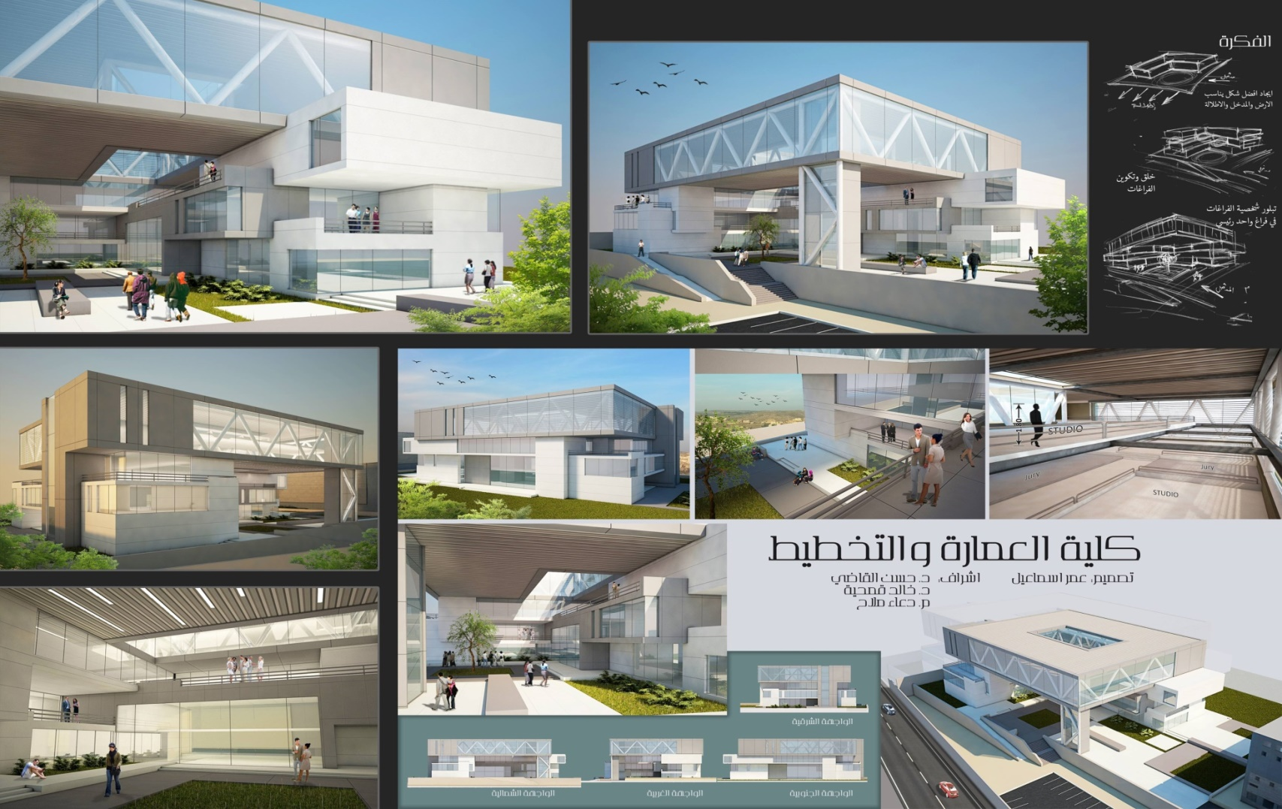
The 3rd model for the existed architectural plan.

Slide 7
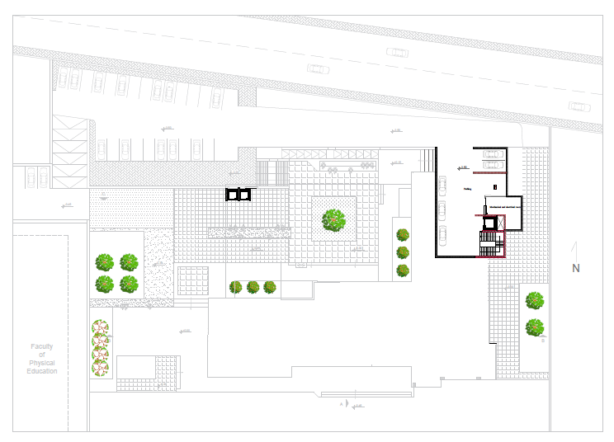
Basement floor with the site

Slide 8
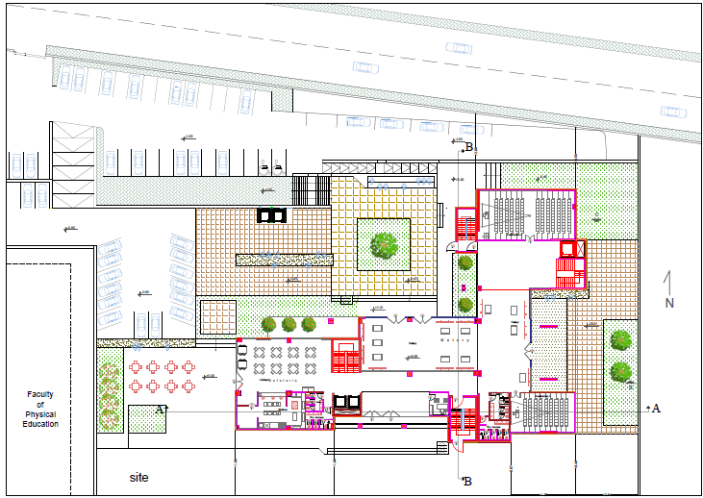
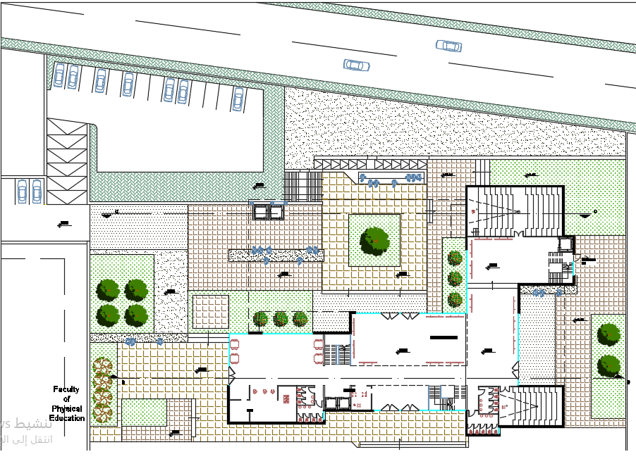
Ground floor with the site
Before
After

Slide 9
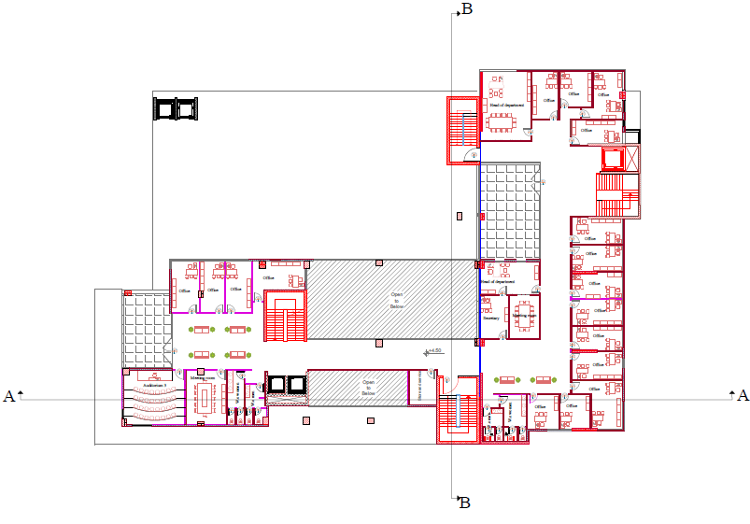
Fist floor

Slide 10
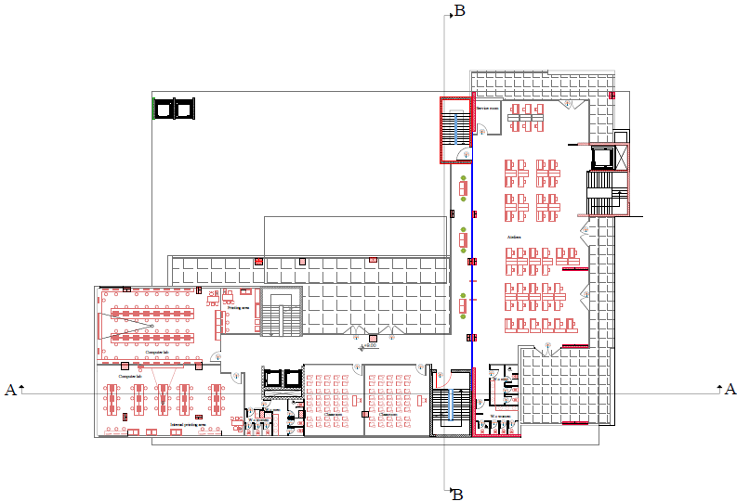
Second floor

Slide 11
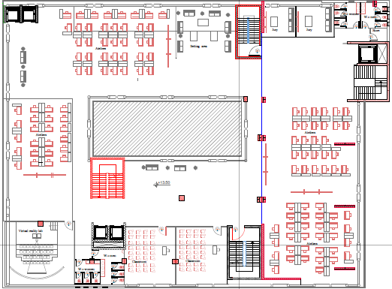
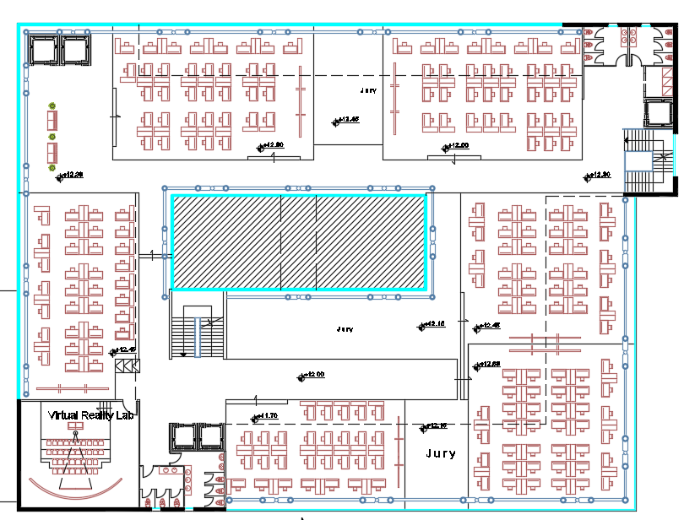
Third floor
Before
After

Slide 12
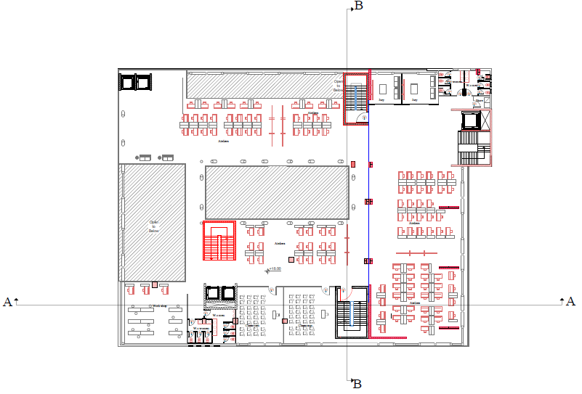
Fourth floor

Slide 13
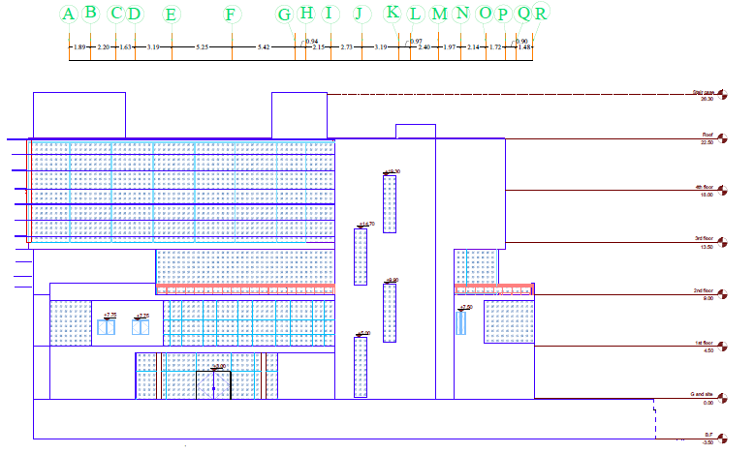
East elevation

Slide 14
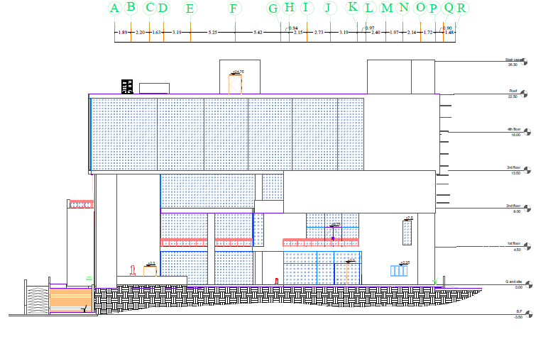
West elevation

Slide 15
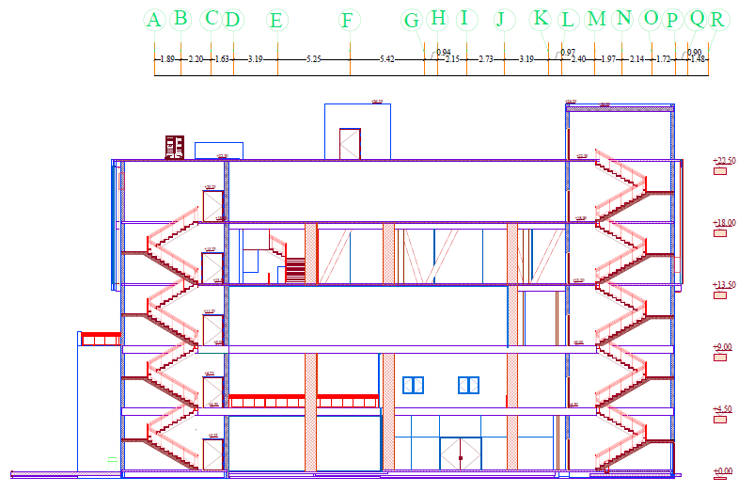
Section B-B

Slide 16
Environmental Design

Slide 17
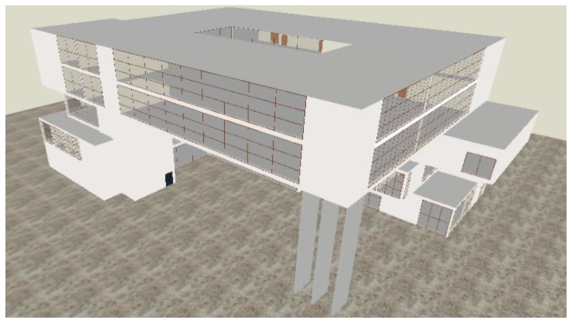
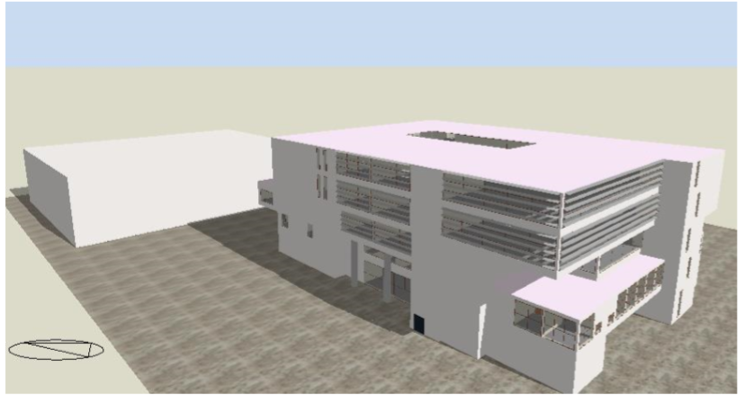
Day lighting
The model of the faculty from Design Builder before and after modification
Before
After
Main modification for day lighting:
Adding Louvers.
Using low transmission glass.

Slide 18
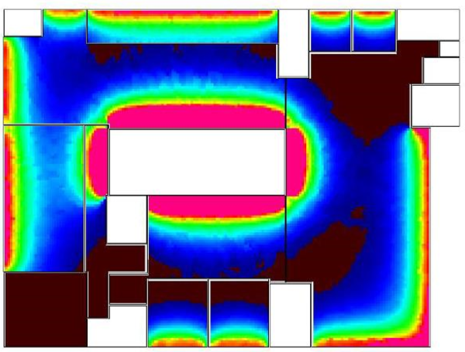
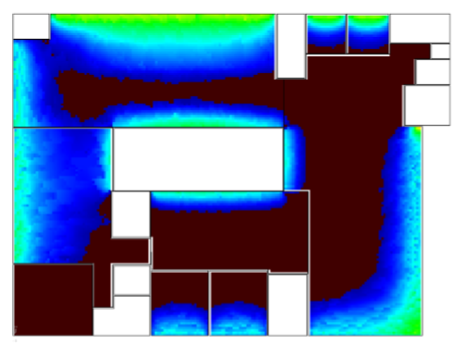
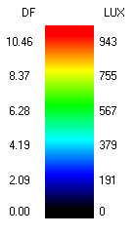
Daylight analysis for the model for the third and fourth floors before and after modification
Before
After

Slide 19
Thermal Design

Slide 20
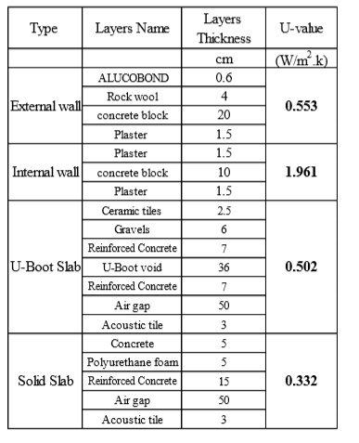
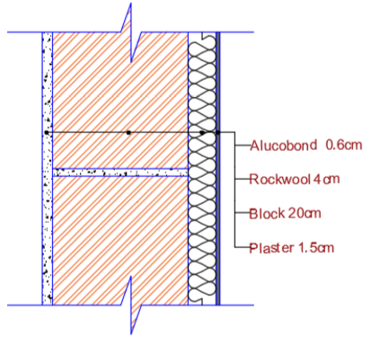
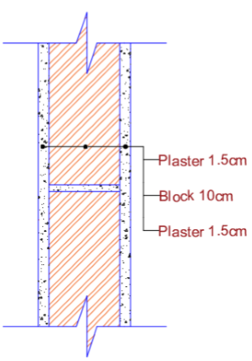
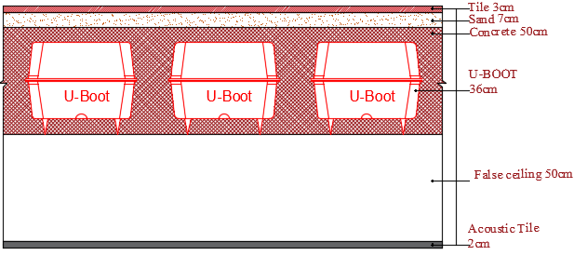
Summary for the materials that were used in the walls and slabs in the faculty

Slide 21
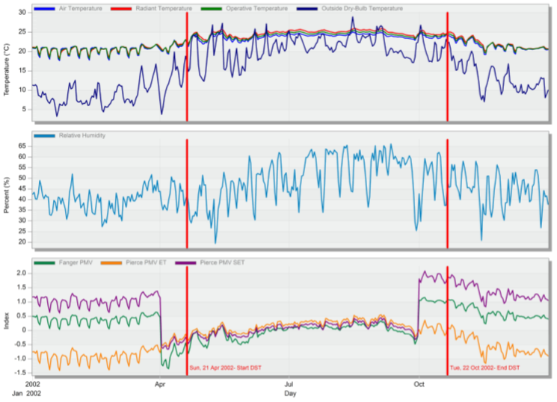
The comfort graph for the faculty from Design Builder

Slide 22
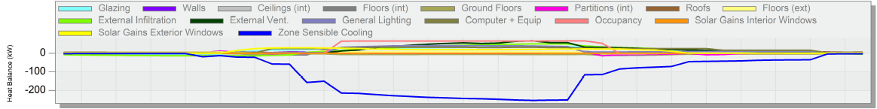
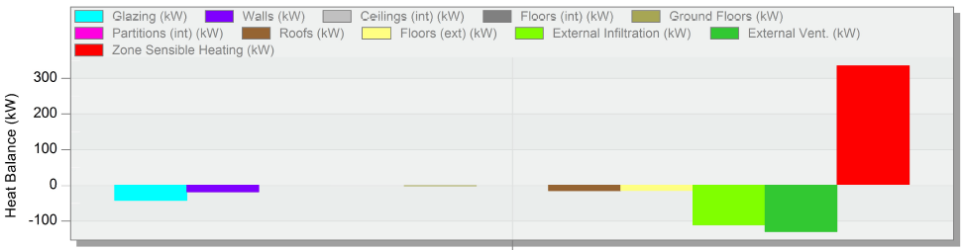
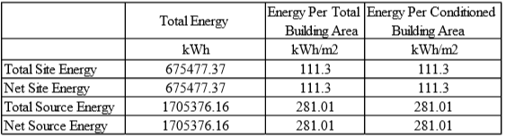
Temperature and heat gain
Temperature and heat loss
The site and source energy for the faculty from Design Builder
The site energy for the faculty = 111.3 kWh/m², and the standard required 411.7 kWh/m² ,for the college (“Portfolio Manager,” n.d.),so it is ok for the faculty.

Slide 23
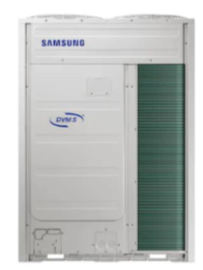
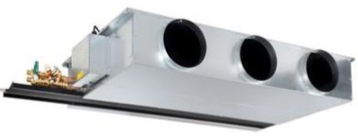
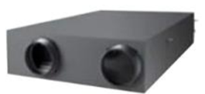
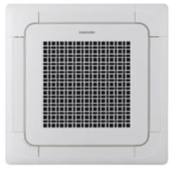
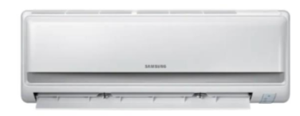
HVAC system
The system that was used is VRF system and the maximum cooling load equal 374.8 KW.
The components of this system is from TROX and Samsung company.
From TROX TECHNIK Company with flow rate of 0.63 m³/s .
From Samsung Company with flow rate of 0.28 m³/s
Four unit with a capacity of 73.6 kw for each unit.
From Samsung Company with flow rate of 0.10 m³/s
From Samsung Company with flow rate 0.275 m³/s. and one with flow rate of 0.16 m³/s .

Slide 24
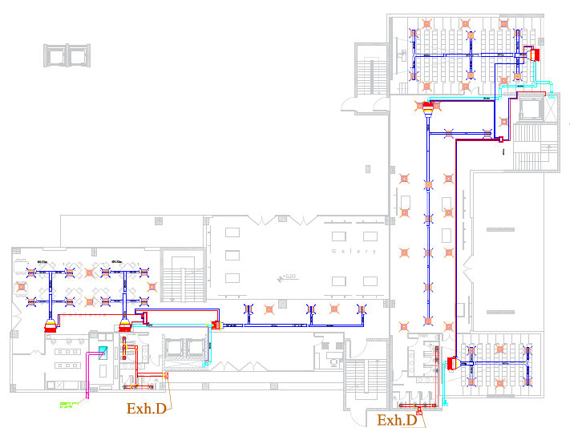
The number of fan coils and indoor unit that are needed in the ground floor
The distribution of the ducts and diffusers in the ground floor.

Slide 25
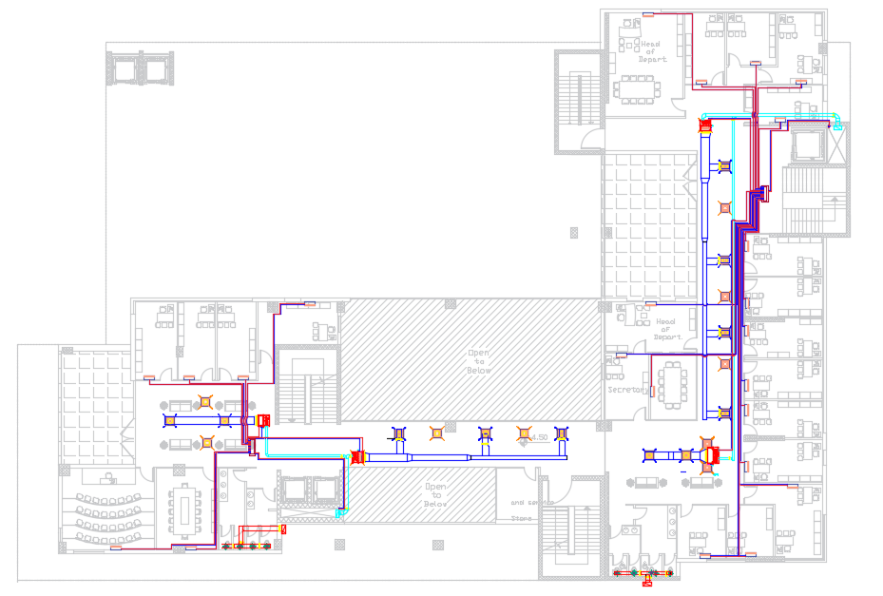
The number of fan coils and indoor unit that are needed in the first floor.
The distribution of the ducts and diffusers in the first floor.

Slide 26
Structural Design

Slide 27
Materials
The parameters for seismic analysis
Concrete with compressive strength of 28 MPa (B350) and 32 MPa(B400)
Steel rebar with yielding strength of 420 MPa
Steel with minimum yield stress of 248.1 MPa.
1
Mass source: 100% for dead laods and SID , 25% for live laods.
2
Seismic zone : The faculty is located in Nablus city Therefore, the seismic zone is 2B and the Z value is equal to 0.20.
3
Soil profile: The soil type is rock so the soil profile is SB .
4
5
6
Force Reduction Factor R = 5.5 (Building Frame System - shear wall)
Importance Factor I = 1.25
Acceleration-Dependent Seismic Coefficient Ca = 0.2
7
Velocity-Dependent Seismic Coefficient Cv = 0.2
8
Response spectrum scale factor = $\frac{I×g}{R}$ = $\frac{1.25 ∗9810}{5.5}$ = 2230
Response spectrum scale factor = (𝐼×𝑔)/𝑅 = (1.25 ∗9810)/5.5 = 2230
Codes
Loads
ACI 318-14
Seismic design UBC 97
ASCE for load design
AISC360-10 for steel analysis,
Live load = 5 kN/m²
SID load = 4 kN/m²

Slide 28
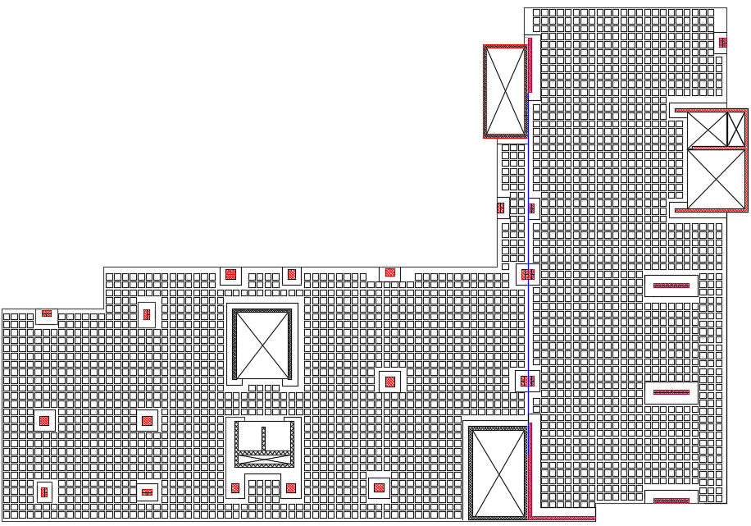
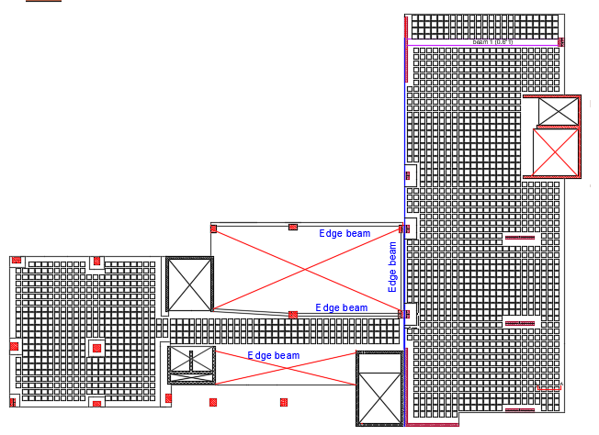
Ground and first floors
Block 2
Block 2
Block 1
Block 1
First floor
Ground floor

Slide 29
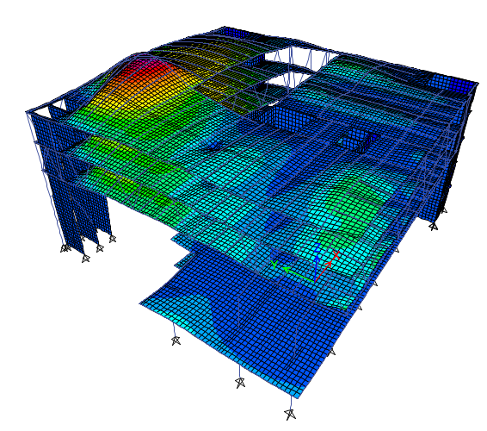
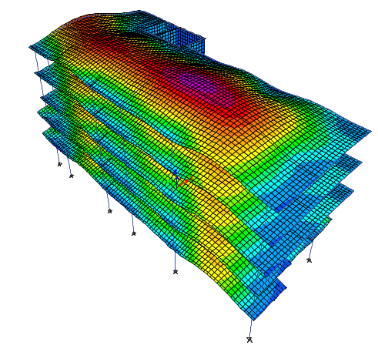
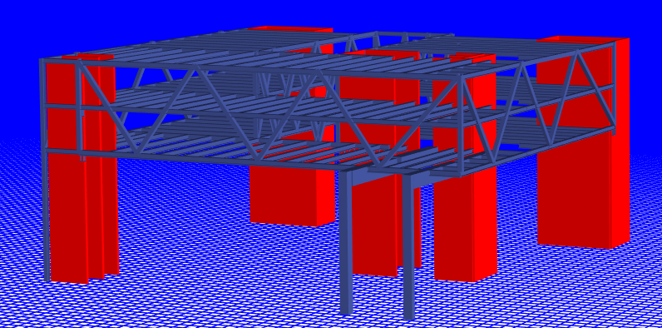
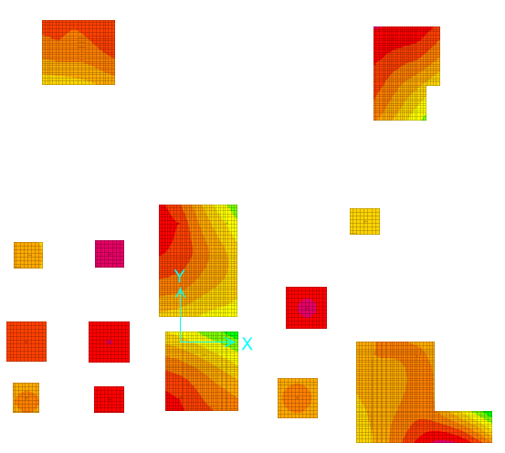
ETABS model of block 1
ETABS model of block 2
ETABS model of block 1
Safe model

Slide 30
Seismic design checks
1. Period and base shear checks for block 1
2. Period and base shear checks for block 2
Time period from mode 1 (Tx) = 0.469 sec < 0.74 sec, the check is ok.
Time period from mode 2 (Ty) = 0.414 sec < 0.74 sec, the check is ok.
shear results from ETABS are greater than manual calculations, so base shear check is ok
Time period from mode 1 (Tx) = 0.633 sec < 0.742 sec, the check is ok.
Time period from mode 2 (Ty) = 0.453 sec < 0.742 sec, the check is ok.
shear results from ETABS are greater than manual calculations, so base shear check is ok
3. Drift check for block 1
4. Drift check for block 2
All drifts in floors < 100 mm, so the check is ok
All drifts in floors < 100 mm, so the check is ok

Slide 31
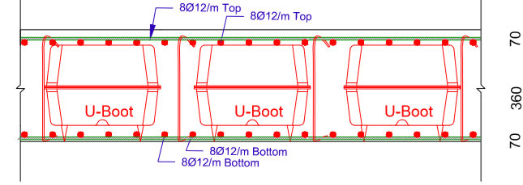
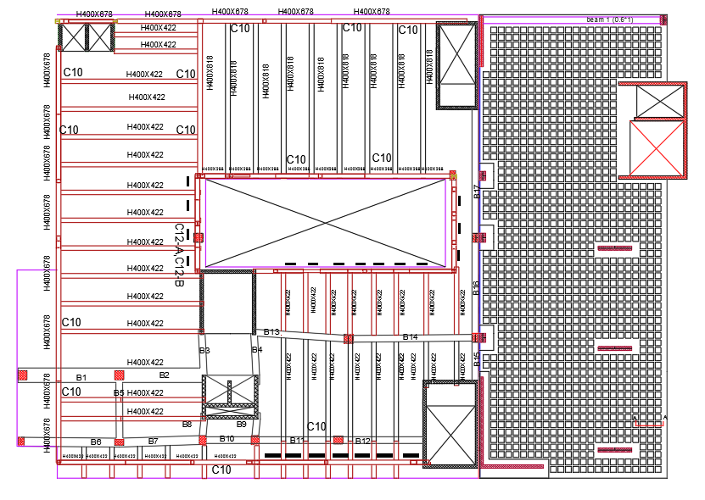
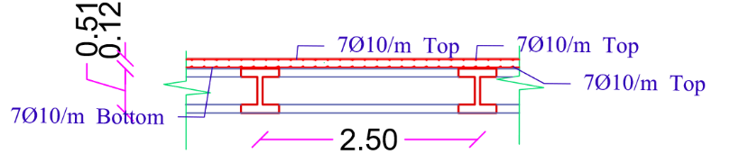
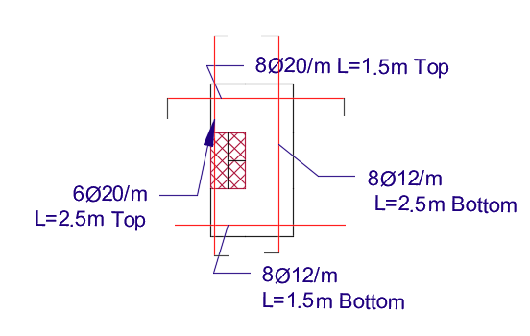
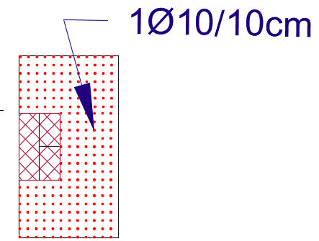
Slabs
U-BOOT slab
Solid slab

Slide 32
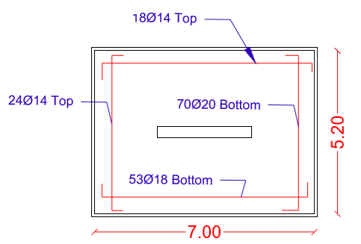
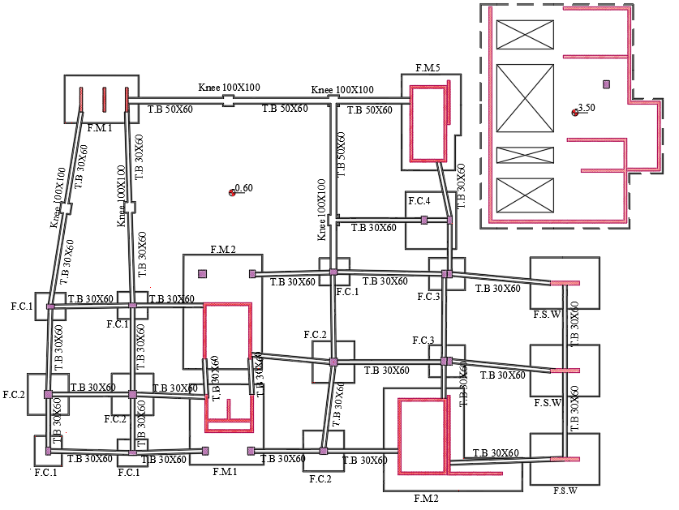
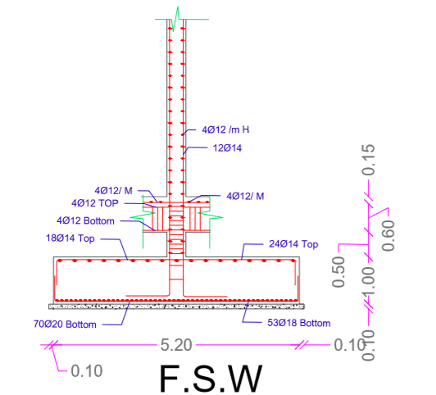
Footings layout

Slide 33
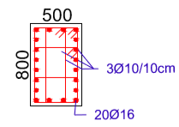





Columns sections
C1
C2
C3
C4
Beams sections

Slide 34



Steel
For steel design
TUBO
HEE

Slide 35


Third floor

Slide 36



Truss 1
C5
C6

Slide 37


C1

Slide 38




SPC2

Slide 39

C12-B

Slide 40

C12-A

Slide 41


Retaining wall design

Slide 42
Electro-Mechanical Design

Slide 43









Artificial lighting
The selected Luminaires
Lighting with switches

Slide 44






Illuminance result from DIALux evo for the classroom .

Slide 45






Result from DIALux evo for the ground floor.
Gallery
Gallery
Jury
Cafeteria
Auditorium
Lap

Slide 46




Sockets plan for the cafeteria
The electrical load of power, lighting and loud speaker system in the ground floor
Distribution of circuit breaker in distribution board 1
Main distribution board of circuit breaker in the ground floor

Slide 47

The electrical load of power, lighting and loud speaker system in the main distribution board 1
The electrical load of elevators and HVAC system in the main distribution board 2

Slide 48

Mechanical system
Water consumption
Water tanks

Slide 49

Water collector
Total Fu & water demand
Diameter of the pipes in the faculty

Slide 50

Summary for diameter & pipe slope

Slide 51

Drainage pipes and manhole on the site

Slide 52

Elevators assessment
The assessment on the number of elevators will depend on the distribution of the elevators and if the number is enough or not by engineering sense. The distribution of the elevators is good and the number is enough for all the student and stuff.

Slide 53
Acoustical Design

Slide 54


The spaces that were designed acoustically in the faculty
The absorption coefficient for the finished material

Slide 55


Reverberation time(RT60):
The reverberation time for the classroom according to Sabine
The reverberation time for the cafeteria according to Sabine

Slide 56



Sound Transmission Loss (STC)
The sound transmission loss (STC) for the internal walls between different spaces
The sound transmission loss (STC) for the internal walls between different spaces in the faculty is more than the limit = 49 dB
The OITC for the external walls = 46dB more than the standard = 42 dB (Egan, n.d.), so it is ok for the external walls

Slide 57

Impact Insulation Class (IIC)
The Impact insulation class for the ceiling = 52 dB between two classrooms and the calculated IIC for the ceiling should be more than 50 dB, so it is ok.
The layers for the ceiling

Slide 58



Loud speaker
Cafeteria
The direct SPL distribution in the cafeteria at 500 HZ

Slide 59
Fire and Safety

Slide 60




The symbols of the suppression system in the plans
Part of firefighting plan for the ground floor
The symbols for the detection and notification system.
The emergency lights and signs

Slide 61





The different types of sprinkler in the faculty
The different types of the extinguisher

Slide 62




Flood sprinkler
FM 200 system
Wet chemical sprinkler

Slide 63

The evacuation plan for the second floor

Slide 64

Reflected false ceiling for ground floor

Slide 65
Quantity Surveying and Cost Estimation

Slide 66
Quantity Surveying
The total cost of the faculty is 22548939 NIS and the total area of the faculty building is 8141 m² which means that the total unit cost per m² is 2770 NIS/ m².
Earth work = 459000 NIS
Foundation Work = 589386 NIS
Sub Structure Work = 308506 NIS
Super Structure = 6804333 NIS
Finishes Work = 8580320 NIS
Electrical work = 449360 NIS
Safety work = 128300 NIS
Mechanical work = 2990850 NIS
Site Work = 2238884 NIS

Slide 67
Percentage for each work from total cost of the faculty

Slide 69


