Slide 1
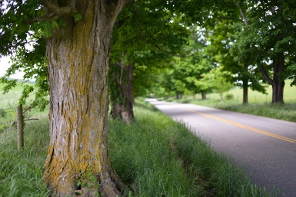
Rehabilitation Project
of Jenin Bypass Road
Prepared By:
Saleem F. Haidareyyeh
Mohammad H. Abu Farha
Supervisor:
Dr. Khalid Al-Sahili

Slide 2
Outline
Location and background.
Significance and objectives.
Data collection and analysis.
Geometric and pavement design .

Slide 3
Location and background
The road is located in the east of Jenin city (North of West Bank) with a length of approx. 14 km.
The road connects Az-Zababida village to Al-Nazareth Street.

Slide 4
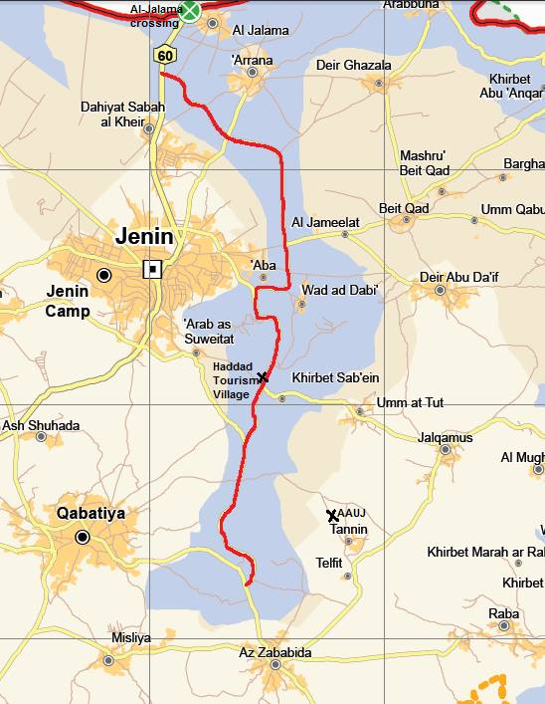

Slide 5
Significance of the project
improve the access of population in the surrounding villages to social services.
Economic integration between the cities around the road.
Travel time.
Congestion in alternative routs may be reduced.

Slide 6
Objectives
Assessment and evaluation of the existing conditions of the road.
New design of the road and a comparison between the existing road and the new design.

Slide 7
Data collection and analysis
Inventory study.
Traffic volume study.
Soil study.
Geometric evaluation.

Slide 8
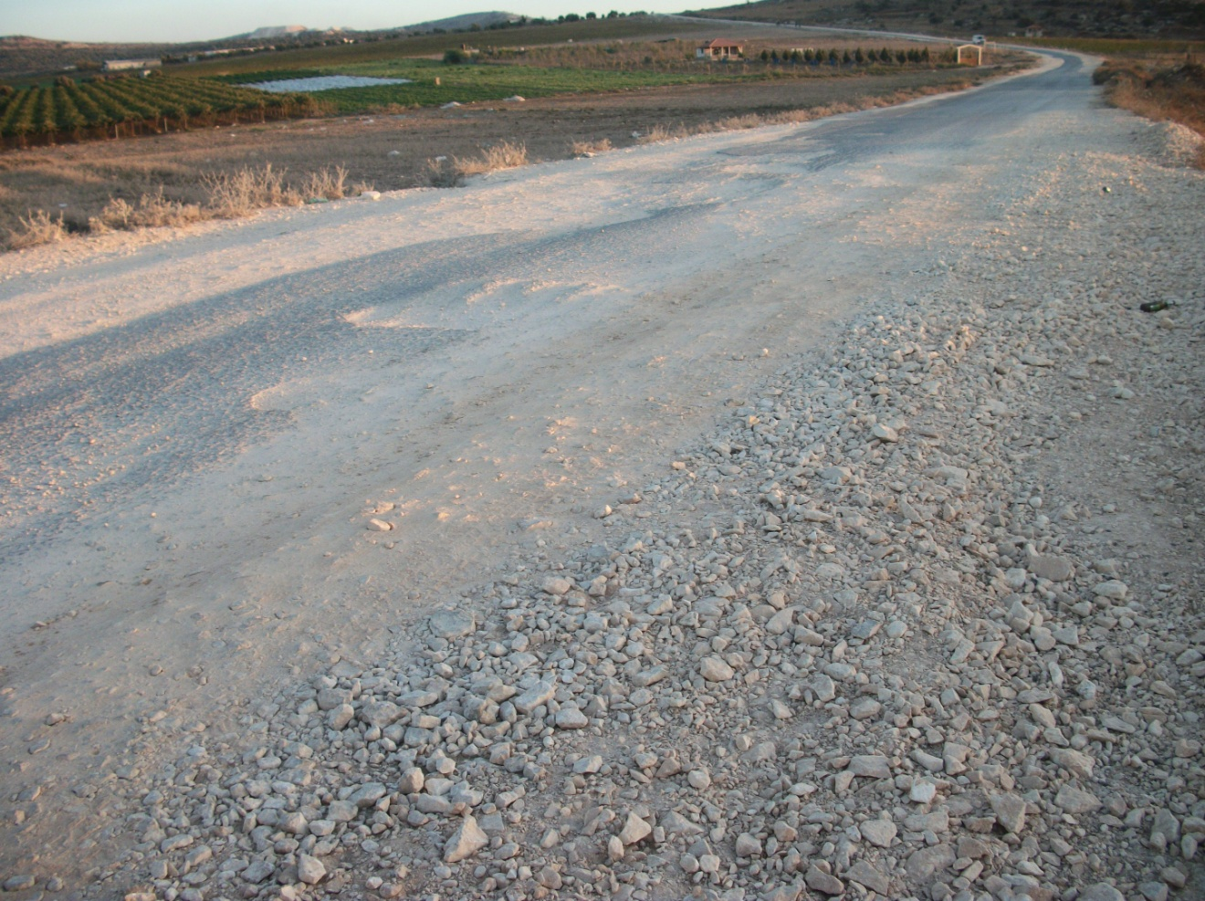
Potholes and loose surface.

Slide 9
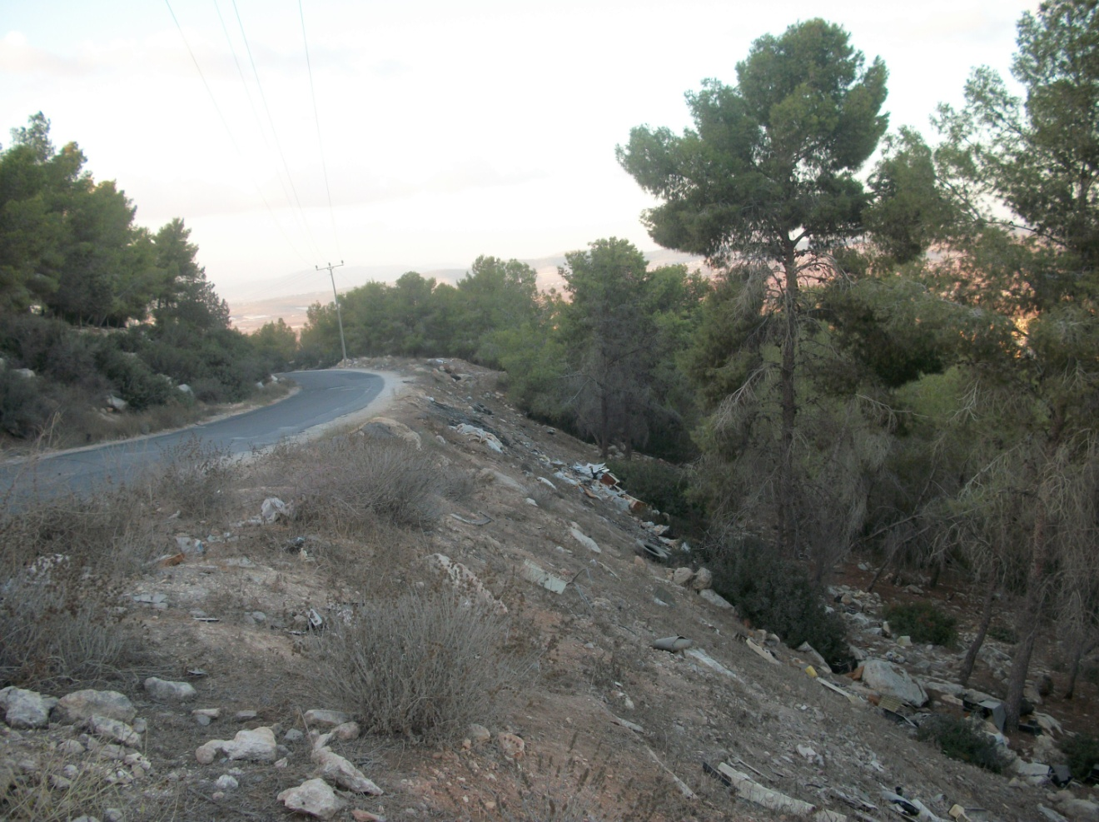
Sharp curve without guardrails

Slide 10
Growth Rate And Traffic Estimation
The future volume is coming from many sources:
Natural growth in number of vehicles (natural growth in population).
Future development in the surrounding area and the drivers coming from alternative roads.
Growth rate 5%.

Slide 11
Level of Service
Existing Level of service
Stations |  | LOS
Start St | End St
0+000 | 5+300 | B
5+300 | 8+100 | C
8+100 | 11+800 | C
11+800 | 14+130 | B

Slide 12
Level of Service
Future Level of service
Stations |  | LOS
Start St | End St
0+000 | 5+300 | B
5+300 | 8+100 | D
8+100 | 11+800 | E
11+800 | 14+130 | C

Slide 13
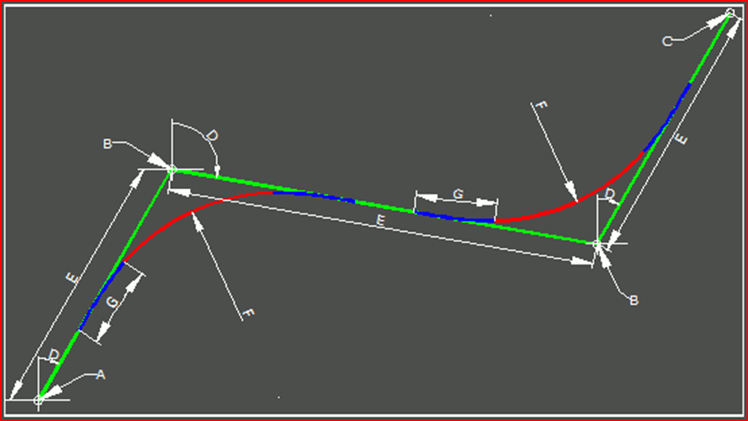
Geometric Design
Horizontal Alignment
      Minimum Radius

Slide 14
Geometric Design
Vertical Alignment
      Stopping and passing Sight Distance(Curve length).
      Maximum Grade.
      Minimum Cut and Fill.

Slide 15
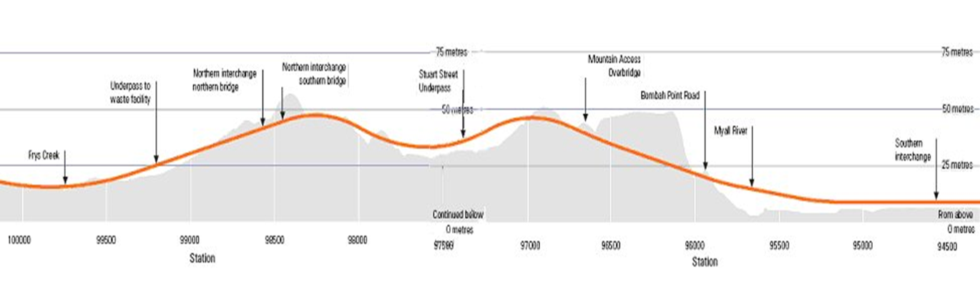
Geometric Design

Slide 16
Geometric Design
Intersection Design
  Four Main intersections:
      Qabatiya-Az-Zababida intersection.
      Arab American University intersection.
      Jenin – Deir Abu Da’if intersection.
      Jenin – Al-Jalama intersection.

Slide 17
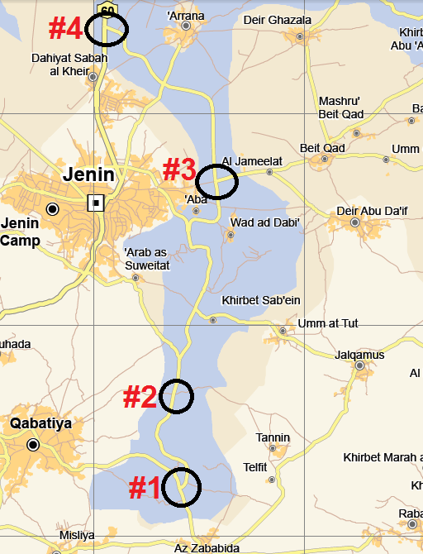
Main intersections along the road

Slide 18
Geometric Design
  Three of four intersection was designed as roundabout intersection because of the conflict in determining the right of way.
  Turning radiuses was designed based on the design vehicle and the angle of intersection.

Slide 19
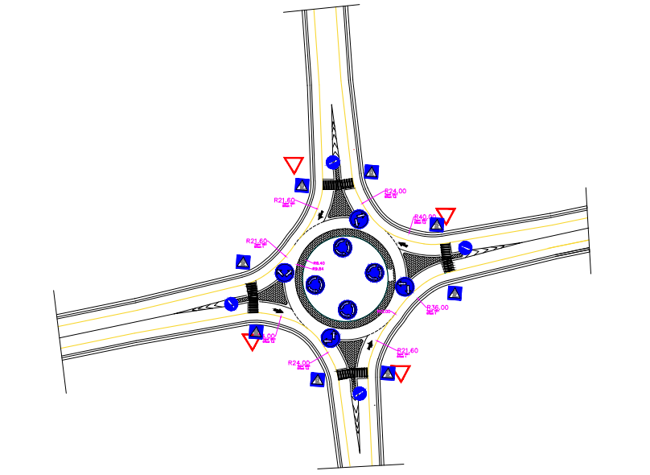

Slide 20
Geometric Design
  Cross Section Design
  Multi Lane Highway(5+300 – 11+800).
  Two Lane Highway(0+000 – 5+300)/(11+800 – 14+130).

Slide 21
Geometric Design
The cross section elements are designed based on AASHTO recommendation to be as follow:
  Lanes : 3.6 m
  Shoulder: 2.5 m
  Inside Shoulder 0.6 m
  Median: 3 m
  Cross slopes: 2%.
  Side slopes.
Cross Section Details
  Guard rail
  Ditches
  Retaining walls

Slide 22
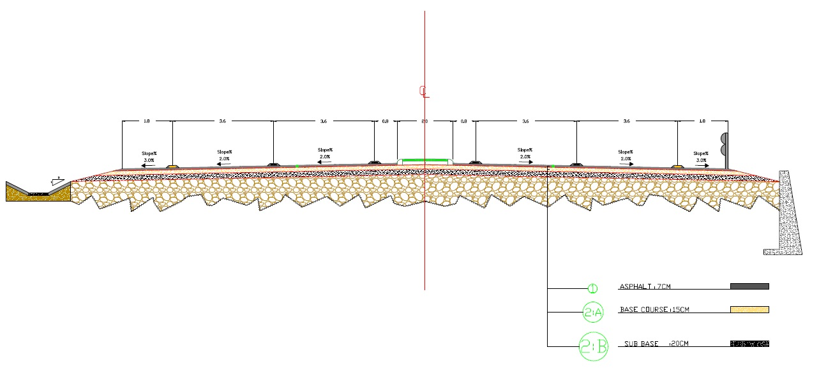
Geometric Design

Slide 23
Pavement Design
Based on soil test.
Estimated future traffic volume and vehicles classification.
Four sections.

Slide 24
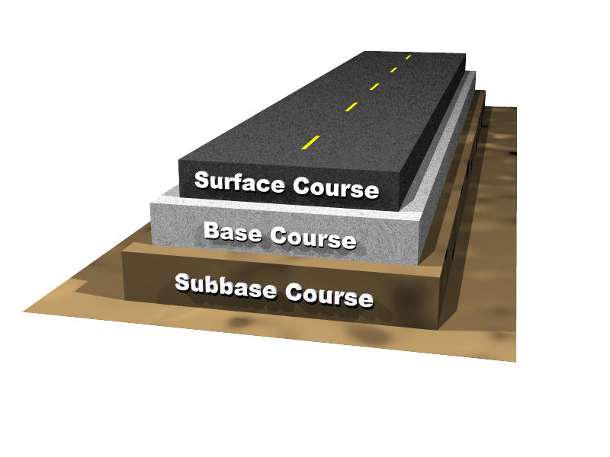
Pavement Design
0+000 – 5+300
Asphalt layer 7 cm
Base coarse 20 cm
Sub base layer No Need
11+800 – 14+130
Asphalt layer 7 cm
Base coarse 30 cm
Sub base layer No Need

Slide 25
Pavement Design
5+300 – 8+100
Asphalt layer 7 cm
Base coarse 20 cm
Sub base layer No Need
Selected Fill Materials (CBR>20)
8+100 – 11+800
Asphalt layer 7 cm
Base coarse 30 cm
Sub base layer No Need
Selected Fill Materials (CBR>20)

Slide 26
Conclusion
Serves many villages in the surrounding area.
8000 student coming from the occupied lands to AAUJ.
The planned for industrial area.
Recreational and tourist centers.
Export crops from the local farms to the occupied lands.

Slide 27
Thank you

