Slide 1
Automating Tags Generation for Web Annotations
Supervisor name:
Amjad hawash, pHd
student :
shahd suleiman -jana hasan- Batool barham

Slide 2
INTRODUCTION
With the rapid increase of text volume on the web, textual data becomes high-dimensional (thousands of thousands of words in each domain)

Slide 3
PROBLEM
The user did not choose the appropriate tags to search for the required annotations

Slide 4
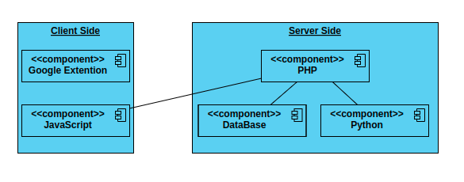
SYSTEM COMPONENT

Slide 5
Client Side
Google Chrome extensions are programs that can be installed into Chrome in order to change the browser's functionality. This includes adding new features to Chrome or modifying the existing behavior of the program itself to make it more convenient for the user.
The tool is a client/server architecture one and the google extension is used to implement the interaction part with the user

Slide 6
Server Side
PHP, python are the languages used for backend development

Slide 7
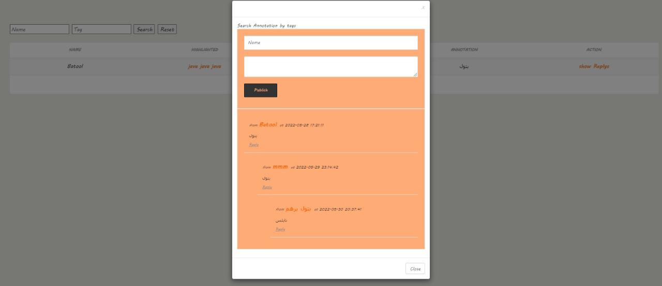
Comments & Replies

Slide 8
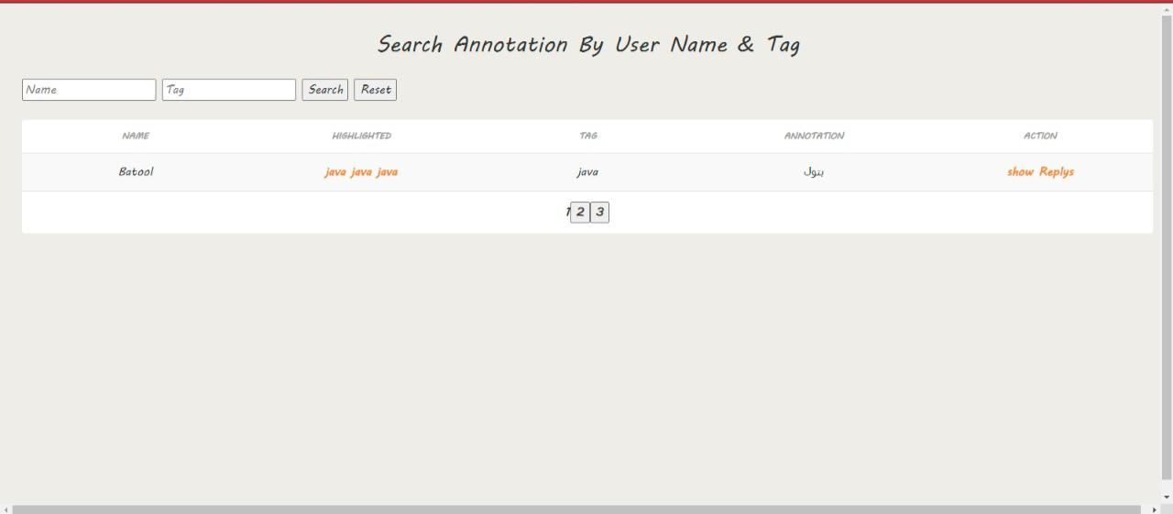
Search Page

Slide 9
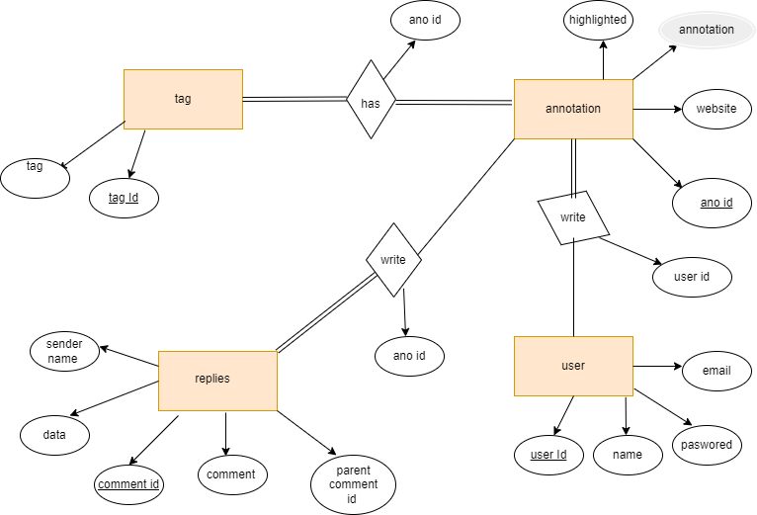
ER-DIAGRAM

Slide 10
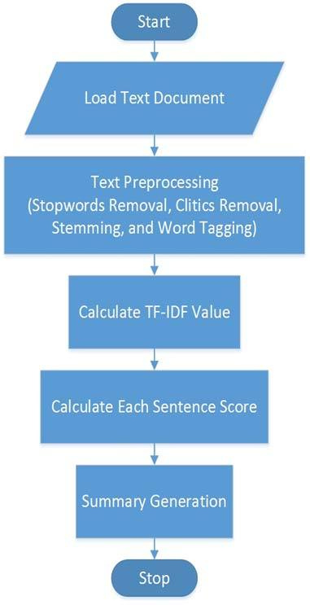
Tags Suggestion Algorithm
Python part

Slide 11
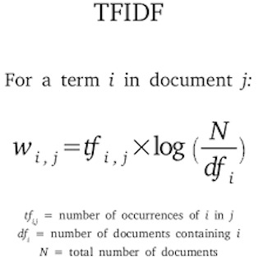

Slide 12
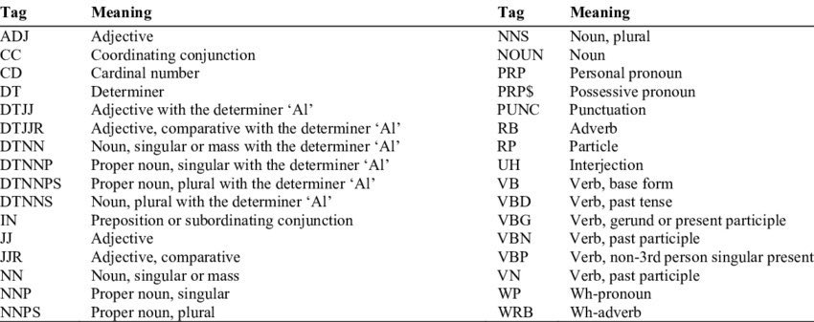
POS Tagger Model

Slide 13
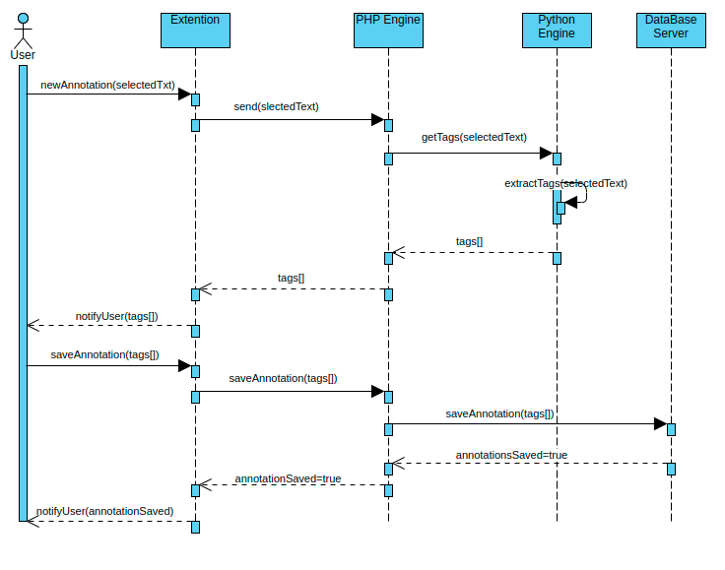

Slide 14
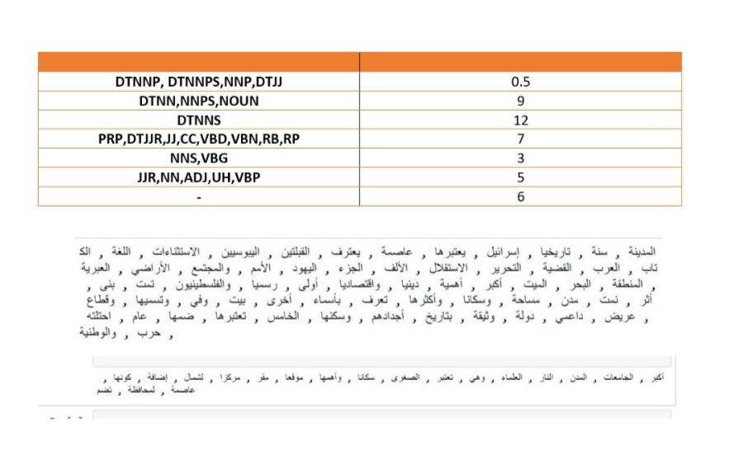
Experimental test:

Slide 15
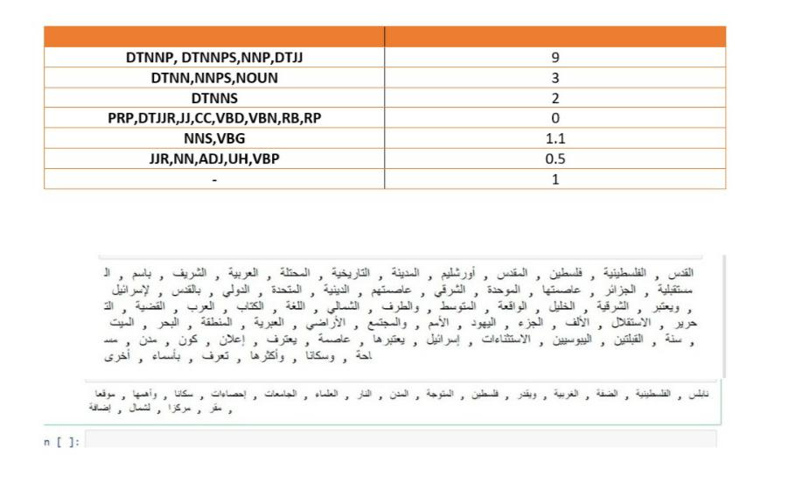
Result:

Slide 16
Future Work
Merge our extension with past our colleagues Audio extension Try different algorithms

Slide 17
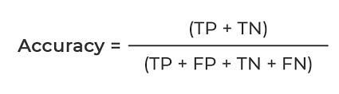
= 78.94%

Slide 18
