Slide 1


Valorization of Low-Grade Dates through Bioethanol Production: A
Sustainable Solution for Palestine
20
24
Department of Chemical Engineering - An-Najah National University
Submitted in Partial Fulfilment of the Requirements for the Degree of Bachelor of Science in the
Department of Chemical Engineering at the Faculty of Engineering and Information Technology
Prepared By
Supervisor
Mahmoud Sallam
Dr. Abdulrahim Abusafa
Graduation Project II
20
24

Slide 2
Table of contents
1. Introduction
2. Methodology
3. Results
4. Conclusions
5. Recommendations

Slide 3
01
Introduction
20
24
Department of Chemical Engineering - An-Najah National University
Mahmoud Sallam – Graduation Project II
20
24

Slide 4
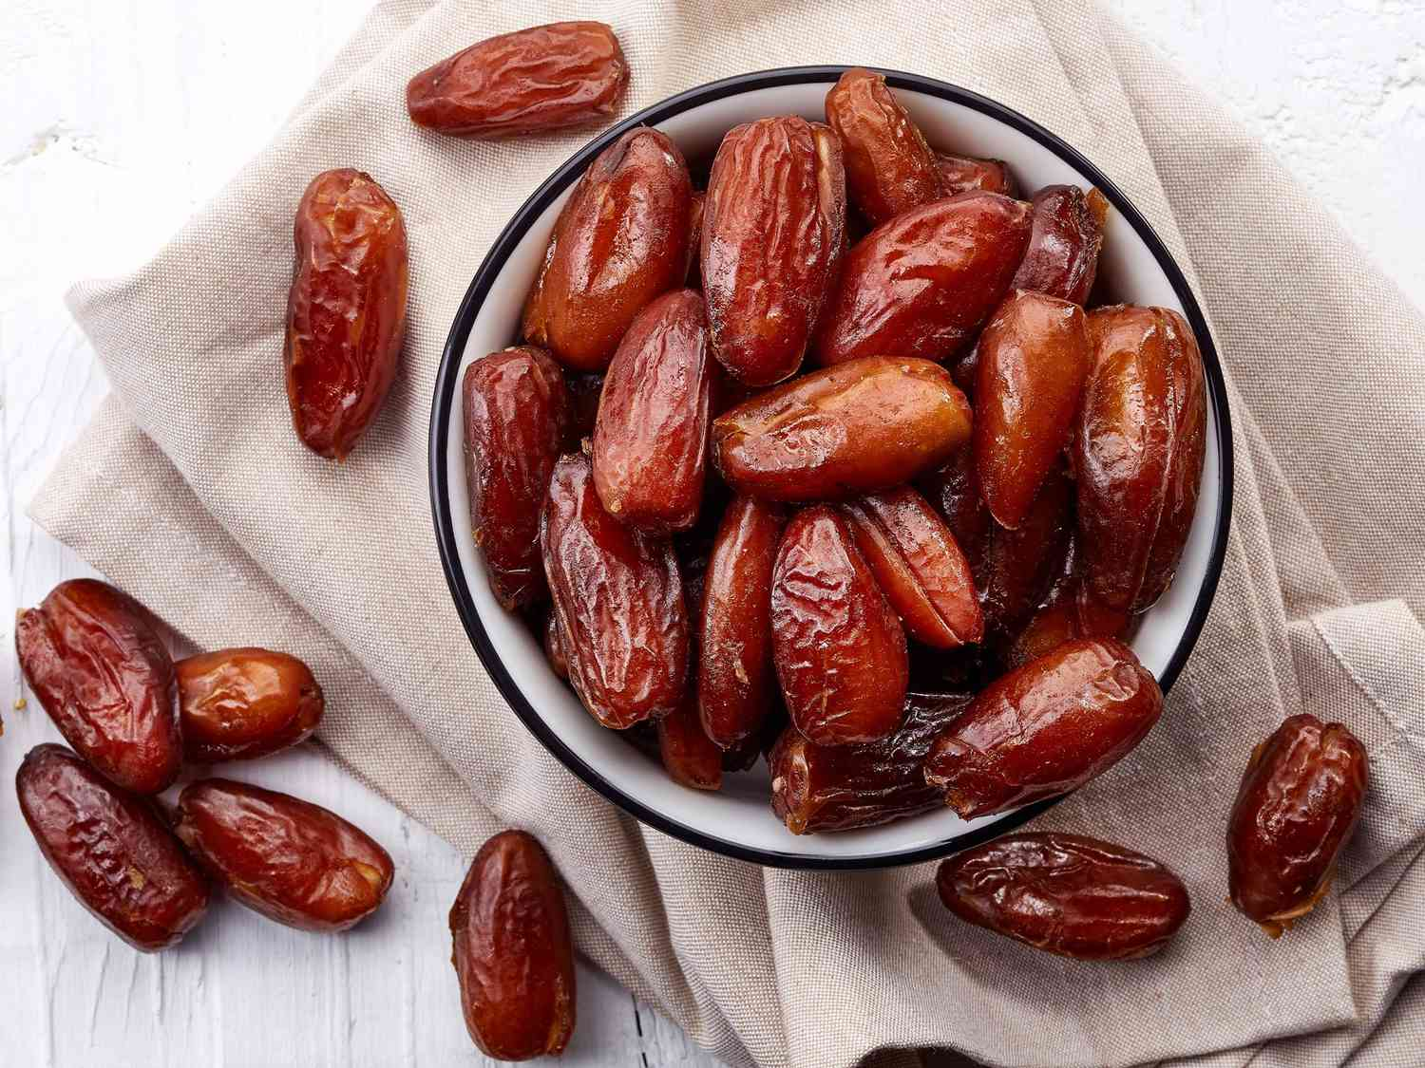
13,500
20
24
Department of Chemical Engineering - An-Najah National University
Tons of dates produced annually
Mahmoud Sallam – Graduation Project II
20
24

Slide 5


Current situation & problems
Challenges
Current situation
60 % of Annual production is consumed and 40% is exported
01
02
03
04
Pollen
Water
Fertilizers
Transportation
Consistent shortage of pollen
Lack of water resources
Difficulties in acquiring fertilizers and pesticides
High transportation costs
Problems

Slide 6


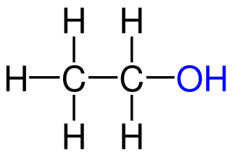
Solution
20
24
Solution
Converting the low-grade dates into second generation bioethanol
Second Generation Bioethanol
Renewable and sustainable liquid biofuel that serves as an alternative to fossil fuels.
Produced through fermentation, using non-edible biomass
Mahmoud Sallam – Graduation Project II
20
24

Slide 7

Objectives
The main objectives in this project:
Produce bioethanol from sugar and dates
Conduct a qualitative analysis on the first goal

Slide 8
02
Methodolgy
20
24
Department of Chemical Engineering - An-Najah National University
Mahmoud Sallam – Graduation Project II
20
24

Slide 9
Project Phases
Density - Concentration
Ethanol From Dates
01
02
03
Ethanol from Sugars

Slide 10

Phase 1—Objective
20
24
Phase 1 — Calibration Curve
Establishing a relation between the density and the concentration of alcoholic solutions
Phase 1—Method
Diluting 6 samples at different concentrations, then measuring their density in order to obtain a calibration curve
Mahmoud Sallam – Graduation Project II
20
24

Slide 11

Phase 2—Objective
20
24
Phase 2 — Sugar Concentration Optimization
Optimize the sugar concentration and yeast amount for ethanol production
Phase 2—Method
Fermentation for 6 samples of different sugar concentrations, then 3 samples of opt. con. With 3 different yeast amounts
(Distillation for all samples)
Mahmoud Sallam – Graduation Project II
20
24

Slide 12

Fermentation Conditions
20
24
Phase 2 — Sugar Concentration Optimization
Temperature
Duration
Volume
25 – 30 °C
7 Days
200 ml
Mahmoud Sallam – Graduation Project II
20
24

Slide 13
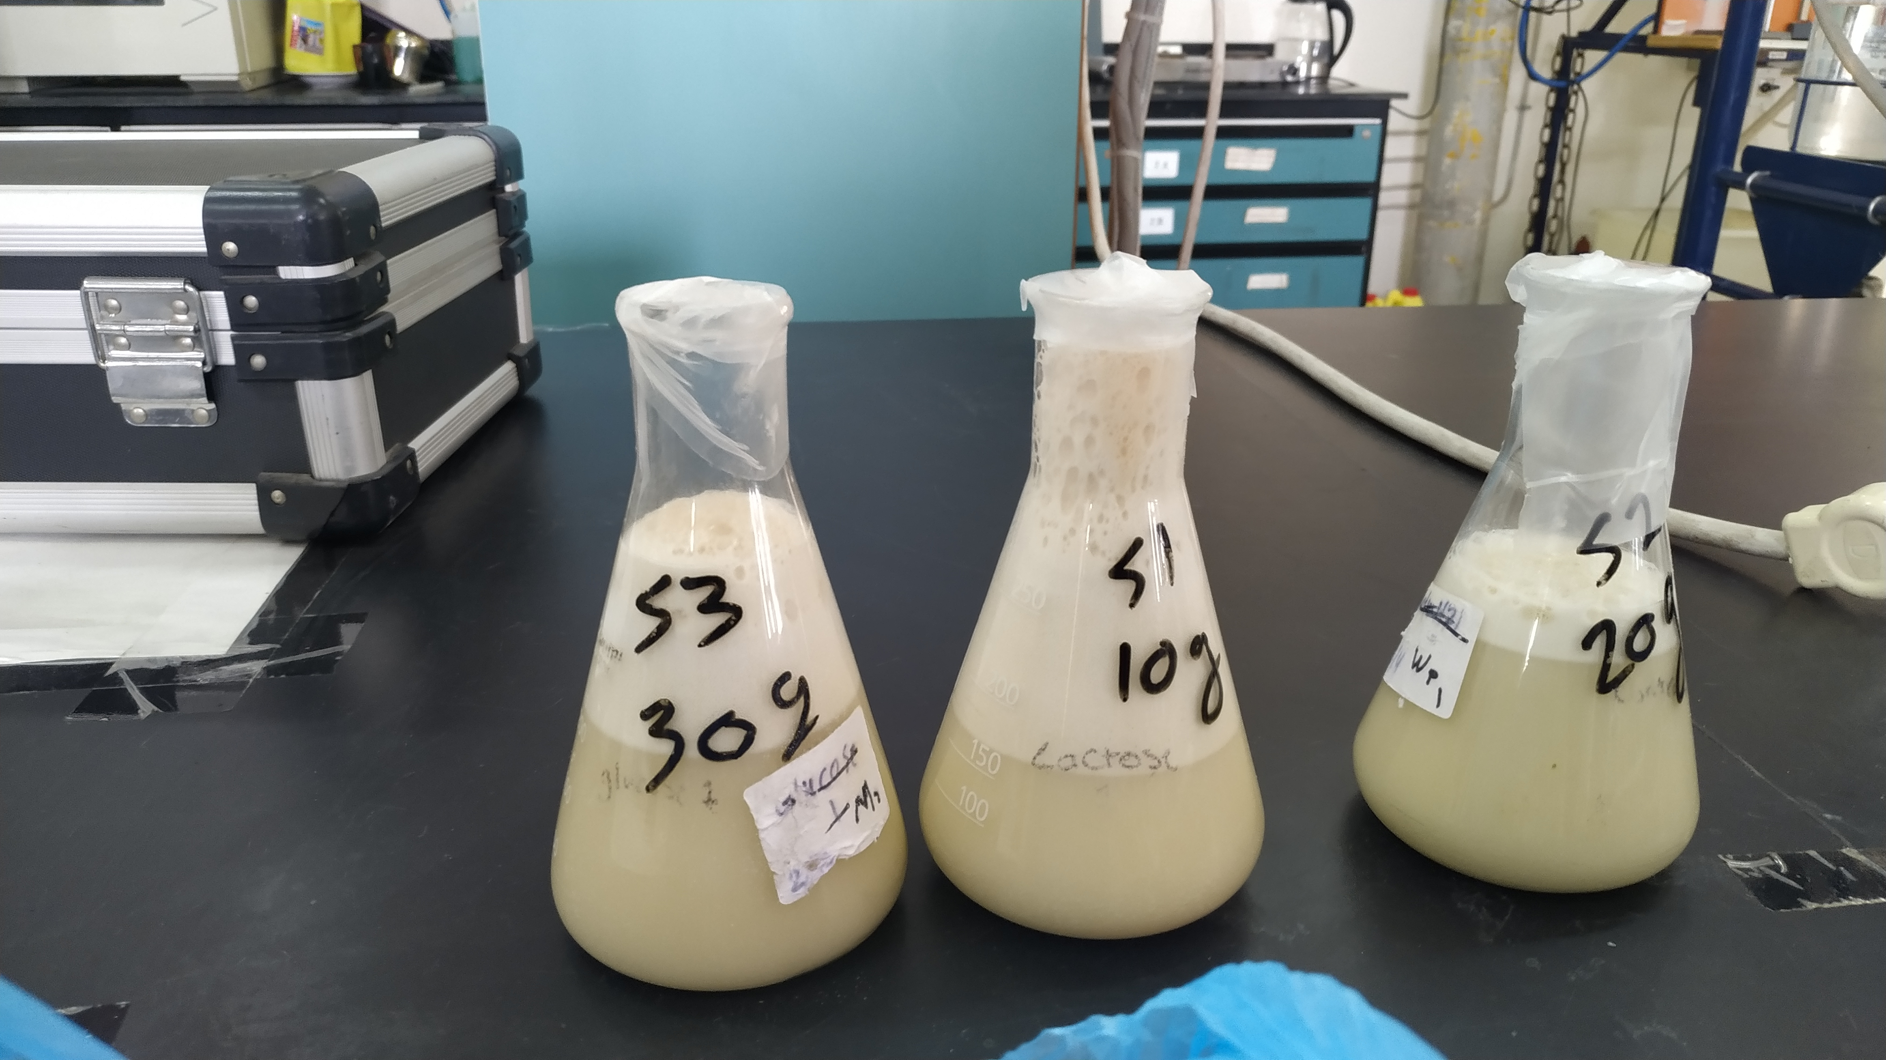
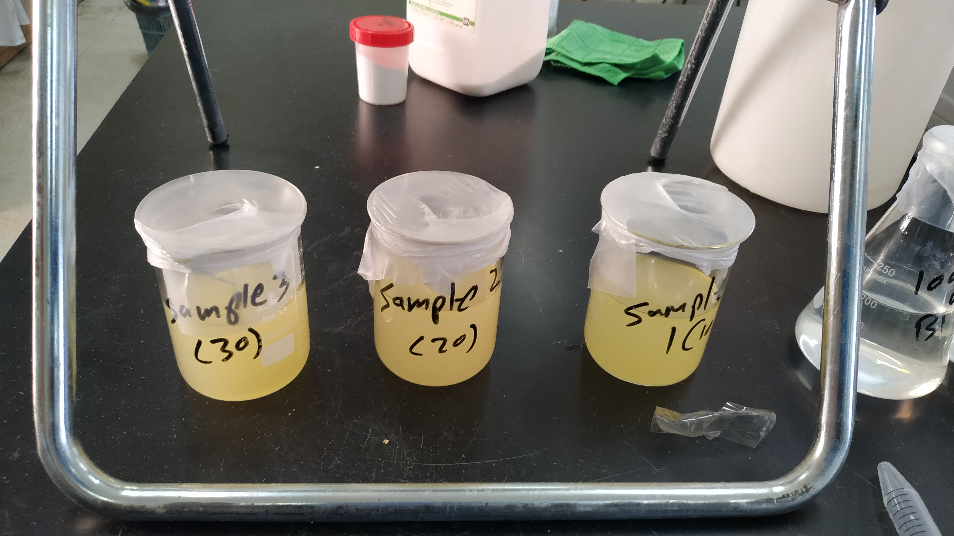
Before Fermentation
20
24
Phase 2 — Sugar Concentration Optimization
Mahmoud Sallam – Graduation Project II
20
24

Slide 14
After Fermentation and Filtration
20
24
Phase 2 — Sugar Concentration Optimization
Mahmoud Sallam – Graduation Project II
20
24

Slide 15
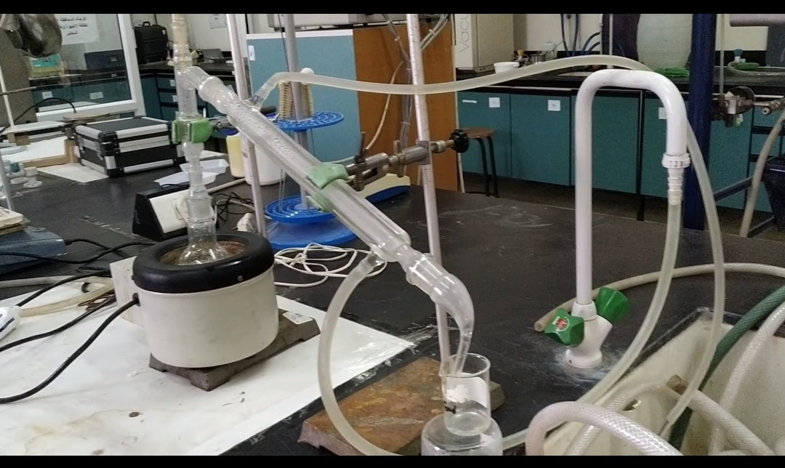
During the Distillation
20
24
Phase 2 — Sugar Concentration Optimization
Mahmoud Sallam – Graduation Project II
20
24

Slide 16
Phase 3—Objective
20
24
Phase 3 — Ethanol from Dates
Producing Ethanol from dates samples
Phase 3—Methods
Thermal Sugar Extraction
Anaerobic Fermentation
Simple Distillation
Mahmoud Sallam – Graduation Project II
20
24

Slide 17

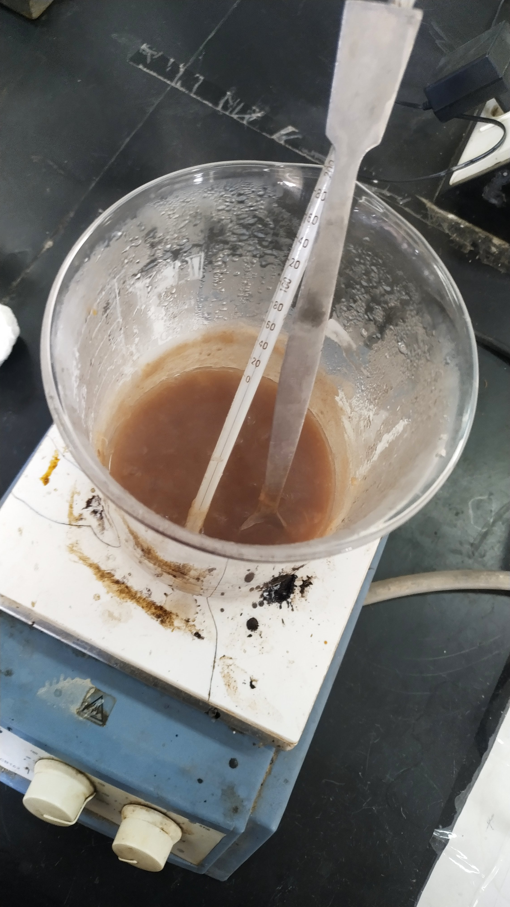


Thermal Sugar Extraction
20
24
Phase 3 — Ethanol from Dates
100 grams
75 – 80 °C
300 ml
20 min
Mahmoud Sallam – Graduation Project II
20
24

Slide 18
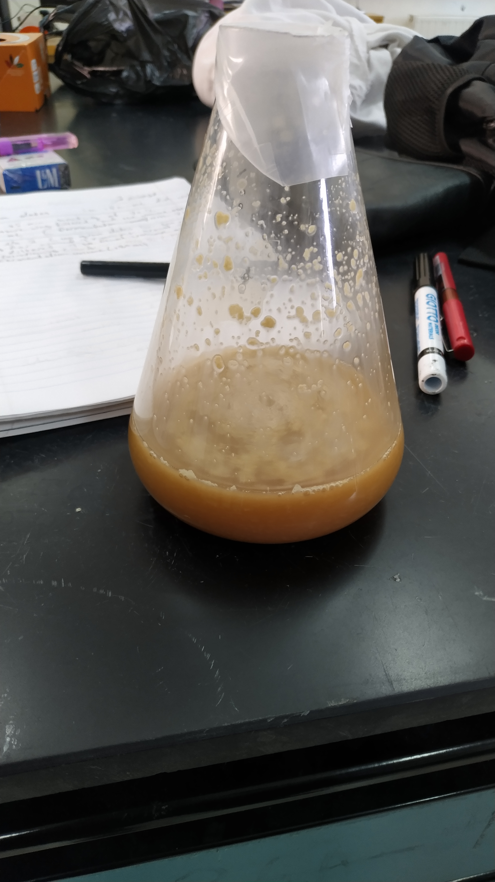
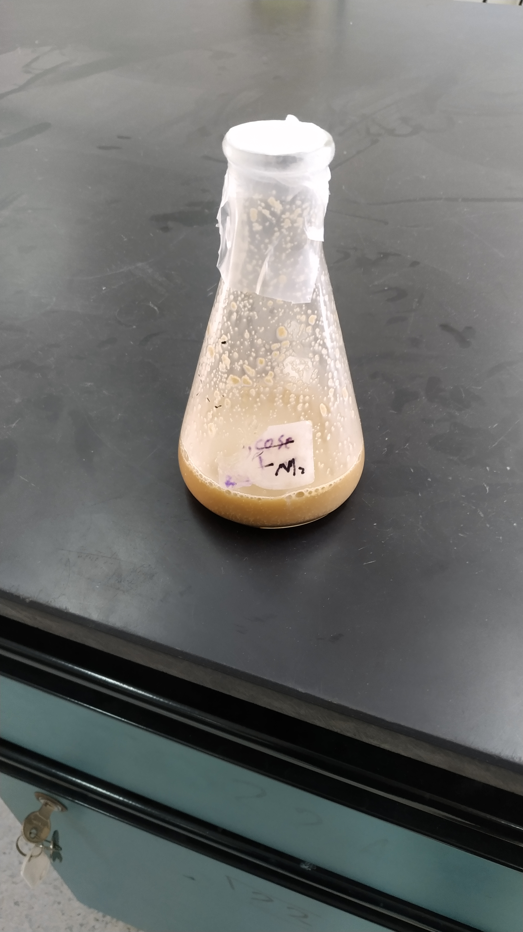
Anaerobic Fermentation
20
24
Phase 3 — Ethanol from Dates
Same conditions for sugar
Mahmoud Sallam – Graduation Project II
20
24

Slide 19
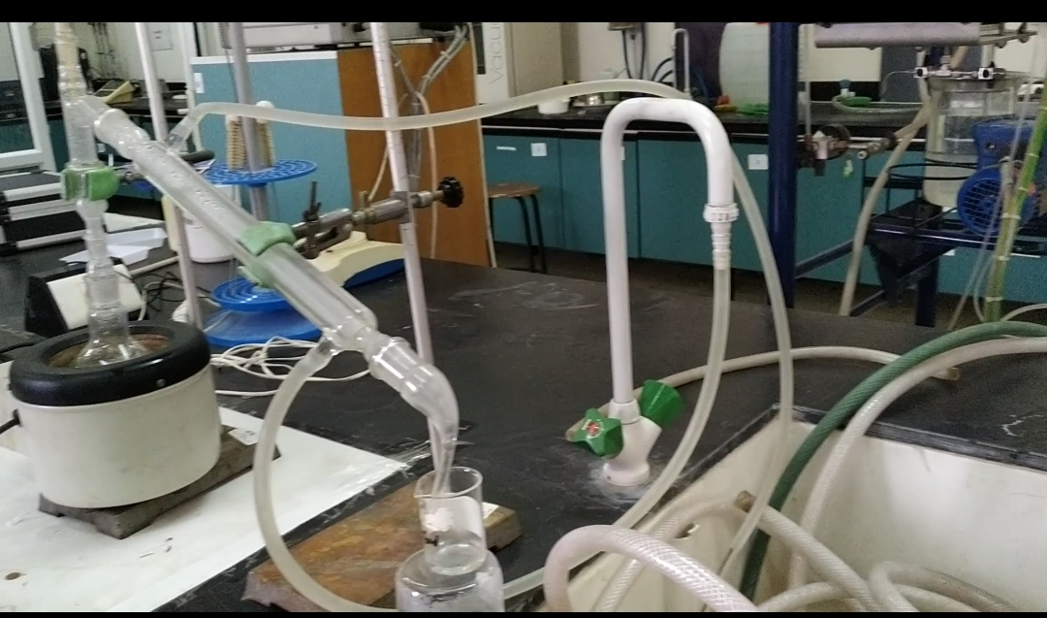
Simple Distillation
20
24
Phase 3 — Ethanol from Dates
Mahmoud Sallam – Graduation Project II
20
24

Slide 20
03
Results
20
24
Department of Chemical Engineering - An-Najah National University
Mahmoud Sallam – Graduation Project II
20
24

Slide 21
20
24
Phase 1 — Calibration Curve
$$EOH \%=−13.278ρ^{2}+19.103ρ−5.819$$
Mahmoud Sallam – Graduation Project II
20
24

Slide 22
Phase 2 – Ethanol from Sugar
20
24
Phase 2 — Ethanol from D-Glucose
Determining the optimum concentration for ethanol yield
Sugar Concentration (g/l) | Max Ethanol Concentration % (by volume) | EOH Yield | EOH Vol
50 | 30.36% | 2.04% | 4.08
100 | 49.12% | 6.53% | 11.43
125 | 45.24% | 5.64% | 10.71
150 | 54.60% | 5.72% | 10.00
160 | 48.63% | 7.71% | 15.80
175 | 53.41% | 7.59% | 15.93
Mahmoud Sallam – Graduation Project II
20
24

Slide 23
Phase 3—Ethanol from Dates
20
24
Phase 3 — Ethanol from Dates
50 grams dates yields 7.96% (by Volume) ethanol
Density (g/cm³) | Sample Volume (ml) | Alcohol Percent % (by volume) | Alcohol Volume (ml)
0.9480 | 10 | 35.81% | 3.58
0.9738 | 7 | 19.26% | 1.35
0.9885 | 6 | 9.04% | 0.54
0.9982 | 5 | 1.98% | 0.10
Mahmoud Sallam – Graduation Project II
20
24

Slide 24
Phase 3—Ethanol from Dates
20
24
Phase 3 — Ethanol from Dates
100 grams dates yields 9.49% (by Volume) ethanol
Density (g/cm³) | Sample Volume (ml) | Alcohol Percent % (by volume) | Alcohol Volume (ml)
0.9056 | 6 | 59.16% | 3.55
0.9157 | 6 | 54.03% | 3.24
0.9295 | 7 | 46.58% | 3.26
0.9459 | 6 | 37.07% | 2.22
0.9553 | 5 | 31.30% | 1.57
0.9691 | 6 | 22.40% | 1.34
0.9758 | 6 | 17.90% | 1.07
0.9826 | 5 | 13.21% | 0.66
0.9885 | 6 | 9.04% | 0.54
0.9907 | 6 | 7.46% | 0.45
0.9968 | 6 | 3.01% | 0.18
Mahmoud Sallam – Graduation Project II
20
24

Slide 25
Addiotional Step – Second Distillation
20
24
Phase 3b — Ethanol from Dates
A volume of 78 ml (34.95% EOH) produced 26.75 ml of (60% EOH)
Density (g/cm³) | Sample Volume (ml) | Alcohol Percent %
0.8631 | 8 | 77.79%
0.8729 | 6 | 73.92%
0.8846 | 6 | 68.97%
0.8858 | 10 | 68.44%
0.9172 | 6 | 53.25%
0.9739 | 10 | 19.19%
Mahmoud Sallam – Graduation Project II
20
24

Slide 26
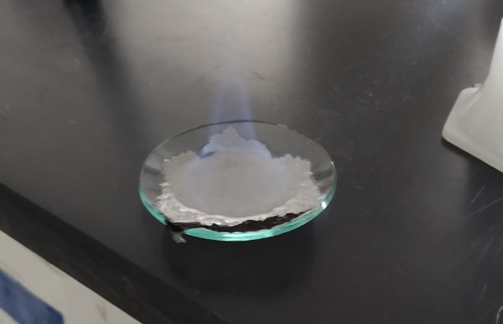
Ethanol Properties
20
24
Phase 3 — Ethanol from Dates
Flammable with blue Flame
Slidesgo
20
24

Slide 27
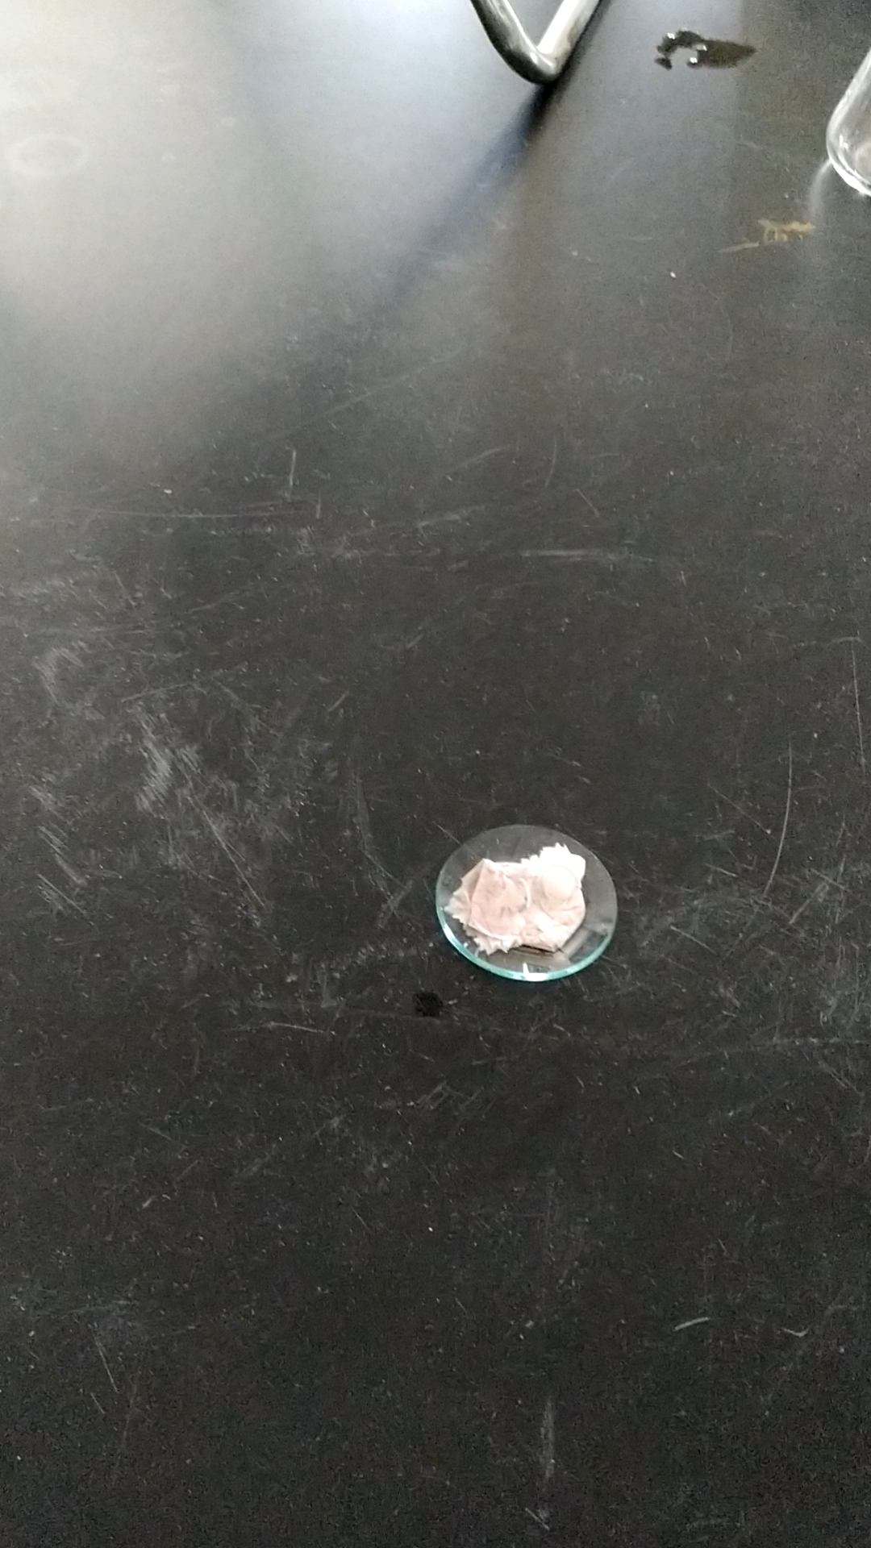
20
24
Video from Lab
Mahmoud Sallam – Graduation Project II
20
24

Slide 28
04
Conclusions
20
24
Department of Chemical Engineering - An-Najah National University
You can enter a subtitle here if you need it
Mahmoud Sallam – Graduation Project II
20
24

Slide 29
Conclusions
Potential
Correlation
Good Yeast
Optimization
We can produce bioethanol from dates with high yield
Successfully obtained a relationship between density and concentration
The bakery yeast could be used for the fermentation
Optimization of sugar concentration is very important

Slide 30
05
Recommendations
20
24
Department of Chemical Engineering - An-Najah National University
Mahmoud Sallam – Graduation Project II
20
24

Slide 31
Recommendations
Conducting a quantitative analysis with a comprehensive design of
experiments approach
Recommendation 1
Investigation on the feasibility of producing ethanol from waste of soft drinks
Recommendation 2

Slide 32
Thanks!
20
22
Formal Research Paper Slideshow
Do you have any questions?
Mahmoudsallam331@gmail.com
Please keep this slide for attribution
Mahmoud Sallam – Graduation Project II
20
22

