Slide 1

Plastic Bags: Environmental Impacts and Possible Alternatives
Case Study in Nablus, Palestine
Najah National University
Civil Engineering department
Graduation project ІІ
Prepared by: Supervised by:
Dana Namroty Dr. Abdelhaleem Khader

Slide 2

INTRODUCTION
Graduation Project І
Modifications
Analysis and Results
Conclusion and Recommendations
Quantitative Data
Qualitative Data

Slide 3
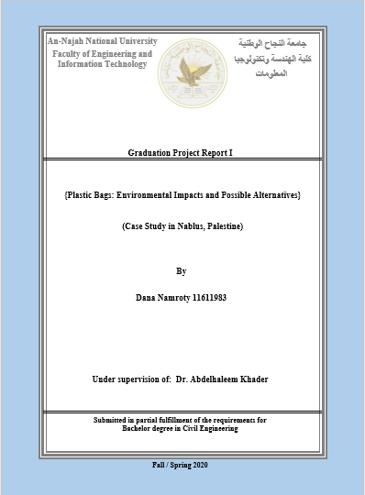
Graduation Project 1
INTRODUCTION
Literature Review
Methodology

Slide 4
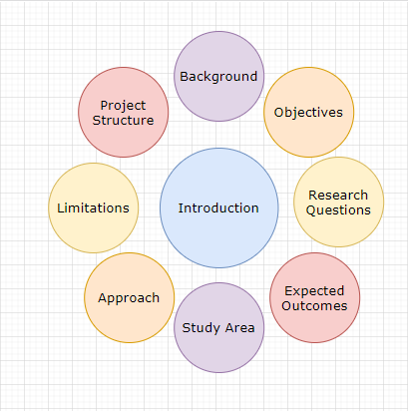
INTRODUCTION
Background
Expected Outcomes
Significant of the work
Study Area
Objectives
Approach
Limitations

Slide 5
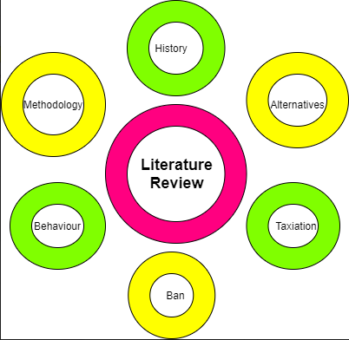
Literature Review
History
Ban Decision
Alternatives
Human Behaviors
Taxation
Methodology

Slide 6
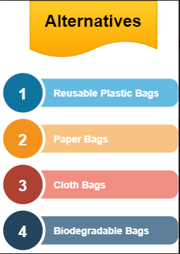
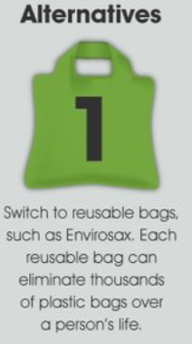
Alternatives
Reusable Plastic Bags
Paper Bags
Cloth Bags
Biodegradable Bags

Slide 7
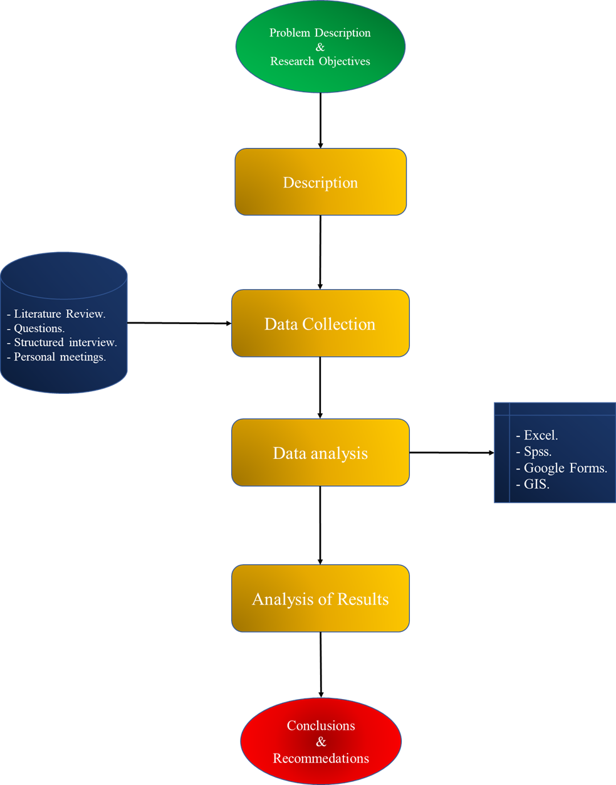
Methodology

Slide 8


Graduation Project 2
Fulfillment of the Questionnaires, structured interviews, and personal meetings.
Analyzing the data.
Extracting the results and find the best recommendations for the problem.

Slide 9


Modifications
Questionnaire
Structured Interviews
Families’ Study

Slide 10

Research limitations
In the progress of the project, COVID-19 pandemic and the quarantine caused a significant delay in the progress of the work and a great change in the work plan.
The lack of public awareness about the plastic bags risks in Palestine.
Some supermarket owners refused to cooperate.
Palestine situation during last time.

Slide 11
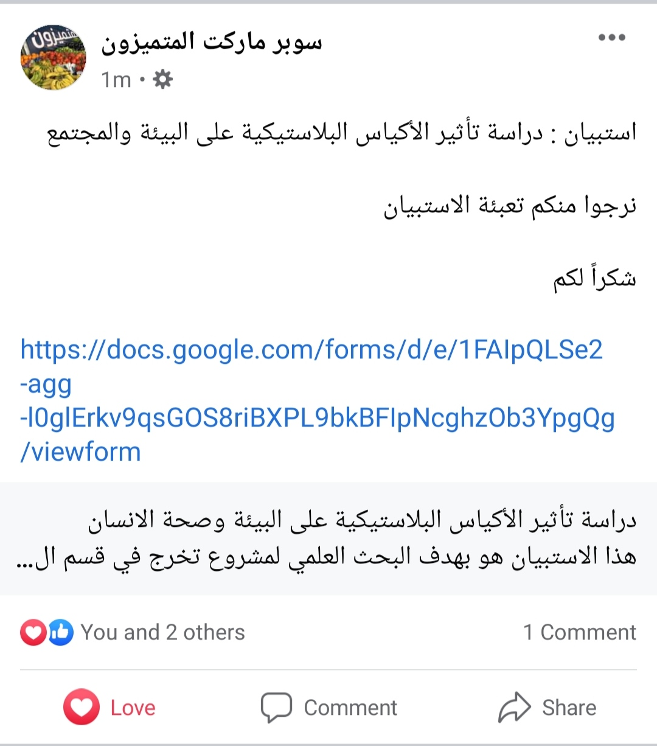
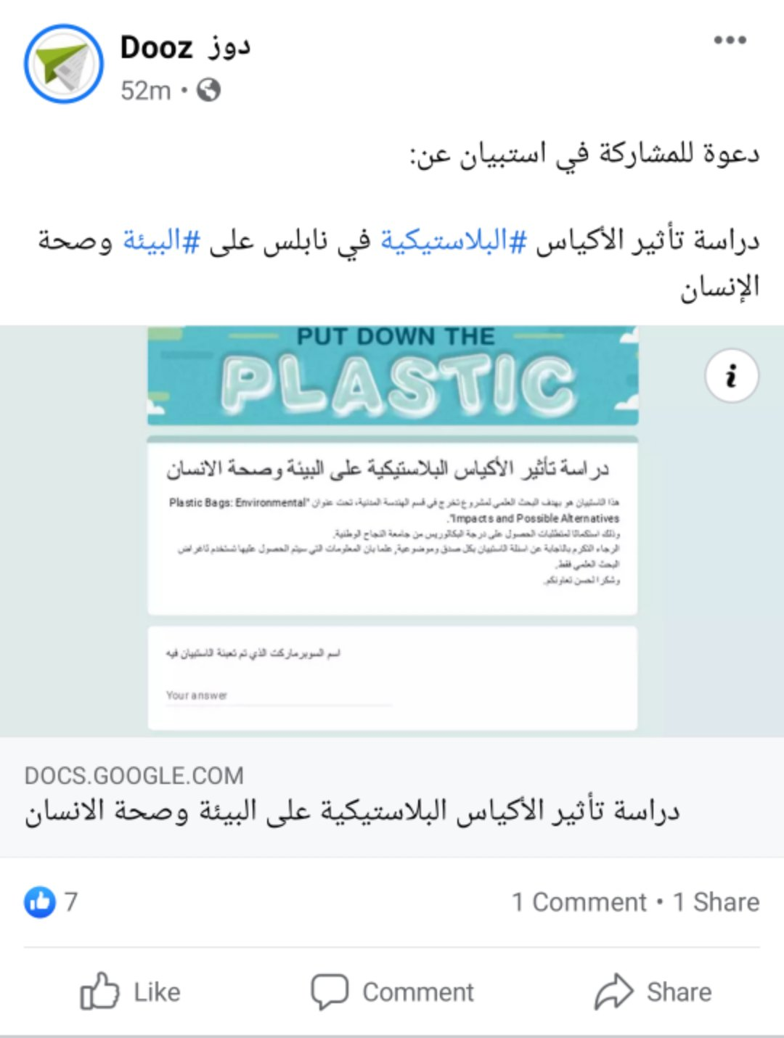
Collecting
Data

Slide 12
Analysis and Results- Quantitative (Questionnaire)

Slide 13
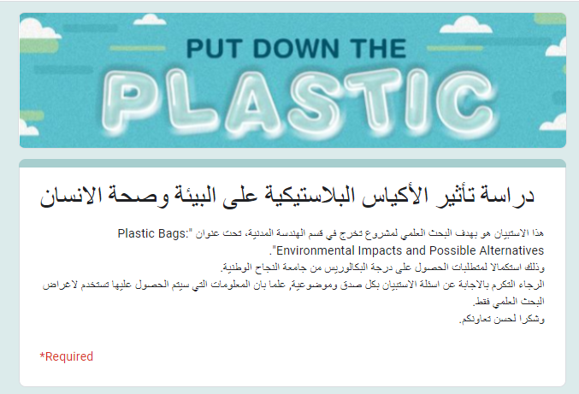
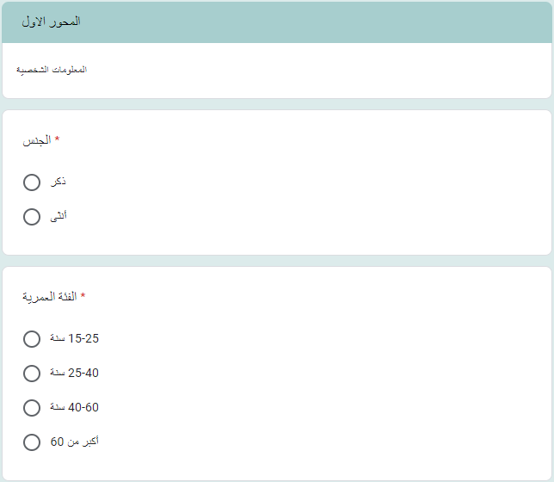
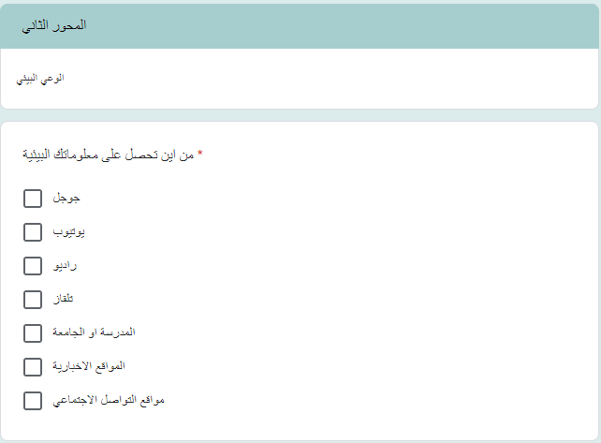
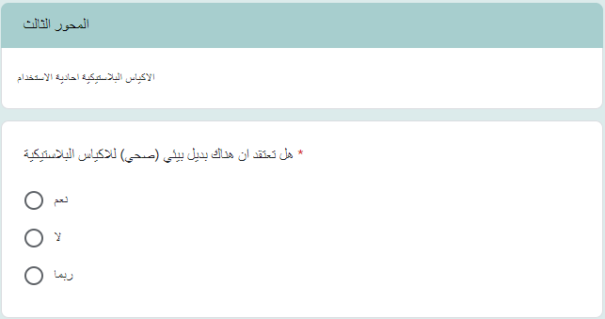
(Questionnaire)

Slide 14
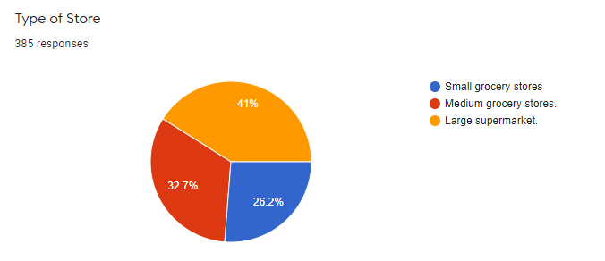
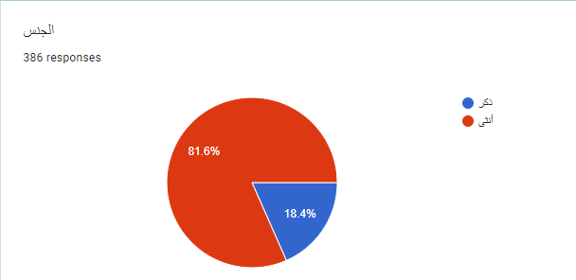
Response Rate
After the distribution of the questionnaire and screening the collected data, the final data set of 385 respondents (N=385), where the respondents' rate was 100%.
Supermarket
Gender

Slide 15
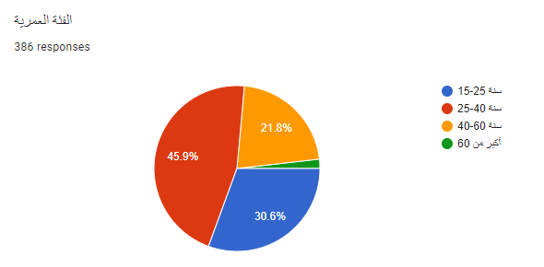
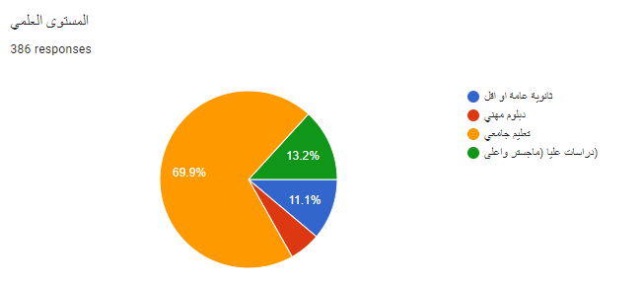
Age
Academic Qualification

Slide 16
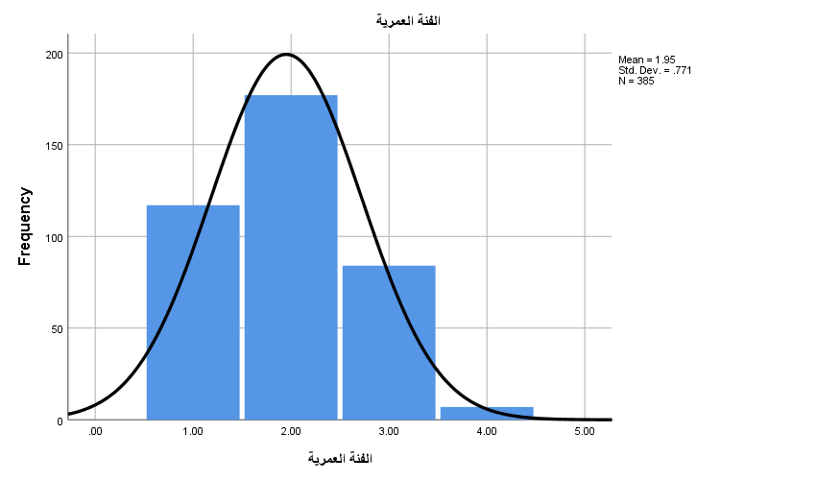
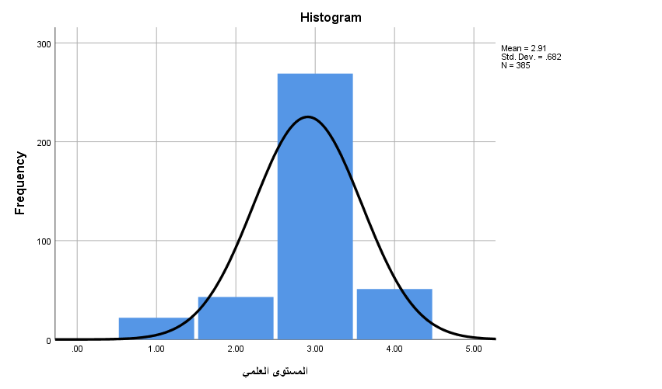
The age here is almost normally distributed.
The academic qualification here is almost normally distributed.

Slide 17
The Questions of the Study
Independent Samples Test
What is the main source of environmental awareness, and the main method that follows up in environmental awareness?
What is the main method of awareness of harmful plastic, and the main method that follows up in reducing plastic?
Are there significant differences in the level of environmental awareness ?
Are there significant differences in the level of awareness of plastic harmful ?
Dependent Samples Test

Slide 18
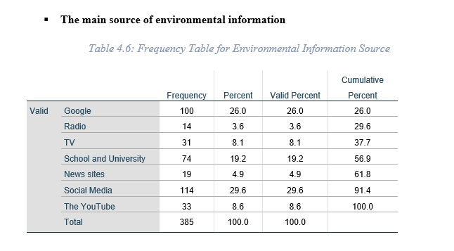
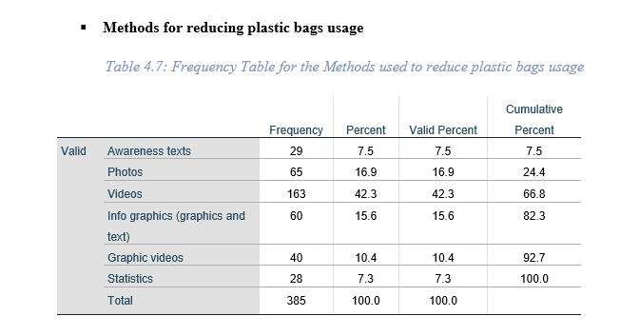
Independent Samples Test
To Answer the first and second questions SPSS were used.

Slide 19
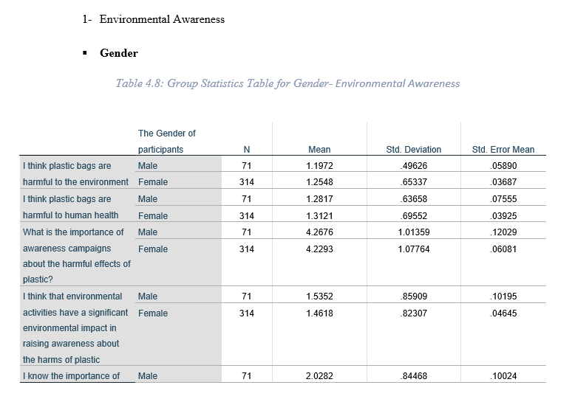
Dependent Samples Test
To Answer the third question related to independent variables; gender, age, academic qualification, the main source of environmental awareness and the main method that follow up in environmental awareness?

Slide 20
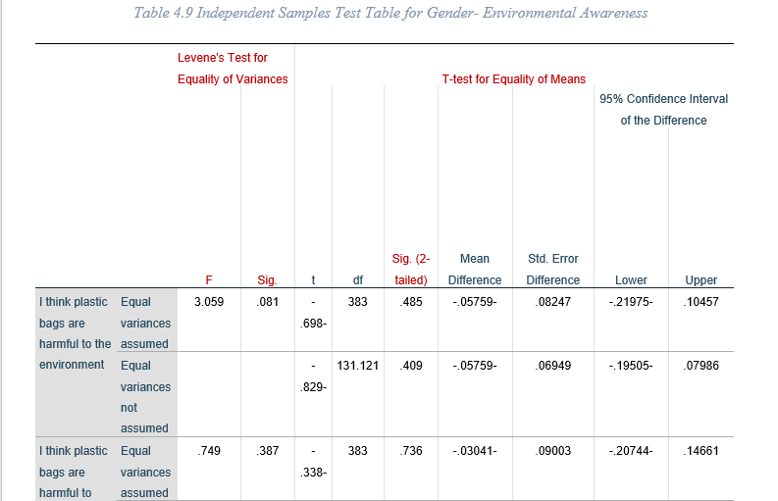
The Gender factor was not normally distributed so Levence Test were conducted.
If Levene’s test is greater than 0.05 this means we can use the T-test for the equal variance estimates to determine if there are any significant differences.

Slide 21
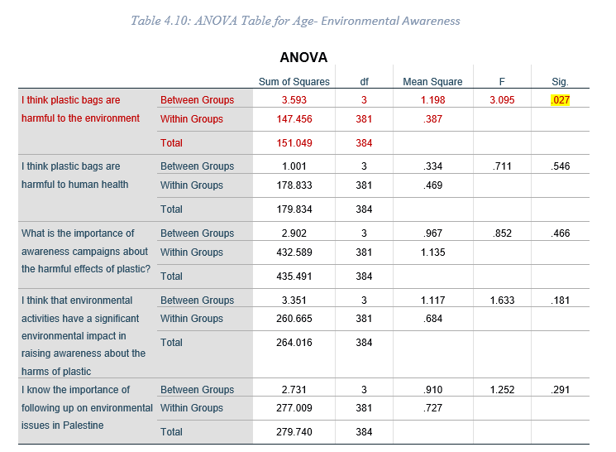
For the ANOVA Test all the values should be above 5% (Normally distributed) to be able to conduct a T test.

Slide 22
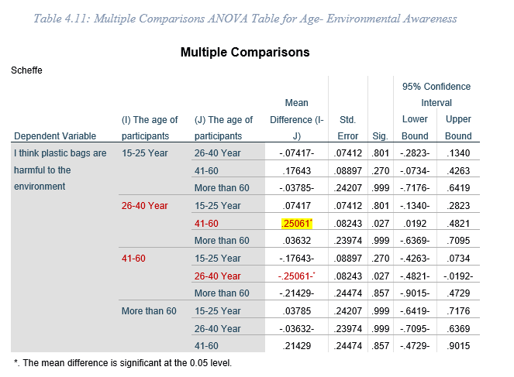
According to the previous table, the differences between the responses from 26-40 years and the responses from 41-60 years favor the first one.

Slide 23
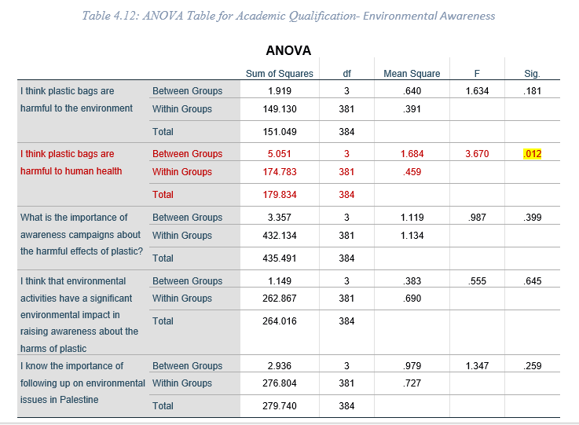
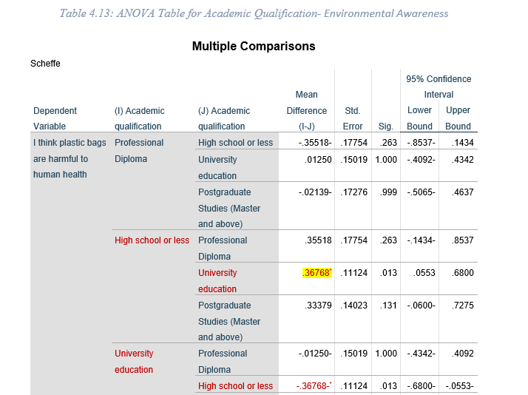

Slide 24
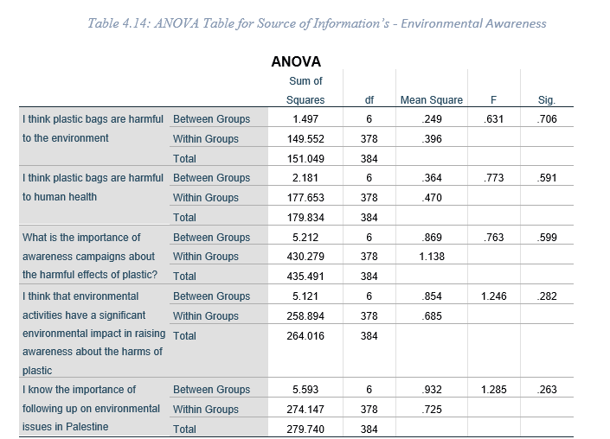
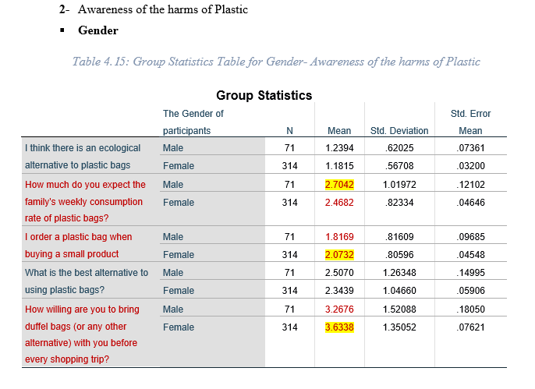

Slide 25
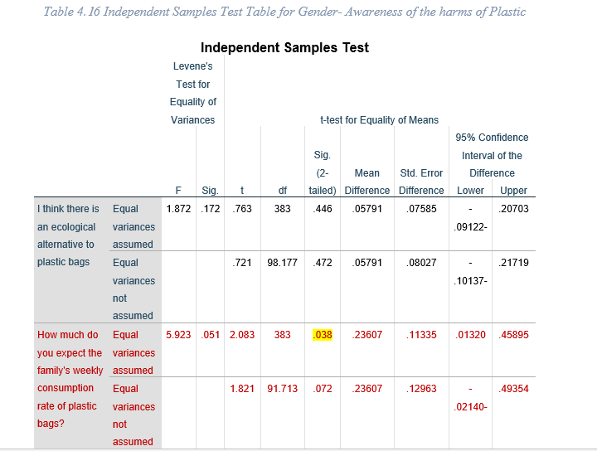
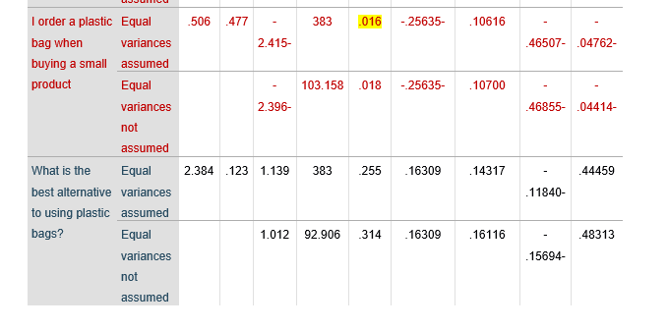
Gender

Slide 26
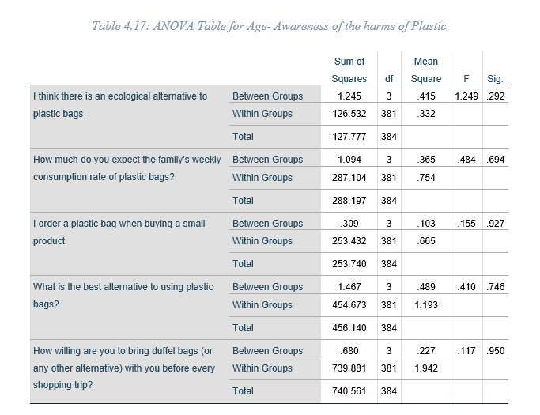
Age

Slide 27
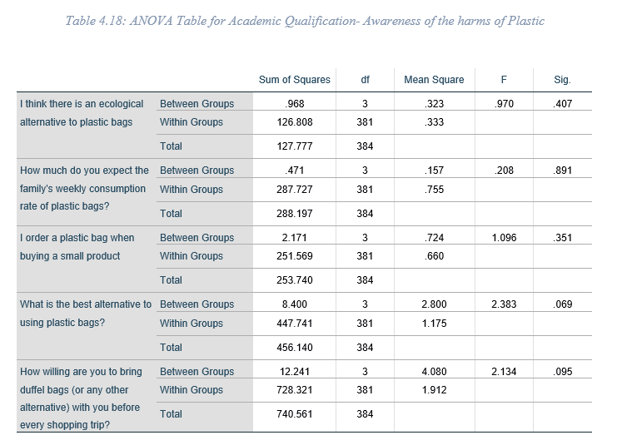
Academic Qualification

Slide 28
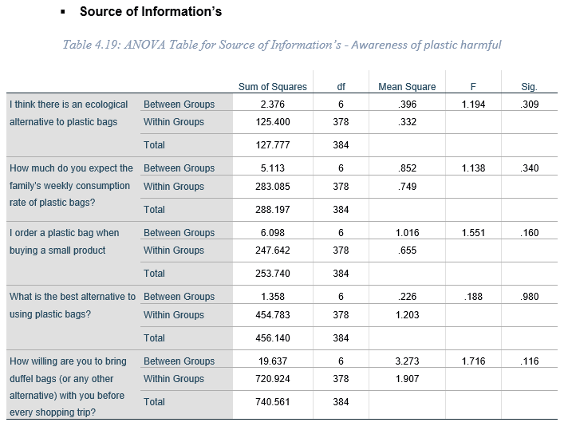
Source of Information’s

Slide 29
Analysis and Results Qualitative

Slide 30
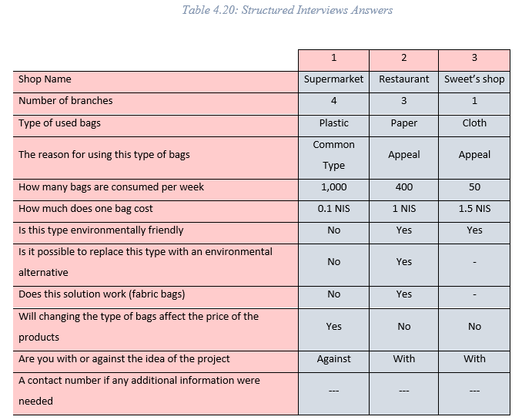
Structured Interviews
Structured interviews were done with three shop owners who use different types of bags to illustrate the differences.

Slide 31
Families’ Study
The family study was performed for two weeks starting from (1 – May – 2021 / 13 – May – 2021) with four families.
The study asked the families to record their daily usage of bags as follows:
One family was supposed to use only the Reusable bags,
Two families were asked to act normally for the first week than to try to use the Reusable bags for the second,
The last family was asked to record its usual use of bags for the two weeks.

Slide 32
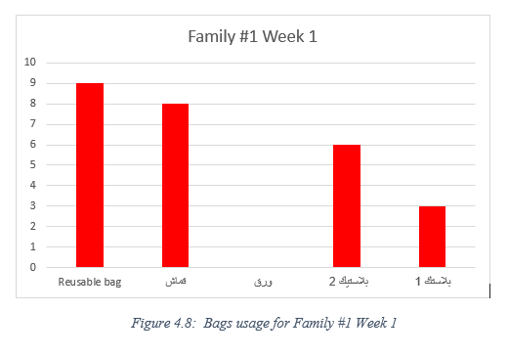
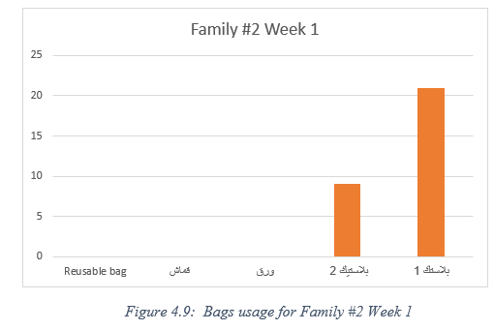
Results of the First Week

Slide 33
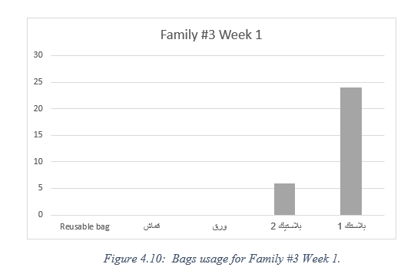
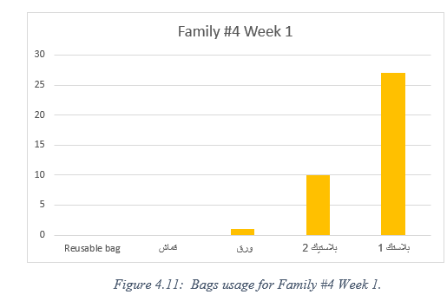
Results of the First Week

Slide 34
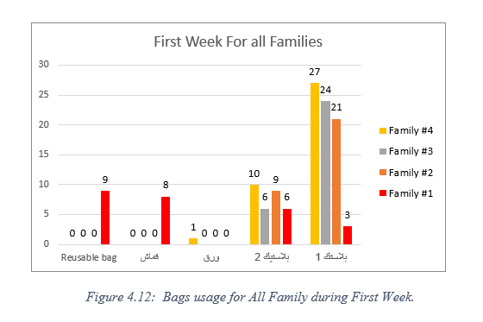
Results of the First Week
There was an enormous difference between the families in the consumption of bags especially the first family.

Slide 35
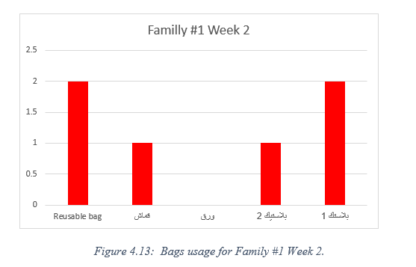
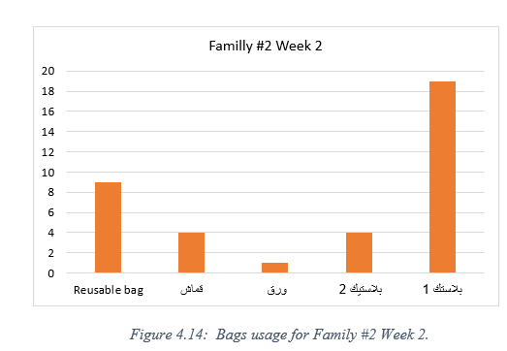
Results of the Second Week

Slide 36
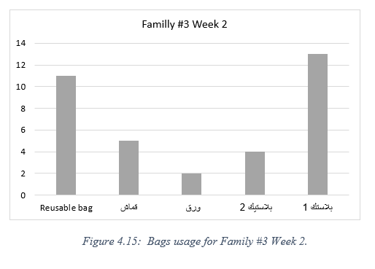
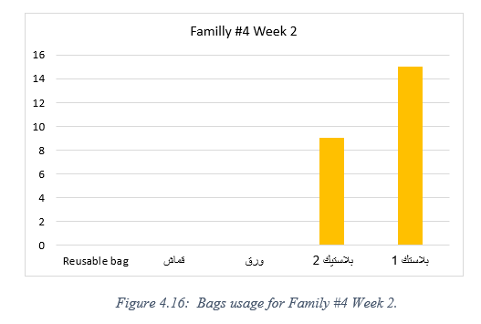
Results of the Second Week

Slide 37
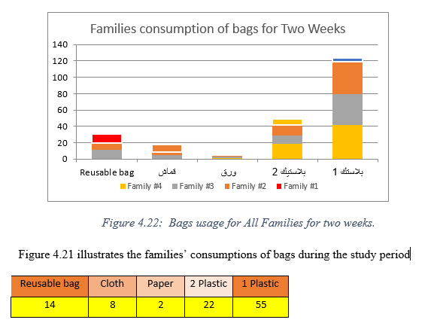
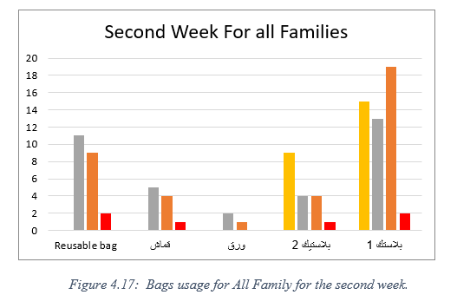
Results of the Second Week

Slide 38
Conclusion and Recommendations

Slide 39
While the use of plastic bags is at its minimum in nearly all countries, countries like Palestine fail to confront this issue with the urgency it deserves.
This research aimed to assess plastic bag pollution in Nablus and assess the alternatives. This study also aimed to study the acceptance of people to change for a more environmentally friendly solution and to study public awareness for this problem.
Some other goals were the potential benefits of a plastic bag ban within Nablus city. If Nablus city bans plastic bags, the sources suggest that it will have a significant impact on the amount of waste and litter that Nablus produces.

Slide 40


END OF PRESENTATION
Thank you all for your support and guidance through the way.

