Slide 1

Design of Rockery Retaining Walls
Prepared by:
Hazar kharoof
Jihad jaradat
Tamara daik
Bissan jamal salah
Supervisor:
Dr. Isam Jardaneh

Slide 2
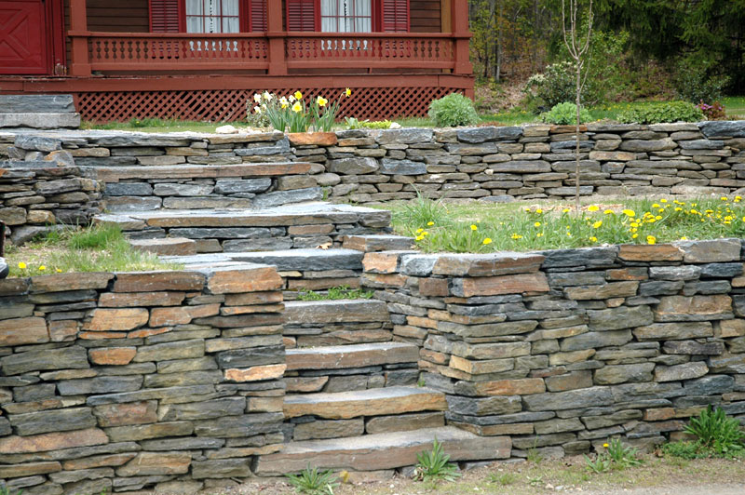
As we know :
A rockery retaining wall is a retaining or protection structure that consists of stacked rocks without mortar, concrete, or steel reinforcement.

Slide 3
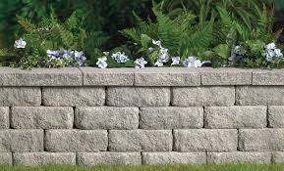
So we can say that we use of rows of big rocks to build walls is one the earliest construction methods used by man.
The design method was based on experience and trial and error. No specific construction or design procedures were available at that time

Slide 4
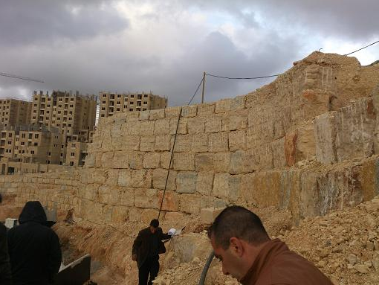
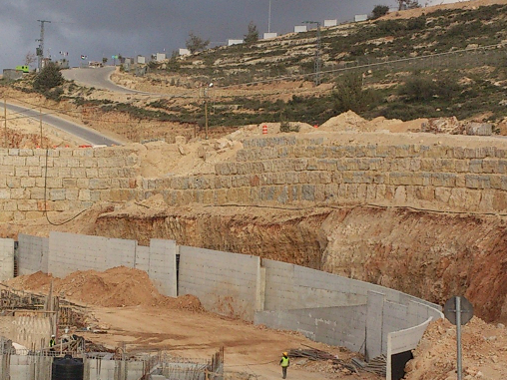
Local Rockeries :
One of the famous use of rockery as retaining wall is in the City of Rawabi. The following pictures show examples of the walls in Rawabi City.
It is usually called big boulder retaining walls. This type of wall is new trend of walls. It is mainly use as excavation support system rather than retaining wall.

Slide 5
We Talked about the main methods of design of rockery walls, such as:
Gray & Sotir,
Herndon,
Hemphill,
SAGE.
In general, all four methods are based on the assumption that the retained soil exerts a lateral earth pressure on the back of the rockery and that the rockery must resist this pressure though rock interaction, rockery weight, and rockery size. In that respect, the methods are almost similar and, as a result, the computed base widths are similar.

Slide 6
ROCKERY CONSTRUCTION GUIDELINES:
The guidelines considered here are including but not limited to the following:
stability analysis
The soil behind the stone boulder retaining wall (crushed rock zone and backfill soil)
And drainage requirements for subsurface and surface drainage.

Slide 7
Important note :
Six most commons causes of stone boulder walls failure were observed as follows :
1.Little or no drainage was provided
2.The backfill was of poor quality or poorly placed and compacted
3.Rockery face was constructed too steep or too high
4.The rockery was constructed over a poor foundation
5.The rockery was constructed of unsound rock
6.The overall workmanship of the constructed product was poor

Slide 8
RECOMMENDED DESIGN METHOD
STATIC DESIGN
Design of any retaining structure involves the determination of two categories of forces: driving forces and resisting forces.
Design parameters:
ɸ: friction angle
Δ: interface friction angle.
Ψ: allowable back cut angle.
γs: Soil unit weight (between 17.2-20.4 KN/m³).
γr: rock unit weight (assumed 23.5KN/m³ ).
Q: allowable bearing pressure .
Qs: surcharge load .

Slide 9
Lateral earth pressure:
The earth pressure is typically computed by multiplying the lateral earth pressure coefficient for active soil conditions) K_{A}) by the unit weight of the soil (γs), are two potential sources of lateral earth pressure acting on the back of the rockery- that exerted by retained soil, and that exerted by the crushed rock back drain. Generally the pressure exerted by the crushed rock back drain is less than that exerted by the retained soil, for three reason:
The friction angle of the crushed rock (ɸ _{CR}) is generally much higher than the soil This will result in smaller value of) Ka).
The crushed rock has a lower unit weight than the retained soil due to the increased void space
The crushed rock layer is generally relatively narrow, on the order of 300 mm (12in) thick. As a result, the active failure wedge typically extends through the crushed rock and in to the retained soil behind the crushed rock

Slide 10

The coulomb method, which accounts for frictional interaction between the retained soil and the retaining structure, is the recommended method for determination of KA. Here the equation:

Slide 11
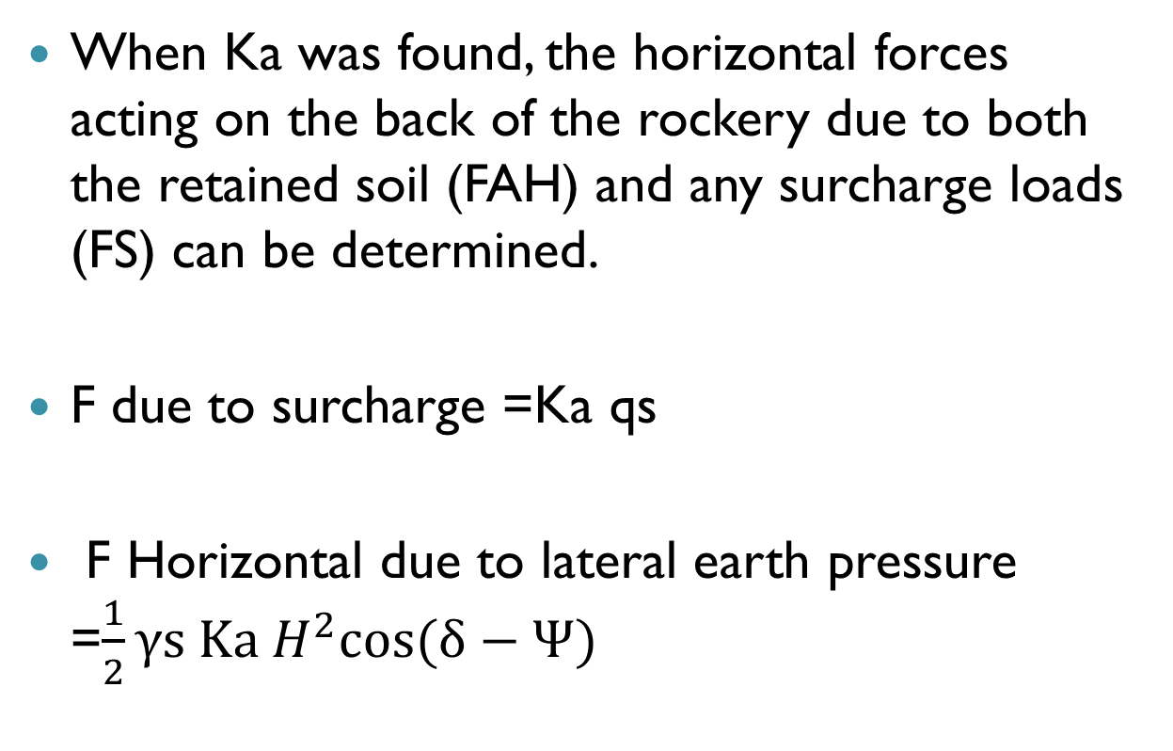
Sliding
When Ka was found, the horizontal forces acting on the back of the rockery due to both the retained soil (FAH) and any surcharge loads (FS) can be determined.
F due to surcharge =Ka qs
F Horizontal due to lateral earth pressure =$\frac{1}{2}γs Ka H^{2}cos⁡(δ−Ψ)$

Slide 12
Sliding resistance:
Rockeries generally resist sliding primarily through friction along the bottom of the base rock, which is a function of the normal force acting on the base of the rockery and the coefficient of sliding between the base rock and foundation soil. The normal force consists of the vertical component of the Coulomb active earth pressure (F_{A,V}) acting downward) and the weight of the rockery.
The weight of the rockery can be estimated by assuming certain minimum dimensions for the rockery

Slide 13
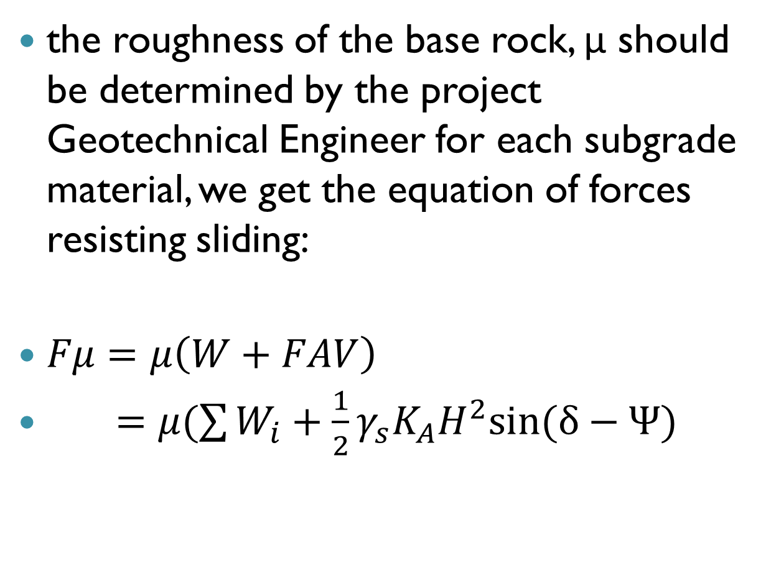
the roughness of the base rock, μ should be determined by the project Geotechnical Engineer for each subgrade material, we get the equation of forces resisting sliding:
$Fμ=μ\left(W+FAV\right)$
$=μ(\sum{W_{i}+\frac{1}{2}γ_{s}K_{A}H^{2}sin⁡(δ−Ψ)}$

Slide 14

Factor off safety for sliding:
FSsl = $\frac{F_{μ}}{F_{H}}$
A minimum factor of safety of 1.5 should be used to check against sliding

Slide 15
Overturning
the forces acting horizontally behind the rockery will also tend to cause it to tip forward about its toe. These forces include the horizontal component of the lateral earth pressure (FA,H) and the additional horizontal pressure to a vertical surface surcharge (FS). The overturning moments caused by these forces are counter balanced by resisting moments due to the weight of the rockery (W), the vertical component of the lateral earth pressure (FA,V), The overturning and resisting moments are computed by summing moments about the toe of the rockery.

Slide 16
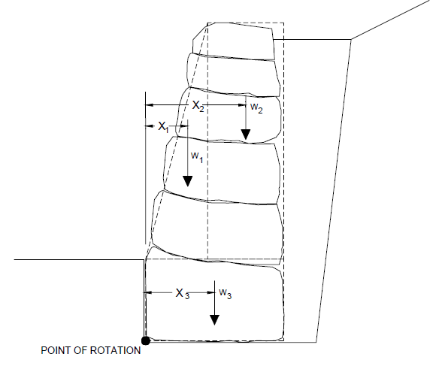

Slide 17
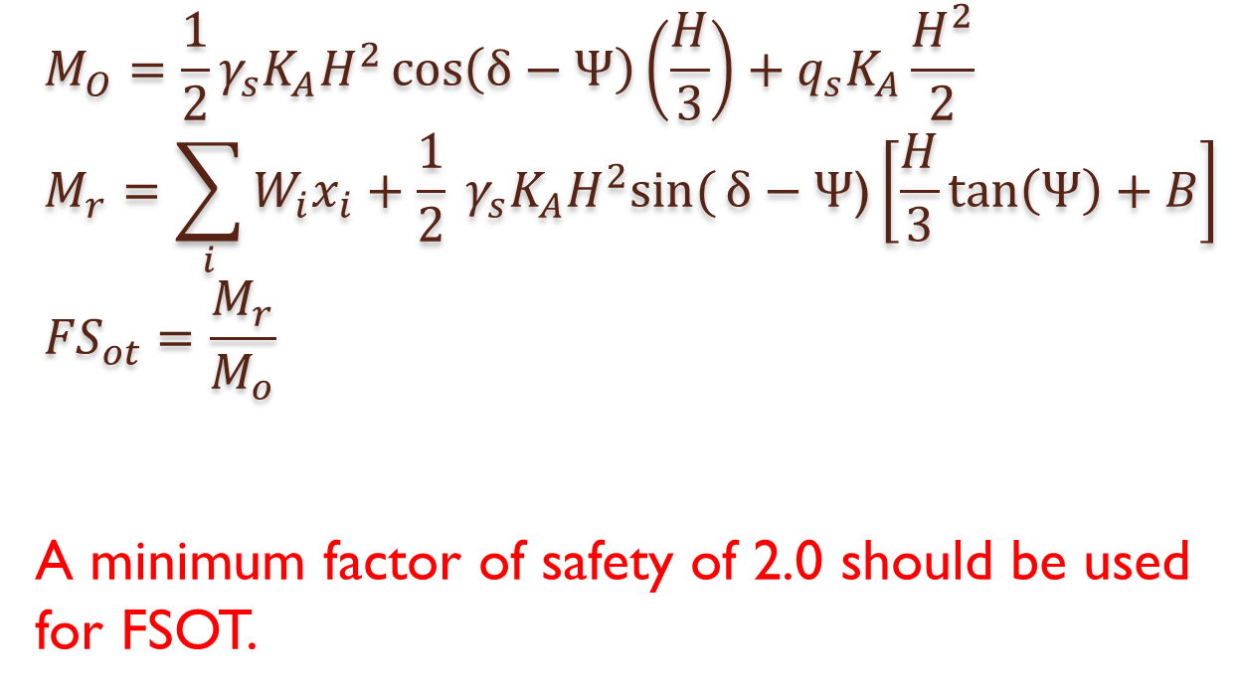
$$M_{O}=\frac{1}{2}γ_{s}K_{A}H^{2}\cos\left(δ−Ψ\right)\left(\frac{H}{3}\right)+q_{s}K_{A}\frac{H^{2}}{2} \\ M_{r}=\sum_{i}{W_{i}x_{i}+\frac{1}{2} γ_{s}K_{A}H^{2}sin⁡(}δ−Ψ\text{)}\left[\frac{H}{3}\tan\left(Ψ\right)+B\right] \\ {FS}_{ot}=\frac{M_{r}}{M_{o}}$$
A minimum factor of safety of 2.0 should be used for FSOT.

Slide 18
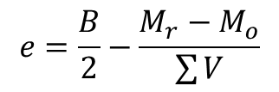
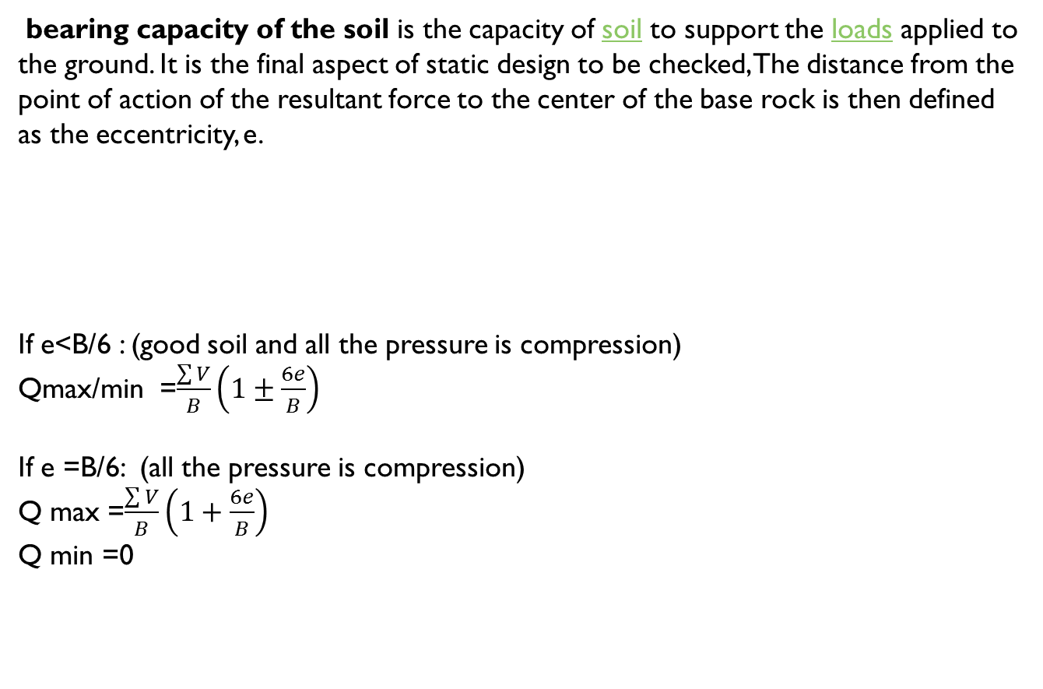
Bearing Capacity
bearing capacity of the soil is the capacity of soil to support the loads applied to the ground. It is the final aspect of static design to be checked, The distance from the point of action of the resultant force to the center of the base rock is then defined as the eccentricity, e.
If e<B/6 : (good soil and all the pressure is compression)
Qmax/min =$\frac{\sum{V}}{B}\left(1±\frac{6e}{B}\right)$
If e =B/6: (all the pressure is compression)
Q max =$\frac{\sum{V}}{B}\left(1+\frac{6e}{B}\right)$
Q min =0
$$e=\frac{B}{2}−\frac{M_{r}−M_{o}}{\sum{V}}$$

Slide 19
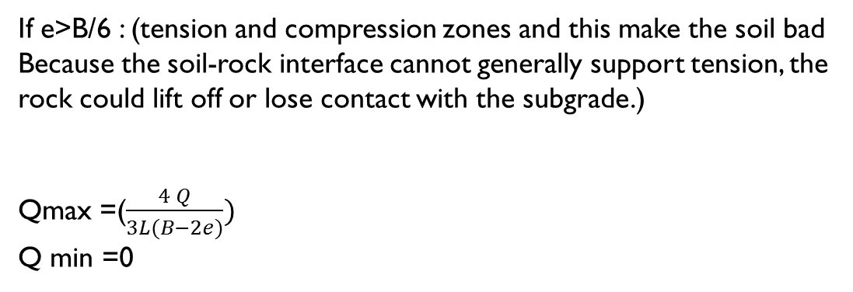
If e>B/6 : (tension and compression zones and this make the soil bad Because the soil-rock interface cannot generally support tension, the rock could lift off or lose contact with the subgrade.)
Qmax=($\frac{4 Q}{3L(B−2e)})$
Q min =0

Slide 20
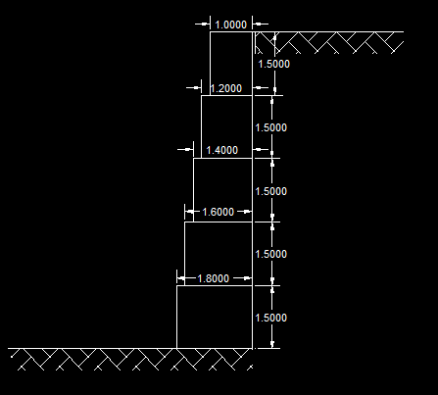
First case solution :
Soil type : silty clay.
ϒsoil =18
ϒ rock =23
ɸ=18

Slide 21
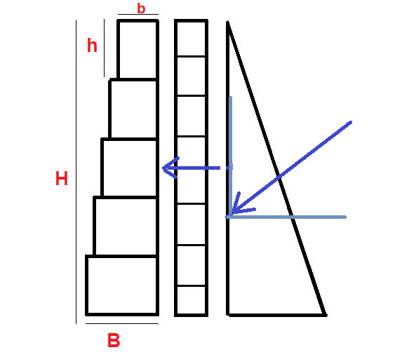

Slide 22
by using equation :
δ=( 2/3) * ɸ = 12.1°
K_{a} =0.473

Slide 23
Sliding :
ᶲ | Ψ | Ɣs | KA | Qs | H | δ | FA,H | FS | FD
0.314 | 0 | 18 | 0.473692 | 0 | 1.5 | 0.209333 | 9.382856 | 0 | 9.382856
0.314 | 0 | 18 | 0.473692 | 0 | 3 | 0.209333 | 37.53142 | 0 | 37.53142
0.314 | 0 | 18 | 0.473692 | 0 | 4.5 | 0.209333 | 84.4457 | 0 | 84.4457
0.314 | 0 | 18 | 0.473692 | 0 | 6 | 0.209333 | 150.1257 | 0 | 150.1257
0.314 | 0 | 18 | 0.473692 | 0 | 7.5 | 0.209333 | 234.5714 | 0 | 234.5714
For first row:
FD= .5*18*(1.5²)*0.473*cos12.1° +0 = 9.38

Slide 24
Friction :
B | H | Wi | ∑Wi | ϻ | ɣr | KA | Δ | Ψ | Ha | FA,v | Wi+F | FR
1.2 | 1.5 | 41.4 | 41.4 | 0.6 | 23 | 0.473692 | 0.209333 | 0 | 1.5 | 1.993346 | 43.39335 | 26.03601
1.4 | 1.5 | 48.3 | 89.7 | 0.6 | 23 | 0.473692 | 0.209333 | 0 | 3 | 7.973385 | 97.67339 | 58.60403
1.6 | 1.5 | 55.2 | 144.9 | 0.6 | 23 | 0.473692 | 0.209333 | 0 | 4.5 | 17.94012 | 162.8401 | 97.70407
1.8 | 1.5 | 62.1 | 207 | 0.6 | 23 | 0.473692 | 0.209333 | 0 | 6 | 31.89354 | 238.8935 | 143.3361
2 | 1.5 | 69 | 276 | 0.6 | 23 | 0.473692 | 0.209333 | 0 | 7.5 | 49.83366 | 325.8337 | 195.5002
For first row:
FR=(1.2*1.5*23*1 +0.5*18*(1.5²)*0.473*sin12.1° )*0.6=26.03

Slide 25
FSsl :
FR | FD | FS_{SL}
26.03601 | 9.382856 | 2.774849
58.60403 | 37.53142 | 1.561466
97.70407 | 84.4457 | 1.157005
143.3361 | 150.1257 | 0.954774
195.5002 | 234.5714 | 0.833436
For first row:
FSSL=26.03/9.38 =2.77

Slide 26
Overturning :
ɣ_{s} | KA | H | Δ | Ψ | Qs | MD
18 | 0.473692 | 1.5 | 0.209333 | 0 | 10 | 10.02046
18 | 0.473692 | 3 | 0.209333 | 0 | 10 | 58.84755
18 | 0.473692 | 4.5 | 0.209333 | 0 | 10 | 174.6298
18 | 0.473692 | 6 | 0.209333 | 0 | 10 | 385.5159
18 | 0.473692 | 7.5 | 0.209333 | 0 | 10 | 719.6543
For first row:
MD=0.5*18*(1.5²)*0.473 cos12.1° *(1.5/3) +0 =9.3

Slide 27
ɣs | KA | H | Δ | Ψ | B | Wi | Xi | ∑Wi*Xi | FA,v | MR
18 | 0 | 1.5 | 0.209333 | 0 | 1.2 | 41.4 | 0.6 | 24.84 | 3.986693 | 28.82669
18 | 0 | 3 | 0.209333 | 0 | 1.4 | 48.3 | 0.7 | 66.93 | 15.94677 | 82.87677
18 | 0 | 4.5 | 0.209333 | 0 | 1.6 | 55.2 | 0.8 | 129.03 | 35.88023 | 164.9102
18 | 0 | 6 | 0.209333 | 0 | 1.8 | 62.1 | 0.9 | 213.9 | 63.78708 | 277.6871
18 | 0 | 7.5 | 0.209333 | 0 | 2 | 69 | 1 | 324.3 | 99.66731 | 423.9673
For first row:
MR =0.5*18*(1.5²)*0.473 cos12.1° *(1.2)+41.4*(1.5/2) =28.8

Slide 28
FSOT :
Mo | MR | FSOT
10.02046 | 28.82669 | 2.876783
58.84755 | 82.87677 | 1.40833
174.6298 | 164.9102 | 0.944342
385.5159 | 277.6871 | 0.7203
719.6543 | 423.9673 | 0.589126
For first row:
FSOT=28.8/10.02 =2.87

Slide 29
Bearing capacity :
B | Mo | MR | ∑Wi | Fv | E | B/6 | e<B/6? | e=B/6 | e>B/6
1.2 | 10.0204 | 28.8266 | 41.4 | 1.993346 | 0.16661 | 0.2 | TRUE | FALSE | FALSE
1.4 | 58.8475 | 82.8767 | 89.7 | 7.973385 | 0.453984 | 0.233333 | FALSE | FALSE | TRUE
1.6 | 174.629 | 164.910 | 144.9 | 17.94012 | 0.859688 | 0.266667 | FALSE | FALSE | TRUE
1.8 | 385.515 | 277.687 | 207 | 31.89354 | 1.351368 | 0.3 | FALSE | FALSE | TRUE
2 | 719.654 | 423.967 | 276 | 49.83366 | 1.907478 | 0.333333 | FALSE | FALSE | TRUE
For first row :
E=1.2/2 –((28.8-10.02)/1.99) =0.166
B/6 =0.2 So e< B/6
Qmax= (1.99/1.2)*(1+6*(0.166/1.2)) =66.2
Qmin = (1.99/1.2)*(1+6*(0.166/1.2)) = 0.277

Slide 30
e<B/6 |  |  | e=B/6 |  | e>B/6
Q max | Qmin |  |  | Qmax | Qmin |  | q | Qmax | Qmin
66.28518 | 0.277322 |  |  | 66.28518 | 0 |  | 150 | 173.355911 | 0
205.508 | -5.38571 |  |  | 205.508 | 0 |  | 150 | 98.40641672 | 0
429.8806 | -24.9349 |  |  | 429.8806 | 0 |  | 150 | -23.8752128 | 0
730.5575 | -62.096 |  |  | 730.5575 | 0 |  | 150 | -180.5470519 | 0
1095.198 | -117.668 |  |  | 1095.198 | 0 |  | 150 | -362.9913066 | 0

Slide 31
STUDY CASES
Now we have to analysis of several suggested real cases for rockery retaining wall. It includes cases for :
Temporary Rocky Retaining Wall
(Two systems were used for this case, for to support silty clay and the second to support marl soil.)
Permanent Retaining Wall
(This section represents analysis and design of rockery retaining wall as permanent retaining wall. In this case, selected backfill is used as backfill soil. The construction of this wall should be according to the recommended construction method regarding backfill soil, drainage, selected fill, etc.

Slide 32
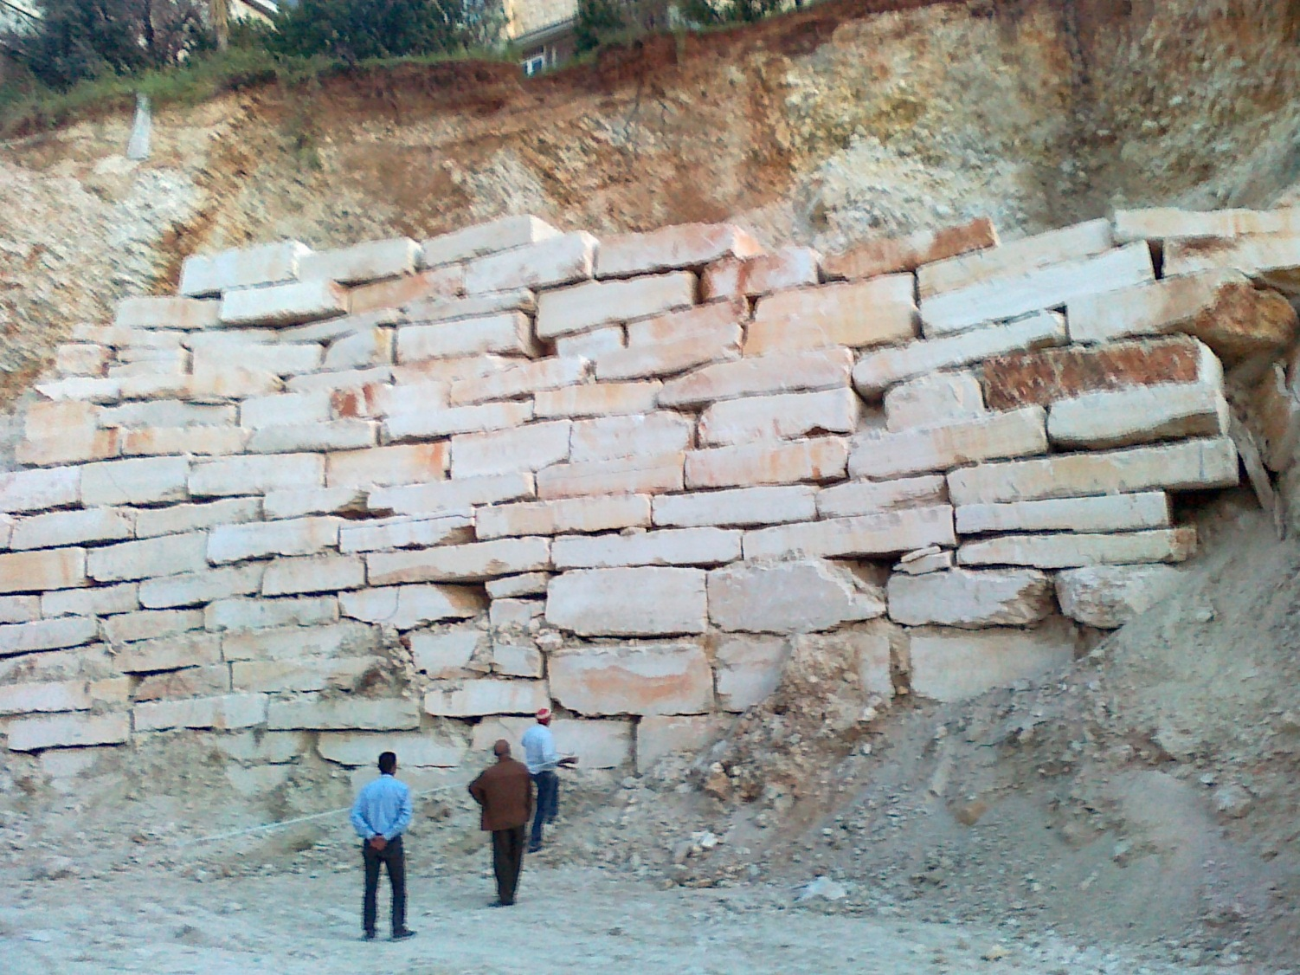
Temporary rockery

Slide 33
Temporary Rocky Retaining Wall
silty clay | marl soil
γ =18 kN/m³ | γ =18 kN/m³
Unit weight of the rockery = 23 kN/m³ (including voids) | Unit weight of the rockery = 23 kN/m³ (including voids)
Angle of internal friction =18° | Angle of internal friction =23°
cohesion = 0 kN/m² to be in the safe side. | cohesion = 0 kN/m² to be in the safe side.
q_{s}= 0 kN/m² | q_{s}= 0 kN/m²
Ψ= 0º | Ψ= 0º
q_{all} =120 kN/m² | q_{all} = 200 kN/m²
Sliding factor of safety = 1.1-1.3
Overturning factor of safety = 1.3-1.5
Bearing pressure should be not more that the of the q_{all} foundation soil.

Slide 34
Permanent Retaining Wall
backfill soil and foundation soil
γ =18 kN/m³
Unit weight of the rockery = 23 kN/m³ (including voids)
Angle of internal friction =30° of selected fill.
q_{s}= 10 kN/m²
Ψ= 0º
q_{all} = 200 kN/m²
Sliding factor of safety = 1.5
Overturning factor of safety = 2.0
Bearing pressure should be not more that the allowable bearing capacity of the foundation soil.

Slide 35
Example of some output results for temporary rockery retaining:
Case number | H | B | FSsl | FS ot | pressure | Safe/not
Marl soil | 7.5 | 2 | 1.4 | 1.17 | 191 | Not safe
It is clear that when using rockery retaining wall as a temporary retaining wall, the factor of safeties are less than the recommended for general retaining walls. In this case, when constructing rockery retaining walls as temporary structure precautions should be considered and the permanent retaining wall should be constructed as soon as possible:

Slide 36
Example of some output results for permanent rockery retaining:
The construction of this wall should be according to the recommended construction method as presented in chapter four regarding backfill soil, drainage, selected fill, etc. The following examples show the output results for different heights using same backfill soil and same foundation soil
Case number | H | B | FSsl | FS ot | pressure | Safe/not
3 | 5 | 2.5 | 2.03 | 2.83 | 172 | Safe
4 | 6 | 3 | 2.16 | 2.99 | 210 | Not safe

Slide 37
Properties of making permanent rockery wall:
Effective world wide system.
Used locally in Rawabi city with height of about 5 Km.
Low cost compared with reinforced wall.
It gives beautiful view.

Slide 38
Properties of making temporary rockery wall:
Support excavation and reduce the expected problem.
safe, no riskiness during installation by cranes.
Quickly solution, no time for curing or pour concrete.
Available locally.

Slide 39
Other support system
These systems are expensive and locally unavailable:
Freezing
Sheet piling
Soil nailing

Slide 40

Thank you

