Slide 1
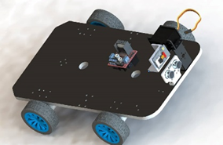
SURVEILLANCE ROBOT
GRADUATION PROJECT II
SEPTEMBER, 2022

Slide 2
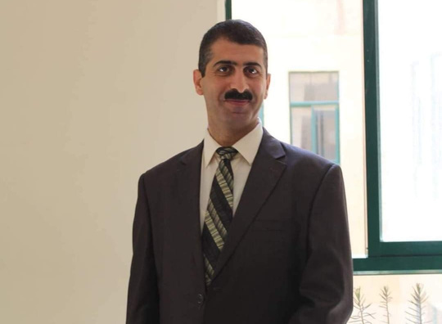


Team
Prepared
by:
Supervisor:
Dr.Aladdin Masri
Sahar Saleh
Hala Abduljalil

Slide 3

Team
Introduction
Hardware Components
Features
Outlines
Future work
Overall Design
Demo

Slide 4
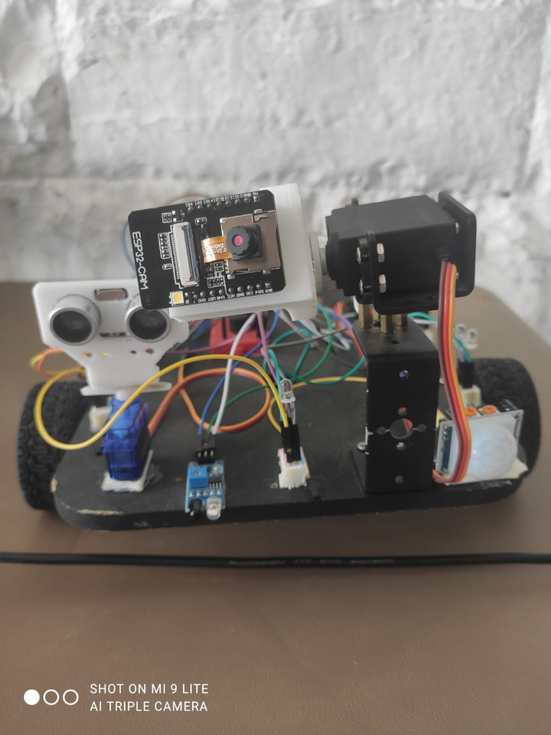
Introduction:
surveillance robot is a possible solution to discover places that it is dangerous for humans to be in these places .
in this project we designed a robot that could be controlled in two different modes :control it to move forward ,backward ,rotate left and right using web page or an autonomous mode
which makes the robot move individually .

Slide 5
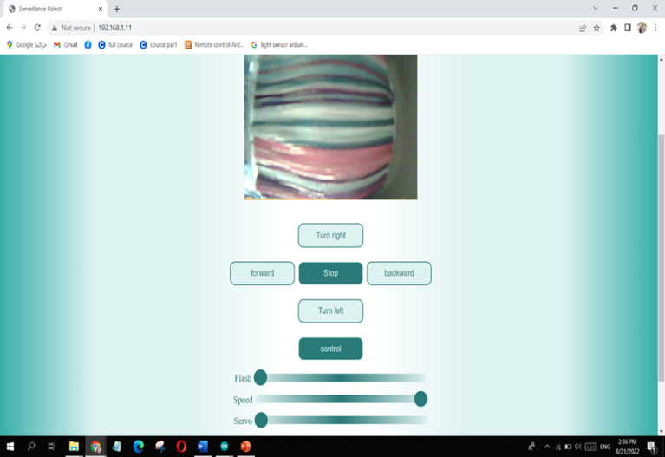

Slide 6
Features
the features we worked in this project as follows :
  we controlled the speed of the robot in range from 0 to 255(highest)
  we put the esp-32 camera on a servo that could be controlled to move up and down .
  we controlled the flash to make a better streaming for camera in the dark

Slide 7

Features
4.we added a gas sensor that Measures the proportion of gas . and if it exceeds the allowed limit it will send us a notification massege "there is a gas leakage" to signal app .
5 . IR sensor :as above it will send a notification " IR detects an object here "
6. LDR: If the place is dark the leds will be on .

Slide 8

Features
7. motion sensor : if the motion sensor detects a movement , the camera will capture a photo and send it to our telegram account .

Slide 9
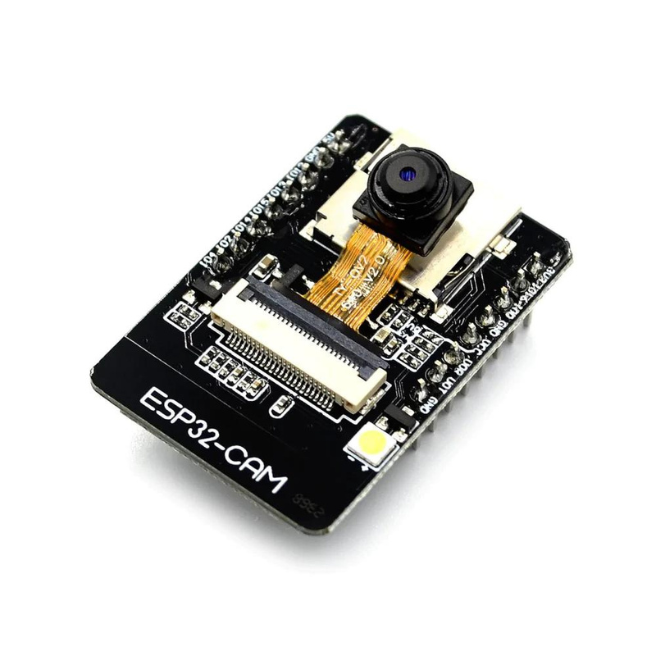
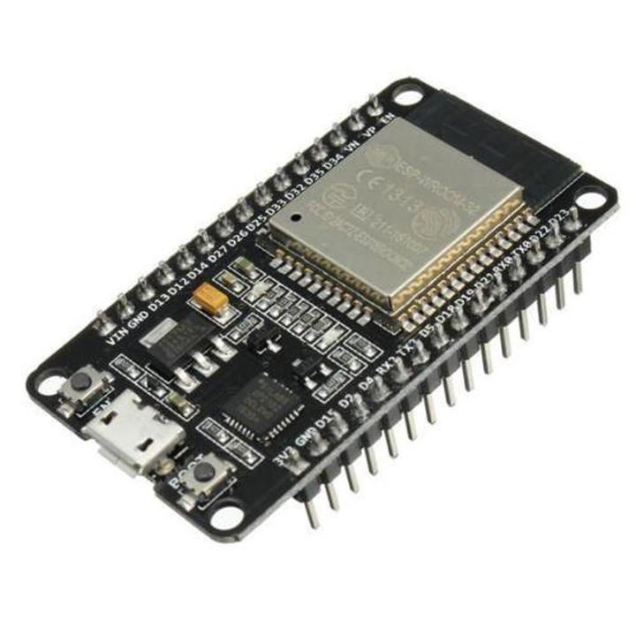
Microcontrollers:
ESP32-Camera
ESP32-WROOM

Slide 10
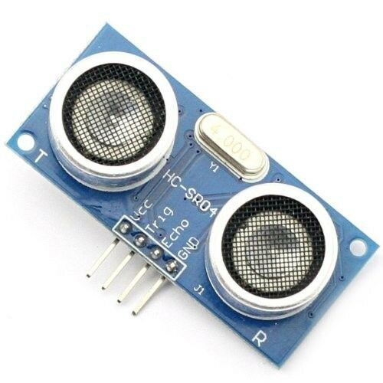
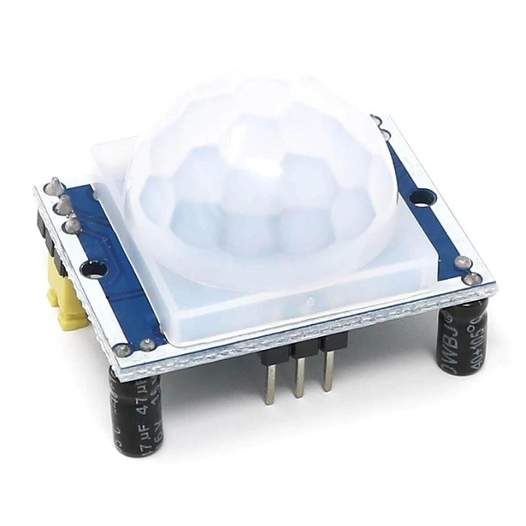
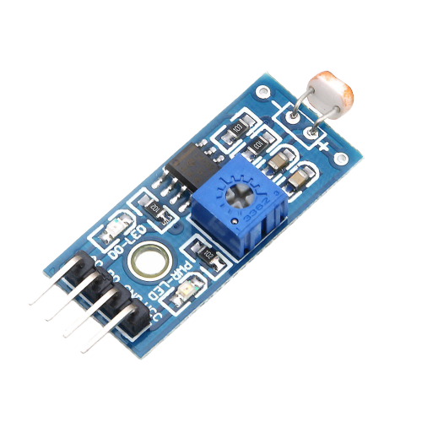
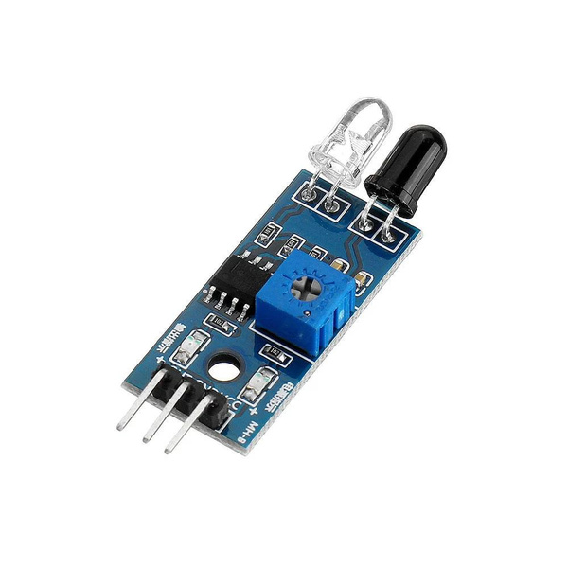
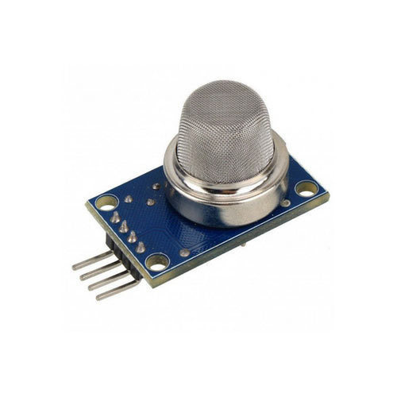
Sensors:
LDR Sensor
Ultra Sonic
Motion Sensor
IR Sensor
Gas Sensor

Slide 11
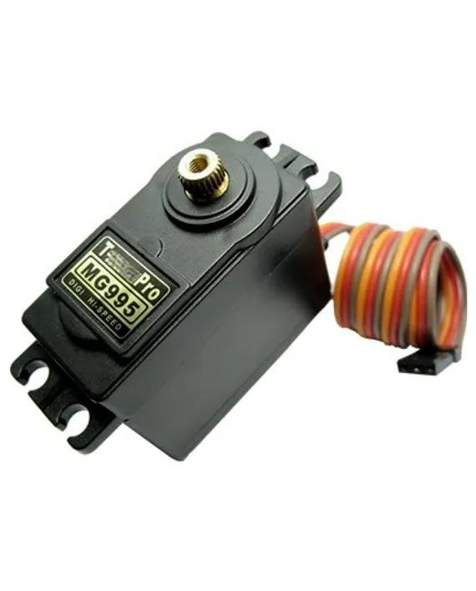
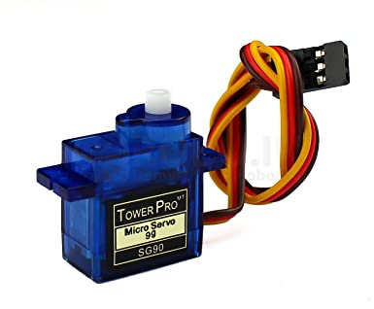
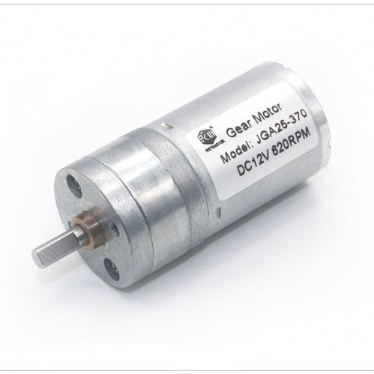
Motors:
MG995 servo motor
Micro Servo
JGA25 Motor x4

Slide 12
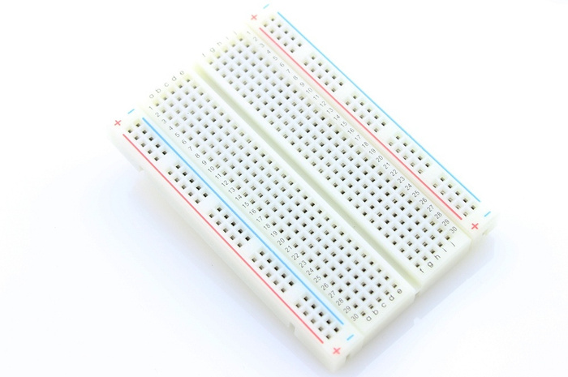
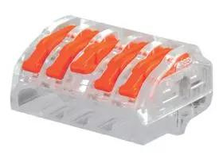
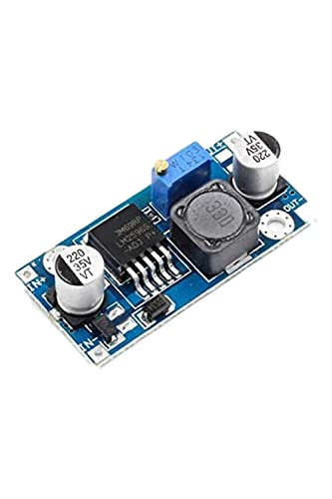
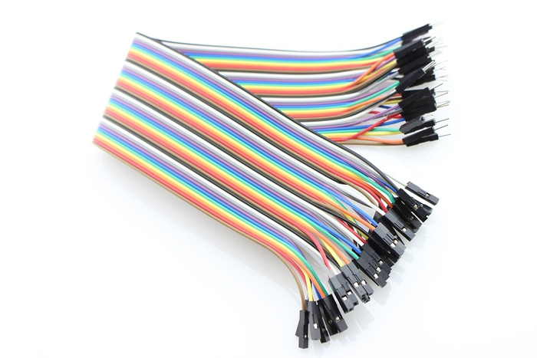
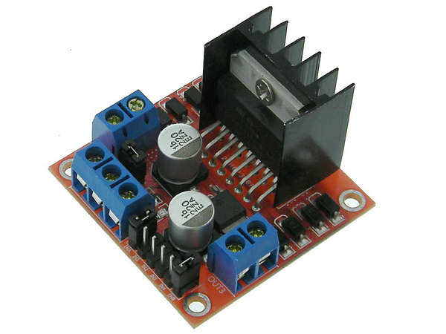
Other Components :
buck convertor
Bread board
Lever
jumber wires
DC Driv

Slide 13
change the tiers to be
like tractor tiers
1
Future
Work
use more accurate
electronic components
2
transmit voice over
the internet
3

Slide 14
DEMO
youtube link
hope you'll like it

Slide 15
THANK YOU

