Slide 1
Smart Home
Presented by: Abdullah BaniOdeh
Supervisor: Dr. Loai Malhis

Slide 2
Outlines
Introduction.
Features.
Technologies and Tools.
Methods and Techniques.
Constrains.
Future work.

Slide 3
Introduction
The purpose of this project is to employ smart tools to simplify the process of
administering the house, controlling it is equipment, and also ensuring the
security and control of it is contents.

Slide 4
Features
RFID was used to control of the door.
Managing the lighting system in the house based on the movement.
Managing the air conditioner according to the temperature.
Fire alarm system.

Slide 5

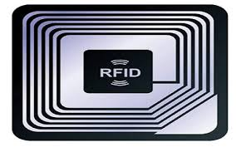
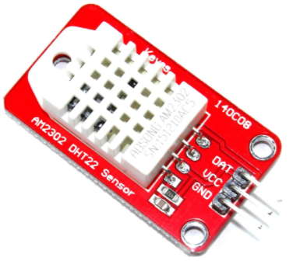

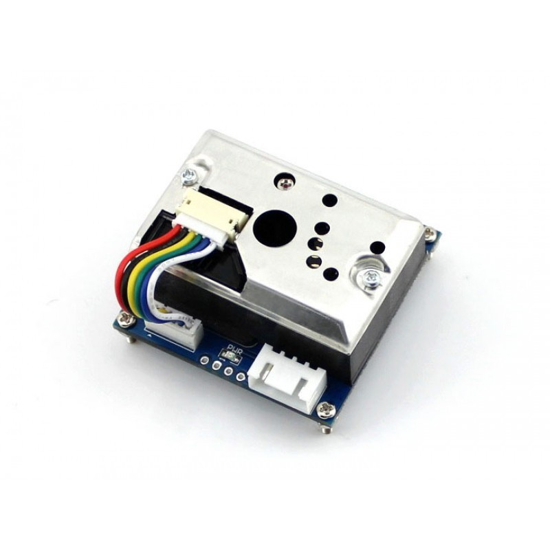
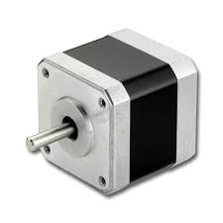
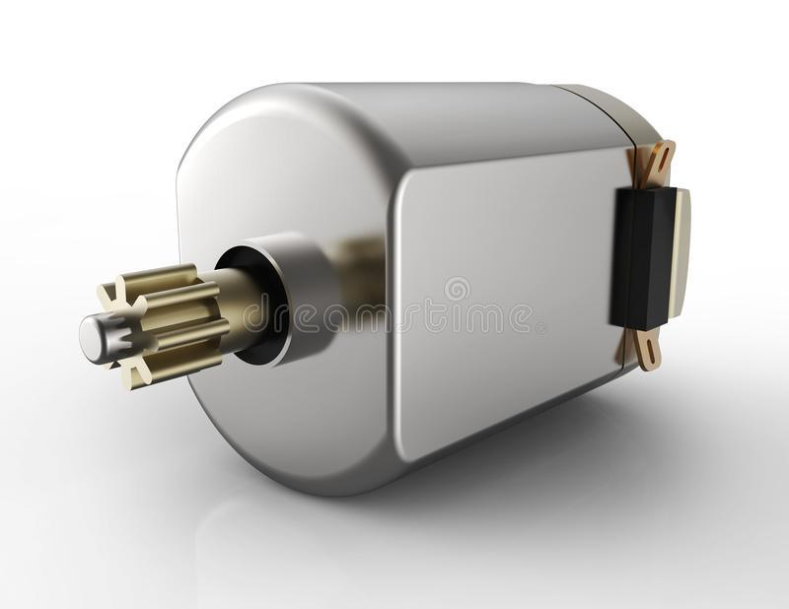
Technologies and Tools.
Main tools used

Slide 6


Technologies and Tools.
Programing technologies used

Slide 7
Methods and Techniques
RFID.
Lighting system.
Air condition system.
Fire alarm system.

Slide 8
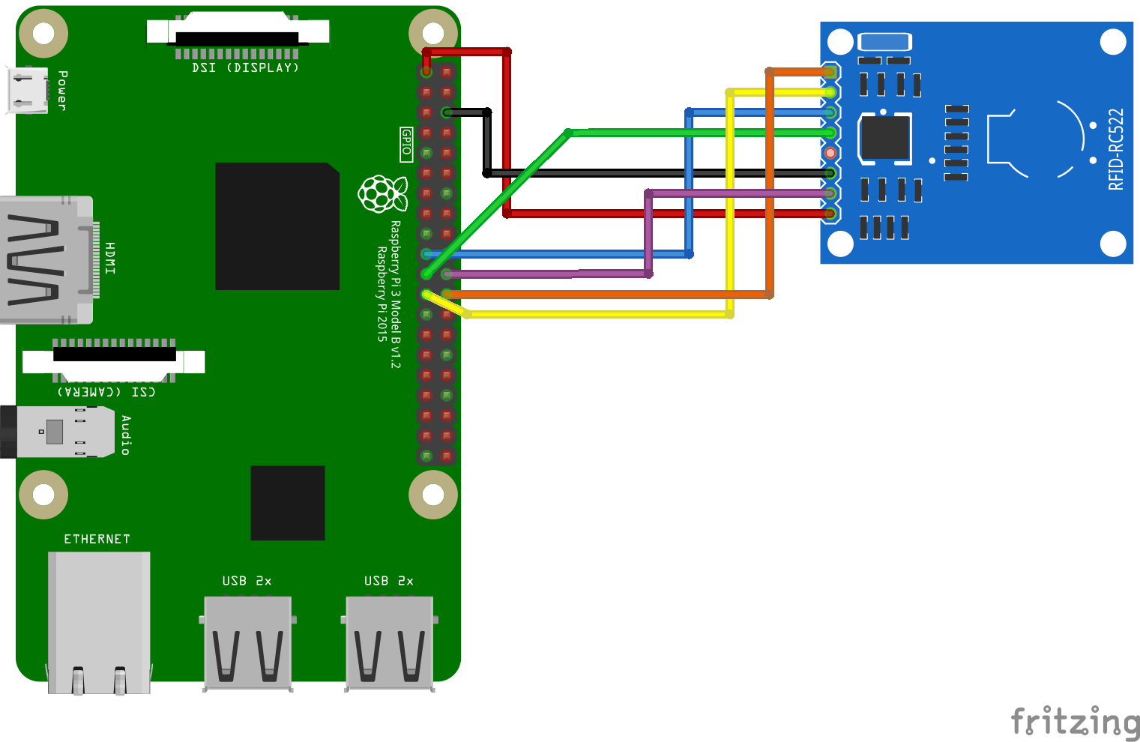
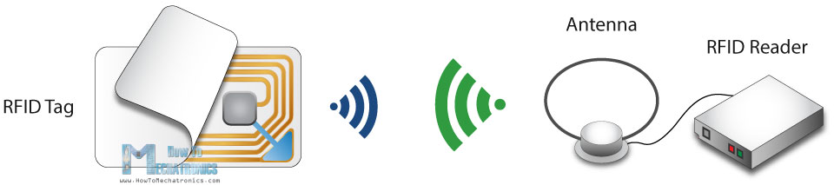
RFID

Slide 9
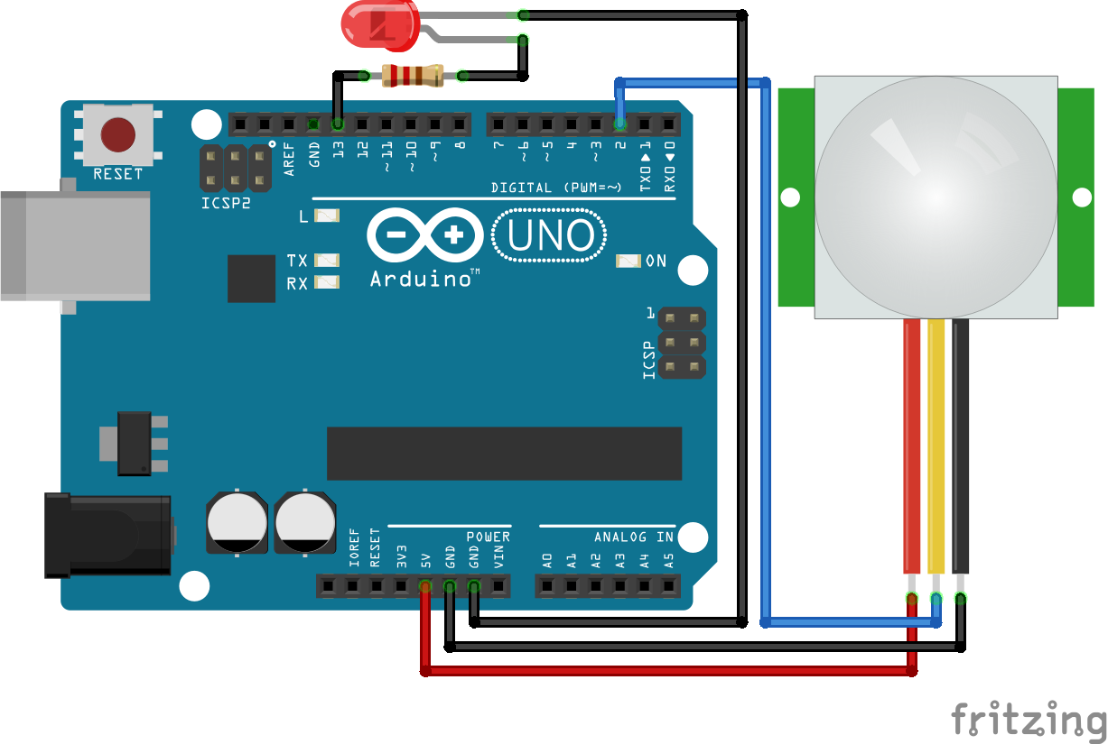
Lighting system

Slide 10
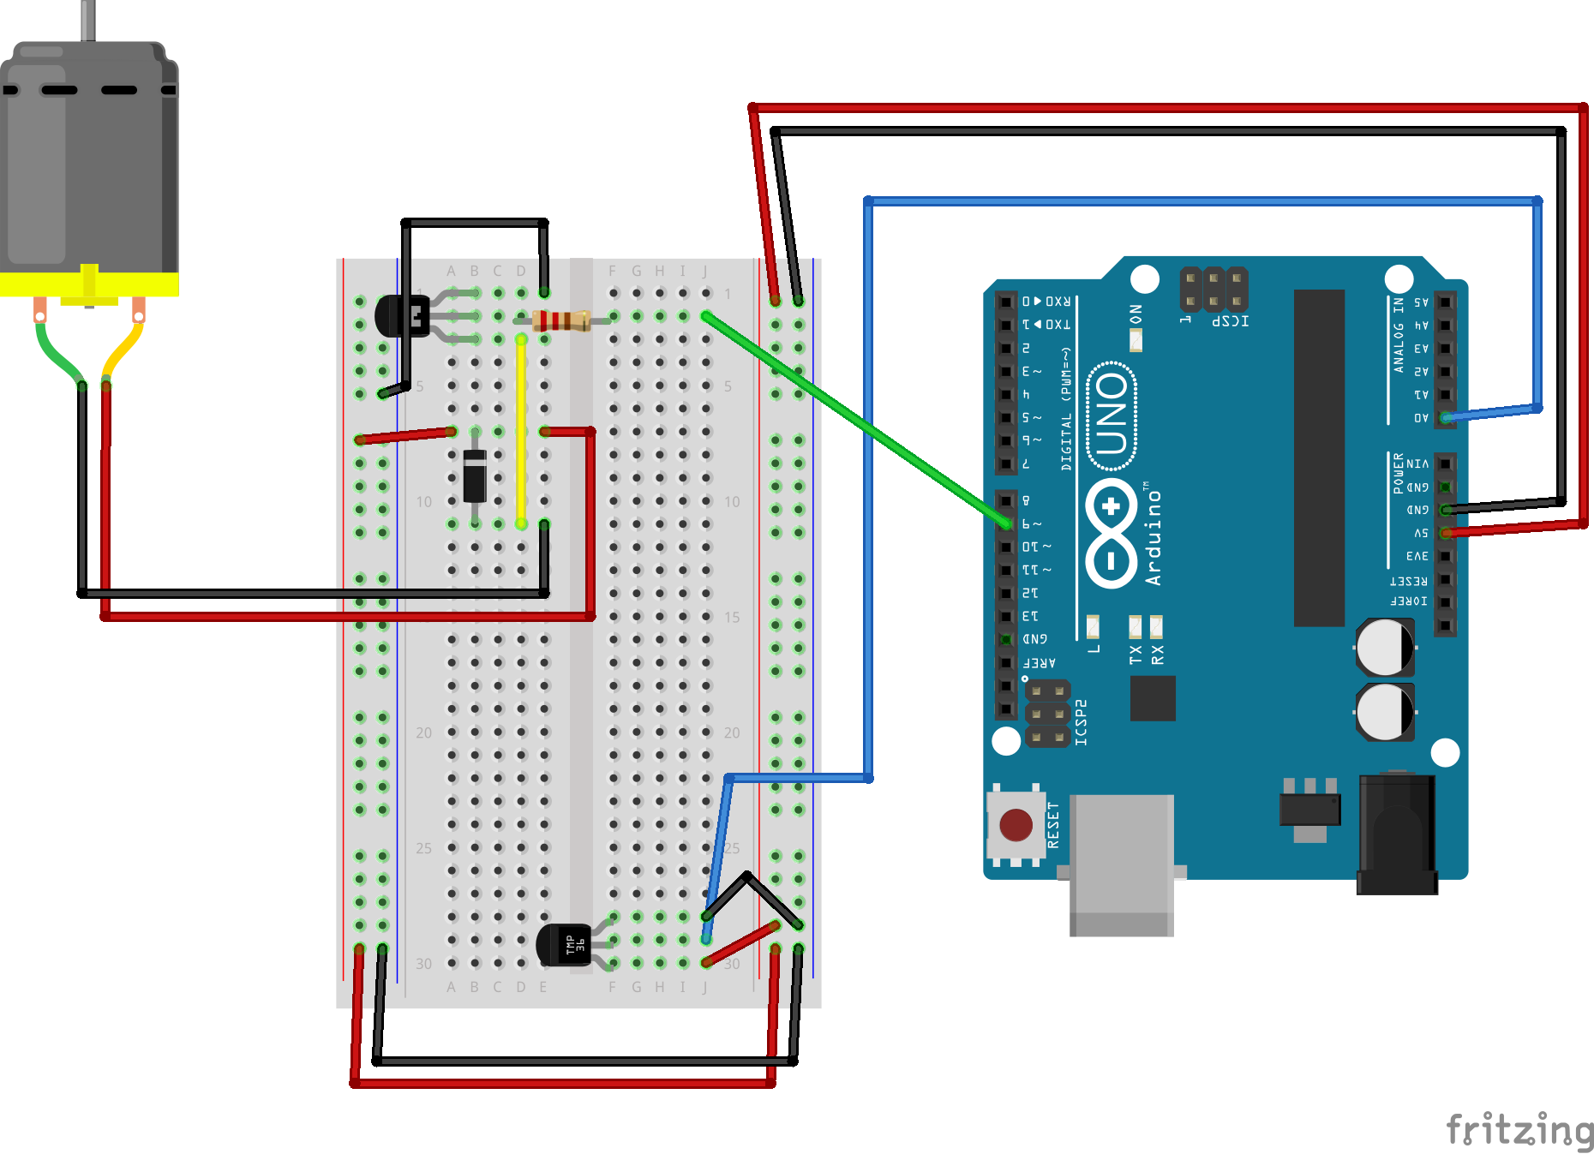
Air condition system

Slide 11
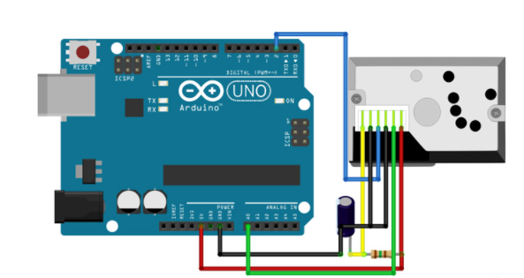
Fire alarm system

Slide 12
Constrains
Difficulty finding some electronic parts.
Learn how to use arduino uno.
Learn how to use arduino ide to write suitable code Who was C.
Be familiar with electrical component.

Slide 13
Future work
Apply sound detection and face recognition to know who want to enter the house.
Create app to know the state of house 24/7 and send and receive notification about the current state or if something happen.

Slide 14
The End
Thank You

