Slide 1
Wastewater collection network & treatment plant for Burqeen village
Graduation Project II
Prepared by :
Yazan omari
Khalil khamaisah
Ibraheem Saeed
Nimer Nofal
Mazen Thaher
Under supervision of: Dr. Abdelhaleem Khader

Slide 2
OUTLINE
Introduction
Objectives and significance of the work
Study area
Methodology
Modeling, Analysis and Design its results
Conclusion and recommendation

Slide 3

Introduction
Water take a great importance to humans in everyday life most of the activities we do need water. So that demand is continuously increasing, this means increasing the wastewater production, where wastewater constitutes about 90% of water demand .

Slide 4
OBJECTIVES
Design a sewage water collection network that have life period of 20 years.
Design treatment planet that have life period of 20 years.
Make some management for the final plant.

Slide 5
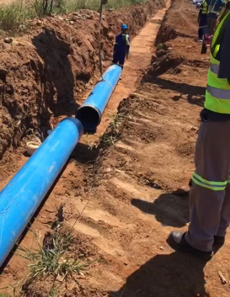
SIGNIFICANCE OF THE WORK
There’s no existing sewer network in Burqeen , so we have to design sewer network that meet the requirements and design a treatment plant at the outlet of the village .

Slide 6
Review to PROJECT I
In the first project we design water destitution network that has one Reservoir ,100 Pipes and 99 Nodes .
It’s a Combination of both Branched and Looped network.
The Water peak demand =5548.32 m³/Day
.

Slide 7
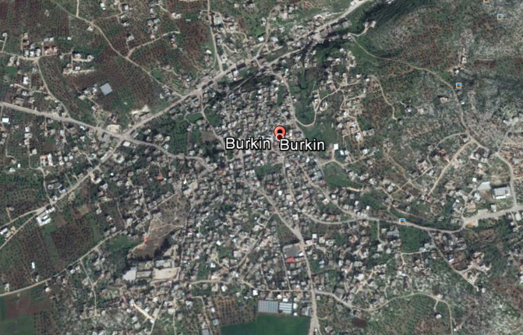
STUDY AREA

Slide 8
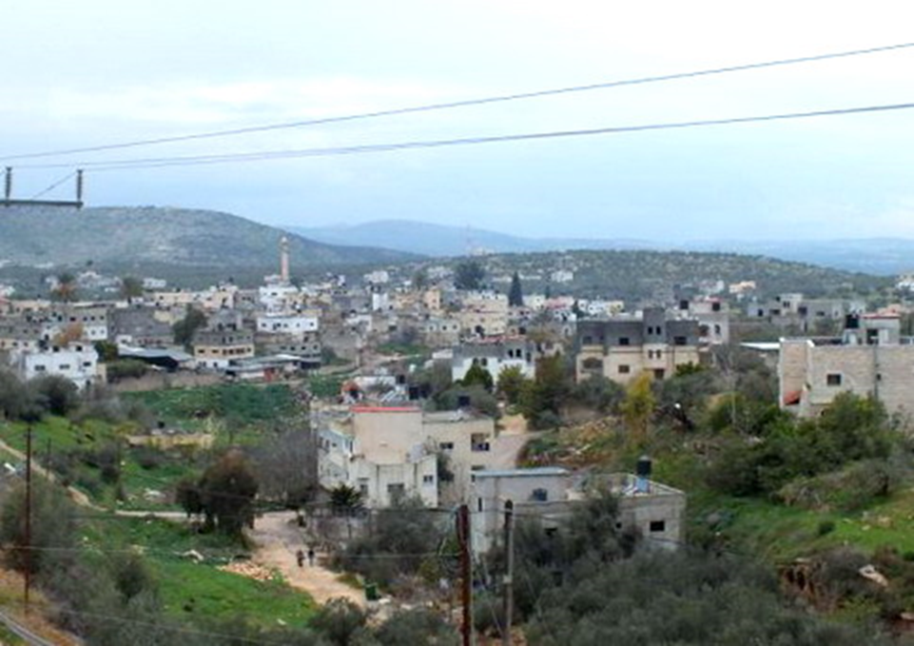
Burqeen Village

Slide 9
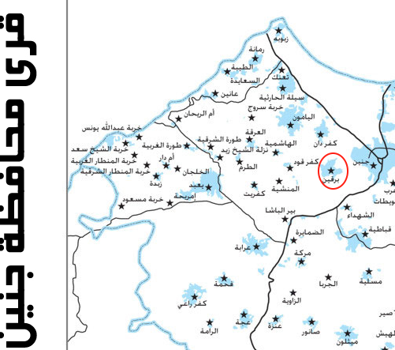
LOCATION
.

Slide 10
TOPOGRAPHY
Maximum elevation = 343 m above MSL
Minimum elevation = 210 m above MSL
Mean elevation = 310 m above MSL

Slide 11
AREA AND LAND USE
Total Area = 19447 donums
Built up Area = 861 donums
Agricultural land = 18,000 donums
Forests and open areas = 586 donums

Slide 12
DATA COLLECTION
Road network
Contour map
Boundary of study area
Population number and population growth rate
House distribution

Slide 13
population prediction
From the Palestinian Central Bureau of Statistics we have:
P1997 =4394
P2007=6062
Pn=P (1+i) ^n
Then P2036 =15412 person
Burqeen population between(1922-2007)
1922 | 1931 | 1945 | 1961 | 1982 | 1987 | 1997 | 2005 | 2007
833 | 1,086 | 1,540 | 2,055 | 2,100 | 2,900 | 4,394 | 5,730 | 6,062

Slide 14
Load Calculation
Water demand per Capita in L/Day = 120
Infiltration rate = 30%
WW/W = 90%
Design period = 20 years
Total P2046 = 15412 person
Peak hourly factor = 2
Peak daily factor = 1.5
Waste Water peak load = =5548.32 m³/Day

Slide 15
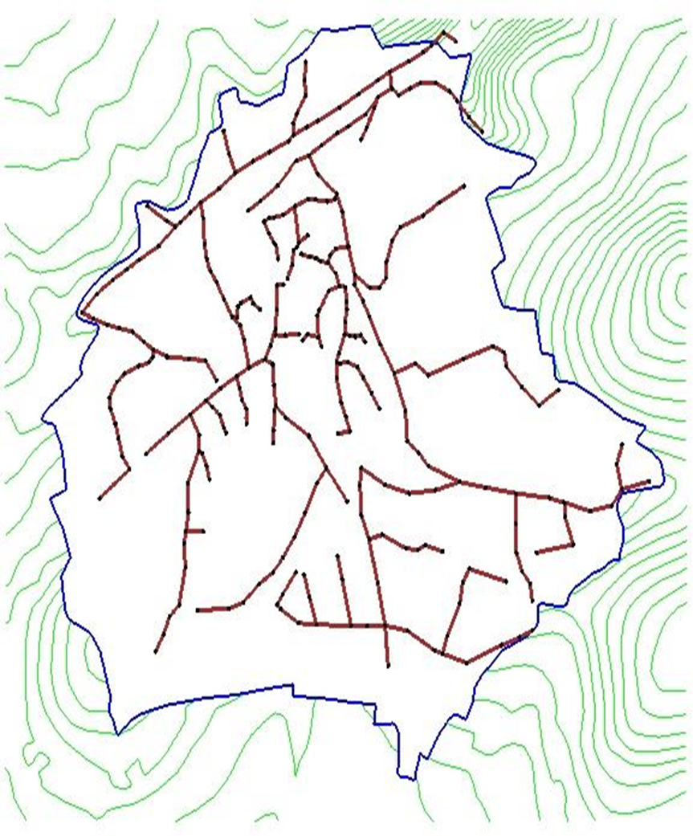
Part I
Design of the wastewater network:

Slide 16
Standards and specifications.
Design Equation
Manning equation is the most commonly used to analyze open channel flow
V: velocity m\sec
n: manning coefficient (.013-.015)
R: hydraulic radius (m)
S: slope of energy line(m\m)

Slide 17
Criteria’s that we considered in the project
Design Constrains
1. Velocity : The range was used is between (0.3-4) m\sec
2. Slope : The design slope range (0.01-0.15)
3. Cover : The range was used is between 1-5 m

Slide 18
MODLEING, ANALYSIS AND DESIGN
Collect data
Start using sewerCAD
Calculate generated wastewater
Distribute manholes
Select study area
Design sewage network
Make preliminary run
Get the result

Slide 19
Design
Preparation of data .
Loud forecasting.
Define the base calculation option
Draw the network.
Input information to SewerCAD.
Get the results.

Slide 20
RESULTS AND DISCUSSION
After we adjusted the network in SewerCAD informed that the calculations were successful. That means that the design of the network was logical.
Number of manholes | 334
Maximum velocity(m/s) | 3.33
Minimum velocity (m/s) | 0.3
Maximum cover (m) | 5.26
Minimum cover (m) | 0.8
Maximum slope(%) | 15
Minimum slope(%) | 0.5

Slide 21
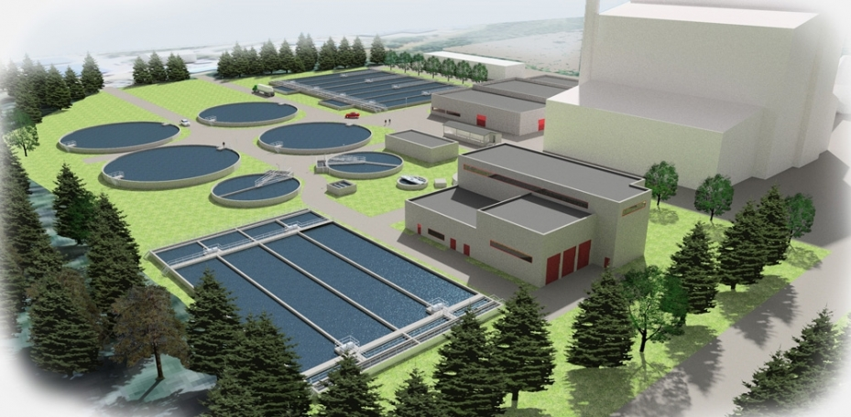
Part II
Design of the wastewater treatment plant

Slide 22
Characteristics of the plant’s influent
Data | Value | Value in (g/liter)
BOD₅ (g/c.d) | 70 | 648
K_{BOD} at 20⁰C ( per day ) | 0.5 | 0.318
COD/BOD₅ | 1.33 | 1.33
TSS (g/c.d) | 55 | 509
TSS/VSS | 1.33 | 1.35
TKN (g/c.d) | 5.5 | 50
NH₃ (g/c.d) | 5.5 | 50

Slide 23
WWTP Elements & Processes
Preliminary Treatment:
Bar Screens
Grit chambers
primary Sedimentation Tank
Secondary Treatment
Anoxic Tank
Aeration tank
Secondary sedimentation tank
Tertiary Wastewater treatment (Disinfection)
Thickener
Anaerobic digestion

Slide 24
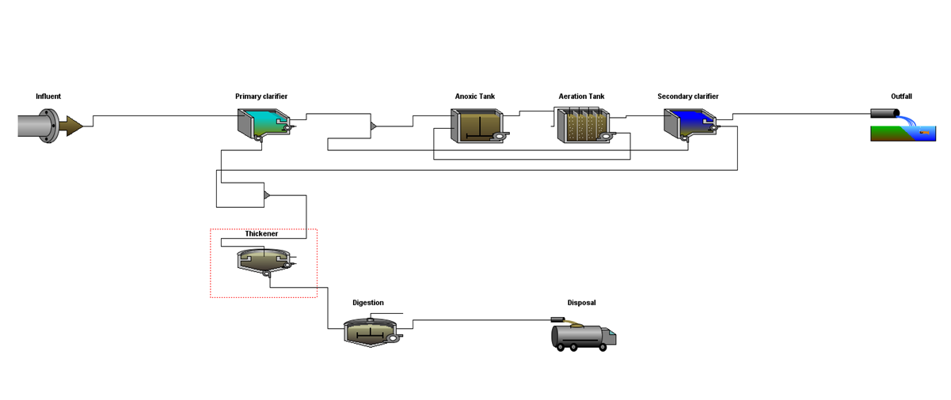
Components of our plant

Slide 25
Design criteria
 | Design criteria |  |  |  | Quality
 | high | good | Intermediate | poor
TSS | 30 | 30 | 50 | 90
BOD | 20 | 20 | 40 | 60
COD | 50 | 50 | 100 | 150
TN | 30 | 30 | 45 | 60

Slide 26
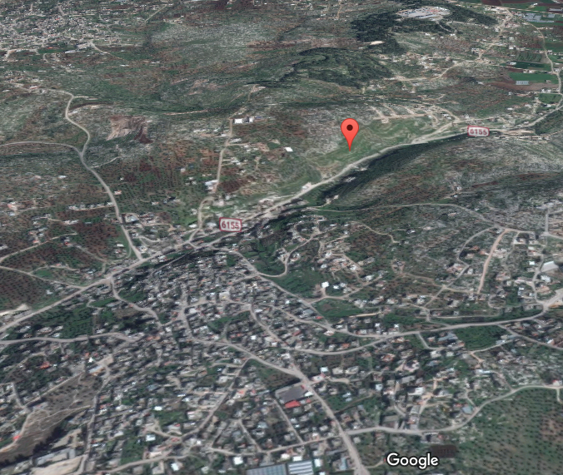
WWTP LOCATIONS

Slide 27
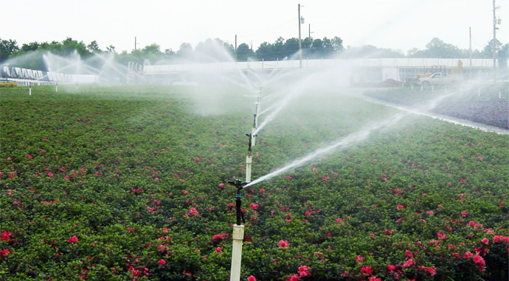
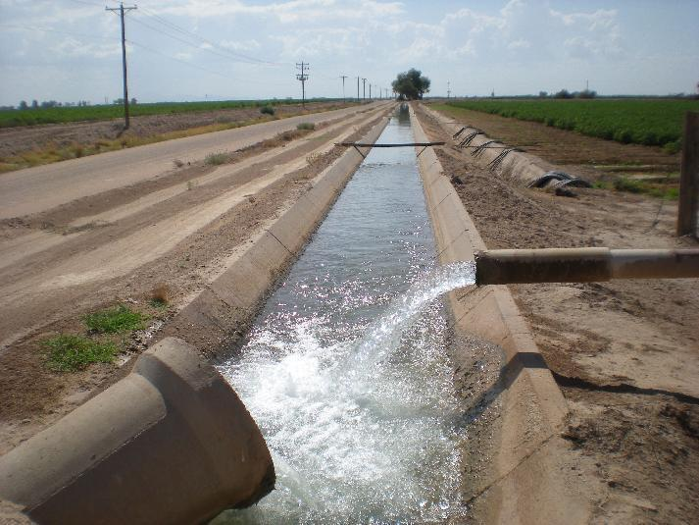
Uses of treated water
A large section of people do not accept drinking from treated water even if it is sterilized so the most of treated water returned to the natural water basins, and some time used for agriculture or in some industrial activates.

Slide 28
CONCLUSION AND RECOMMENDATION
By we finished design the WWTP, we can say that all results of the design are matching design standards and specifications of the Palestinian Ministry of Environment.
1: Standards
2: Influent
3: Effluent

Slide 29
CONCLUSION AND RECOMMENDATION
The following is notes about wastewater collection network for Burqin village:
1. Distribution of load on manhole based on predicting and counting houses in the village.
2. The main conduit size in network is (8, 10,12)in.
3. All conduit meet the cover constrain (0.8-6) m
4. All conduit meet velocity constrain (0.3-3.6) m/s

Slide 30
References
Burqin. (2017, march 27). Retrieved from burqin: https://goo.gl/L9jrGw
Burqin. (2017). Retrieved march 27, 2017, from https://en.wikipedia.org/wiki/Burqin
GeoMolg. (2017, march 27). Retrieved from GeoMolg: https://goo.gl/sQgz35
Mohammad Nihad Almasri - Palestine. (2017, march 27). Retrieved from Mohammad
Nihad Almasri - Palestine: https://sites.google.com/site/mohammadnablus/Home
sewerCad. (2017, march). Retrieved from sewerCad: https://www.bentley.com/en/products/product-line/hydraulics-and-hydrology- software/sewercad
world health organanization. (2017, march 27). Retrieved from WHO:
http://www.who.int/en/

Slide 31
THANK YOU

