Slide 1

Operations Improvement for Al-Shunnar for Food Industries
(GRADUATION PROJECT II)
Prepared by:
Abdullah Abu Mohsen
Anas Abdulfattah
Mosup Othman
Omar Awad
Younis Malik
Supervised by:
Eng.Walaa Johari
2nd Semester
(2021-2022)

Slide 2
Table of contents .
Introduction……………………………………………………………………. 3
Bicycle parts…………………………………………………………………….4-9
Bicycle dimensions …………………………………………………………….10
Analysis ……………………………………………………………………….11
Machine elements (handle bar)……………………………………………….12
Machine elements (pulley)…………………………………………………….13
Machine elements (pedal)……………………………………………………..14
Refrences …………………………………………………………………….15

Slide 3
Introduction.
Al-Shunnar factory for food industries will be taken as a case study. It's a Palestinian factory that was established in 1990
. It deals with more than 130 items of food and beverages. 17 items of beverages, jelly, Choco, and cappuccino. It also produces more than many types of herbal oils.
It's considered one of the leading companies as it attracts a large number of retail stores on the west bank due to the diversity of its products and its geographical location in Beit-Elba, Nablus .

Slide 4
Introduction - Problem statement.
Al-Shunnar factory faces many problems due to the absence of integrated operation systems, material handling systems, factory layout, and management systems.
Al-Shunnar is considered one of the oldest factories with poor planning and inventory management. If the factory continues to use the same strategy, it will not be able to meet the market demand because the demand for the product is high,
an absence of a computerized system to track the entry and exit of goods, know the available quantities, and determine the point of re-ordering and the required quantities.
Shortage in raw materials and basic resources such as water.
Figure 1:parts

Slide 5
Introduction- objectives.
our objective which is to avoid disasters and improve all aspects of operation and keep pace the development by using different tools and techniqus.

Slide 6
Methodology- data collection methods
The first step is to conduct a thorough examination of the subject by visiting the factory. After that, we put our knowledge and tools to use in order to carry out the objectives.
the project team conclude to the following areas to be development priority areas.1- Facility Layout.2- Warehouse Management.3- Raw Materials Shortage.
The data collected in the current situation of Al-Shunnar Factory are divided into 3 phases: 1. the design and layout of factory 2. Inventory management. 3. Production lines.

Slide 7
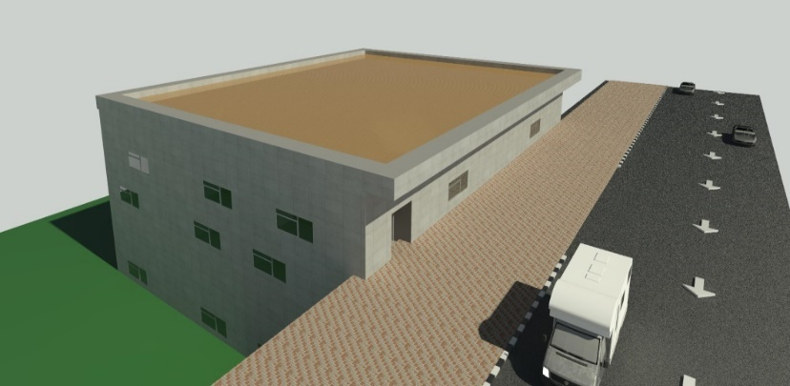
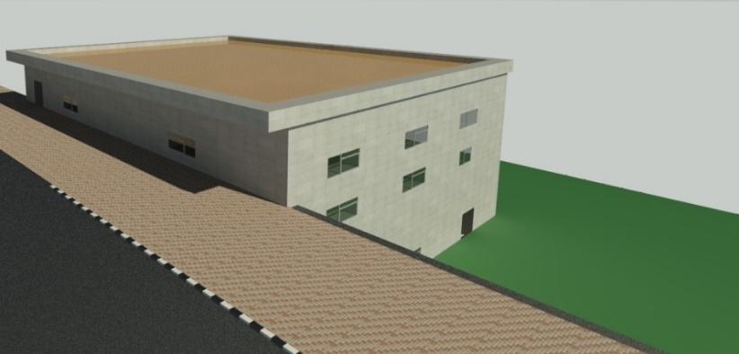
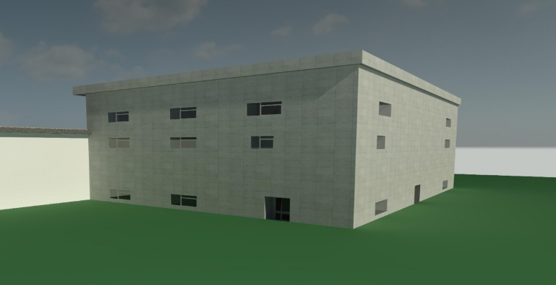
Methodology-existing layout
The existing layout is designed in such a way that it does not serve the concept of plant layout.
there is not enough space for loading and unloading goods.
the lack of specific lanes and random storage

Slide 8
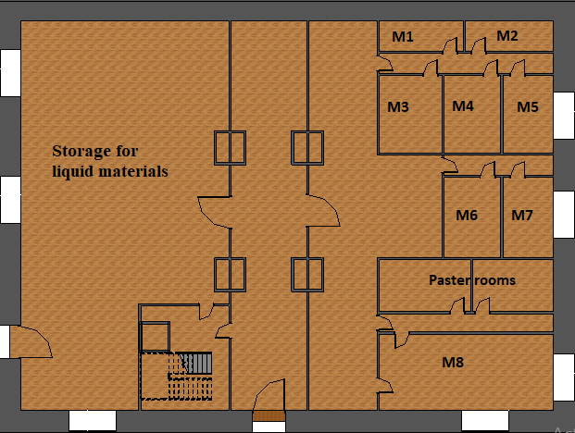
Methodology- first floor.
first floor has a private entrance, and it’s related only to the liquid’s production, it consists of 7 liquid filling machines, one sterilization machine and 2 pasteurization machines

Slide 9
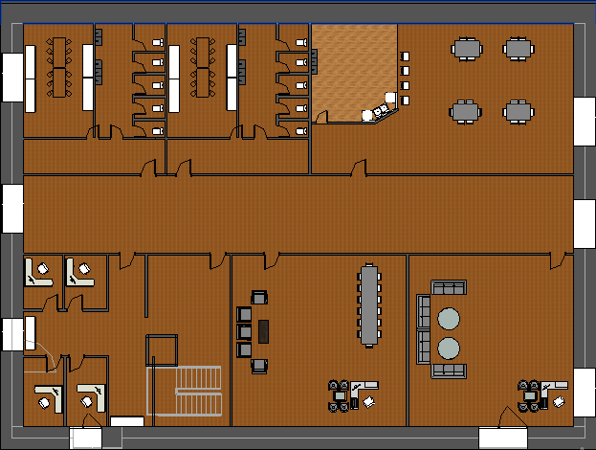
Methodology – second floor .
2ndfloor, it has one bathroom, one kitchen, a changing room, a break room for employees, and meeting rooms.

Slide 10
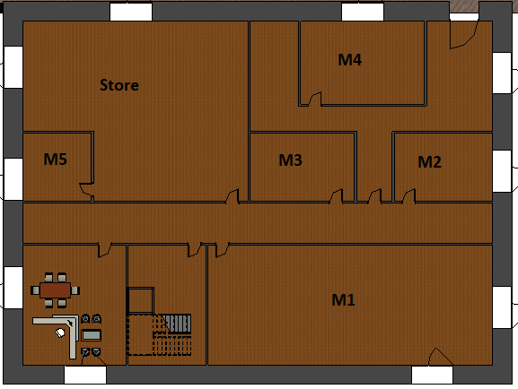
Methodology – third floor.
it’s related to powder production; it has a private entrance. There is 6 machine describes M1 to M5 and one sterilization machine. Also, a small room to store raw materials and a storage room.

Slide 11
Methodology- production lines.
Three production lines are present in the factory: 1-Concentrated fruit drinks line. 2-Liquid products line.3-Powder products line.
are 16 machines in the factory, 10 machines for liquid products and 6 for powder products, and they are divided: into 13 filling machines, 2 pasteurization machines, and one sterilization machine .

