Slide 1

An-Najah National University.
Faculty of Engineering & Information Technology.
Computer Engineering Department.
Hardware Graduation Project.
Hand Gesture-Controlled Car Robot
Students:
Reham Helo and Aya Shaheen.
Supervisor:
Dr. Emad Natsheh.

Slide 2
Table of contents:
Motivation.
Objectives.
Programs.
Part1: Glove (Hand Gestures).
Part2: Robotic Car.
Conclusion and Future work.

Slide 3

Motivation
A very natural tendency to move objects with the movement of one’s hand is something of great convenience, and to be able to control a car, its speed, direction with the same motions, make a lot of different movements and enjoyable at the same time is every child’s dream.

Slide 4
Objectives
make a car that can be controlled wirelessly by hand gestures.
This involves two modules:
  glove that translates the motions of the hand using multiple sensors.
  Robotic car that interprets and modifies its motion with respect to the signal given by the hand gesture.

Slide 5
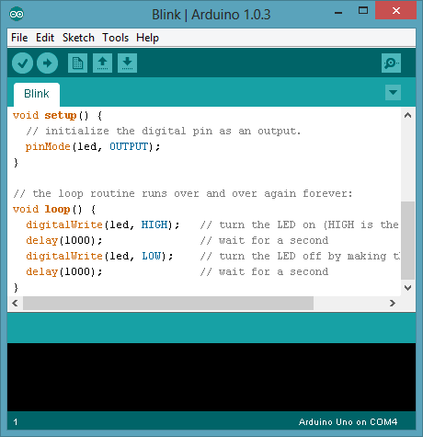

Program

Slide 6
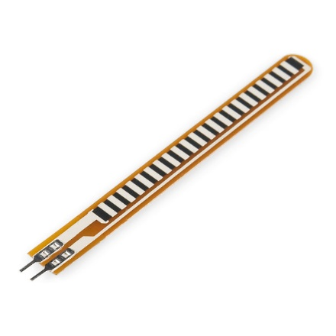
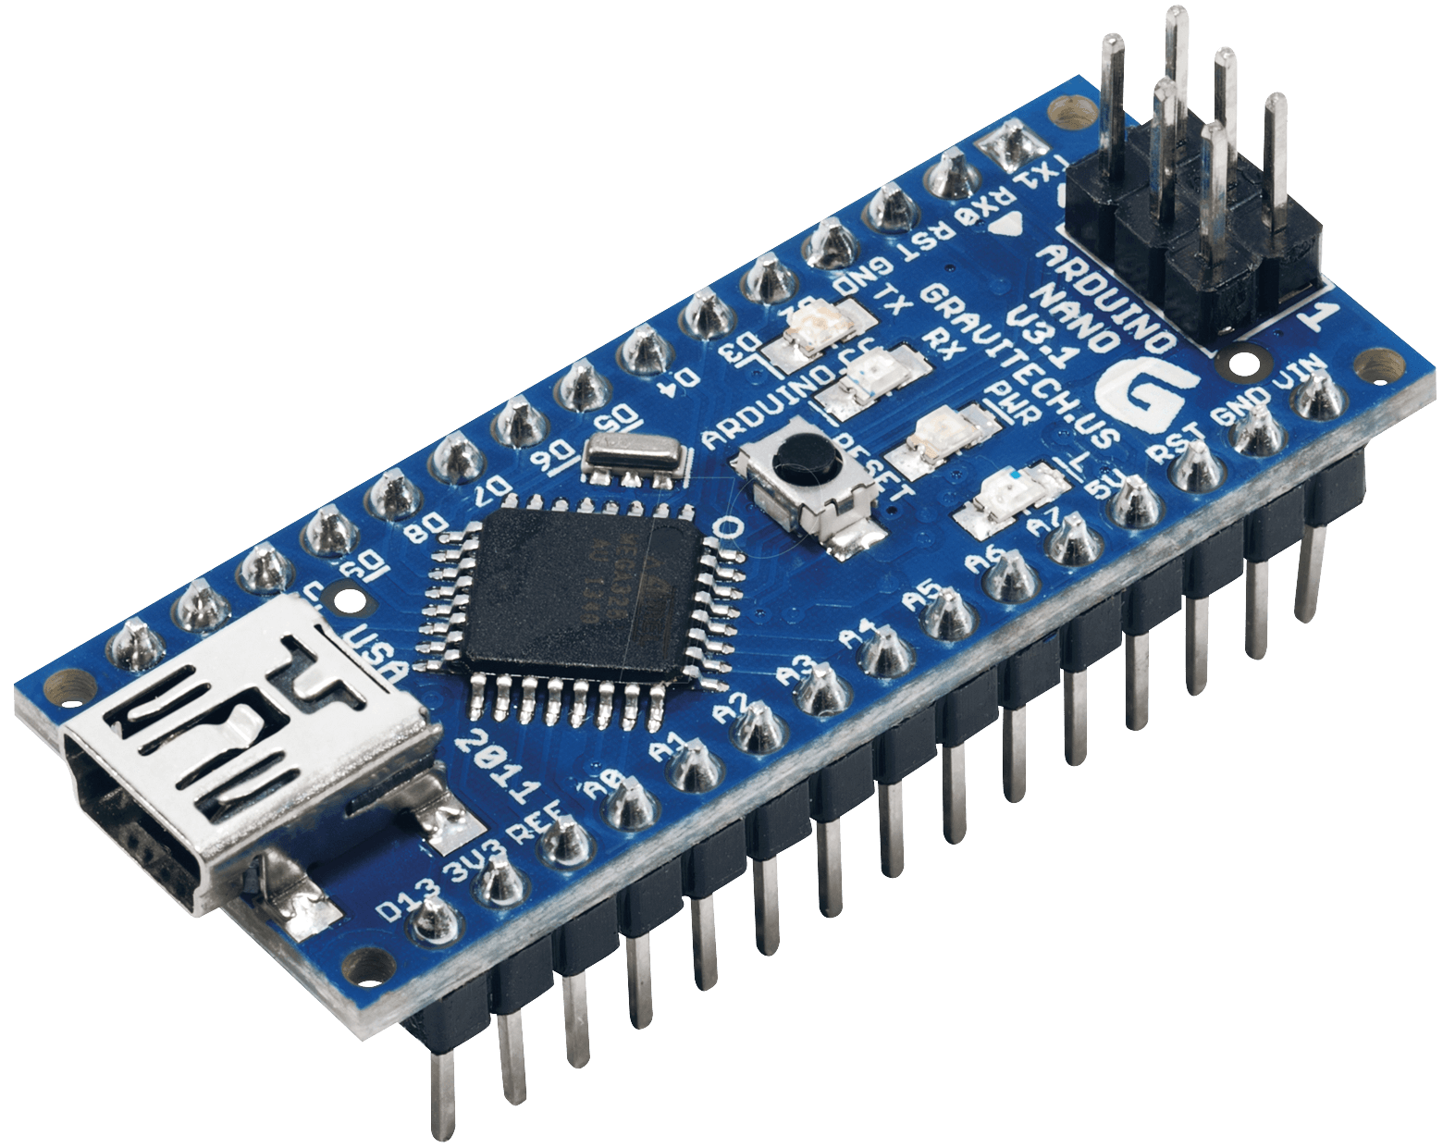
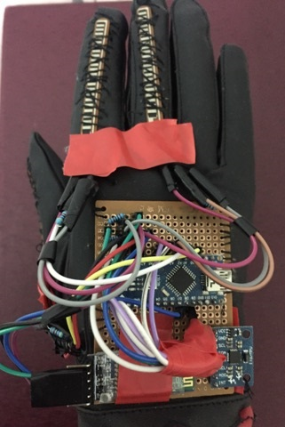

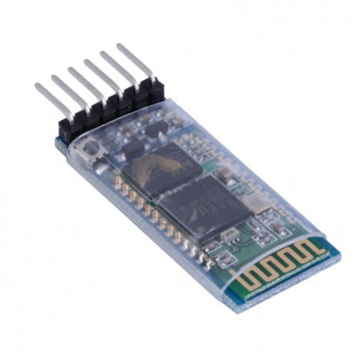
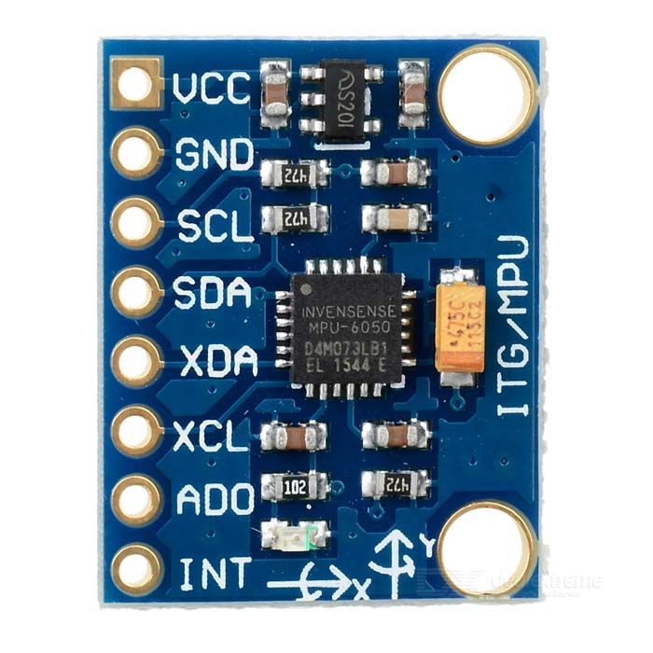
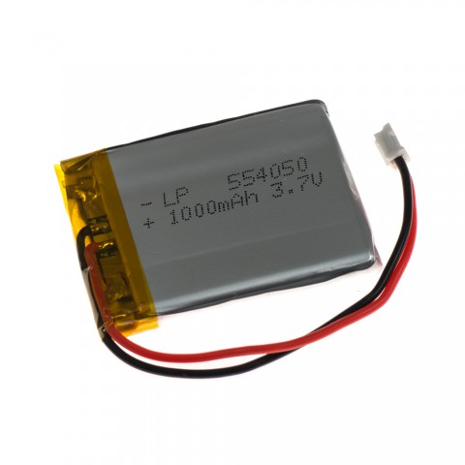
Part1: Glove (Hand Gestures)

Slide 7
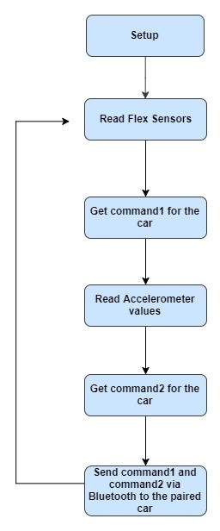
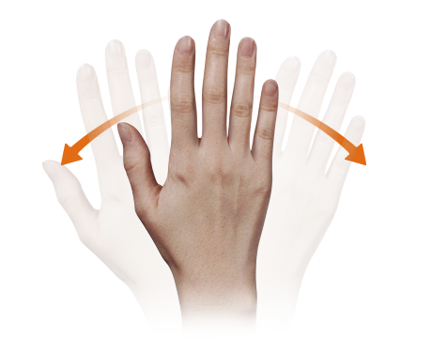
Hand Gesture flow chart

Slide 8
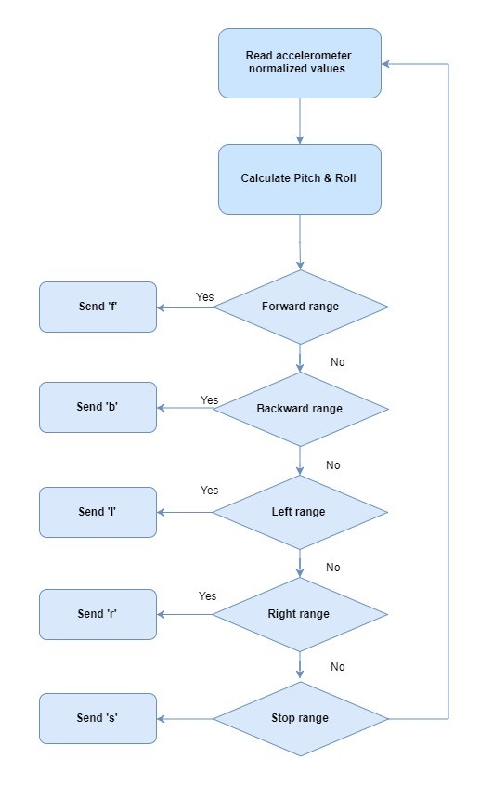
Accelerometer flow chart
MPU 6050

Slide 9
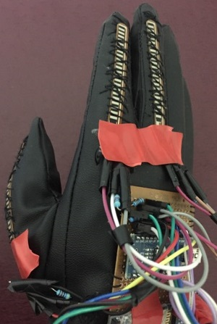
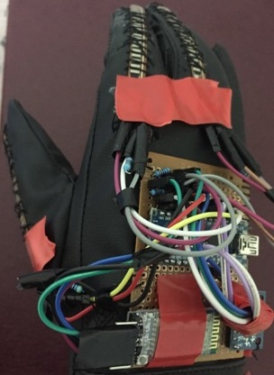
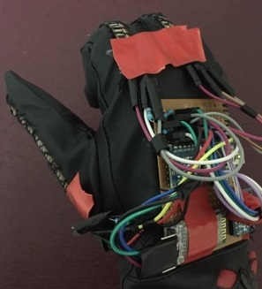
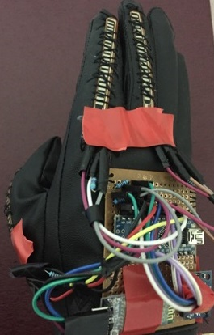
Combination of Flex sensors
Play musical note
Finger 1: 45 degree bending angle
Low speed
Finger 2 and 3: 45 degree
bending angle
High speed
Finger 2 and 3: 130 degree
bending angle
Stop musical note
Finger 1: 130 degree bending angle

Slide 10
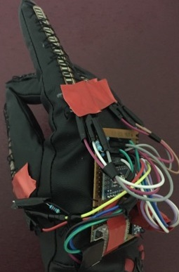
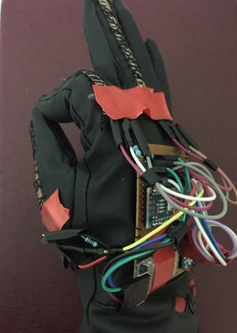
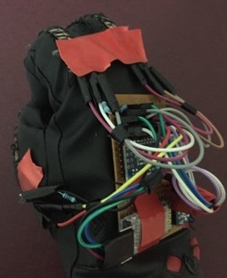
Start record
Finger 1: 45 degree
Finger 3: 90 degree
Stop record
Finger 1: 45 degree
Finger 2: 90 degree
Play record
All Fingers closed (130 degree)

Slide 11
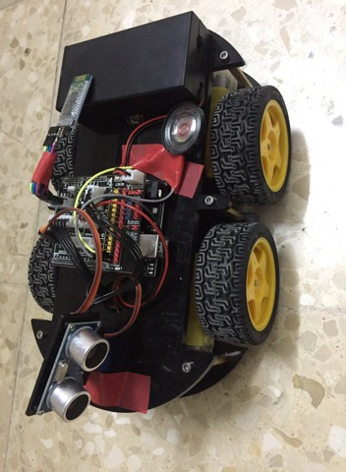
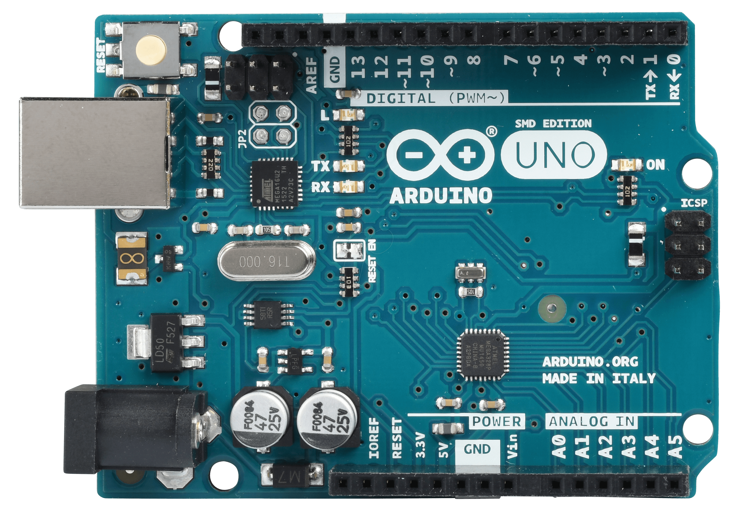
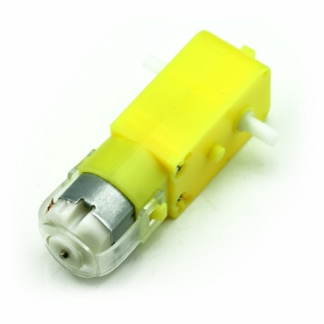
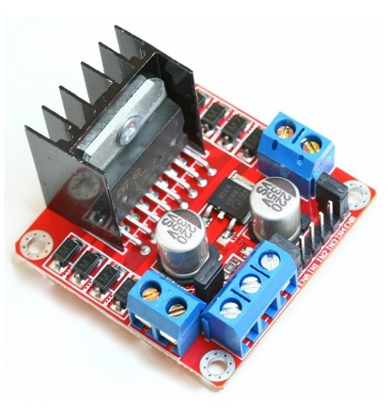
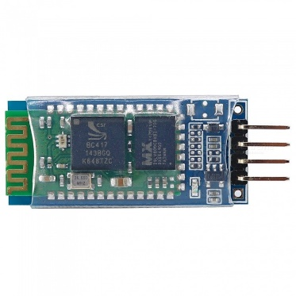
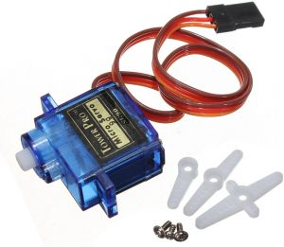
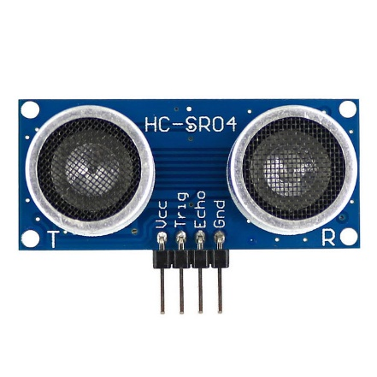
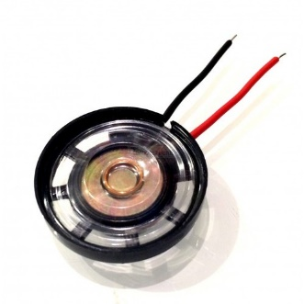
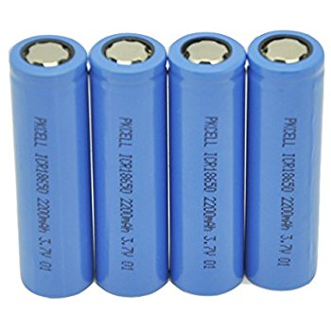
Part2: Robotic Car

Slide 12
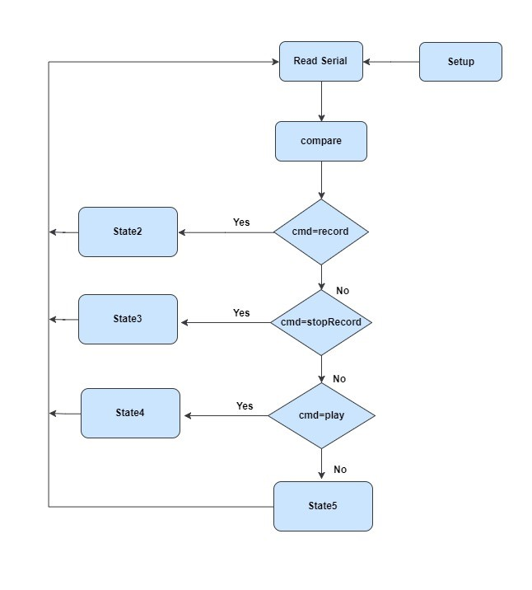
Robotic car movement
flow chart

Slide 13
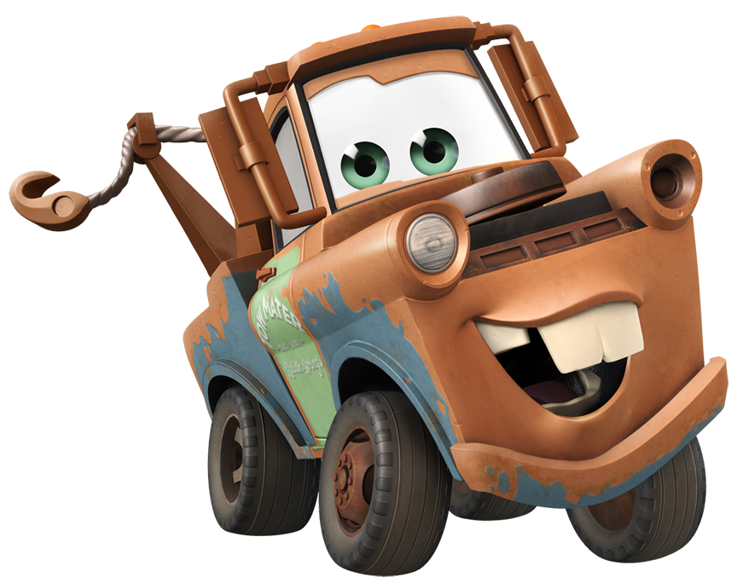
Conclusion and Future work.
The robot is showing proper responses whenever we move our hand. Different Hand gestures and multiple actions make our project very joyful and suitable for children to play with.
For future work,
The storage can be increased using external storage which allows for multi-record mode. Gestures to run every record separately would be defined.

