Slide 1



An-Najah National University
Faculty of Engineering
Urban Planning Department
Planning Jerusalem as a unified city
Prepared By:
Malak Raouf Hamadeh
Supervised By:
Dr. Ali Abdelhamid
Eng. Salah Shakhshir

Slide 2

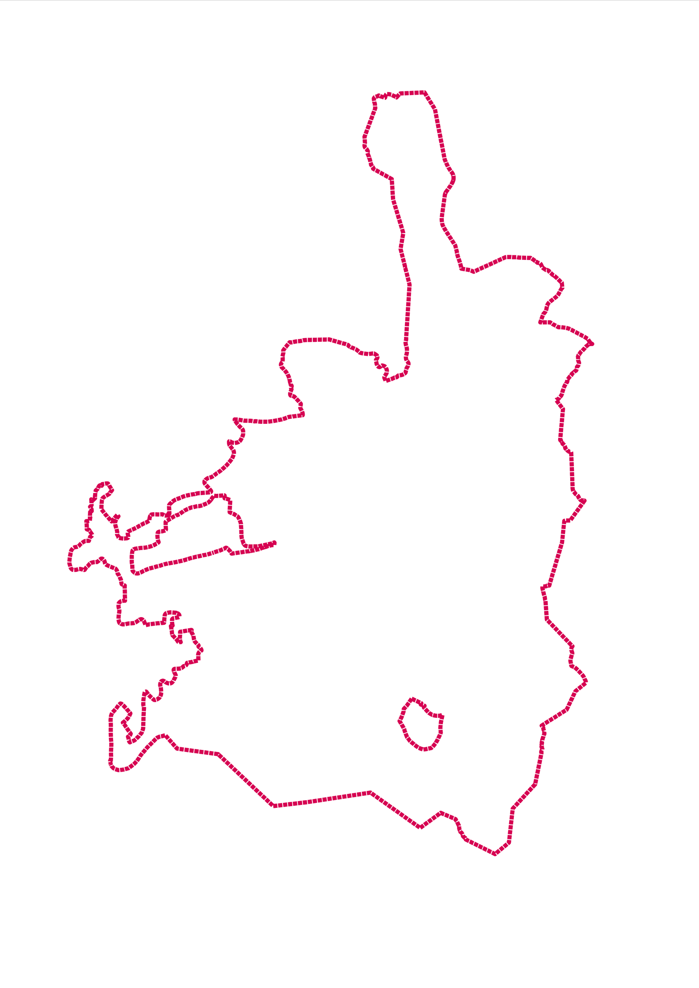




Project Concept
1
2
3
Jerusalem is considered one of the rare cities in the world, as it is divided into two parts: East and West.
This division has led to structural and functional disparities in the planning of all sectors within both parts of the city, resulting in a progressive western part and a regressive eastern part.
The study aims to:
A. Diagnose the current situation at both the regional and local levels, and shed light on the causes of the division.
B. Plan Jerusalem as a unified city and as the capital of Palestine under Palestinian sovereignty, while creating urban continuity among the Palestinian presence.

Slide 3

Project Objectives and Justifications
  The lack of studies on the city of Jerusalem is due to the political complexities and obstacles that hinder the availability of comprehensive data and information, as well as the gap created by the Israeli occupation. Therefore, this project aims to provide a comprehensive database.
  To assess and understand the current situation at both the regional and local levels.
  Redesigning Jerusalem will address existing problems, reduce disparities between its two parts, and serve as a reference for a resistant and alternative planning approach to Israeli attempts to impose control over the city.
  To improve coordination and cooperation among Jerusalem’s villages and enhance joint planning efforts.
  To create investment opportunities and open new horizons for economic development in Palestinian communities.

Slide 4

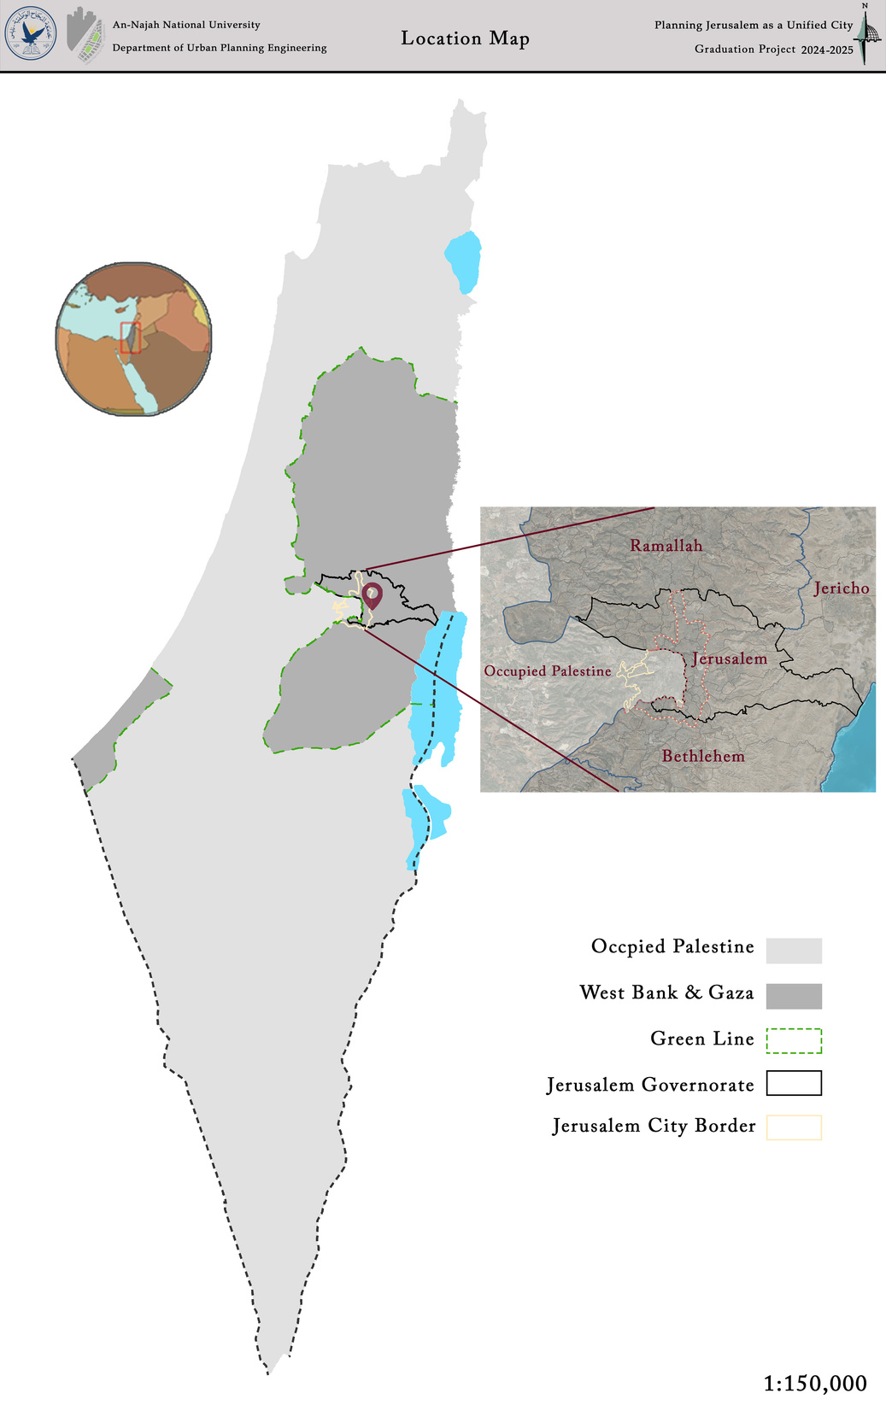
Location
Reason for Site Selection
  The historical and religious significance of Jerusalem, and its status as the capital of Palestine located at its heart.
  The scarcity of studies on the city and the distortion of facts by the Israeli occupation.
  Ongoing Israeli violations against residents, including land confiscation and forced displacement.
  The absence of proper Palestinian planning, as all current plans are imposed by the Israeli authorities.
  The presence of urban challenges such as:
Inadequate public services
Traffic and transportation problems
Urban sprawl
Weak infrastructure in certain areas
  The increasing threat of Israeli settlement expansion, leading to further fragmentation of Palestinian geographic continuity.

Slide 5
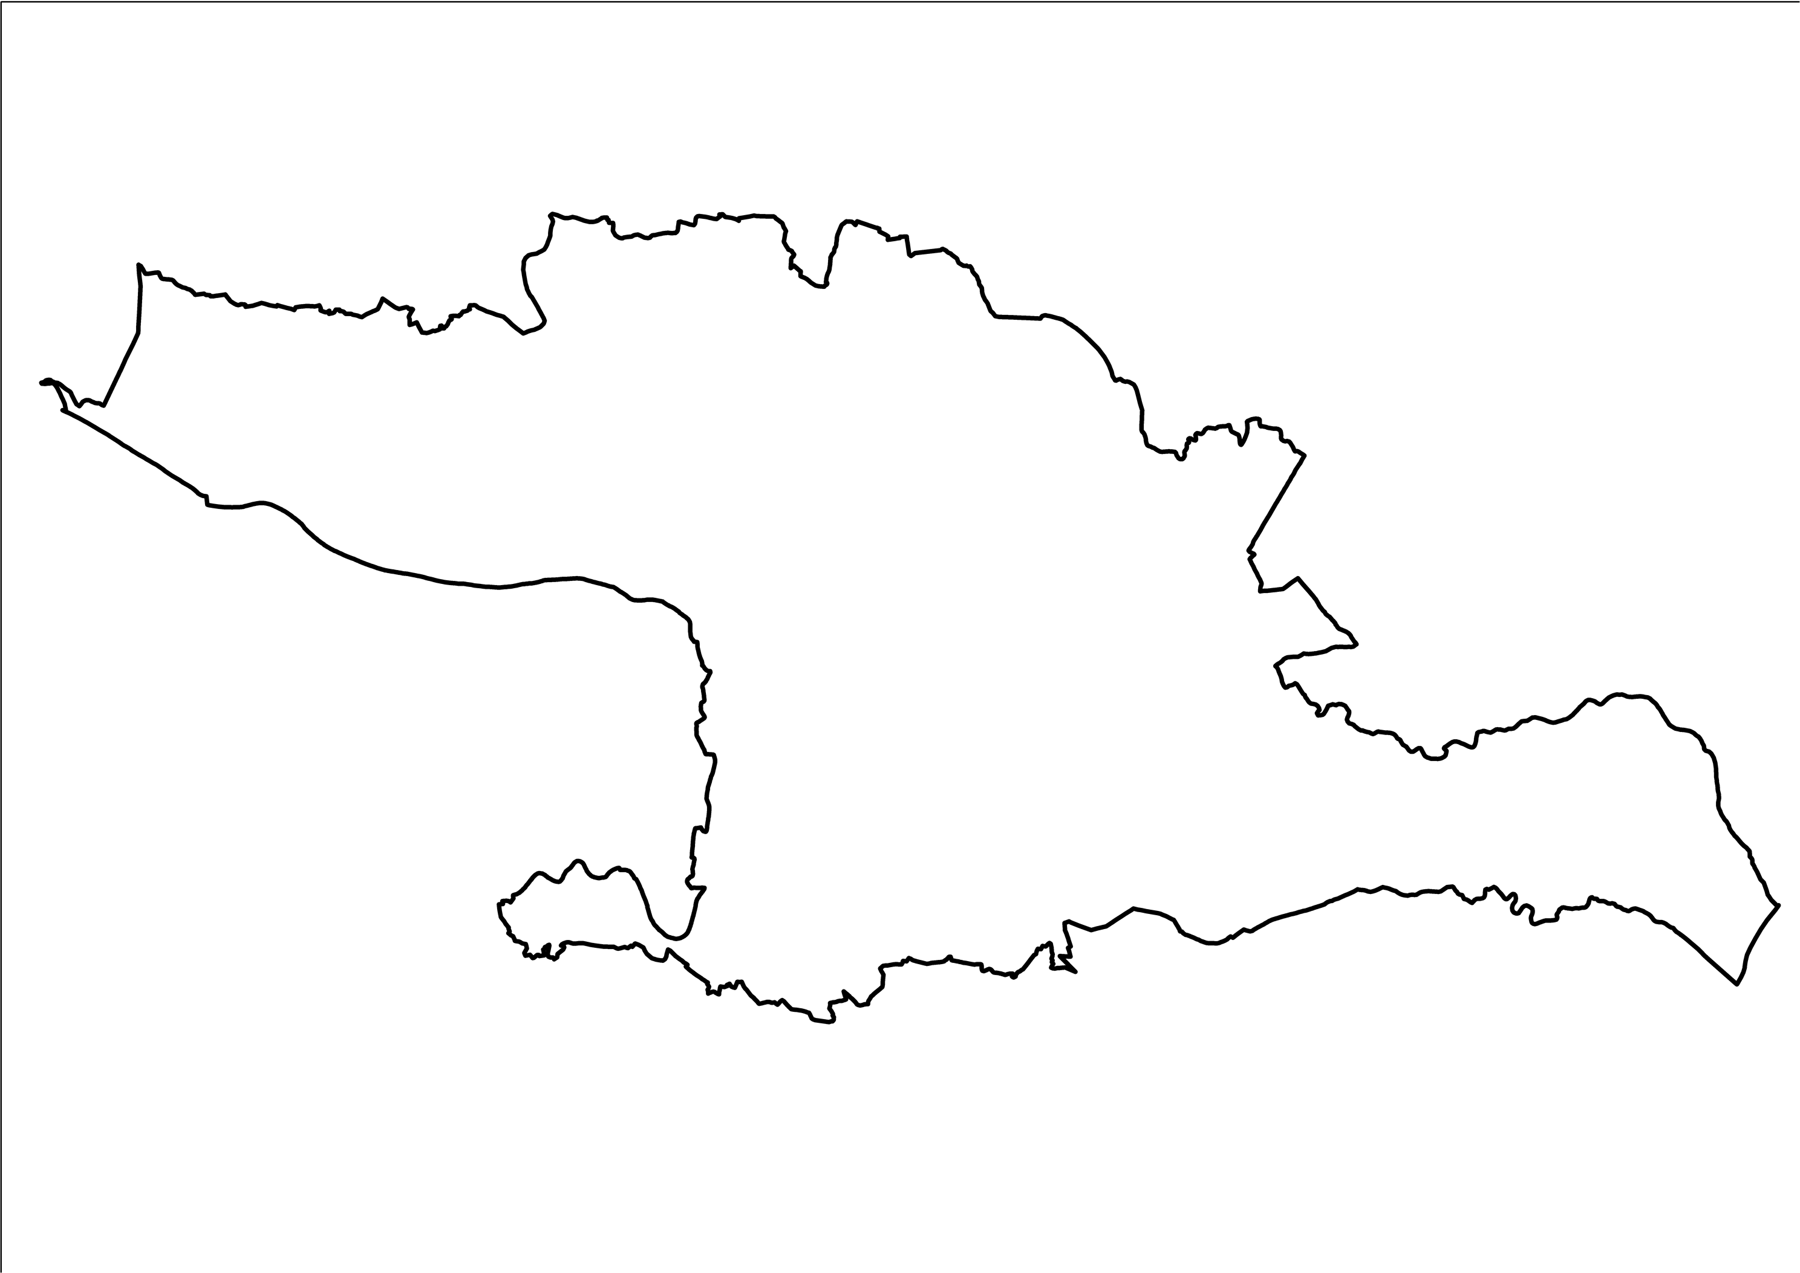
Regional Analysis

Slide 6
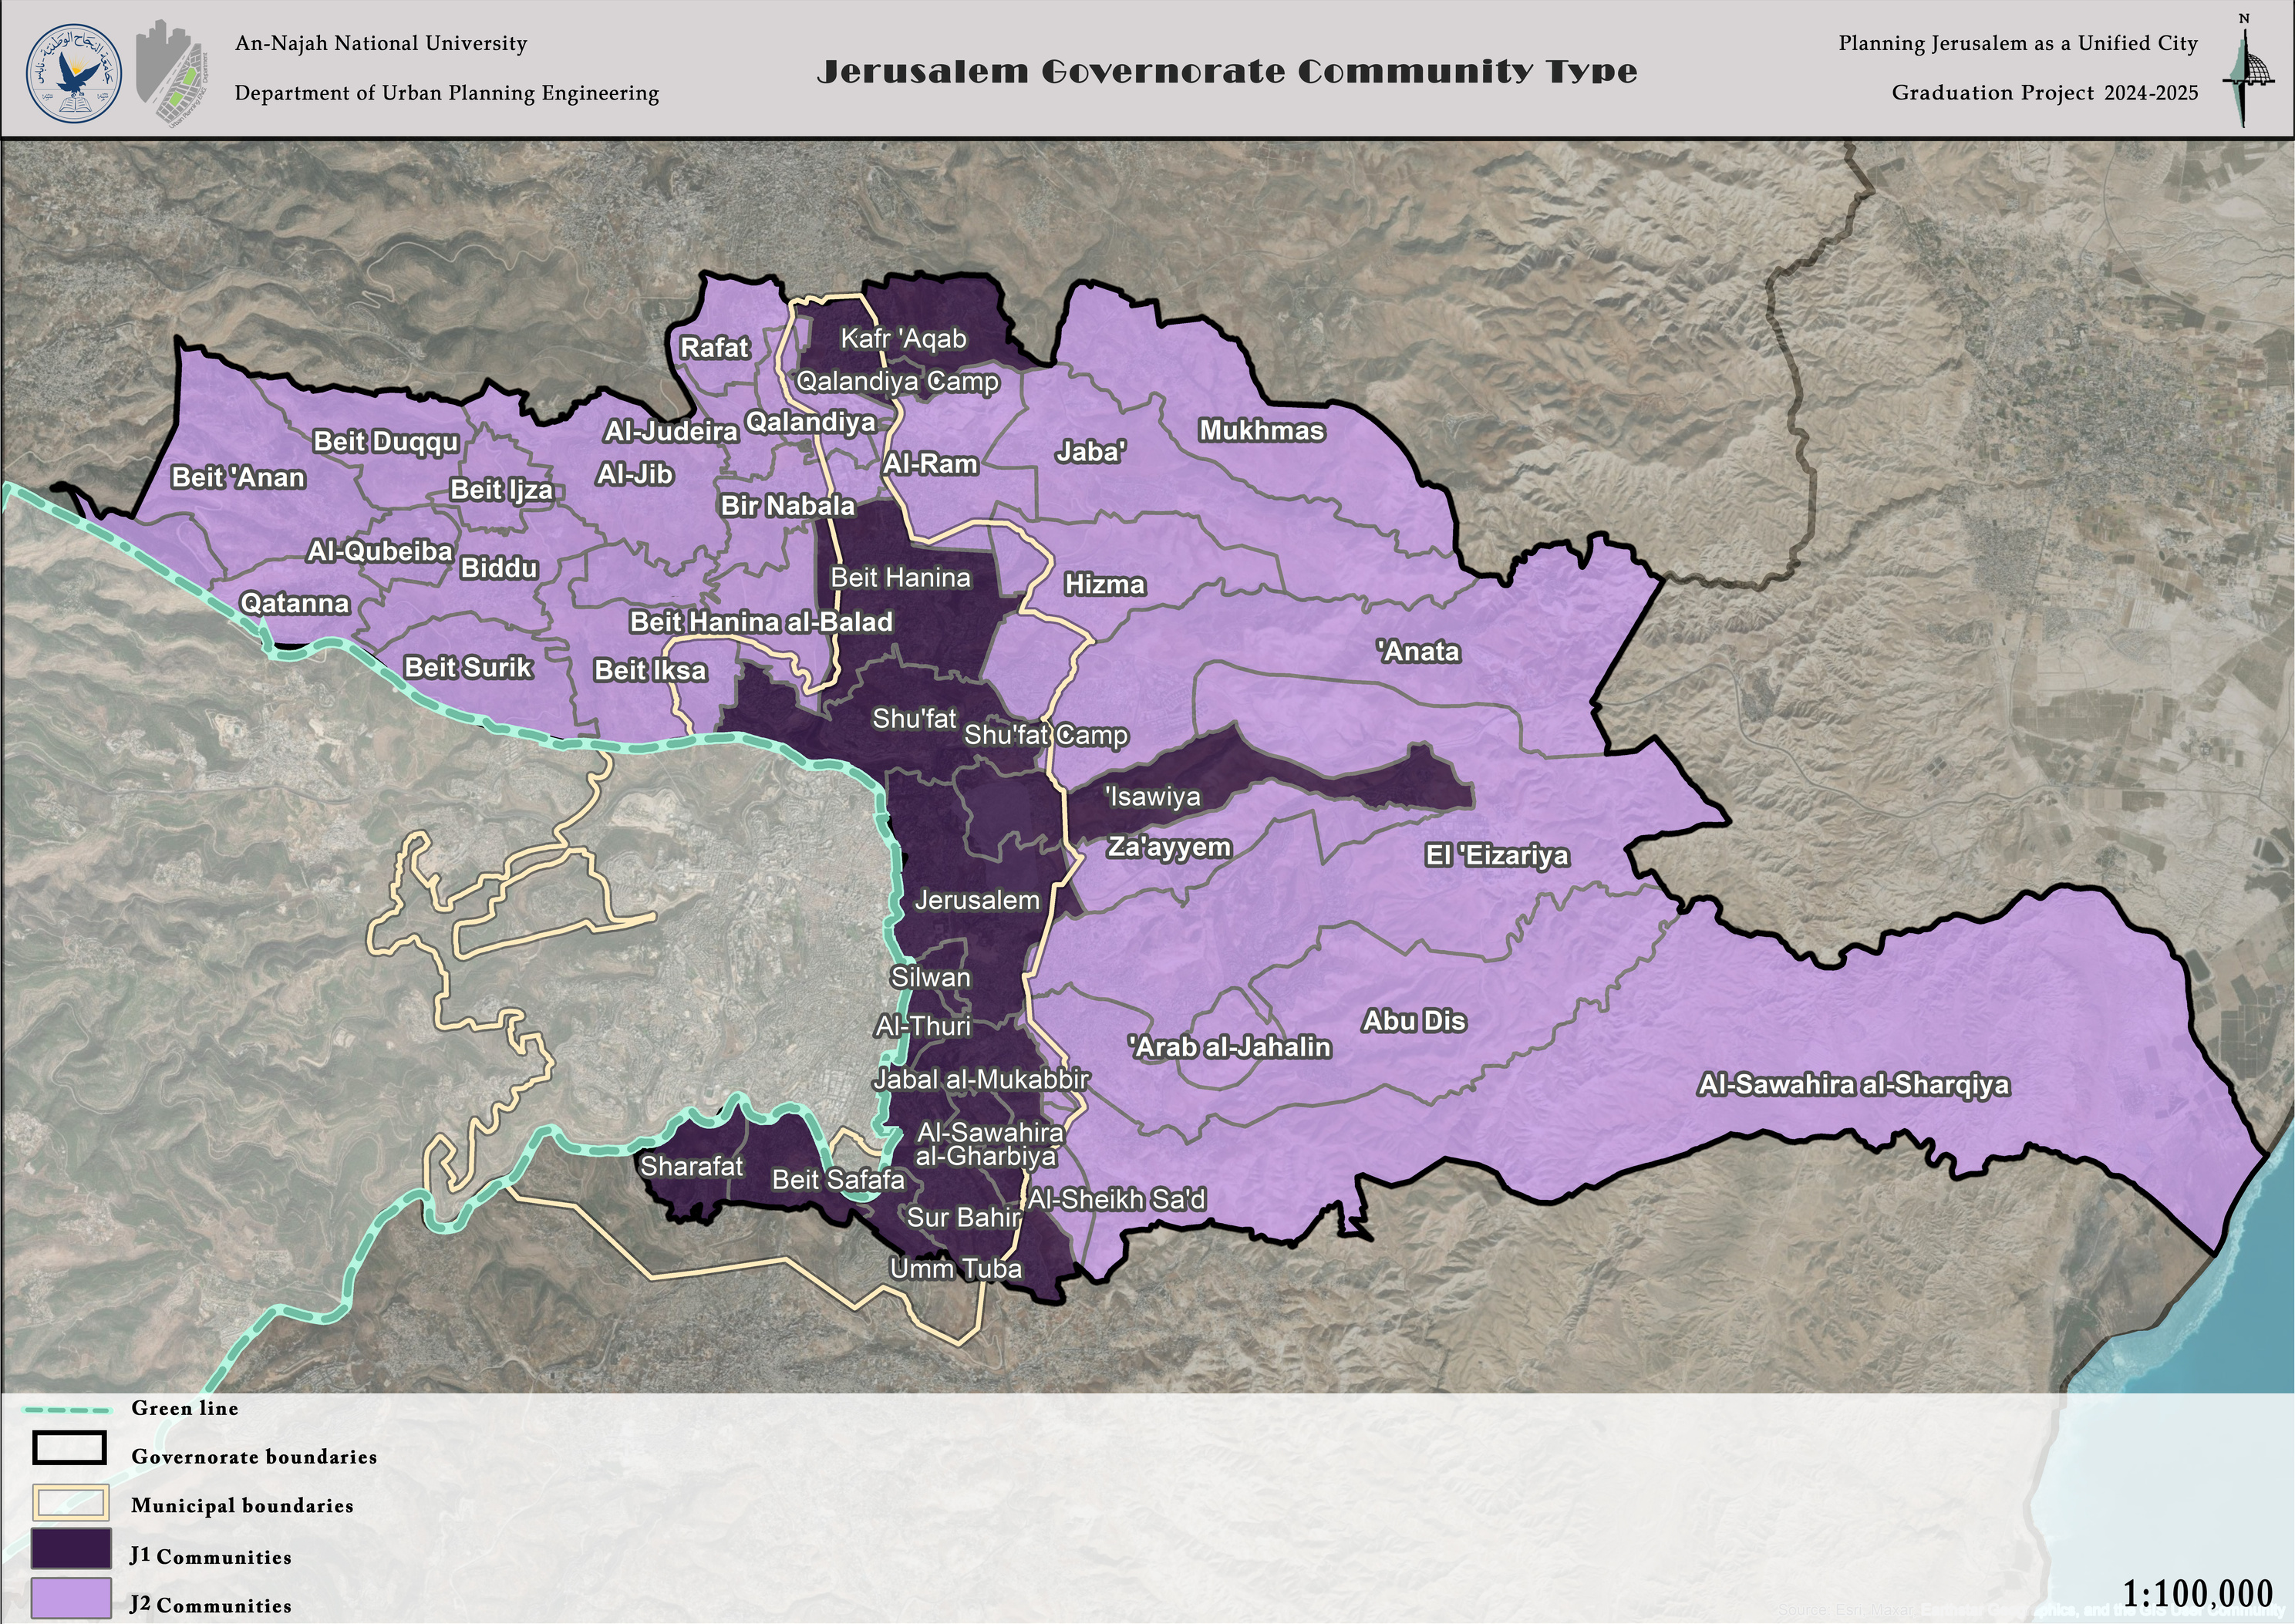
General Analysis
Community Type

Slide 7
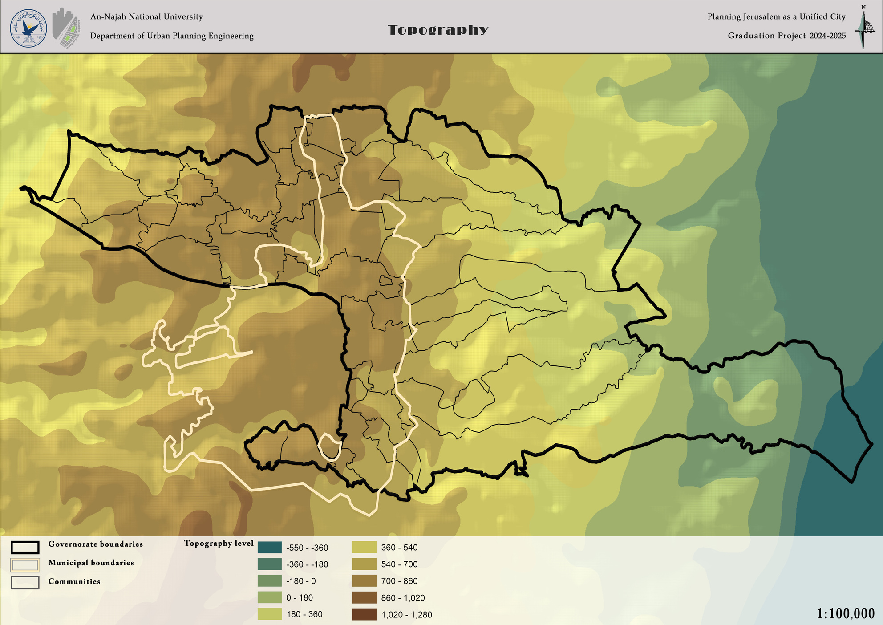
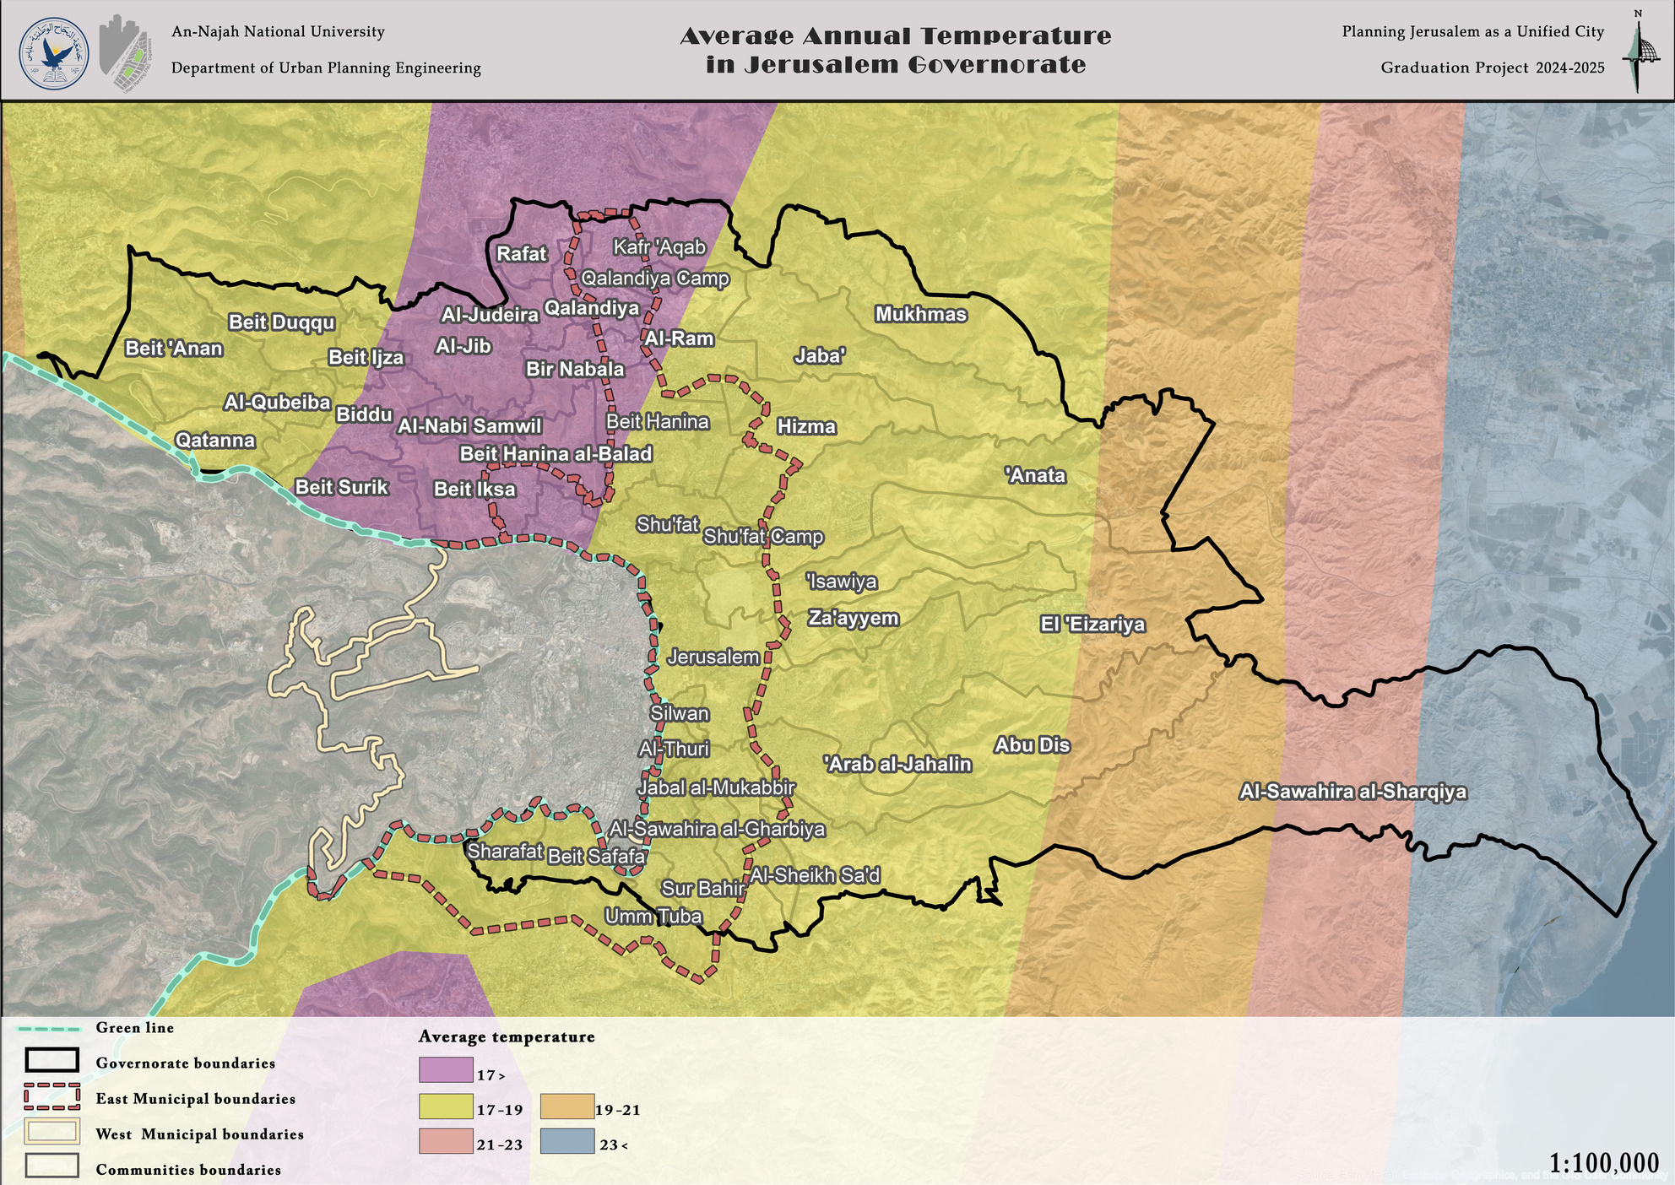
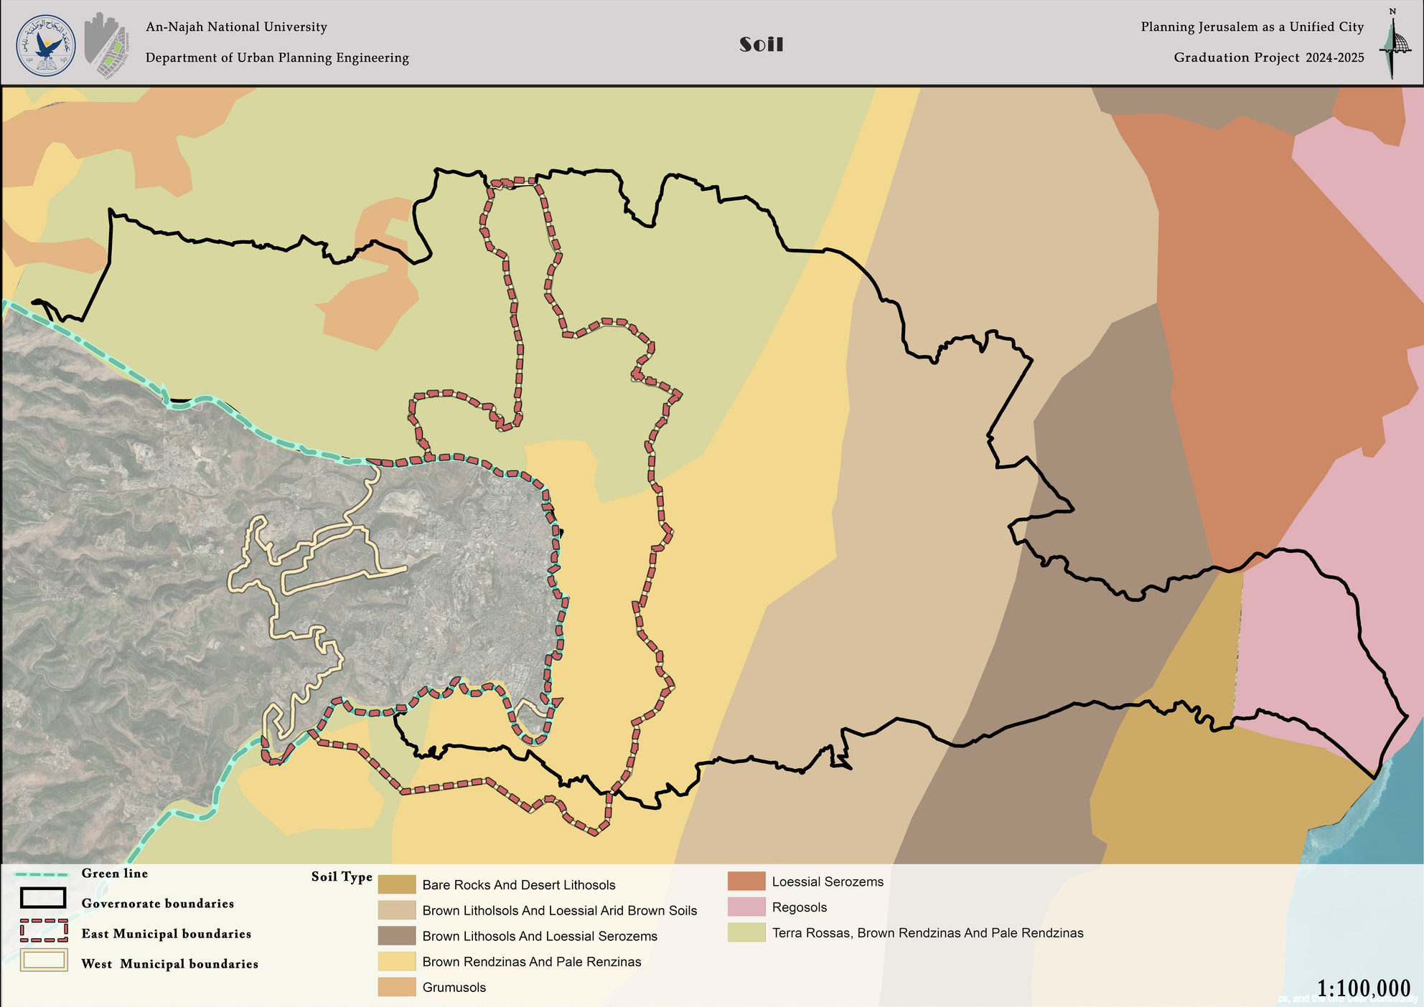
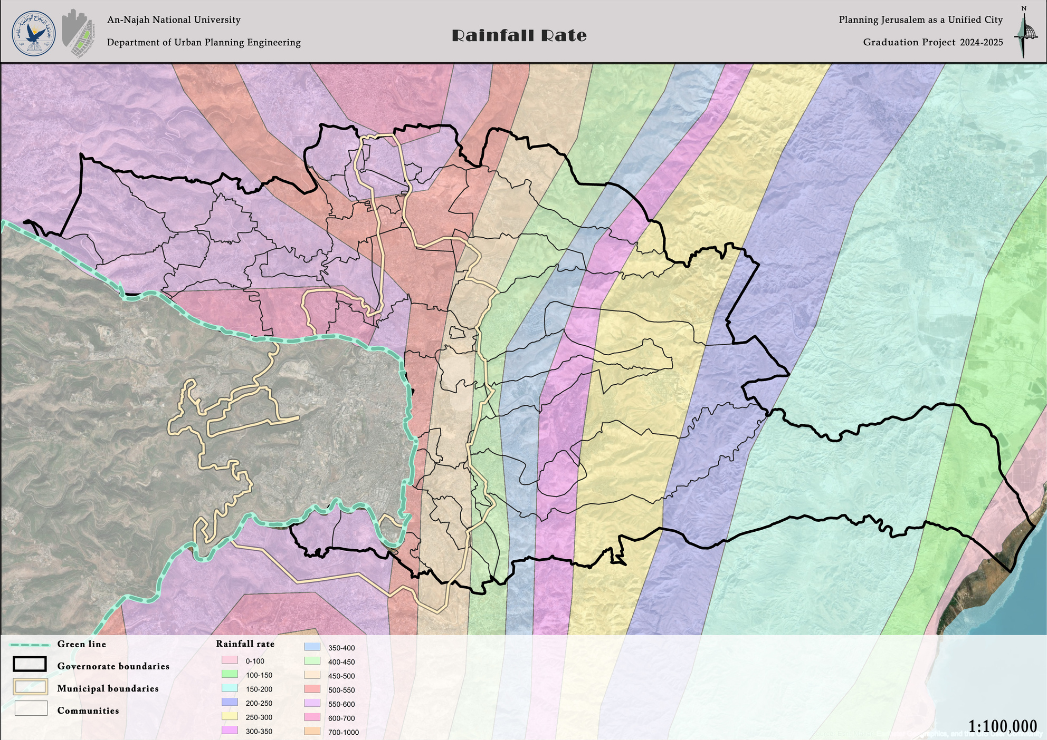
General Analysis
Topography
Avg. Temp
Soil
Rainfall

Slide 8
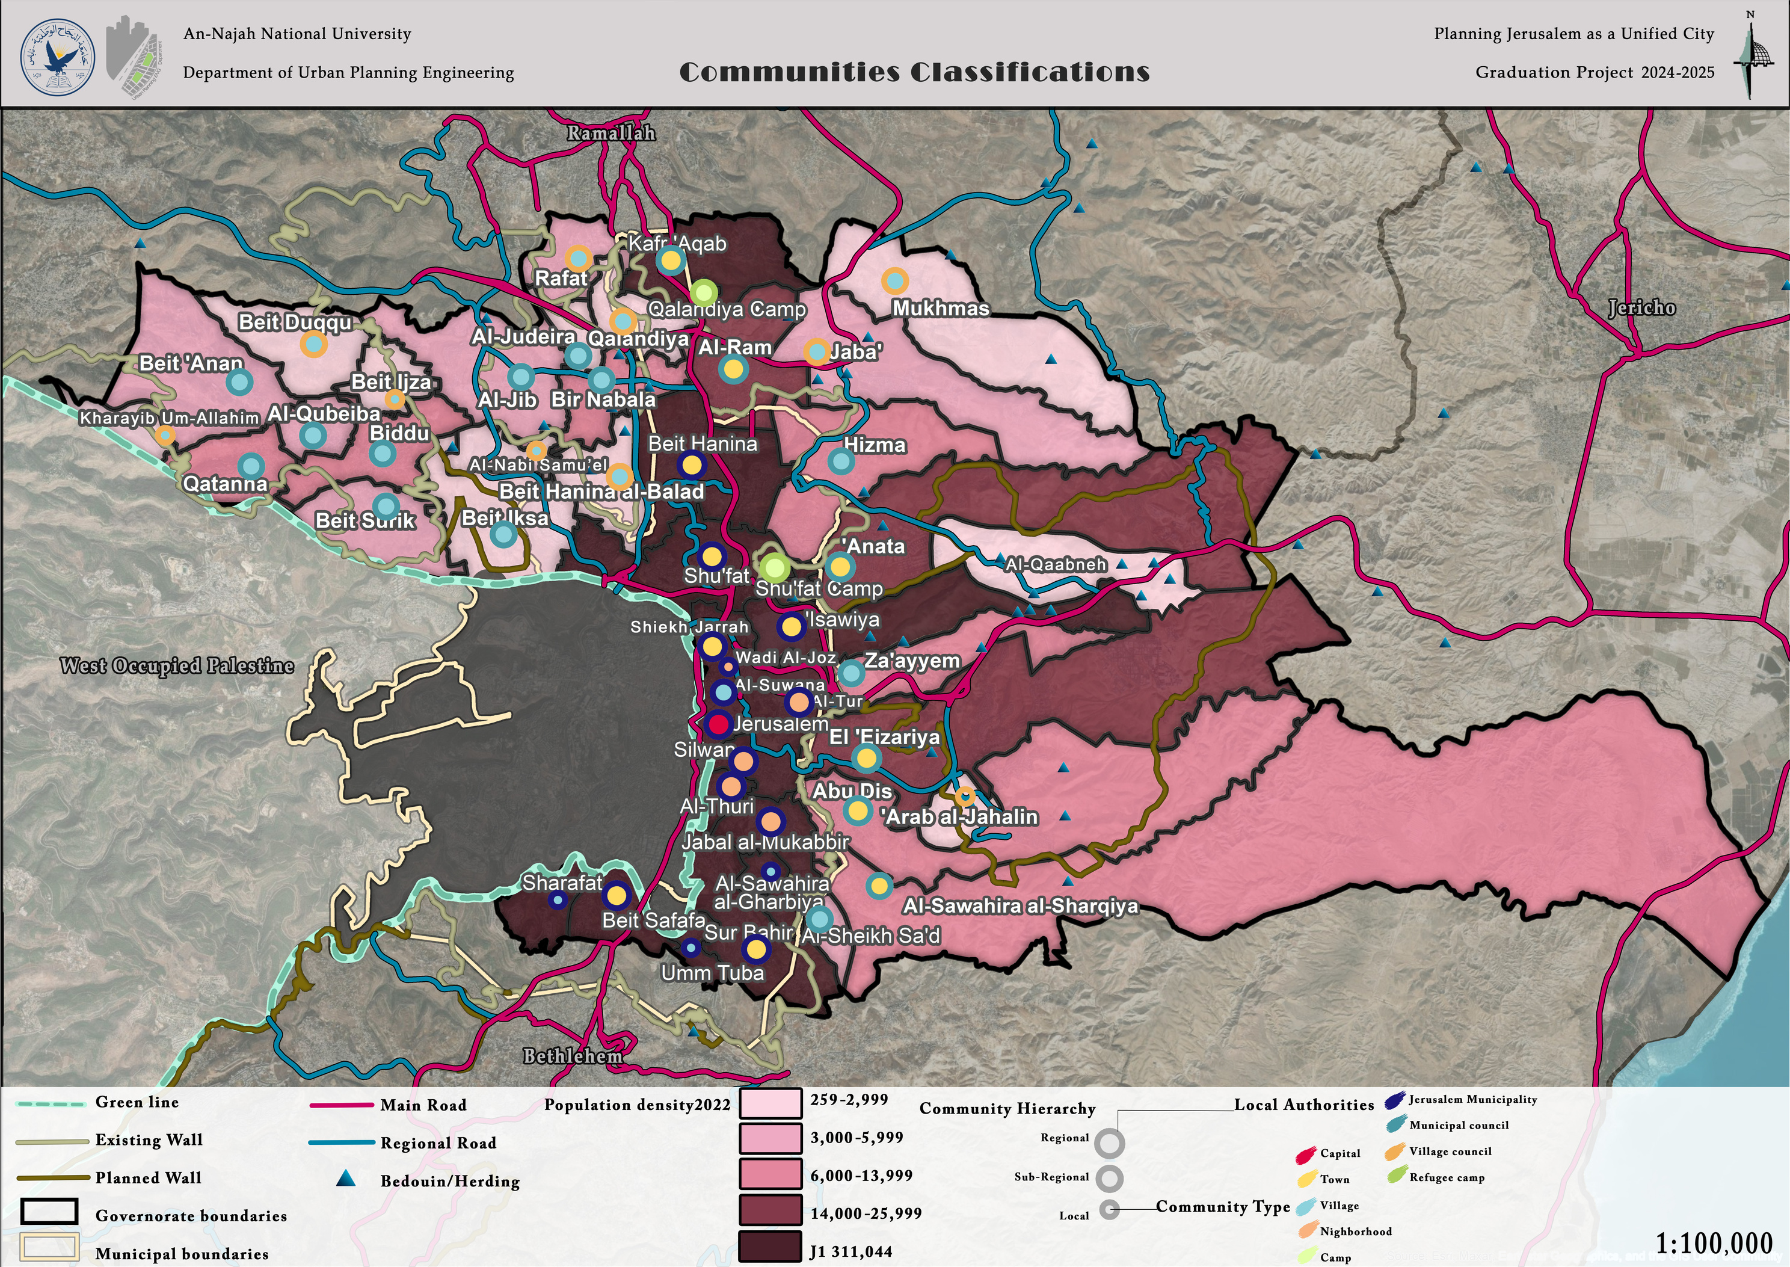
General Analysis
Topography

Slide 9
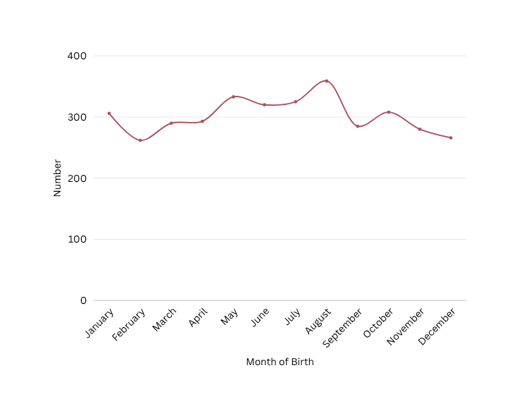




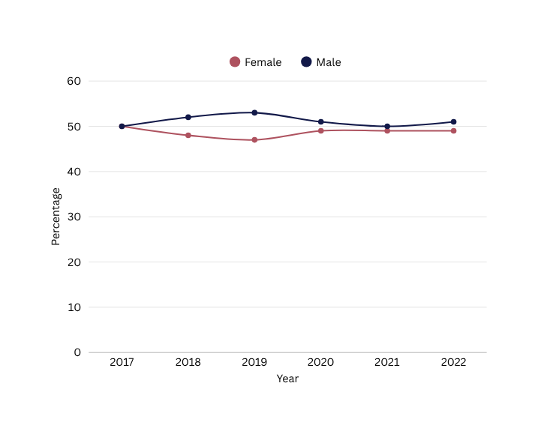



General Analysis
Number of Registered Life Births* in Jerusalem Governorate, by Month of Birth, 2022
Demography
Population in Jerusalem Governorate mid-2023
492,340
174,665
317,675
J2 Area
J1 Area
Percentage of males and females out of the total registered live births in Jerusalem Governorate, 2022
*Data includes live births of Jerusalem governorate holding Palestinian ID’s only.
49%
51%
Percentage Distribution of the Number of Registered Births* in Jerusalem Governorate and by Sex, 2017-2022
Percentage of males and females among the total number of registered deaths in Jerusalem Governorate, 2022
45%
55%

Slide 10
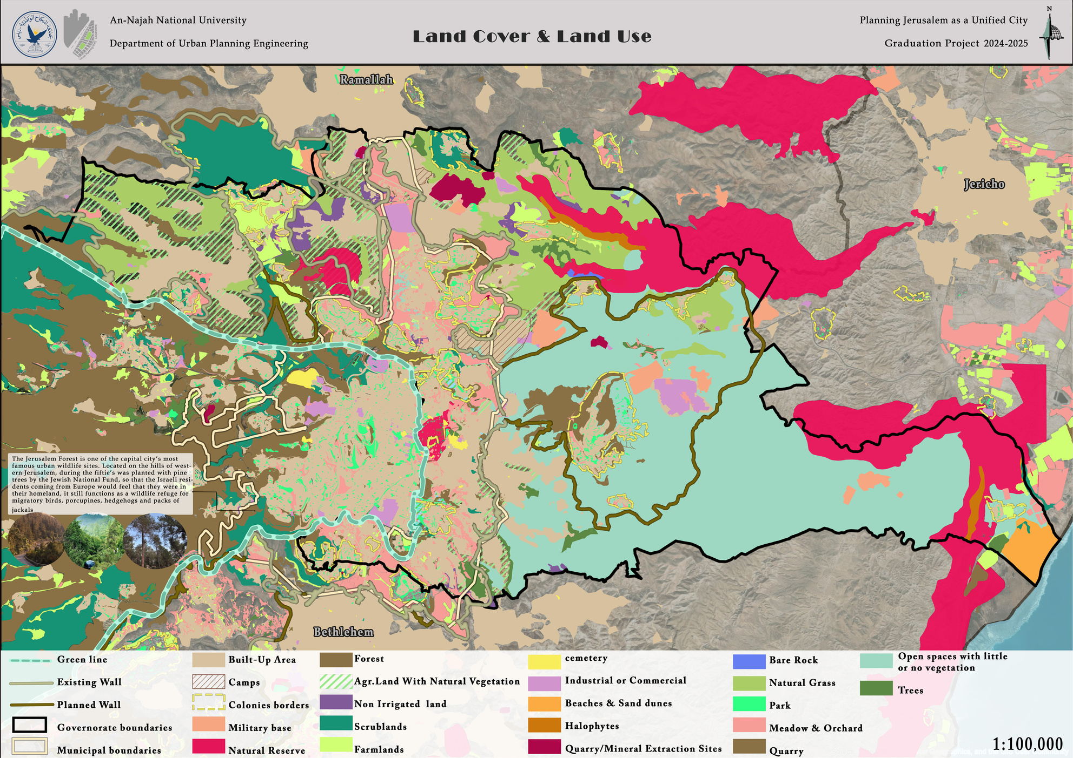
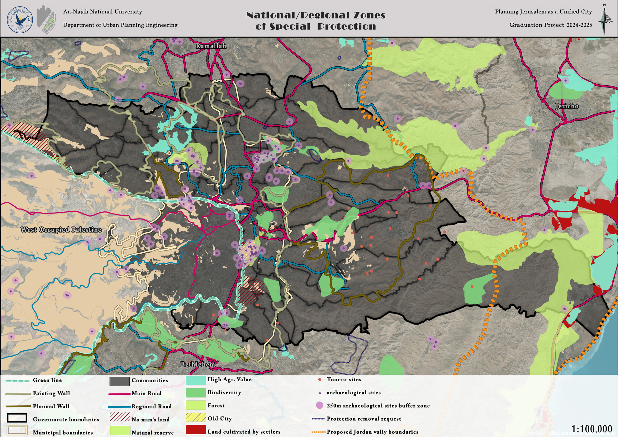
Land Use Analysis
Land Cover & Land Use
National/Regional Zones of Special Protection

Slide 11
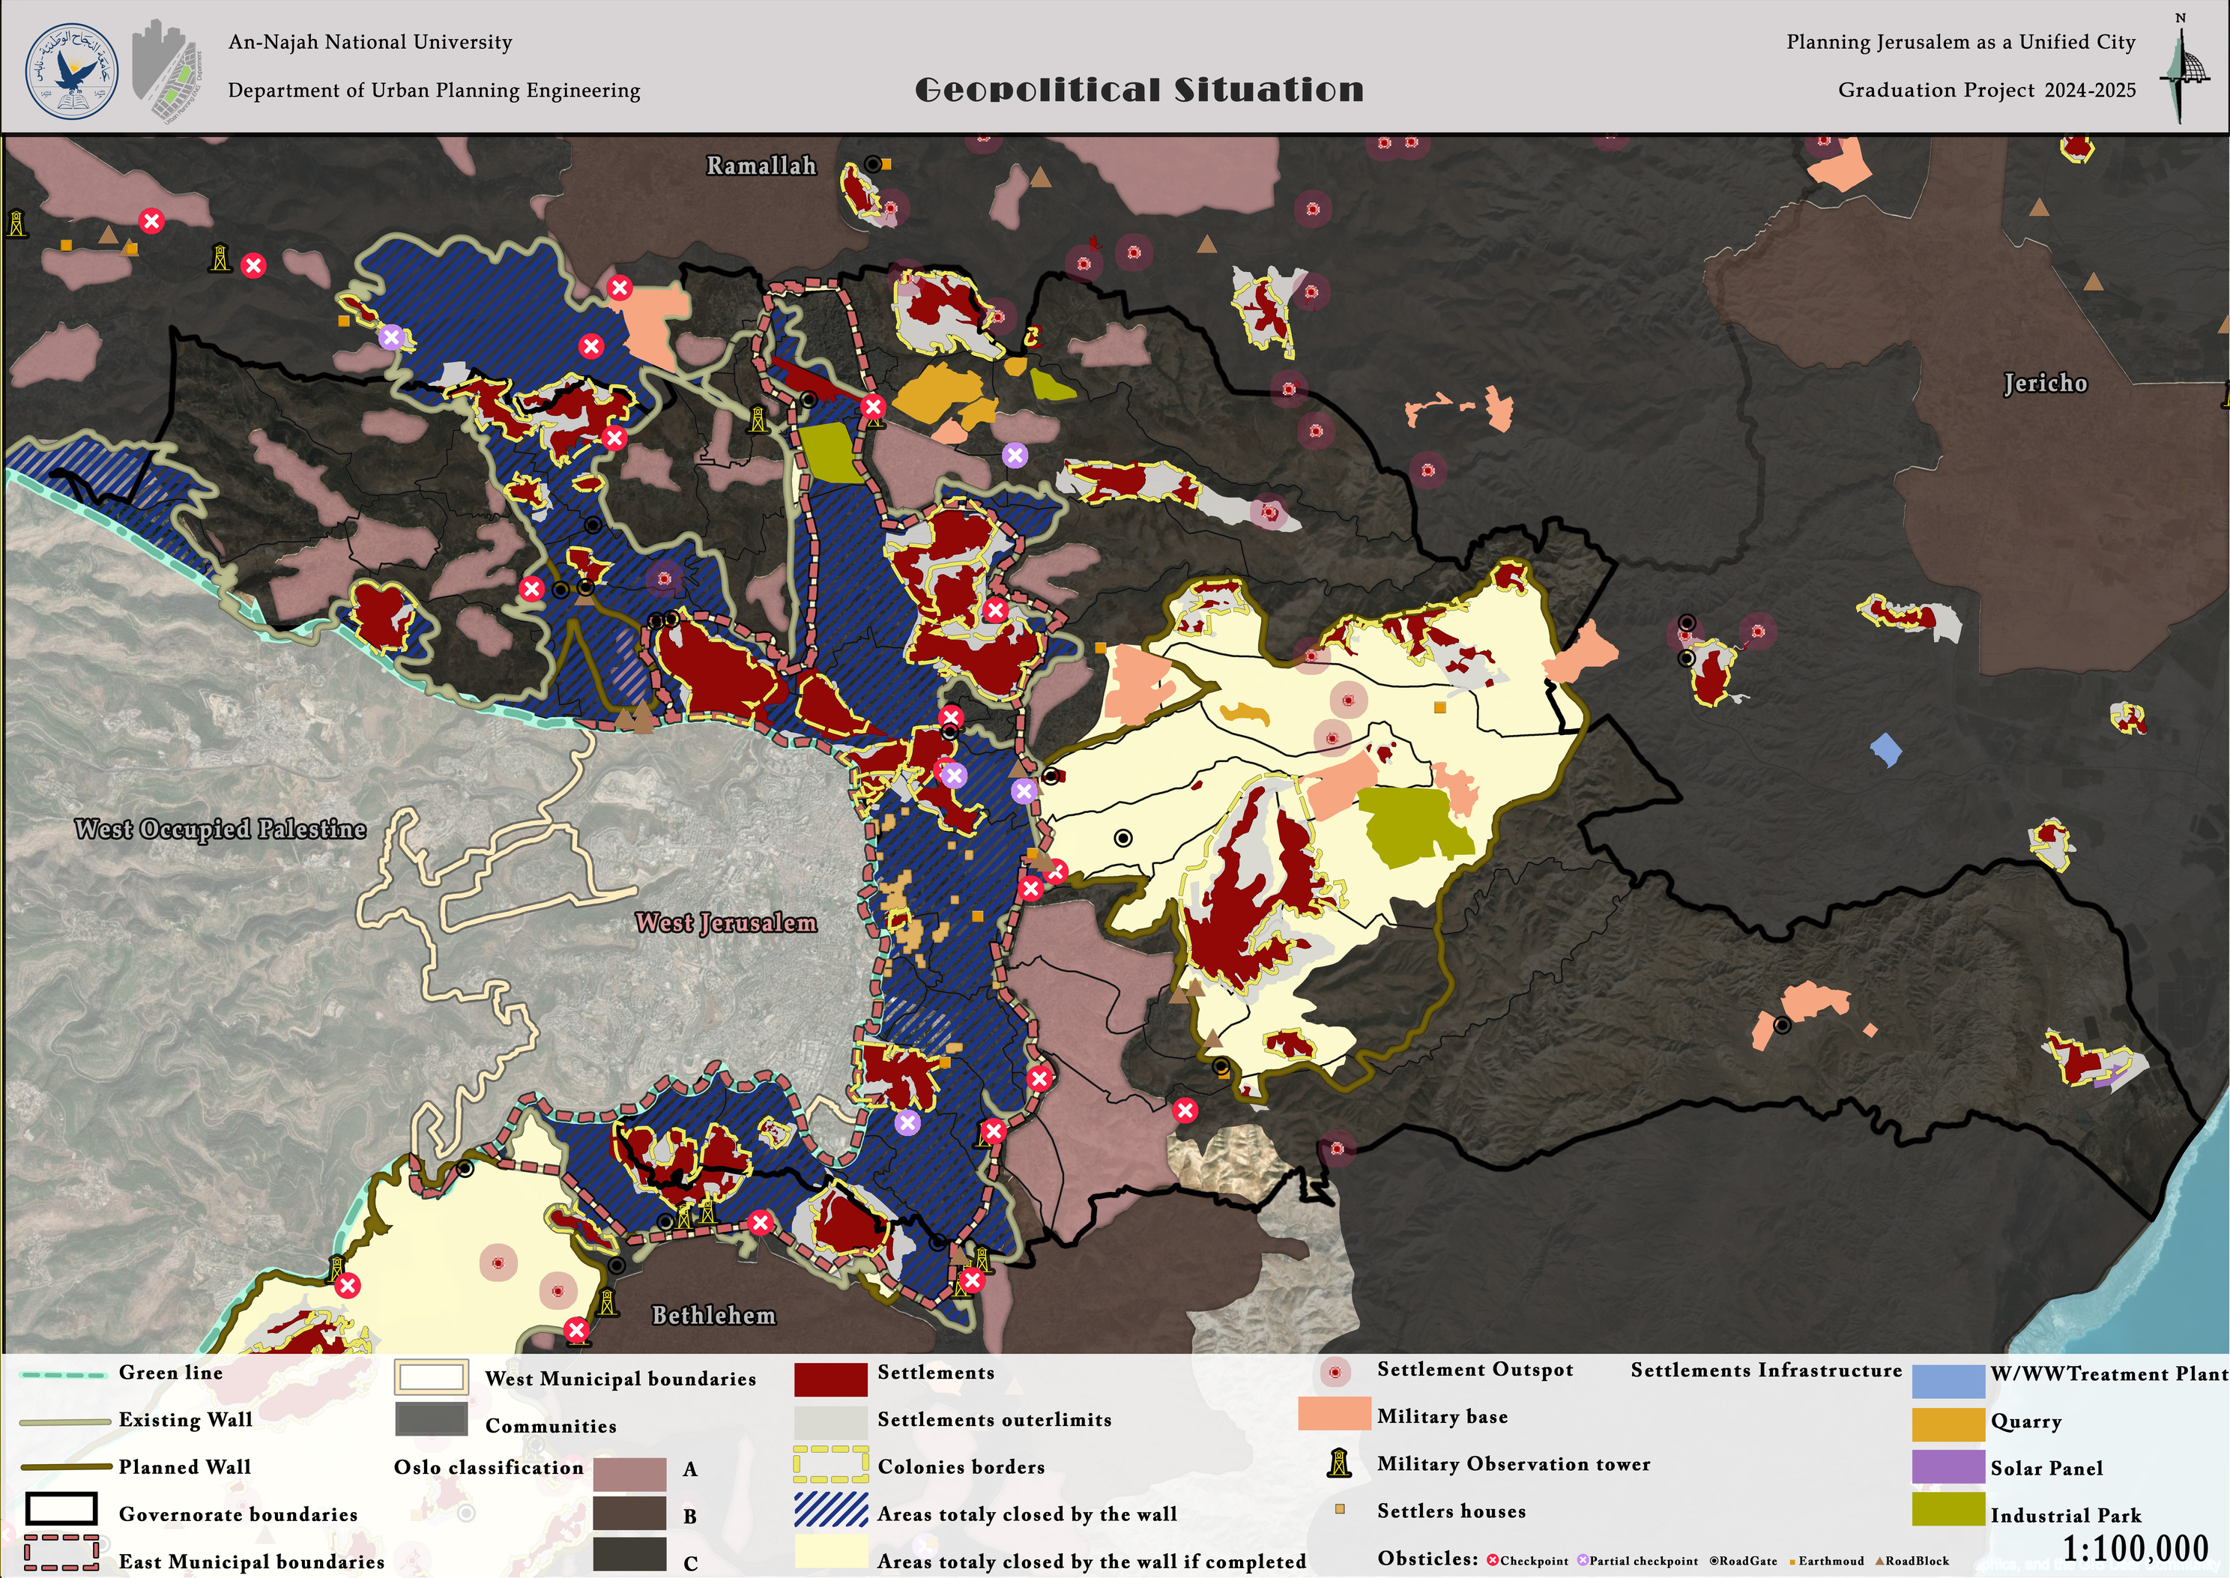
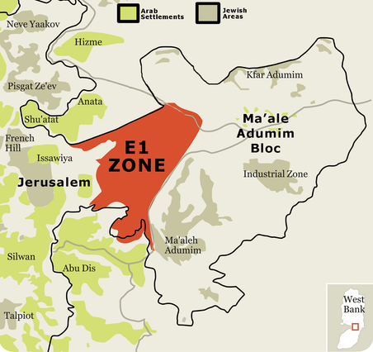
Geopolitical Analysis

Slide 12
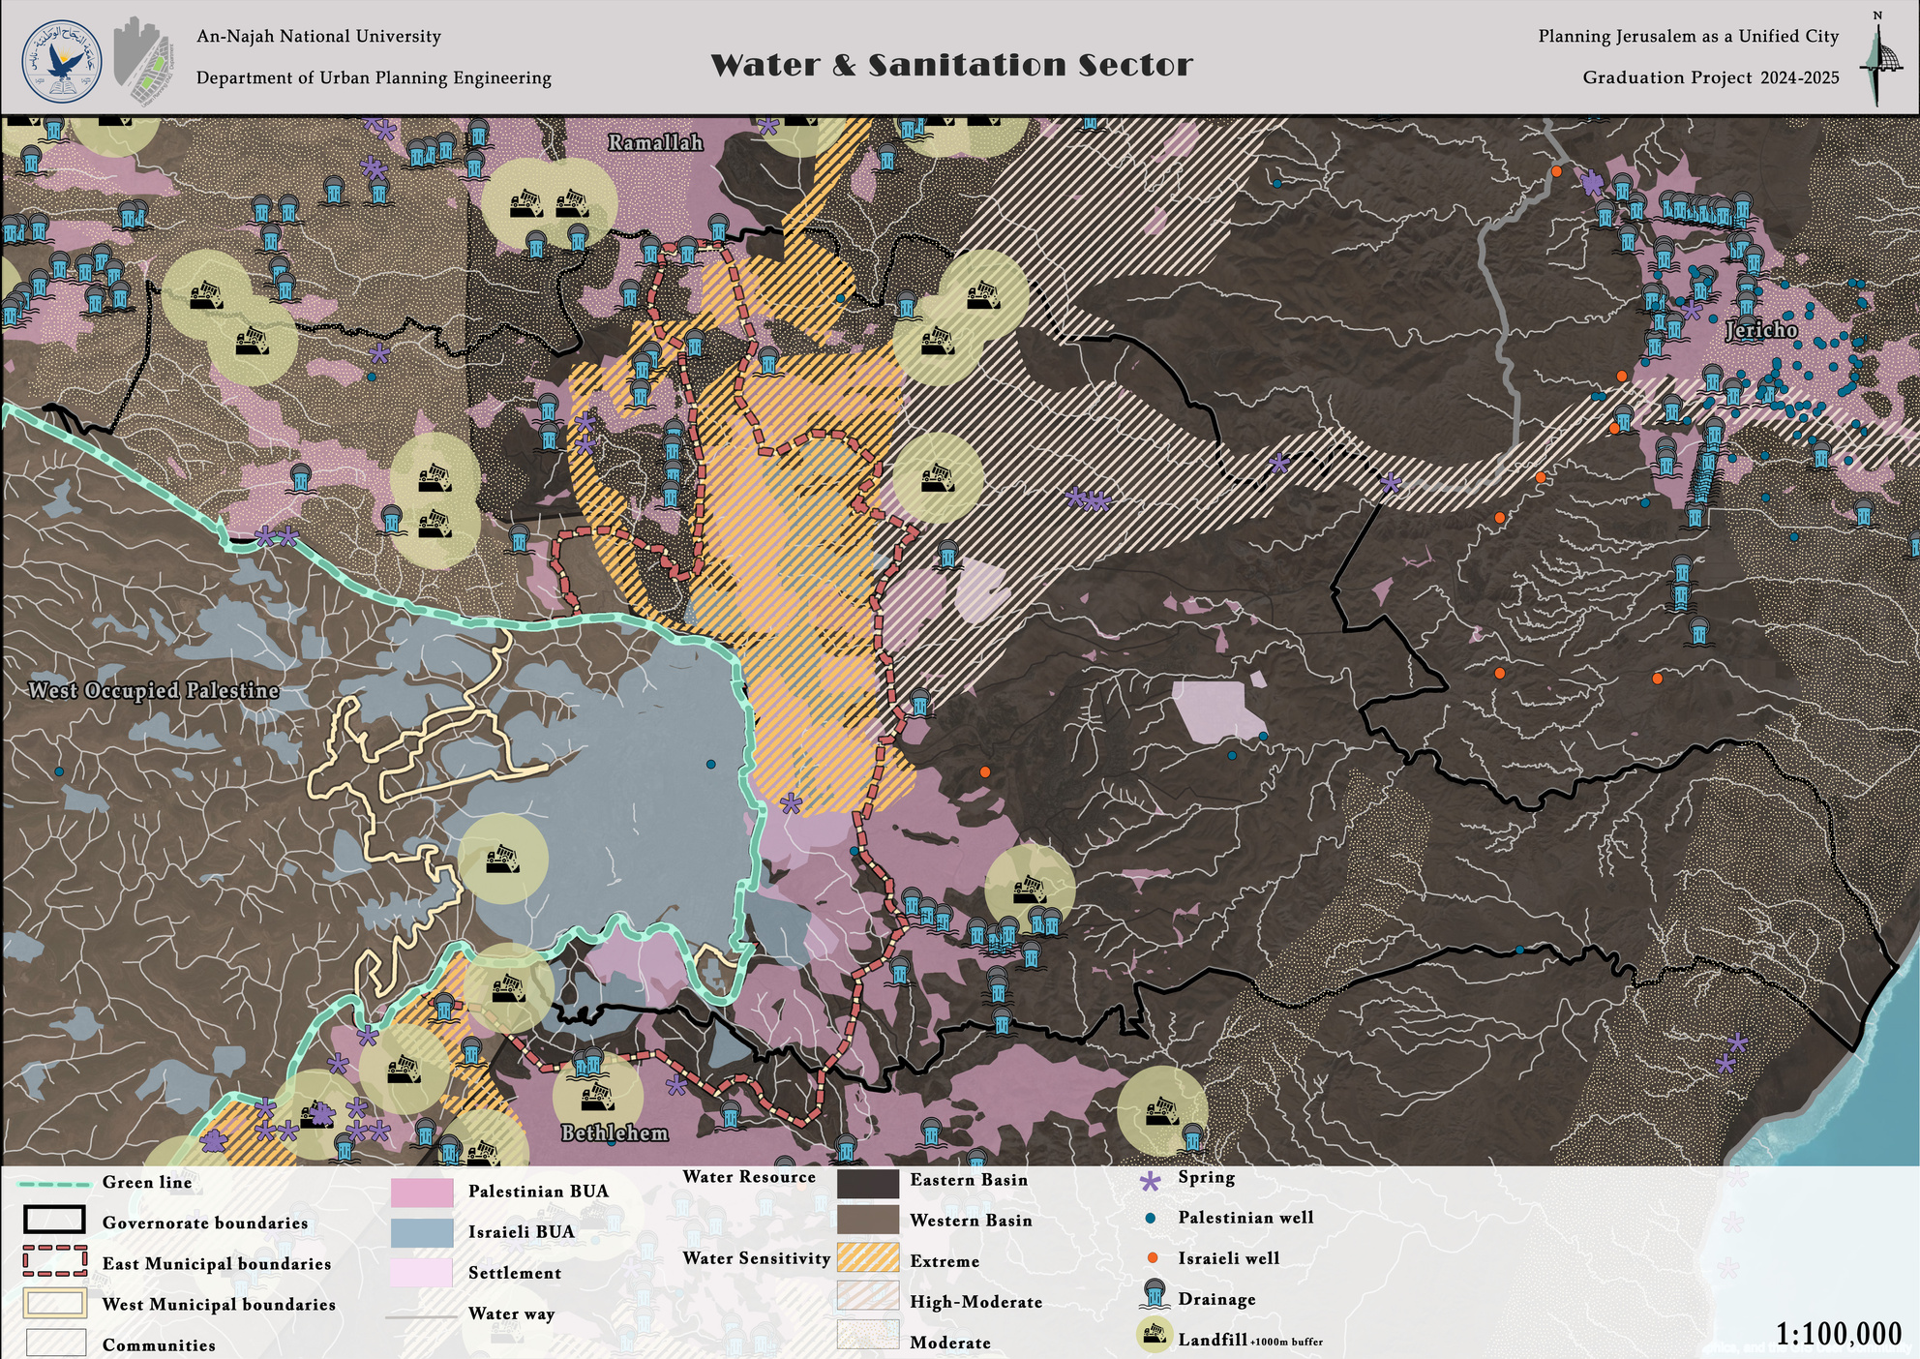
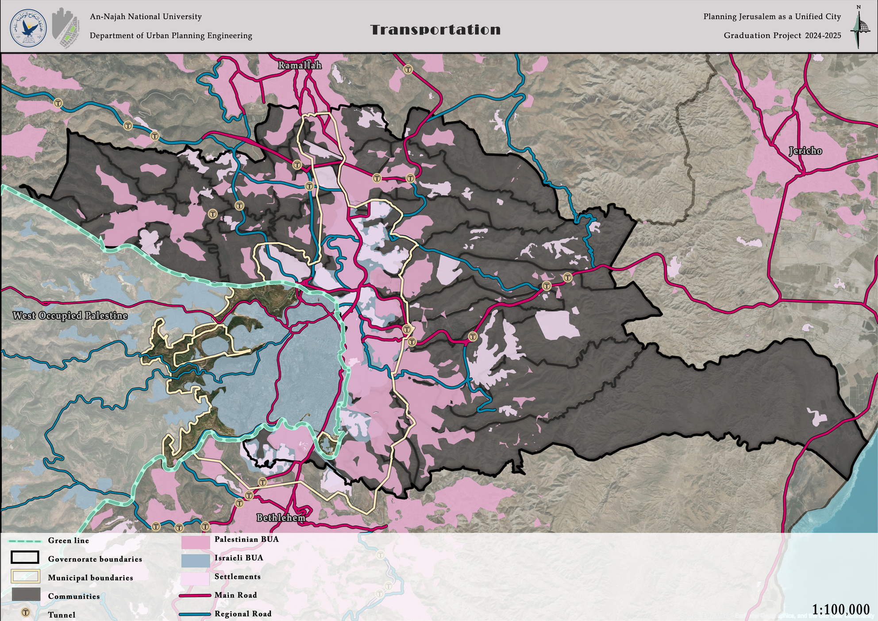
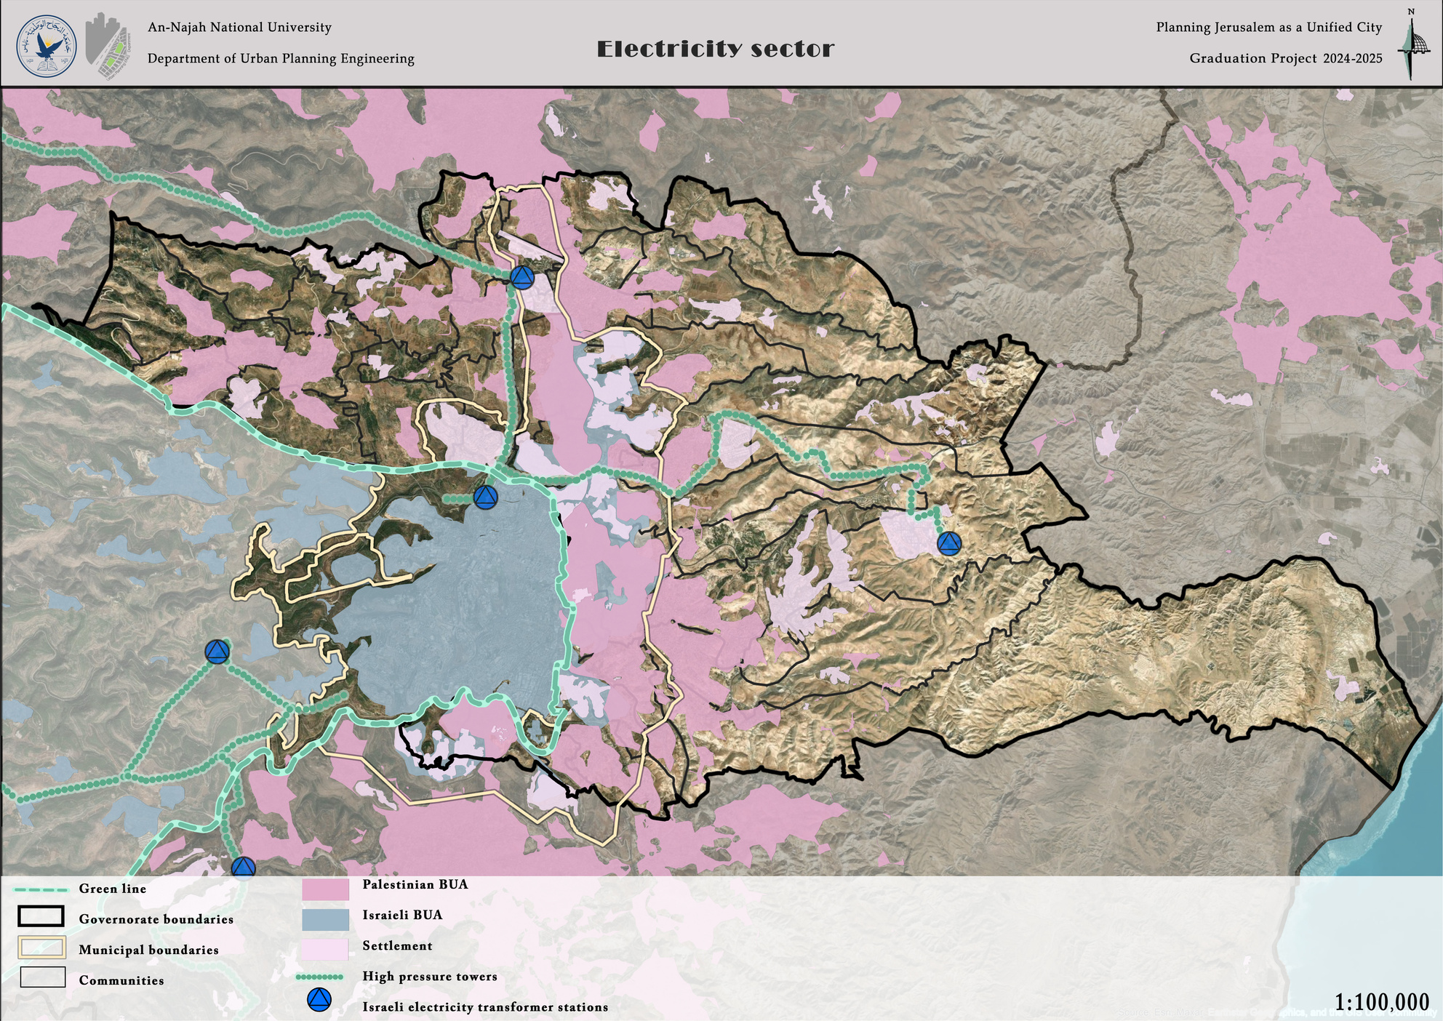
Infrastrucural Analysis
Water & Sanitation
Transportation
Electricity

Slide 13
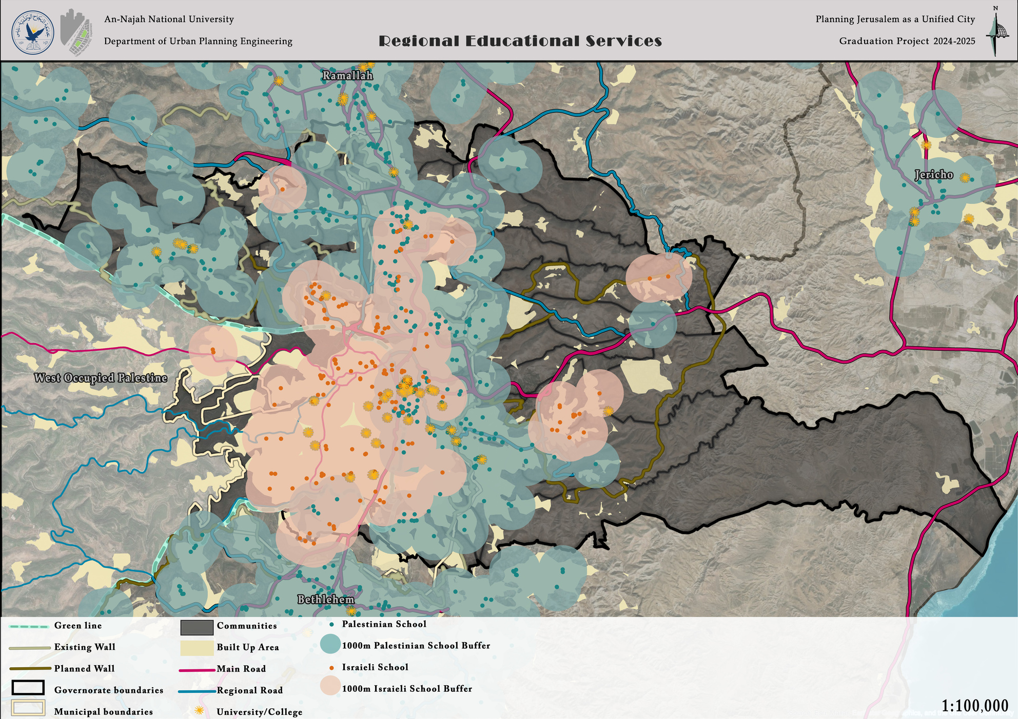
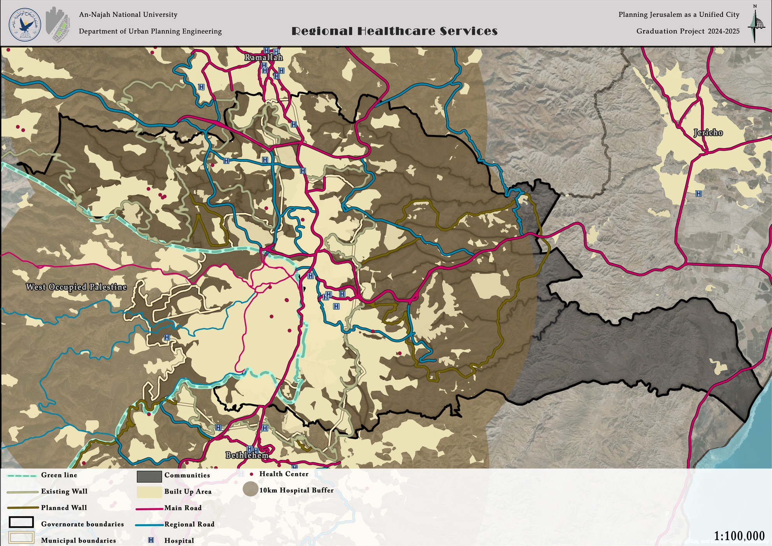



Services Analysis
Education
Health
Government
UNRWA
Private
23 Student
Jerusalem Governorate
J1 Area
J2 Area
23 Student
22 Student
22 Student
24 Student
24 Student

Slide 14
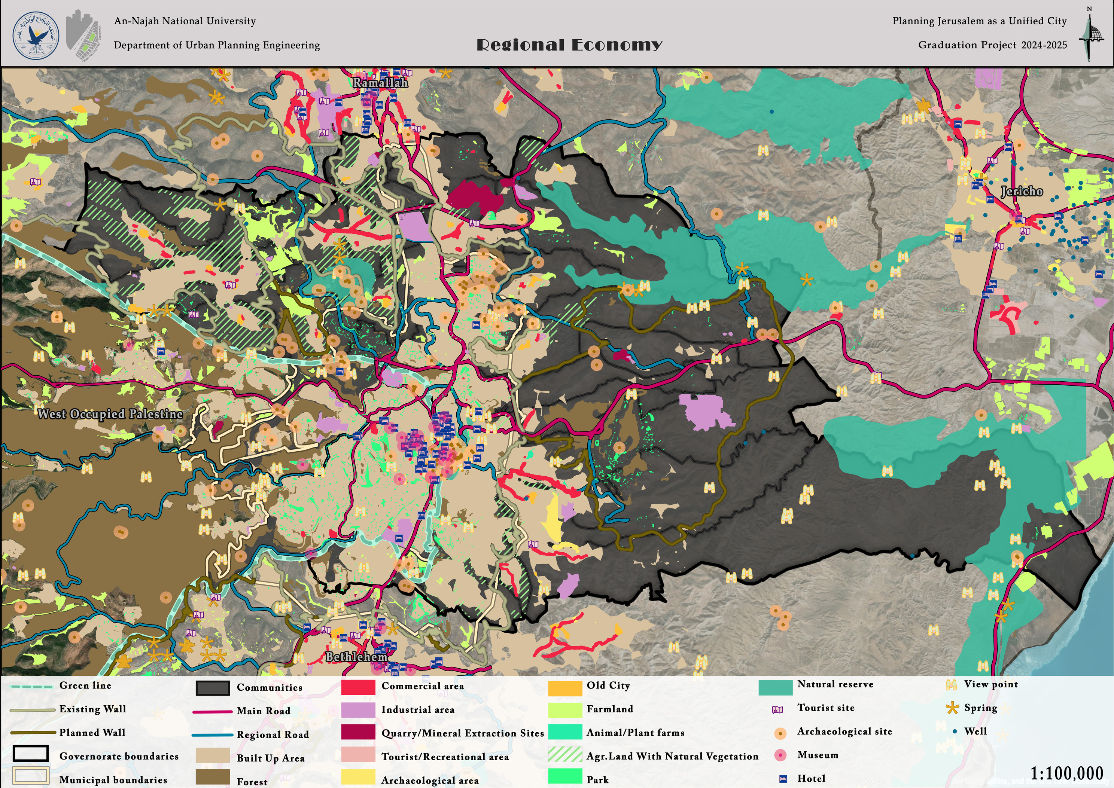



Economic Analysis
The value of monitored commodity exports for the Jerusalem Governorate for the year 2022 (value in thousand US dollars)
The total value added of monitored economic activities that are consistent with international standards in the Governorate Jerusalem Area 1 for the year 2022
The value of monitored commodity imports for the Jerusalem Governorate for the year 2022 (value in thousand US dollars)
1,382.3
Million Dollar
(At commercial prices)

Slide 15
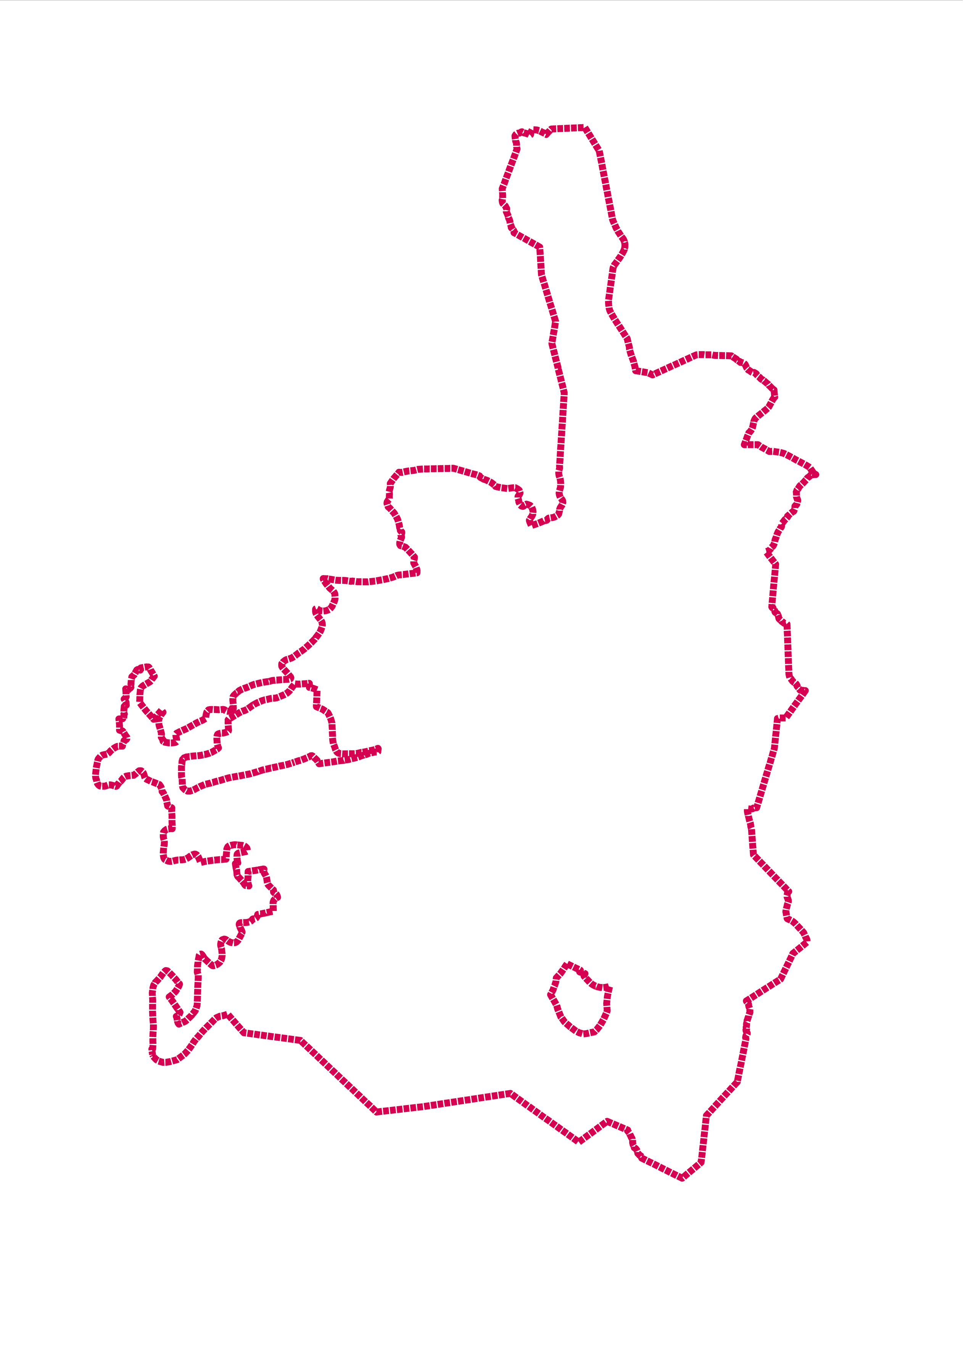
Local Analysis

Slide 16
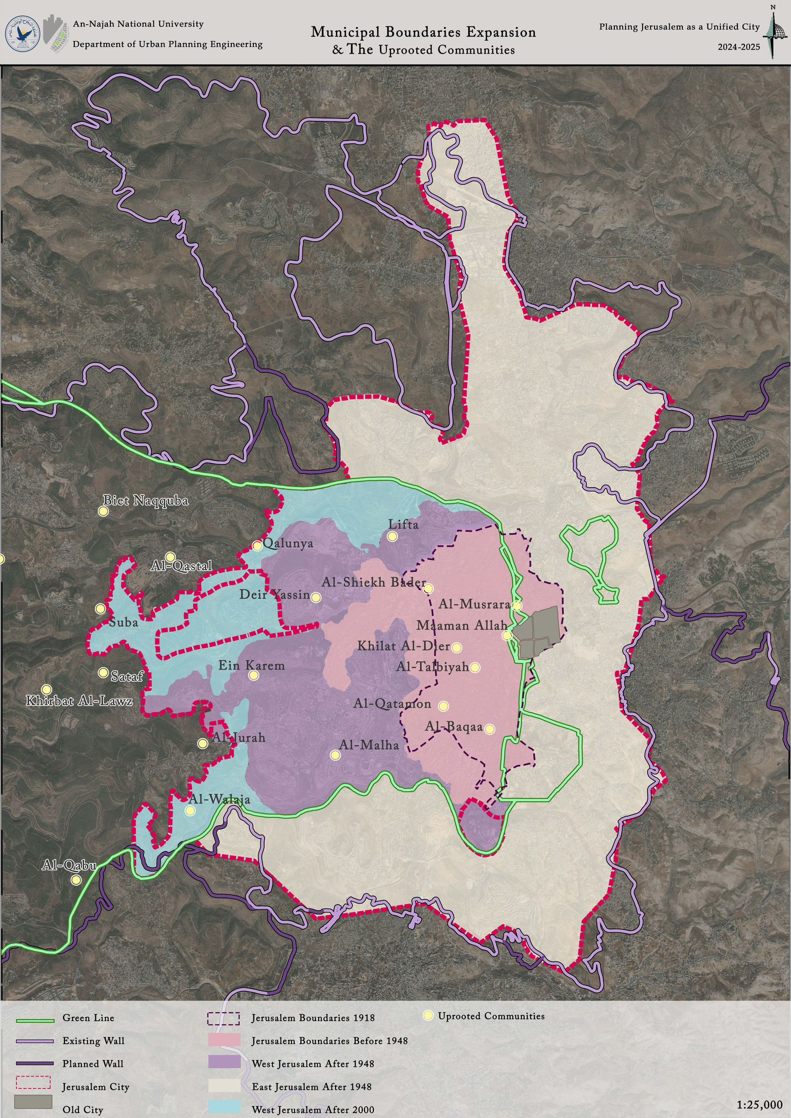
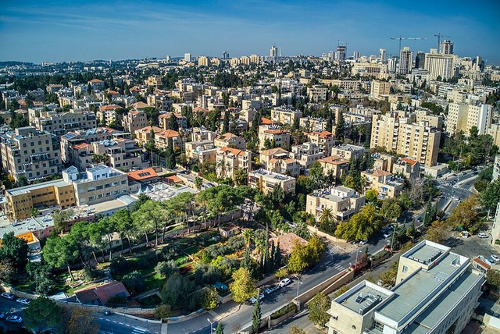
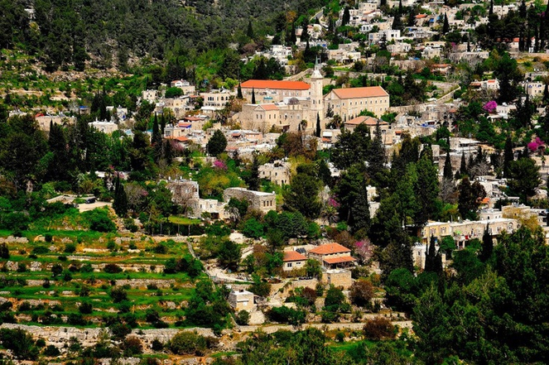
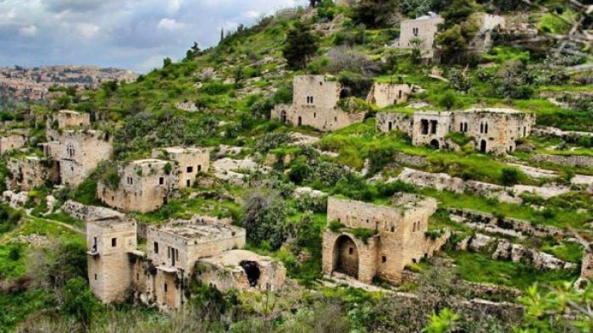
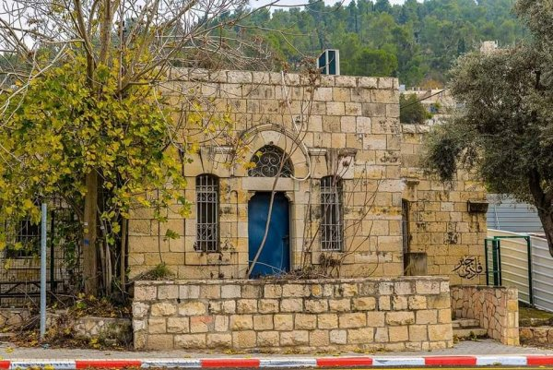
Boundaries

Slide 17
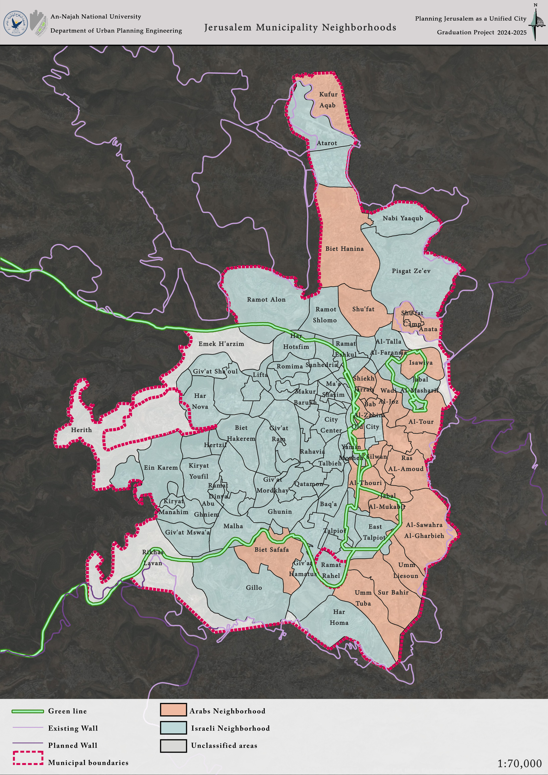
Municipal Nighborhoods

Slide 18
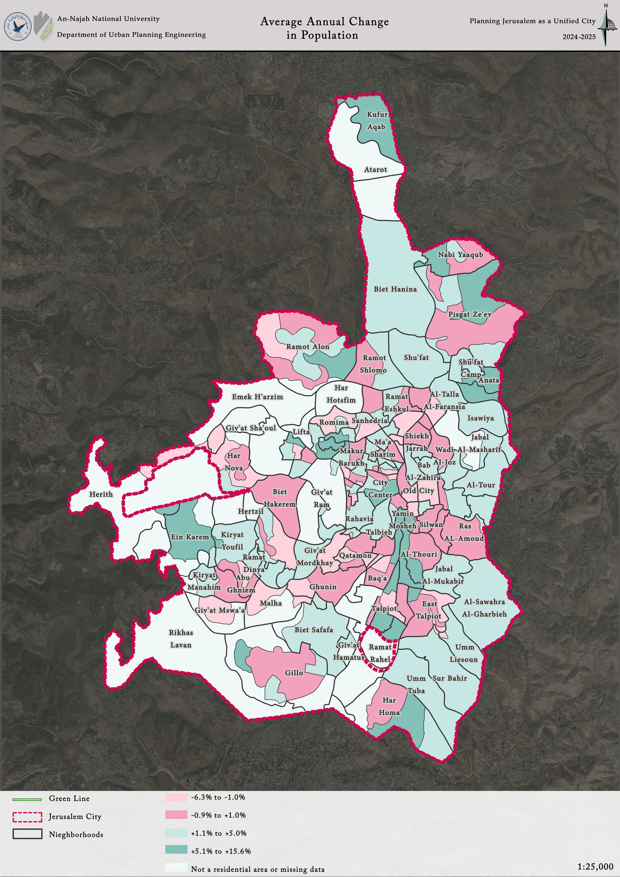
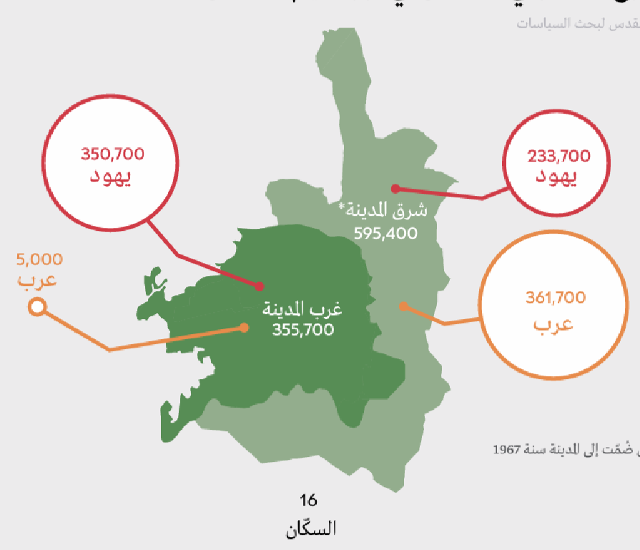
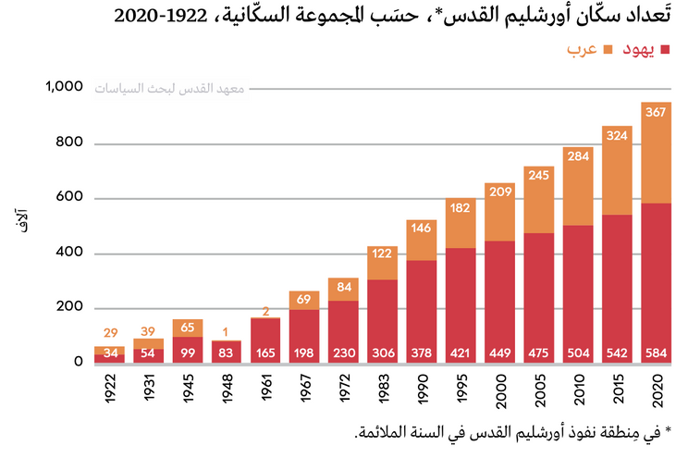
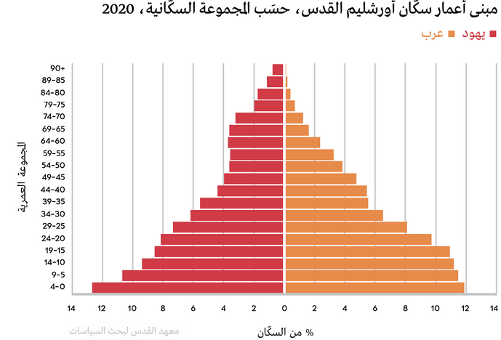
Demography
Jwish
Jwish
East Jerusalem
Arab
West Jerusalem
Arab
Jewish
Palestinian
Thousands
Jewish
Palestinian
Age group
% of population

Slide 19
Jwish
Jwish
East Jerusalem
Arab
West Jerusalem
Arab

Slide 20
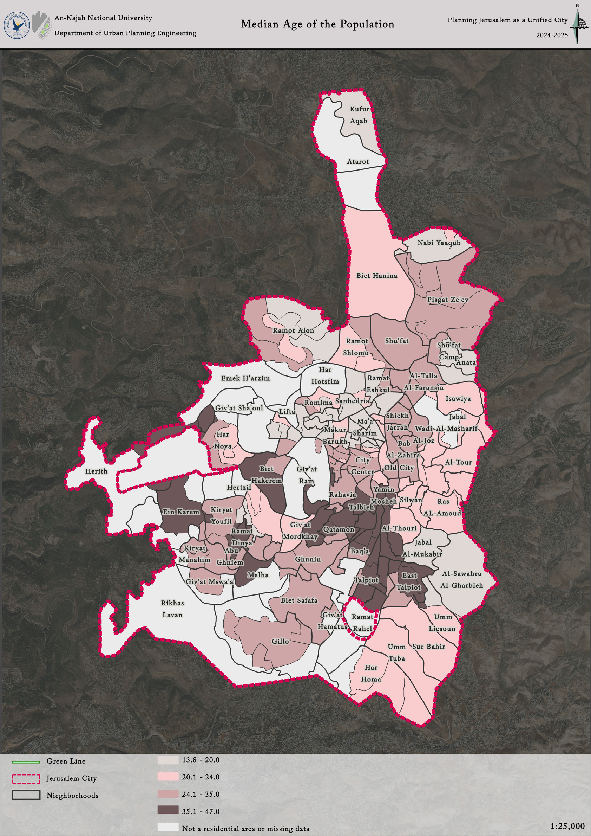
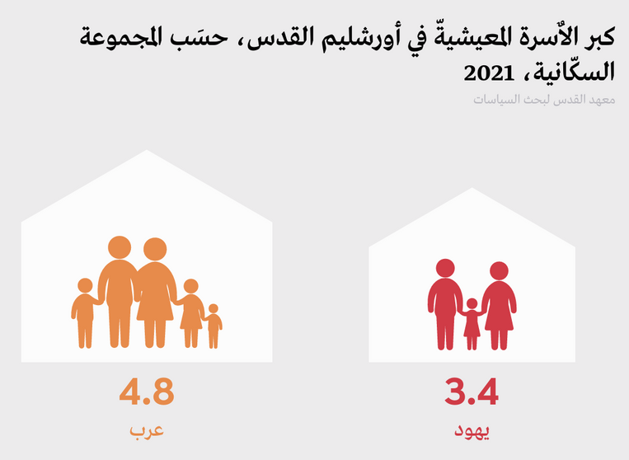
Demography
Household size in Jerusalem by population group 2021
Palestinian
Jewish

Slide 21
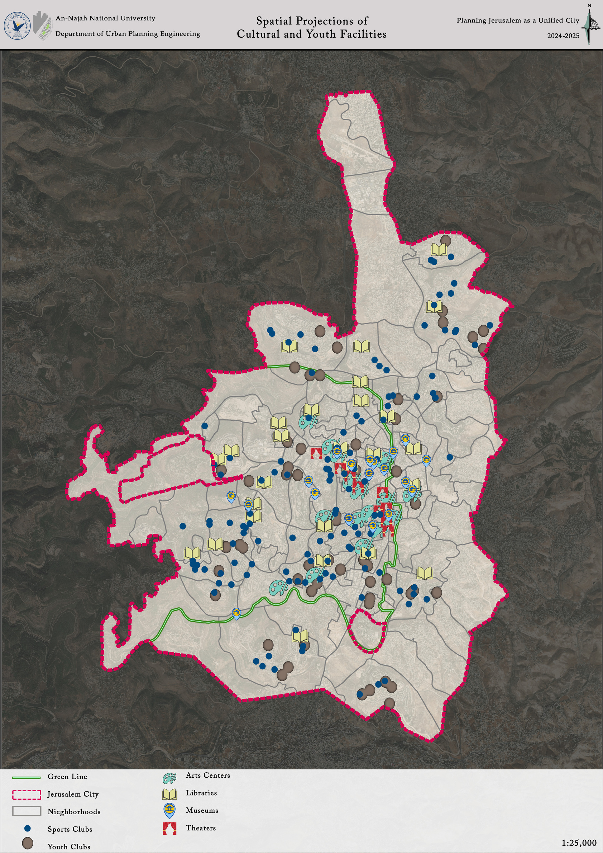
Services

Slide 22
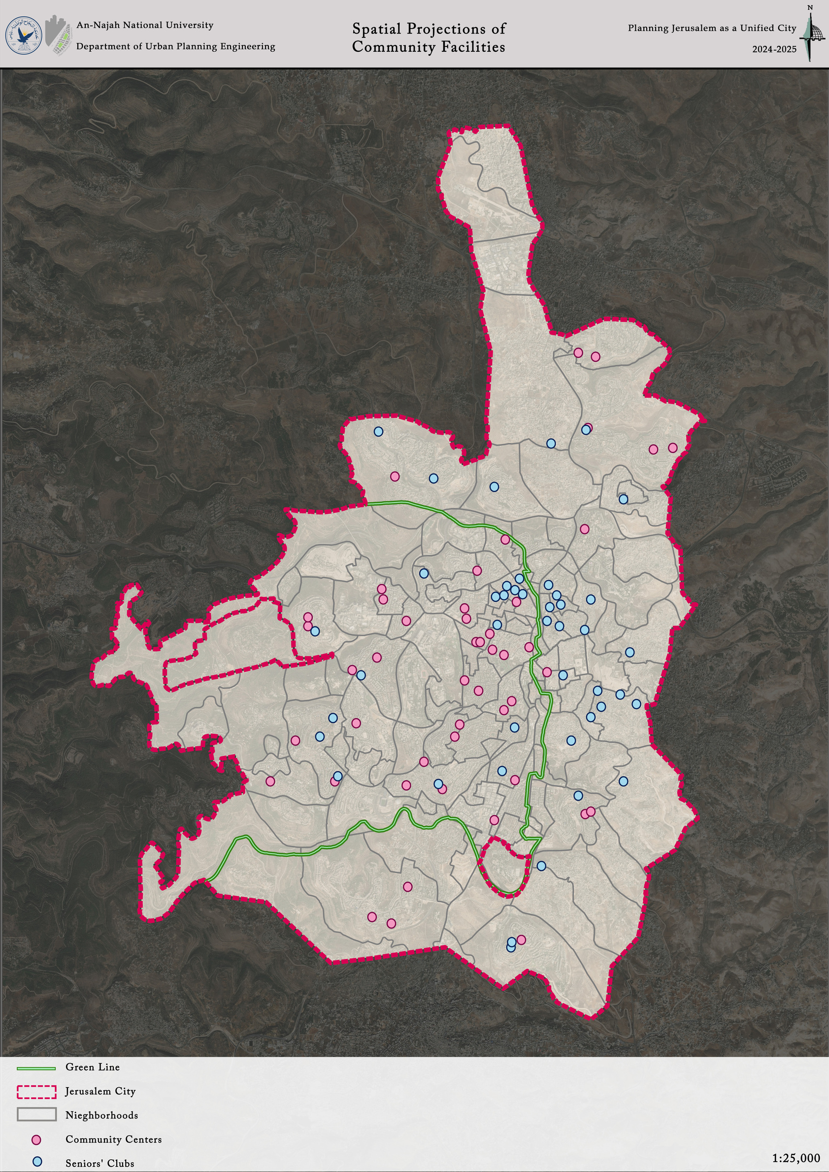
Services

Slide 23

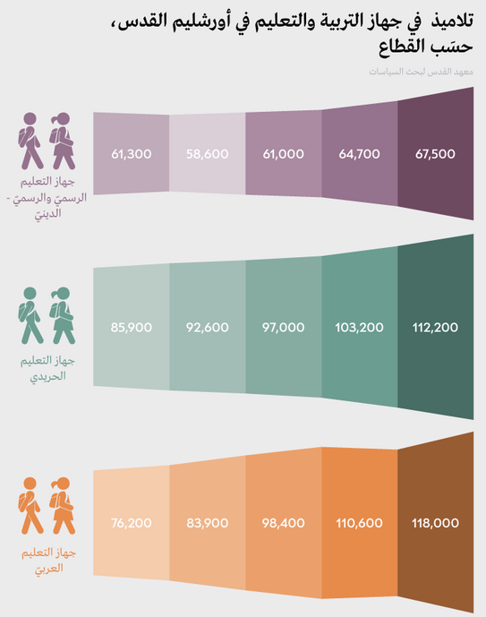
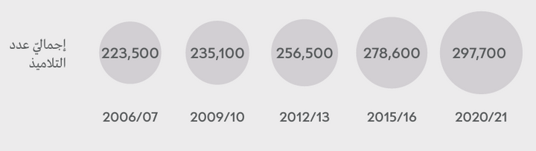
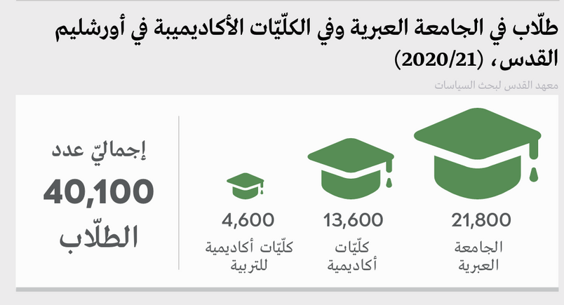
Services
Official/Official-Religious Education System
Total number of students
Haredi Education System
Total number of students
Palestinian Education System
4O,100
Academic Colleges of Education
Academic Colleges
Hebrew University

Slide 24
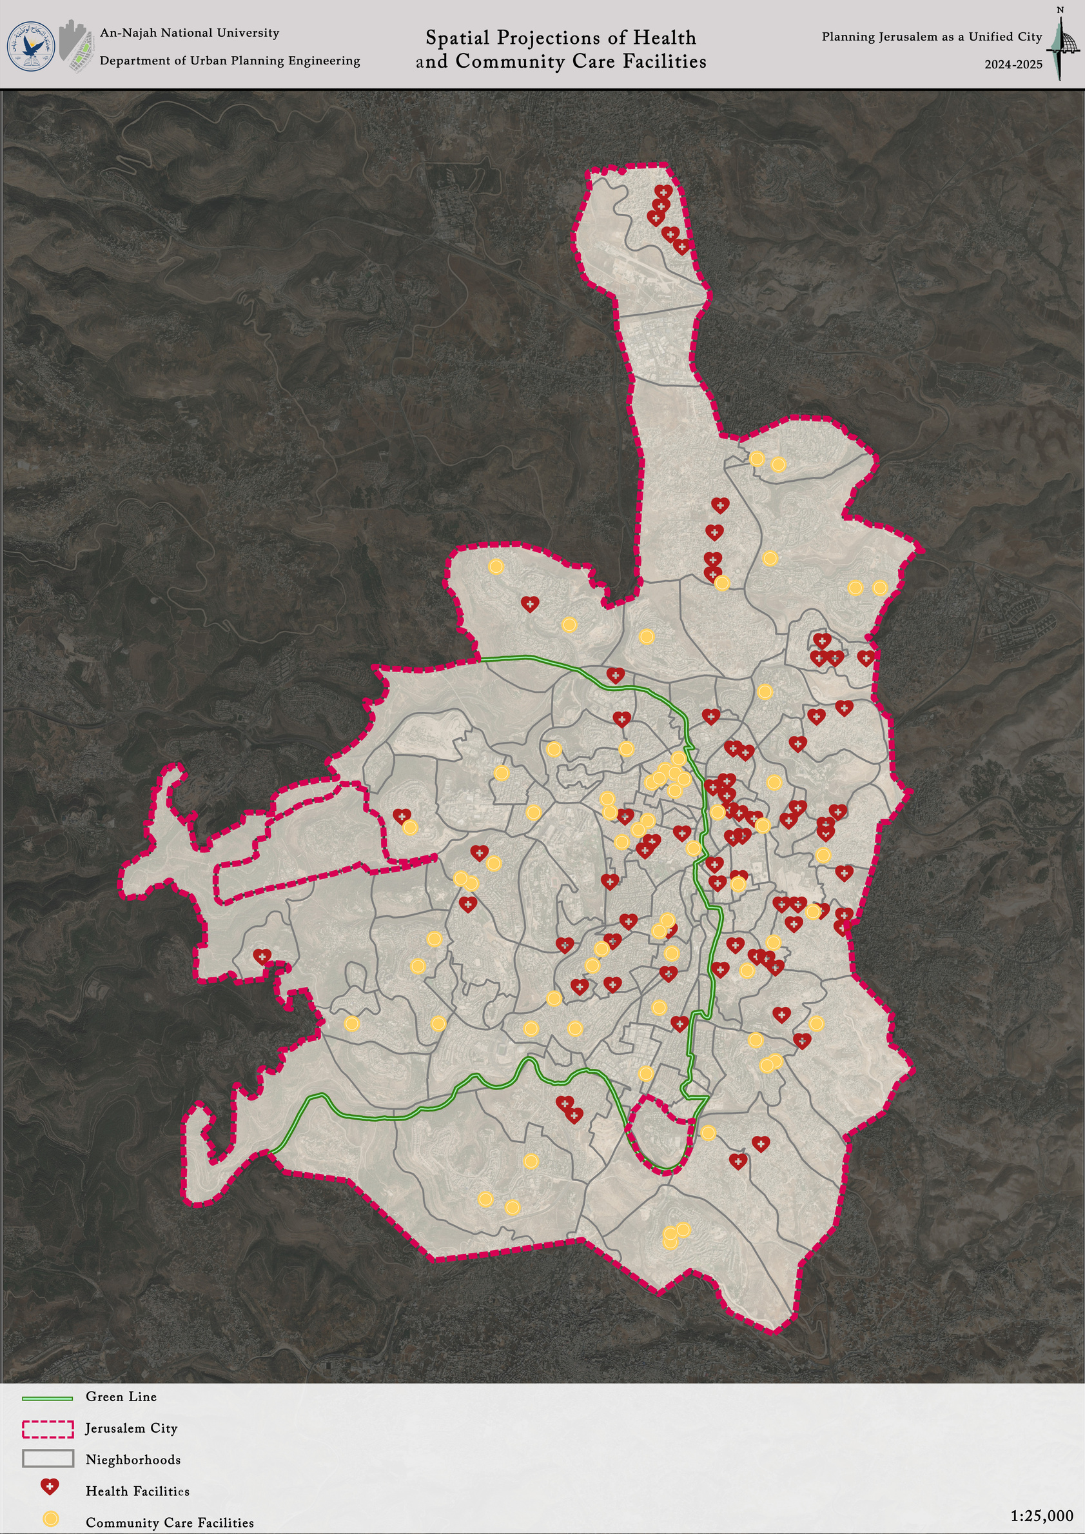
Services

Slide 25
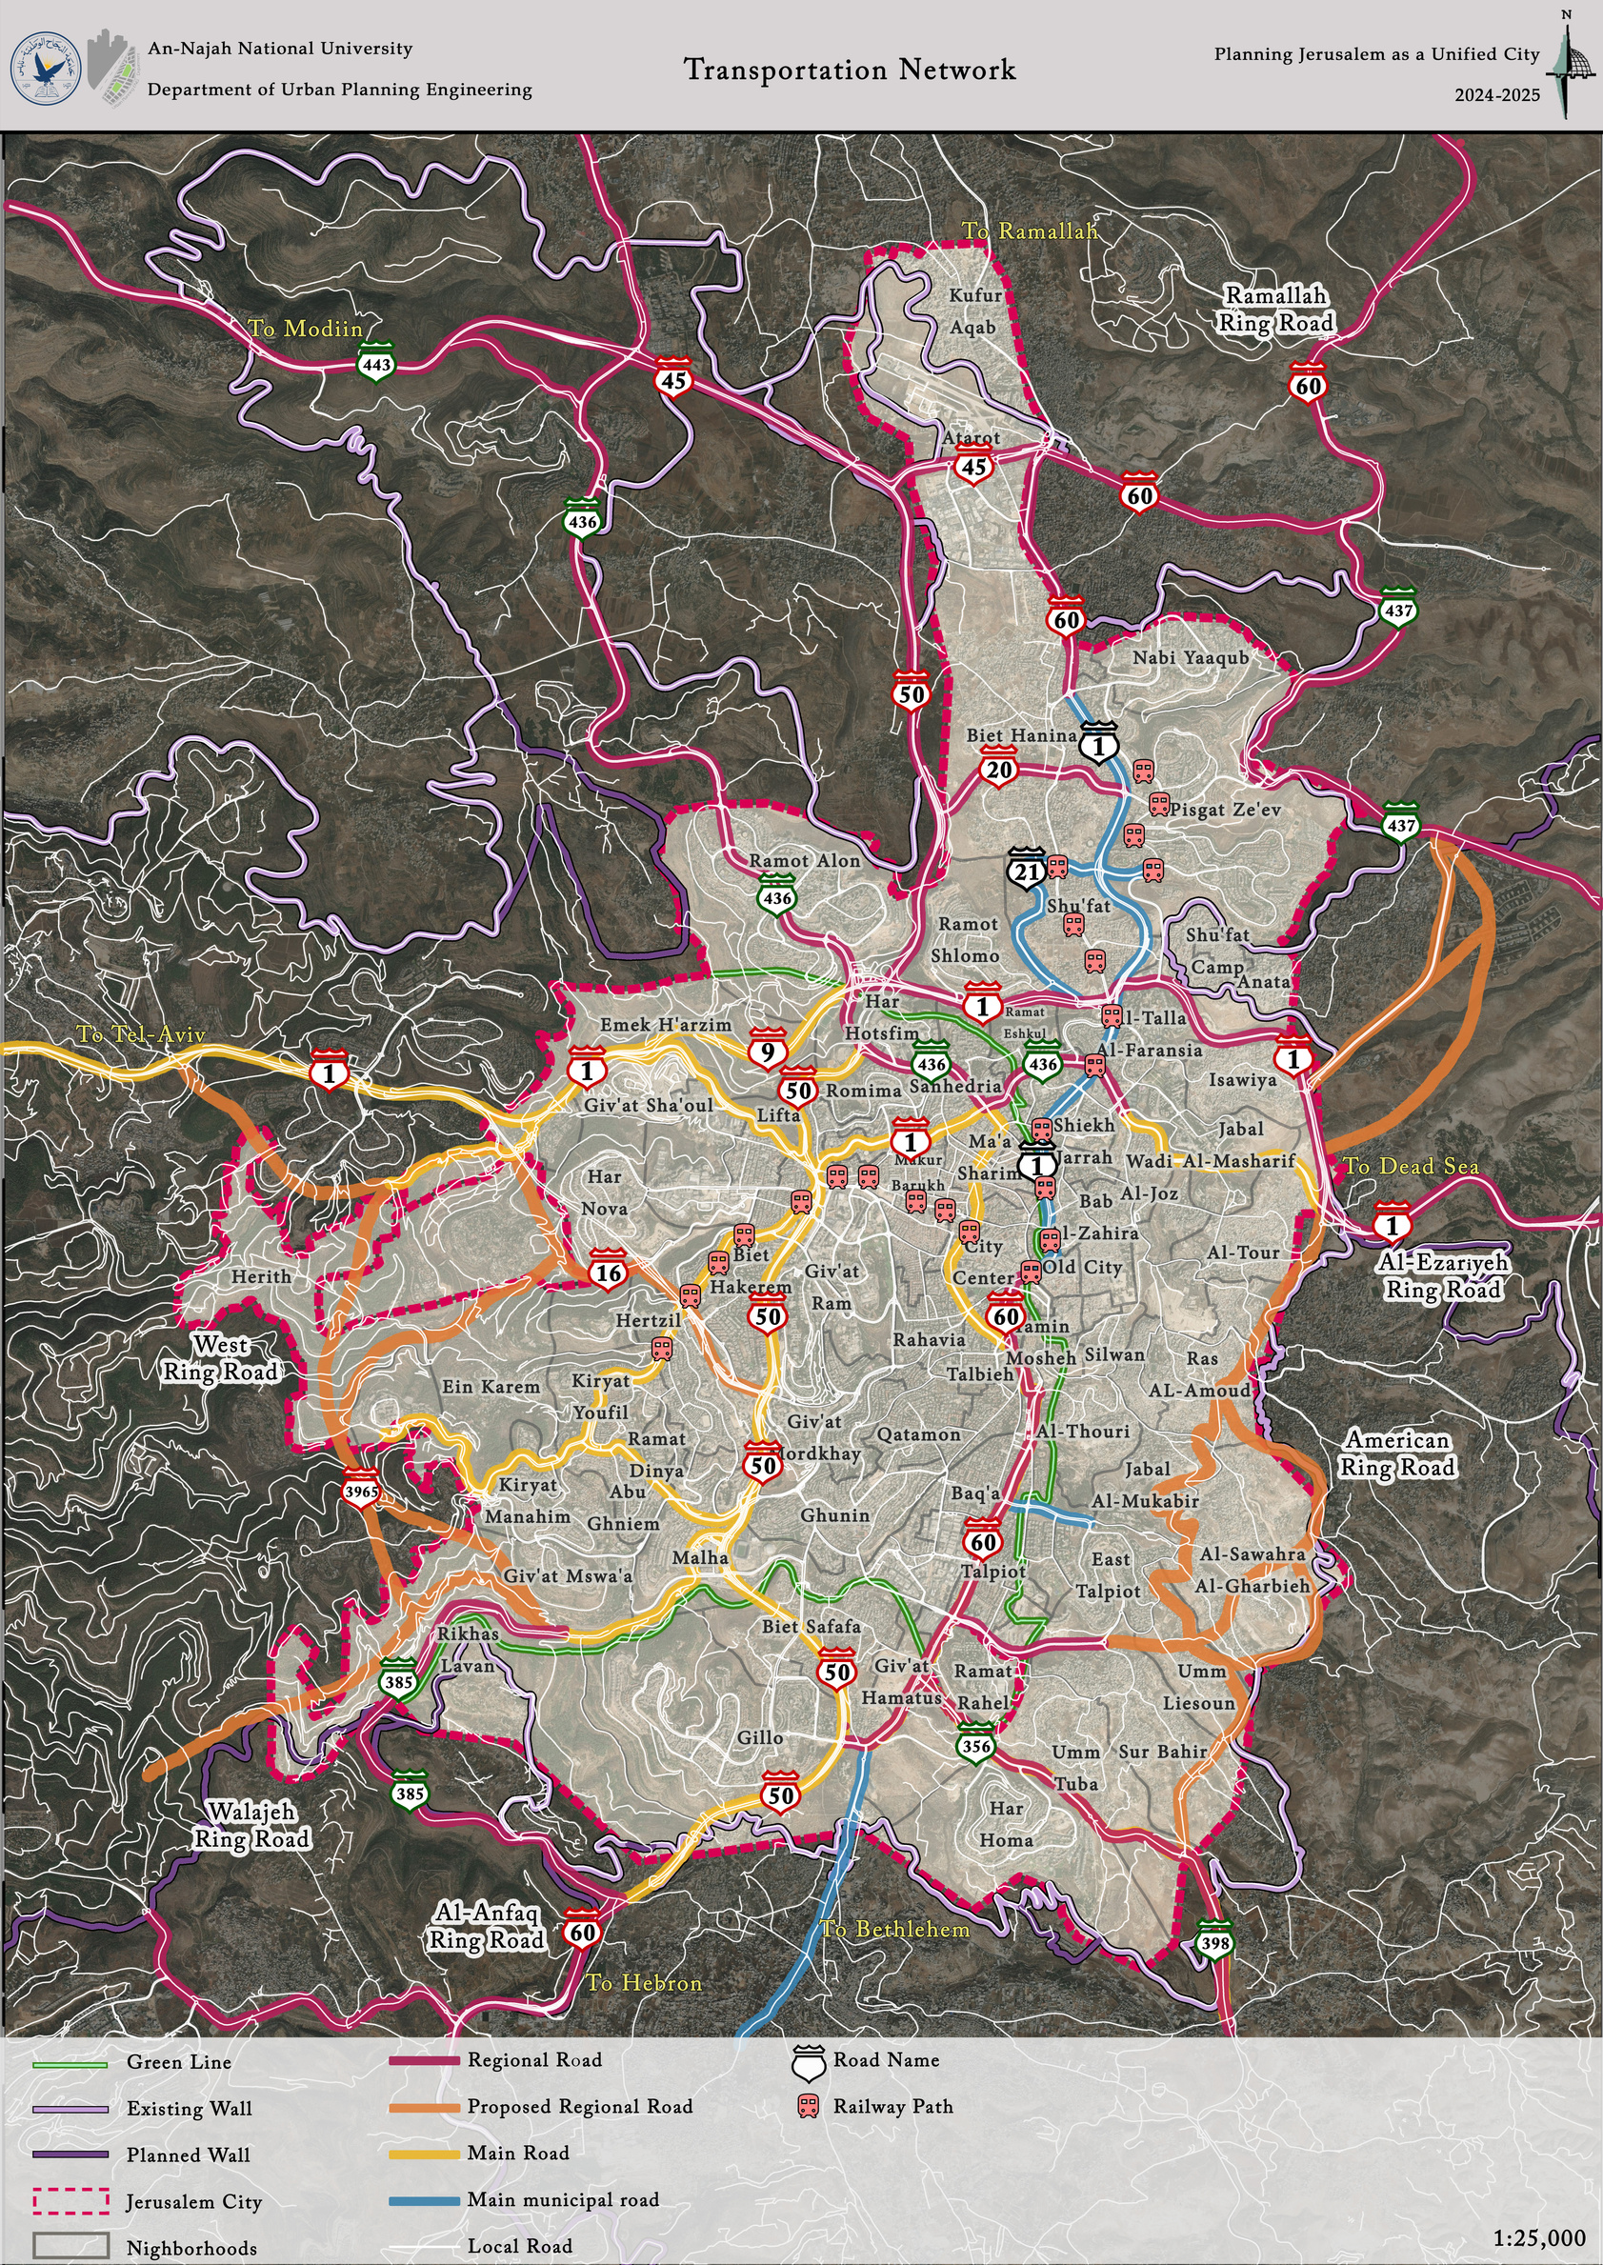
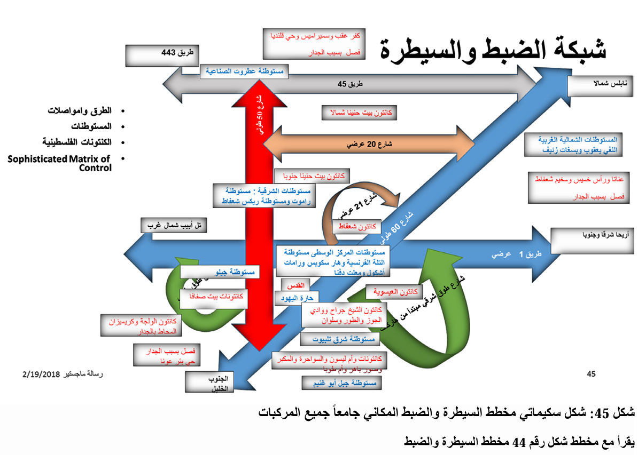
Transportation

Slide 27
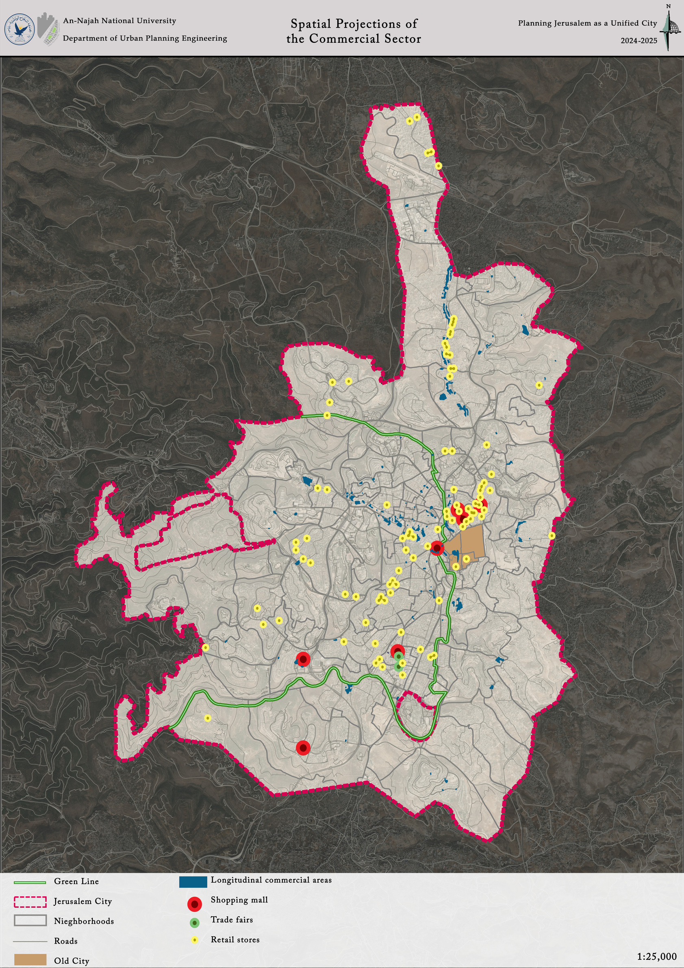
Economy

Slide 28
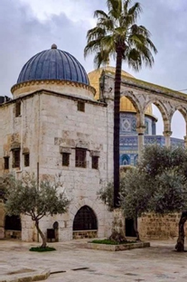
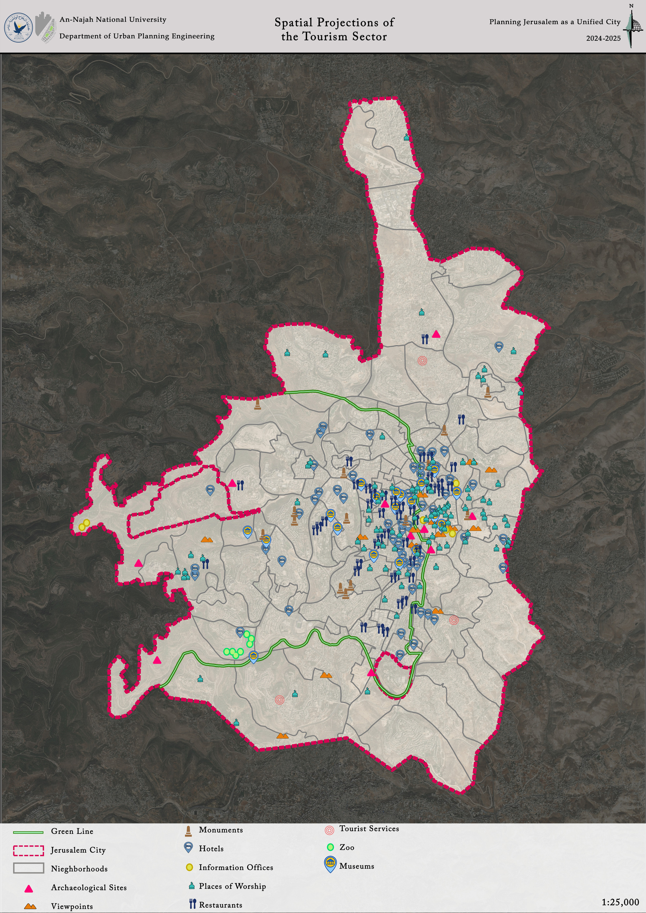
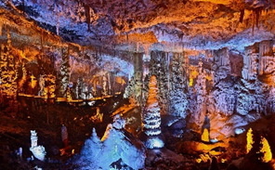
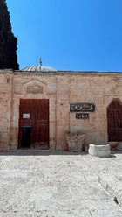
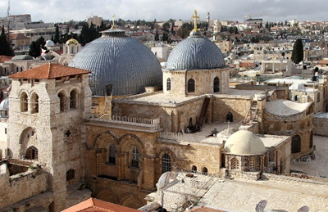
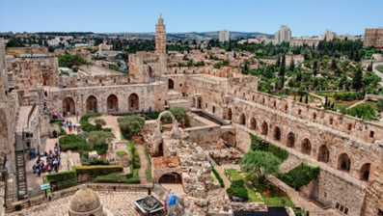
Economy

Slide 29
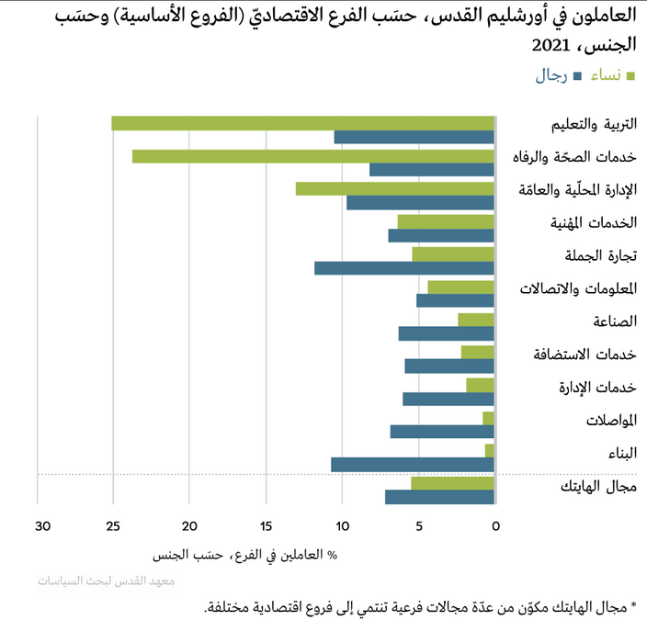


Economy
Employee in Jerusalem by economic branch (main branches) and by gender, 2021
Percentage Distribution of Value Added in Jerusalem Governorate (J1) by Economic Activity, 2022 (Jerusalem Statistical Yearbook,2024)
Male
Female
Education
Health and Welfare Services
Local and Public Administration
Professional Services
Wholesale Trade
Information and Communications
Industry
Hosting Services
Administrative Services
Transportation
Construction
High-Tech
% of branch employees by gender
Note: Value added within national accounts includes all value added incurred from all economic sectors including the informal sector.
Poverty rates* in the Occupied territories and Jerusalem, 2020, (Jerusalem Institute for Policy Research)
Palestinian
Jewish
Occupied territories
Palestinian
Jewish
Jerusalem
*Percentage of population below the poverty line

Slide 30

Socio Economic Clusters

Slide 31








Economic Analysis

Slide 32

Economic Analysis

Slide 33


Planning

Slide 34

Planning

Slide 35


Planning
  Introduced as a updated municipal master plan in 2004, with a vision extending to 2020 (later updated to 2030) .
  Includes demographic targets favoring a 70% Jewish – 30% Arab balance and delineates extensive development zones for Jewish neighborhoods, while significantly restricting Palestinian urban growth
126,000 dunums

Slide 36

Planning

Slide 37


STRENGTHS
WEAKNESSES
  Urban segregation between Arab and Jewish areas.
  The Separation Wall divides neighborhoods and hinders movement.
  Poor infrastructure in many Palestinian neighborhoods.
  Lack of public spaces and services in Arab areas.
  Displacement of Palestinian residents from depopulated villages
  Well-developed infrastructure in several western neighborhoods (e.g., Beit HaKerem, Romema, Givat Ram, Kiryat Yovel).
  The city is rich in religious, historical, and touristic sites.
  A regional road network connects Jerusalem with surrounding areas.
  Availability of green spaces, forests, and parks.
  High population density in some areas supports commercial activity
SWOT
OPPORTUNITIES
ANALYSIS
THREATS
  Potential to redevelop depopulated villages and allow return of displaced residents.
  Utilize unused open areas for sustainable urban expansion.
  Develop public transportation networks (e.g., train lines).
  Leverage religious and historical sites to boost tourism and the economy.
  Promote integration between East and West Jerusalem.
  Convert buffer areas into ecological green corridors
  Ongoing Israeli settlement expansion.
  Israeli planning and wall projects aiming to divide Palestinian neighborhoods.
  Demographic threat of losing Arab majority.
  Risk of eroding the city’s cultural and architectural identity.
  Environmental degradation due to uncontrolled urban sprawl.

Slide 38

SWOT Analysis

Slide 39


Vision
"A unified, sustainable, and secure Jerusalem, a religious and cultural capital, attractive to tourists, diverse in its population, with a Palestinian Arab majority."

Slide 40
Main Goals
  Unify the city (East & West) and remove separation barriers.
  Promote sustainability and protect green/open spaces.
  Ensure social equity and improve services in Arab areas.
  Preserve cultural and religious heritage.
  Boost tourism through integrated site development.
  Support economic growth and Arab commercial hubs.
  Improve mobility with inclusive public transport.
  Maintain a Palestinian Arab majority and reduce displacement

Slide 41


Jerusalem Master Plan
annexed lands
annexed lands
Residential Area
Future Development
Open Area
Roads
Public & Mixed Use
Industrial & employment
Commercial Area
Tourist Area
Archaeological Sites
Cemeteries
Qalandia Airport
Old City

