Slide 1
Graduation project2
Milk Machine
Dr.Sofian samara
Asma Affife
Israa mousa
Jenan Majdalawi

Slide 2
Outlines
Problem
Introduction
Tools
Procedure
Future work
Demo

Slide 3



Problem
Big View

Slide 4


Problem (cont.)
Small View

Slide 5
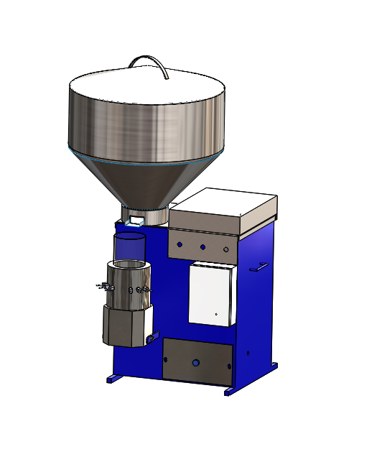
Introduction

Slide 6
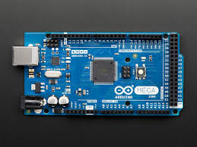
Tools
1- Arduino mega

Slide 7
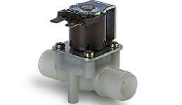
Tools (cont.)
2- solenoid valve

Slide 8
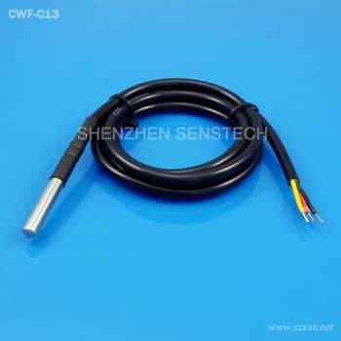
Tools(cont.)
3- Heat sensor (CWF-C13)

Slide 9
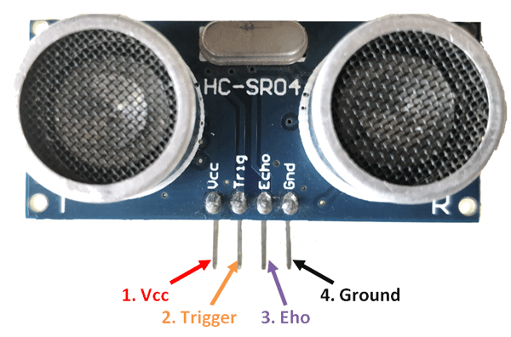
Tools(cont.)
4- ultrasonic sensor

Slide 10
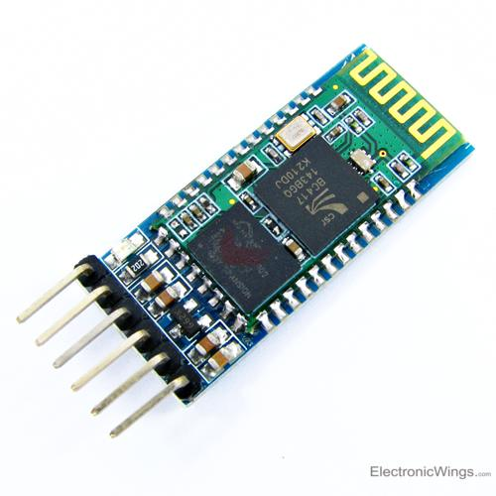
Tools(cont.)
5- Bluetooth Module HC-05

Slide 11
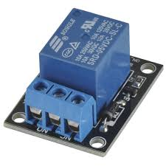
Tools(cont.)
6- relay (220 volt)

Slide 12
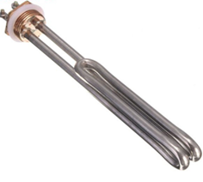
Tools(cont.)
7- heater
8- Motors

Slide 13




Presudure
Stage (1)
Stage(3)
Stage (4)
Stage (2)

Slide 14
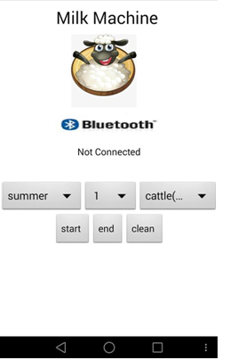
Mobile Application

Slide 15
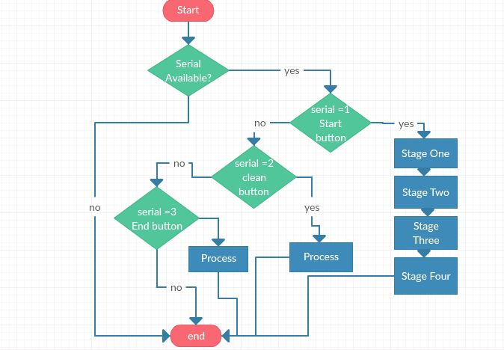
ASM Chart-whole system

Slide 16
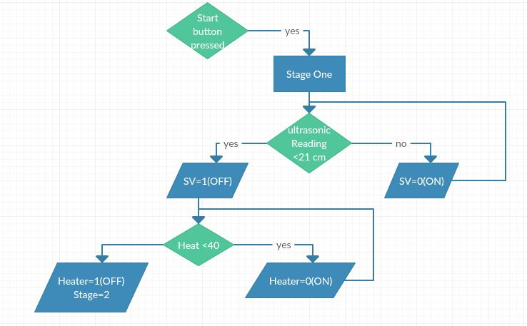
ASM Chart-Start operation (stage1):

Slide 17
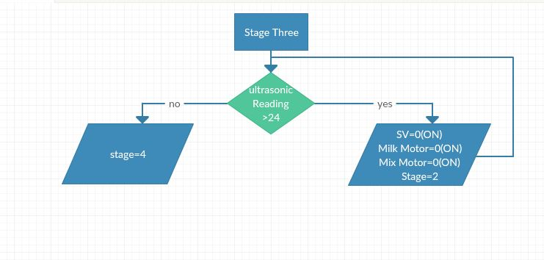
ASM Chart-Start operation (stage3):

Slide 18
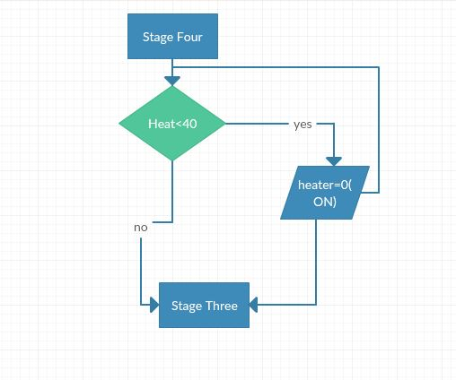
ASM Chart-Start operation (stage4):

Slide 19
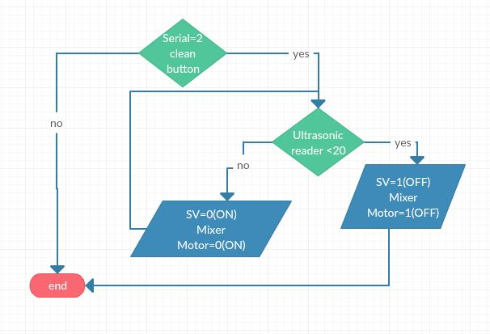
ASM Chart-Clean operation:

Slide 20
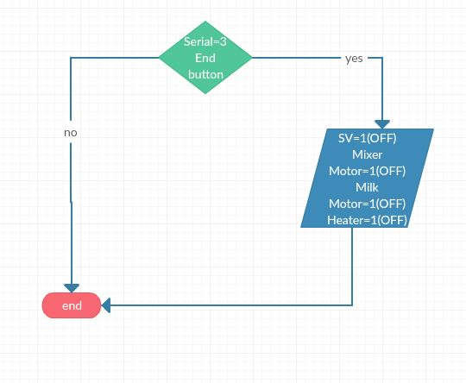
ASM Chart-Finish operation:

