Slide 1

An-Najah University
Chemical Engineering and Environment and Energy Engineering Departments.
Graduation project (2)
Solar Drying System Design for Sludge Produce at NWWTP
Prepared by:
Aya Odeh
Itaf Shaablo
Maysoon Sholi
Noor Shabaro
Sojoud Dwaikat
Supervisor:
Eng. Mays Shadeed

Slide 2
Outline:
Introduction
Objective .
Drying system design .
Environmental Impact Assessment.
Feasibility Study.
Importance of Work.
Conclusion.
Recommendations.
Constrains.

Slide 3
Introduction:
Nablus WasteWater Treatment Plant NWWTP was established in 2013 at the west of Nablus city, it has treated 11000 m³ of wastewater and produced 15 ton of dewatered sludge per day. It is the biggest and most improvement plant in the West Bank.

Slide 4
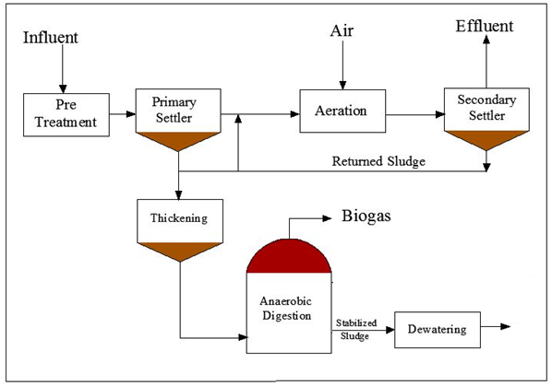
Many units used to operate the plant, which is:

Slide 5
Problem Statement:
NWWTP produce 15ton/day of dewatered sludge, this sludge is disposing in landfills, but the problems associated with its handling and disposing forced many landfills such as Zahrat Al Fenjan landfilll, to stop receiving it any longer.

Slide 6
Objective :
The main objective of this project is designing drying system utilizing solar and thermal to reduce volume and moisture content of sludge to an acceptable level (from 75% to 10%).

Slide 7
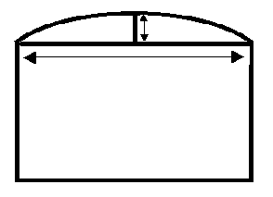
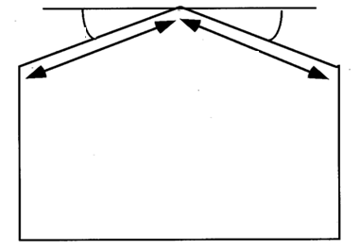
Design Selection:
Tunnel structure Even-span structure

Slide 8
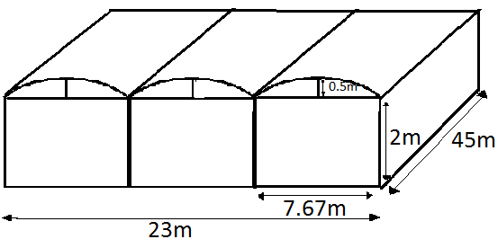
Solar dryer design and dimensions:
The Tunnel Greenhouse Dryer is a suitable low-cost design for a forced convection greenhouse dryer.
The length of the arc is 7.76 m
Technical information
The structure | 1.25-2 galvanized steel pipe. Polyethylene cover.
Gable opening (m) | 7.67
Maximum height (m) | 2.5
Ultimate wind velocity (Km/h) | 120
Temperature (ºC) | 52-60
Cost ($ ) | 7000 for each 1000 square meter.

Slide 9
Mass balance :
Mass balance summary
Average temperature of input air ( C) | 20
%Relative humidity for input air | 0.35
Temperature of dewatered sludge ⁰C | 25
Density of dewatered sludge (Kg/m^3) | 1300
thickness of sludge (m) | 0.00279
Number of beds | 4
Number of batches at a day | 1
Temperature of dried sludge ⁰C | 90
Average temperature of outlet air ( C) | 56
% Relative humidity of outlet air | 0.850
Volumetric flowerate of ventilation (m^3/hr) | 950
number of ventilator | 6
Drying time (hr) | 4

Slide 10
Heat balance:
Heat balance summary
T of sludge in (K) | 298
T of sludge out (K) | 368
T of air in (K) | 293
T of air out (K) | 329
T of water in (K) | 368
T of water out (K) | 353
m of water (Kg/hr) | 836.69
T of water in (K) | 298
T of water out (K) | 368
calorific value of peat (MJ/Kg) | 12
weight of peat (Kg) | 81.72

Slide 11
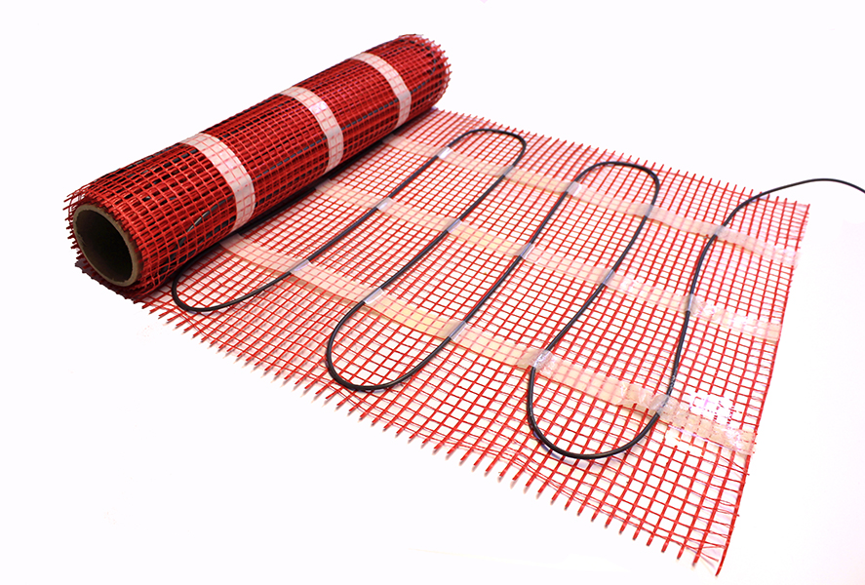
Under floor heating system (ASME):
It is a distribution of pipes under floor, hot water from boiler flows inside the pipes. Foam under the pipes is found for isolation.
Flat heat exchanger
fluid inside pipes | Water
Temperature of input water (ºC) | 95
Pipes type | HDPE
Distance between pipes (cm) | 20
Diameter of pipe (mm) | 16
Thickness of concrete layer (cm) | 10

Slide 12
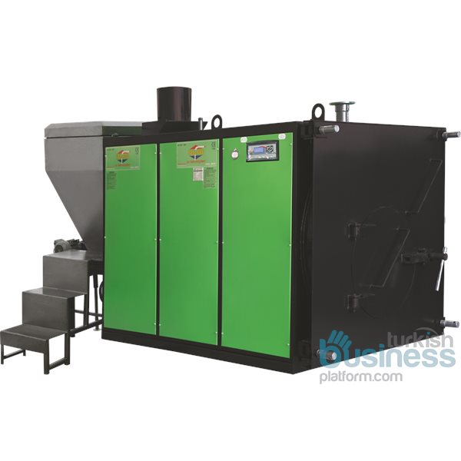
Central Full Cylindrical Stoker Heating Boiler (series TMS-STK):
The boiler is operated by peat to heat water to 95 degrees and pumped into heat exchangers with an efficiency of 89%.
Central full cylinder stoker heating boiler
%η | 89
Price ($) | 10,000
Power source | Peat
Made in | Turkey
Usage | Automatic and manual
Capacity of water(Kg/h) | 800

Slide 13
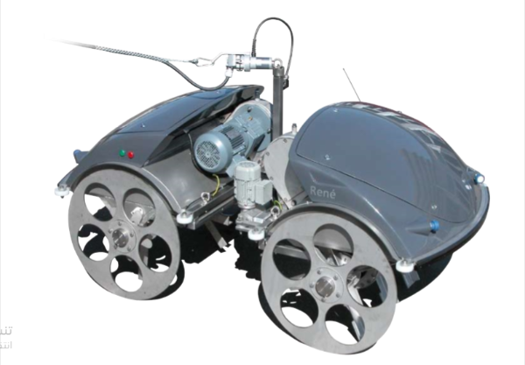
Electric mole (NA):
Dimension of the electric mole, is 2150 mm in length, 1205 mm in width and 1160 mm in height.
The machine capacity is 3 kW.
It operates 4 times on a day.
It works for 20-60 minutes per working hour.

Slide 14
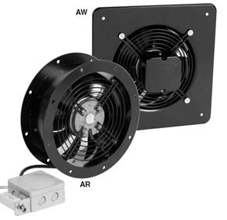
Exhaust fan (250E4-K):
It a fan for ventilating an interior by drawing humid air from the interior and expelling it outside.
Six fans are needed for each bed.
Ventilator
Power (W) | 54
Maximum air flow (/h) | 950
Maximum temperature of transferred air | 45
Weight (kg) | 3.5
Diameter (mm) | 286
Thickness (mm) | 95
Number of blades | 7

Slide 15
Environmental impact assessment(EIA):
EIA is the process of assessing the potential impacts (negative or positive) of a proposed project on the natural environment, which include:
    1. Screening and Scoping.
    2. Project Legal Frameworks.

Slide 16
3. Project Processes:
settle the drying basins.
A suitable tunnel greenhouse structure has been adopted.
The boiler has been operated by peat to heat the water.
The sludge was moved by electric mole.
The dried sludge will be transported manually to the packing places to be used as fertilizer.

Slide 17
4. Description of Existing Environment:
Nature of the land.
Noise.
The climate.
5. Mitigation and monitoring measure:
It is the process of identifying, measuring, controlling and reducing the risks facing the project.

Slide 18
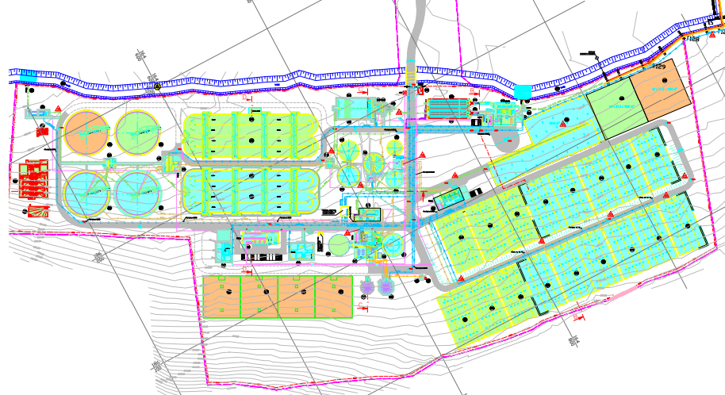

Slide 19
Feasibility Study :
Purchased cost:
Purchased cost
Purchased cost of greenhouse dryer structure ($) | 7000
Purchased cost of boiler ($) | 1000
Purchased cost of electric mole ($) | 3000
Purchased cost of ventilator ($) | 7800
Purchased cost of flat heat exchanger ($) | 23800
Total purchased cost ($) | 51600

Slide 20
Depending on the current conditions of the NWWTP: FCI cost was estimated by using Holland method it equals 170990 $.
The annual operating cost is 71950 $, it includes :
    Raw material .
    Utilities .
    Labor (3 worker ).
    Payroll (30% labor).
    Maintenance (2% FCI).
    Supplies (5% labor).
    Packaging (2% sales).
    SARE (6% sales).
The annual sales equal 532500 $ ( 5 NIS for each kilogram of fertilizer).
The payback period is 5 years.

Slide 21
Importance of Work:
Use of renewable energy sources for sludge drying so low energy requirements.
Low annual operating cost needed to the operating of the equipment that equal 71900 $.
Saving in transportation and disposal cost since before solar drying the cost of transport the sludge to dumps equal 137800 $/year.
Reducing the moisture content to 10% (recommended value) so sludge can be used: Fertilizer, incineration or gasification

Slide 22
Conclusion :
1. Drying system proposed to dried sludge using combined solar and thermal system.
2. The expected reduction in water content from 75% to 10%.
3. The dimensions for one bed 23 m in width, 45 m in length and 2.5 m in height.
4. Some auxiliary equipment added to increase the efficiency.
5. High evaporation rate and efficiency due to thin sludge layers.
6. Solar and thermal dryer gives more efficient product characteristics than the conventional dryer.
7.The one bed annual investment cost was 168687 $ and annual operating cost was 71900 $.

Slide 23
Recommendation:
1. Drying can enhanced by mechanical pressing.
2. The expected way after drying is the gasification or incineration process.
3. Addition air heat exchanger may be used up the sludge layer, will be more efficient and less drying time.
4. The humid air can be condensed and used in boiler.
5. Fiberglass instead of polyethylene will be effective regardless the cost.

Slide 24
Constrains:
The required water content to reach (10%) is low compared to initial content (75%) 65% needed to reduction.
Lack of information and previous studies about the combined dryer (solar and thermal dryer) and Lack of access to information about the axillaries and cost.
The use of greenhouse as sludge dryers for the first time in Palestine has make chosen the best shape and appropriate material an ppastical in this project.

Slide 25


Slide 26


