Slide 1
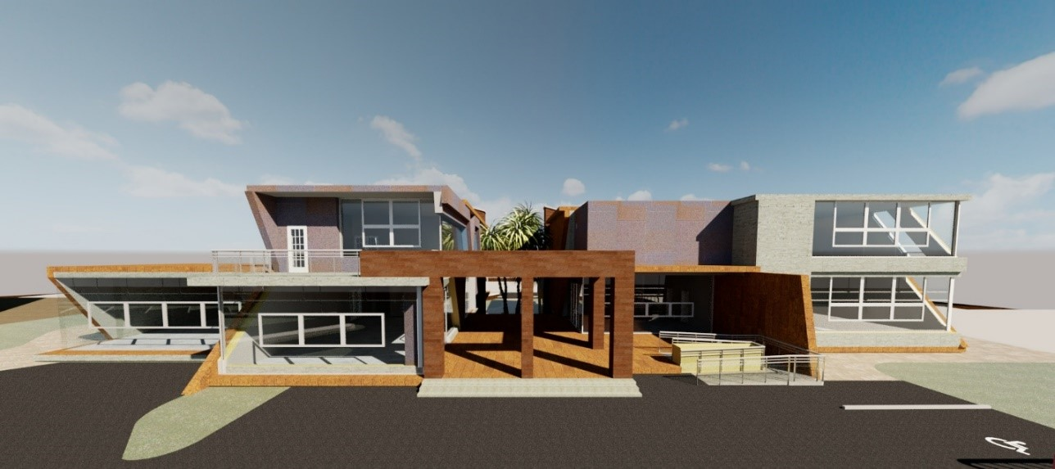

An-Najah National university
Building Engineering Department
Children Creativity Center
Prepared by :
Abdullah Hamdan
Ahmad Illaiwi
Sarah Shaheen
Supervisor :
Dr.Ahmad haj –Saleh

Slide 2
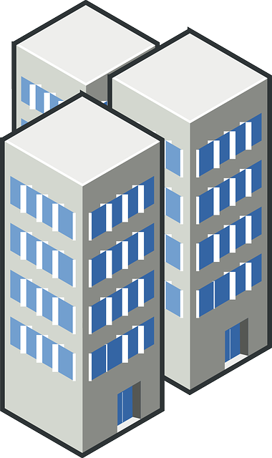
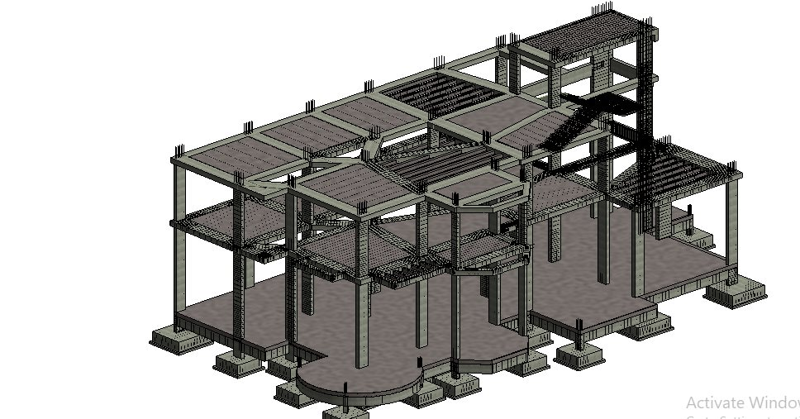



The Outlines
Architectural design
Structural Design
Environmental Design
Cost and Quantity
End

Slide 3
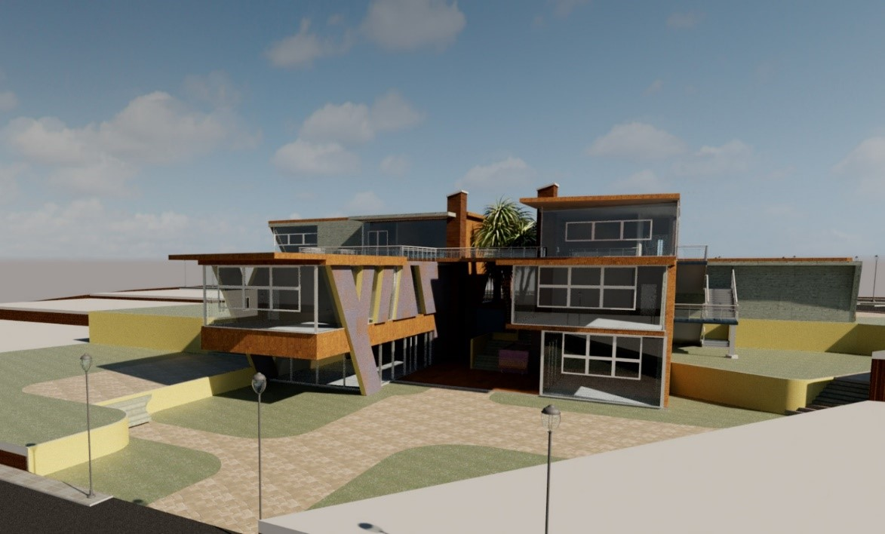
Architectural Design
This section will show the modifications were done on the architectural design.

Slide 4
Architectural Design

Slide 5
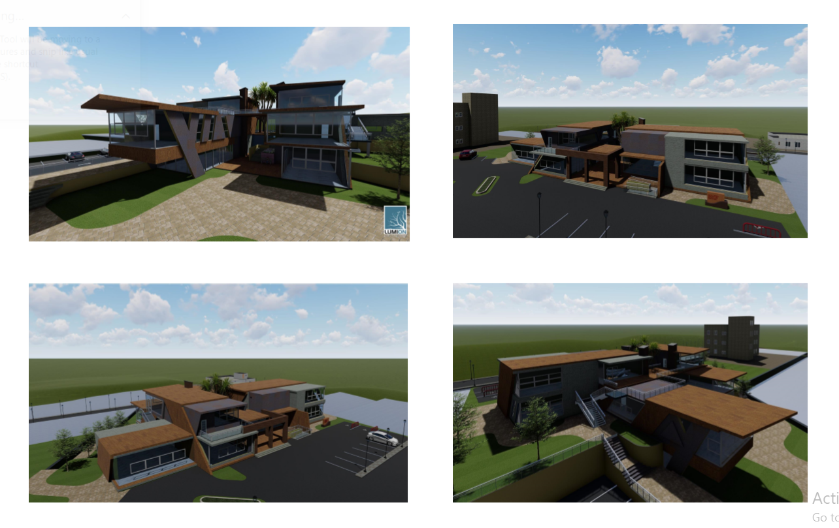

Slide 6
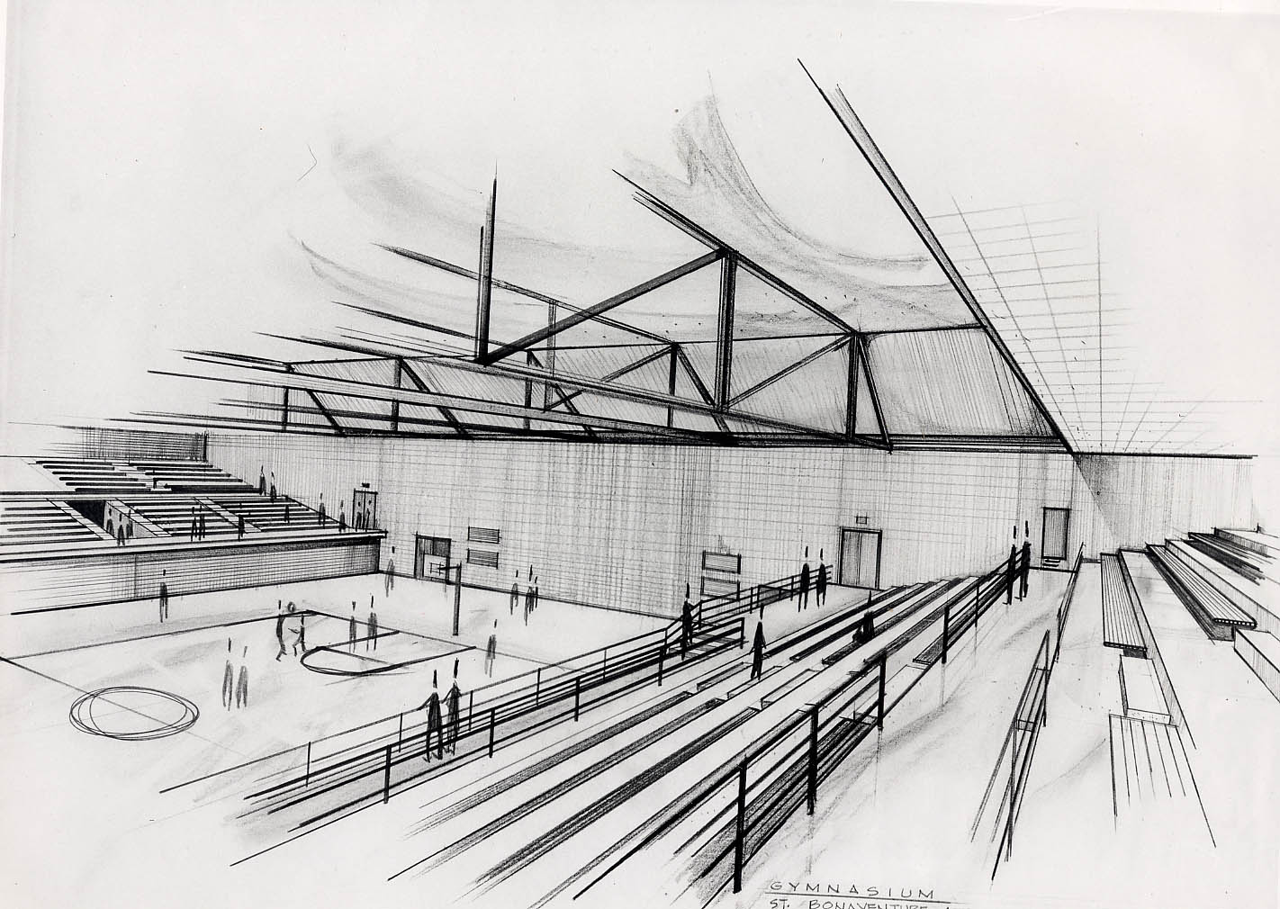
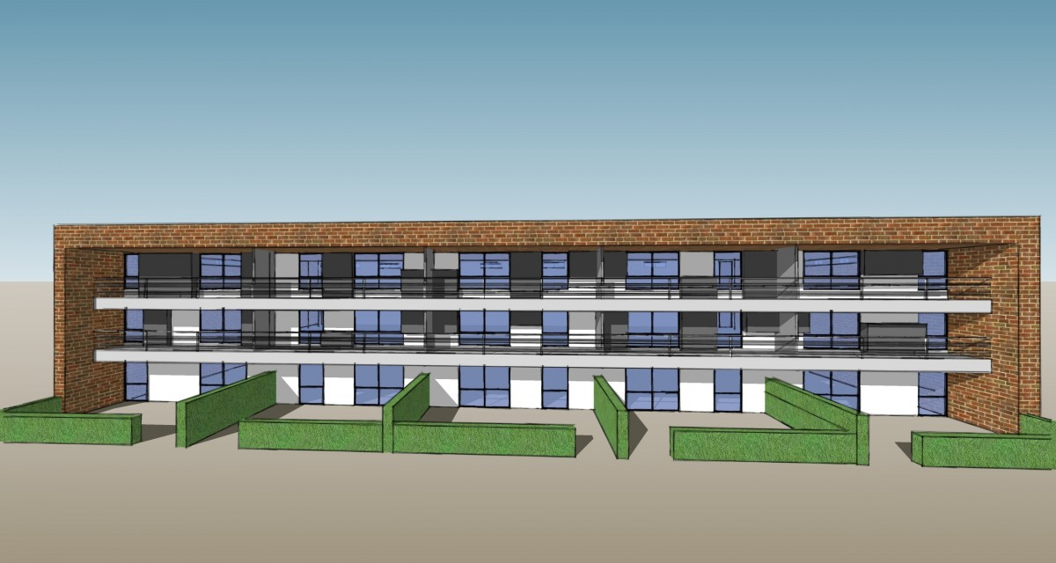
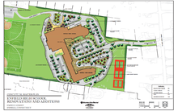
Location and Site Plan
Architectural Plans
Elevations and Sections

Slide 7
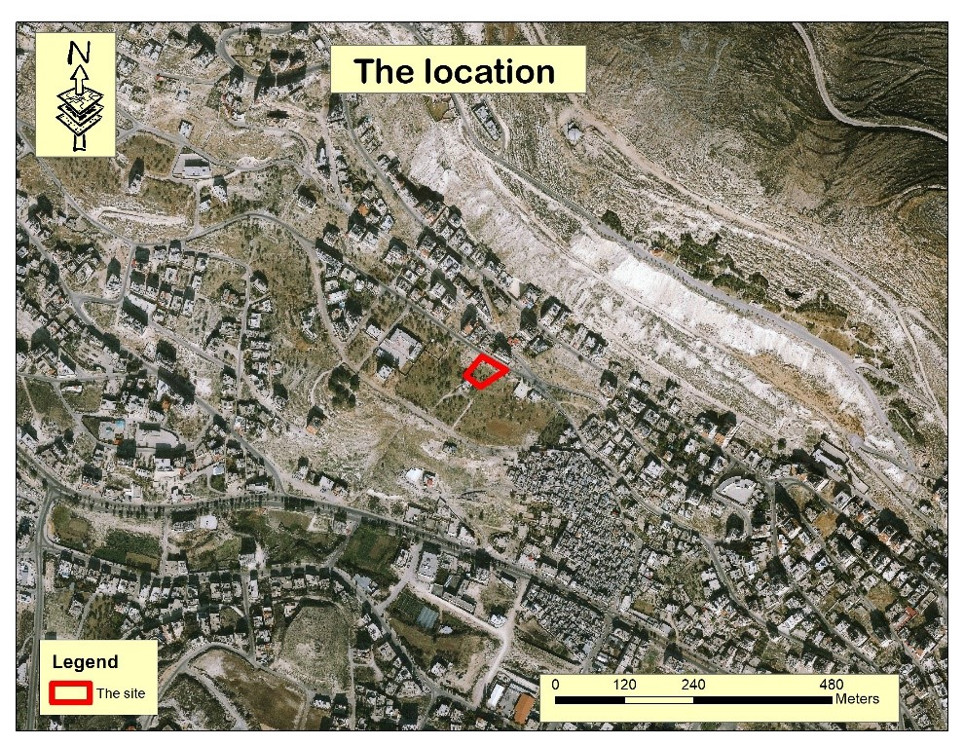

Location and Site Plan
Children creative center is located in Nablus city of distance 2Km from the center of the city. The area of the land 3090 $m^{2}$and the contour lines is between 520-510 m above sea level in the northern mountain in Nablus city above Al-aen refugee camp.

Slide 8
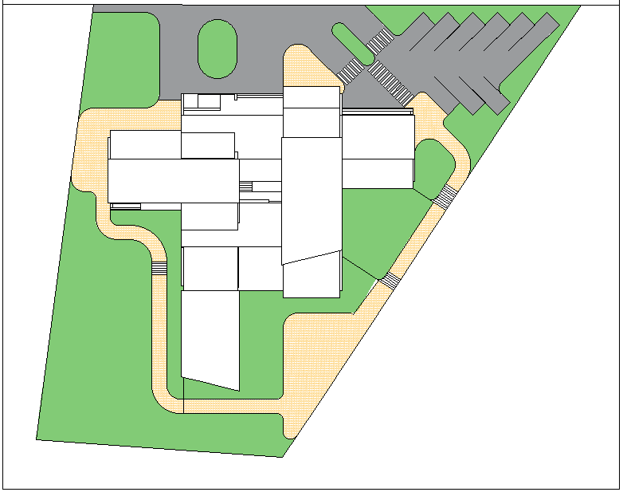
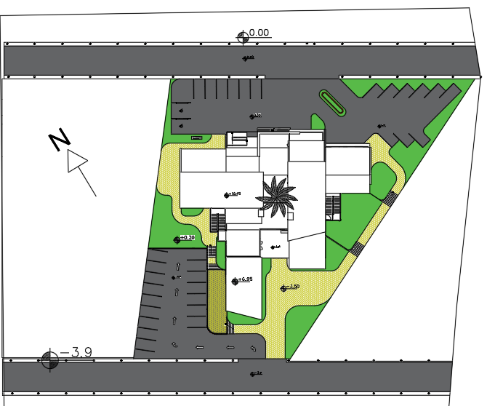
Before
After

Slide 9
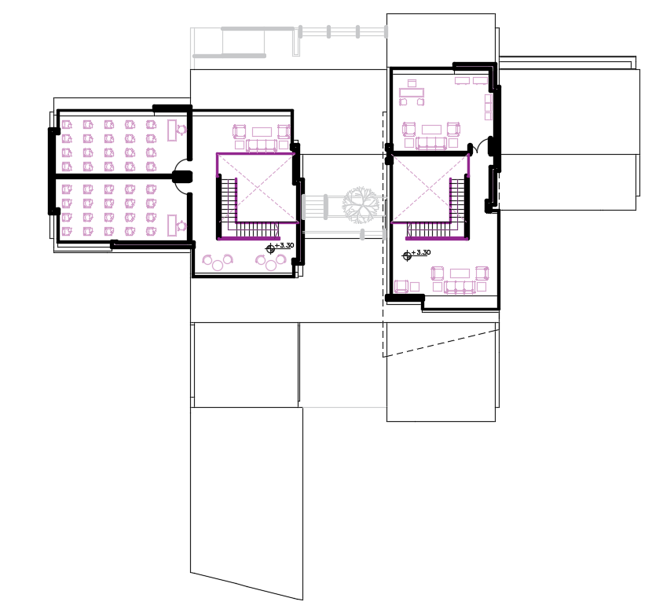
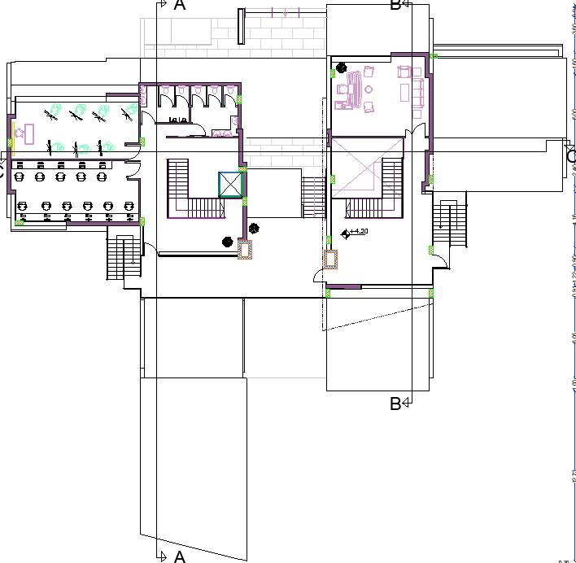
Plans
First floor before
First floor after

Slide 10
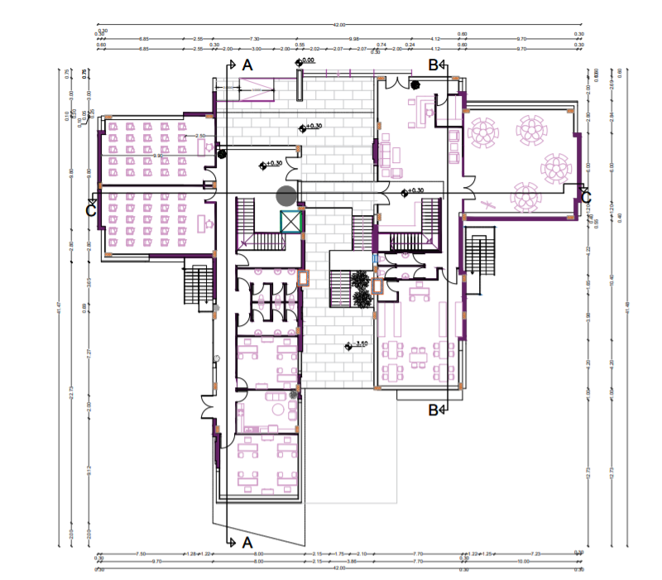
Ground Floor

Slide 11
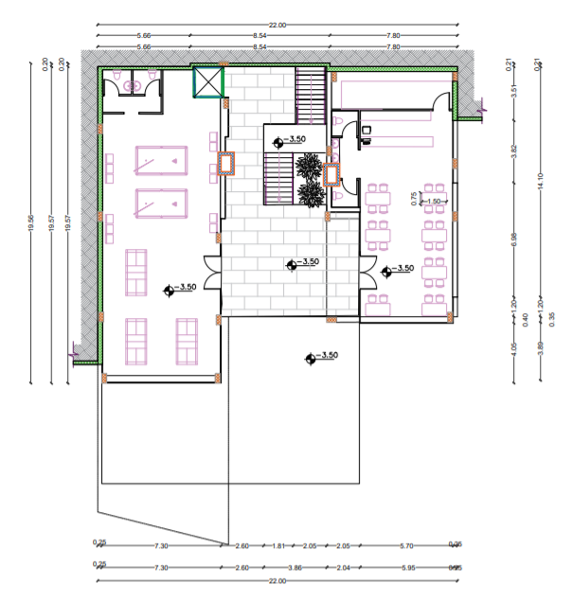
Basement Floor

Slide 12
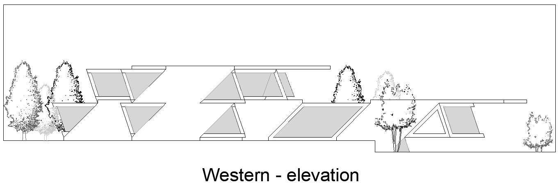
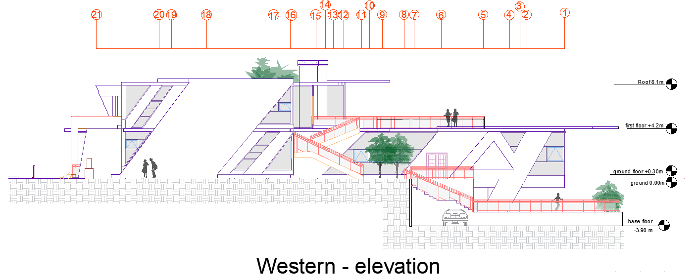
Elevations
Before
After

Slide 13
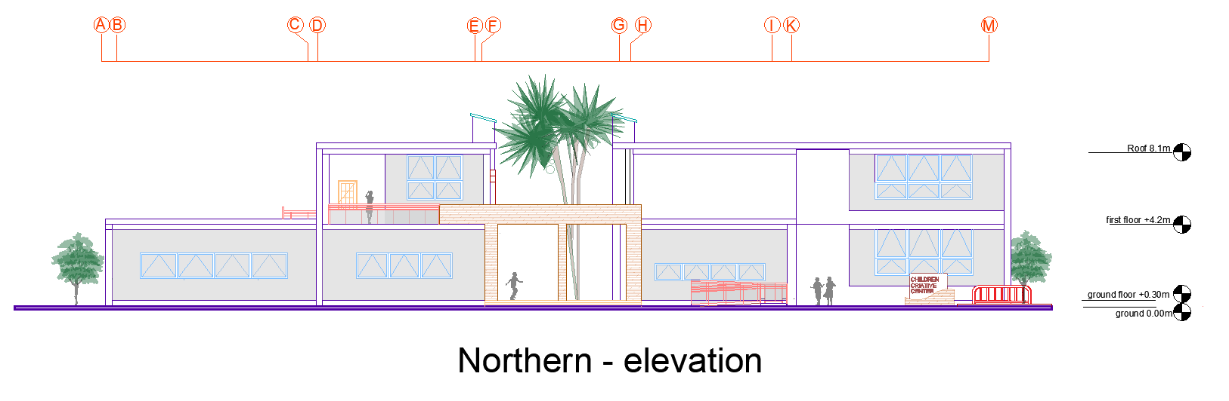

Slide 14
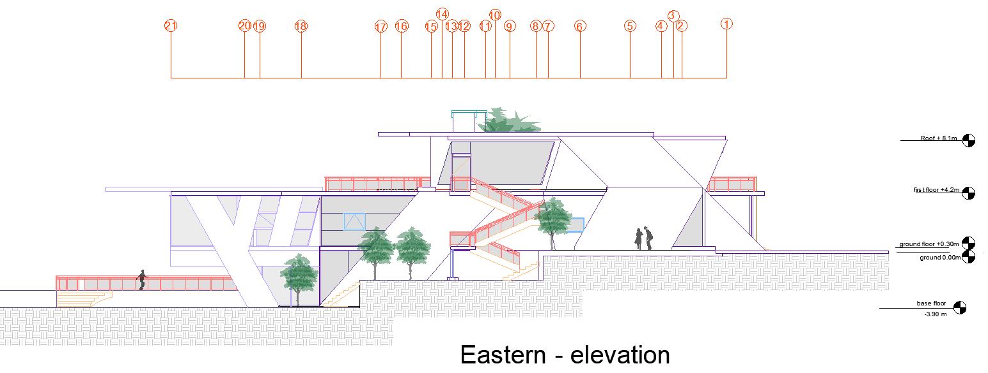
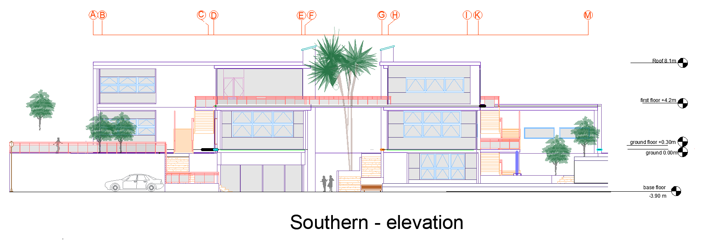
Elevations

Slide 15
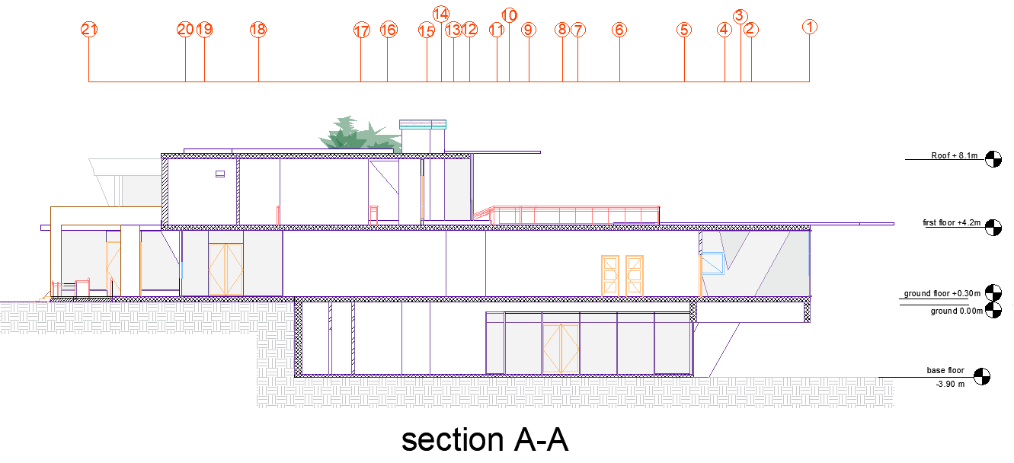
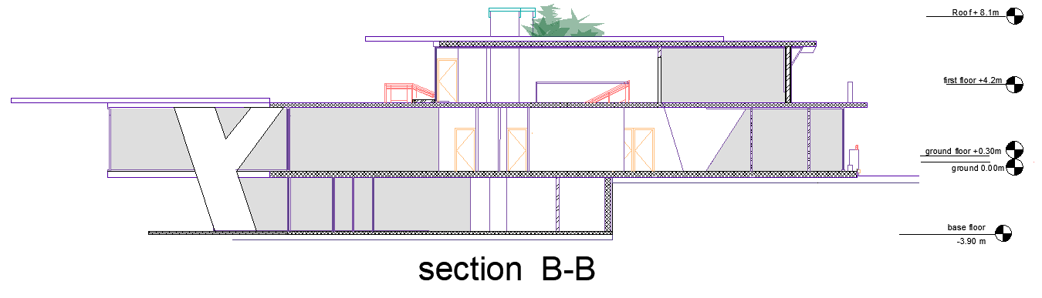
Sections

Slide 16
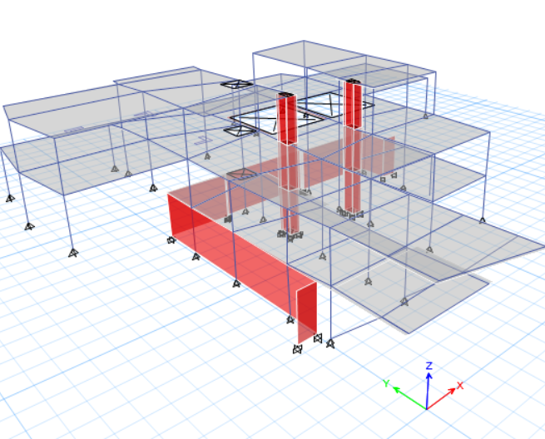
Structural Design
This section will show the whole structural design for the building in addition to water tank and retaining wall.

Slide 17
Seismic Factors
Cs | 0.2
Z→(peak ground acceleration for the rock ) | 0.2
Ca→(peak ground acceleration for the soil ) | 0.28
T,Tetabs(period) | (0.43),(0.62) sec
Hn(hight) | 10.5
Ct | (0.03ft)(0.0731m)
R,Response factor | 5.5
I,(importance factor) | 1
Cv | 0.4

Slide 18
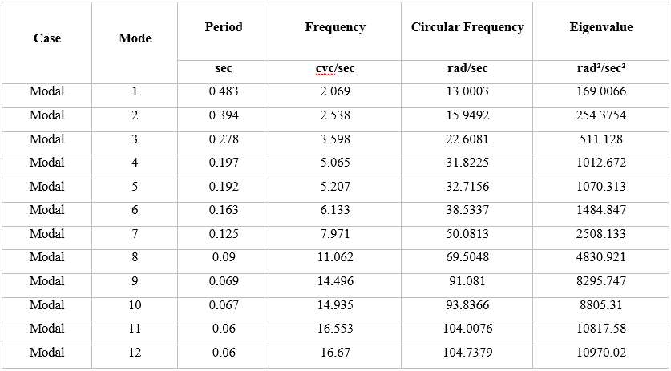
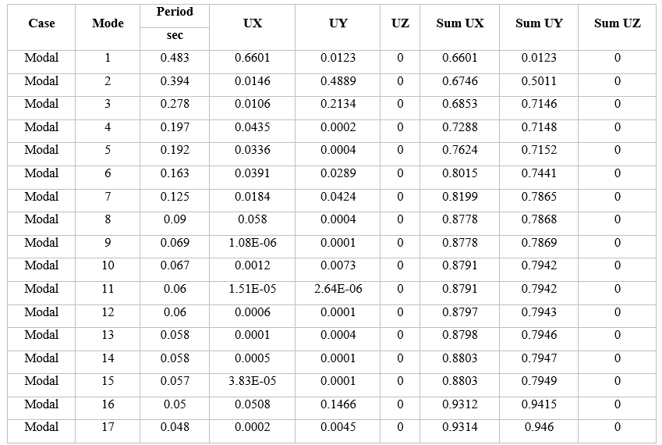
Seismic checks
Mass model ratio
The mass participation ratio has to achieve 90% of the building moving in x and y direction. For the table below shows that 17 modal needed to achieve more 90%.
Check period
The period was calculated to be less then Etabs which equal 0.602

Slide 19
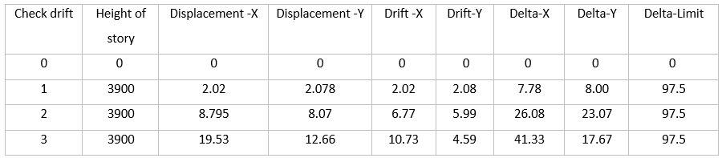
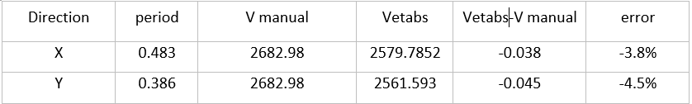
Seismic checks
Check Drift
The displacement of each floor in both direction X and Y has to be less than delta limit. The delta limit from the table below is less than 97.5.
Check base shear
The base shear check is to make sure that the difference manual calculation and Etabs is less than 5% error in both direction and the table below shows that it is less than 5% percent.

Slide 20
Footing design
Single footing
Combined footing
Mat foundation

Slide 21
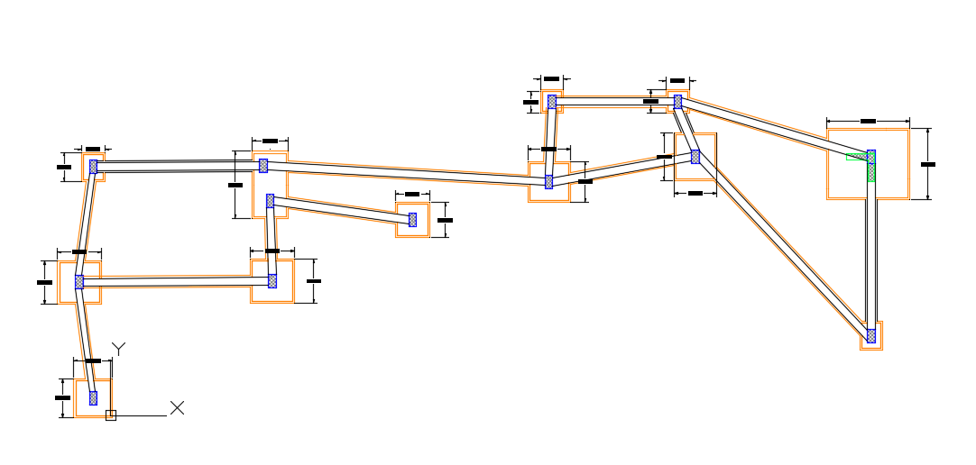
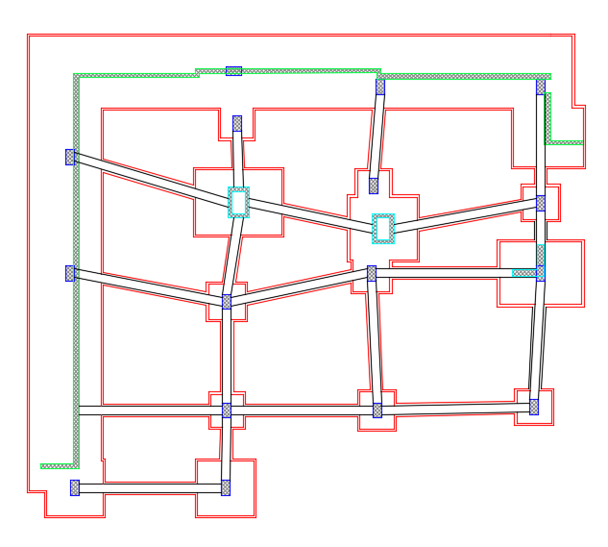
Footing layout
Basement floor
Ground floor

Slide 22
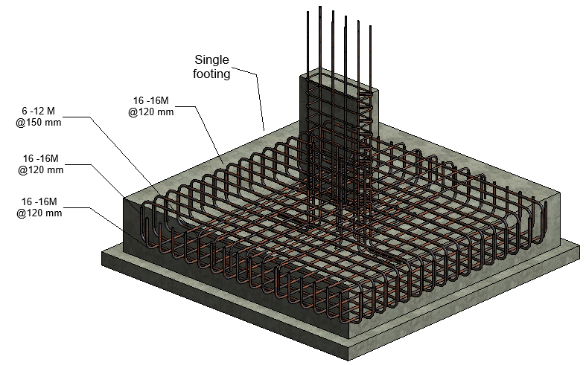
Detailing

Slide 23
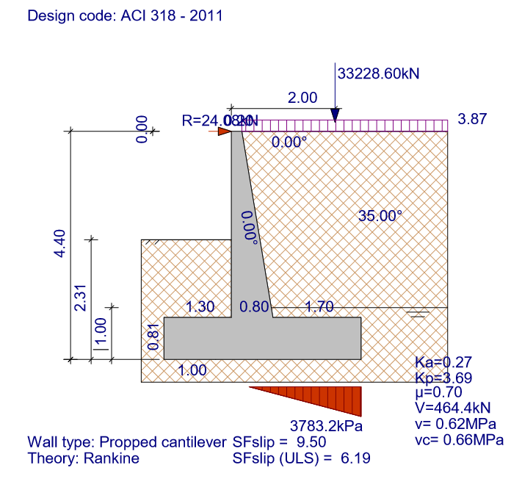
Retaining wall design

Slide 24
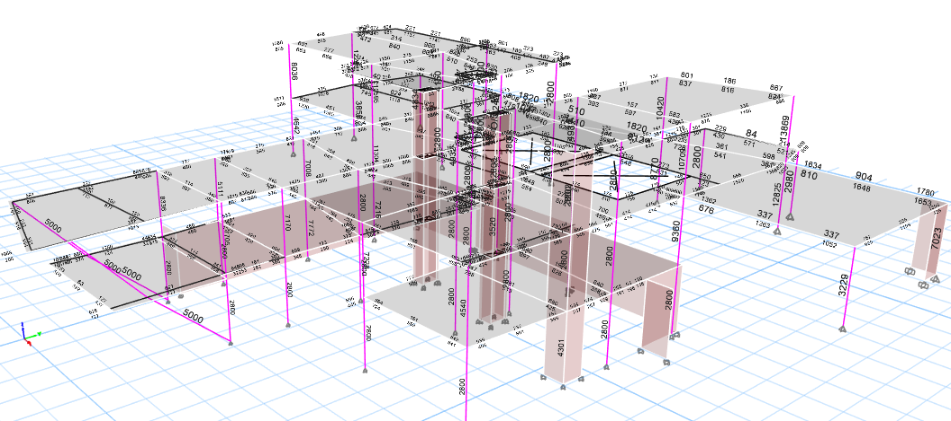
Column
Steel area have been taken from ETABS and converted to bars in each column:

Slide 25
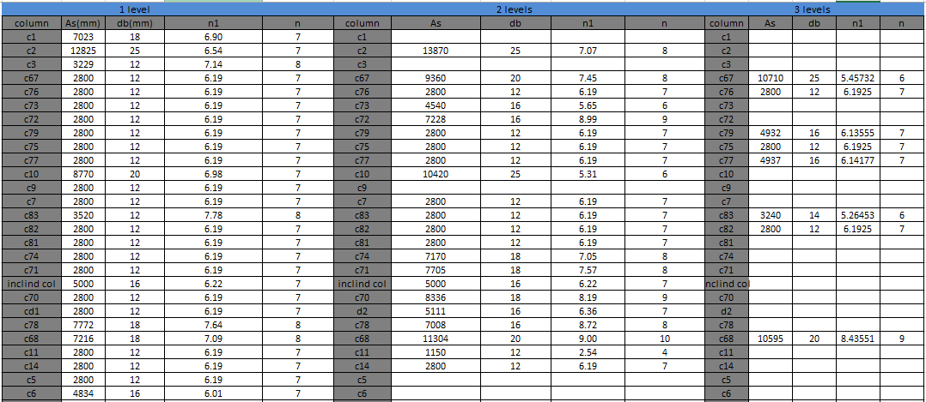
Tables

Slide 26
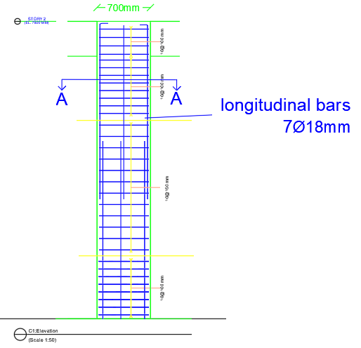
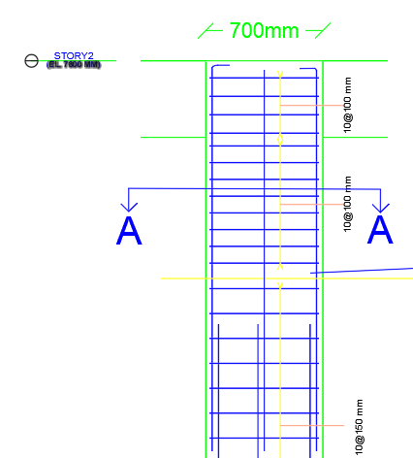
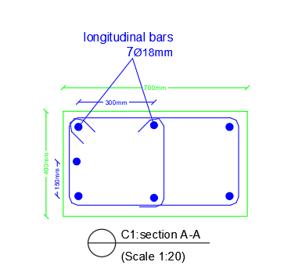
Detailing

Slide 27
Beams and Slabs

Slide 28
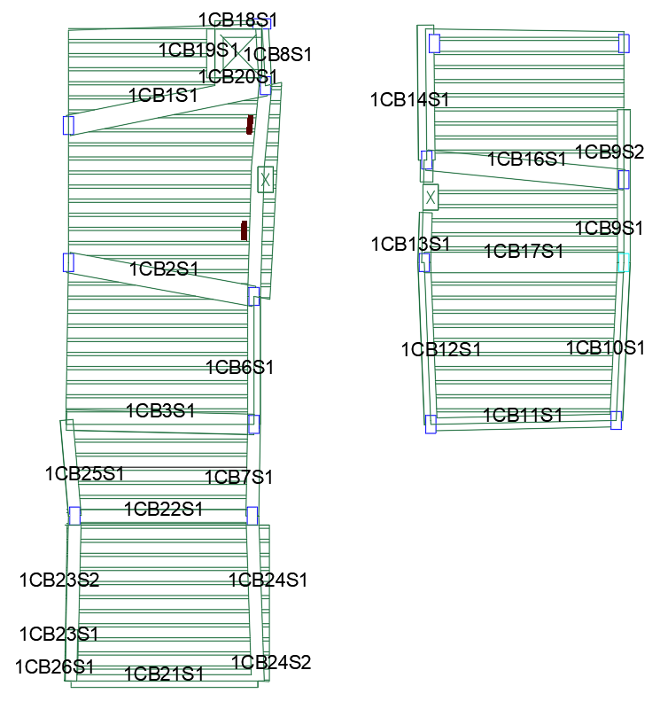
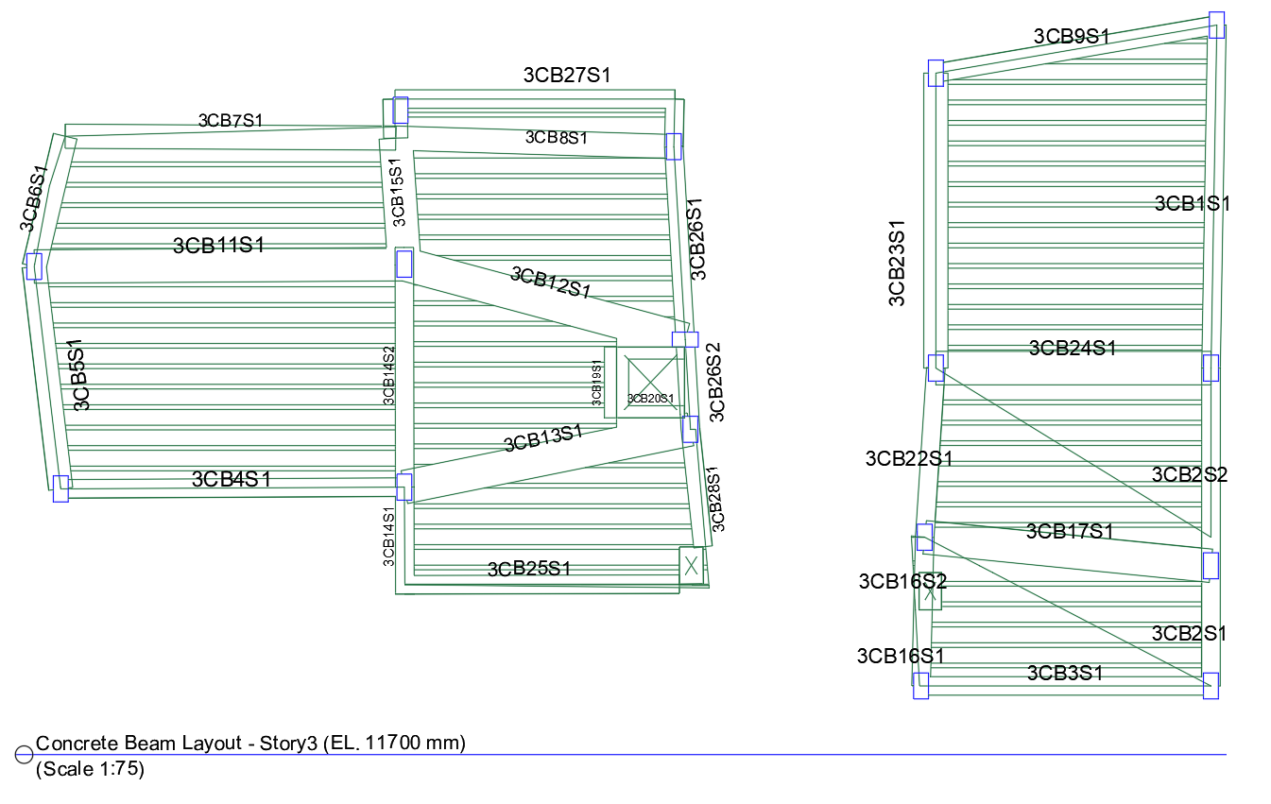
Basement floor layout
Transfers from ETBS each beam have been designed according to the loads they can carry
First floor layout

Slide 29
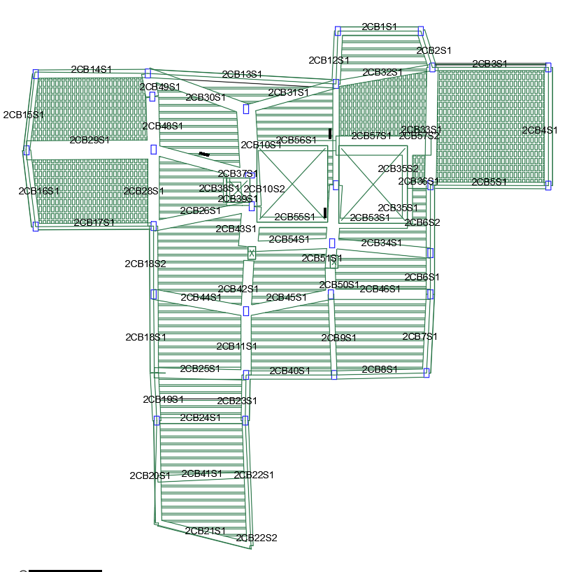
Ground floor layout

Slide 30
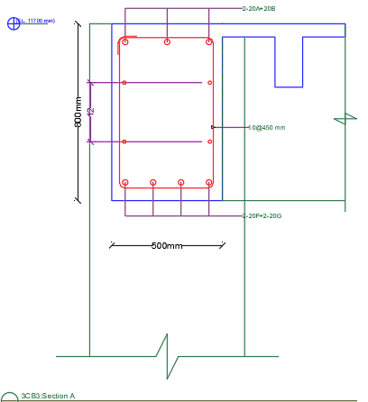
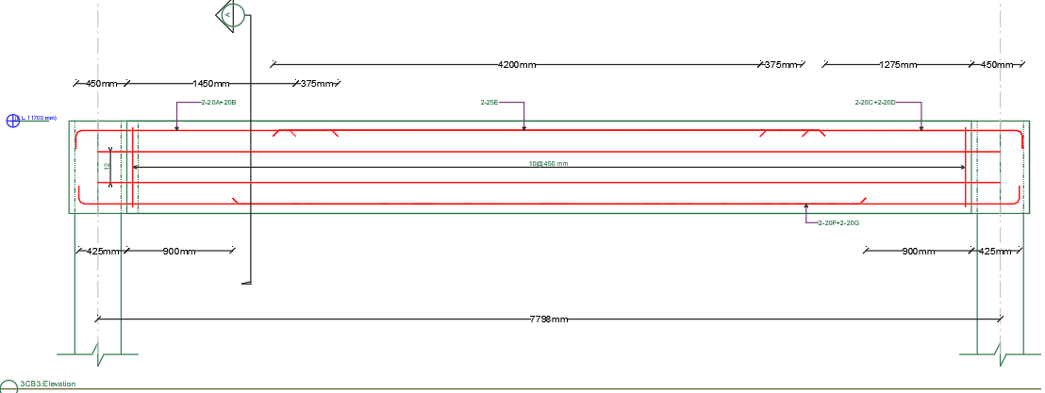
CSI details is used for the detailing of beams
Beam 2CB9 section
Beam 2CB9 elevation

Slide 31
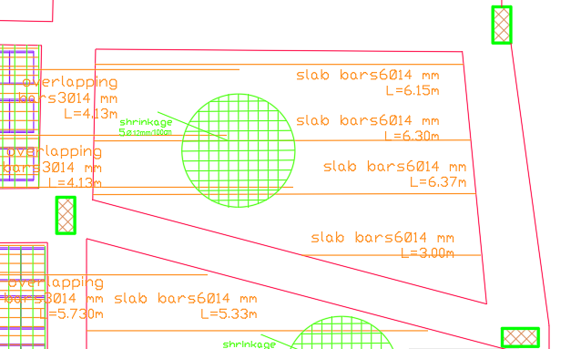
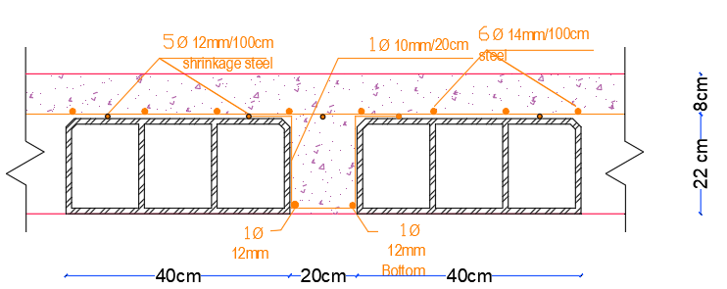
Slabs Detailing

Slide 32
Water Tank

Slide 33
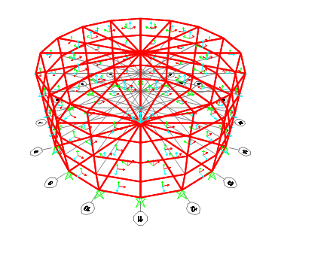
Water tank
Cylindrical Water tank will be designed with the following dimensions as 2.7 meter radius and 2.5 meter height.
SAP 2000 program used for the design.

Slide 34
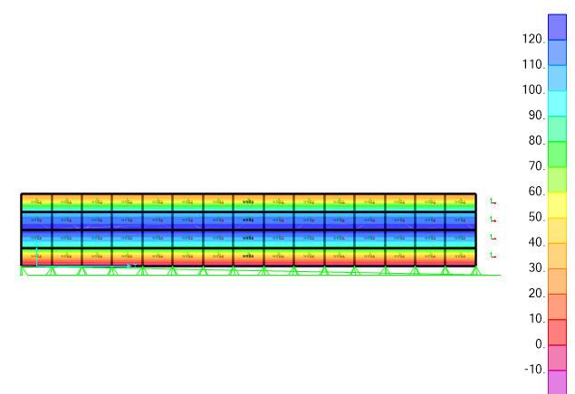
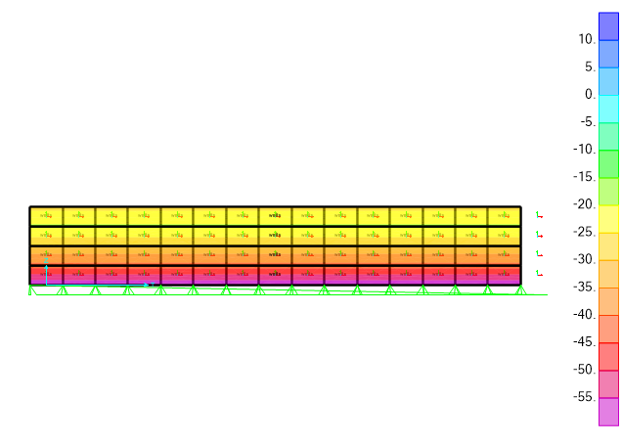
Loads
The water tank effected of two types of load soil and water
After inserting the loads equations on SAP2000, it was concluded From the results that water effect is the bigger which used in the design of the water tank.
Water F11: horizontal forces on the wall
Water F22: Axial forces on the wall

Slide 35
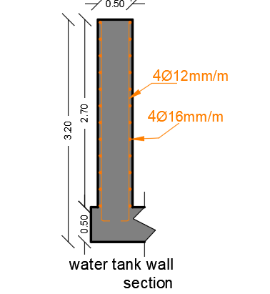
Detailing
After calculation have been made according to ACI350 code the reinforcement of the retaining wall haven been calculated and drawn:
Tu design =406.33KN
Two layers of reinforcement is used.
As = 4ø16. In each face for hoop
As= 4ø12. On each face for meridian.

Slide 36
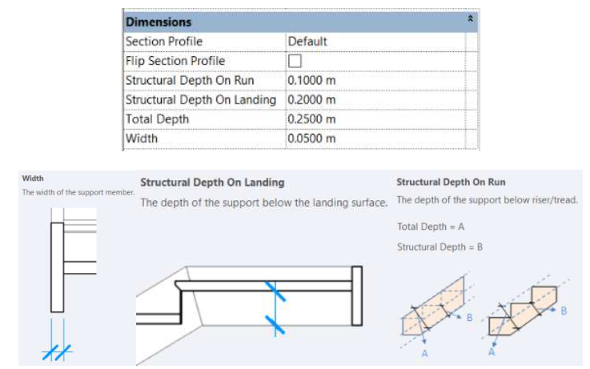
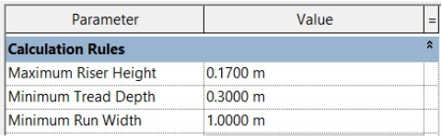
Steel staircase: (Done by Rivet)
The design of the exterior which will discuss the use of the Revit and AutoCAD program to the SAP2000, where all matters related to dimensions and construction elements will be included.
Dimensions:

Slide 37



Sections used
W-shape column
W-shape main beam
W-shape secondary beam

Slide 38




Connections
Purlin connection with plate
Base plate
Knee of frame bolted with haunch
Moment flange T (double)

Slide 39




Parts of the structure

Slide 40




The whole structure
Parts of the structure

Slide 41

Environmental Aspects
This section includes the design for Mechanical ,Electrical ,Lighting ,Acoustic designs and thermal comfort.

Slide 42


Sun path in winter
Sun path in Summer

Slide 43
Ventilation
It is important to study the wind on building for the case of ventilation since it provides fresh air and get rid of odors and humidification.
For this purpose
Analysis on Wind direction effecting the building .
Wind model simulation .
Editions on the building opening to get the benefit of the fresh air .
Evaluation of spaces .
Create solution for transversal and a sort turbulence wind flow .

Slide 44


Wind simulation

Slide 45


Wind simulation

Slide 46


Wind simulation

Slide 47


Ingrid cloud simulation

Slide 48


Internal circulation

Slide 49

Design builder
After inserting the building elements layer on design builder heating loads compared with the efficient range in KW/m.
Design capacity evaluation
Design capacity(W/m²) | Evaluation
20-25 | High efficient
26-40 | Good efficient
41-60 | Efficient
61-80 | accepted
Above 80 | Fail( consumes energy)

Slide 50

Temperature and Heat Loss

Slide 51
HVAC Design

Slide 52
HVAC
VRF system contains three types of HAVC systems:
Split unit
Cassette unit
Fan coil unit.
Comfort and cost are the main reasons to design which one of these systems to be used .

Slide 53

Heating and Cooling loads summary of the building
Building peak design load occurs in cooling phase which is 116.5 Kw.
LG company products will be used in the design.
.

Slide 54


HVAC Systems Types Catalogues
List of catalogues from LG company used in the three designs (Indoor Units):
Cassette units
Split units

Slide 55


HVAC systems types catalogues
List of catalogues from LG company used in the three designs:
Fan coil → Indoor Units
Fan coil →Outdoor Units

Slide 56

1) Split Unit Design
Ground Floor

Slide 57

Basement

Slide 58

First floor

Slide 59

2)Cassette Unit Design
Ground Floor

Slide 60

Basement

Slide 61

First floor

Slide 62

3) Fan coil-split unit system
Ground Floor

Slide 63

Basement

Slide 64

First floor

Slide 65
Comparison
Split Unit Design
Cassette Unit Design
Fan coil-split unit system
Cost → 261836$
Air and refrigerant distribution → Lowest
Evaluation → Average
Cost → 365606$
Air and refrigerant distribution → Middle
Evaluation → Worst system
Cost → 265127.5$
Air and refrigerant distribution → Best
Evaluation →Best system

Slide 66
Power Design

Slide 67


Ground plan power distribution
First floor plan power distribution

Slide 68

First floor power distribution
The electrical load of elevators and HVAC system
The electrical load of the whole building
H-VAC & lift DP | power | current |  |  |  |  | thickness
unit | watt
one lift | 14600 | I load | I C.B | I Cable | C.B | Cable IEC | Cable
H-VAC unit | 116535 | Ampere | Ampere | Ampere | Ampere | Ampere | -
total power- 3 phases | 131135 | 210.31 | 241.85 | 278.13 | 310 | (115 A ) | 35 mm^2
Each phase | 43711.667 | 70.10 | 80.62 | 92.71
THE BUILDING | total power | I load | I C.B | I cable | C.B | Cable
 | Watt | Ampere | Ampere | Ampere | Ampere | -
M.D.B -3 phases | 22616.2 | 36.27 | 43.52 | 52.23 | 50 | (65A)16mm^2

Slide 69


The electrical load of power, lighting and loud speaker system in the ground floor.
Ground Floor
DB # | Number of sockets | Normal load (sockets) |  | Lighting load | Total power | I load | I C.B | I Cable | C.B | Cable IEC | Cable | Number of power branches | Number of lighting branches
 | - | Watt | Watt | Watt | Watt | Ampere | Ampere | Ampere | Ampere | Ampere | - | - | -
DB1 | 38 | 250 | 9500 | 1450 | 4010 | 20.25 | 23.29 | 26.78 | 25 | 28 | 4mm^2 | 10 | 11
DB1-UPS | 14 | 250 | 3500 | 867.2 | 1743.76 | 8.81 | 10.13 | 11.65 | 16 | 28 | 4mm^2 | 3 | 7
DB2 | 26 | 250 | 6500 | 2240.6 | 3742.48 | 18.90 | 21.74 | 25.00 | 25 | 28 | 4mm^2 | 5 | 13
DB2-UPS | 6 | 250 | 1500 | 580.4 | 914.32 | 4.62 | 5.31 | 6.11 | 16 | 28 | 4mm^2 | 3 | 4
DB3 | - | - | 0 | 2602.3 | 2081.84 | 10.51 | 12.09 | 13.91 | 16 | 28 | 4mm^2 | 0 | 15
M.D.B G-F /3 phases |  | TOTAL POWER= |  |  | 12492.4 | 20.03 | 23.04 | 26.50 | 25 | 36 | 6mm^2 | 5 | -
Main distribution board of circuit breaker in the ground floor.
Location of main DB, lift and H-VAC and G-F DB

Slide 70


Lighting Design
Dialux Simulation (Artificial lighting):
Artificial lighting simulation was done and all requirements were fulfilled.
Luminaire list
Index | Manufacturer | Article name | Luminous flux | Connected load | Quantity
 | - | - | lm | Watt | #
1 | PHILIPS | DN570B PSE-E C | 1350 lm | 11.8 | 36
2 | ARTEMIDE | TAGORA 570 SOSPENSIONE LED EMISSIONE DIRETTA DIMMERABIL | 3820 lm | 60 | 27
3 | PHILIPS | SM480C W24L134 ACC-MLO LED40S/- NO | 4000 lm | 34.5 | 6
4 | PHILIPS | SM480C W24L134 ACC-MLO LED35S/- NO | 3500 lm | 29.5 | 11
5 | Thorn | CETUS LED 1000 HF 830 [STD] | 1000 lm | 9.4 | 32
6 | PHILIPS | SM505S XA DA25W LED66S/830 NO | 6600 lm | 41 | 7
7 | PROLED | Flex Strip 1200-80 Mono - NW | 1900 lm | 19.2 | 18
8 | FLOS | 2097/30 | 3000 lm | 450 | 3
9 | BRIGHTSPECIALLIGHTING | UP DOWN 3 | 3100 lm | 30 | 15
Ground floor lighting

Slide 71


First floor lighting
Base floor lighting

Slide 72
Generator:
- Generator is connected to some of the lighting system of the building, power outlets and the elevator.
- This generator is with a capacity of 25000 Watt.
THE GENERATOR
total power |  | Reserve capacity = Full load kW x 0.25 | generator size = Full load kW + reserve capacity
Watt |  | Watt | Watt
19248.1 | 20000 | 5000 | 25000

Slide 73


Lighting Design
An artificial and day lighting simulations were done using DIALux software, all lighting requirements achieved.
These photos shows the artificial lighting simulation in the cafeteria zone.
Space information: this cafeteria is a 12.6*5.65 m room.

Slide 74






These green panels were used for an acoustical purpose, and they play an atheistic role as well.
The selected Luminaires

Slide 75



Lighting design in the Entertaining zone
Louvers were used as a decorative elements.

Slide 76




The selected Luminaires
Results of lighting in entertaining room

Slide 77


Lighting design in the Multimedia zone
Spots and cove lighting were using in this room

Slide 78



These tables shows the results of the artificial lighting simulation of all functional areas in the building.
All lighting and glare requirements were achieved.

Slide 79

DIALux Simulation (Natural lighting):
Daylighting simulation was done using DIALux and many functional areas have enough daylight, it was determined that these area can totally depend on daylight from 12:00 till 3:00 PM.

Slide 80


Computer laboratory
Art room

Slide 81


Reception Area
Corridor (GF)

Slide 82


Staff room
Library

Slide 83
What do these simulations add to the scientific value and analytical output of the building?
How can we take advantage of these simulations in energy saving concept?

Slide 84
Through further calculations, it was determined that up to nearly 150 ILS can be saved depending on natural lighting from 12:00 to 3:00 PM.
Electricity tariff rate= 0.747 ILS/KW
Area | Quantity | Power | Duration of operation (hours) | Operation cost
Computer lab | 5 | 29.5 | 3 | 7.27
Art Room | 6 | 41 | 3 | 12.13
Reception | 2 | 450 | 3 | 44.37
Reception | 12 | 11.5 | 3 | 6.80
Lobby GF | 4 | 60 | 3 | 11.83
Lobby GF | 8 | 9.4 | 3 | 3.71
Lobby FF | 1 | 450 | 3 | 22.19
Lobby FF | 10 | 11.8 | 3 | 5.82
Library | 6 | 41 | 3 | 12.13
Staff room | 6 | 60 | 3 | 17.75
Corridor | 3 | 60 | 3 | 8.87
savings |  |  | Savings per month | 152.87
 |  |  | savings per year | 1834.45

Slide 85

Outdoor Lighting
Lighting units were used in an elegant, simple way to show the architectural cuts of the building.

Slide 86


Slide 87



Slide 88



Slide 89
Fire fighting system

Slide 90


The symbols of the fire fighting and evacuation systems in the building.
firefighting plan of the ground floor

Slide 91




Extinguishers according to the space:
sprinklers according to the space:
Functional area | Type of extinguisher
Corridors | Water extinguisher
Library | Dry powder extinguisher
Class rooms | Dry powder extinguisher
kitchen | Dry powder extinguisher
Computer lab | Dry powder extinguisher
Art room | Dry powder extinguisher
Manager room | Dry powder extinguisher
Cafeteria | Water extinguisher
Entertaining room | Dry powder extinguisher
Functional area | Type of sprinkler
Corridors | Water sprinkler
Library | Dry sprinkler
Multimedia room | Dry sprinkler
Cafeteria | Water sprinkler

Slide 92



Evacuation plans:

Slide 93
Acoustic Design

Slide 94



Acoustic Design
Material used
Material added
Miniperf laine
perforated wooden panels
Fabric acoustic material

Slide 95




Acoustic Design
Reverberation time (RT60)
Classroom RT(60) according to Sabine
Office RT(60) according to Sabine

Slide 96




Acoustic Design
Reverberation time (RT60)
Entertainment room RT(60) according to Sabine
Cafeteria RT(60) according to Sabine

Slide 97



Acoustic Design
STC and IIC
Floor
Ceiling
External walls

Slide 98



Acoustic Design
STC and IIC
Roof
Internal walls
External glazing walls

Slide 99




Acoustic Design
Loud Speakers

Slide 100
Water Supply System

Slide 101

Water supply system
Water Tanks Used

Slide 102


Water consumption
Domestic use consumption
Drinking consumption
Firefighting consumption
Irrigation consumption
All cube needed is 58 cubes and 3 cube for hot water use

Slide 103



Slide 104
Drainage System

Slide 105

Pipes used
The total number of fixture units is 99 fu the main diameter for the main stack is ${4 }^{̎}$
The diameters for the pipes as follows
Horizontal pipe for the water closet is ${4 }^{̎}$ with slope 1%
Horizontal pipe for the lavatory is ${2 }^{̎}$ with slope 2%
Horizontal pipe for the kitchen sink is ${2 }^{̎}$ with slope 2%
Vent pipe is ${2 }^{̎}$
The pipe between the manholes is ${6 }^{̎}$ with slope1%
The rain water main vertical stack ${4 }^{̎}$

Slide 106


Slide 107



Slide 108



Integration in designing all systems in the building (H-VAC, Fire fighting system, lighting)
Base floor
Ground floor
First floor

Slide 109
Quantity Surveying and Cost Estimation
This section contains quantity for each element and its cost .

Slide 110
The total cost of the building is 3599387 NIS and the total area of the building is 1366m² which means that the total unit cost per m² is 2635 NIS/m², nearly 750 $/m².
Earth work = 42230 NIS
Foundation = 177415 NIS
Building (construction) = 277316 NIS
Finishing = 1485007 NIS
Site Plane work = 824803 NIS
Electrical = 463975 NIS
Mechanical = 328640 NIS

Slide 111
Team
The end
Thank You
Ahmad Ilaiwi
Sarah Shaheen
Abdullah Hamdan

