Slide 1
Pilot Study on Smart Campus:
Modeling Pedestrian Behavior at NNU, New Campus
Feras Elsaid
Watheq Sayeh
Supervisor: Prof. Sameer Abu-Eisheh

Slide 2
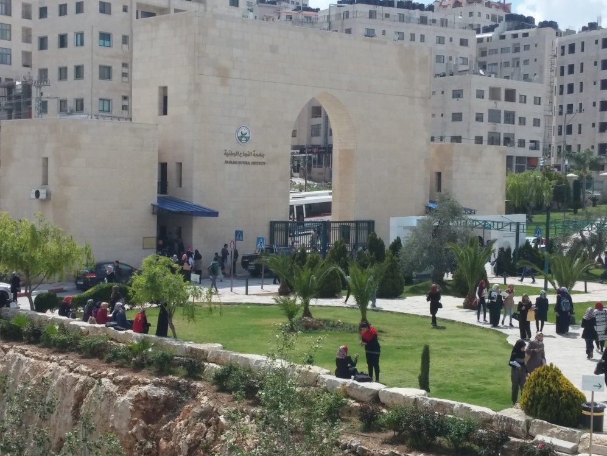
Why not smart ?!
Study Area
Objectives
Literature Review
Methodology
Data Collection
Data Analysis
Results
Future work

Slide 3
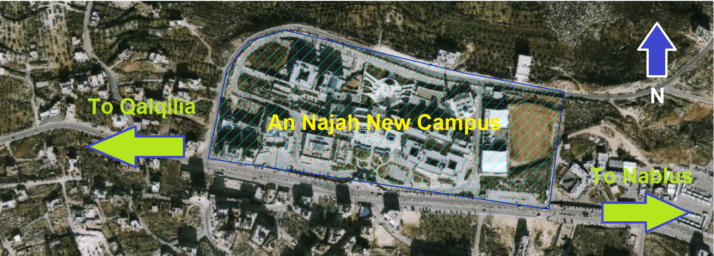
Study Area

Slide 4
Objectives
Detecting pedestrians’ problems
Understanding behavior of pedestrians
Utilizing new technology, mainly smartphones, in transportation aspects
Basis and first step of research in this field in Palestine

Slide 5
Done so far ..
Van Langelaar and van der Spek (2010)
Ghanim and Abu-Eisheh (2014)
Asadi-Shekari, Moeinaddini and Shah (2014)
Sahania, R. and P. K. Bhuyan (2013)
Christopoulou and Pitsiava-Latinopoulou (2012)

Slide 6
Done so far ..
Some studies utilized smartphones for urban planning purposes, others studied transportation aspects of pedestrians movement, like LOS, but no one considered both aspects.

Slide 7
Our work
No such a study in Palestine!

Slide 8
Methodology
Do a surveillance in the study area to detect problems
Collect data (both manual and smart)
Analyze data
Review past solutions
Conclude and recommend

Slide 9
Data collection
Manual data (simultaneously):
speed study of vehicles
count of pedestrians
count of vehicles
Mobile phone data:
11 volunteers

Slide 10
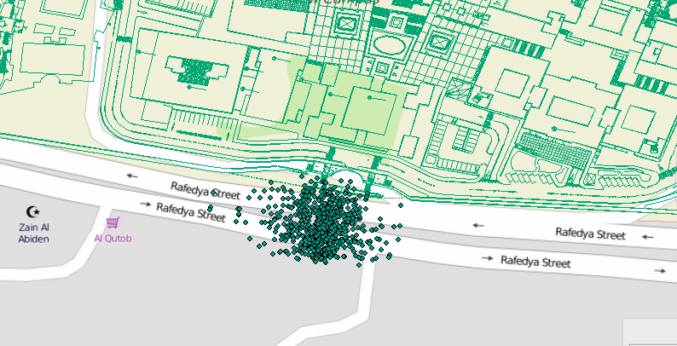
ArcGIS Work
WGS-84 as spatial reference
Representing of data

Slide 11
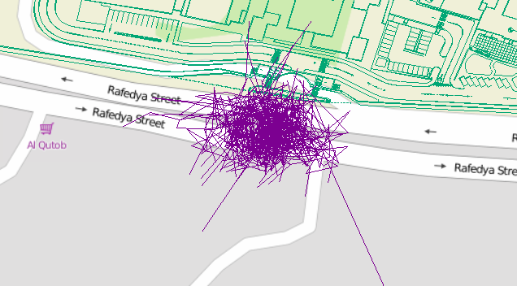
ArcGIS Work
Lines representing the direction and length of each movement

Slide 12
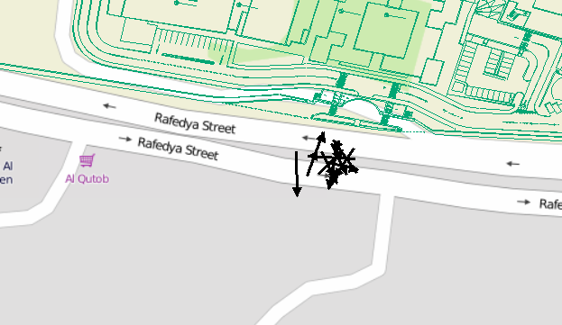
ArcGIS Work
Lines representing the directional mean of each group

Slide 13
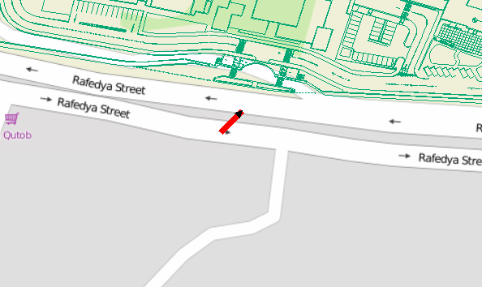
ArcGIS Work
The directional mean of all movements

Slide 14
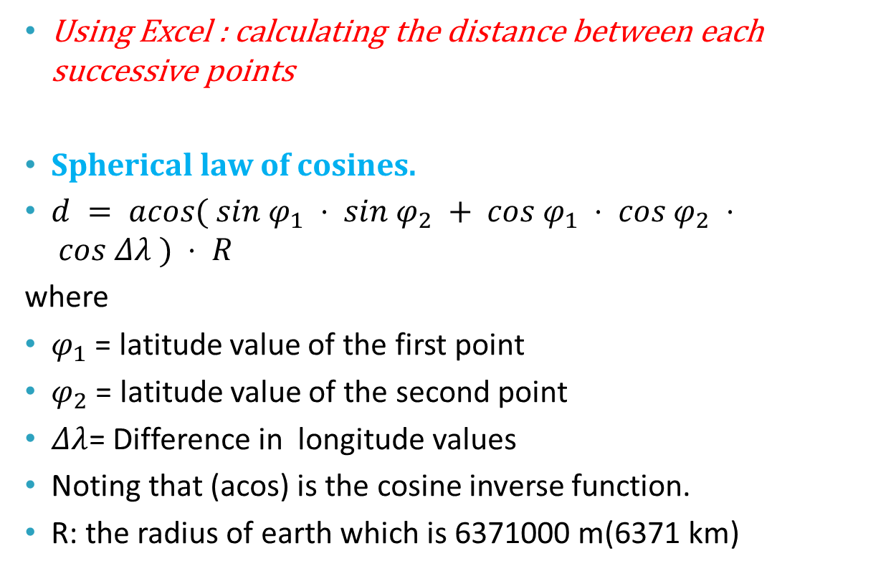
ArcGIS Work
Using Excel : calculating the distance between each successive points
Spherical law of cosines.
$d = acos( sin φ_{1} ⋅ sin φ_{2} + cos φ_{1} ⋅ cos φ_{2} ⋅ cos Δλ ) ⋅ R$
where
$φ_{1}$ = latitude value of the first point
$φ_{2}$ = latitude value of the second point
$Δλ$= Difference in longitude values
Noting that (acos) is the cosine inverse function.
R: the radius of earth which is 6371000 m(6371 km)

Slide 15
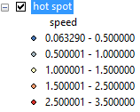
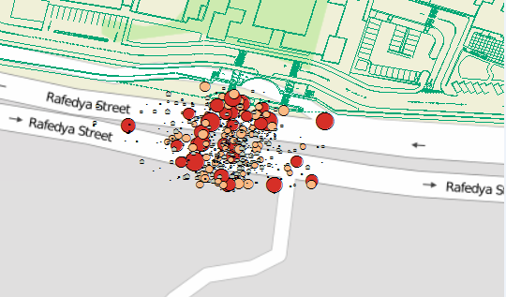
ArcGIS Work

Slide 16
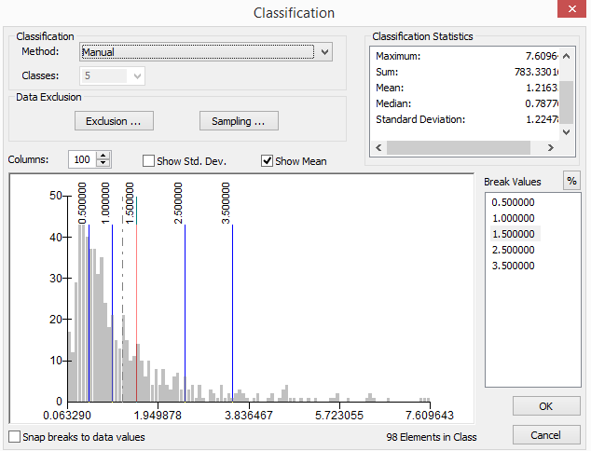
Results
Speed Variations

Slide 17
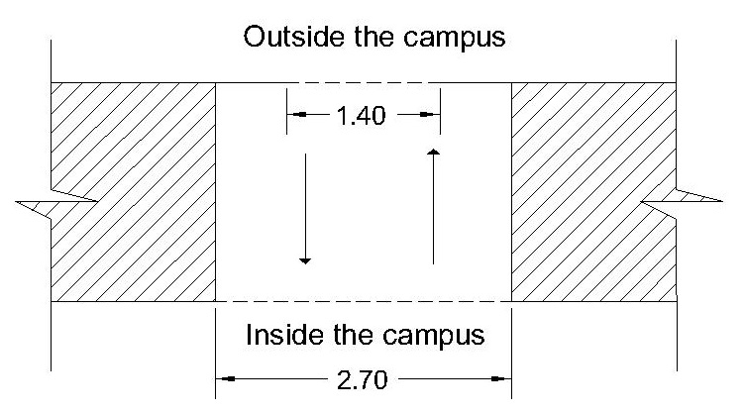
Level Of Service(LOS) Analysis
Pedestrian Level of Service (PLOS)
PLOS: Main gate of the campus

Slide 18
PLOS: Main gate of the campus
Period | Direction of movement | Total Pedestrian per hour(flow rate) | max 15 min-interval volume | Peak 15 min
Mon. 7:36 – 8:36 am | Entering the campus | 2274 | 1220 | 7:44 - 7:59
Sun. 2:00 – 3:00 pm | Leaving the campus | 1778 | 849 | 2:45 – 3:00
Wed. 12:30 – 13:24 pm | Entering the campus, Leaving the campus(Total) | 1773 | 614 | 12:30 -12:45
Sun. 7:42 – 8:42 am | Entering the campus | 2538 | 1275 | 7:48 – 8:03

Slide 19
PLOS: Main gate of the campus
Period | max 15 min-interval volume | Effective width =1.4 m |  | Effective width =2.30 m
 |  | Flow Rate (p/min/m) | PLOS | Flow Rate (p/min/m) | PLOS
Mon. 7:36 – 8:36 am | 1220 | 58.10 | E | 35.36 | D
Sun. 2:00 – 3:00 pm | 849 | 40.43 | D | 24.61 | C
Wed. 12:30 – 13:24 pm | 614 | 29.24 | C | 17.80 | B
Sun. 7:42 – 8:42 am | 1275 | 60.71 | E | 36.96 | D

Slide 20
PLOS: Crosswalk in front of the campus
Day | Time interval | Total pedestrian volume | Peak 15-min pedestrians’ volume
Thursday | 3:57 – 3:12 | 1468 | 581
Wednesday | 9:20 – 9:35 | 1556 | 540
Tuesday | 2:50 – 3:05 | 1283 | 580
Date | Day | Time | PLOS Score | PLOS
20/10/2015 | Tuesday | 2:45-3:45 | 4.0 | E
21/10/2015 | Wednesday | 8:45-9:45 | 3.5 | F
22/10/2015 | Thursday | 2:45-3:34 | 3.8 | F

Slide 21
Vehicular Level of Service (VLOS)
HCM (2010) was used to calculate VLOS for the street in front of the campus as a multilane highway for the current the traffic situation
Upgrade
Day | Time interval | Peak 15-min vehicles’ volume | VLOS
Thursday | 2:47 – 3:02 | 229 | B
Wednesday | 9:15 – 9:30 | 265 | B
Tuesday | 3:00 – 3:15 | 265 | B

Slide 22
Vehicular Level of Service (VLOS)
Downgrade
Day | Time | Peak 15-min vehicles’ volume | VLOS
Thursday | 2:47 – 3:02 | 252 | B
Wednesday | 9:20-9:35 | 270 | B
Tuesday | 3:15 – 3:30 | 225 | B

Slide 23
But… Synchro
Direction | East Bound | West Bound
Number of lanes | 2 | 2
Width of lane (m) | 3.6 | 3.6
Grade (%) | -9% | 9%
Peak Volume (pc/hr) | 1080 | 1060
Percentage of heavy vehicles (%) | 2 | 2
Pedestrian Volume (ped/hr) | 2160 | 2160
Sign control | Yield | Yield
Approach LOS | E | E

Slide 24
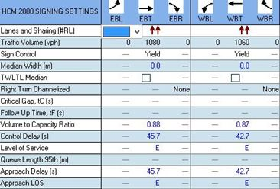
VLOS using Synchro

Slide 25
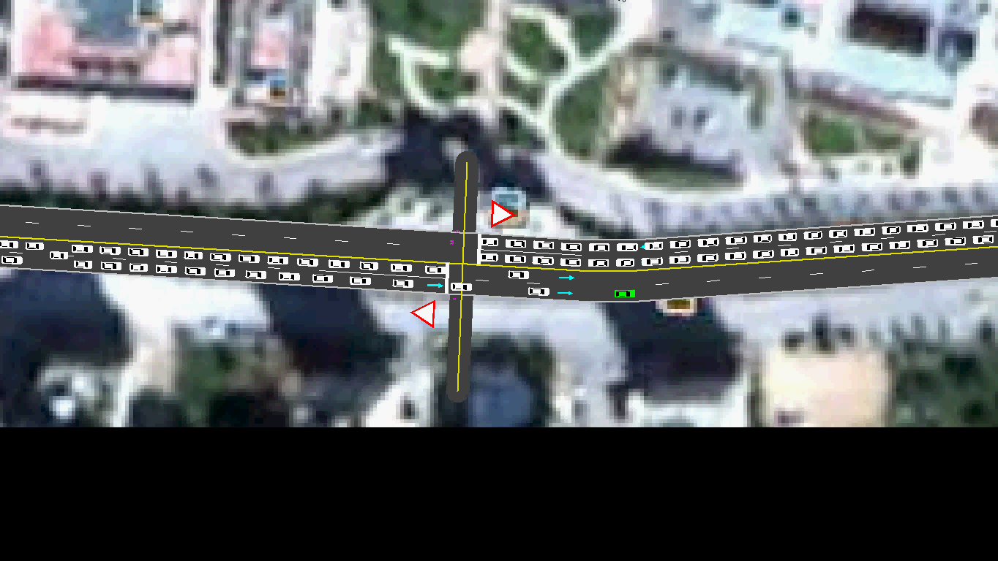

Slide 26
REVIEW OF SOME PROPOSED SOLUTIONS
“Evaluation and Re-Design of the Transportation System Around the New Campus of An-Najah National University”

Slide 27
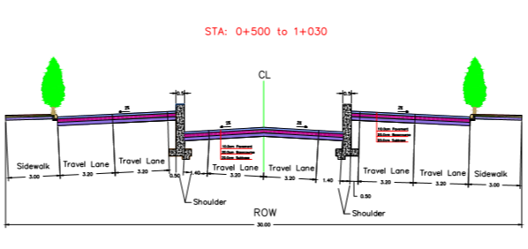
Cross-section

Slide 28
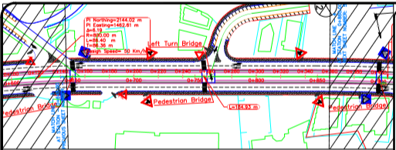
Plan view

Slide 29
Designed as:
Underpass ,Two-way Two-lane highway
Width of lane= 3.20m , width of shoulder = 1.40m
Grade greater than 4%
530 m long

Slide 30
LOS of Two-way, two-lane Underpass
Assumptions:
class II highway as:
Serves as a way to an arterial two-lane highway
Limited length
Specific grade method as the grade of this segment greater than 4 %

Slide 31
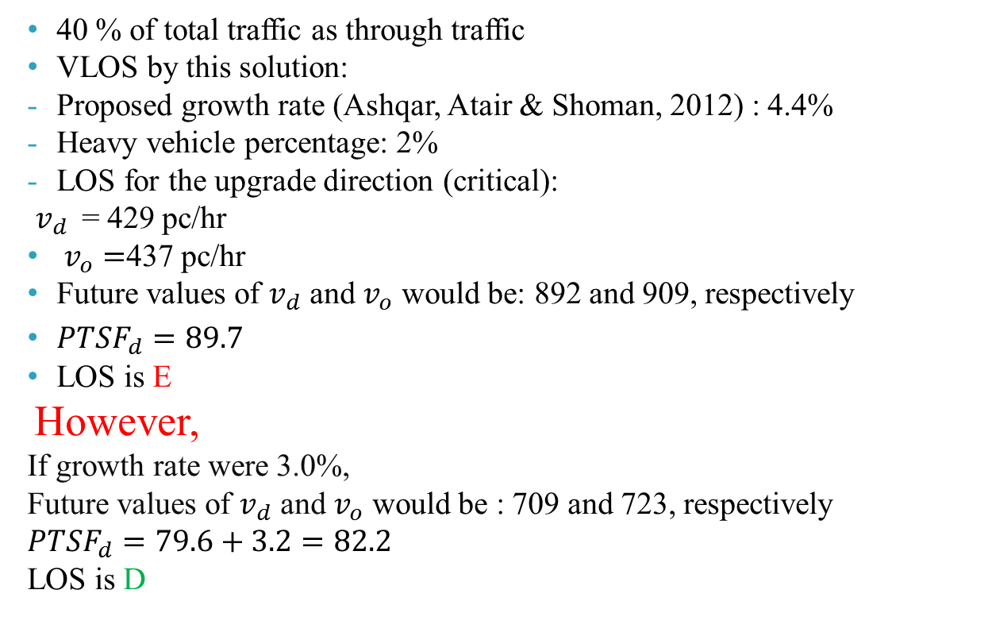
LOS of Two-way, two-lane Underpass
40 % of total traffic as through traffic
VLOS by this solution:
Proposed growth rate (Ashqar, Atair & Shoman, 2012) : 4.4%
Heavy vehicle percentage: 2%
LOS for the upgrade direction (critical):
$v_{d}$= 429 pc/hr
$v_{o}=$437 pc/hr
Future values of $v_{d}$ and $v_{o}$ would be: 892 and 909, respectively
${PTSF}_{d}=89.7$
LOS is E
However,
If growth rate were 3.0%,
Future values of $v_{d}$ and $v_{o}$ would be : 709 and 723, respectively
$${PTSF}_{d}=79.6+3.2=82.2$$
LOS is D

Slide 32
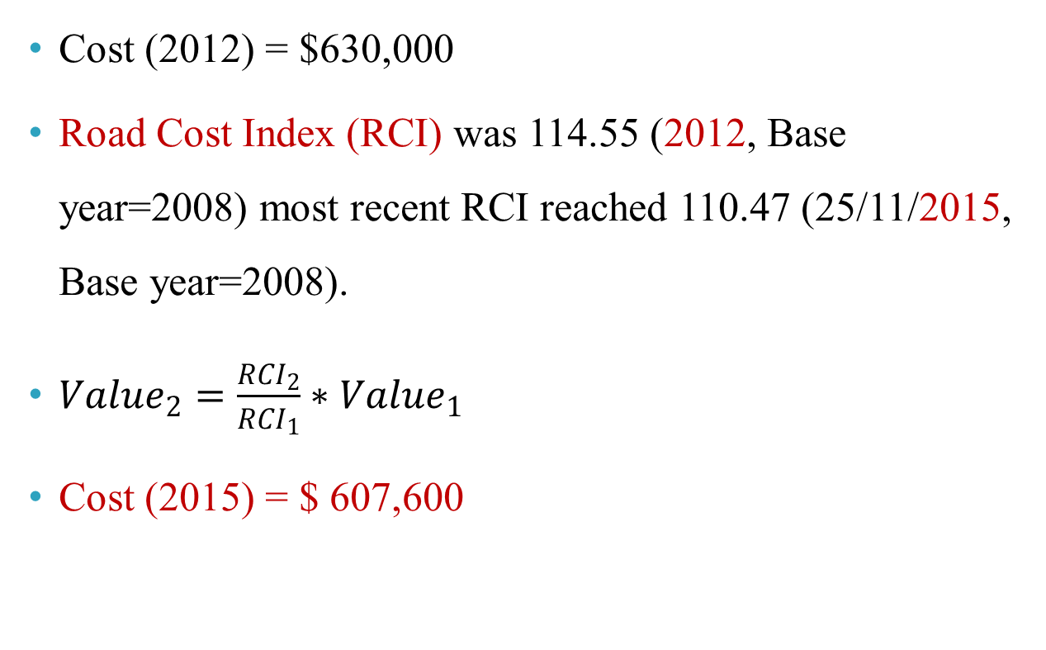
Total Cost of the project
Cost (2012) = $630,000
Road Cost Index (RCI) was 114.55 (2012, Base year=2008) most recent RCI reached 110.47 (25/11/2015, Base year=2008).
${Value}_{2}=\frac{{RCI}_{2}}{{RCI}_{1}}∗{Value}_{1}$
Cost (2015) = $ 607,600

Slide 33
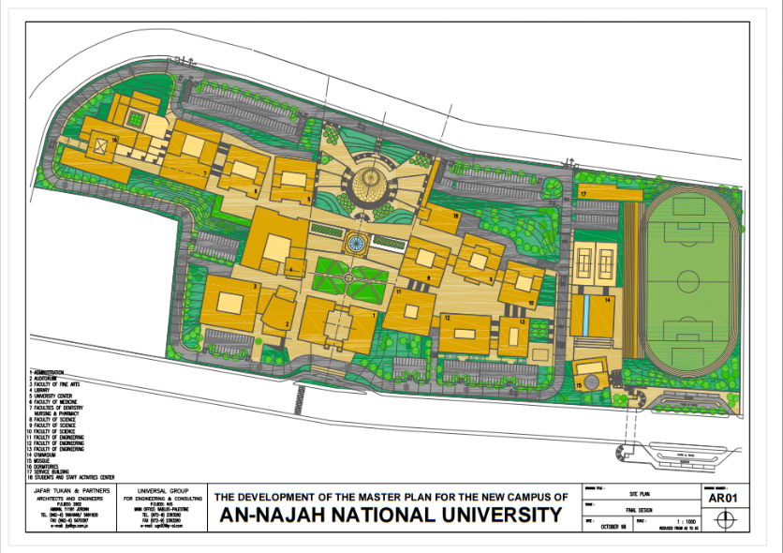
New Campus’s Master Plan

Slide 34
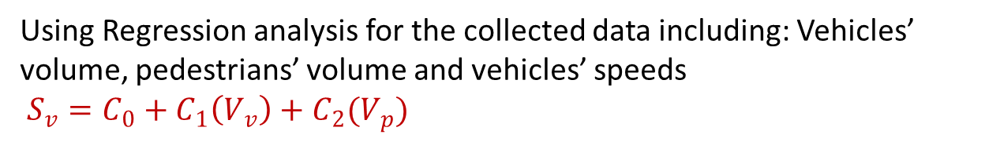
Modeling Multimodal Effect on Vehicular Speeds
Using Regression analysis for the collected data including: Vehicles’ volume, pedestrians’ volume and vehicles’ speeds
$S_{v}=C_{0}+C_{1}\left(V_{v}\right)+C_{2}(V_{p})$
West Bound Direction
Date | Day | Time | Constant | Vehicular volume Coefficient | Pedestrian Volume Coefficient | R Square
20/10/2015 | Tuesday | 2:40-3:40 | 39.880 | -0.012 | -0.108 | 0.828
21/10/2015 | Wednesday | 8:45-9:45 | 43.445 | -0.111 | -0.020 | 0.650
22/10/2015 | Thursday | 2:47-2:37 | 53.146 | -0.526 | -0.002 | 0.781

Slide 35
Modeling Multimodal Effect on Vehicular Speeds
East Bound Direction
Date | Day | Time | Constant | Vehicular volume Coefficient | Pedestrian Volume Coefficient | R Square
20/10/2015 | Tuesday | 2:40-3:40 | 16.894 | 0.099 | -0.056 | 0.866
21/10/2015 | Wednesday | 8:45-9:45 | 29.266 | 0.080 | -0.122 | 0.356
22/10/2015 | Thursday | 2:47-2:37 | -30.613 | 0.682 | 0.032 | 0.839

Slide 36
Summary
Cross walk PLOS: F
VLOS:
Current situation:
Manually, was B.
Using Synchro, was E.
Proposed by Ashqar, Atair and Shoman, (after 17 years): D
Pedestrians tend to cross the road randomly, might be diagonally, so they do not stick to the cross walk.
Average speed of pedestrians in front of the campus was 1.2m/s.

Slide 37
Future work’s Recommendations
Image processing
Real-time vehicular traffic information.
The proposed solution by Ashqar, Atair and Shoman.
Multimodal models:
Increase the study period and consider the analysis period as least as one or two minute.
Measure all the multimodal parameters in the field, e.g., parking maneuvers, etc…
Take surrounding environment hindrances into account.
Consider safety issue in front of the campus.

Slide 38
Thank you for listening

