Slide 1

An-Najah National University
Faculty of Engineering & Information Technology
Building Engineering DEPARTMENT
Environmentally friendly Mosque
Prepared by:
Mohammad Omareyah
Ahmad Mizher
Alaa Omar
Supervisor: Eng. Amer Shareef

Slide 2
Outline
Introduction
Site location
Architectural Design
Environmental Design
Structural Design
Electrical Design
Mechanical Design
Safety Design
Estimated Cost

Slide 3
INTRODUCTION
OBJECTIVES OF THE PROJECT :
Design an environmentally friendly mosque, considering the following aspects: Architectural, Mechanical, Environmental & Electrical.

Slide 4
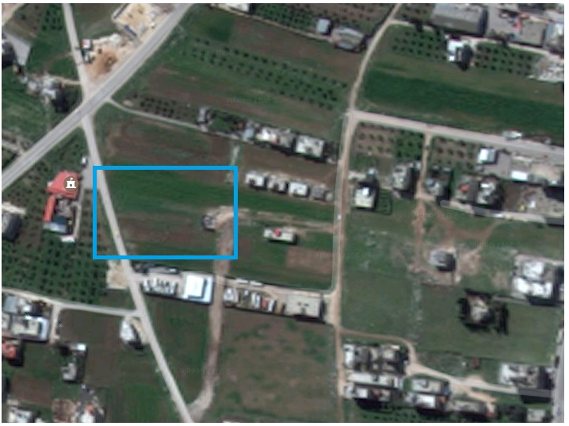
SITE LOCATION
Al al-dahiya al-tahta, alquds Street, Nablus – Palestine .
Total area of 2100m².

Slide 5
ARCHITECTURAL DESIGN
The total area of the Mosque = 736 m², It divided in to two floors .
The area of each floor is shown in the following table :
Floor | Area (m²)
Ground floor | 527
First floor | 209
Total | 736

Slide 6
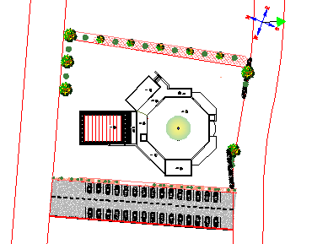
ARCHITECTURAL DESIGN
Site Plane:

Slide 7
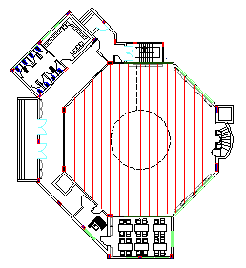
ARCHITECTURAL DESIGN
G.F Plane:

Slide 8
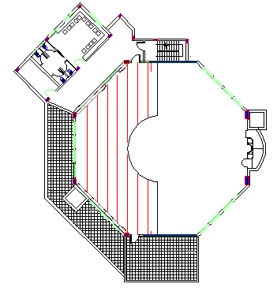
ARCHITECTURAL DESIGN
1st Plane:

Slide 9
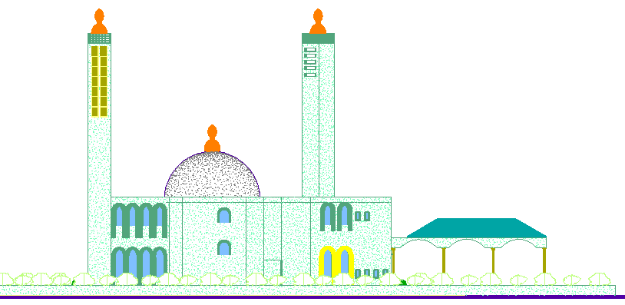
ARCHITECTURAL DESIGN
North Elevation:

Slide 10
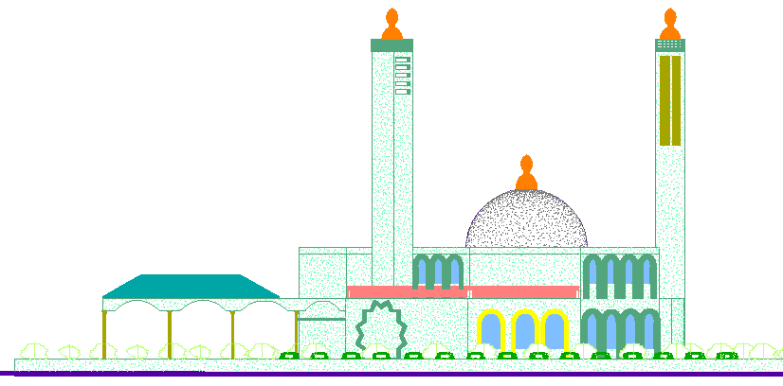
ARCHITECTURAL DESIGN
South Elevation:

Slide 11
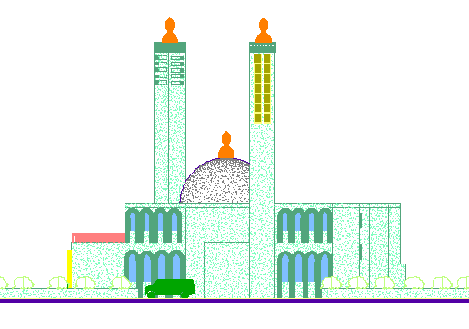
ARCHITECTURAL DESIGN
East Elevation:

Slide 12
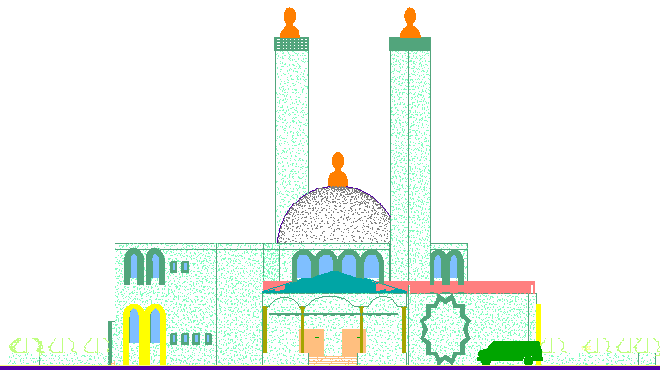
ARCHITECTURAL DESIGN
West Elevation:

Slide 13
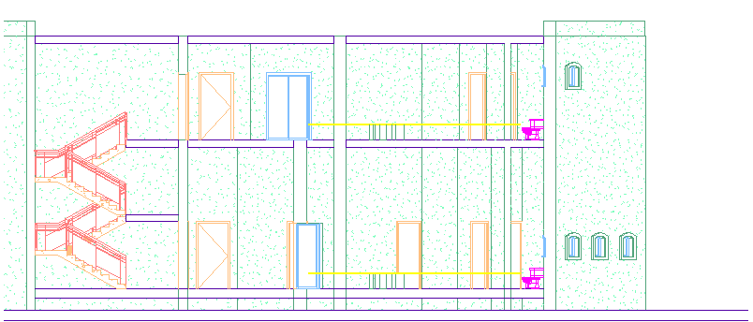
ARCHITECTURAL DESIGN
Section A-A:

Slide 14
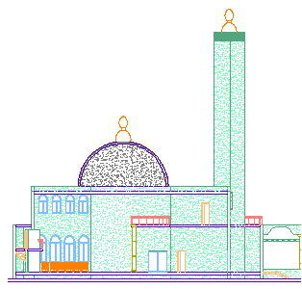
ARCHITECTURAL DESIGN
Section B-B:

Slide 15
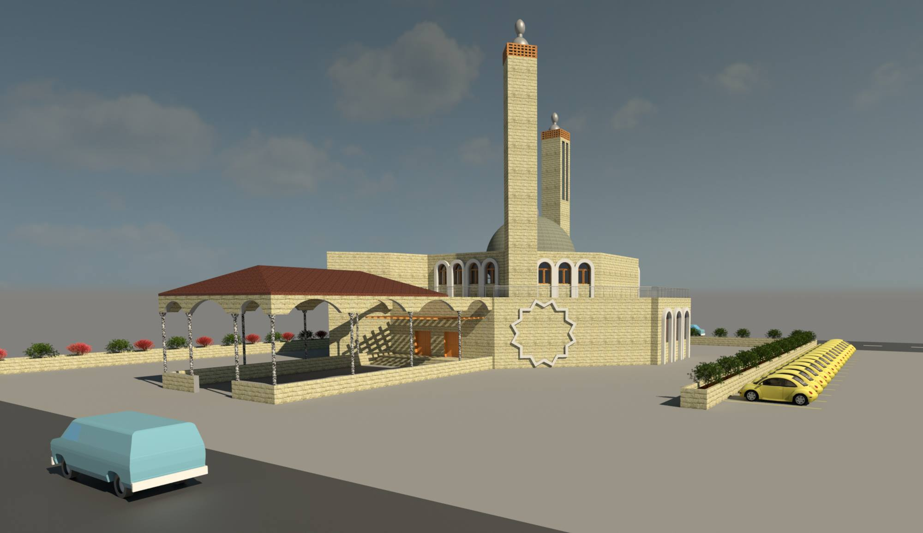
ARCHITECTURAL DESIGN
3D View:

Slide 16
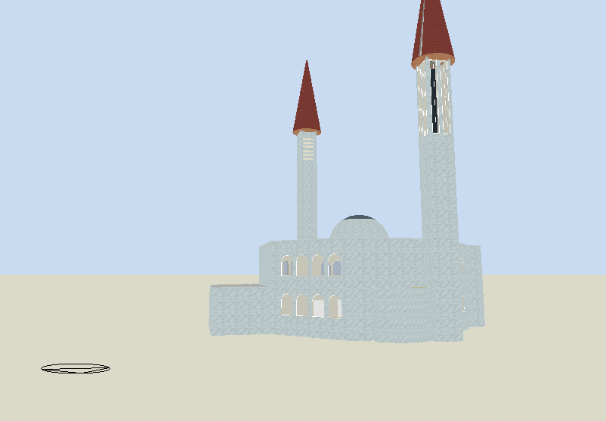
Environmental design

Slide 17
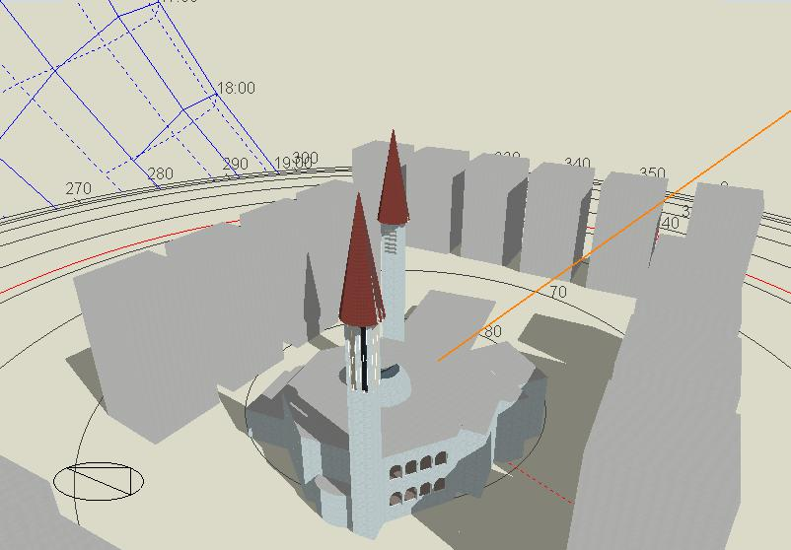
Shading from nearby building summer 15 July AT 9:00 AM

Slide 18
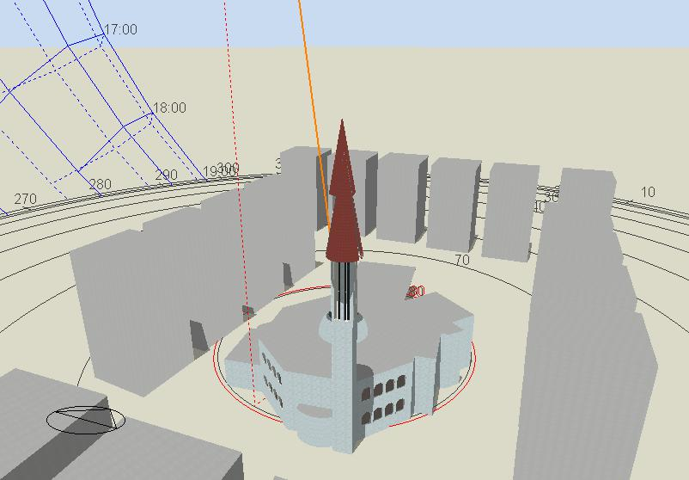
Shading from nearby building summer 15 July AT 12:00 pM

Slide 19
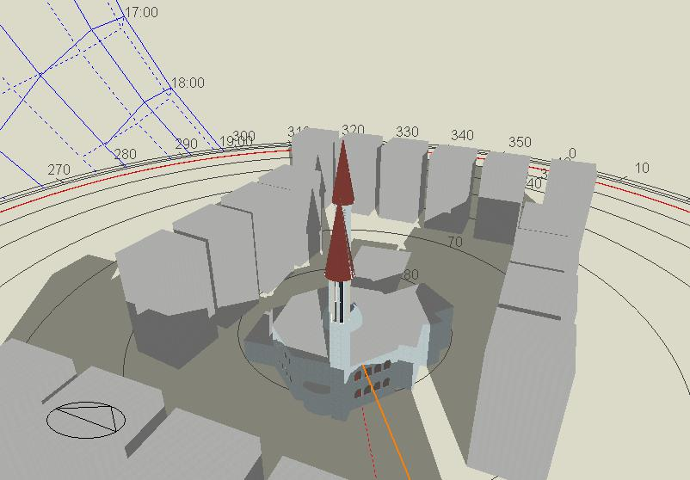

Shading from nearby building
winter 15 January AT 9:00 am

Slide 20
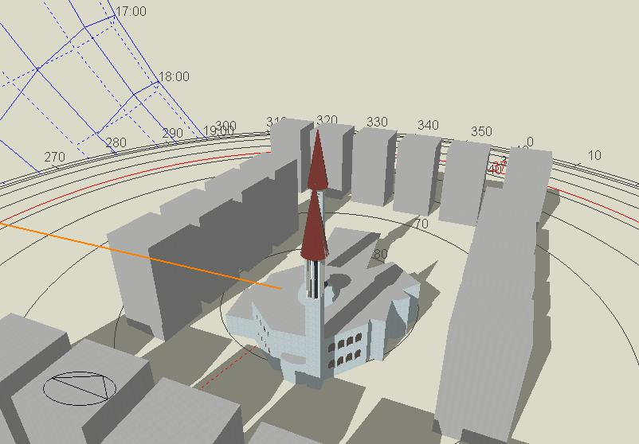
Shading from nearby building
winter 15 January AT 12:00 pm

Slide 21
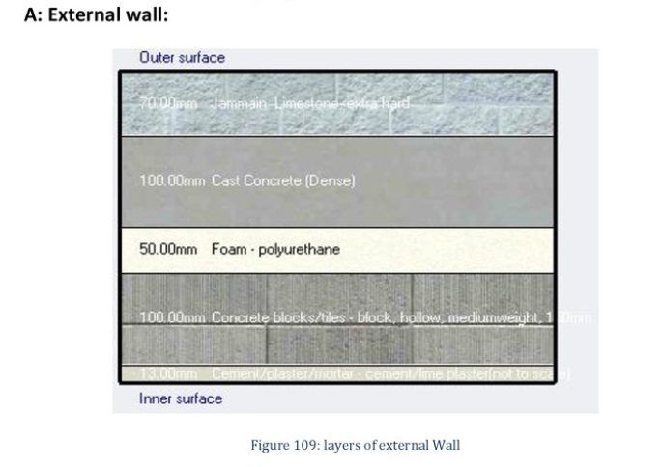
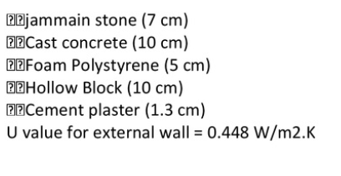
Environmental design

Slide 22
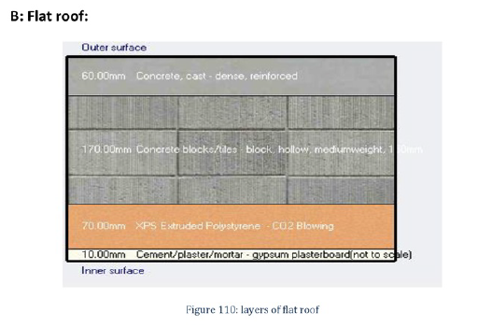
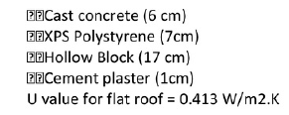
Environmental design

Slide 23
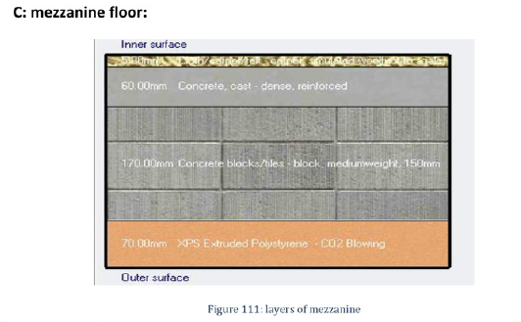
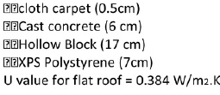
Environmental design

Slide 24
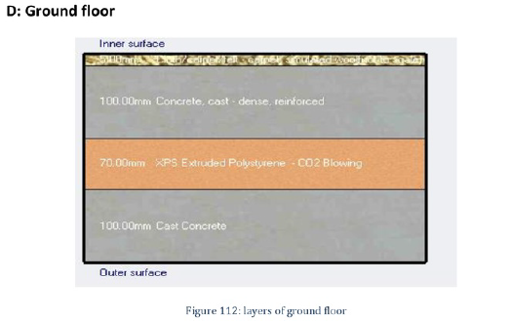
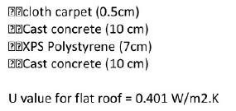
Environmental design

Slide 25
Environmental design
Glasses:
Double glass with 13 mm air
U value = 1.75
Light transmission= 0.3
Direct solar transmission = 0.3

Slide 26
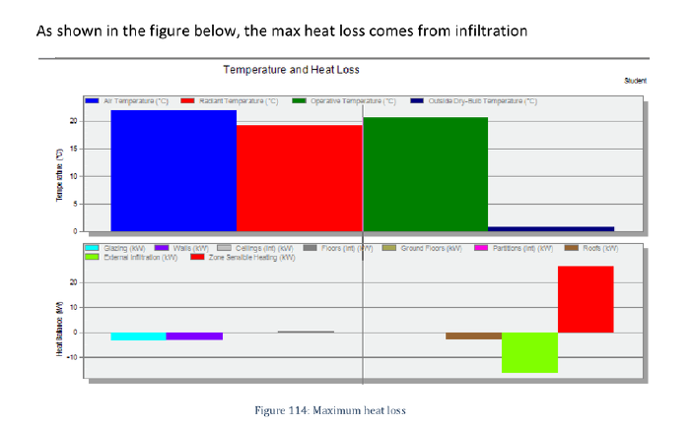
Environmental design
Heating Design:

Slide 27
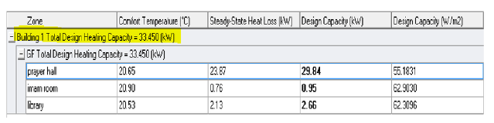
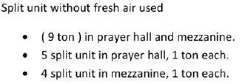
Environmental design
The total Heating Capacity = 33.45 KW

Slide 28
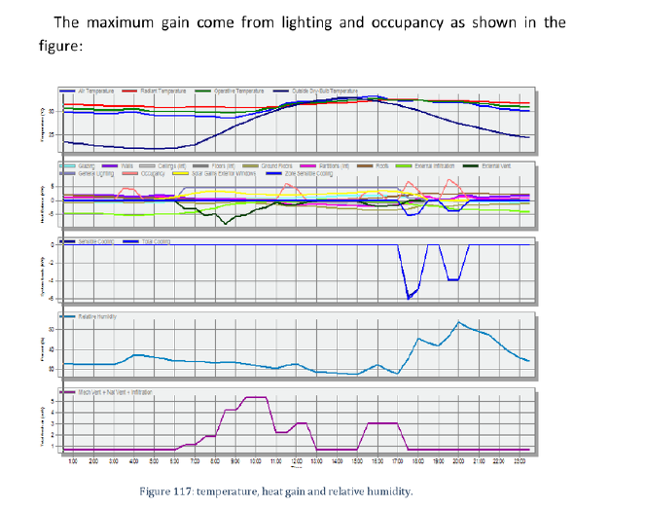
Environmental design
Cooling Design:

Slide 29
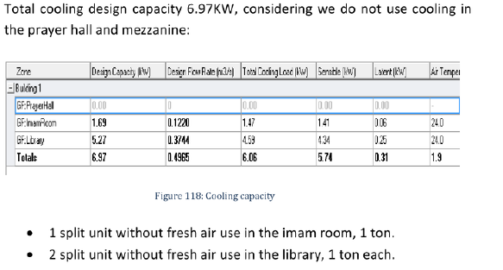
Environmental design

Slide 30
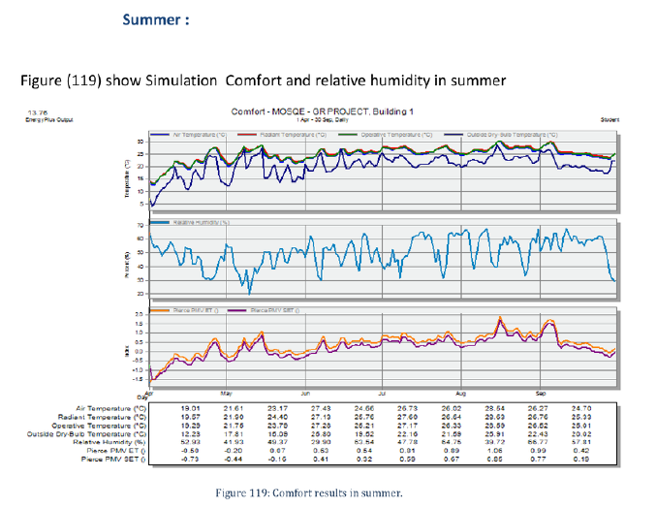
Environmental design
comfort :

Slide 31
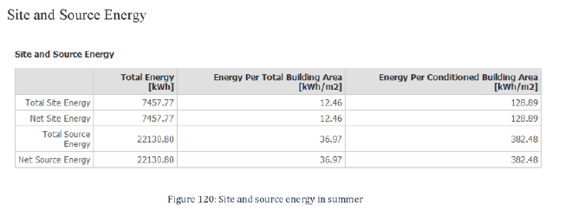
Environmental design

Slide 32
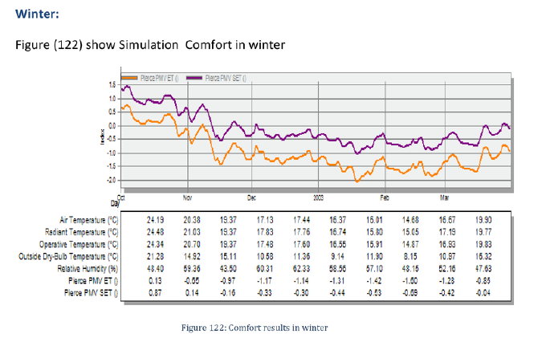
Environmental design

Slide 33
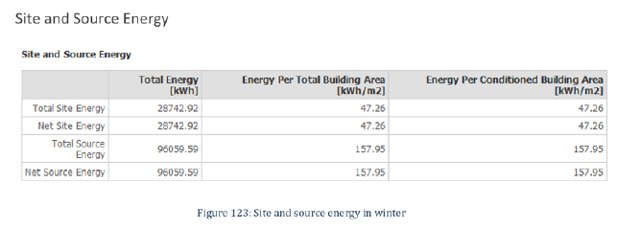
Environmental design

Slide 34
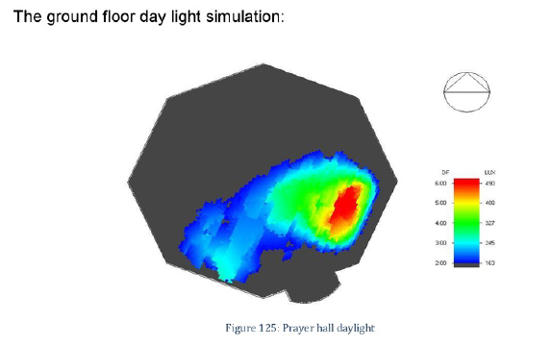
Environmental design
Daylight:

Slide 35
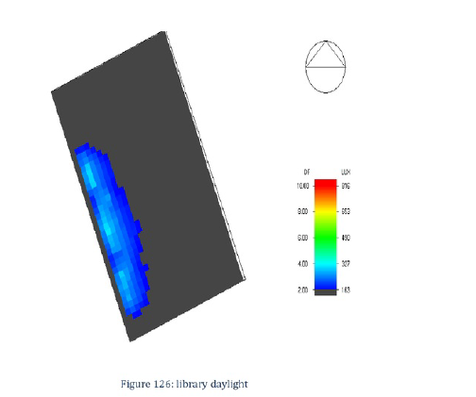
Environmental design

Slide 36
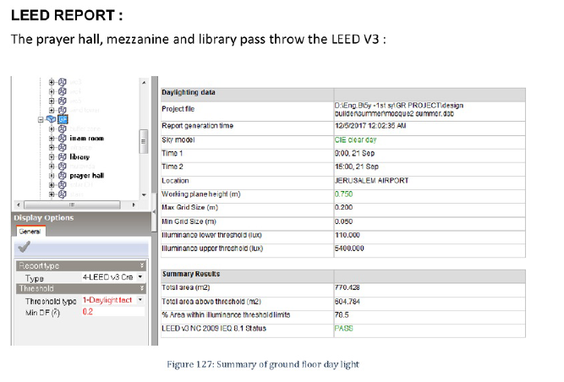
Environmental design

Slide 37
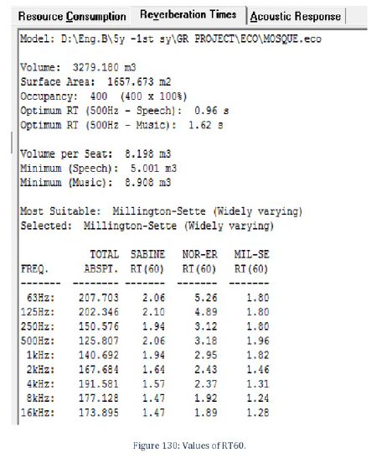
Environmental design
Acoustics Design:
According to specifications of mosque the required RT60 is ( 1.2-2) s

Slide 38
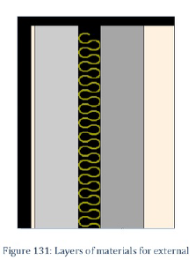
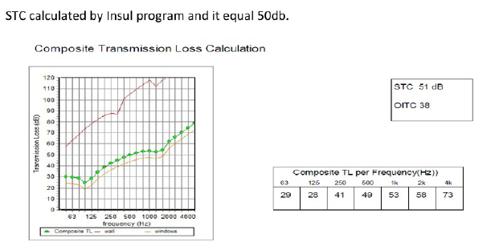
Environmental design
STC Calculations:
For external wall

Slide 39
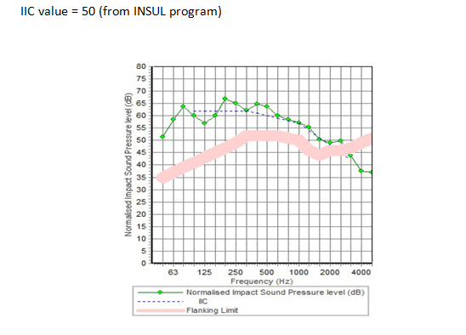
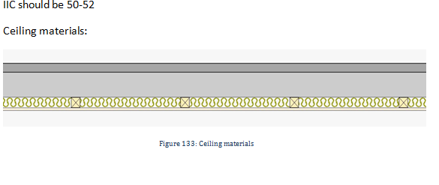
Environmental design

Slide 40
STRUCTURAL DESIGN

Slide 41
STRUCTURAL DESIGN
Codes and Standards:
ACI -318-11 for reinforced concrete structural design.
UBC -97 for earthquake design.
ASCE 7 2010 for load combinations

Slide 42
STRUCTURAL DESIGN
Design data:
Concrete strength for slabs and beams, f’_{c}=24 MPa.
Concrete strength for columns and shear walls ,f’_{c}=28 MPa.
Steel yield strength f_{y}=420 MPa.
Bearing capacity for soil = 350 kN/m²

Slide 43
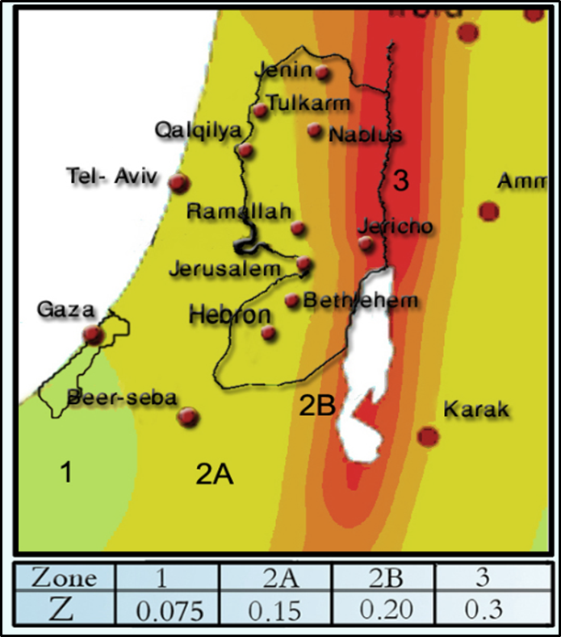
STRUCTURAL DESIGN
Lateral loads:
The city of structure is Nablus.
The seismic zone factor. Z=0.2.
The soil profile is type Sc.
The acceleration seismic coefficient Ca=0.24
The velocity seismic coefficient Cv=0.32.
The Seismic importance factor is 1.25 .
The structural design type is intermediate, R=5.5

Slide 44
STRUCTURAL DESIGN
Loads:
Load type | Ribbed slab
Live | 5(kN/m²)
S.I.D | 4(kN/m²)

Slide 45
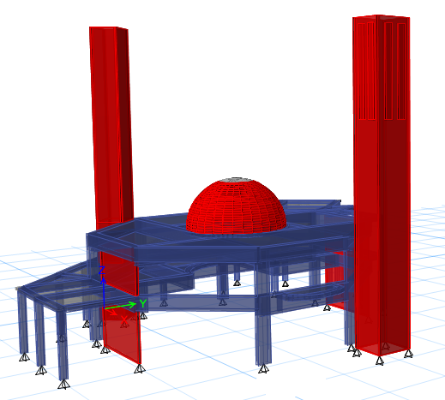
modeling

Slide 46
ANALAYSIS of model AND CHECKS
Deflection check
Compatibility check
Equilibrium check
Internal force check
Drift check
Period check
Model participating mass ratio check

Slide 47
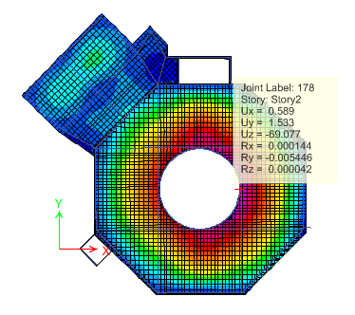
STRUCTURAL DESIGN
Deflection check:
Longest span = 19.5 m
19.5/240 = 81.25 mm
The maximum deflection
from ETABS is 69.077 mm
as shown in Figure, so the deflection is OK.

Slide 48
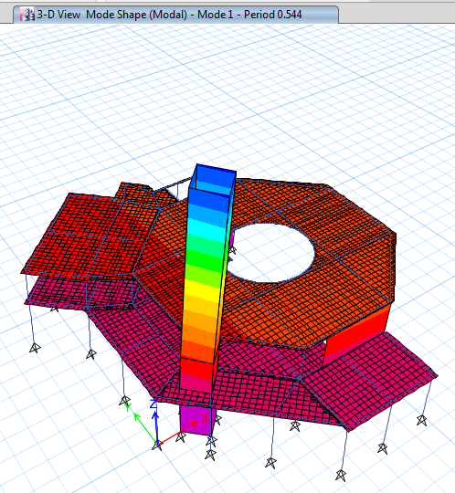
STRUCTURAL DESIGN
Compatibility check:

Slide 49
STRUCTURAL DESIGN
Equilibrium check:
Loads | ETABS results | Manual Results | % of error
Live | 2966.6359 | 3000 | 1.1
Dead | 12143.3727 | 12393.145 | 2
SID | 5516.2516 | 5529.04 | 0.23
Error = ( ( Manual – ETABS Load ) / Manual Load ) * 100% < 5%

Slide 50
STRUCTURAL DESIGN
Internal forces Check:
For column 23:
Manual Pu (KN) | ETABS Pu (KN) | % error
1022.66 | 1034 | 1.1

Slide 51
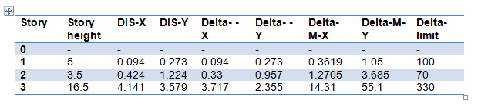
STRUCTURAL DESIGN
Drift check:
Since all delta-M-X and delta-M-Y is less than delta limit the check is OK.

Slide 52
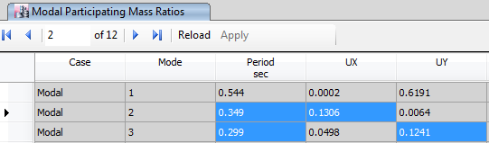
STRUCTURAL DESIGN
Period check:
T standard = 0.545 sec
From ETABS:

Slide 53
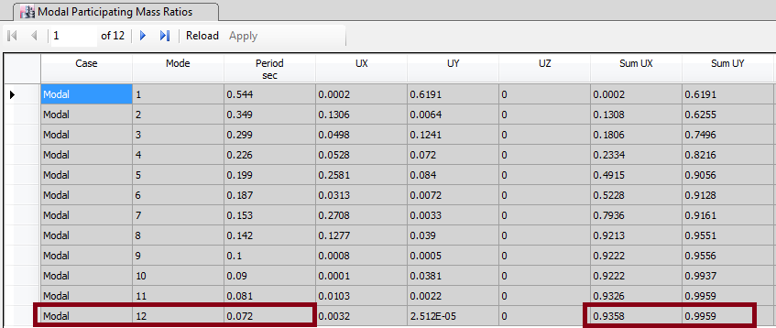
STRUCTURAL DESIGN
Modal participating mass ratio:

Slide 54
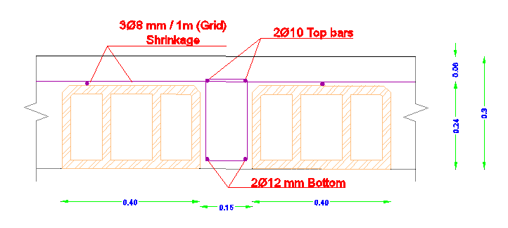
Slab reinforcement

Slide 55
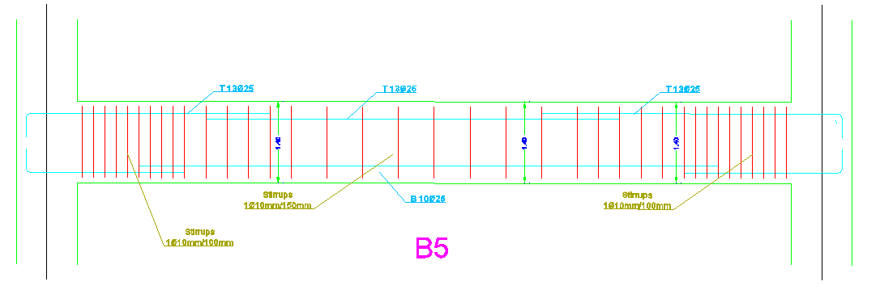
Beams reinforcement

Slide 56




Columns reinforcement

Slide 57

Columns reinforcement

Slide 58

Stair reinforcement

Slide 59

STRUCTURAL DESIGN
DOME DESIGN
Dimensions:
The diameter of the dome = 8m.
The maximum height of the dome = 4 m.
Thickness of dome = 0.12 m
Loads:
Super imposed load = 0.5 KN / m².
Live load = 1 KN/m².
Snow load = 0.5 KN/m².

Slide 60


DOME reinforcement

Slide 61


STRUCTURAL DESIGN
MINARET DESIGN

Slide 62
Mechanical design
Drainage system
Water supply system
HVAC system

Slide 63


Mechanical design
Drainage system:
Distribution of manholes:

Slide 64

Mechanical design
Distribution of drainage pipe through ceiling:

Slide 65
Mechanical design
Water supply system:
Diameter of fresh water pipes for all stories shown in this table :
Diameter | Vertical | Horizontal | branch
Ground Floor | 2 in | 1.5 in | 3/4 in
1st floor | 2 in | 1.5 in | 3/4 in

Slide 66

Mechanical design

Slide 67

Water supply design

Slide 68

Mechanical design
HVAC system
In Mosque we used the split unit system.

Slide 69


Slide 70


Slide 71

Safety design
Distribution of sprinklers:

Slide 72

Safety design
Distribution of extinguisher :
We used type A of fire extinguisher in the mosque
That is located in the library and prayer hall.

Slide 73


Safety design
Exit signs:

Slide 74
Electrical design

Slide 75

Electrical design
The table below shows the recommended lux for different spaces:

Slide 76


Electrical design
Artificial lighting for pray hall and mezzanine :

Slide 77

Electrical design

Slide 78

Electrical design
Isolines for pray hall

Slide 79

Electrical design
Output from DIAlux:
E = 329 lx → Target 300 – 350 lx → Ok
U = 0.69 > 0.6 → Ok
Glare = 18.6 < 22 → Ok

Slide 80

Electrical design
Artificial lighting for Library

Slide 81

Electrical design

Slide 82

Electrical design

Slide 83

Electrical design
Output from DIAlux:
E = 500 lx = 500 lx (Target) → Ok
U = 0.69 > 0.6 → Ok
Visual task → Ok

Slide 84

Quantity Survey
The total cost did not include decoration, land scape and furniture costs.

Slide 85


