Slide 1
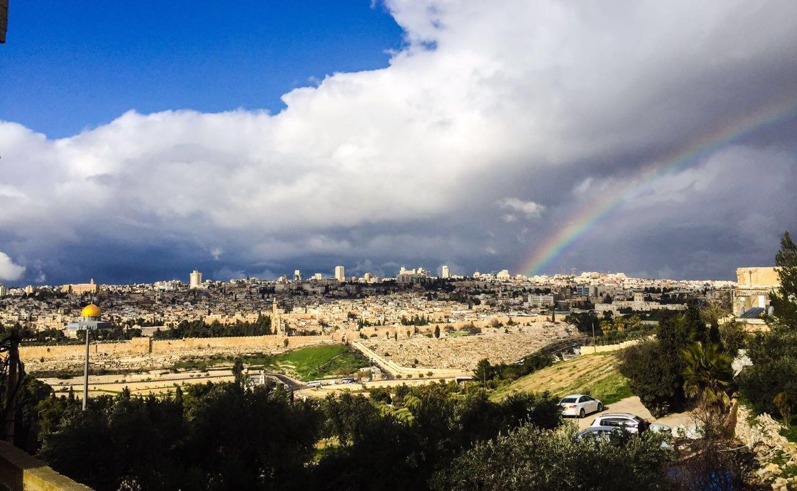
Conservation of the Material Cultural Heritage in Al-Aqsa Mosque
Prepared by:
Isra’a Maraabeh – Chemical Engineering
Hadeel Qawariq – Materials Engineering
Omaila Taweel – Materials Engineering
Supervisor:
Dr. Hamdallah Bearat

Slide 2
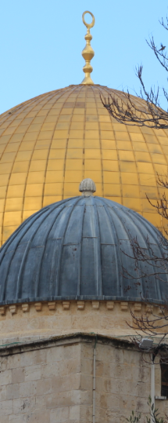
Content:
Introduction
Objective
Methodology and Results for:
- Kashani
- Wood
- Marble
- Lead
Conclusion and Recommendation
Constrains

Slide 3
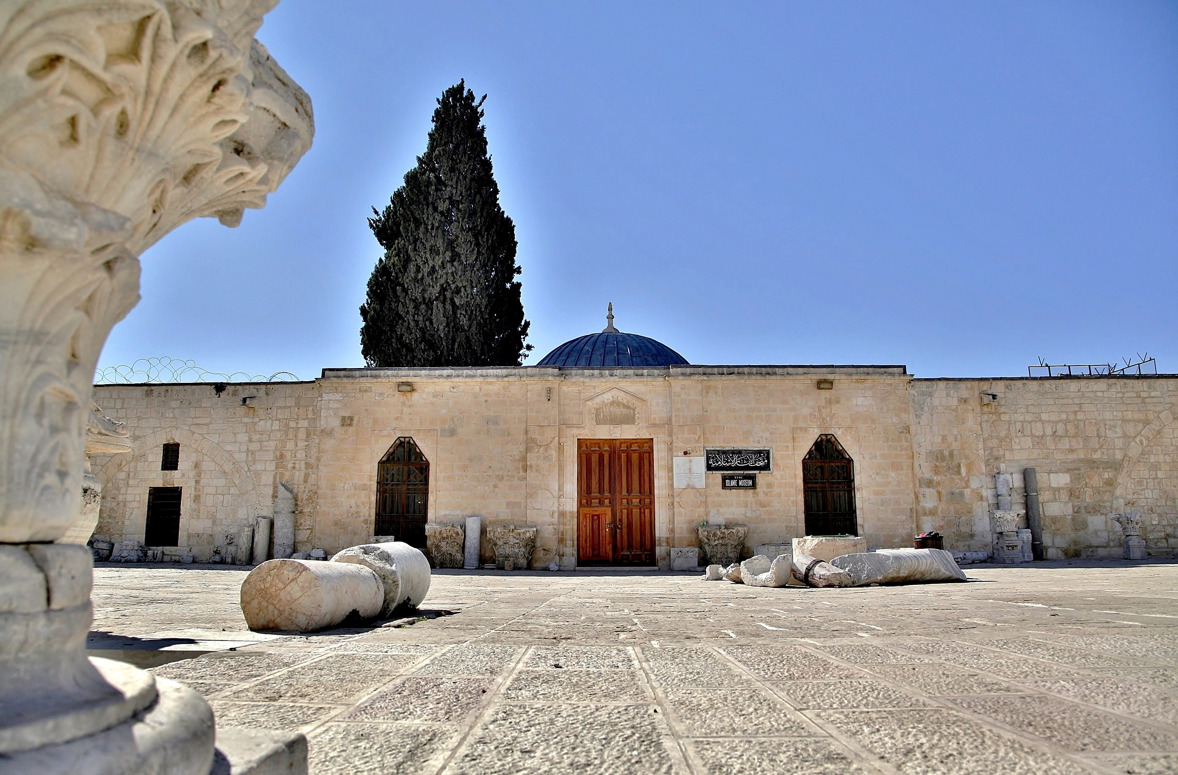
Introduction
- Conservation-Restoration of cultural heritage.
- Historic and Islamic sites in Palestine.
- Al-Aqsa Mosque is one of the most important landmarks.

Slide 4
Objective:
Continuing efforts in restoration and preservation of the material Islamic heritage in Al-Aqsa mosque through the scientific study of materials and their degradation processes

Slide 5
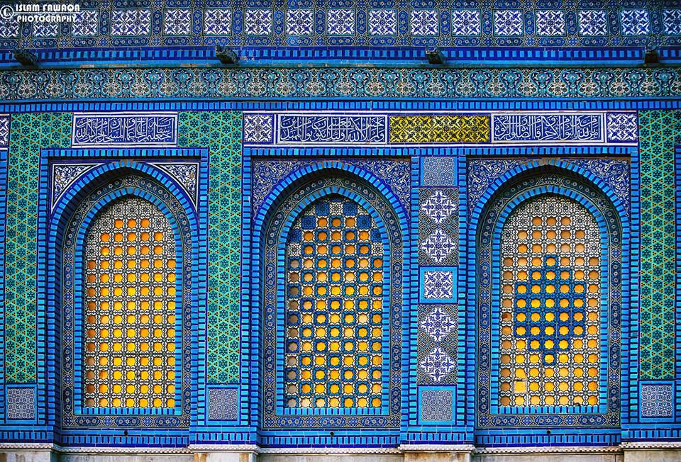
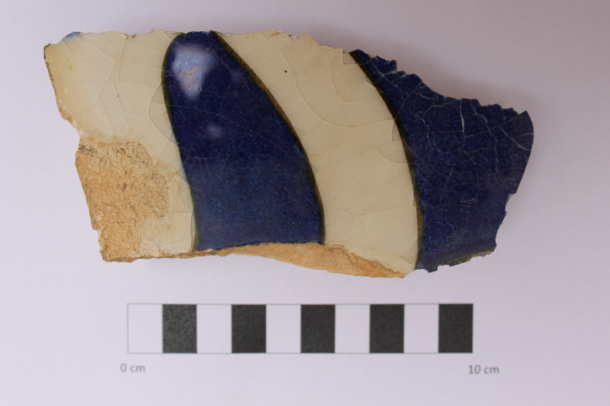
Methodology and Results:
Kashani
Description of the sample:

Slide 6
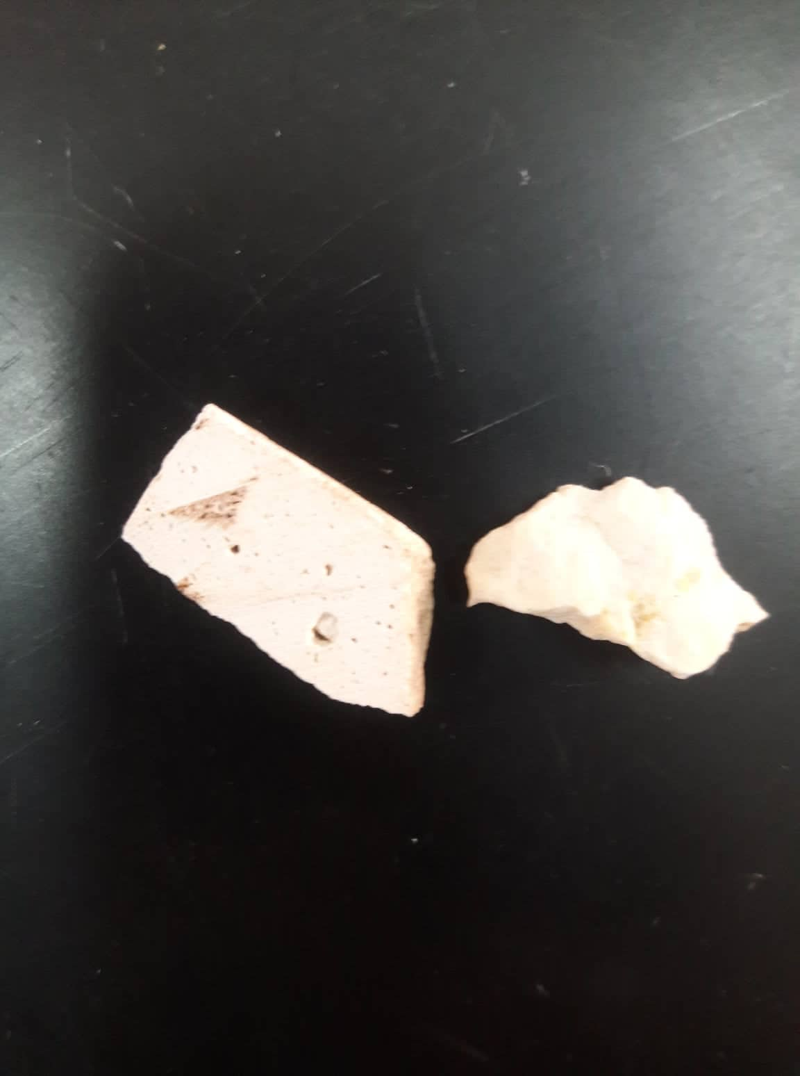
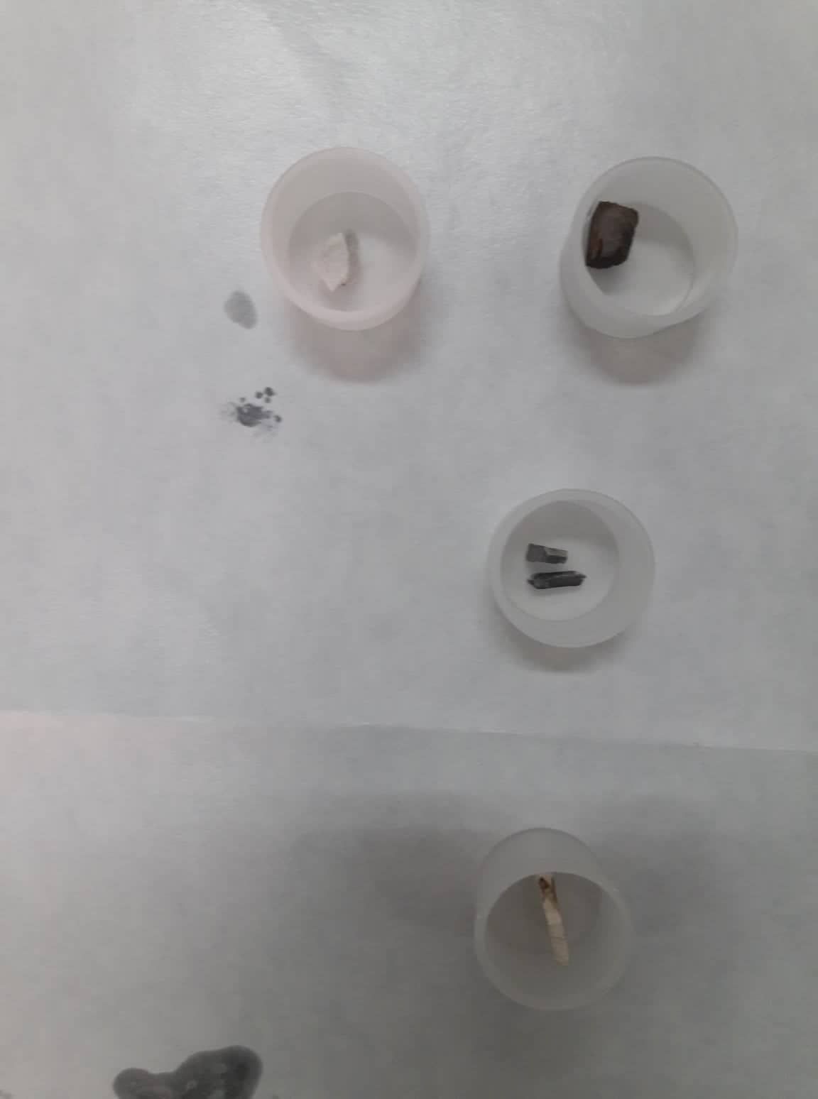
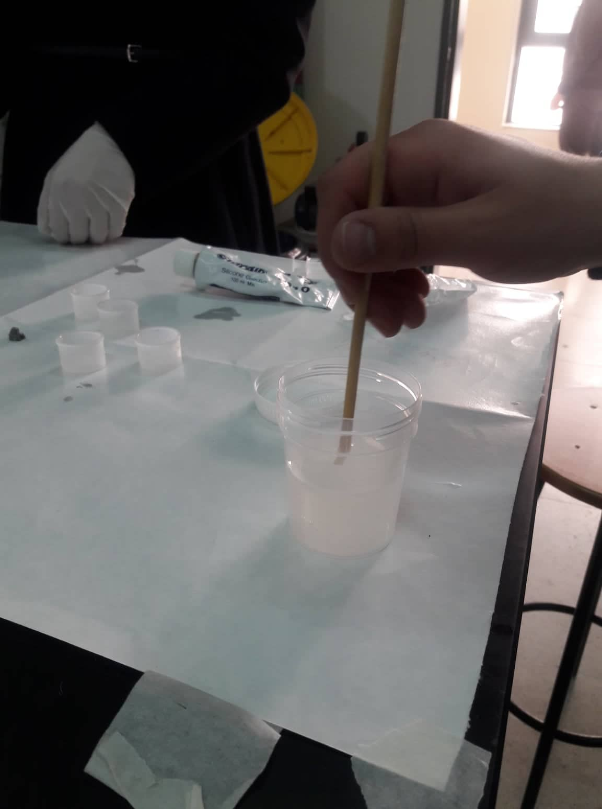
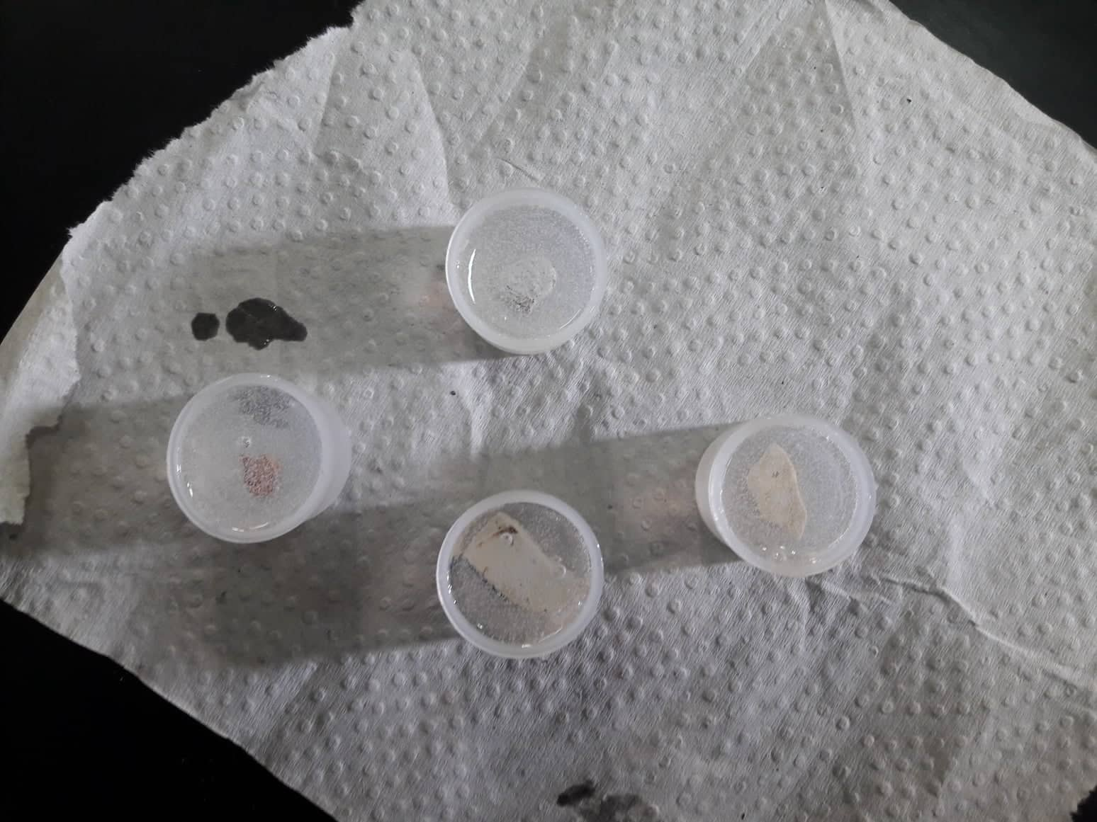
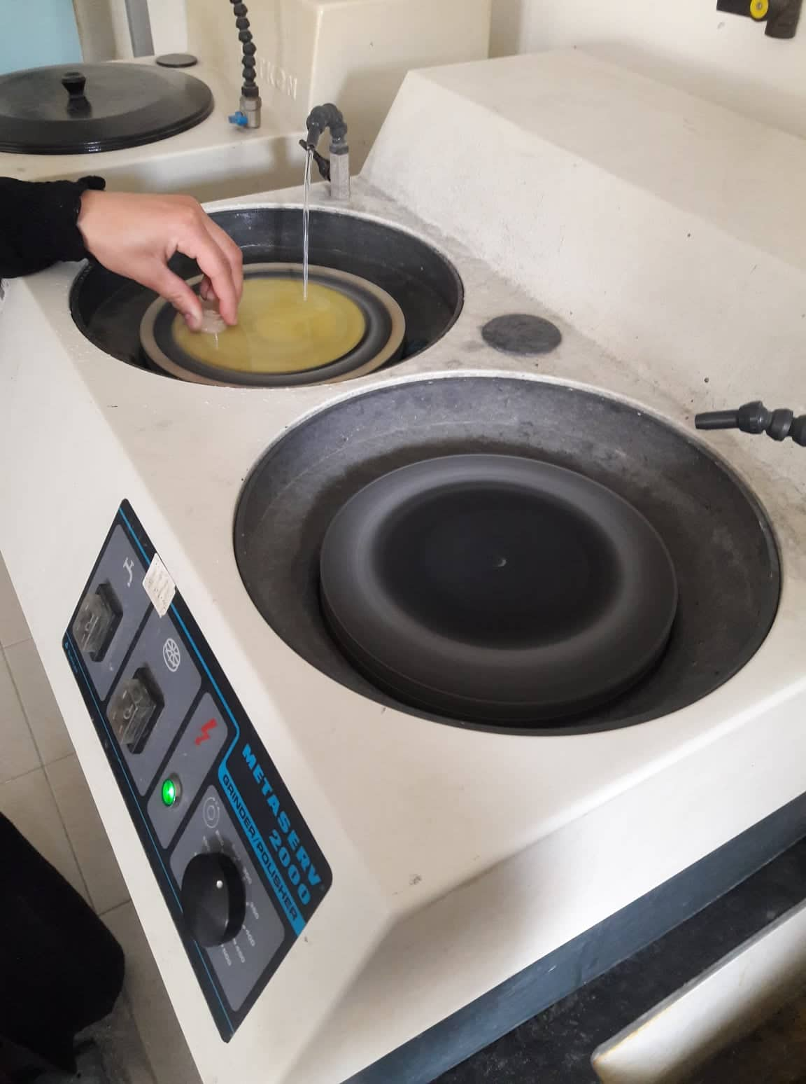
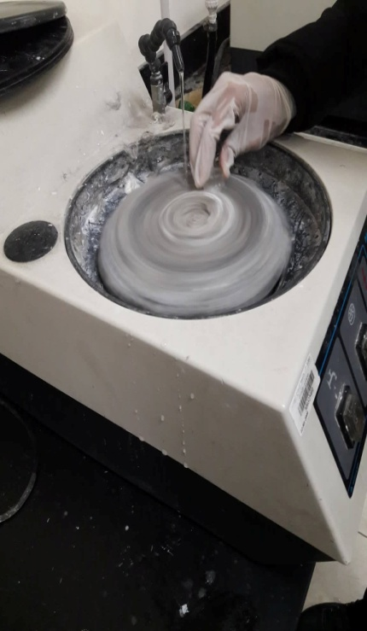
Sample preparation:

Slide 7
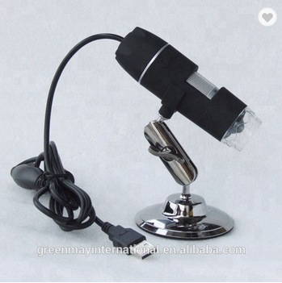
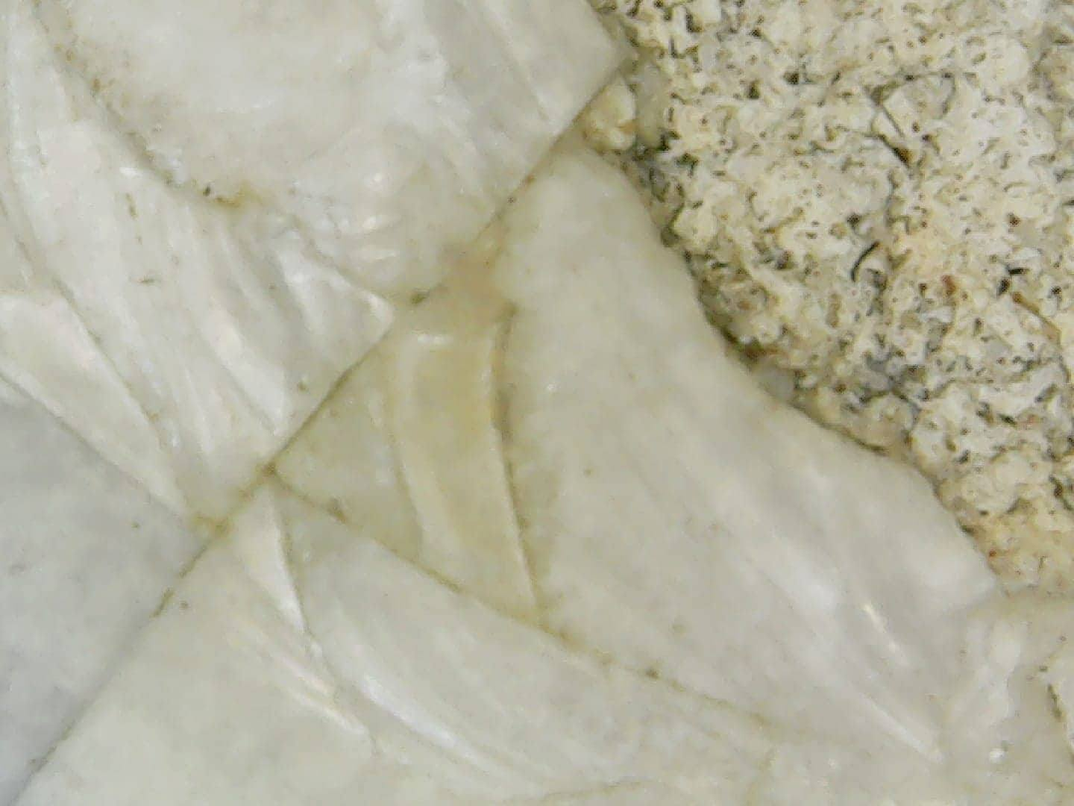
Experimental part (with result):
Optical microscope:

Slide 8
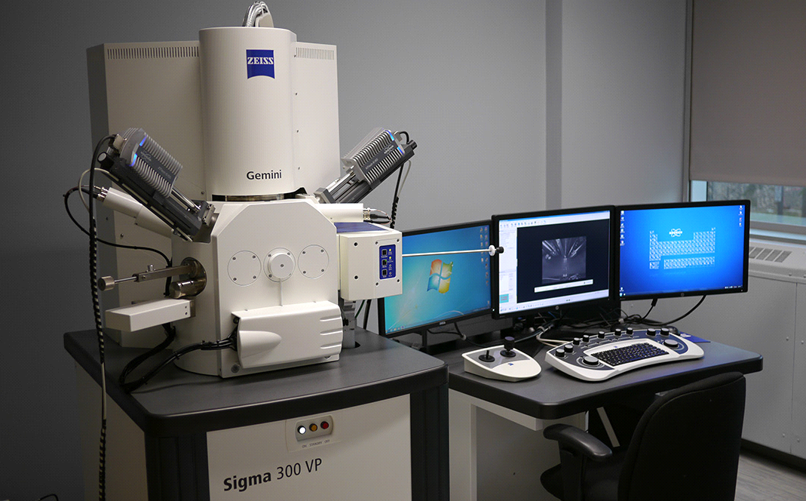
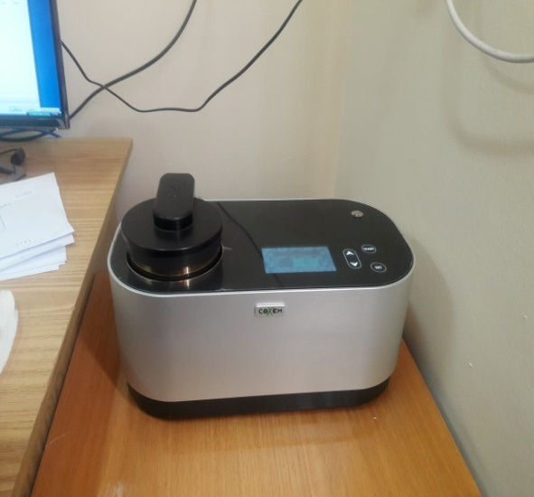
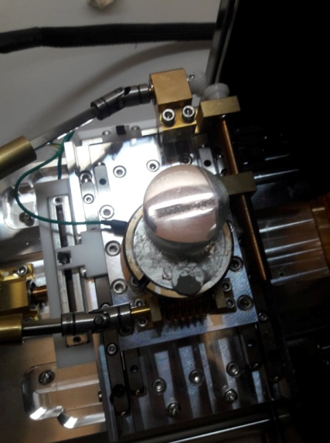
- SEM/EDX:

Slide 9
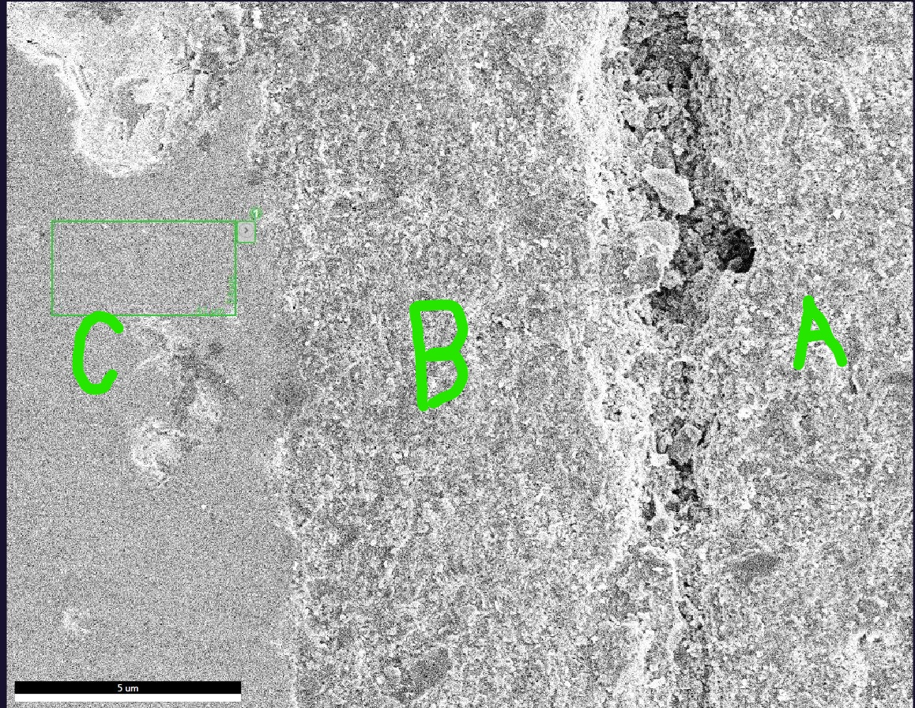
- SEM/EDX results:
Three layers in kashani sample was clearly visible (A, B and C)
A- Kashani paste (ceramic substrate): The EDX analyses shows that the layer contains those elements; Si > Al >> Na > Mg > Cl > K .
B- Kashani intermediate zone (next to glaze): The EDX analyses shows that the layer contains those elements; Si >> Al >> Mg > Na > Cl > Ca > K .
C-Kashani-glaze: The EDX analyses shows that the layer contains those elements; Si > Pb > Zn > Al > Cl > Ca

Slide 10
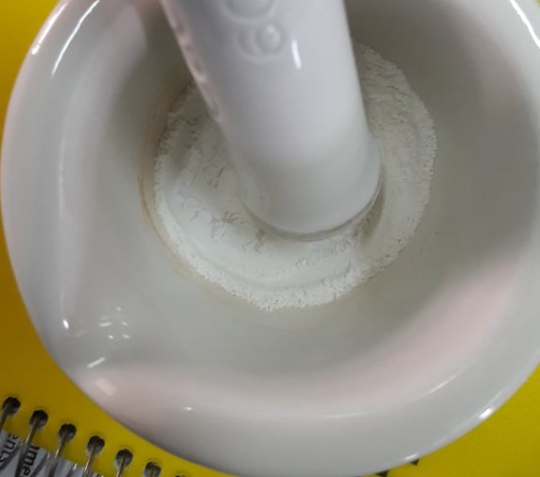
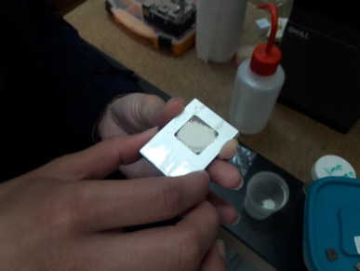
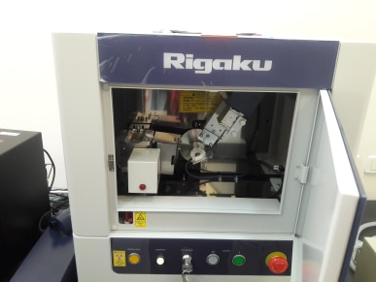
- XRD:

Slide 11
XRD (results):
XRD results for Kashani was plotted, But there is No database to compare with.

Slide 12
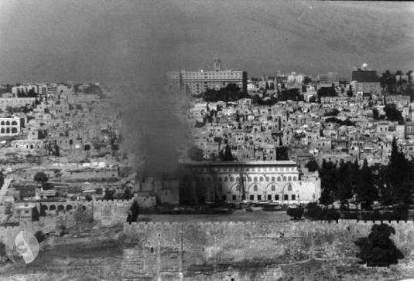
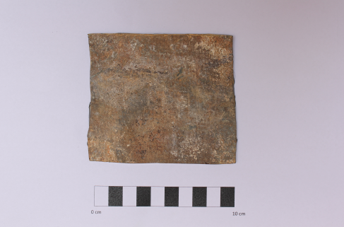
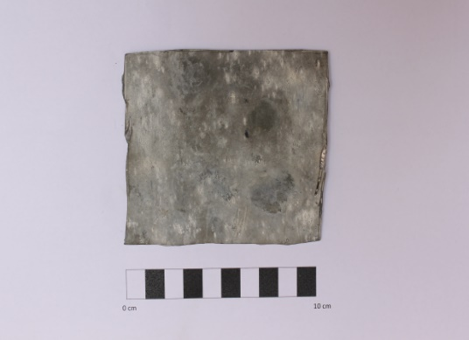
Lead
Description of the sample

Slide 13
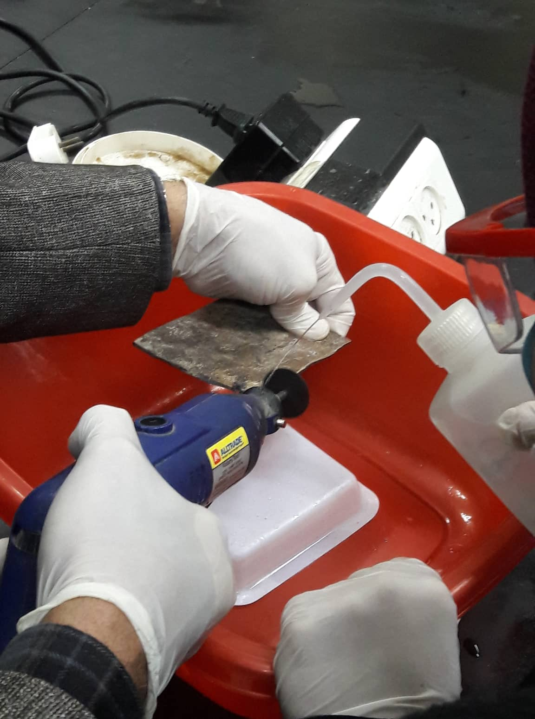
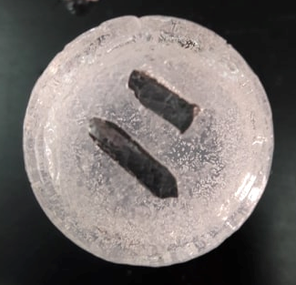
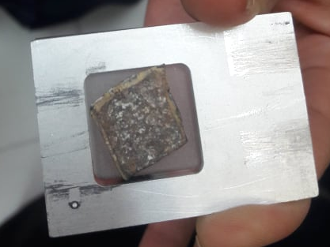
Sample preparation:

Slide 14
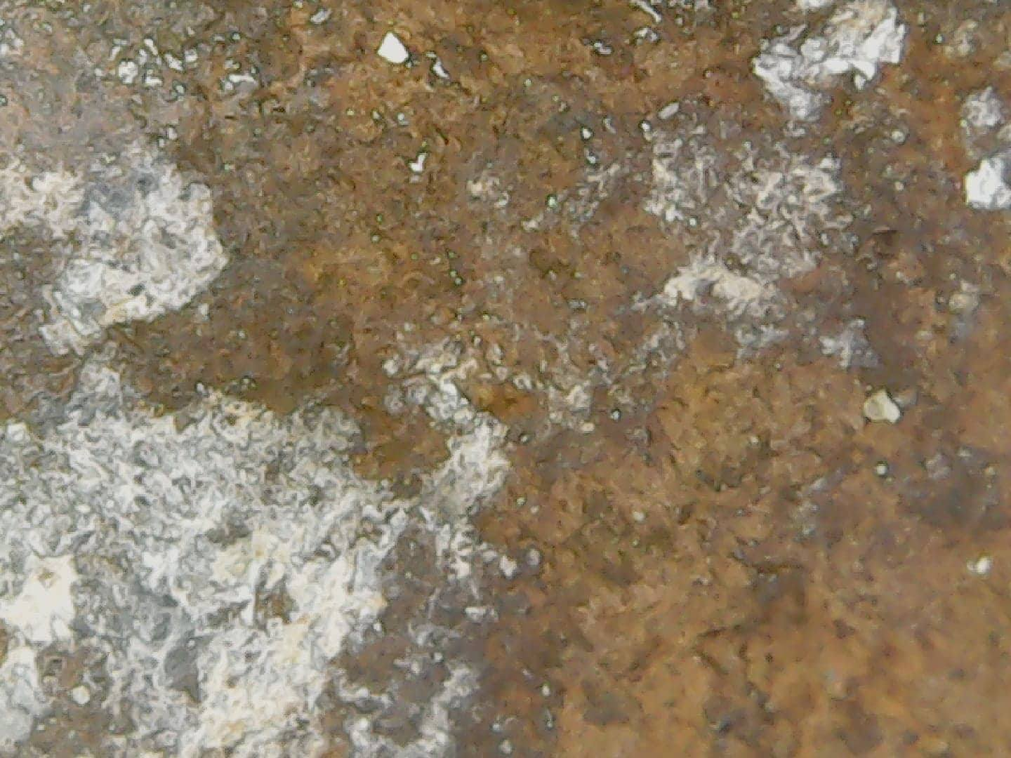
Experimental part (with results)
Optical microscope

Slide 15
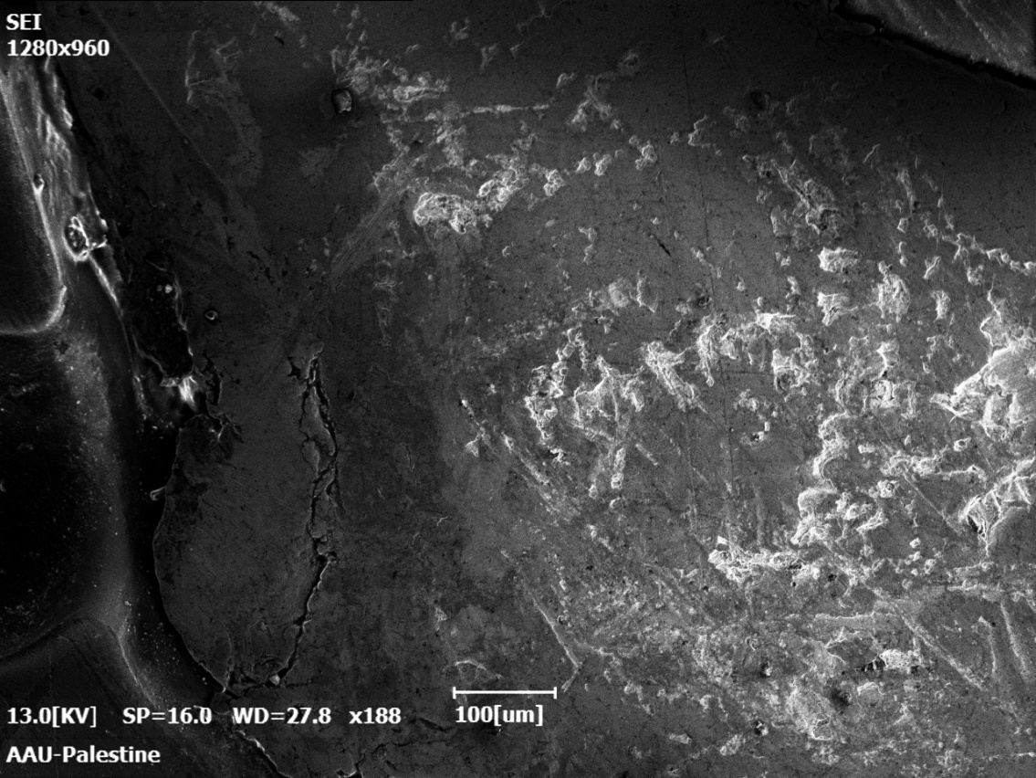
SEM/EDX

Slide 16
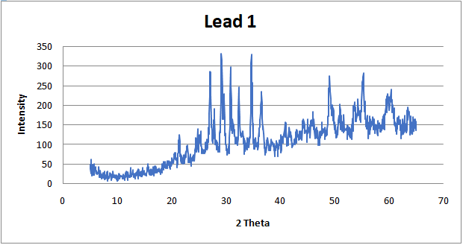
XRD:

Slide 17
IR:

Slide 18
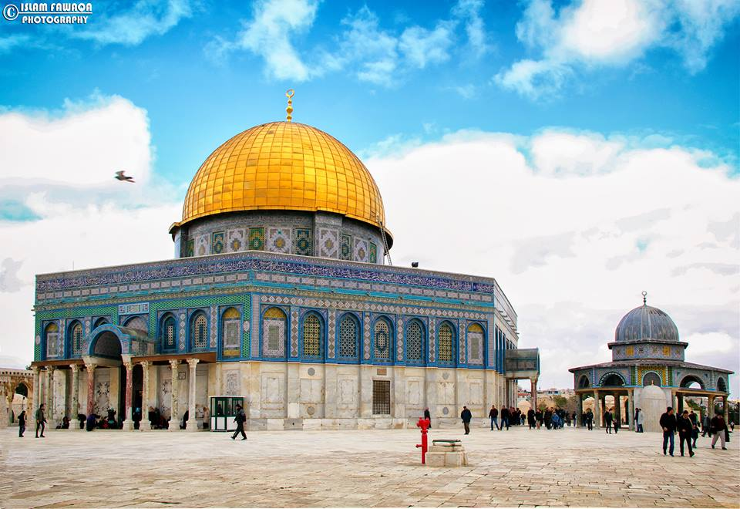
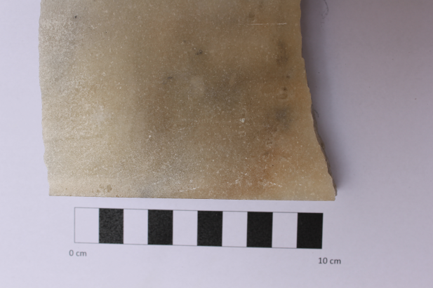
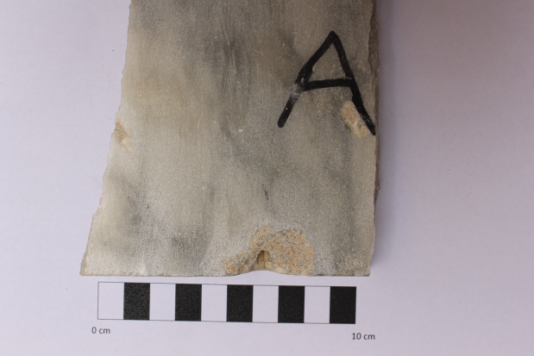
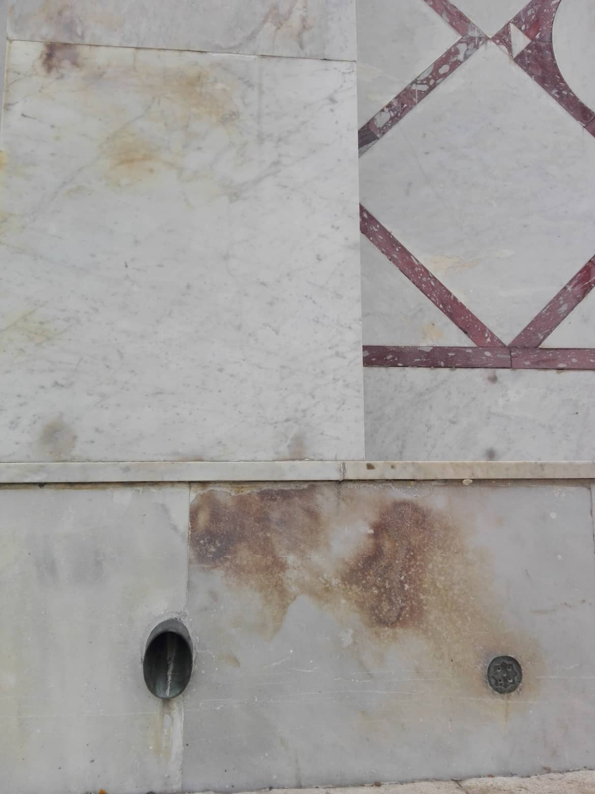
Marble
Description of the sample:

Slide 19
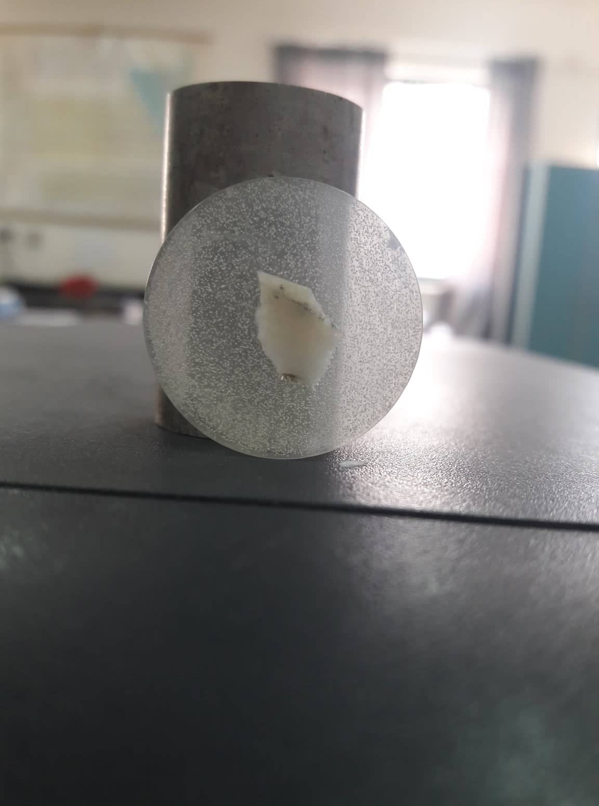
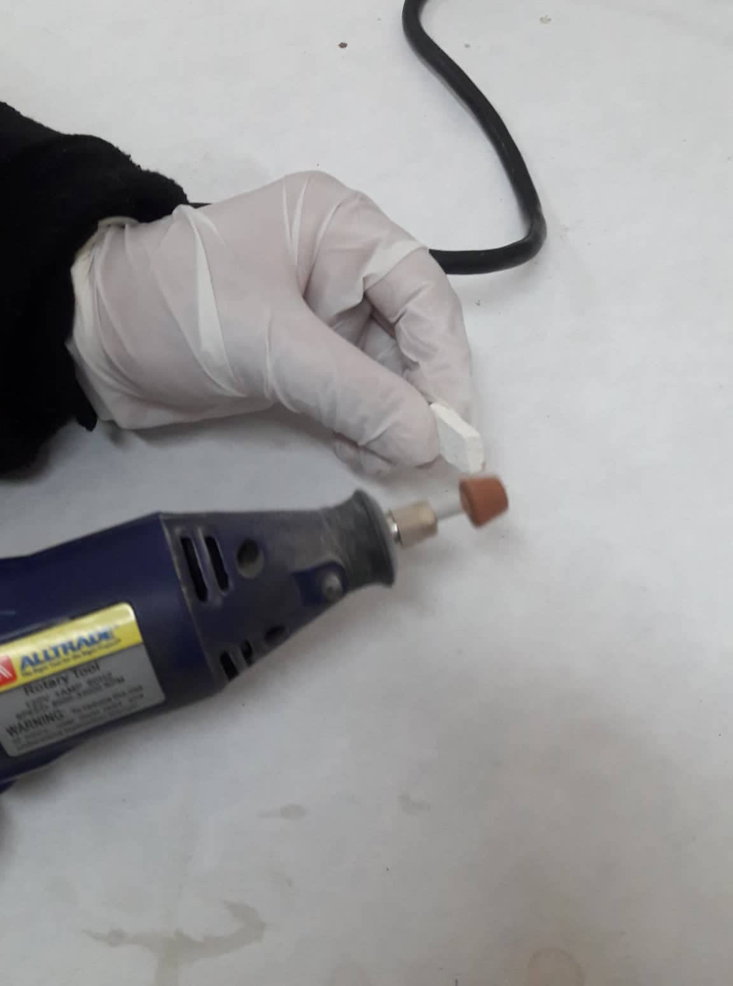
Sample preparation:

Slide 20
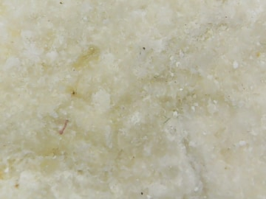
Experimental part:
Optical microscope

Slide 21
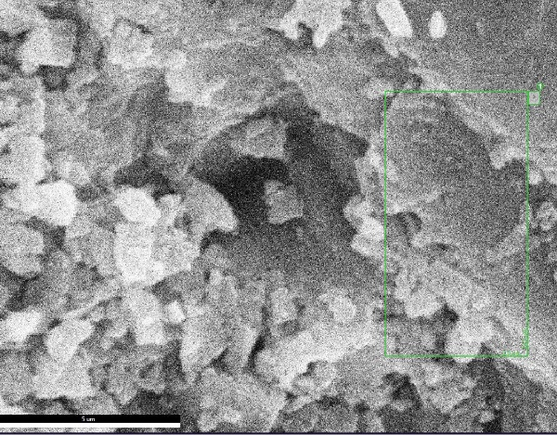
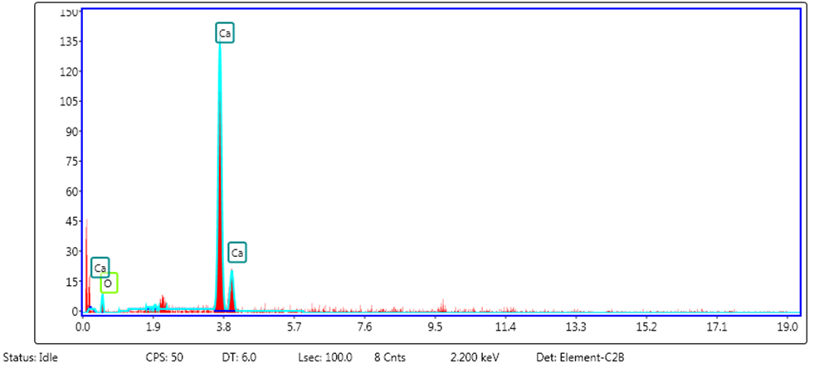
SEM/EDX
The EDX shows that the marble is almost pure calcium carbonate (CaCO₃)

Slide 22
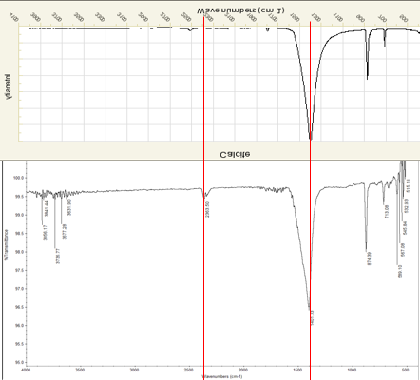
IR:

Slide 23
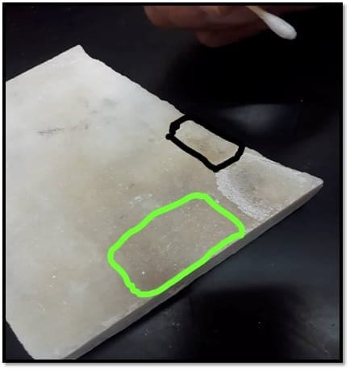
Chemical treatment:
H2O2
Aceton

Slide 24
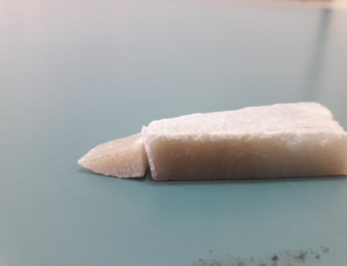
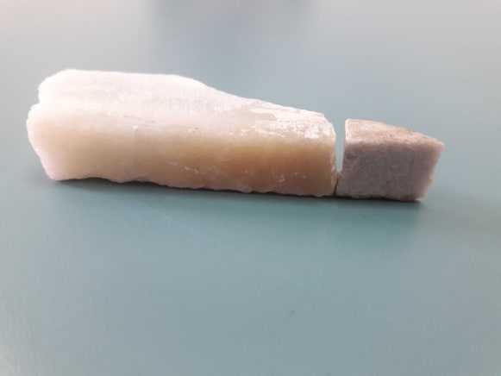
Thermal treatment:
The sample was put at oven at 412֯֯C
Before
After

Slide 25
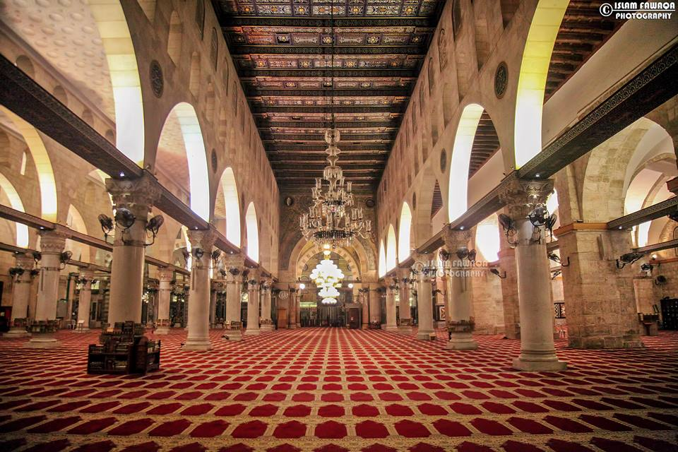
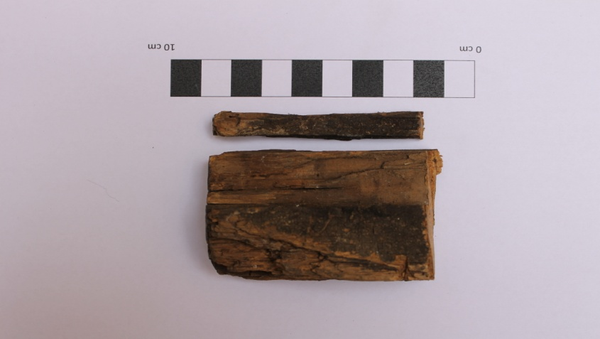
Wood
Description of the sample

Slide 26
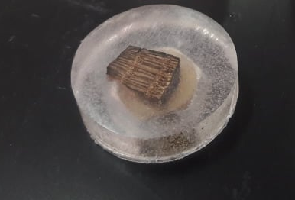
Sample preparation:

Slide 27
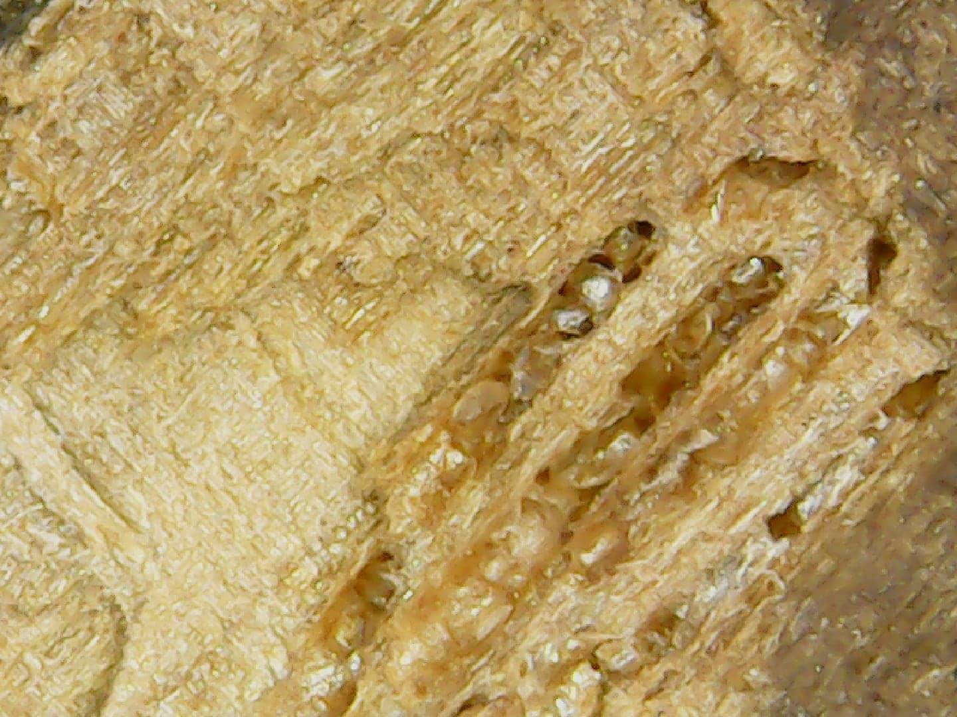
Experimental part (with result):
Optical microscope

Slide 28
SEM/EDX
SEM picture shows that there is black hole in the sample, we believe that microorganisms are the cause. These tunnels may be made while passing through the sample or because of their waste.

Slide 29
Conclusion and Recommendation:
Our focus in this preliminary work is on the Al-Aqsa Mosque, which is an important religious and historical landmark. Samples were taken from three different locations in the Al-Aqsa Mosque (the Dome of the Rock and Al-Qibili mosques) , These samples suffered deterioration of different and nature levels. The anticipated objectives of this project have been to identify the causes and mechanism of degradation in each type of these archeomaterial and to propose some remedies for each problem.

Slide 30

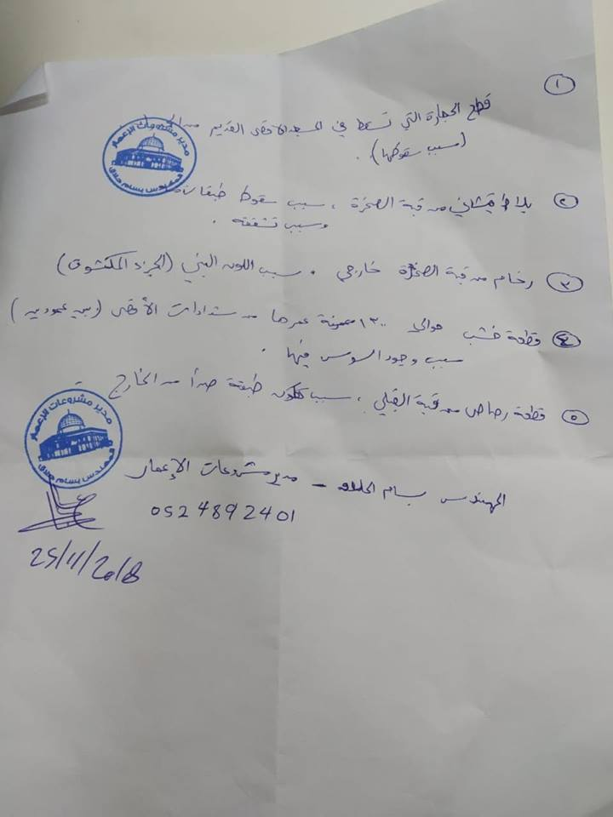
Constrains
Delay in obtaining the samples.
Difficulty to visit and observe the location of samples, since the Israel occupation put obstacles to visit of Jerusalem city.
Difficulty to know the exact age of the samples.
Limited information available on sample manufacturing.
Our laboratories lack the necessary equipment for sample preparation, characterization, and testing.
The high price of epoxy and the lack of it in the market and the inability of laboratories to provide it on time.
Lack of specialized programs (software) to analyze the results of microscopic and XRD examinations.
Short time available to interpret analytical results, since most of tests were done in the last month at the Arab-American University in Jenin.

Slide 31
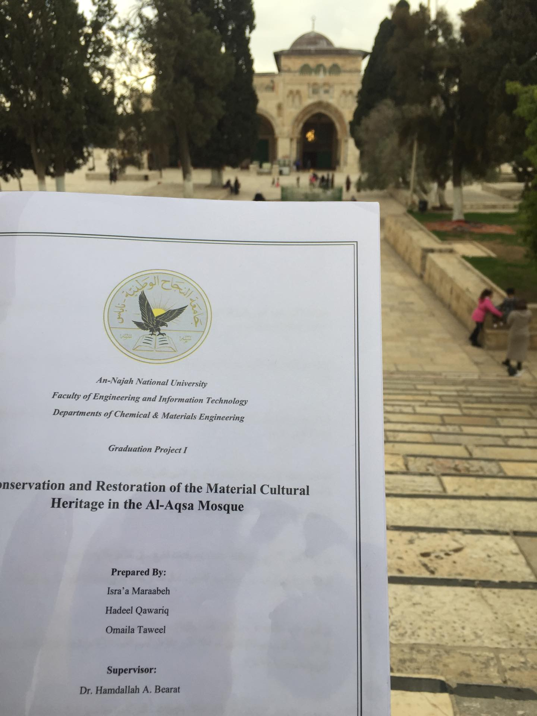
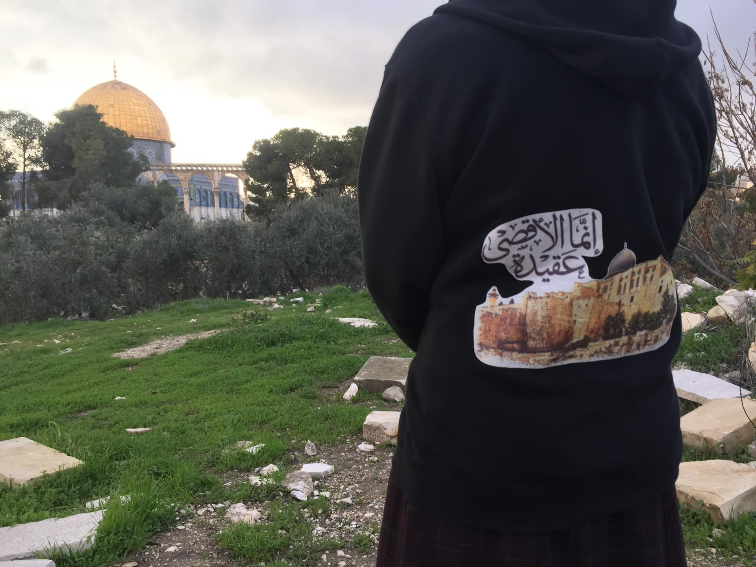
Thanks For Listening
Any Question?

