Slide 1


MohammaD AL-Khuffash , Rasool Bani Matar , Raja’y Kelany
GSM Network Planning For Nablus City ( Third Phase )
Submitted to: Dr.Jamal Kharosha

Slide 2

special thanks

Slide 3
The objectives of Our project
The objectives of Our project
Increase Covered subscribers in Nablus city to 150,000 subscribers with minimum number of sites.
Increase covered area in Nablus city to 30 km².
Achieve the indoor and outdoor conditions.
Obtain high quality and minimum percentage of dropped call.
To make us capable to deal with problems to solve them with scientific approach and with engineering sense.
Notes:
3

Slide 4
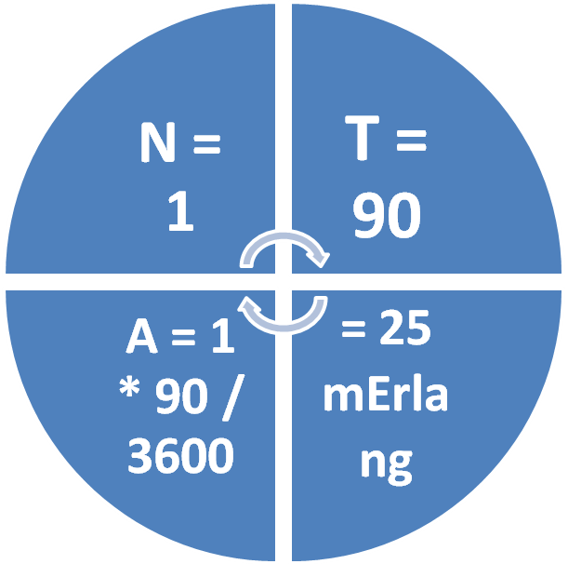
Calculate the number of sites required
Calculate the number of sites required
25mErlang * 150,000 subscribers = 3750 Erlang .
From equations and Eralng table → we need 35
site for the third phase.
Notes:
4

Slide 5
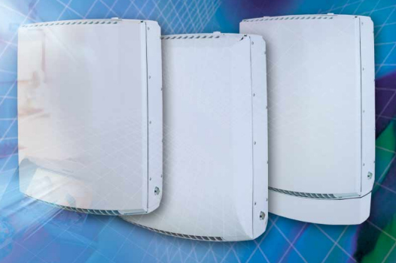
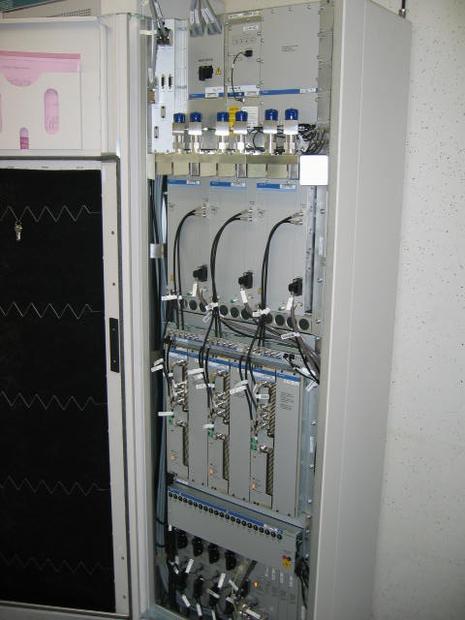
Equipments
Equipments
Ericsson RBS 2302 Ericsson RBS 2206
(Micro Base Station)
With 6 TRU
(Macro Base Station)
With 12 TRU
Notes:
5

Slide 6
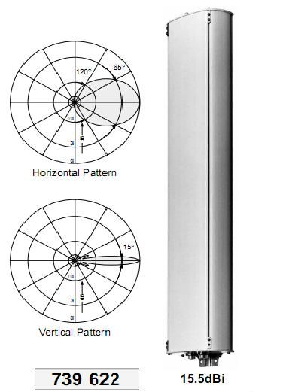
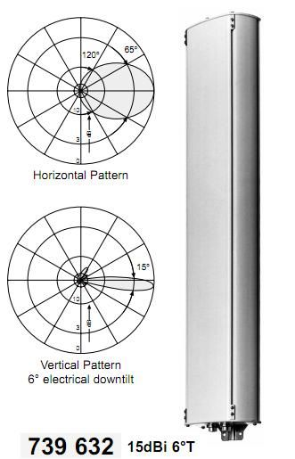
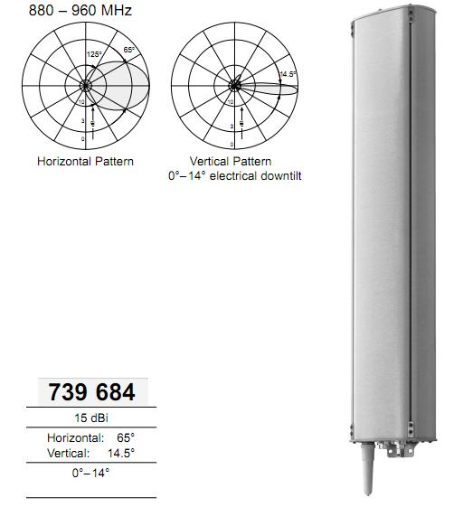
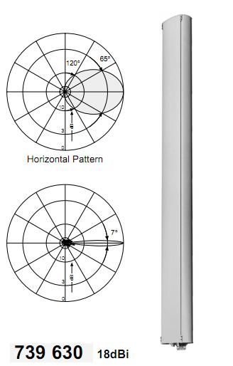
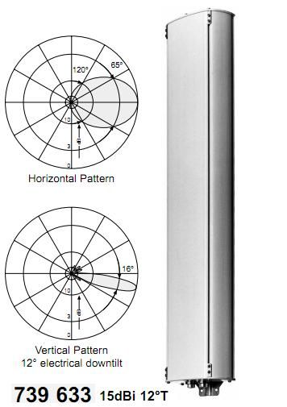
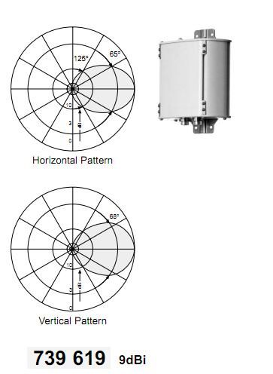
Equipments ..
Equipments ..
Notes:
6

Slide 7
Performance requirements summary
Performance requirements summary
In our project we define the following :
Capacity
Third phase : we assume that our network can serve 150,000 subscribers.
Coverage
Third phase
Indoor coverage : < 90% indoor
Outdoor coverage : > 10% outdoor
Notes:
7

Slide 8
Simulation of the Third phase
Simulation of the Third phase
As a result of increasing number of subscribers in our operator , we need to improve our network in both sides ; capacity and coverage, to be able to serve all needs of subscribers .
We have 19 site , so we should distribute 35 new site to achieve our condition without leading to frequency interference .
Also we should do limitation on the previous sites...
Notes:
8

Slide 9
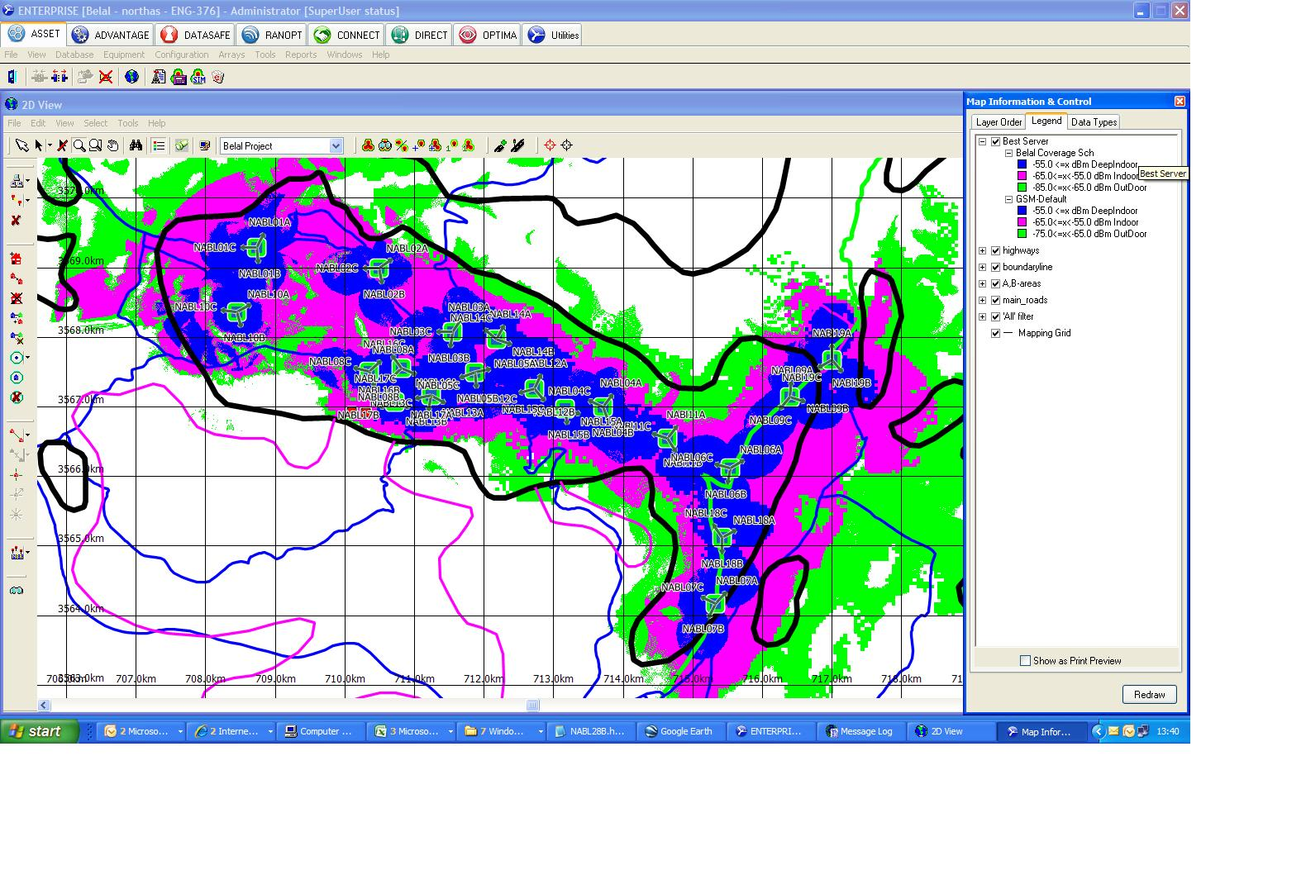
Simulation of the Third phase…
Simulation of the Third phase…
Coverage problem
Notes:
9

Slide 10
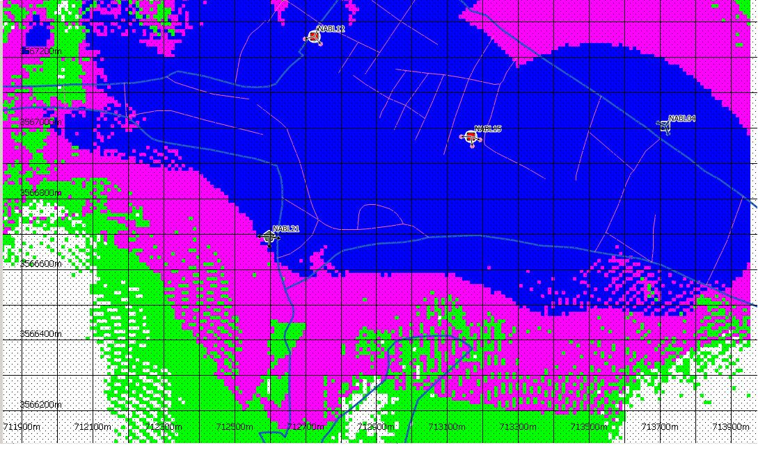
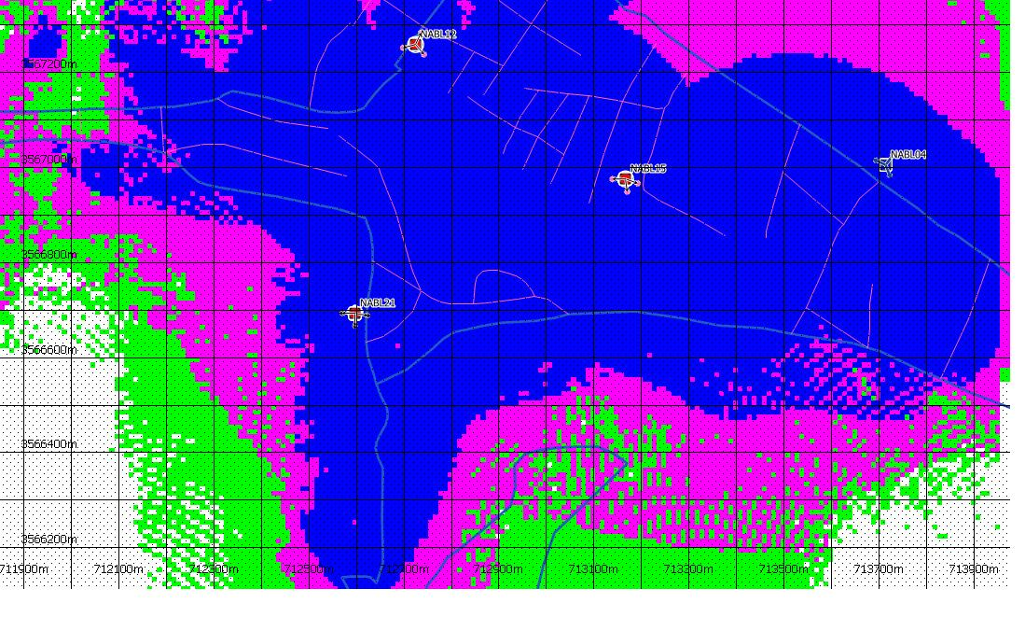
Simulation of the Third phase…
Simulation of the Third phase…
Solve the coverage problems…
Before
After
Notes:
10

Slide 11
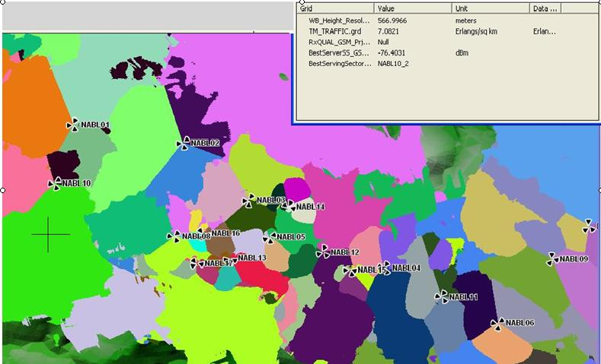
Simulation of the Third phase…
Simulation of the Third phase…
A
C
B
Capacity problem
Notes:
11

Slide 12
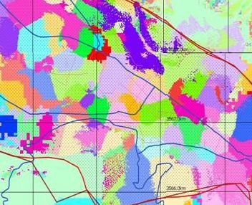
Simulation of the Third phase…
Simulation of the Third phase…
A
C
B
Notes:
12

Slide 13
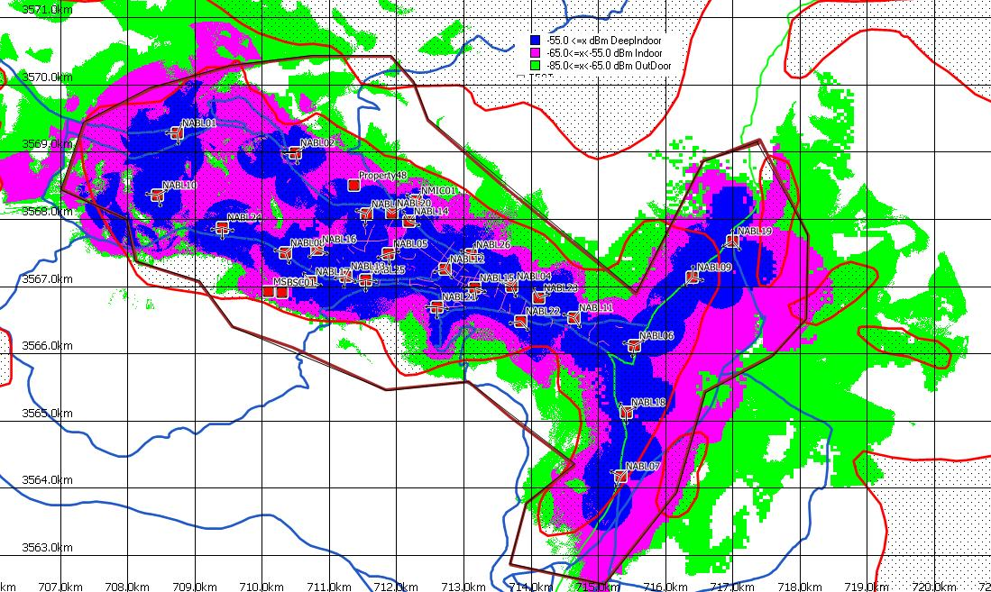
Simulation of the Third phase…
Simulation of the Third phase…
Notes:
13

Slide 14
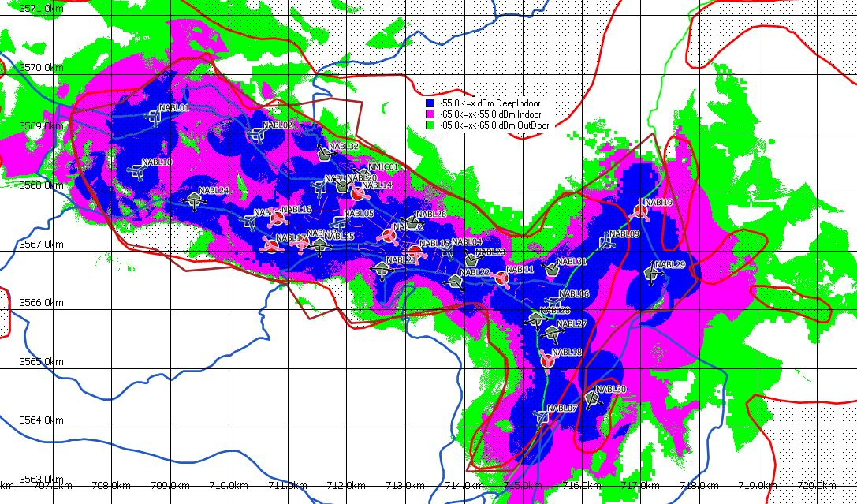
Simulation of the Third phase…
Simulation of the Third phase…
Notes:
14

Slide 15
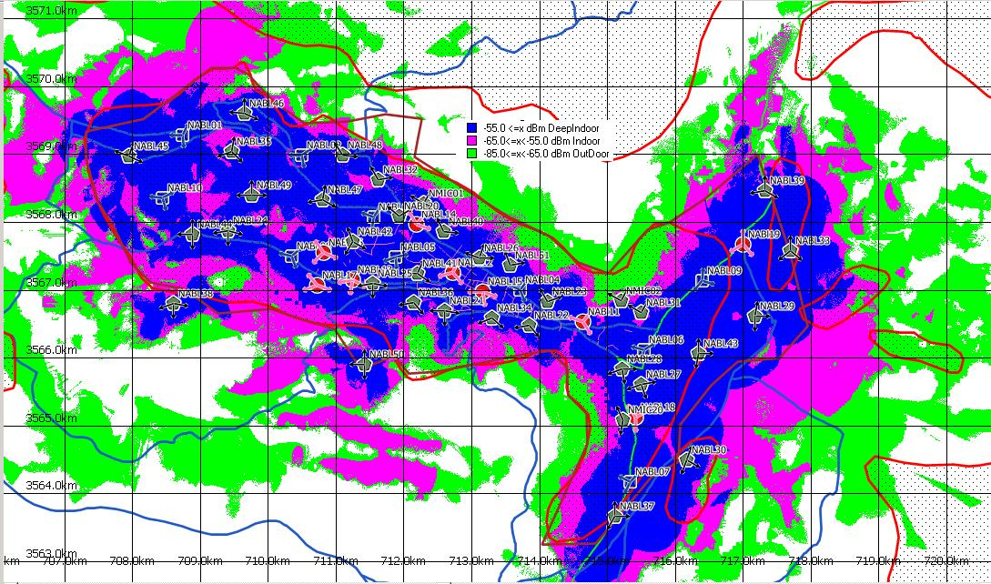
Simulation of the Third phase…
Simulation of the Third phase…
Notes:
15

Slide 16
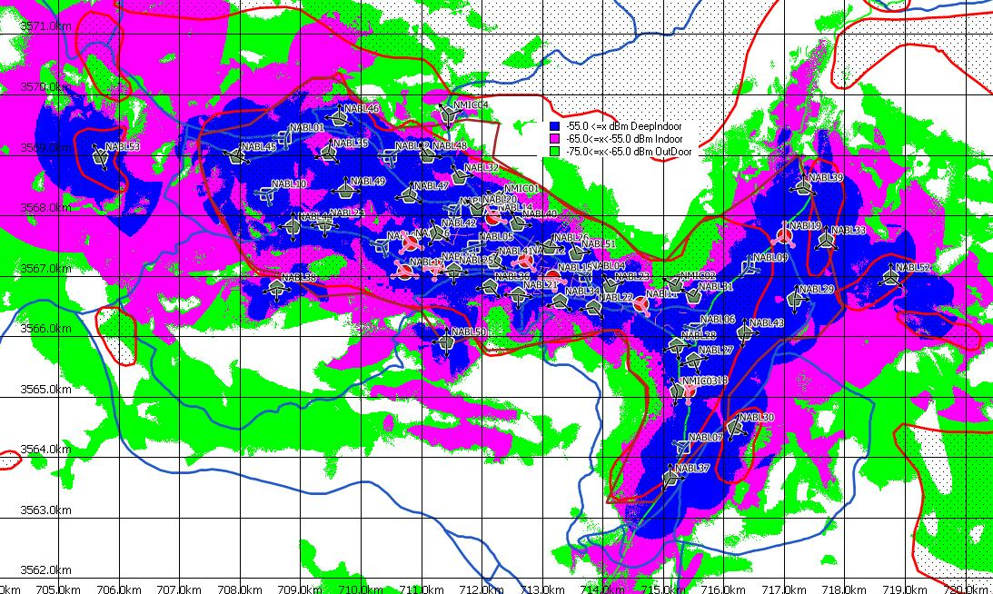
Simulation of the Third phase…
Simulation of the Third phase…
Notes:
16

Slide 17
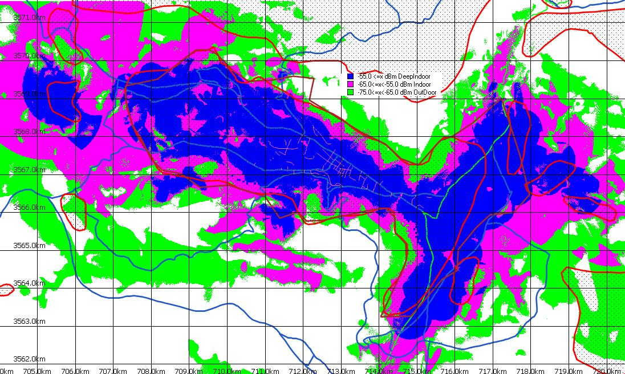
The Final Maps
The Final Maps
Best Server Signal Strength Map
Notes:
17

Slide 18
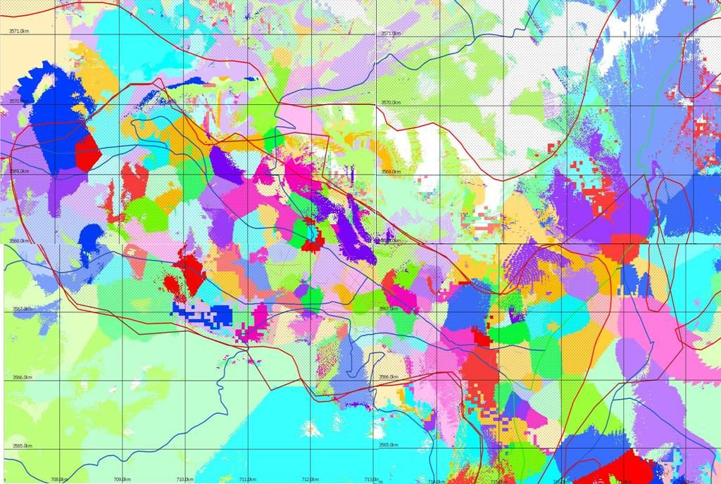
The Final Maps
The Final Maps
Best Serving Sector Map
Notes:
18

Slide 19
The percentages of coverage
The percentages of coverage
The percentage of the coverage with 56 sites
Type of coverage | Covered area(km²) | Covered area (%)
Deep Indoor | 21.427 | 70.47%
Indoor | 6.063 | 19.94%
Outdoor | 2.724 | 8.96%
Poor | 0.191 | 0.63%
Third Phase ( Total covered area 30.403 km² )
Notes:
19

Slide 20
satisfy our requirements
Satisfy our requirements
Notes:
20

Slide 21
Comparison
Coverage Comparison
Now we compare the percentage of covered area in the Second phase (19 sites) and the Third phase (56 sites) …
Notes:
21

Slide 22
Automatic frequency plan
Automatic frequency plan
We will apply AFP to our project Using Mentum tool
Which is adopted by Jawwal company , for AFP
We need many parameters to help us in defining the frequencies in each cell :
Traffic Map
Best Serving sector Map
Best Server Signal strength Map
Neighbor cells Table
Interference Matrix
Notes:
22

Slide 23
Automatic frequency plan …
Automatic frequency plan …
Traffic Map for Each Cell
In our project we deal with estimated traffic depends on the density of subscribers, type of area (dense urban, urban, suburban and rural), open area , the distance between the sites , last group project congested cells .
table shows the estimated traffic for each cell :
Site | Sector | Traffic (Erlang)
GSM20 | 1 | 28
GSM20 | 2 | 22
GSM21 | 1 | 12
GSM21 | 2 | 14
GSM21 | 3 | 11
GSM22 | 1 | 17
GSM22 | 2 | 13
GSM23 | 1 | 12
GSM23 | 2 | 14
GSM24 | 1 | 25
GSM24 | 2 | 25
GSM24 | 3 | 25
Total : 2102 Erlang
Max : 3750 Erlang
Notes:
23

Slide 24
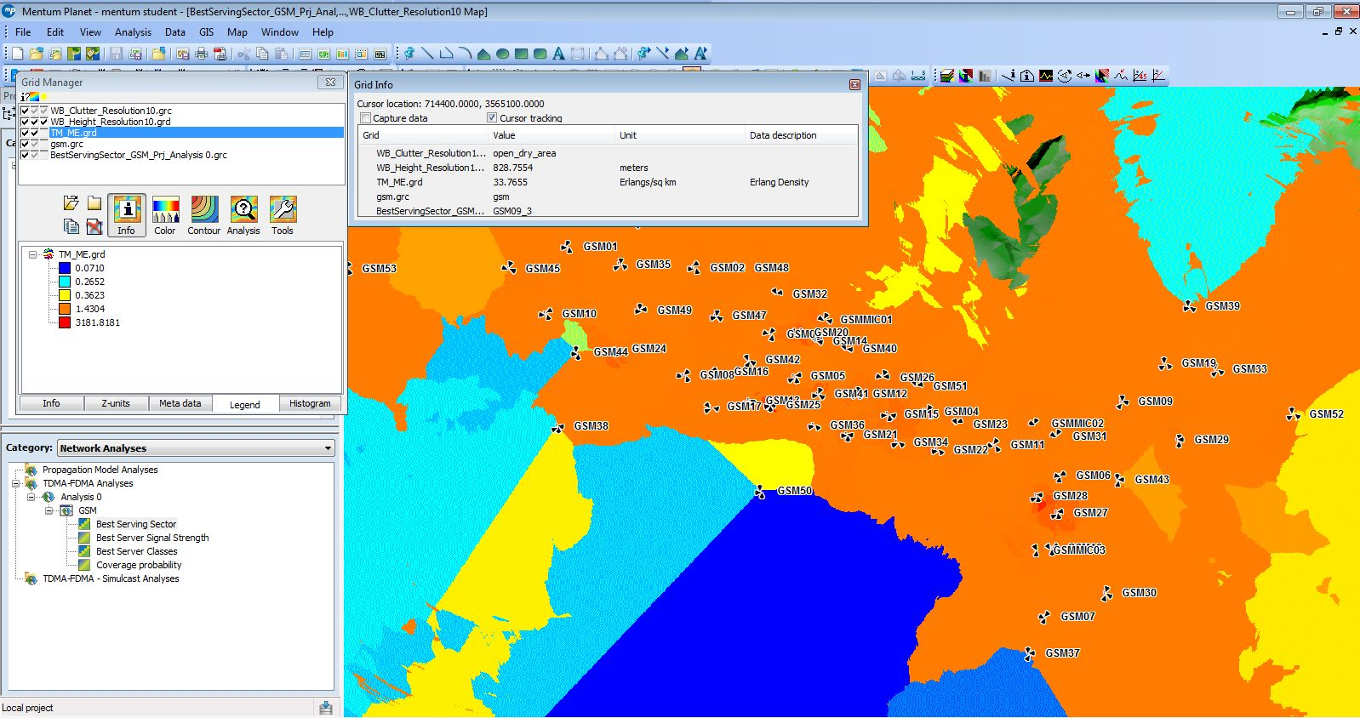
Automatic frequency plan …
Automatic frequency plan …
Every color represent a range of traffic Earlang/sqr Km
Notes:
24

Slide 25
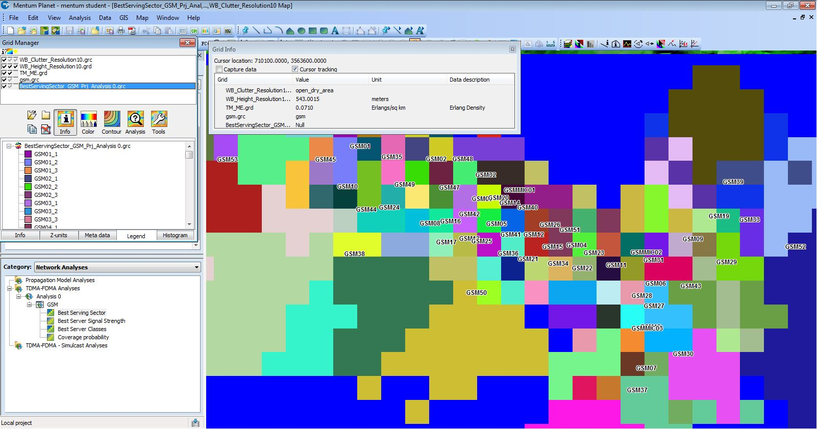
Automatic frequency plan
Automatic frequency plan
Best Serving Sector Map
Notes:
25

Slide 26
Automatic frequency plan
Automatic frequency plan
Best Server Signal Strength Map
Notes:
26

Slide 27
Automatic frequency plan
Automatic frequency plan
Neighbor cells Table
We attended the table depending on :
RBS Distribution Map
Height resolution Map
Distance between cells
sSite | sSector | nSite | nSector
GSM01 | 1 | GSM01 | 2
GSM01 | 1 | GSM01 | 3
GSM01 | 1 | GSM46 | 3
GSM01 | 2 | GSM01 | 1
GSM01 | 2 | GSM01 | 3
GSM01 | 2 | GSM35 | 3
GSM01 | 2 | GSM10 | 1
GSM01 | 2 | GSM45 | 2
GSM01 | 3 | GSM01 | 1
GSM01 | 3 | GSM01 | 2
GSM01 | 3 | GSM45 | 1
GSM02 | 1 | GSM02 | 2
GSM02 | 1 | GSM02 | 3
GSM02 | 1 | GSM48 | 2
Notes:
27

Slide 28
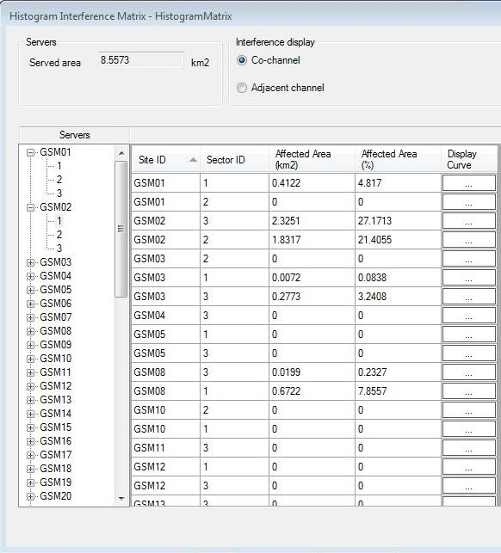
Automatic frequency plan
Automatic frequency plan
Interference Matrix
From Traffic Map & Best Serving Sector Map & Best Server Signal Strength Map & Neighbor cells Table , the Mentum tool Concludes interference Matrix
Notes:
28

Slide 29
Automatic frequency plan
Automatic frequency plan
Frequency of each site
Finally from all of the previous data we can determine the best frequency of each cell
We assume that the range of frequencies is ( 100-124)
The range of BCCH is from 111-124
And the Range of TCH 101-110
Notes:
29

Slide 30
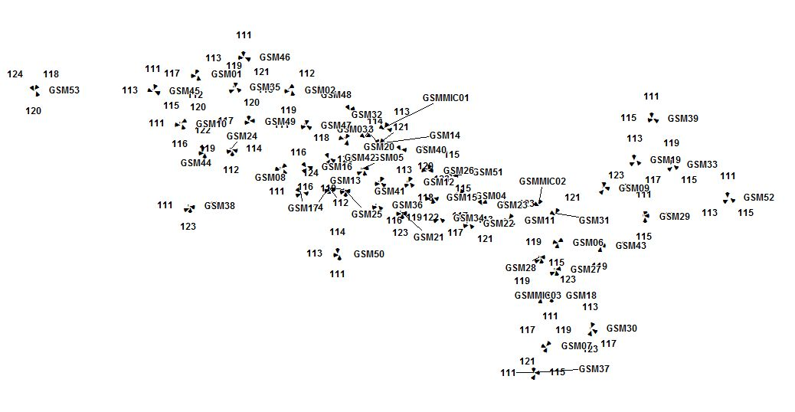
Automatic frequency plan
Automatic frequency plan
Final BCCH Distribute Map
Notes:
30

Slide 31
Comparison
C/I & C/A Comparison
Now we COMPARE the C/I ( Carrier-to-interference) & C/A ( Carrier-to-adjacent) Factors in the Second phase and the Third phase …
C/I Decreased to 13.2 dB but allowed to 12 dB
C/A Decreased to 3.7 dB but allowed to 3 dB
Notes:
31

Slide 32
Comparison
Our Operator & Jawwal Comparison
Notes:
32

Slide 33
GSM Network Planning (Third Phase)
GSM Network Planning (Third Phase)
?
Notes:
33

Slide 34
GSM Network Planning (Third Phase)
thanks
Notes:
34

