Slide 1


Slide 2

CSC
Community
Service Center
System Analysis & Website
PRESENTED BY:
Mazen Thaher & Bara Antari
SUPERVISOR:
Dr.Maher Arafat

Slide 3

CSC
  About Community Services Center
  Why Community Services Center
Table
  Current working mechanism
of
  Current System problems
  Project Objectives
  Community Service Center Website
  CRM
  Reports
  Plugins
  Testing
Content

Slide 4

CSC
About CSC
An-Najah Community Service Center: A pivotal unit established in collaboration with McGill University in 1999, aiming to adopt the rights-based community practice model. The center has become a vital human rights advocacy organization in Nablus, deeply embedded in the local community and linked to An-Najah National University. It leverages the voluntary efforts of university students and local community members to organize and empower marginalized groups to solve their issues actively.

Slide 5
CSC
Why CSC?

Slide 6
CSC
Current working mechanism

Slide 7

CSC
Current System problems
Time-Consuming | Difficulty in Performance Tracking | Lack of Centralized Information | Human errors
Each step from volunteer reception to the evaluation of completed work requires manual handling, making the system slow and cumbersome. | Without automated tools, tracking the performance and contributions of volunteers is labor-intensive and often inaccurate. | Data on volunteers and programs are stored in various places, leading to inconsistencies and difficulties in accessing information. | The reliance on manual data entry and record-keeping increases the risk of errors, affecting the reliability of volunteer information and program management.

Slide 8

CSC
Project Objectives
Main Objectives
Specific Objectives
  Registration of new users
  Event posting
  Participation to events
  Event management
  Donation & Donation Blood
  Comments section
  Communication and interaction
  User accounts management
Improving the volunteers selection and management processes, as well as facilitating the communication between organization and associated volunteers.

Slide 9



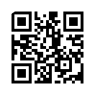
CSC
Enter website
www.rose.ps.com
Scan here!

Slide 10
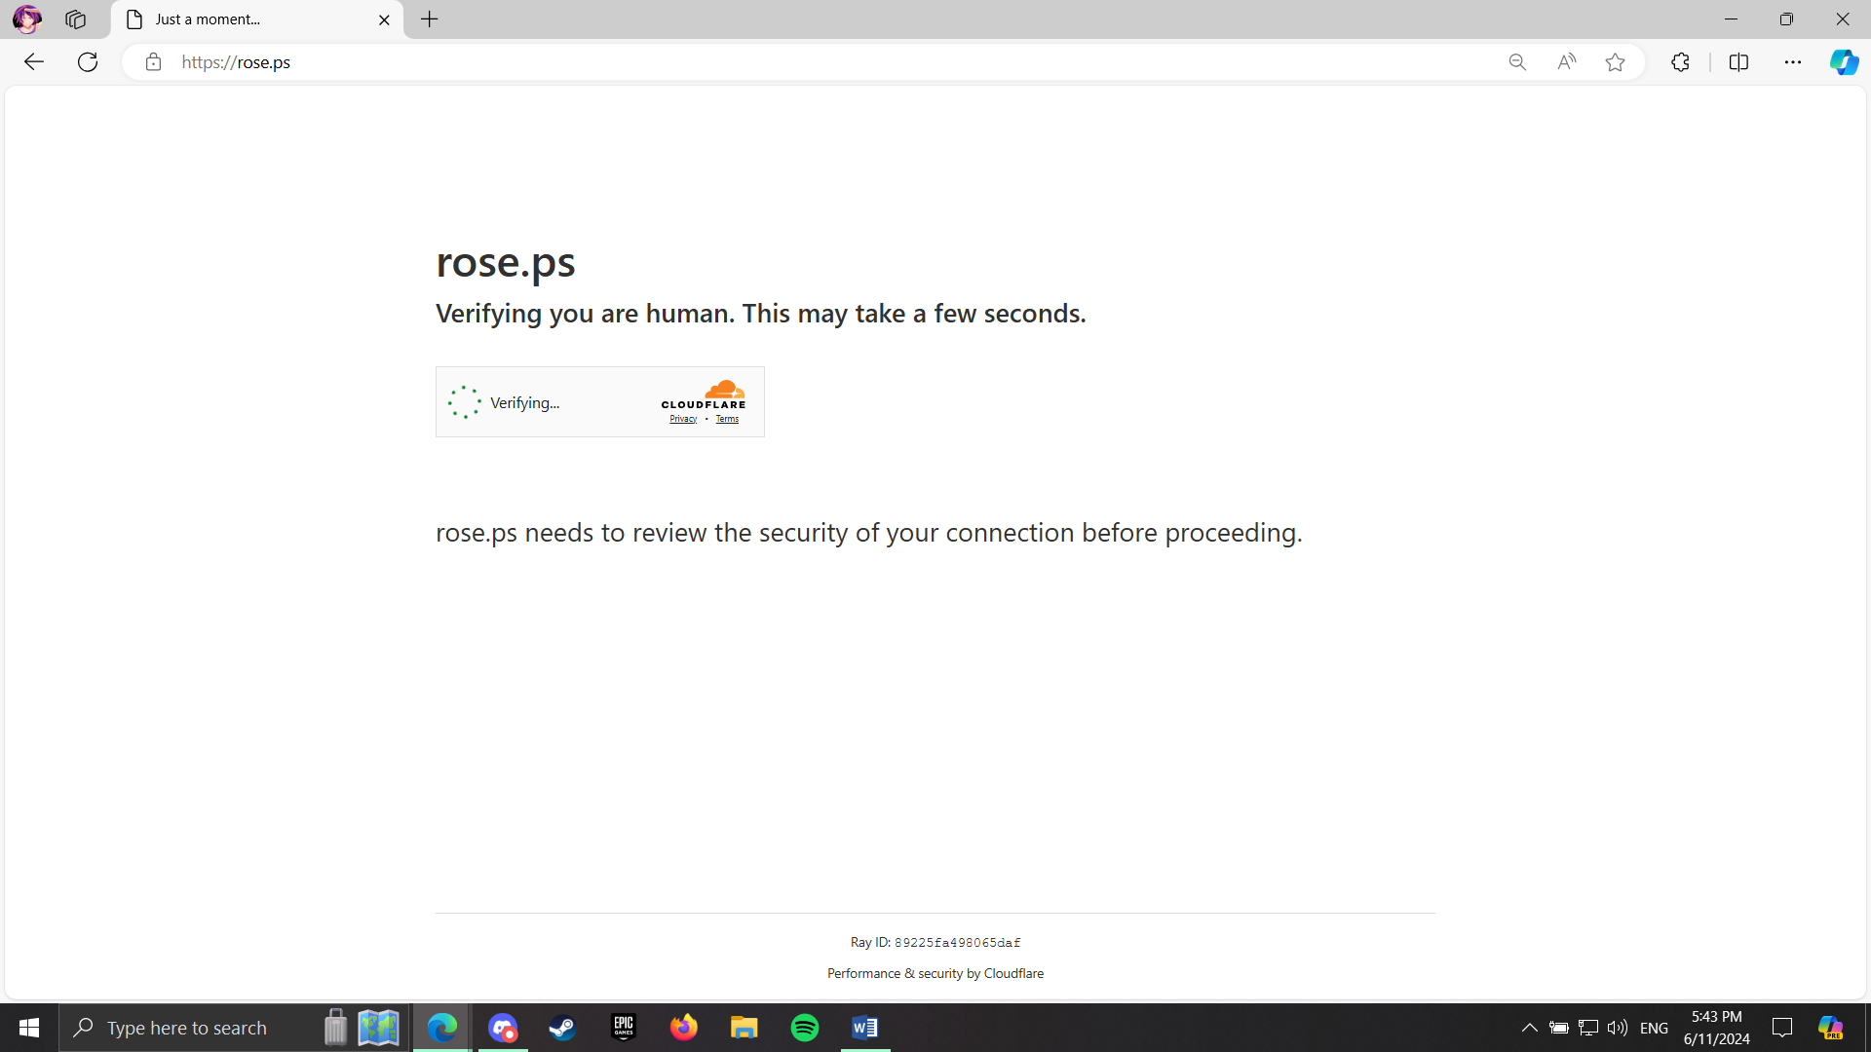

Slide 11
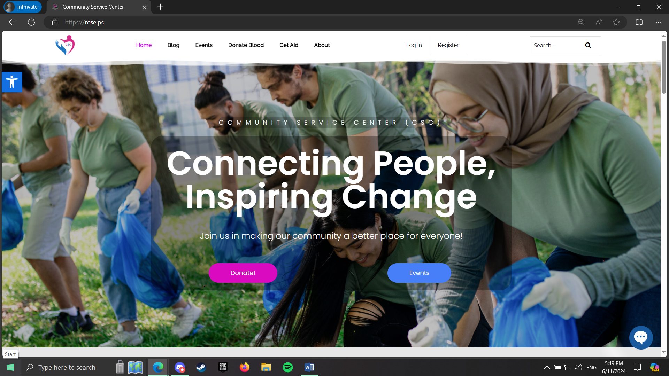

Slide 12
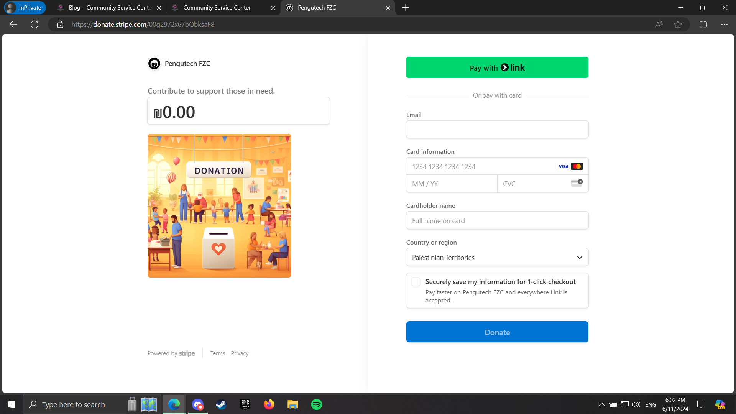

Slide 13
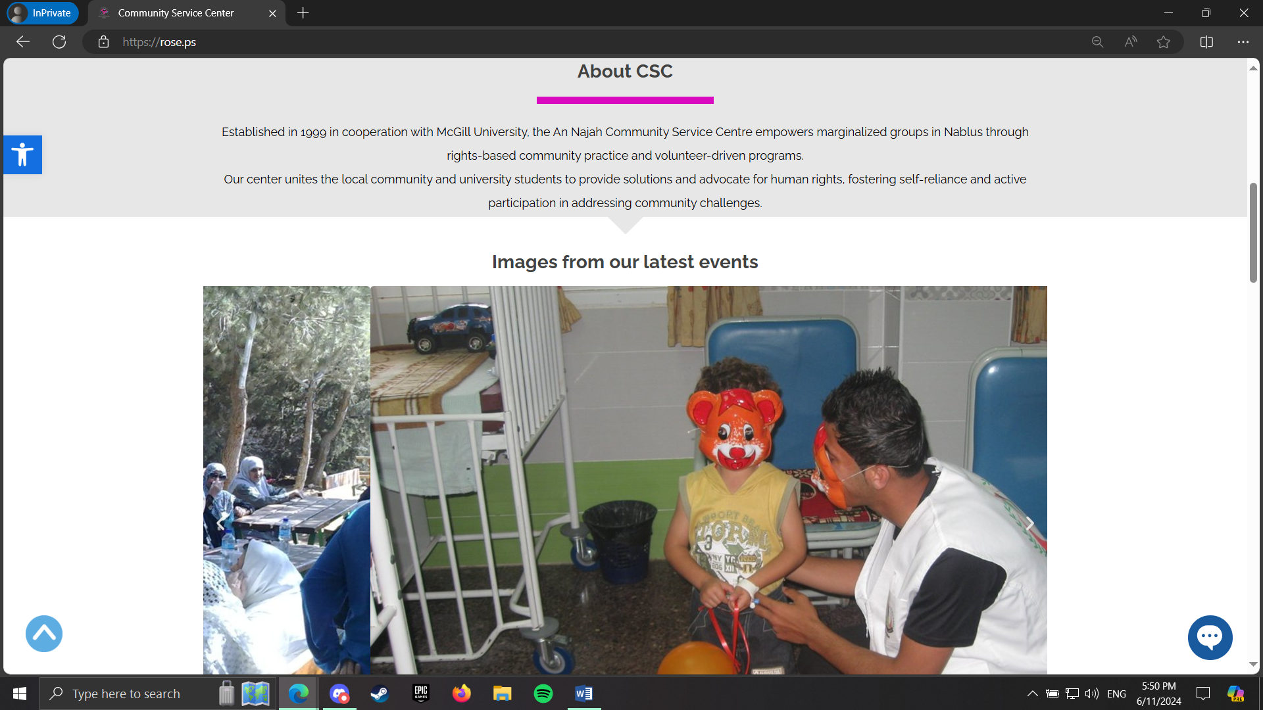

Slide 14
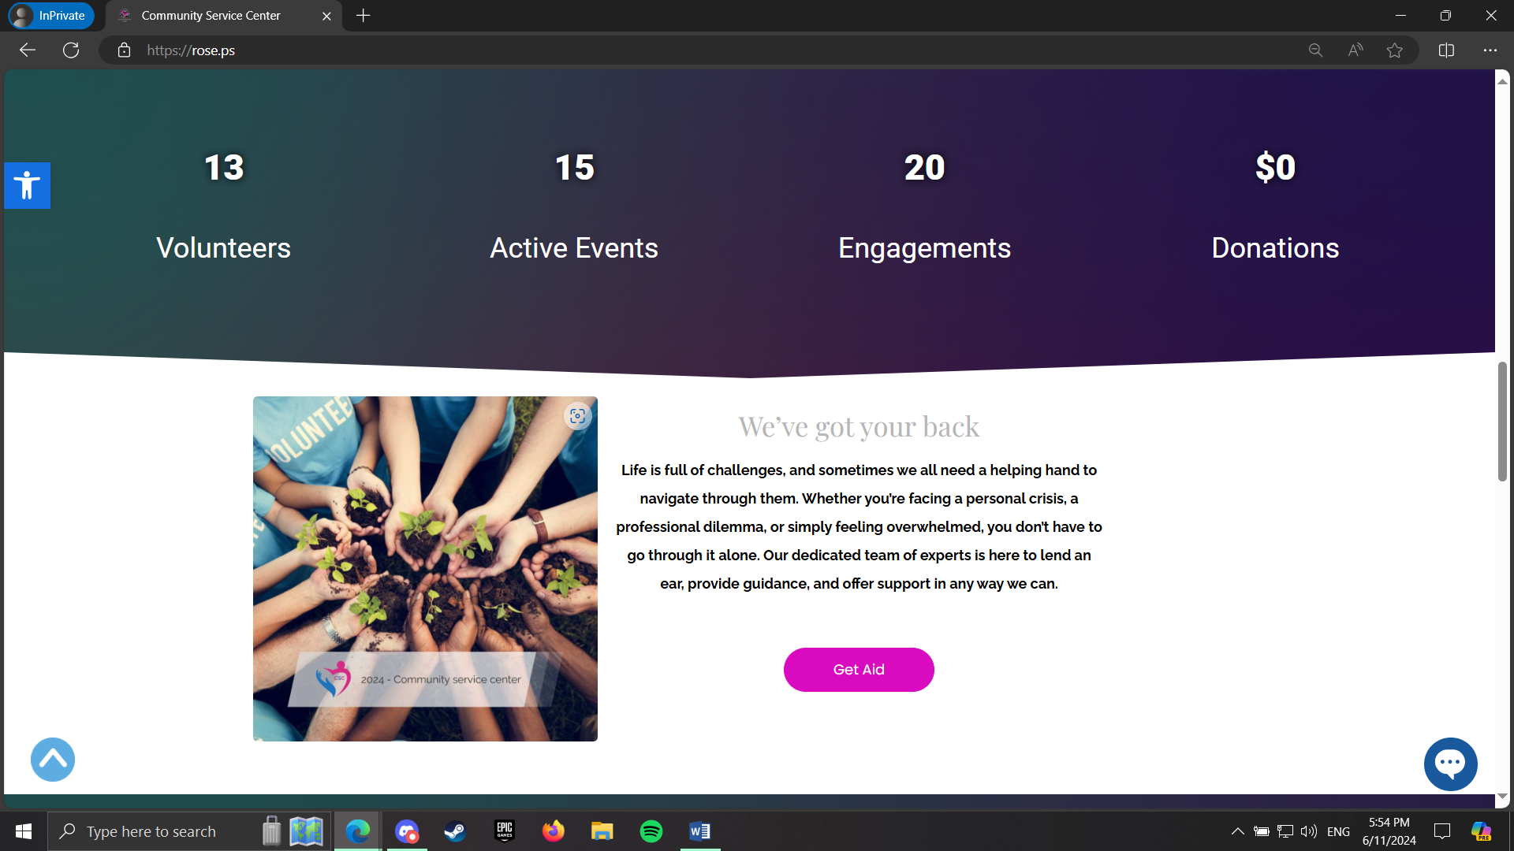

Slide 15
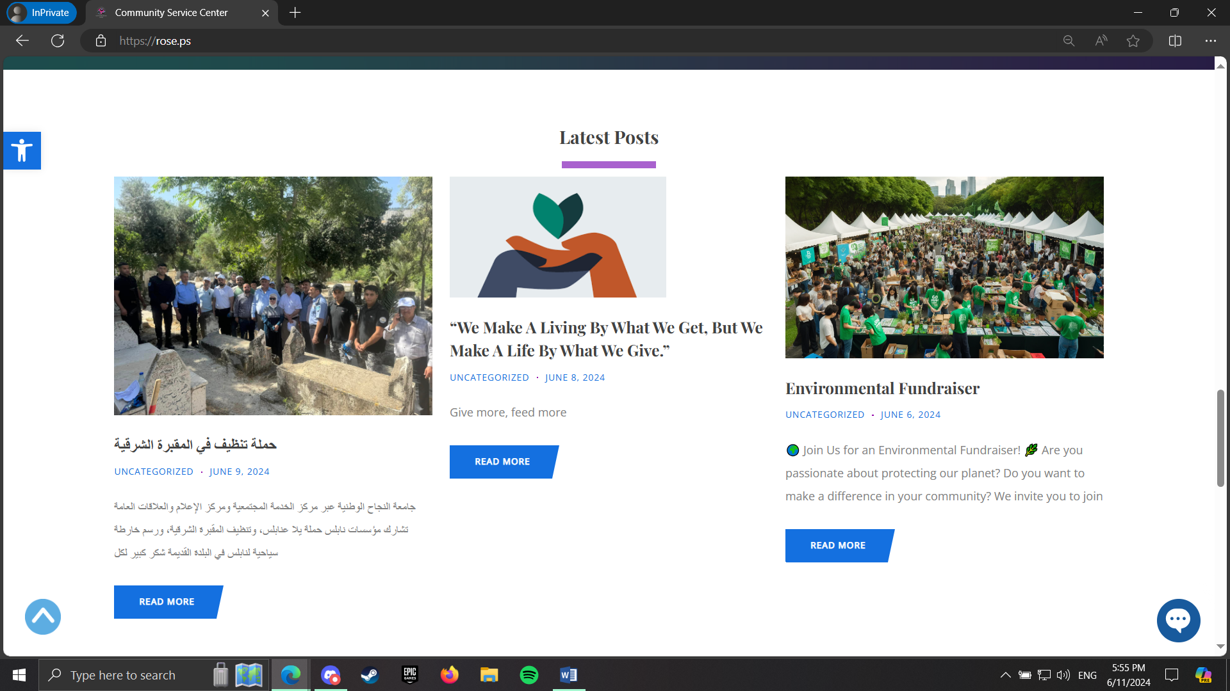

Slide 16
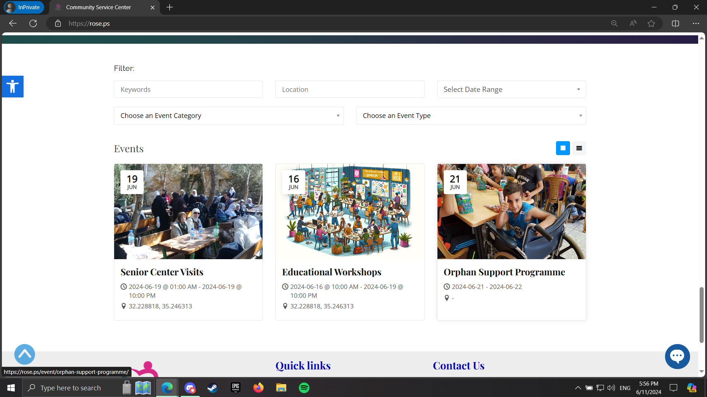

Slide 17
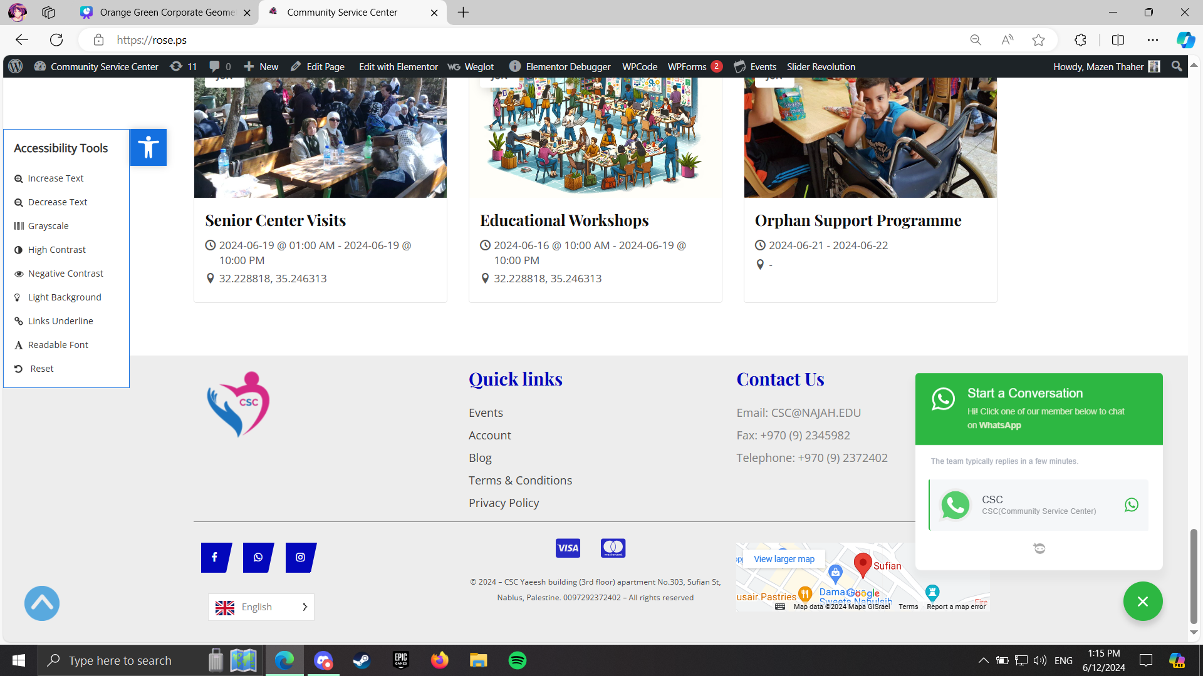

Slide 18
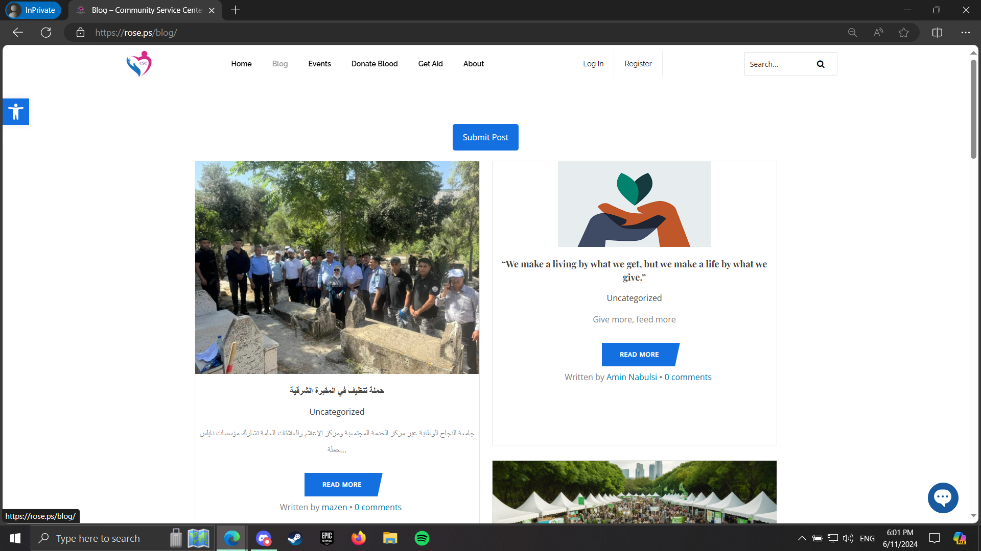

Slide 19
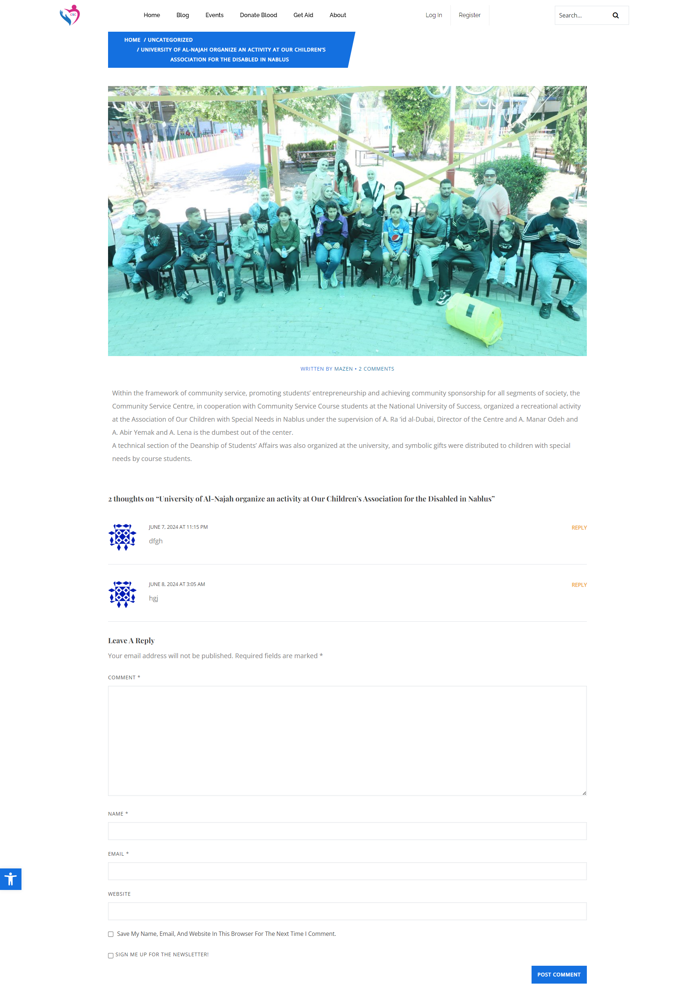

Slide 20
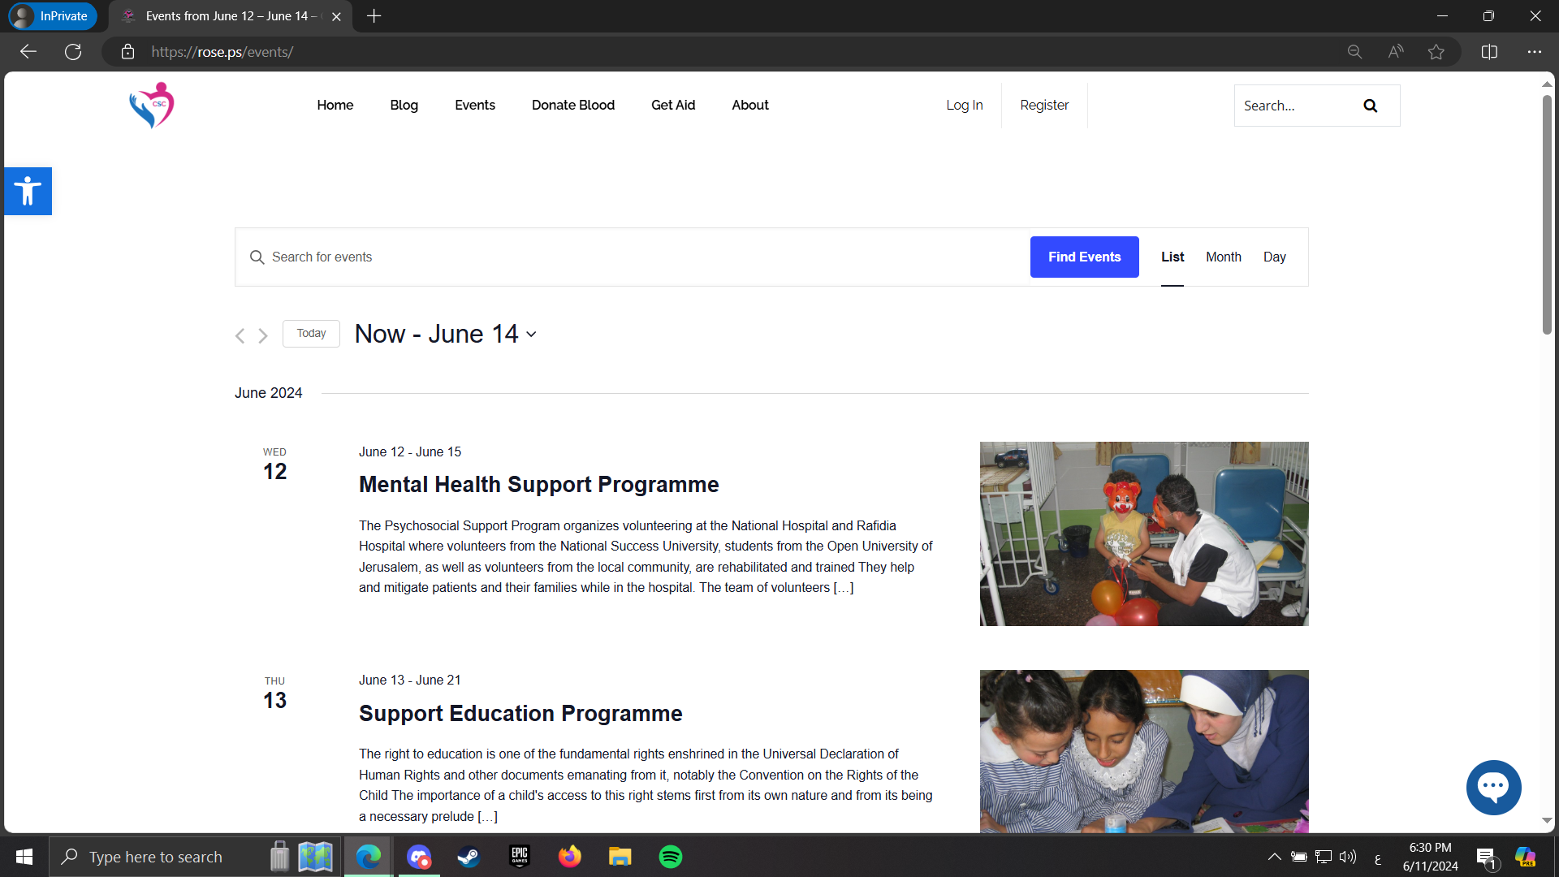

Slide 21
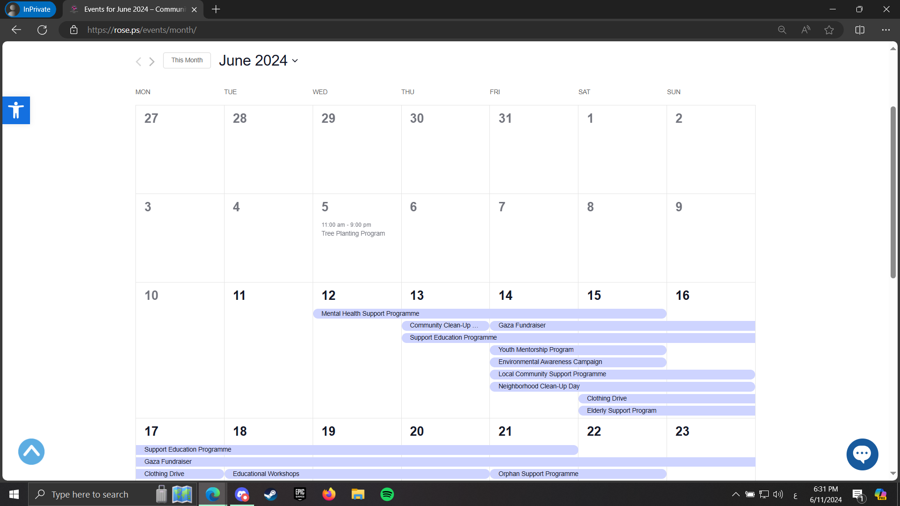

Slide 22
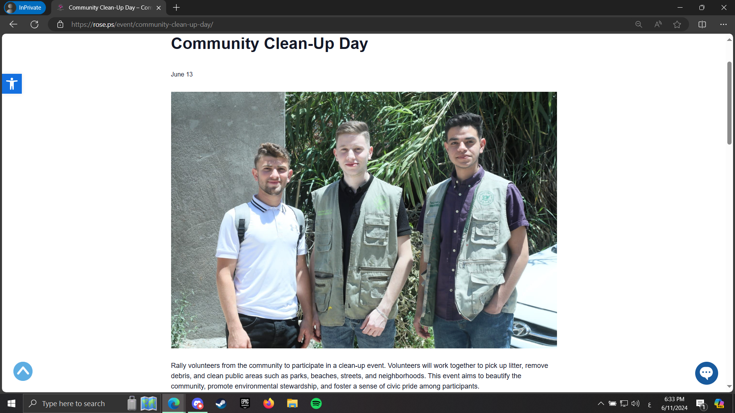

Slide 23
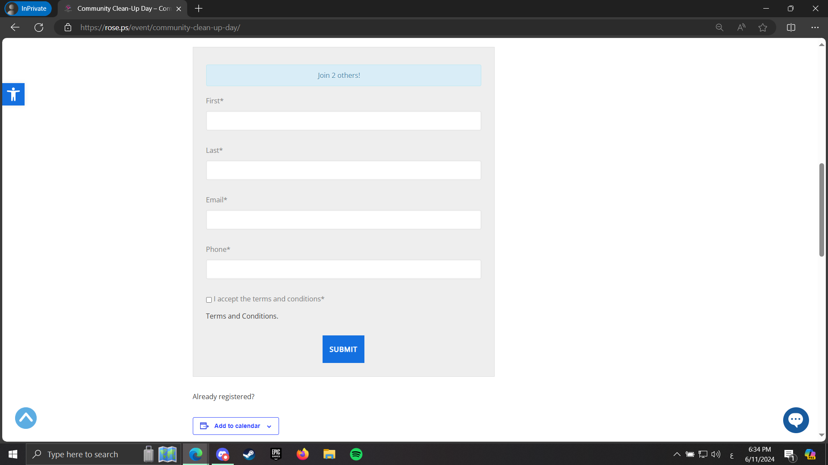

Slide 24
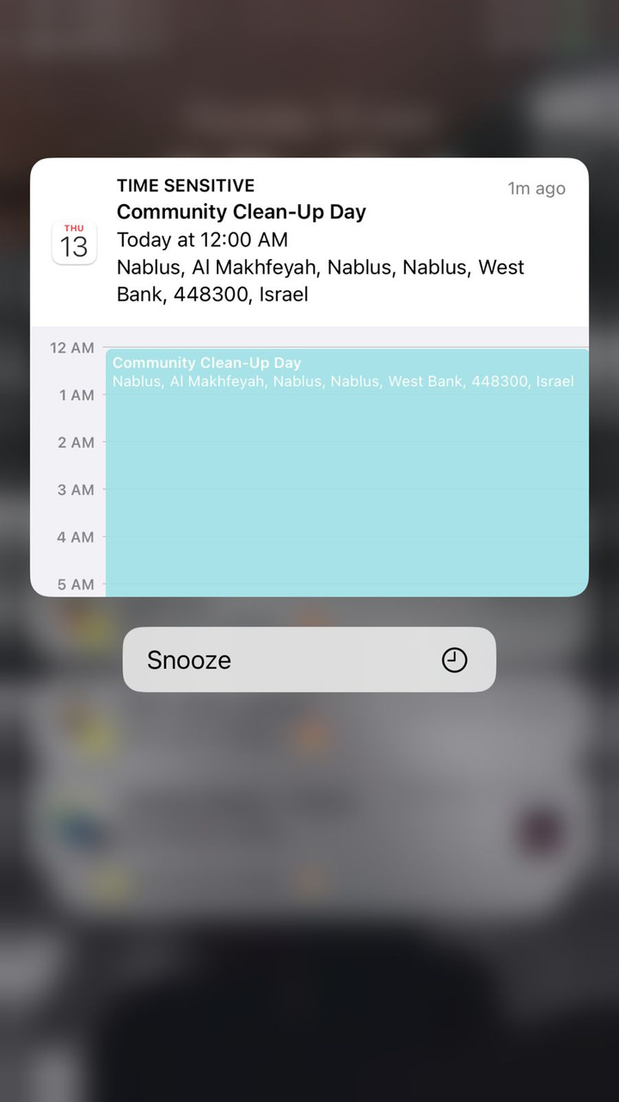

Slide 25
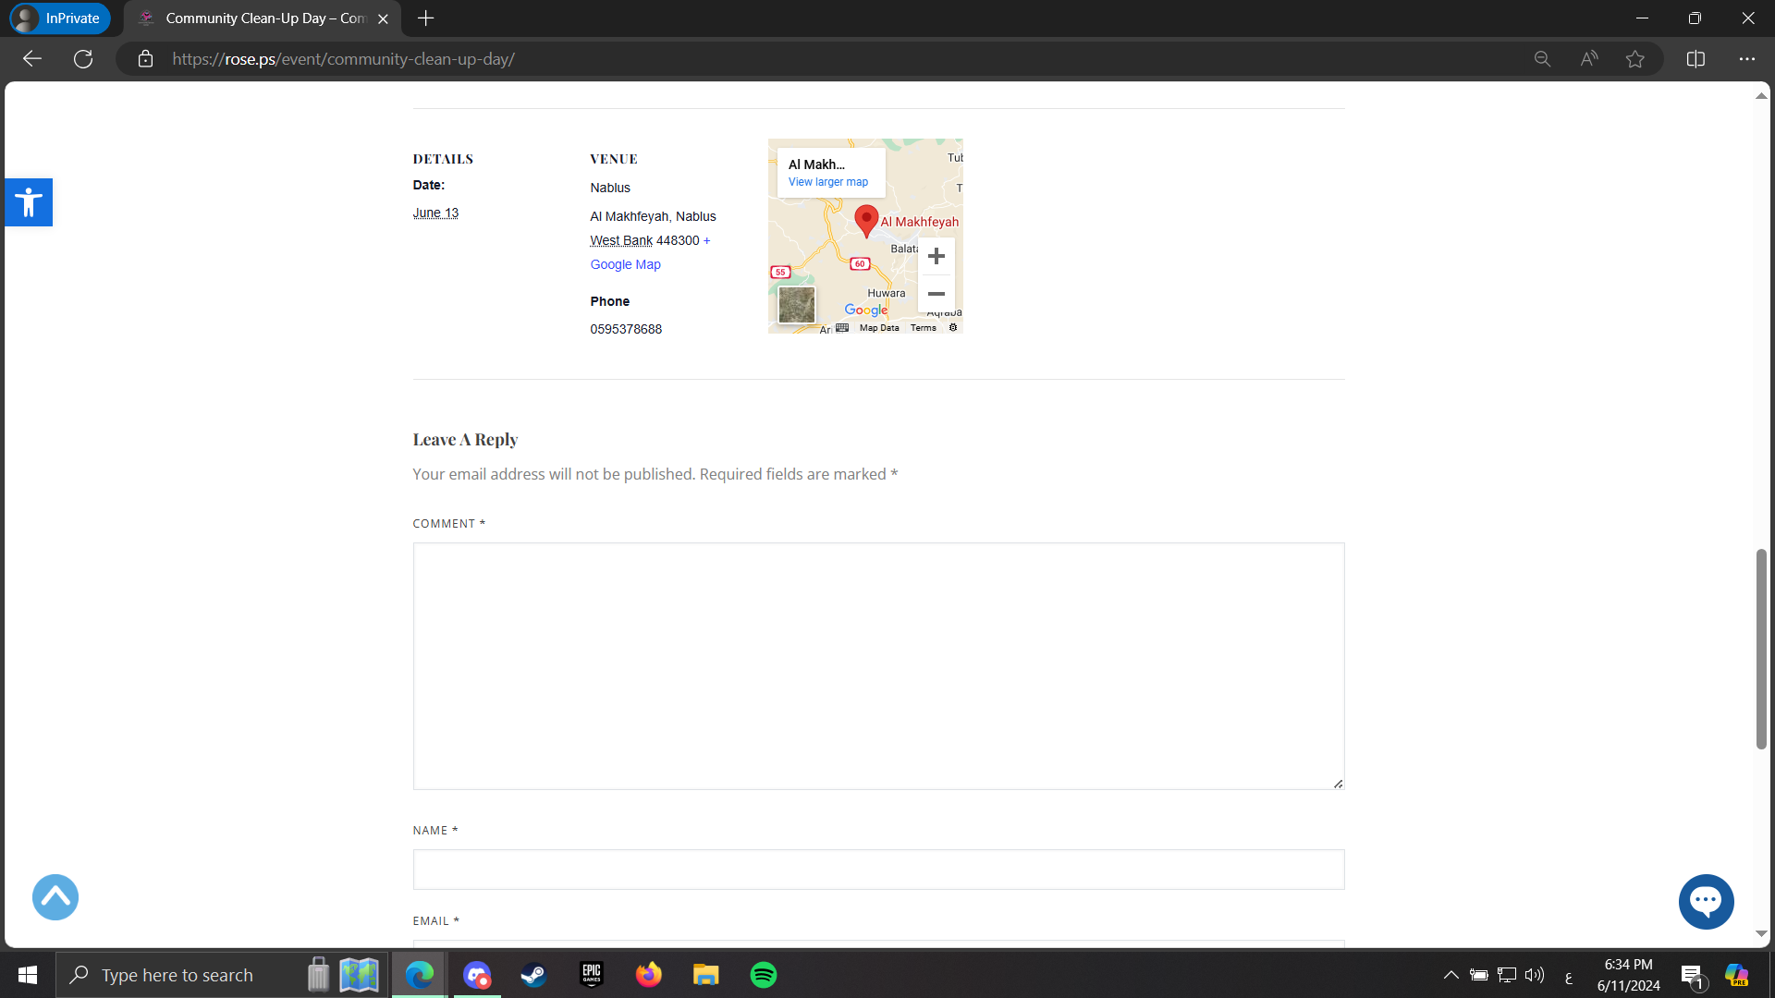

Slide 26
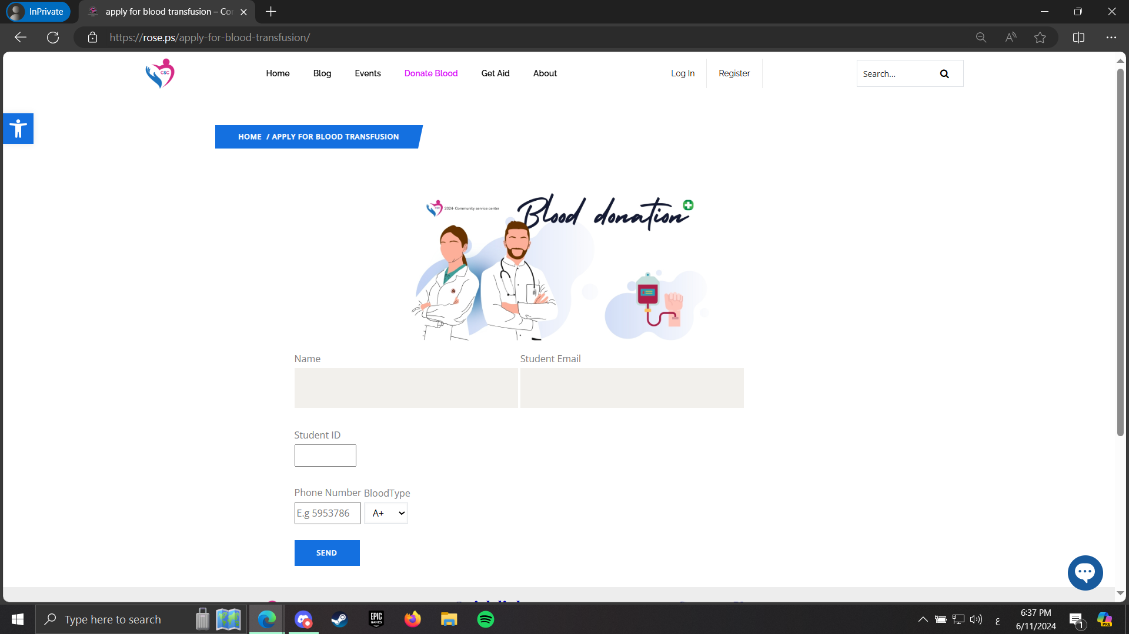

Slide 27
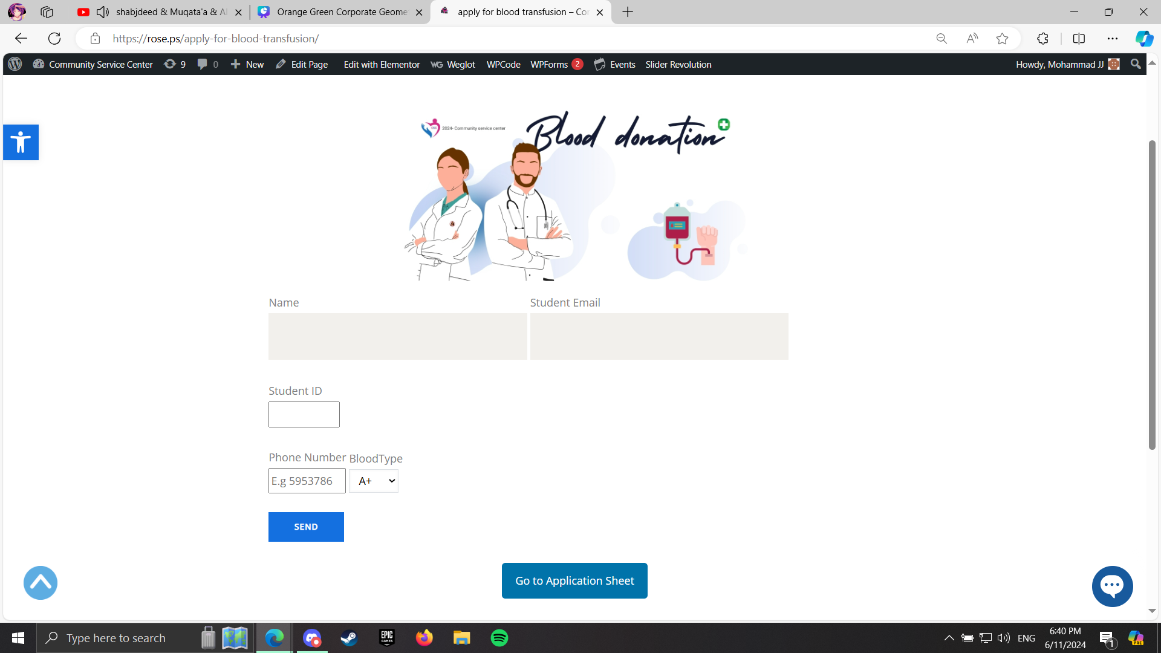

Slide 28
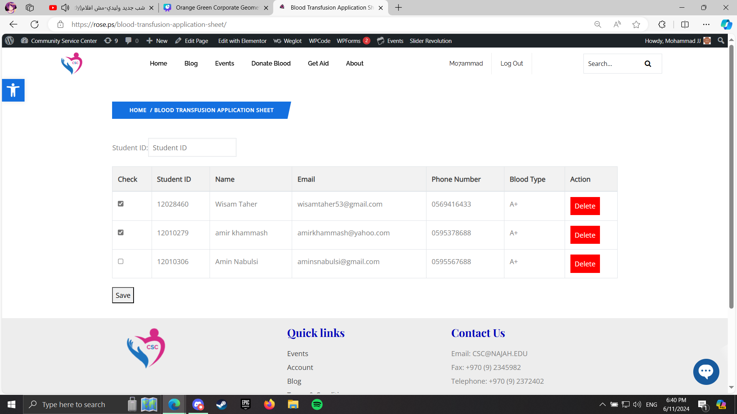

Slide 29
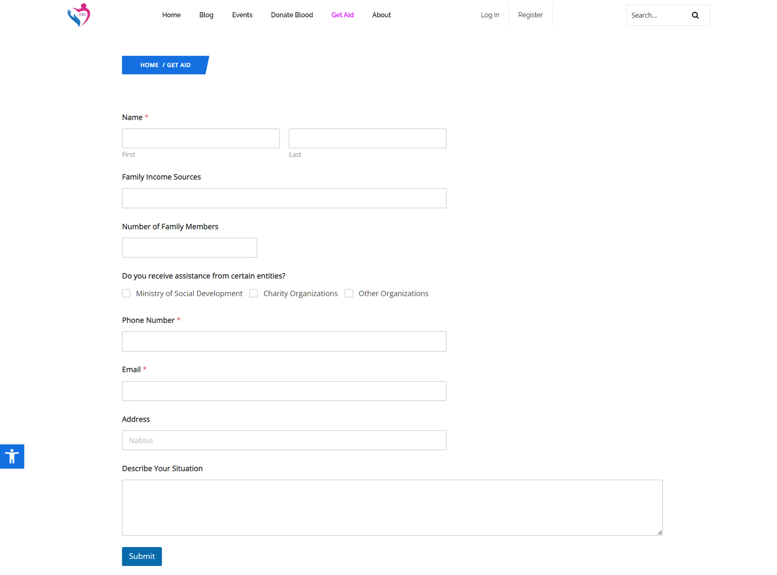

Slide 30
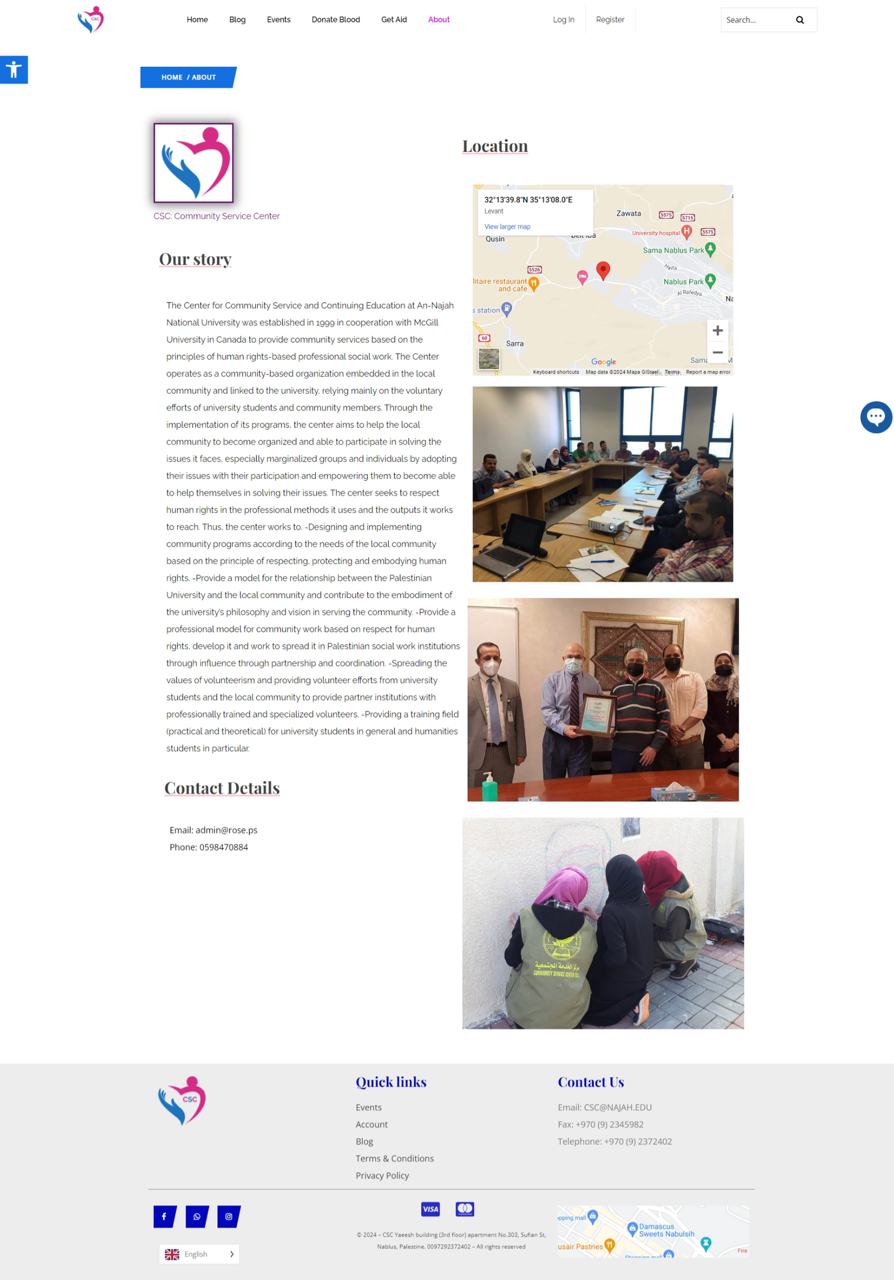

Slide 31
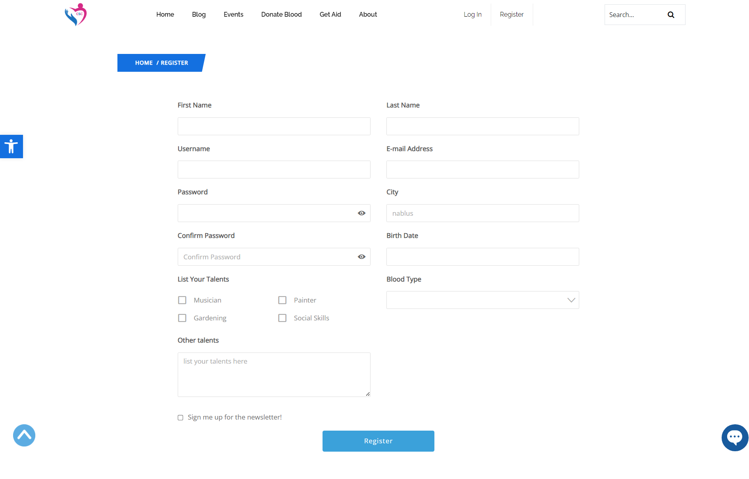

Slide 32
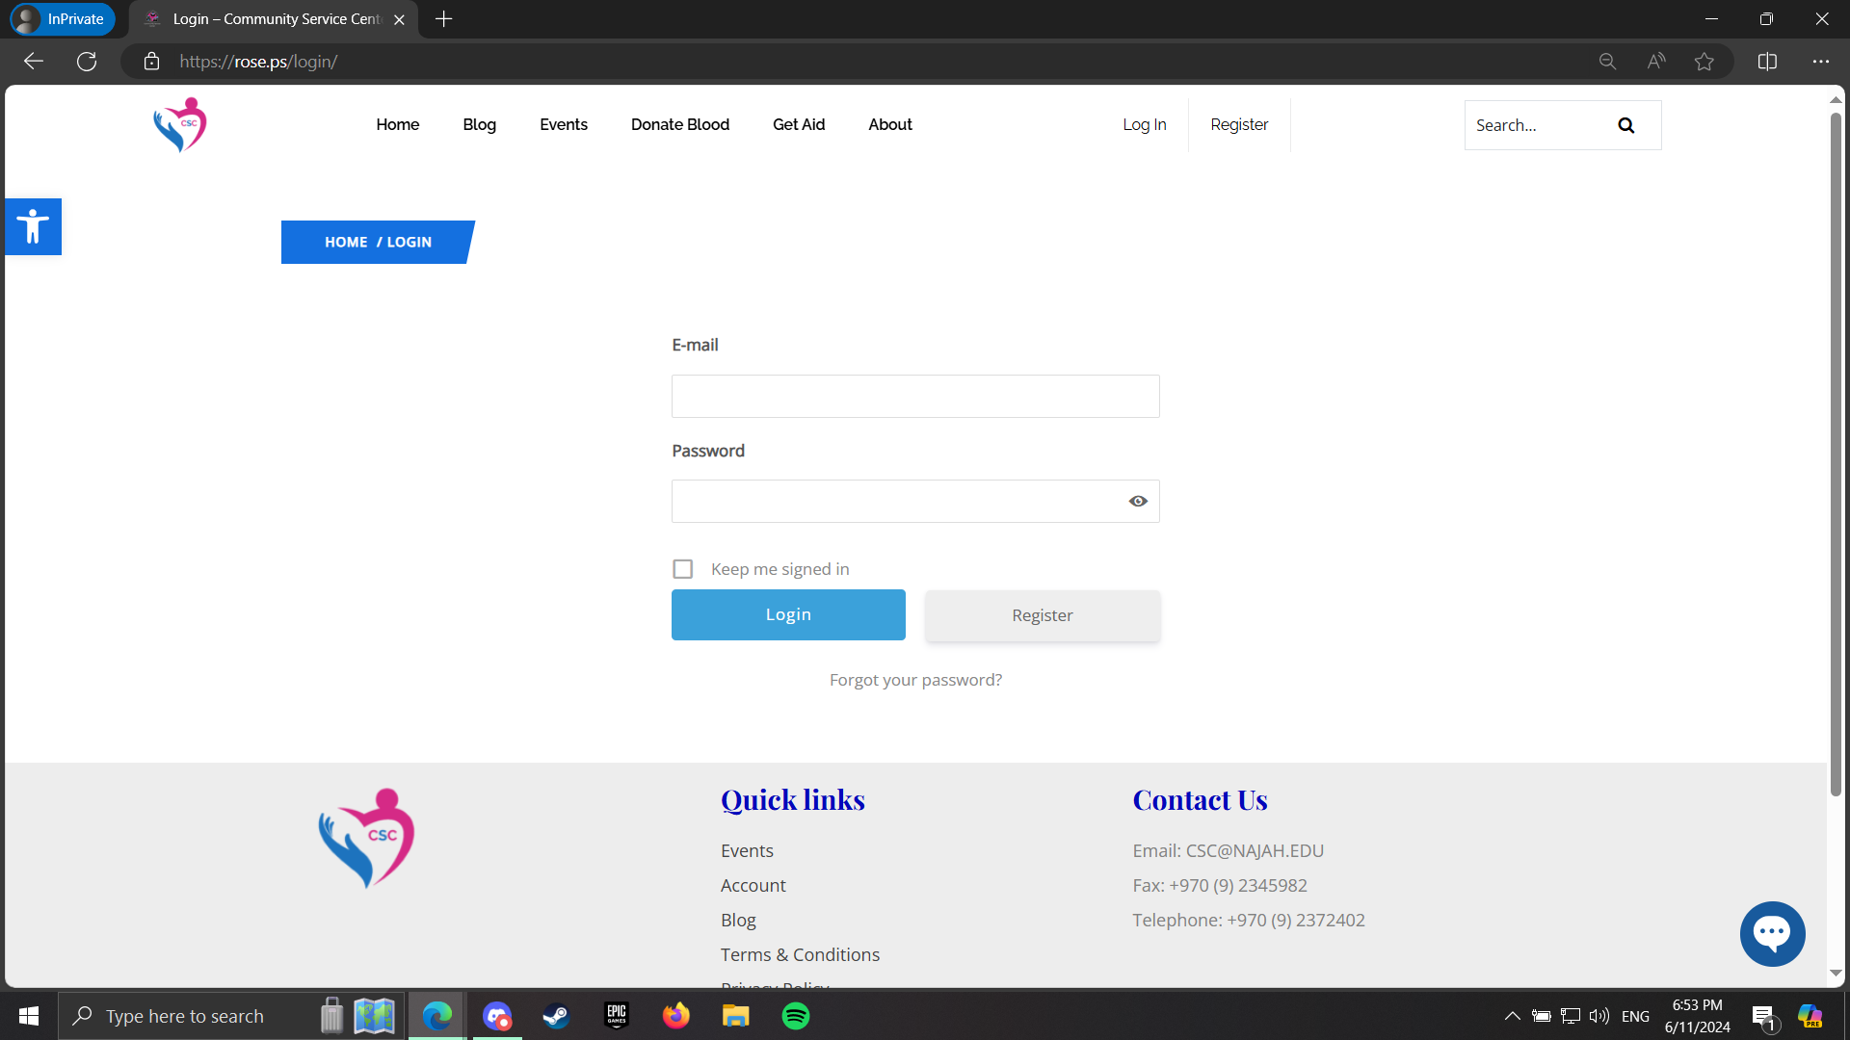

Slide 33
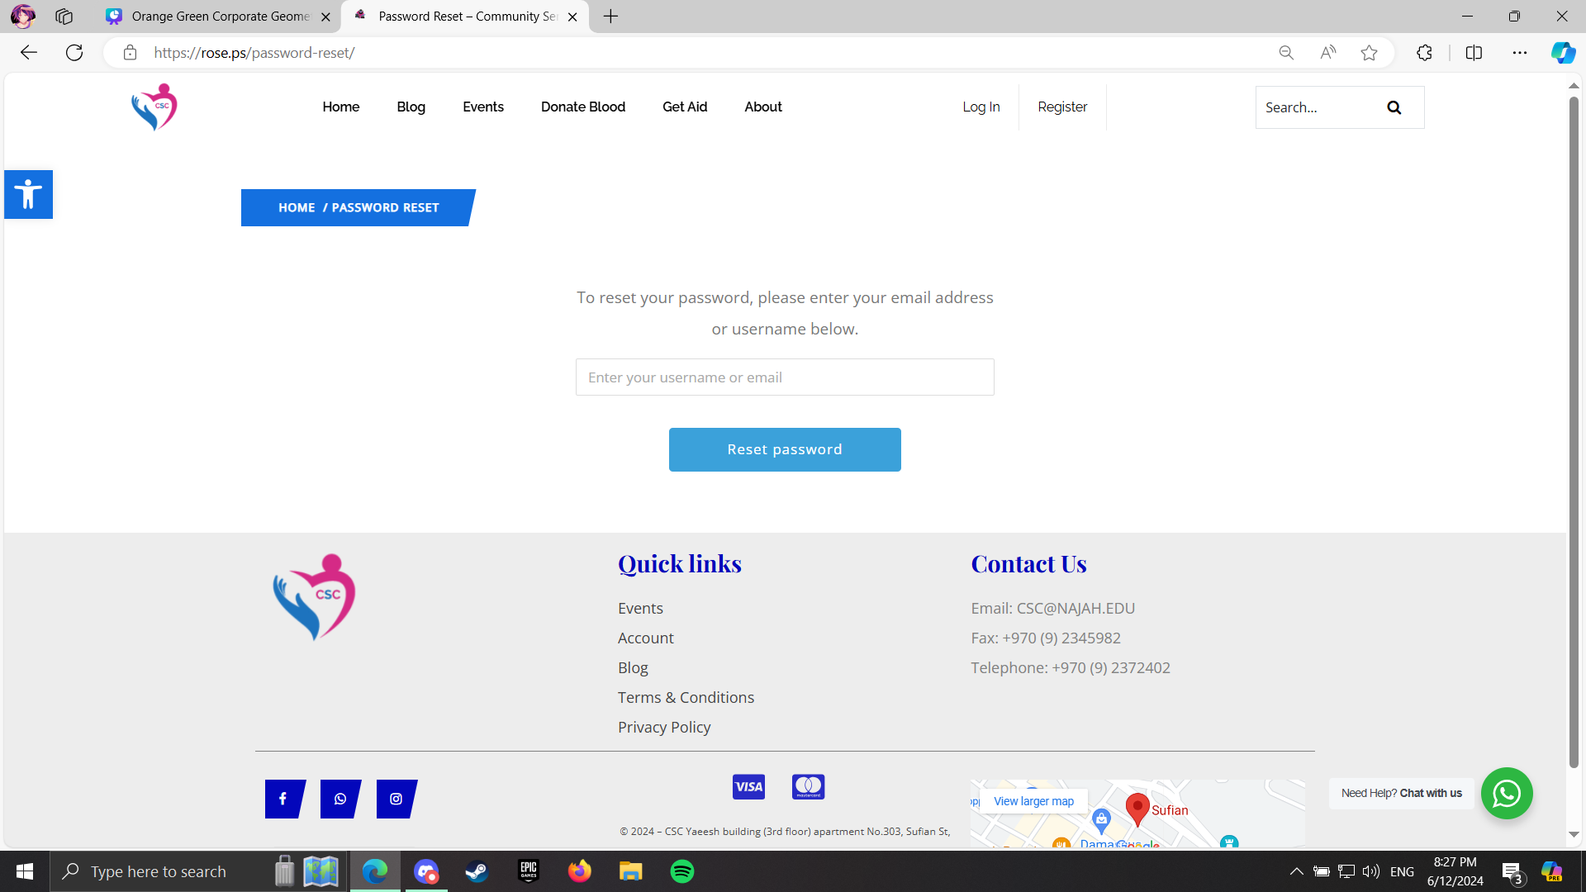

Slide 34
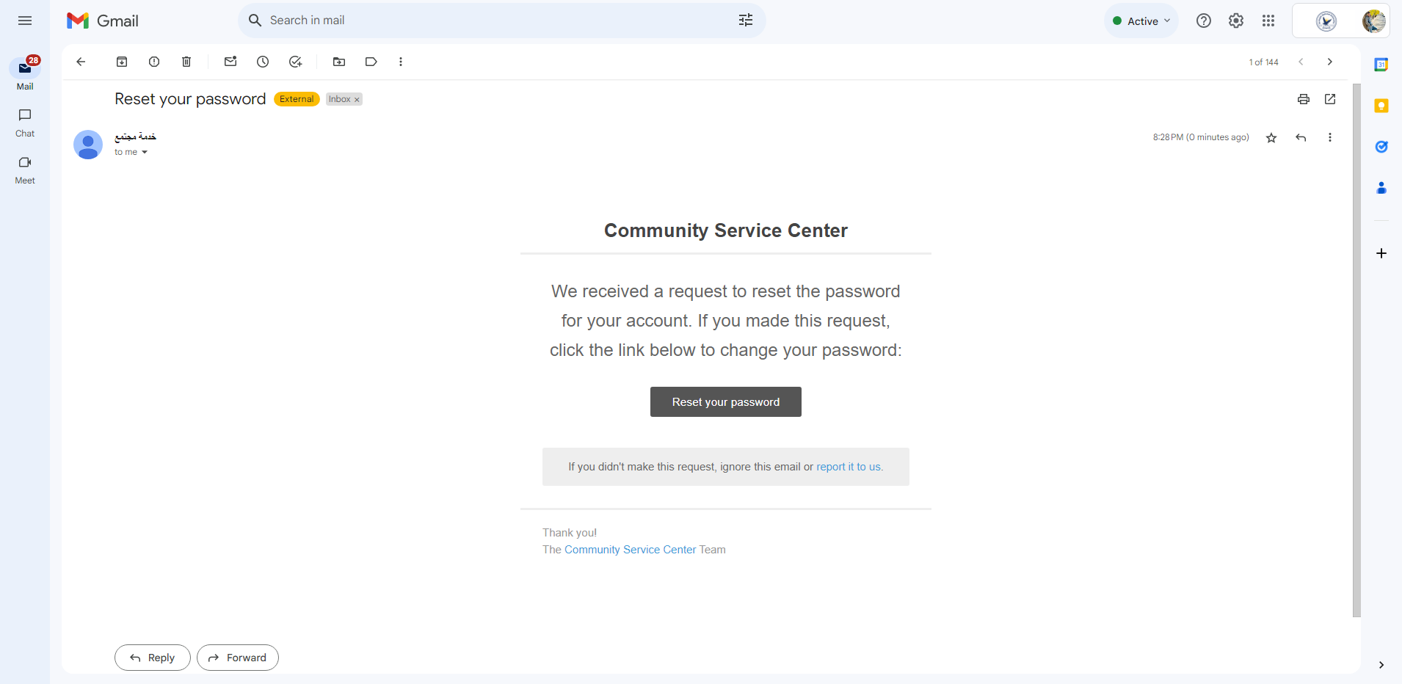

Slide 35
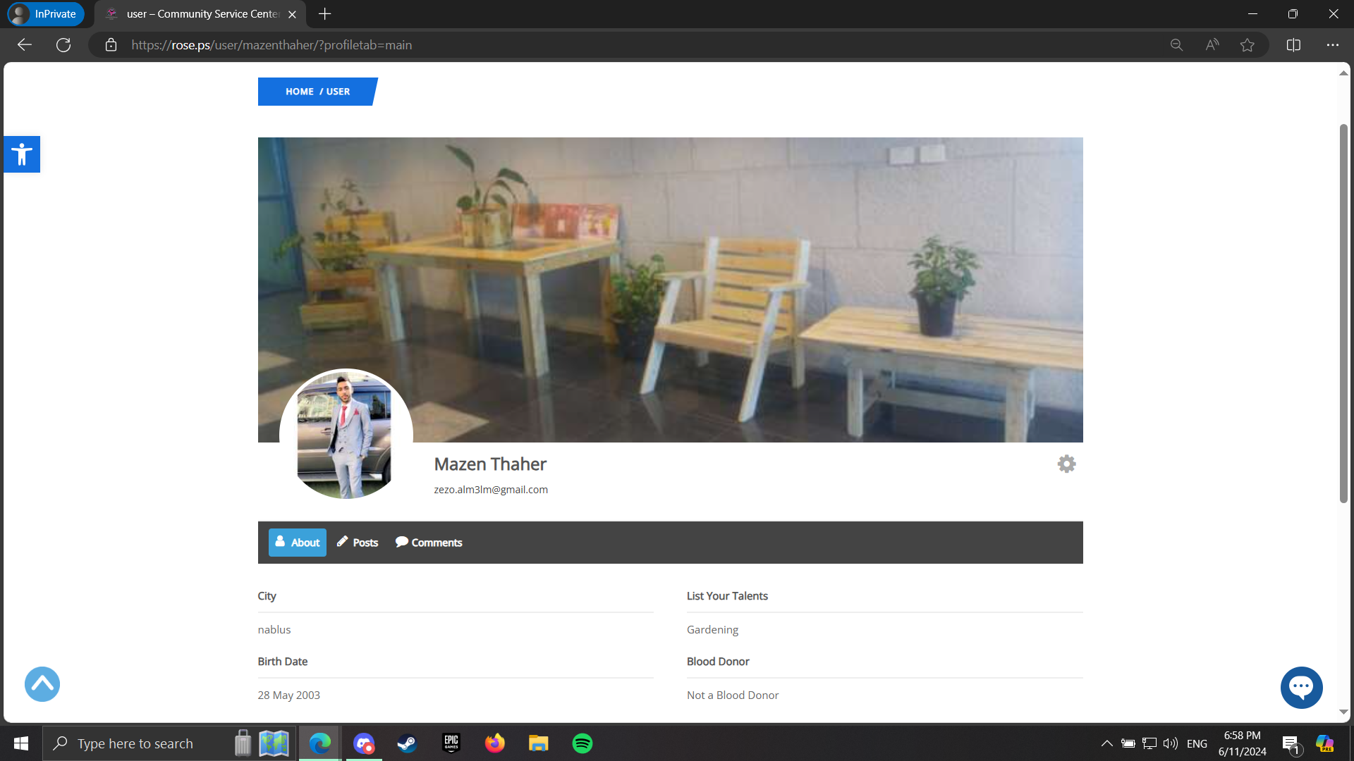

Slide 36
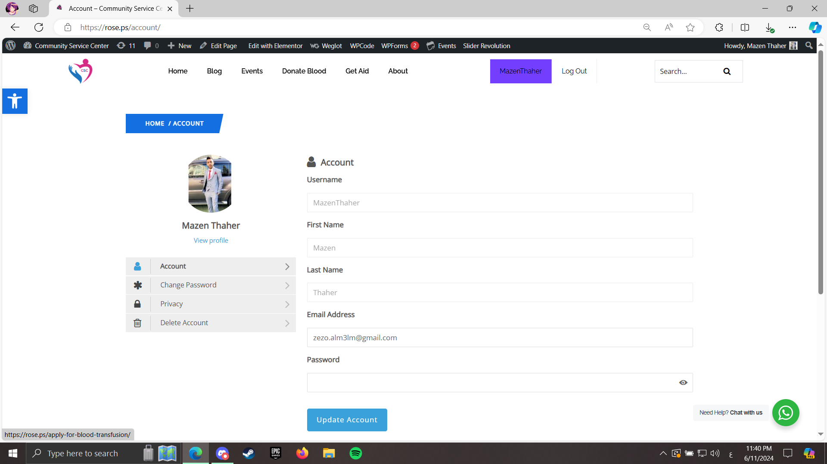

Slide 37
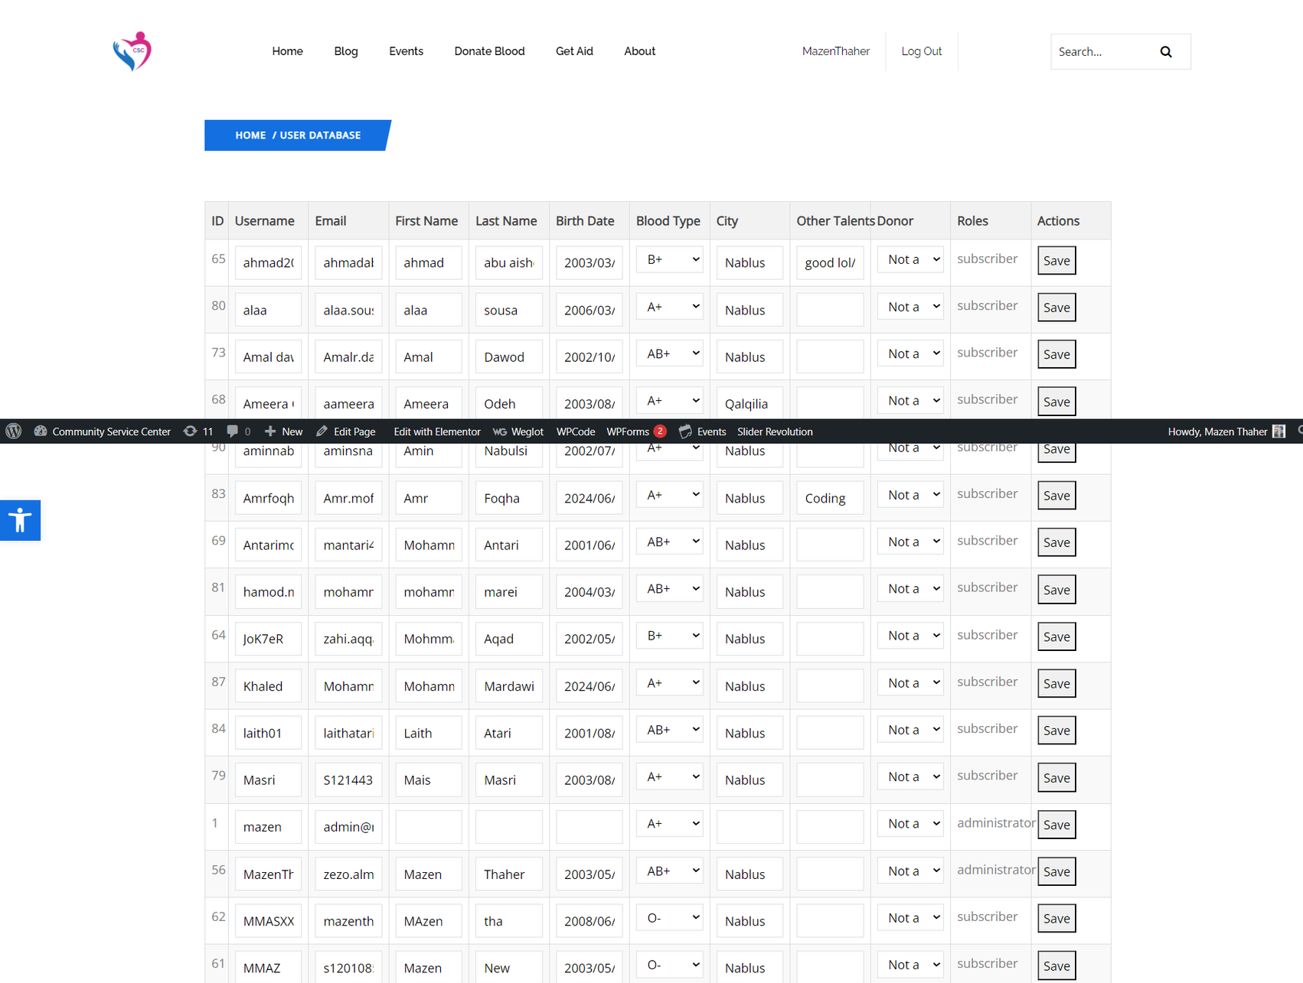

Slide 38

CSC
CRM

Slide 39
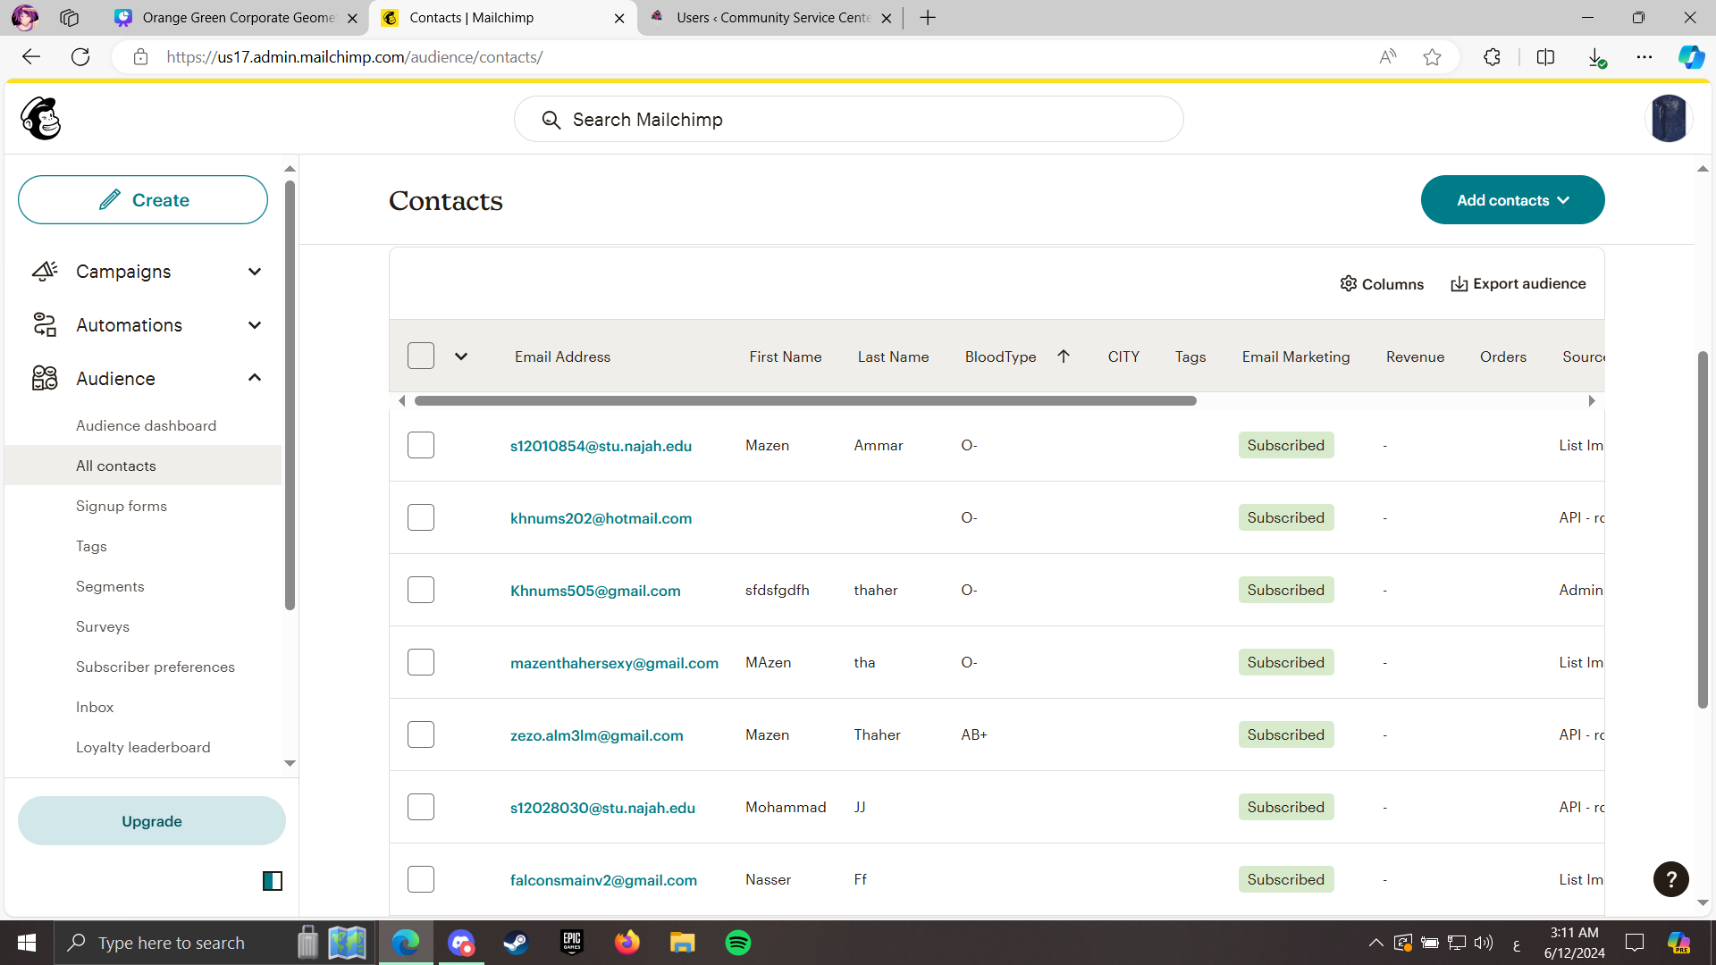

Slide 40
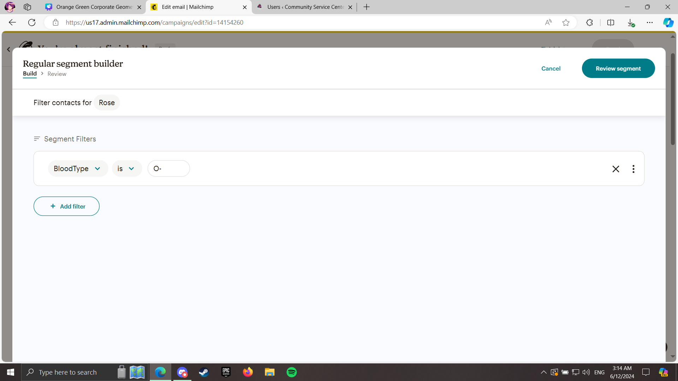
CRM

Slide 41
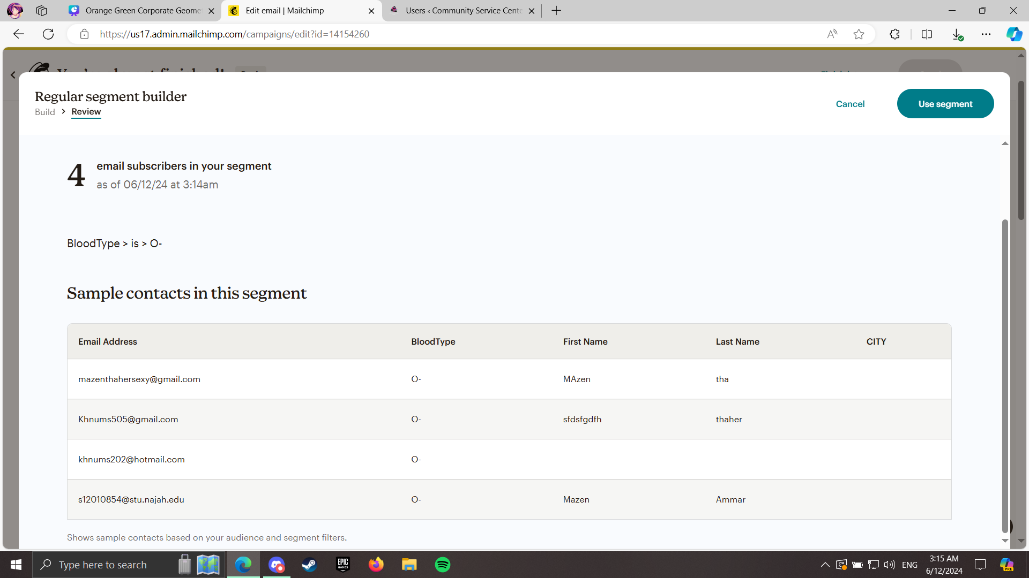

Slide 42
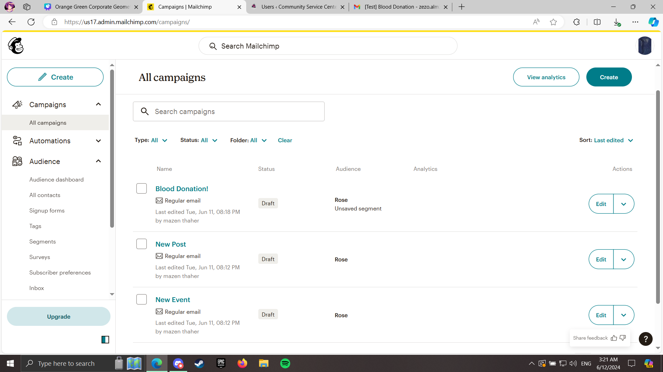

Slide 43
CSC
REPORTS

Slide 44
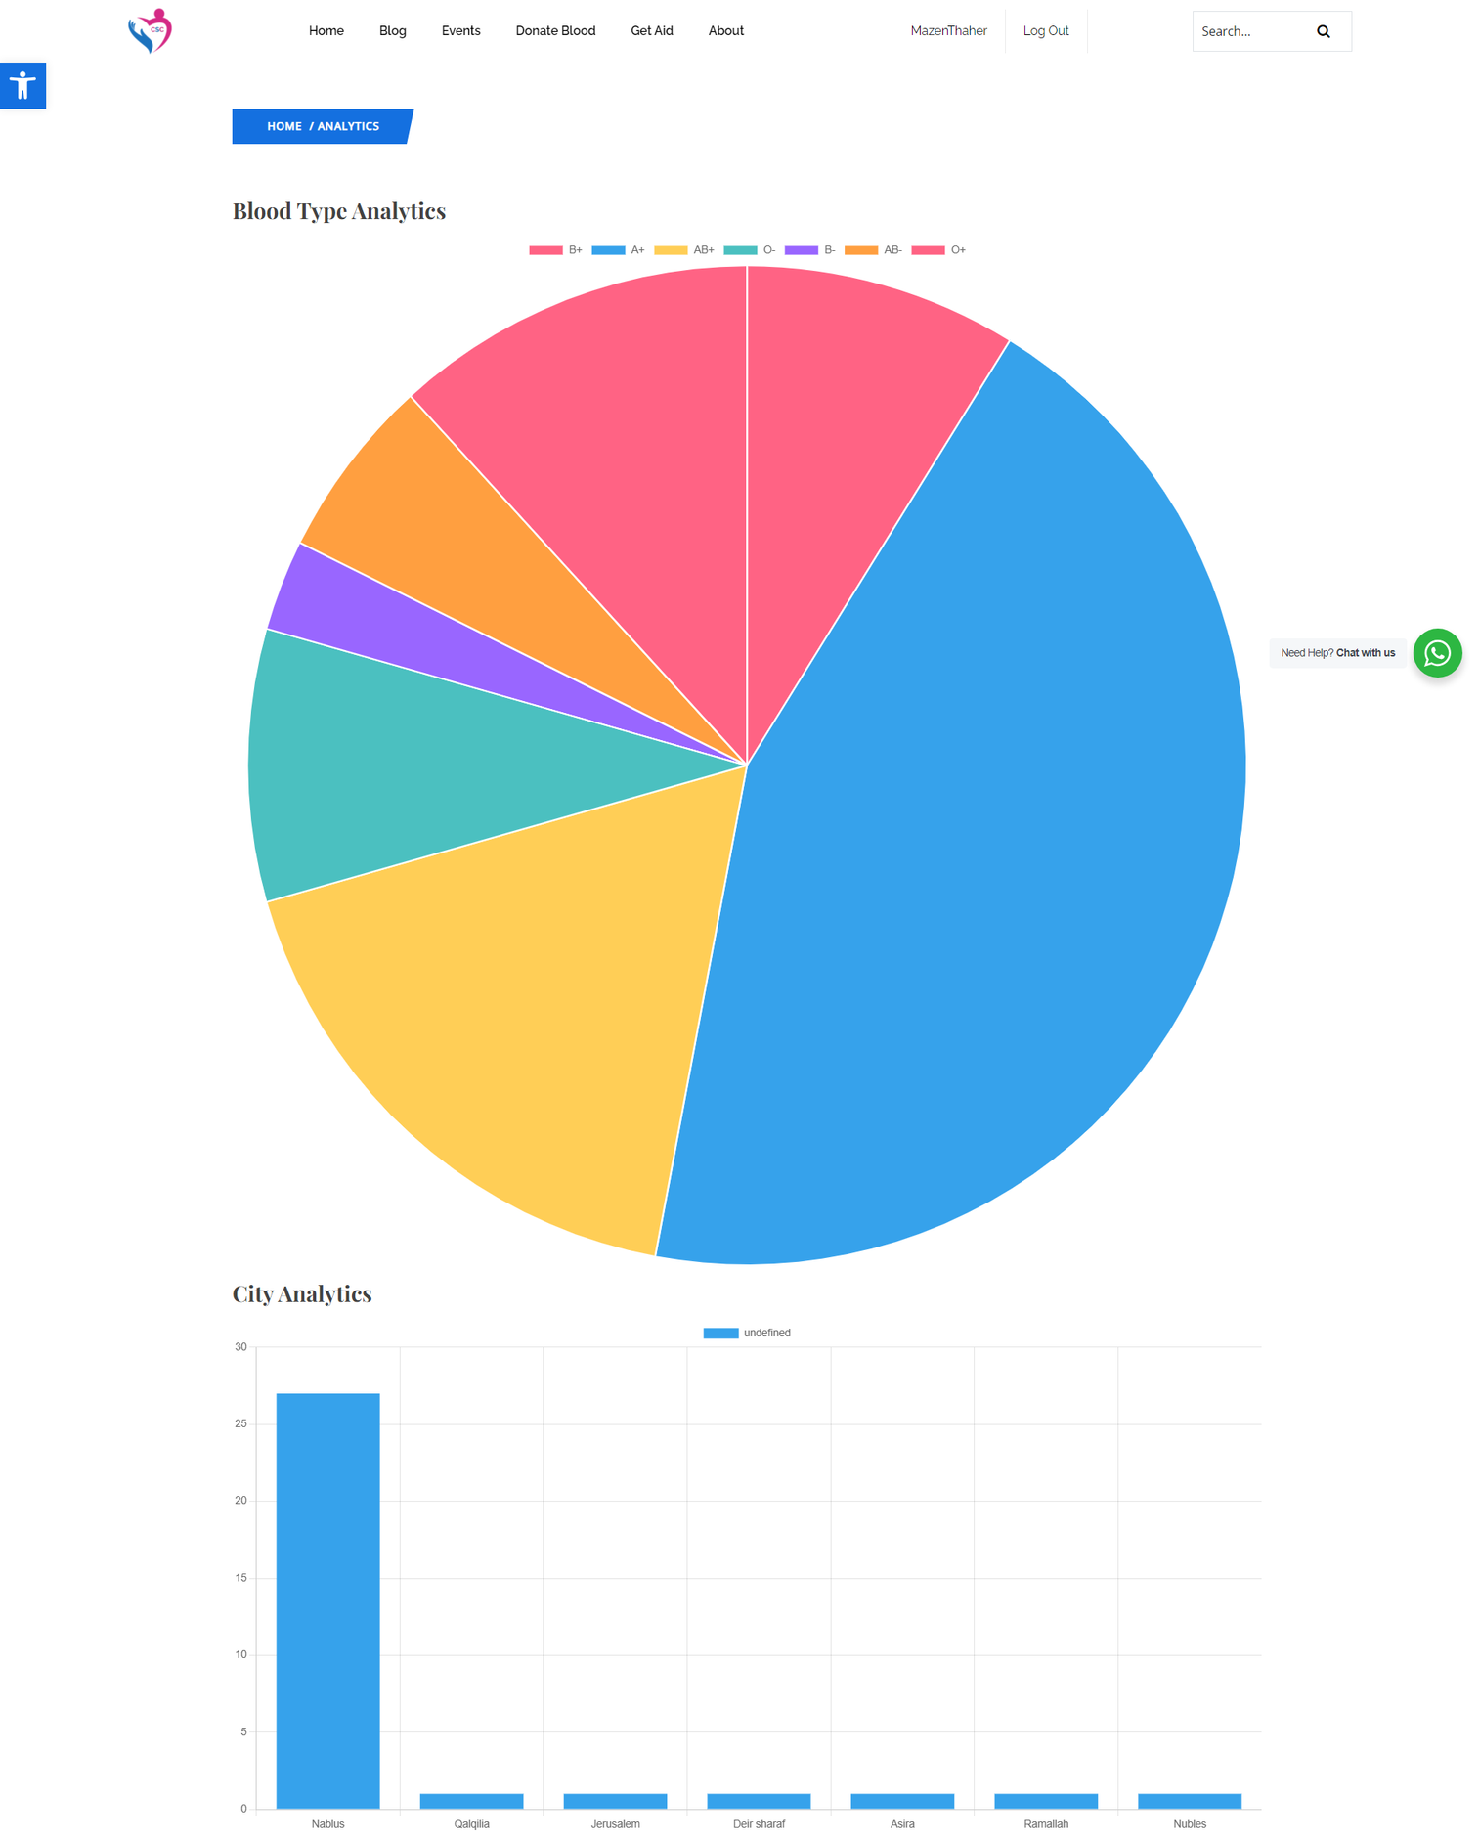

Slide 45
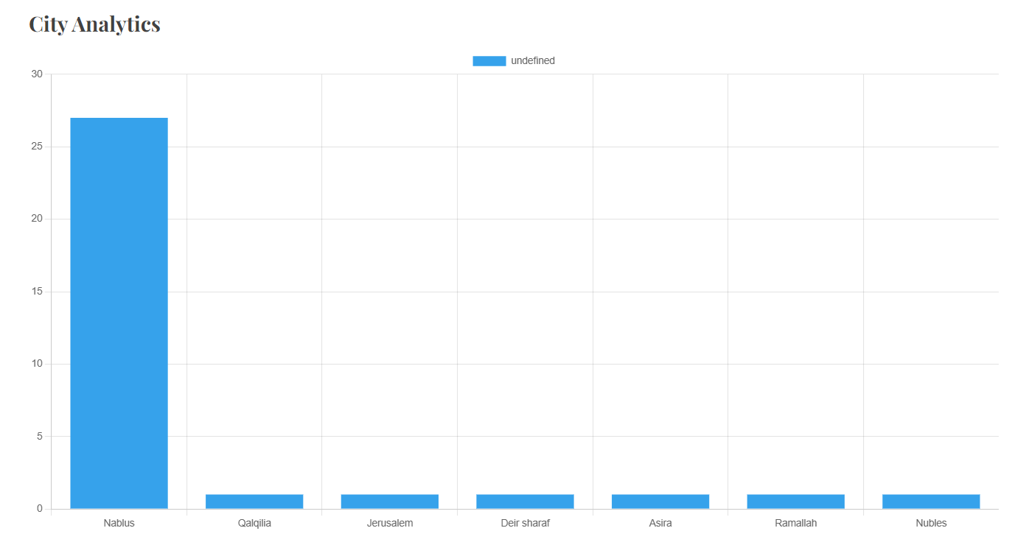

Slide 46
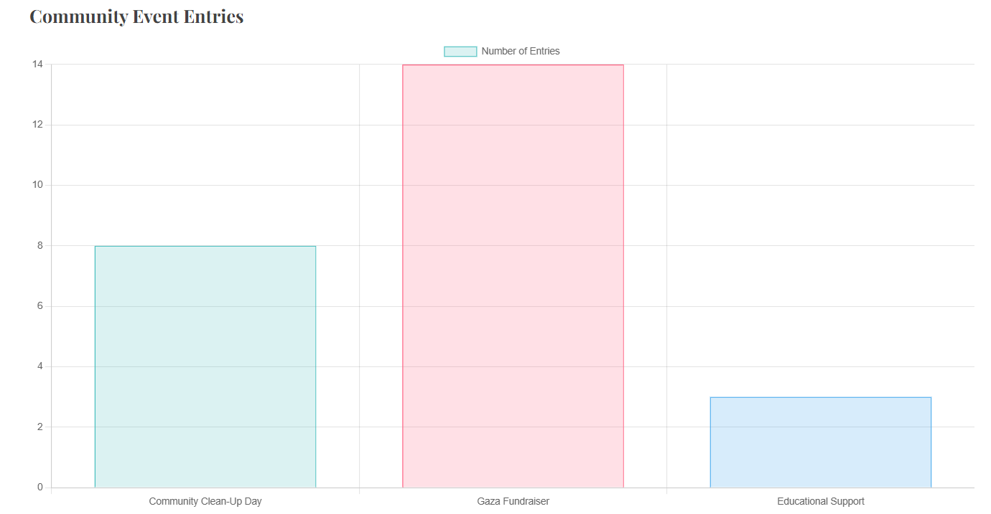

Slide 47
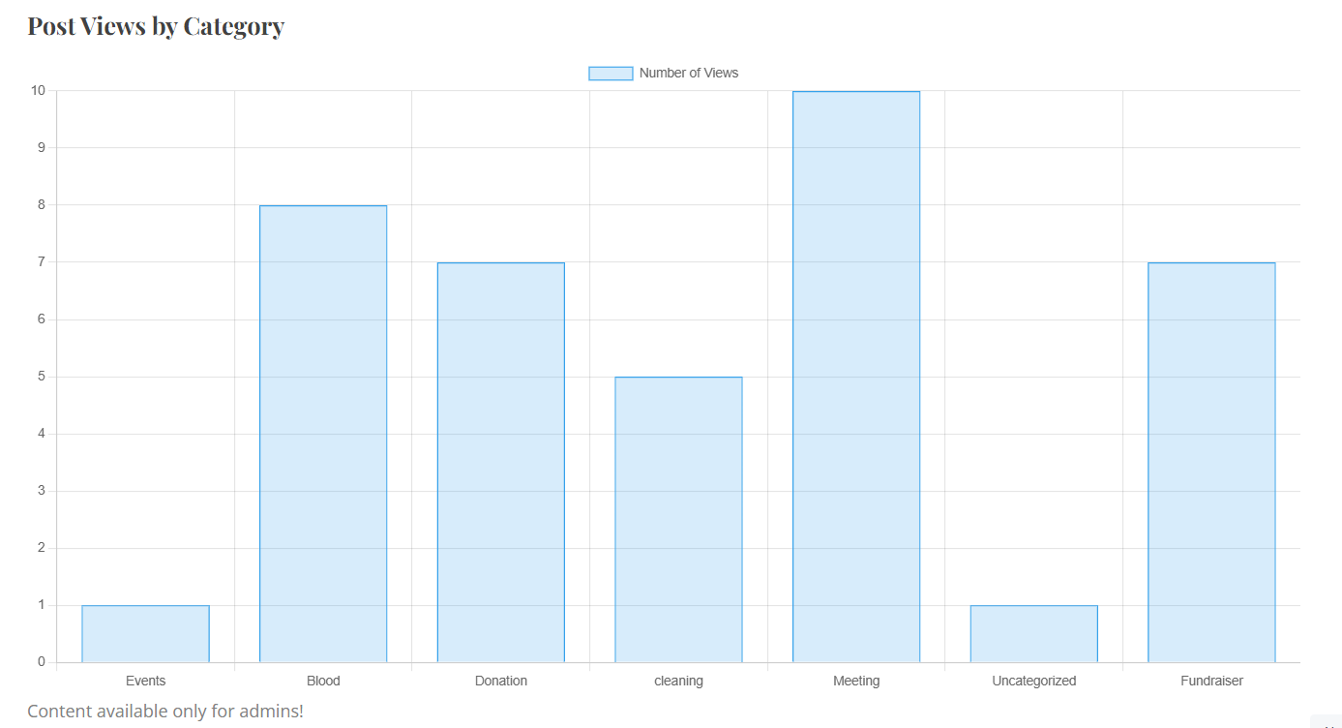

Slide 48
CSC
PLUG-INS

Slide 49









CSC
ivory
Contact form 7
Events calendar/
registrations addon
Magic SEO
Weglot translate
Elementskit
Elementor
Wp statistics
Ultimate member

Slide 50

CSC
Usability testing
By:

Slide 51
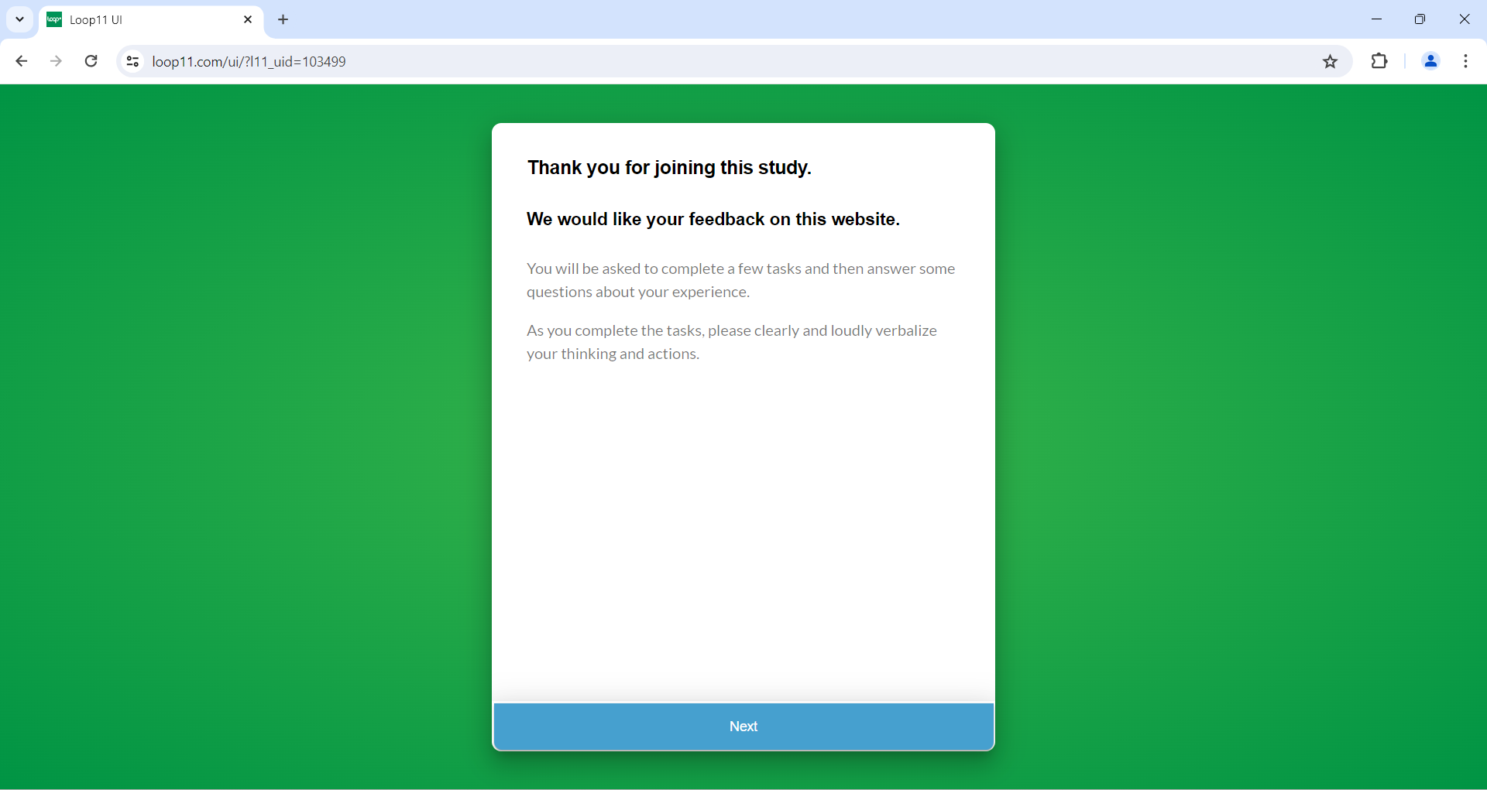

Slide 52
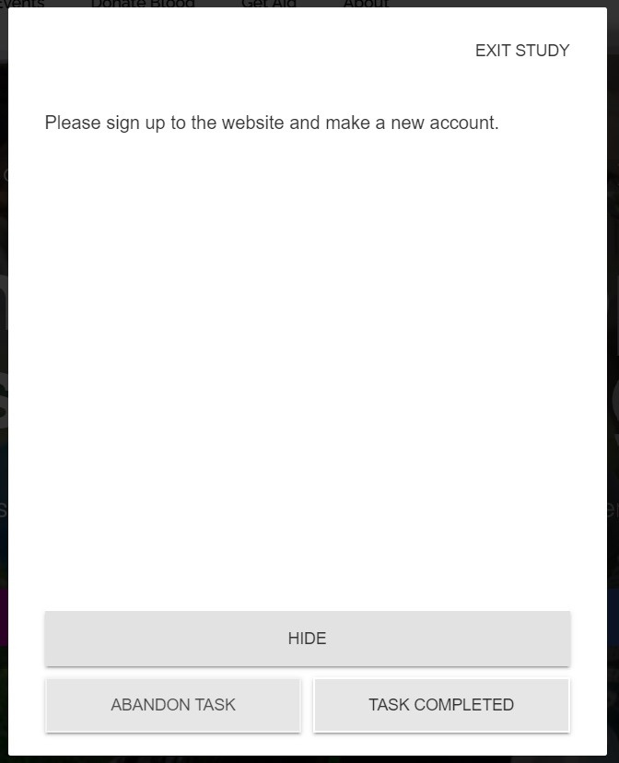
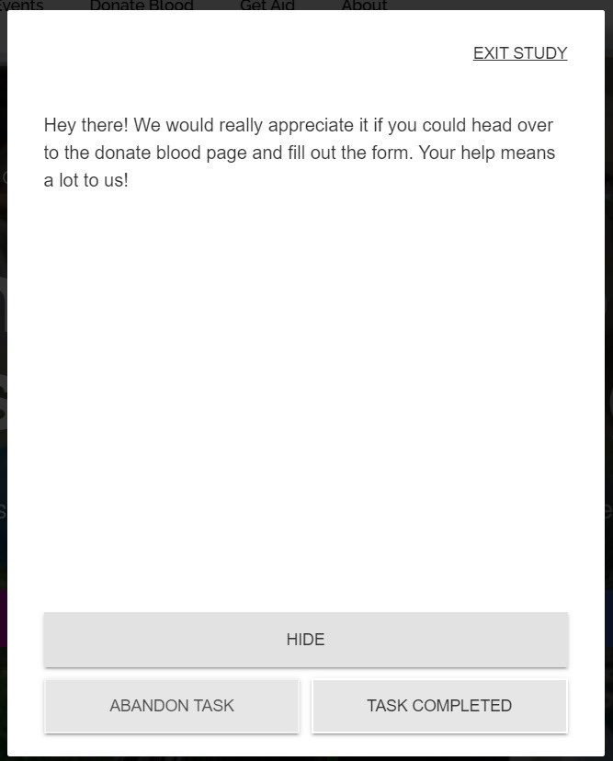
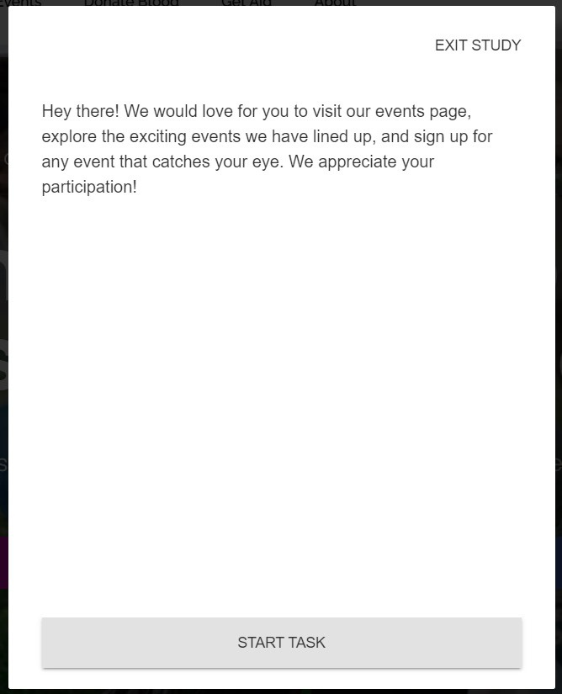
CSC
Tasks:
Sing-up
Donate blood
Events

Slide 53
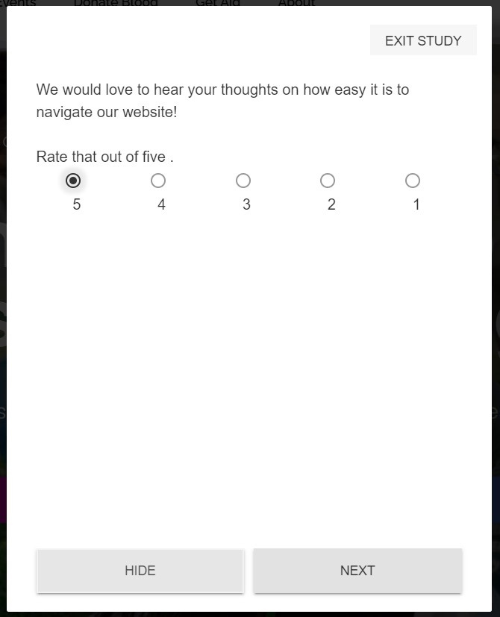
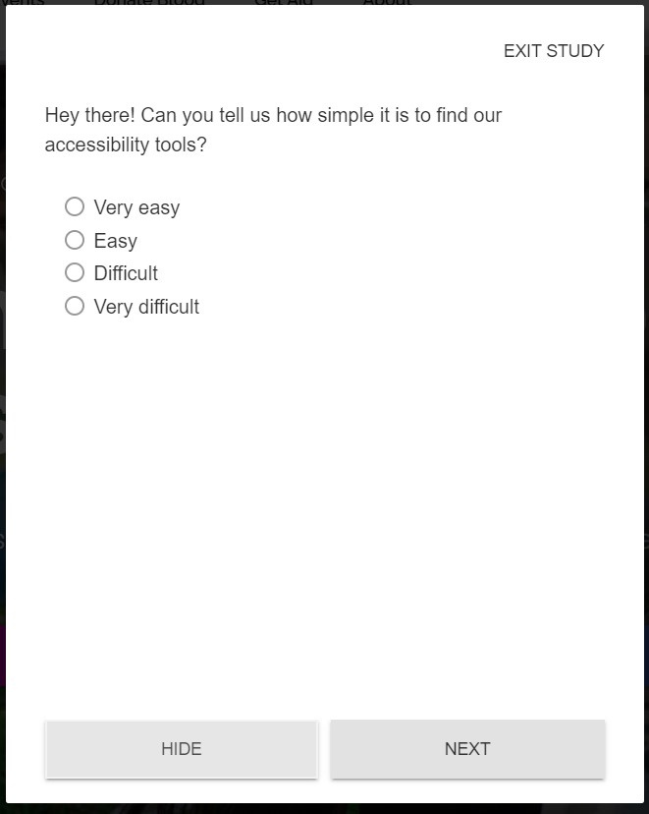
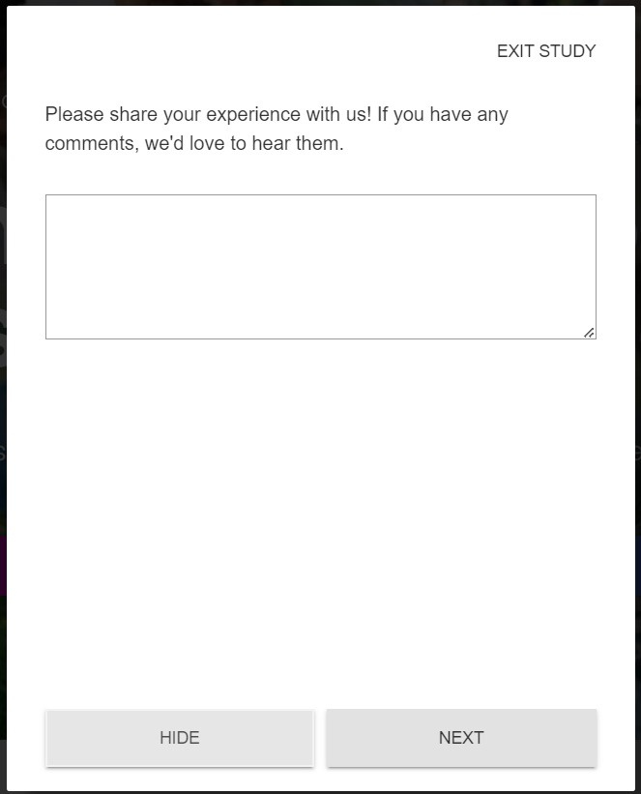
CSC
Questions:
Navigations
Accessibility tools
Feedback

Slide 54
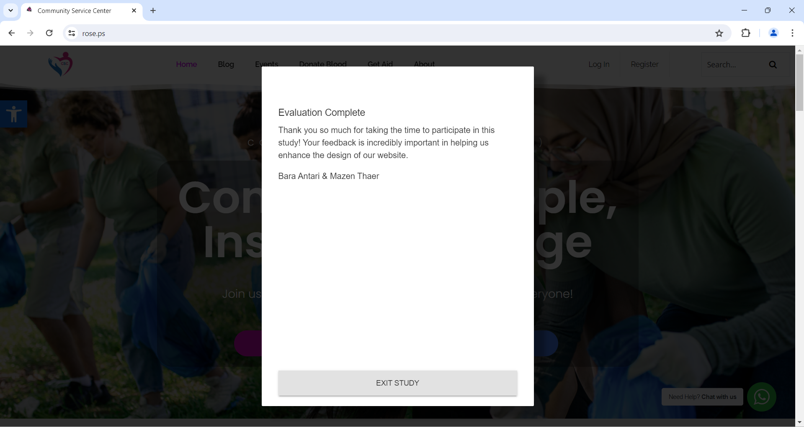

Slide 55
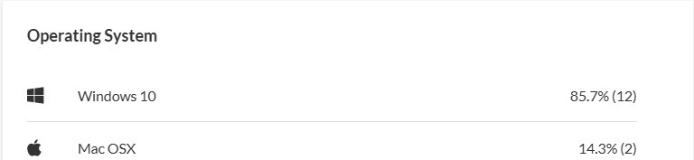
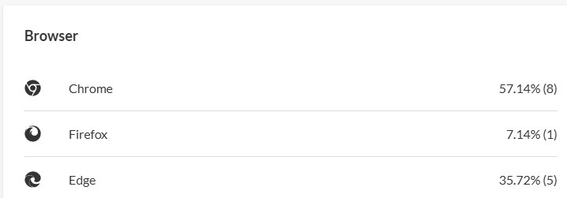
CSC
Loop 11 reports:

Slide 56
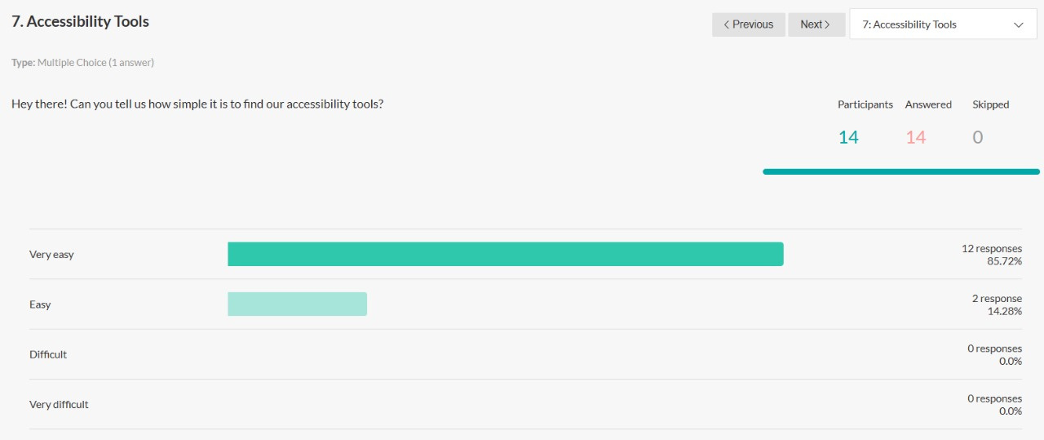
CSC
Loop 11 reports:

Slide 57

CSC
#طوفان_الأقصى

Slide 58

CSC
THANK YOU !
For Your Attention
By:
Mazen & Bara
Supervisor
DR. Maher Y Arafat

