Slide 1
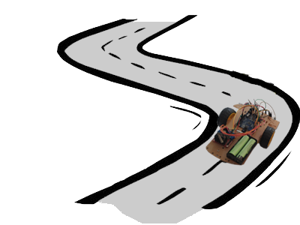
Optimizory Self-Learning Robot
Prepared by:
Ashraf Ghanem
Futna Shoqo
Supervisor: Dr. Raed Qadi

Slide 2
Outline
Introduction
Methods and Techniques
Constraints
Demo
Future Work

Slide 3
Introduction
1

Slide 4
Problem
Manufacturing regions.
Enhancing existing robots.

Slide 5
Objectives
Save people’s efforts in moving things to some destination.
Save time due to many optimized robots.

Slide 6
Methods and Techniques
2

Slide 7
Dynamic Maze
How Dynamic?
Left-Hand Rule

Slide 8
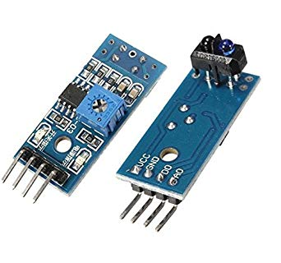
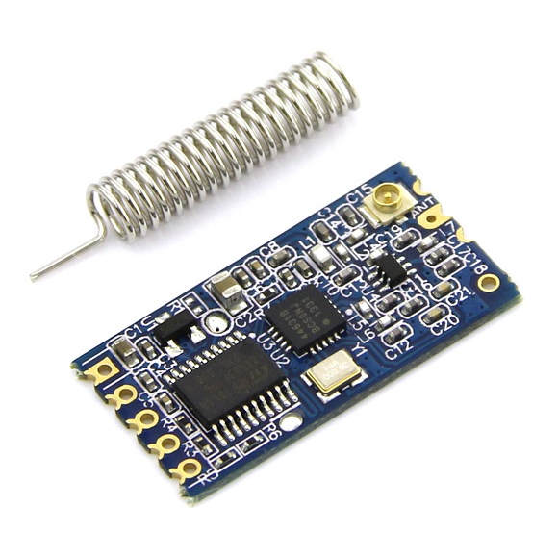
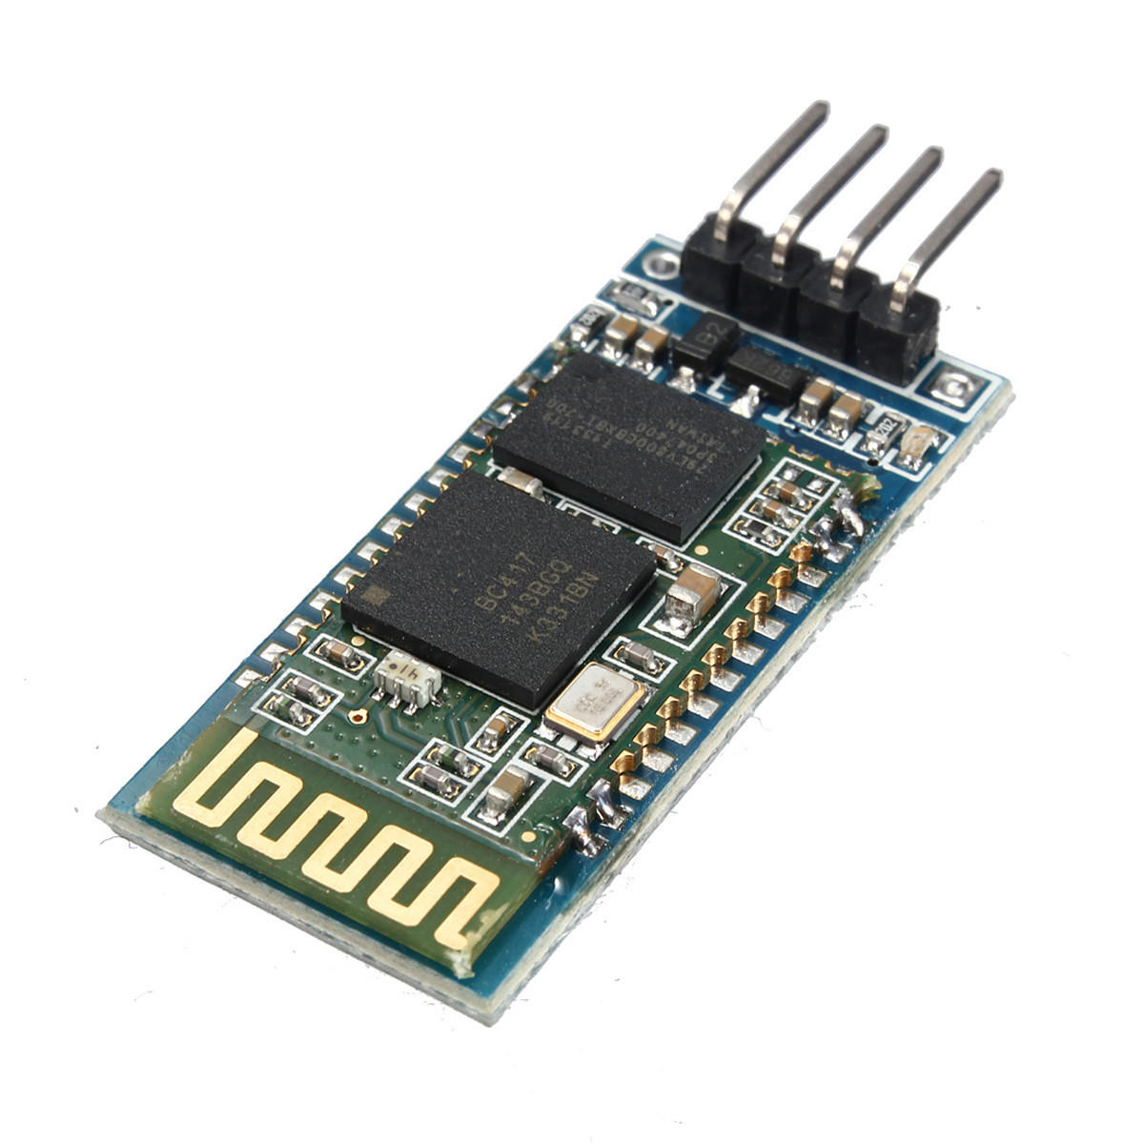
Robot
Hardware Components
Car Body
9V two DC Motors
One H-Bridge (L293D) Driver
Two 4V rechargeable batteries.
One Arduino Uno Microcontroller.
Four IR (TCRT5000) Sensors.
RF (HC-12) module
Holder for IR Sensors
Bluetooth (HC-06) Module [for debugging issues]

Slide 9
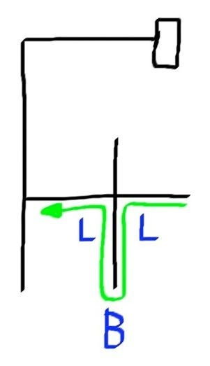
Optimization
LBR = B
LBS = R
RBL = B
SBL = R
SBS = B
LBL = S

Slide 10
Optimization

Slide 11
Constraints
3

Slide 12
Hardware Issue [Sensor Accuracy and Wheels Efficiency]
Couldn’t have identical DC motors. [Speed of motors affects the robot performance]
Needed environment unavailable.

Slide 13
Demo
4

Slide 14
Demo 1
From simple start twice video

Slide 15
Demo 2
From complex start twice video

Slide 16
Demo 3
Sending path to other robot video

Slide 17
Future Work
5

Slide 18
Change the body of the robot such that we use a more rigid and suitable one for holding things while moving.
Using better sensors that have bigger accuracy that those are used.
Make the robot capable to get back to starting point with optimized path when it reaches the destination.

Slide 19
THANKS!
Any questions?

