Slide 1








CAREERLY+
SUPERVISOR:
DR. MANAR QAMHIAH
STUDENTS :
SAMYA HAMED
EMAN ABD AL-AZIZ

Slide 2
TABLE OF CONTENTS
1
2
3
INTRODUCTION
TECHNOLOGIES USED
FEATURES
4
6
CONSTRAINTS AND FUTURE WORK
CONCLUSION

Slide 3
PROBLEMS
1
2
Manual job applications via email or drive links(in palestine).
Scattered job platforms
3
Employers waste time reviewing CVs manually.
4
Difficulty finding the best-matching candidates.
5
Lack of AI-based matching and screening tools.

Slide 4

MAIN FEATURES
1
2
Smart ranking for the right opportunities.
All-in-one platform
3
4
Direct online apply
AI CV screening
5
AI chatbot for real-time support

Slide 5




TECHNOLOGIES USED

Slide 6





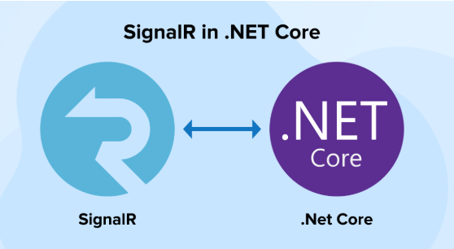



FRONTEND
BACKEND
REACT WITH VITE + TYPESCRIPT
AND REACT NATIVE
PYTHON
(AI FEATURES)
EXPO GO
ASP .NET
DATABASE
NOTIFICATIONS
TOOLS & OTHERS
GITHUB
(VERSION CONTROL)
POSTMAN
(API TESTING)
AZURE
(EMAIL SERVICE AND BLOB SERVER TO STORE FILES)

Slide 7

FEATURES

Slide 8
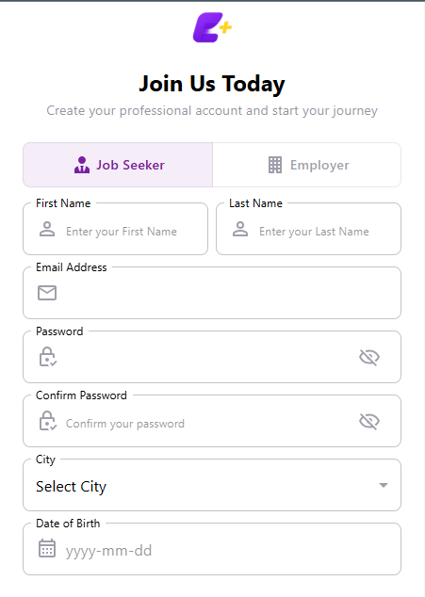
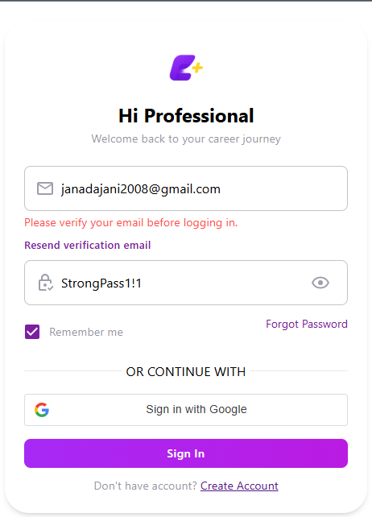
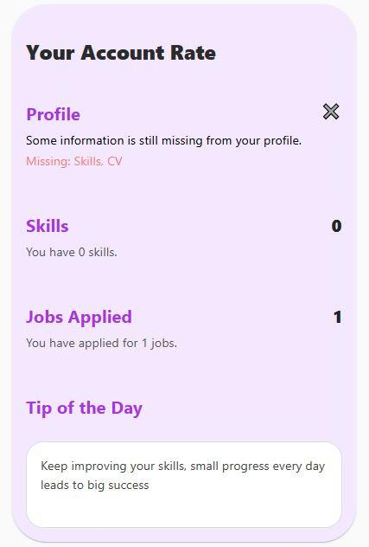
JOBSEEKER
SIGNUP,LOGIN & PROFILE

Slide 9
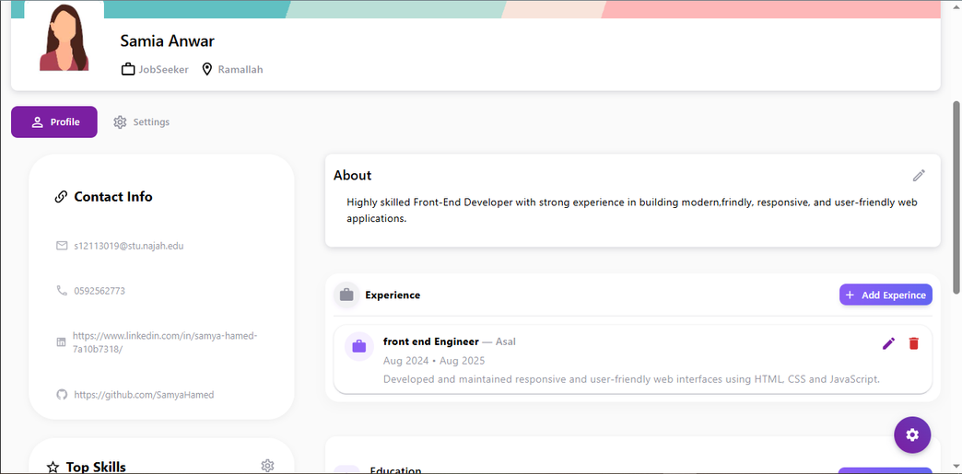
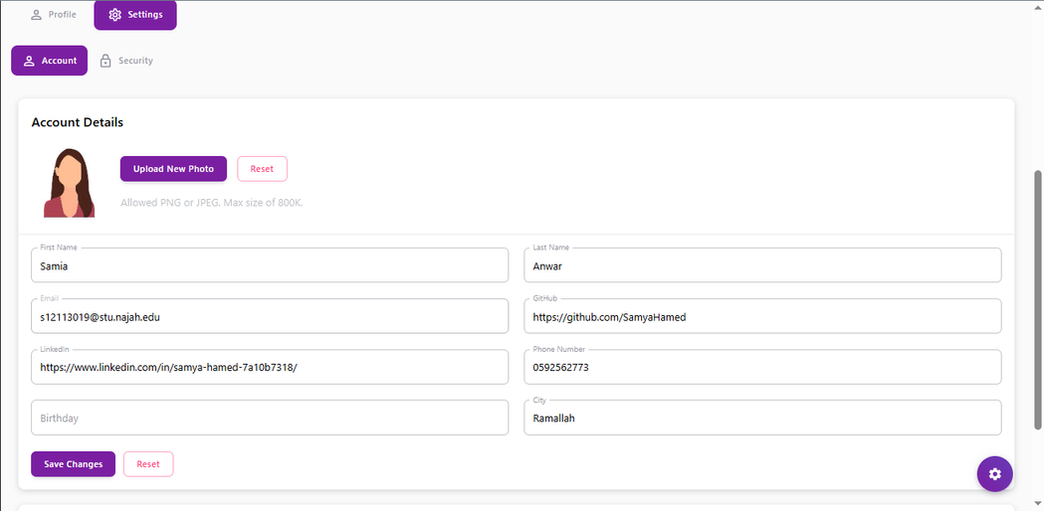
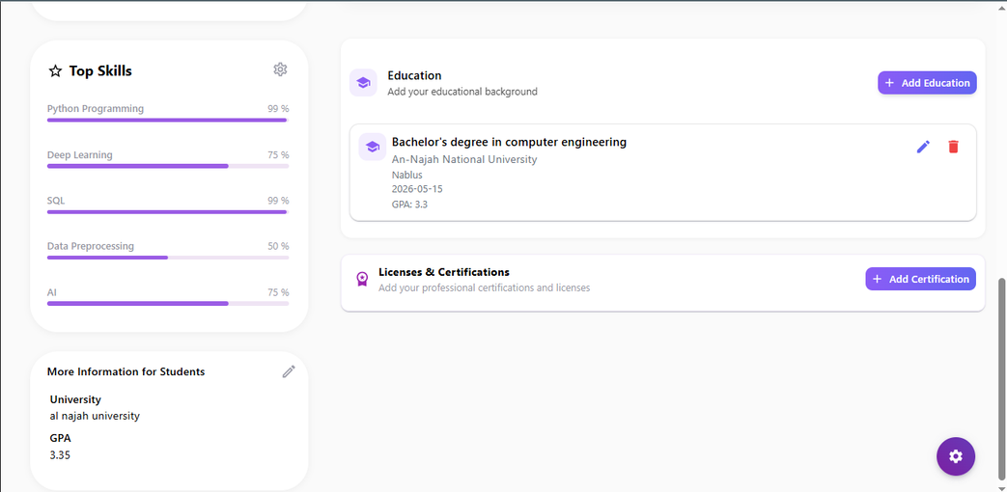
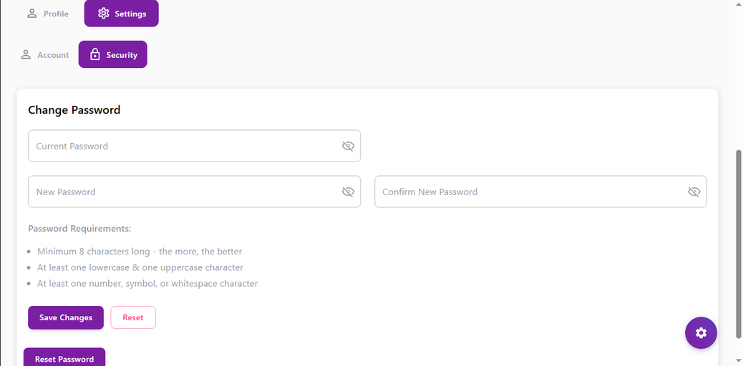
JOBSEEKER
PROFILE

Slide 10
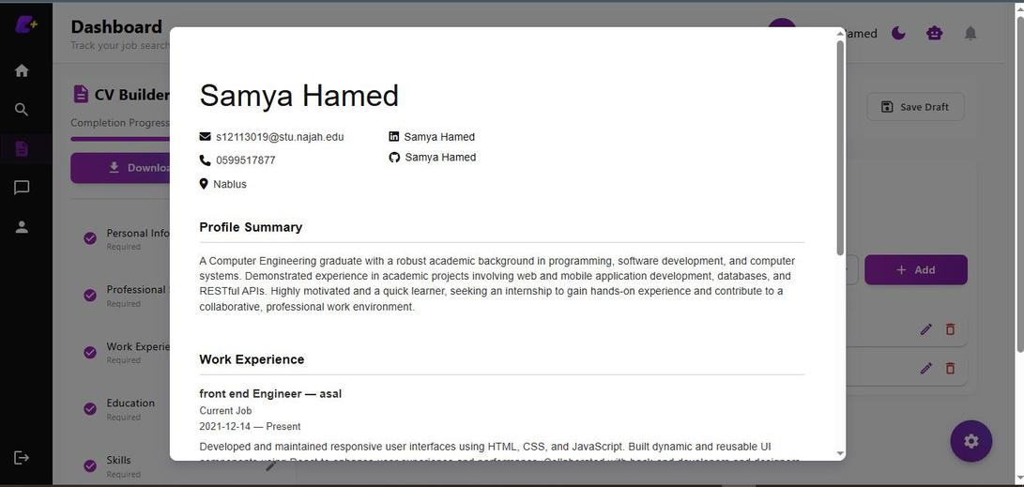
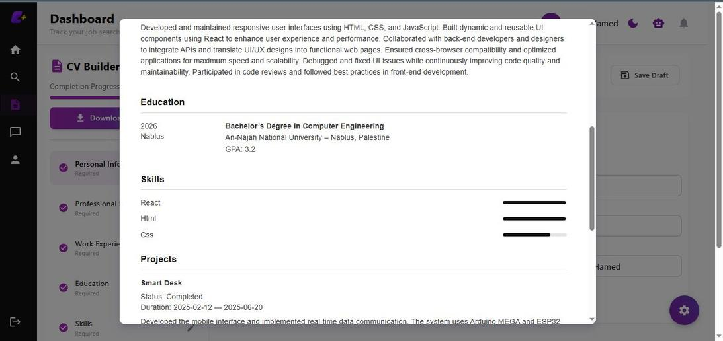
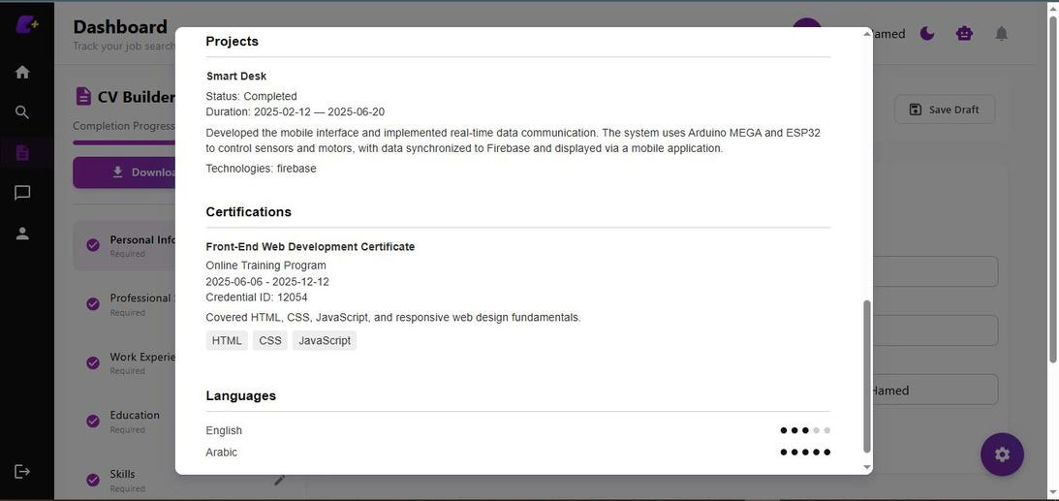
JOBSEEKER
CV VIEW

Slide 11
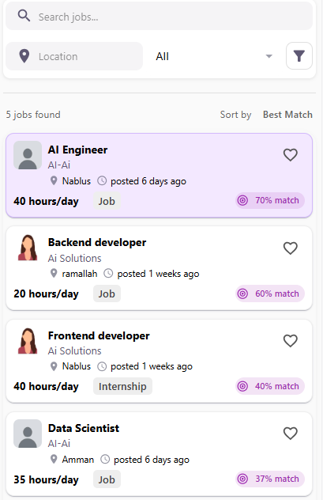
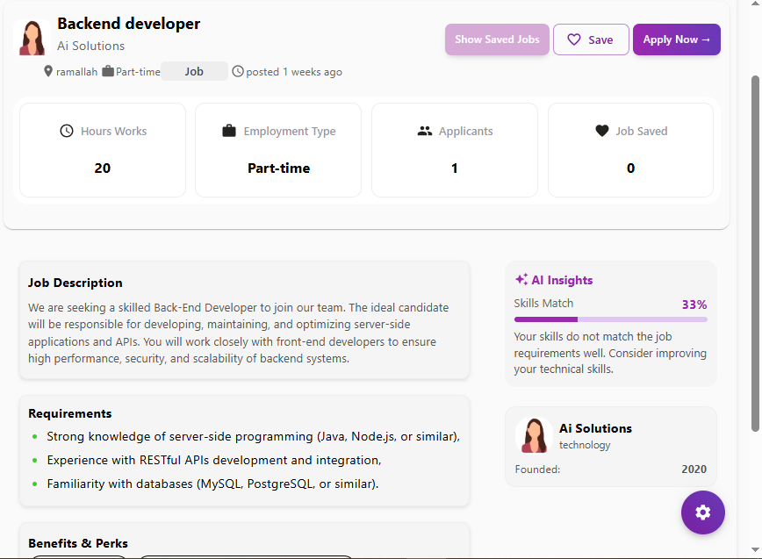

JOBSEEKER
SEARCH&APPLAY JOBS/INTERNSHIPS

Slide 12
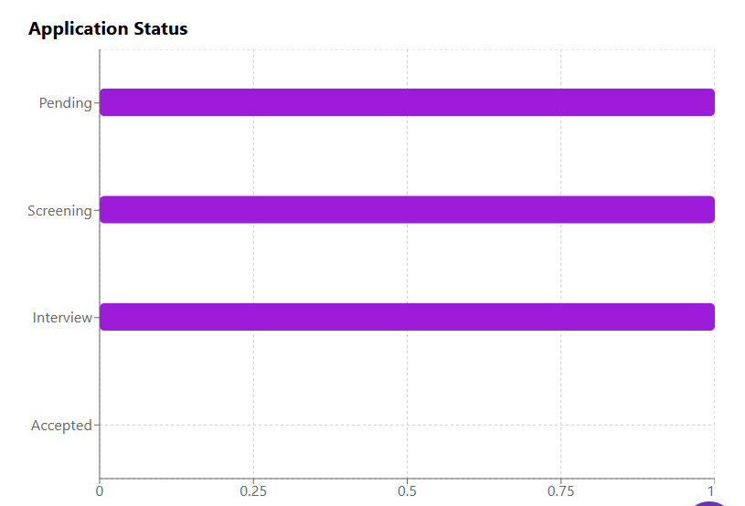
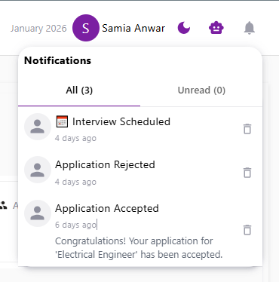
JOBSEEKER

Slide 13
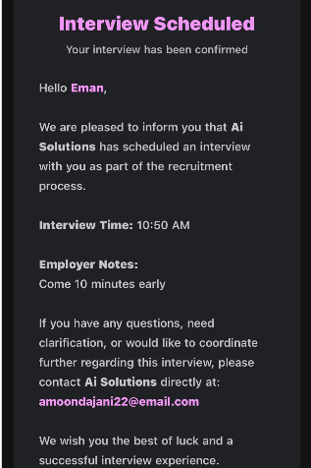
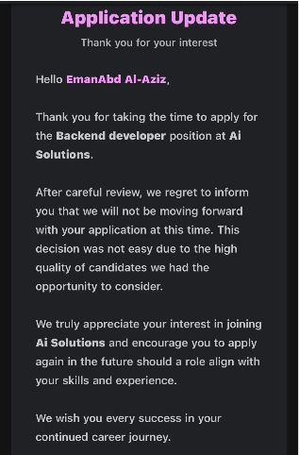
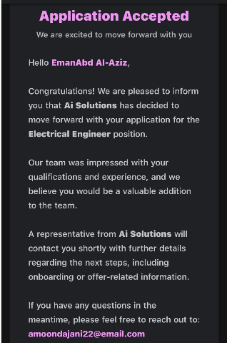
JOBSEEKER
INTERVIEW
REJECT
ACCEPT

Slide 14
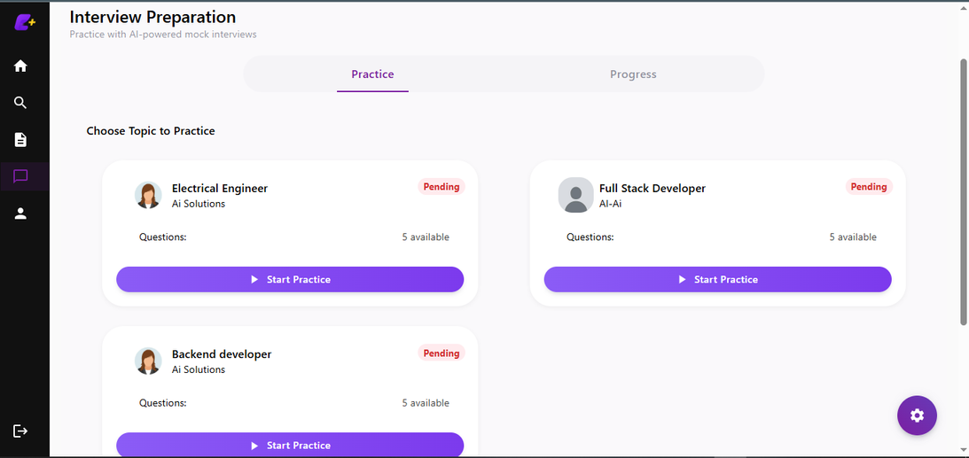
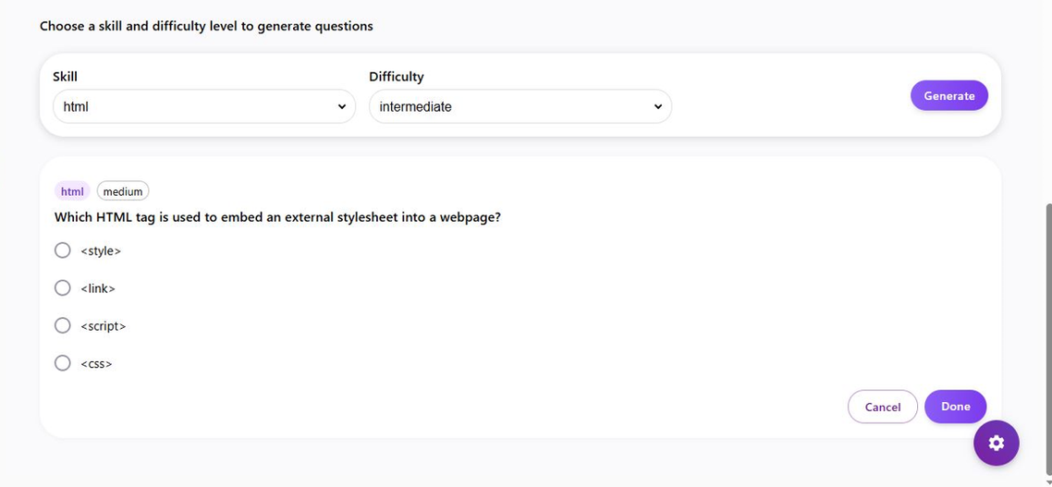
JOBSEEKER
QUESTIONS

Slide 15
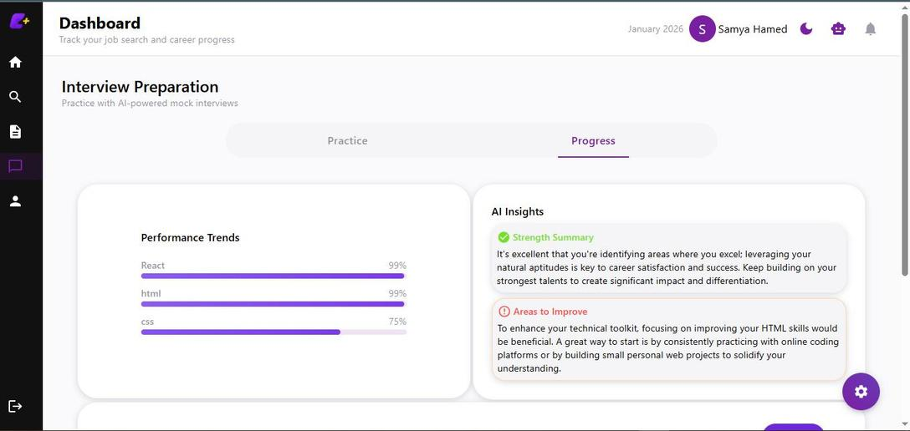
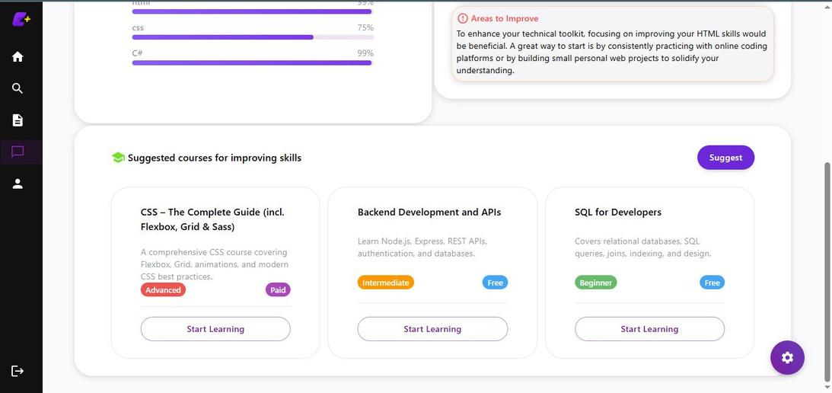
JOBSEEKER
AI RECOMMENDATION

Slide 16
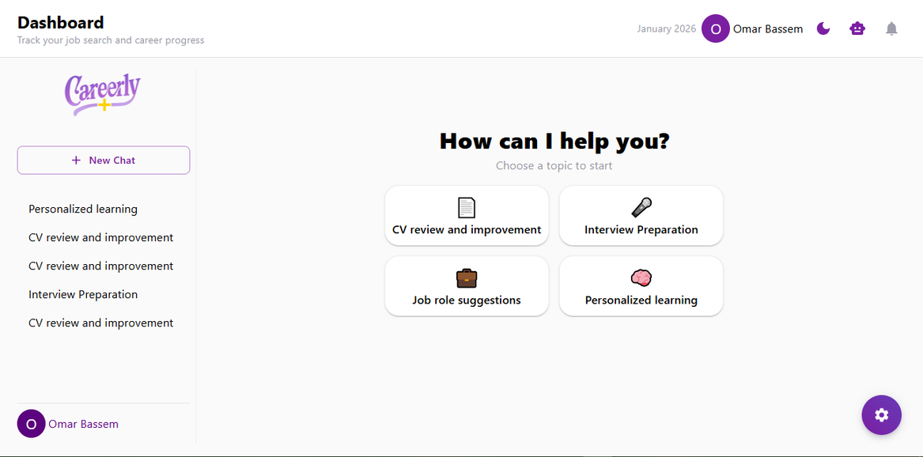
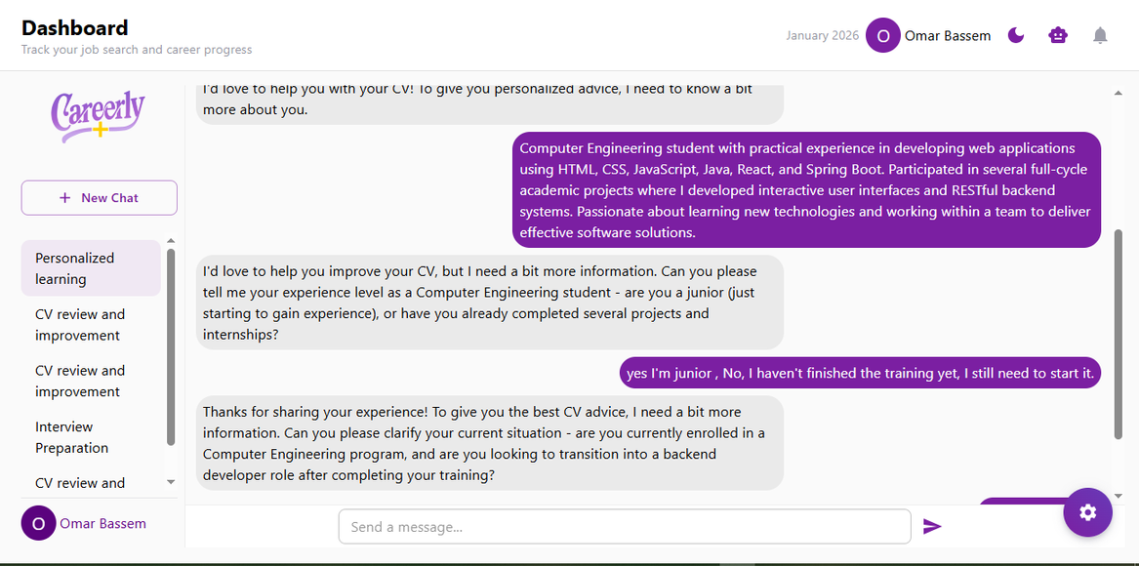
JOBSEEKER
CHATBOT

Slide 17
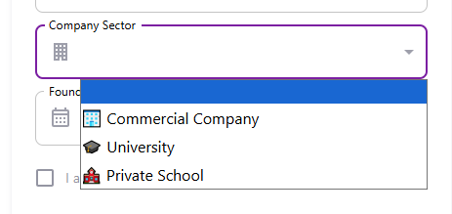
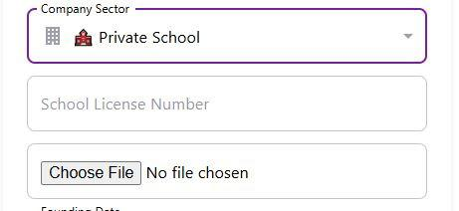
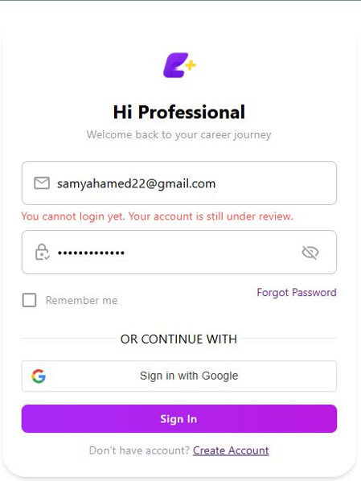
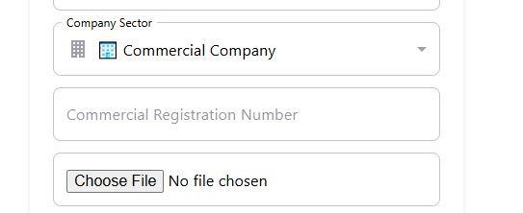
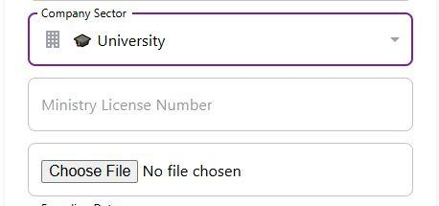
EMPLOYER
SIGNUP & SIGNIN

Slide 18
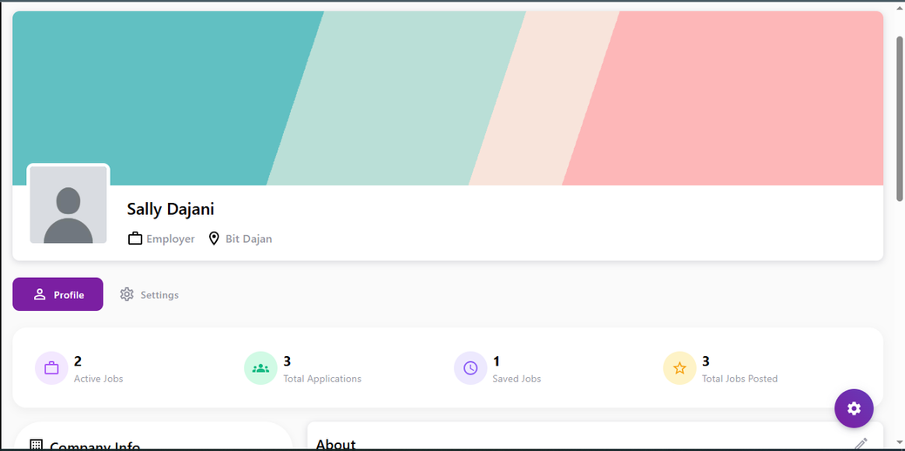
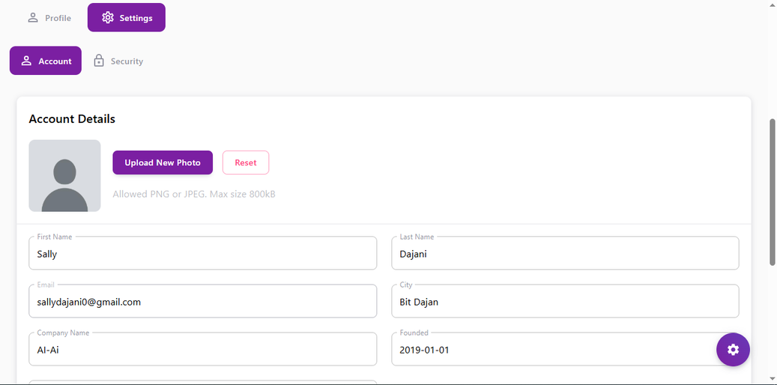
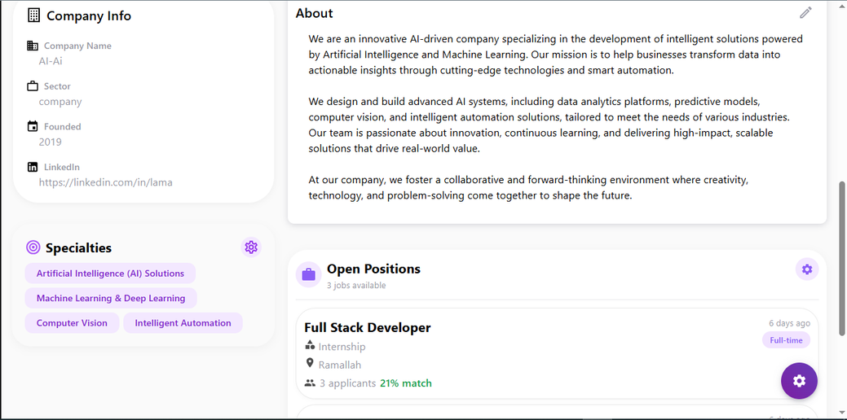
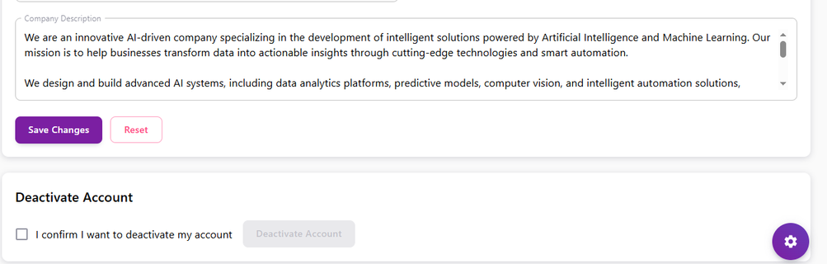
EMPLOYER
PROFILE

Slide 19
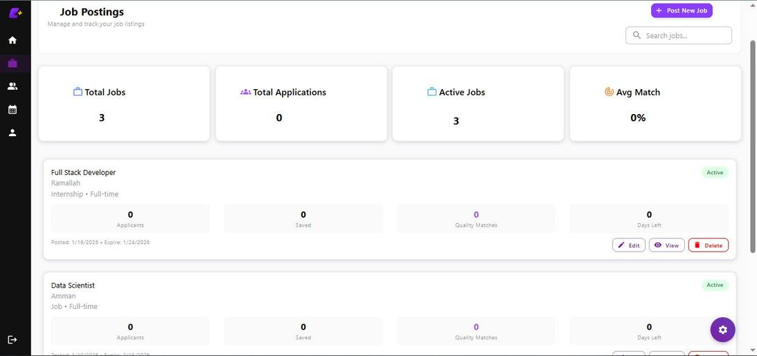
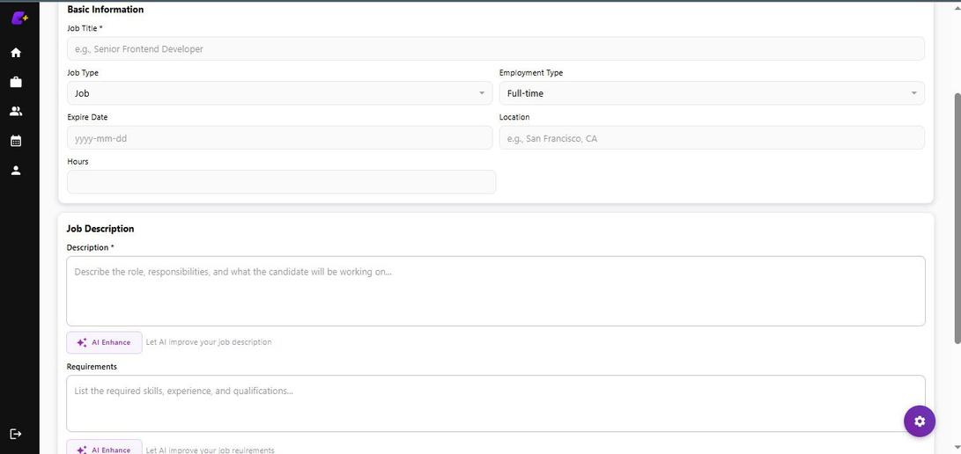
EMPLOYER
MANAGE & CREATE POSTS

Slide 20
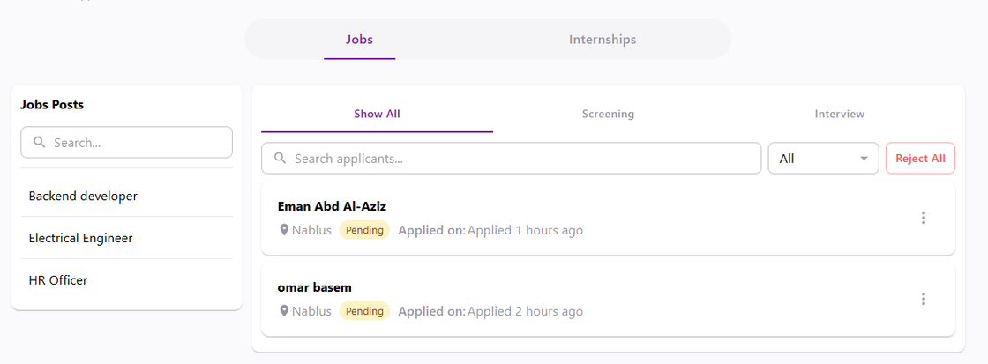
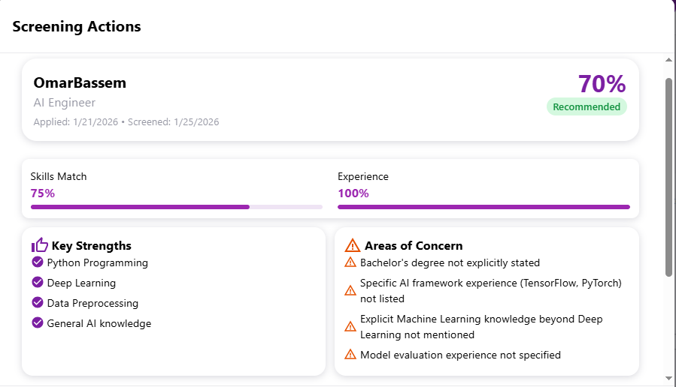
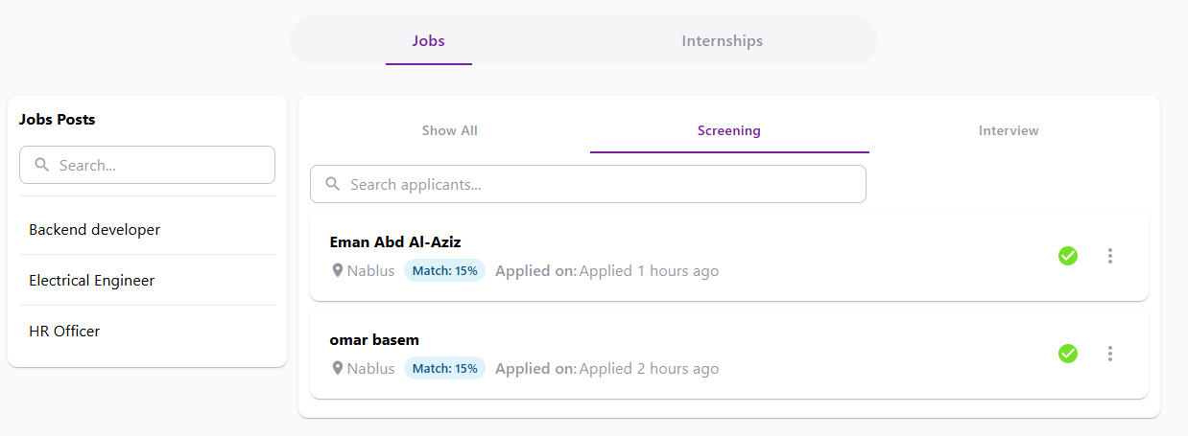
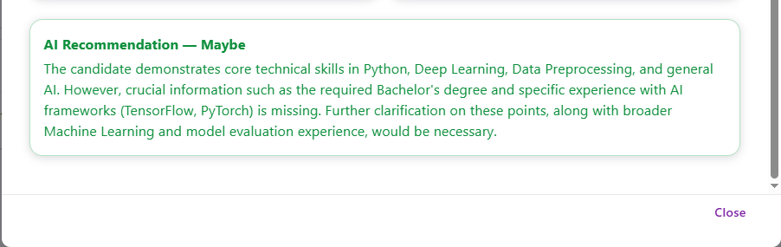
EMPLOYER
CANDIDATE

Slide 21
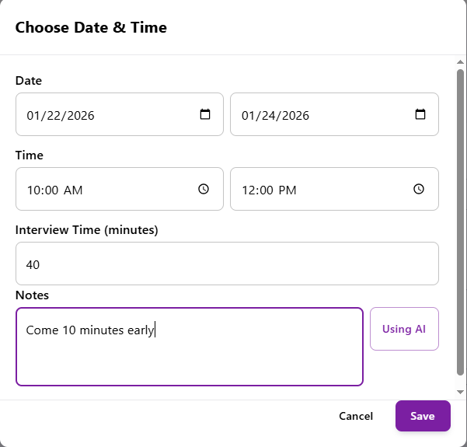
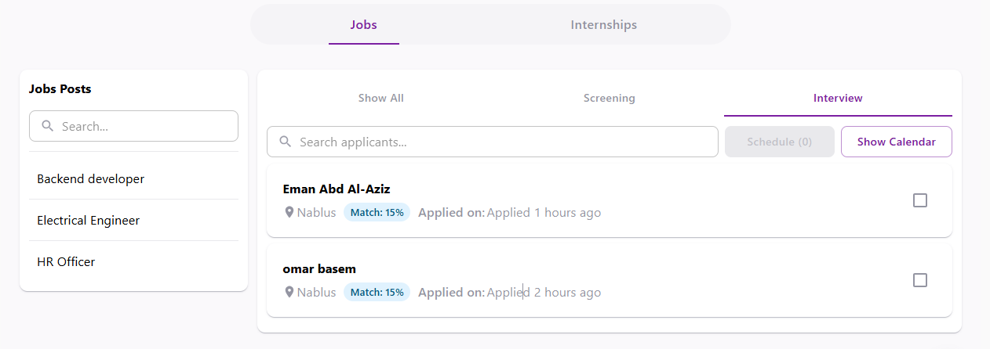
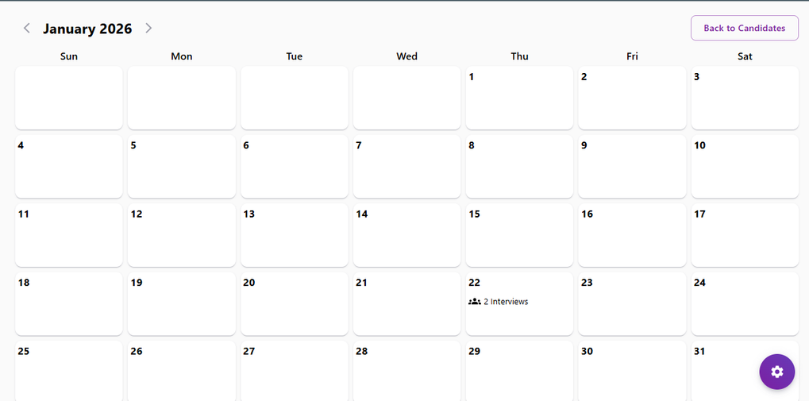
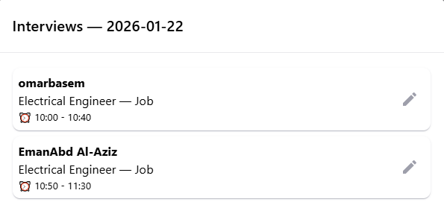
EMPLOYER
INTERVIEW & CALENDAR

Slide 22
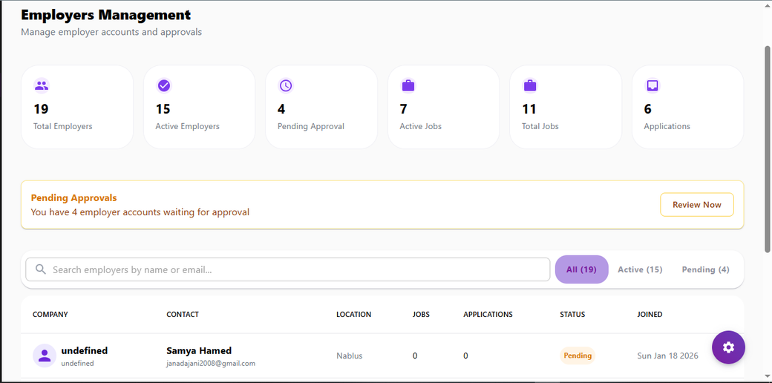
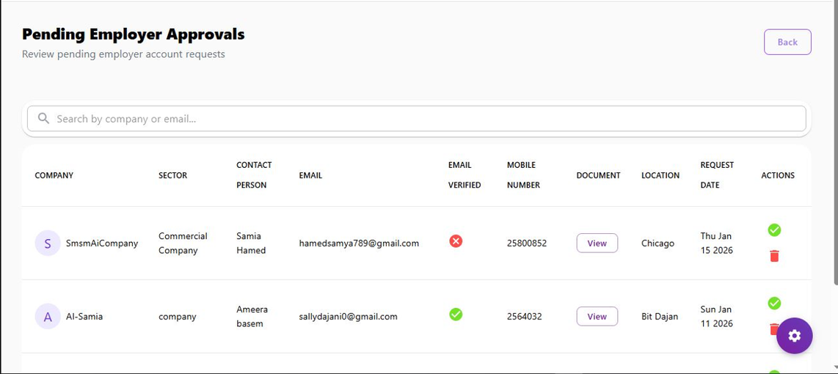
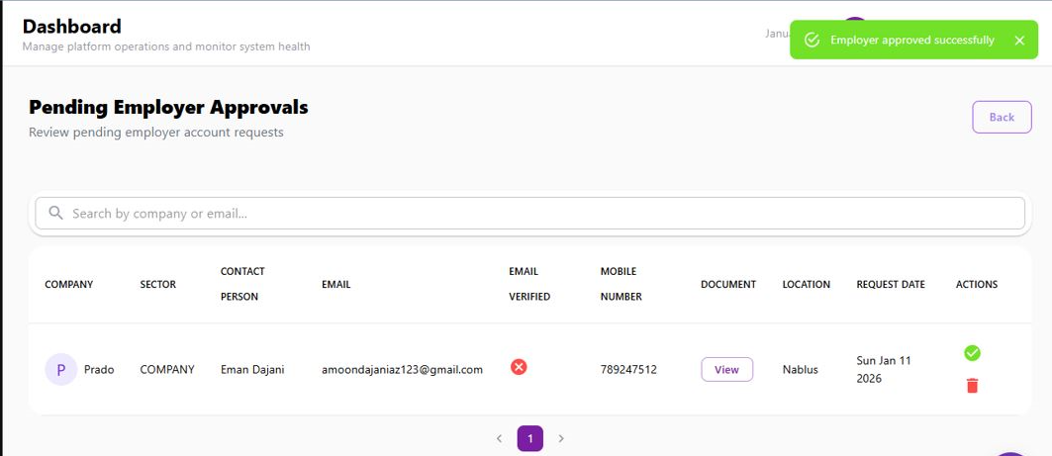
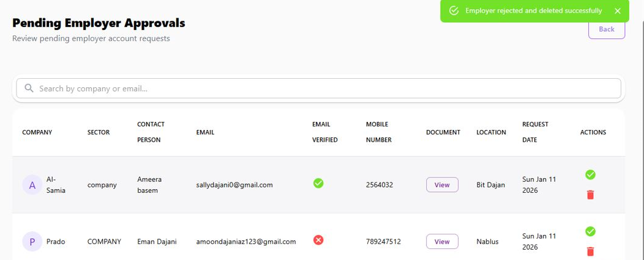
ADMIN
EMPLOYER MANAGEMENT

Slide 23
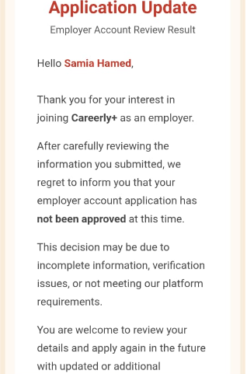
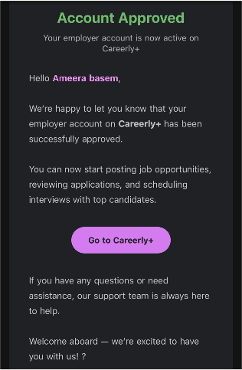
ADMIN
REJECT
ACCEPT

Slide 24
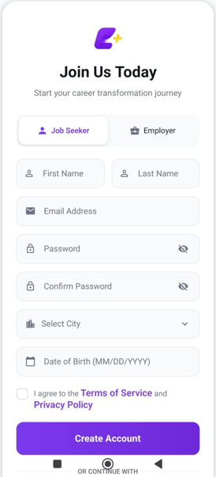





MOBILE APP
JOBSEEKER SIGNUP
EMPLOYER SIGNUP
EMPLOYER SIGNUP
LOGIN
JOBSEEKER DASHBOARD
EMPLOYER DASHBOARD

Slide 25
CONSTRAINTS
01
02
Limited experience with mobile app development
AI Free Trial Limitations
03
Deployment Limitations: Cloud, and email services were restricted to specific regions only.

Slide 26
FUTURE WORK
01
Courses and Skill Development Section
02
In-Platform Chat System
03
Integrated Interview System (online interviews)

Slide 27



THANK YOU

Slide 28


SCAN QR CODE TO SEE MORE DETAILS
SAMYA HAMED'S GITHUB ACCOUNT
EMAN ABD AL-AZIZ'S GITHUB ACCOUNT

