Slide 2
TABLE OF CONTENT
Introduction.
Objectives.
Traditional and alternative plastering, external cladding, and formwork systems.
Case study description and methodology.
Results.

Slide 3
introduction
The traditional material is a critical problem in our country in term of both duration and cost.
For the cost of construction material forms approximately 60% of the total project cost and affect the project duration.

Slide 4
objectives
Studying the possible alternatives for formwork plastering, and external cladding systems.
Redesign the affected parts of the building to check applicability of proposed material.
Making cost analysis for traditional and alternative material.
Traditional and alternative cost comparison.

Slide 5
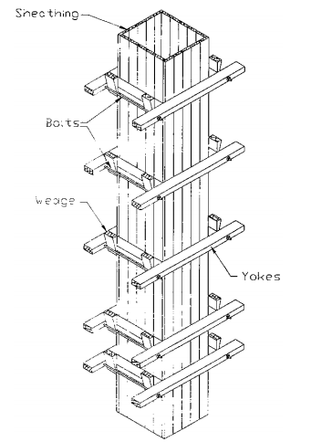
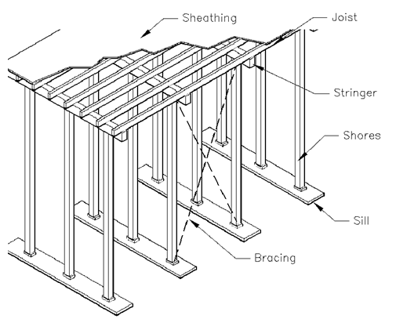
TRADITIONAL AND ALTERNATIVE FORMWORK SYSTEMS
Traditional system

Slide 6
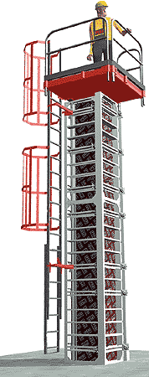
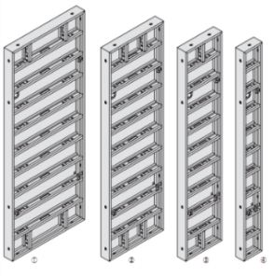
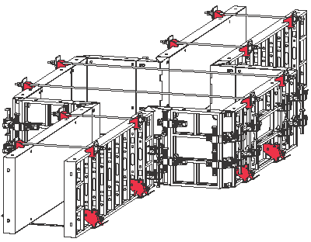
TRADITIONAL AND ALTERNATIVE FORMWORK SYSTEMS
Alternative systems
PERI formwork

Slide 7
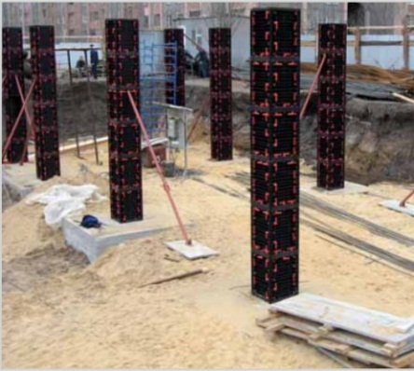
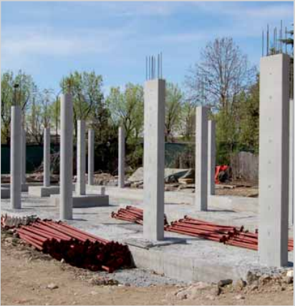
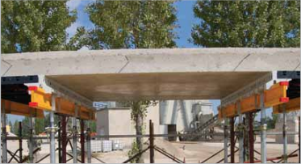
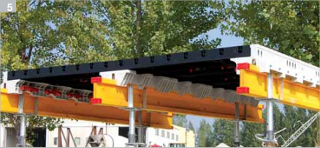
TRADITIONAL AND ALTERNATIVE FORMWORK SYSTEMS
2. GEO-Plastic formwork

Slide 8
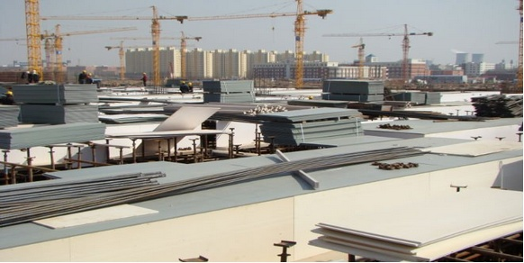
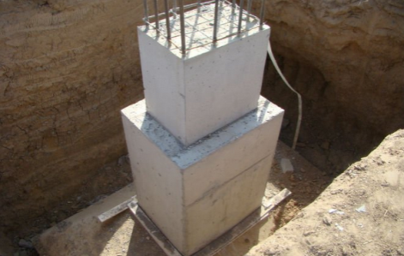
TRADITIONAL AND ALTERNATIVE FORMWORK SYSTEMS
3. PVC formwork

Slide 9
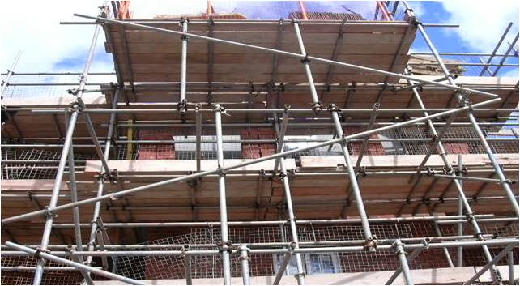
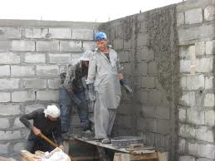
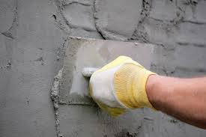
TRADITIONAL AND ALTERNATIVE PLASTERING SYSTEMS
Traditional plastering system

Slide 10
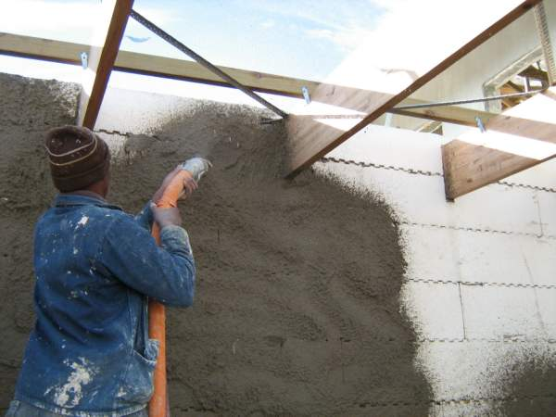
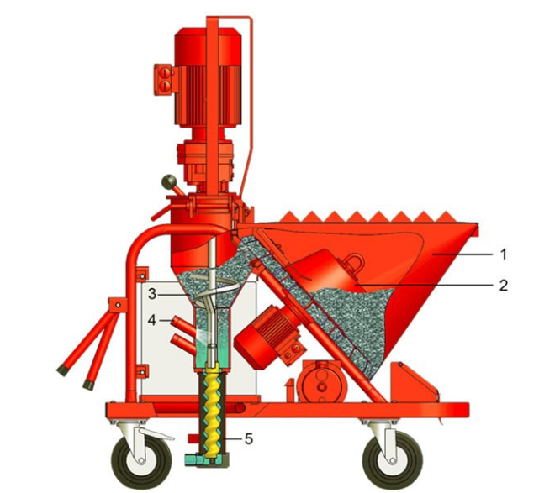
TRADITIONAL AND ALTERNATIVE PLASTERING SYSTEMS
Alternative plastering system
Ready Mix plaster

Slide 11
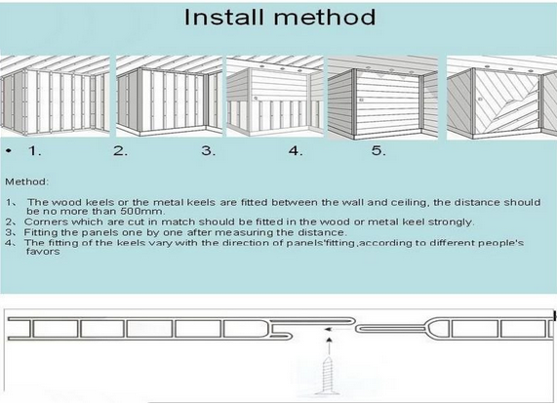
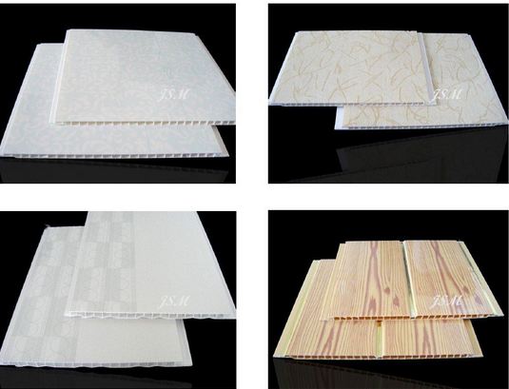
TRADITIONAL AND ALTERNATIVE FORMWORK SYSTEMS
PVC Panel

Slide 12
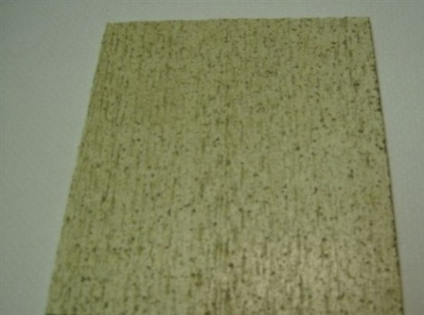
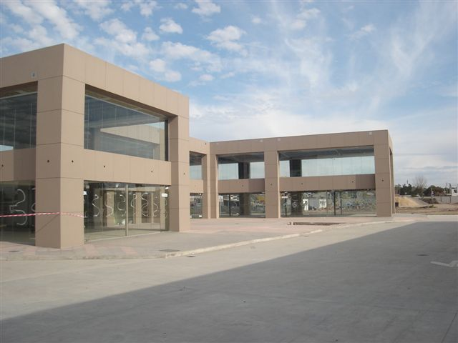
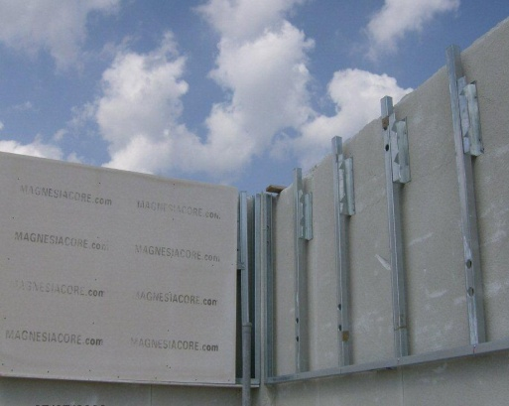
TRADITIONAL AND ALTERNATIVE FORMWORK SYSTEMS
Magnesia Core Panels

Slide 13
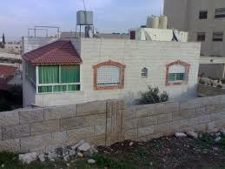
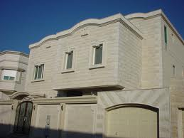
TRADITIONAL AND ALTERNATIVE Cladding SYSTEMS
Traditional exterior cladding system

Slide 14
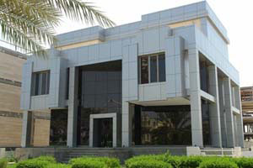
TRADITIONAL AND ALTERNATIVE FORMWORK SYSTEMS
Alternative exterior cladding systems
Aluminum Composite Panel

Slide 15
TRADITIONAL AND ALTERNATIVE FORMWORK SYSTEMS

Slide 17
Case study description and methodology.
The selected case study is residential building located in Jenin city, it consists from two floors, the first floor is not finished (just stand on column) but the second floor is ready for use.
The area of the floors is summarized as follow:
Basement floor | 153 m²
Ground floor | 158.5 m²
stairs | 13.5 m²
Total | 325 m²

Slide 18
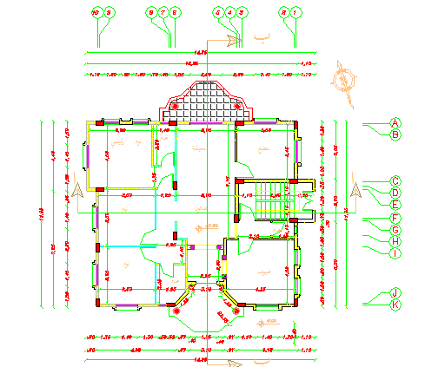

Slide 19
Methodology
The work in this research take two phases, the first phase is quantity serving for the both material traditional and alternative
the second phase is redesign for the affected part of selected building when aluminum composite panels for external cladding were used.

Slide 20
Results
Form work results
Formwork Systems | Unit Cost (NIS/m²)
traditinal | 13.19
pere | 47.07
geo | 8.99
Pvc | 9.55

Slide 21
Plastering system | Unit Cost (NIS/m²)
traditinal | 13.19
pere | 47.07
geo | 8.99
Pvc | 9.55

Slide 22
claddingsystem | Unit Cost (NIS/m²)
traditinal | 13.19
pere | 47.07
geo | 8.99
Pvc | 9.55

Slide 23
نكتب ارخص اسامي الانواع الي اخترناها مع سعرها ونسبة السعر الي قل لكل نوع مقارنه مع الترديشنال | Unit C ost (NIS/m²) 4 اعمده
traditinal | 13.19
pere | 47.07
geo | 8.99
Pvc | 9.55

Slide 24
منعملها جدول
According to the final results shown in tables (22-26):
The decrease proportion in the steel weight of the external beam
= *100% = 10.5%
The decrease proportion in the steel weight of the column
= *100% = 0.53%
The steel weight of the footing not change when use alternative system.
While we redesign the building on SAP, we noticed that there's beams not satisfied(B2)group, so we increase the dimension of it from (.25m*.5m) to (.3m*.5m)

Slide 25
منعملها جدول
The total cost of the project when traditional material used= construction cost+ mechanical and electrical cost
Construction cost= 279058.3 from table 27
Mechanical and electrical cost= 19700 from table 29
The total cost=298758.3 NIS
Alternative construction cost= 212109.3 from table 28
Mechanical and electrical cost= 19700 from table 29
The total cost=231809.3 NIS
The decrease proportion in the total cost of the project in alternative system
= *100% = 22.4%

Slide 26
So we recommended using these alternatives by various construction professionals

