Slide 1

Feasibility study for Olive mill pomace piston
Supervisor :
Dr. Walaa Johari

Slide 2


Members of the group
RAZAN DAHER
OBYDA ABBADI
ALI DWEKAT
BARA MELHEM
ROA SAWAFTA

Slide 3
Outline
01
02
03
Introduction
Methodology
Production line
04
05
06
Layout
Conclusion and Recommendation
Feasibility study

Slide 4
olive mill pomace
it is a crushed mixture consisting of the pits of the olive fruits that have been pressed, combined with olive oil, where it is kneaded inside the blenders of the olive press and pressed with a press. It can only be obtained in the fall or early winter after the olive harvest and pressing season. Fortunately, modern mills are working on sorting olives from peat separately; What makes it easy to use,

Slide 5
olive production represents 57% of the cultivated land in the Palestinian territories,
498 thousand dunums
total area planted with olive trees amounting to
11 million trees
Number of olives trees in the West Bank and Gaza Strip
302 olive mills
- The number of olive presses in the Palestinian territories reached
177.610.8 metric tons
Oil production in 2019

Slide 6
The products of the olive pressing process
olive mill pomace
zebar
Which could turn into a disaster if not exploited
the amount of wastewater (Zebar)
1085.7 m3. per ton
the amount of pomace produced approximately (31.61 tons).

Slide 7
in this project, we chose peat to try to find a way to use it As fuel, for example.
pomace is a material commonly used in stoves instead of wood, in the olive season, huge quantities of olive mill pomace are produced in contemporary times. These quantities can be turned into advantages, as their availability in quantities in addition to their cheap price, if compared to other means of fuel such as diesel, gas and electricity, enables it to become one of the most important means of auxiliary energy.

Slide 8
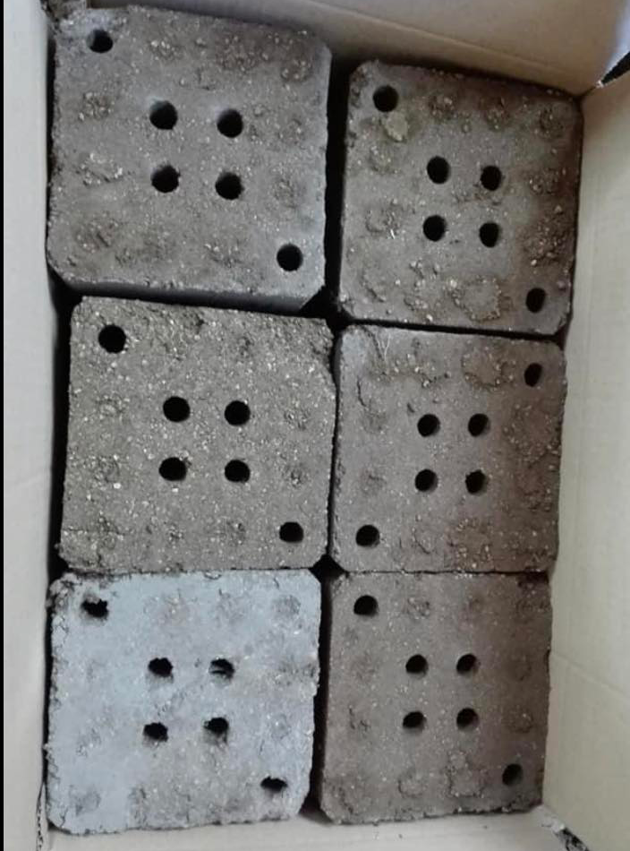
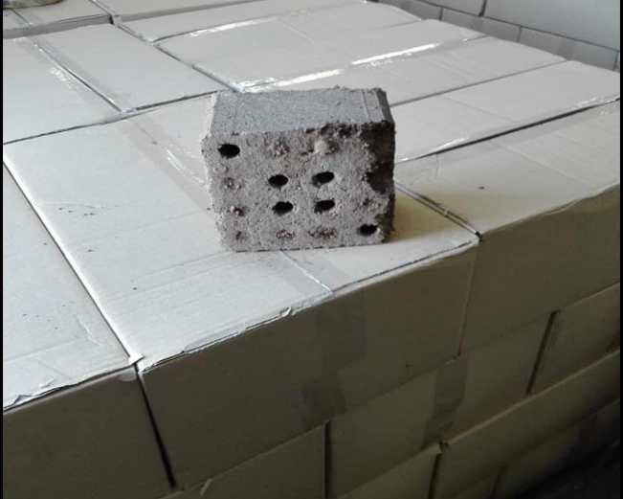
square mold
square template |  | Demand
size | 10*15*15 | 20,000
 | (12PCS/pouch) | 10,000

Slide 9
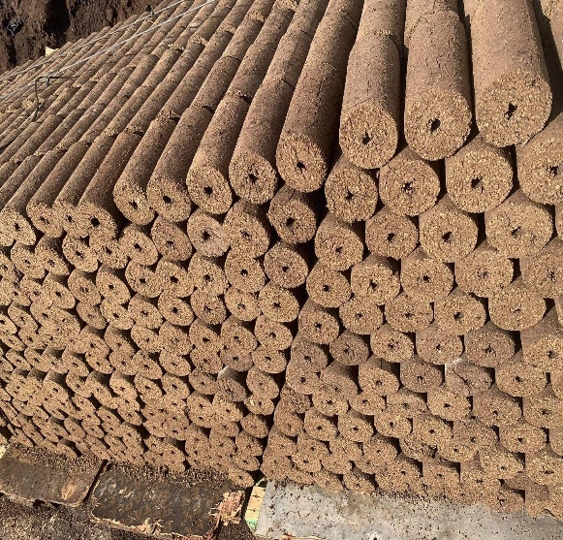
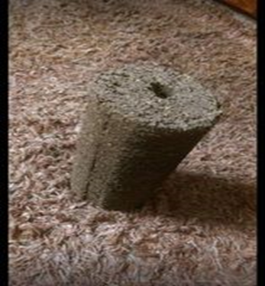
cylindrical mold:
cylindrical mold |  | Demand
size | D10/L20 | 17,000
 | 4PCS/pouch | 12,000

Slide 10
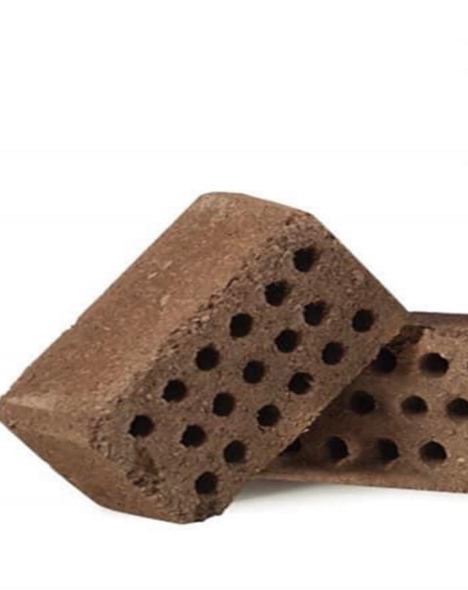
Rectangle MOLD
Rectangle template |  | Demand
size | 10*25*15 | 10,000
 | 10PSC/pouch | 5,000

Slide 11
manufacturing process

Slide 12
manufacturing process
1
2
3
4
Peat compress
Forming peat breaquettes
Molding dry
Mold backiging

Slide 13
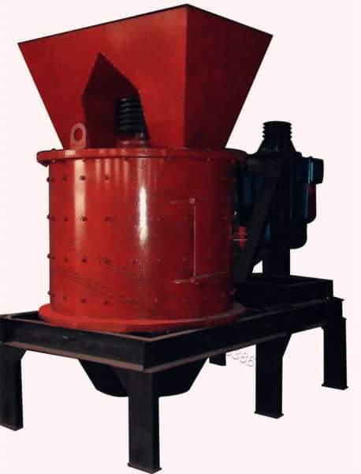
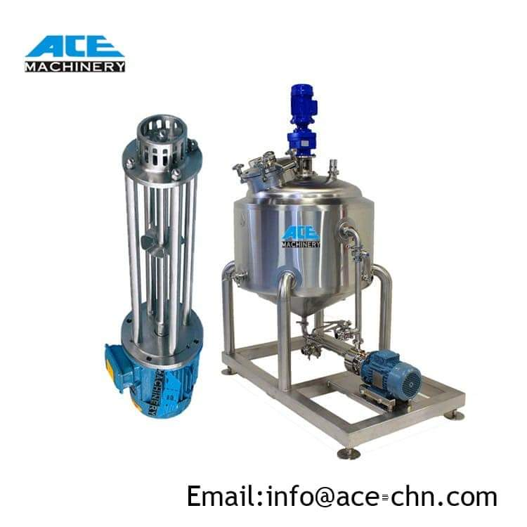
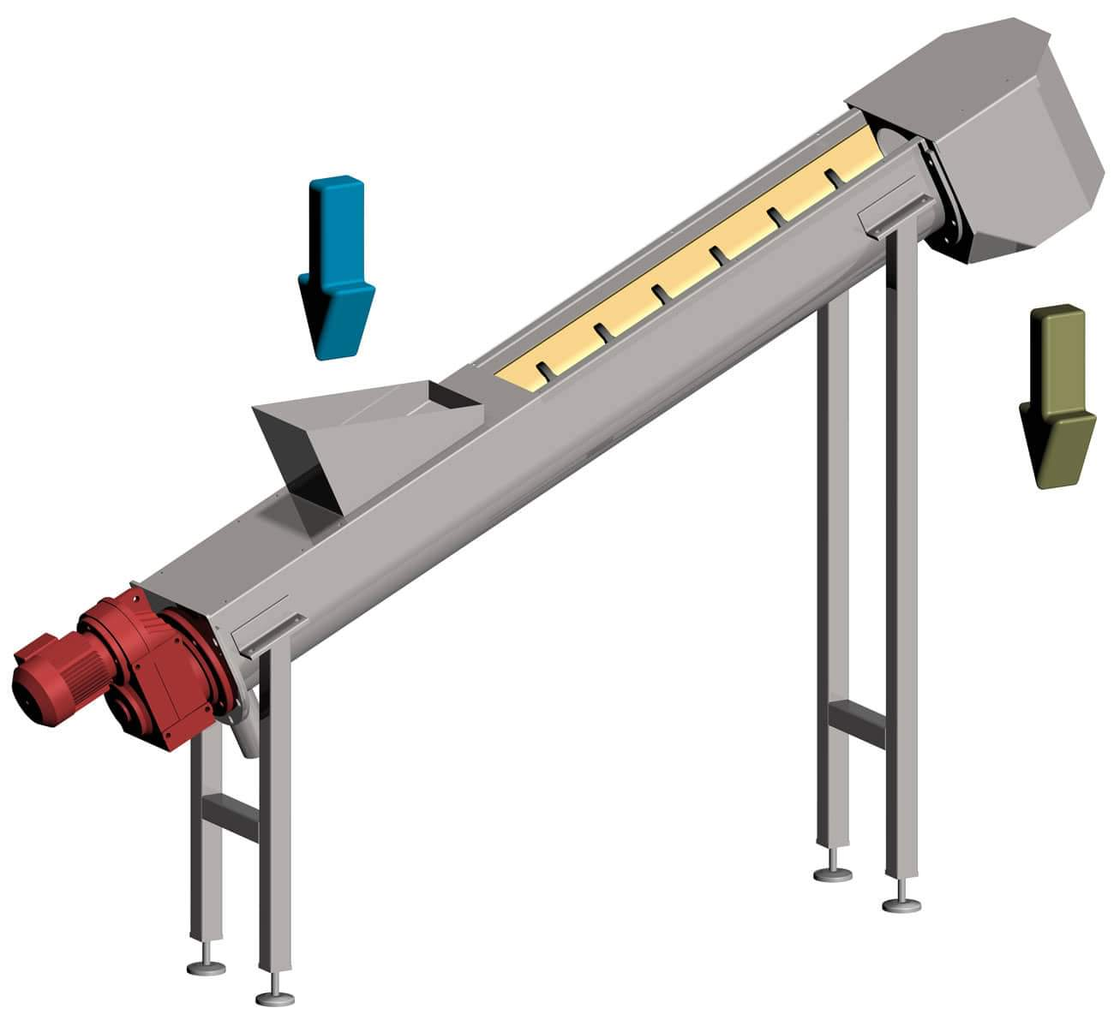
Machines related
Charcoal crusher machine Screw conveyor

Slide 14
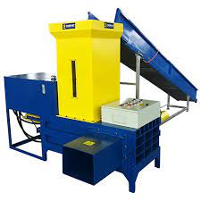
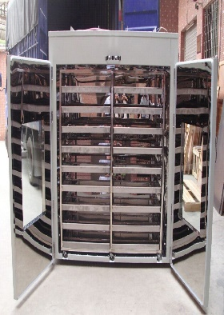
The peat pressing machine
Forced Air Drying Oven

Slide 15
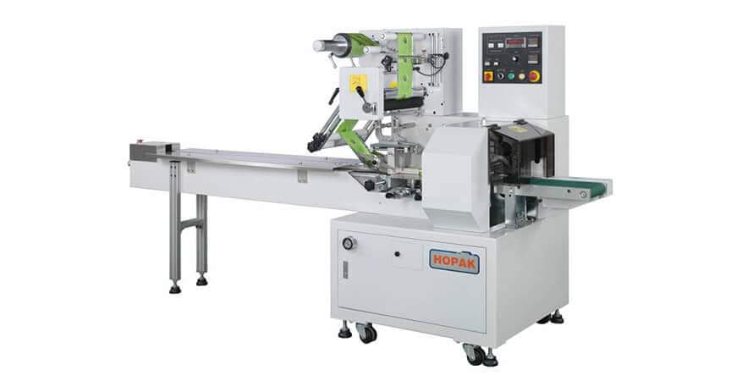
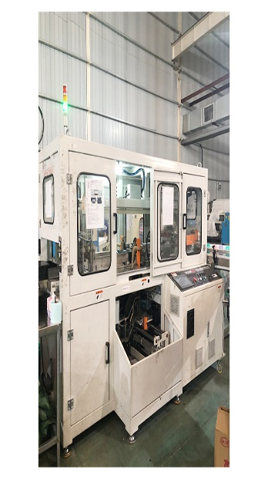
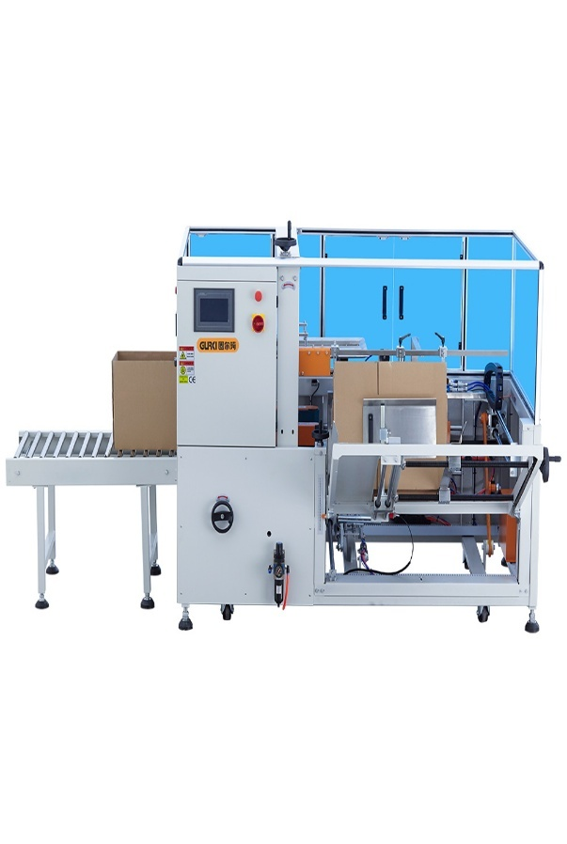
Tradetional packaging machine
paper packaging machine
Carton Box Forming Machine
New

Slide 16
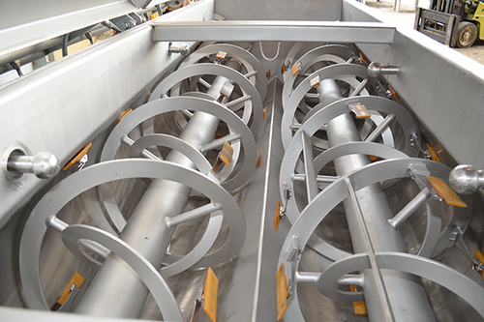
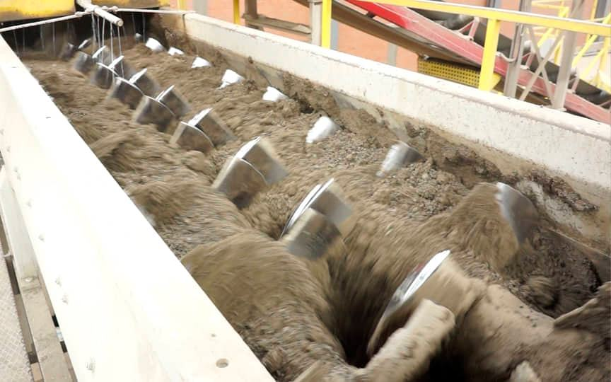
NEW MACHINE

Slide 17
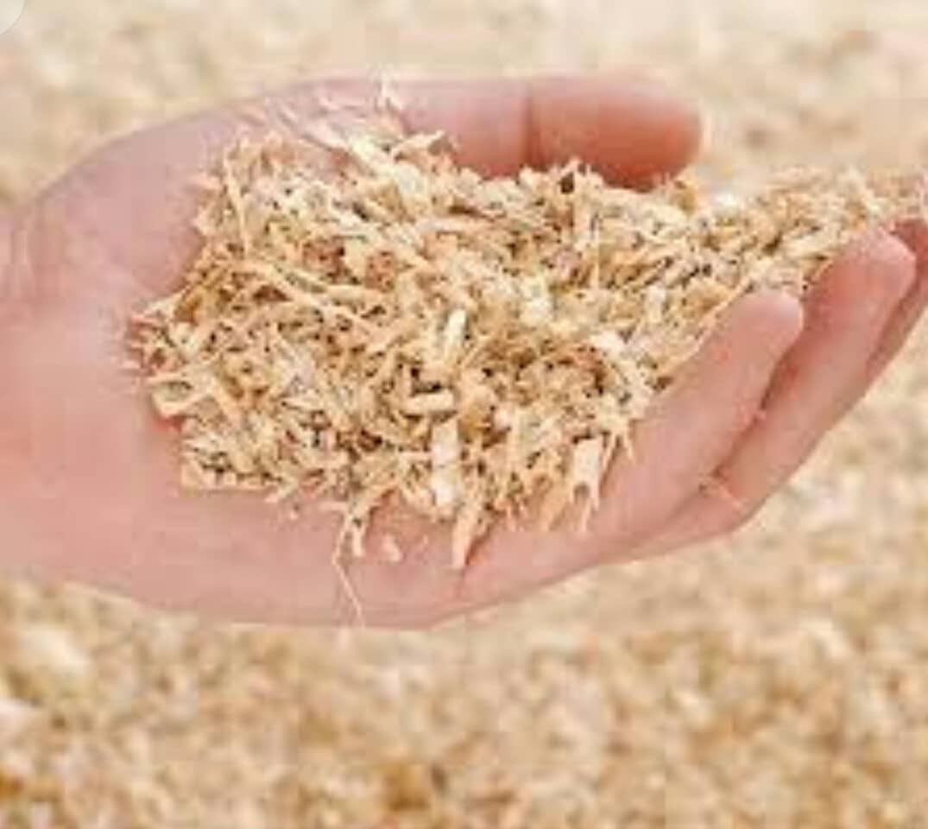

NEW MATERIAL

Slide 18

VR :

Slide 19
Market share

Slide 20
Market share percentage (30%)
Types | Demand (PCS) | Raw material (Wight of row material) | cost of Raw material (ILS)
square template (1 PCS) | 6,000 | 9,000 K.g | 1,125 (ILS)
square template (12PCS/pouch) | 3,000 | 54,000 K.g | 6,750 (ILS)
cylindrical mold (1 PCS) | 5,100 | 5,100 K.g | 637.5(ILS)
cylindrical mold (4PCS/pouch) | 3,600 | 14,400 K.g | 1,800(ILS)
rectangle template (1 PCS) | 3,000 | 6,000K.g | 750(ILS)
rectangle template 10PSC/pouch | 1,500 | 30,000 K.g | 3,750(ILS)
Sum | 22,200 | 118,500 | 14,813(ILS)

Slide 21
Market share percentage (50%)
Types | Demand (PCS) | Raw material (Wight of row material) | cost of Raw material (ILS)
square template (1 PCS) | 10,000 | 15000 KG | 1875 (ILS)
square template (12PCS/pouch) | 5,000 | 90000 KG | 11250 (ILS)
cylindrical mold (1 PCS) | 8,500 | 8500 KG | 1062.5(ILS)
cylindrical mold (4PCS/pouch) | 6,000 | 24000 KG | 3000(ILS)
rectangle template (1 PCS) | 5,000 | 10000 KG | 1250(ILS)
rectangle template 10PSC/pouch | 2,500 | 50000 KG | 6250(ILS)
Sum | 37000 | 197500 KG | 24687.5 (ILS)

Slide 22
Market share percentage (80%)
Types | Demand (PCS) | Raw material (Wight of row material) | cost of Raw material (ILS)
square template (1 PCS) | 16000 | 24000 KG | 3000 (ILS)
square template (12PCS/pouch) | 8000 | 144000 KG | 18000 (ILS)
cylindrical mold (1 PCS) | 13600 | 13600 KG | 1700 (ILS)
cylindrical mold (4PCS/pouch) | 9600 | 38400 KG | 4800 (ILS)
rectangle template (1 PCS) | 8000 | 16000 KG | 2000 (ILS)
rectangle template 10PSC/pouch | 4000 | 80000 KG | 10000 (ILS)
Sum | 59200 | 316000 KG | 39500 (ILS)

Slide 23
Lay out

Slide 24
Lay out
In this chapter, we will discuss the mechanism of worker and machine distribution in the factory using planning principles, as well as the locations of finished and raw material products using factory space optimization. To make it easier for workers and to capitalize on downtime, whether it's setting up machines or moving time between lanes, in order to increase productivity.

Slide 25
Space requirements
The quantity of space necessary in the building is maybe the most challenging decision in facilities design

Slide 26
Warehouse Layout & Design
We must think about finding the ideal storage space scheme in order to reduce the total time needed to transport peat briquettes from one place to another; It is one of the most important factors to consider to ensure proper workflow and has a significant impact on work flow and productivity.

Slide 27
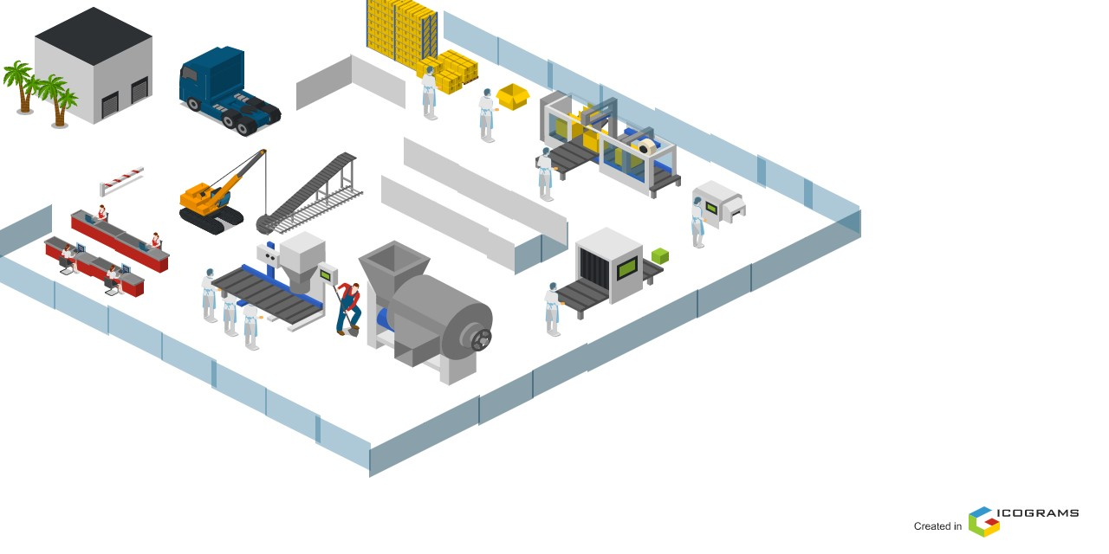
3D layout modeling

Slide 28
Workstation Specification
A workstation, like any other facility, has room for equipment, supplies, and people.

Slide 29
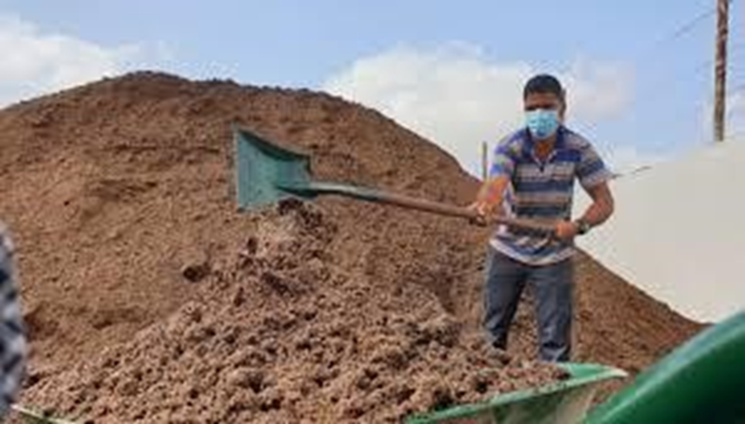
Area of the factory
newly produced peat is only during the season for a period of 30 days
Approximately 500 tons of peat will be supplied
According to estimates, one ton needs 3 square meters, and therefore we need a huge space to store it, but if we put it in the form of high piles, the estimated area is 200 square meters

Slide 30
Area of the production line
Depending on the Market share percentage (30%) , we need the following spaces for machines that mentioned in the following table:.
N. | Machine Name | Number | Dimensions “m” | Area “m2”
1 | Carton Box Forming Machine | 1 | 2.8 × 2.5 | 7
2 | paper packaging machine | 1 | 2.5 × 1.7 | 4.25
3 | Forced Air Drying Oven | 1 | 5.5 × 1.5 | 8.25
4 | The peat pressing machine | 3 parts | 9 × 1.4 | 12.6
The Total area of machines |  |  |  | 40

Slide 31
So, the area of the packiging = 172.66 m
In this section
1 machine for the production of molds, which is the baler. The piston consists of three parts, so it needs a relatively larger space,
2 packaging machines, which are the paper packing machine and the carton packing machine (boxes).
large electric oven that needs a large area to contain the cubes
The length = (paper packaging machine ) + (Forced Air Drying Oven) + (Carton Box Forming Machine)
The length = 2.8+ 9 + 6 =17.8 m
• The width = (Space to open the oven door and take out the metal cage) + (Arrangement of pressed cartons packages) + (Putting paper rolls) + (Moving from one machine to the next)
The Width = 2.5 + 1.7 + 1.5 + 4 = 9.7

Slide 32
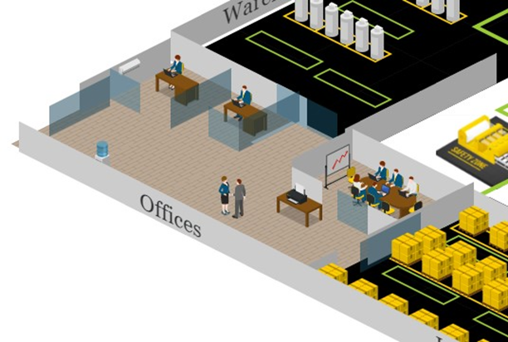
Arrangement stage
• parking space
Parking space for trucks and forklifts
➢ The area = 110 m
Square meters in total = 300
Office
➢Office width = 7 m
➢Office length = 15
➢ So, the area of offices = 105 m
➢ So, the area of the whole industry = 1000 m2

Slide 33
Feasibility study

Slide 34
initial setup cost:
ID | Type | Cost (Nis)
1 | rent cost | 21000nis/year
2 | factory infrastructure | 495,506 nic
3 | Machine (production line) | = 764766.45 Nis
4 | Handling system and tools | 35700
5 | Vehicles | 200,000
 | Total cost | 1,517,041

Slide 35
Running cost
ID | Cost type | Type | Annual cost (Nis)
1 | Fixed running cost | Salaries | 417600
2 |  | Electricity consumption | 79788
3 |  | Water consumption | 1,800
4 |  | Internet and phone | 6,000
5 |  | Fuel | 36,000
6 |  | Maintenance | 28013.61
7 |  | Insurance | 5613
8 |  | Depreciation | 31444.7
9 |  | Waste | 910
10 | Variable running cost | Raw materials | 45500
11 |  | Packaging | 15540
Total annual cost |  |  | 656986.7

Slide 38
THANK YOU
ANY QUESTIONS?

