Slide 1
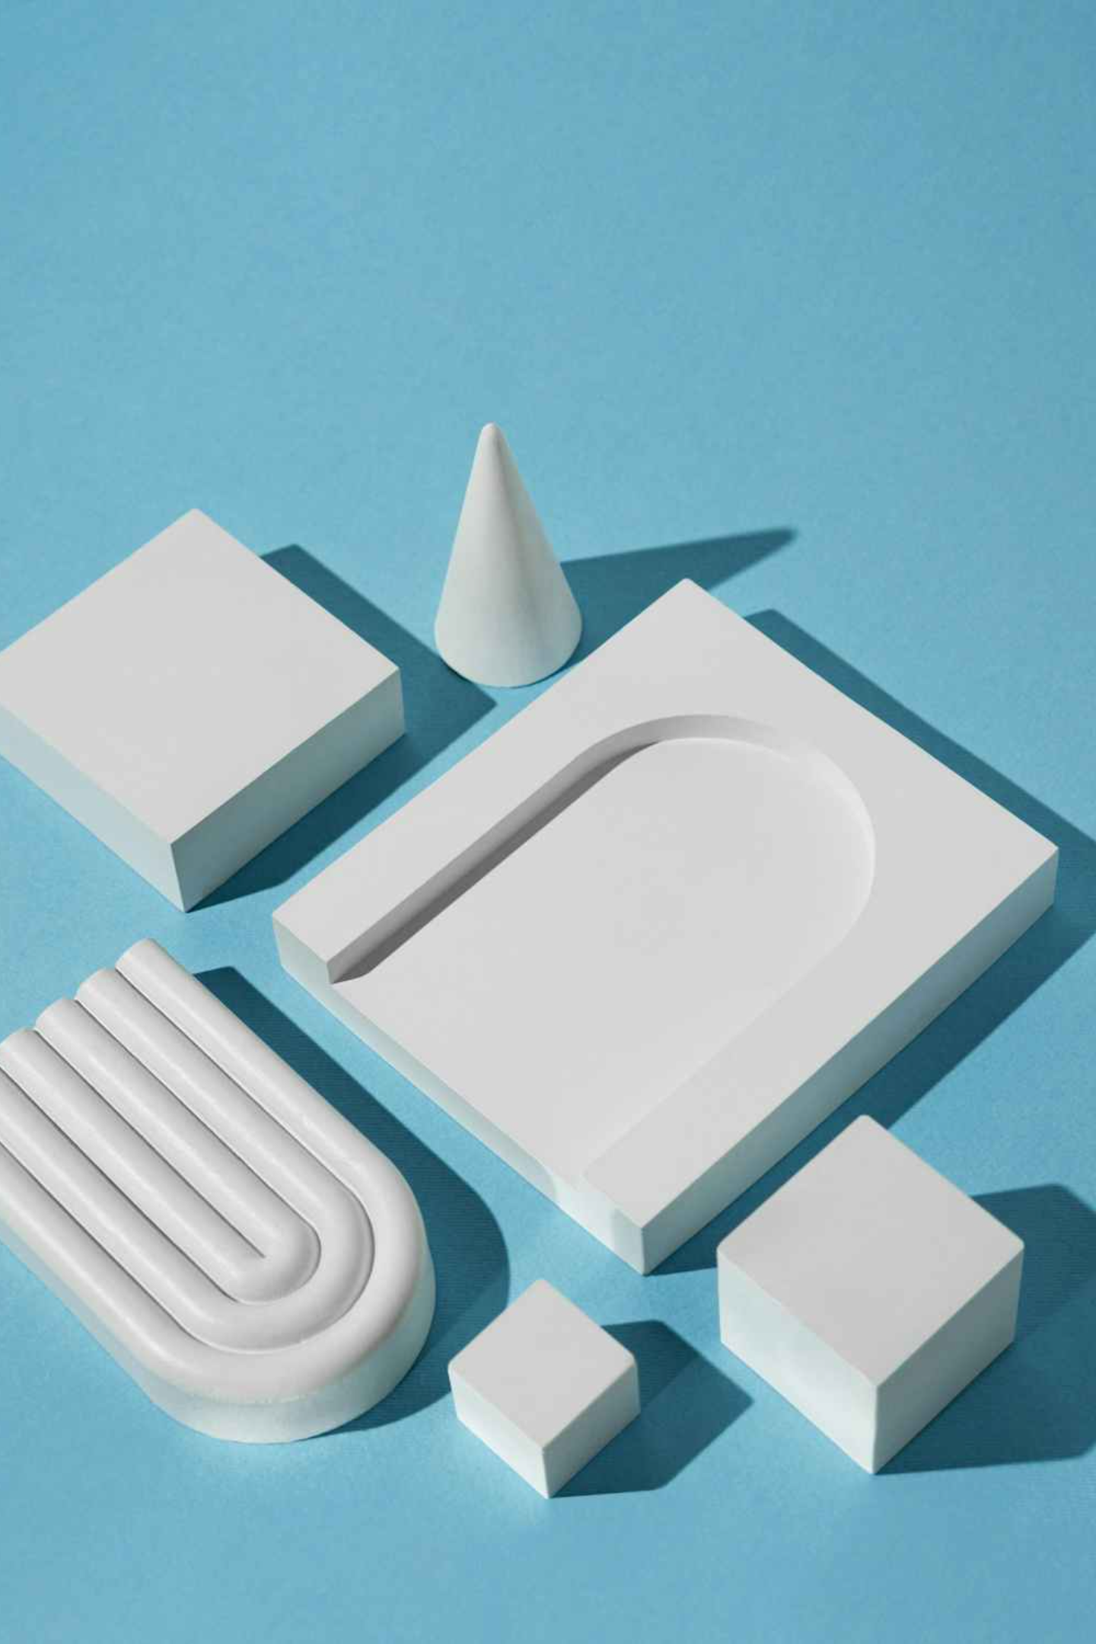
ScuptoFoam
CNC Foam Cutting System
Mohammed Jaddou, Amajad Mousa
Supervisor: Dr. Hanal Abu-Zant

Slide 2
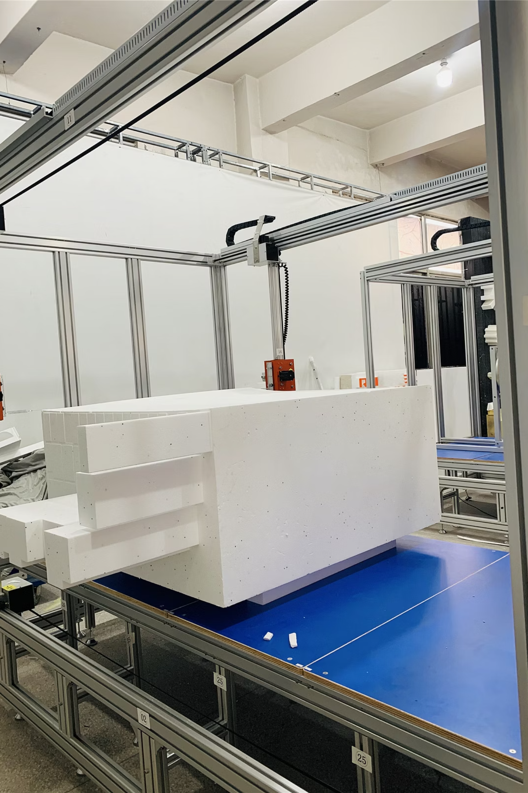
Foam is widely used in packaging, insulation, and prototyping, but cutting it precisely can be difficult.
Current Methods
Our Inspiration
Manual cutting: Lacks accuracy, consistency, and repeatability.
This gap inspired our project to design a system combining CNC precision with affordability and portability for students, researchers, and small businesses – making it compact, cost-effective, and easy to operate without high-end industrial infrastructure.
Industrial CNC: Precise, but bulky, expensive, and inaccessible for many.

Slide 3
Project Objectives:
1
2
3
2D & 3D Cutting
Standalone Control
Remote Operation
Build a CNC foam cutter capable of both 2D and 3D operations using Arduino Uno and heated nichrome wire.
Integrate a Raspberry Pi with a monitor to eliminate the need for a laptop.
Develop a Flask-based mobile/web application for remote control, G-code upload, and real-time monitoring.

Slide 4
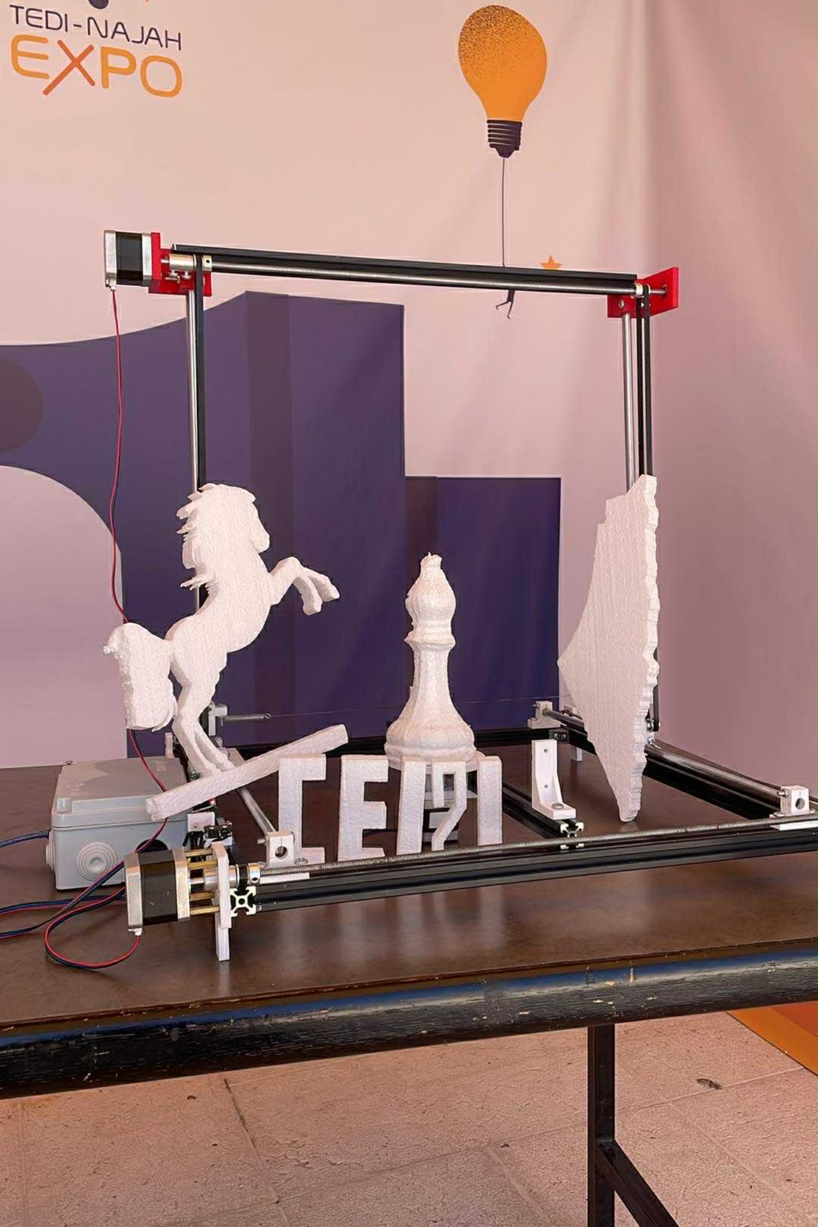
Hardware Components:
NEMA Stepper Motors: Three motors for X, Y, and Z axis movement.
Raspberry Pi & Display: User interface for standalone operation.
Arduino Uno: Serves as the motor controller.
Nichrome Heated Wire: Provides precise cutting through controlled heat application.
DC-DC Converter: Regulates current to the heated wire for stable cutting.
Custom Frame: Provides stability during operation.

Slide 5



Raspberry Pi Communications:
The Raspberry Pi runs a PyQt5 GUI application, allowing users to jog motors, upload/preview G-code, and start/stop cutting jobs.
PyQt5 GUI
USB Serial
GRBL Firmware
User interface for direct machine control.
Communication link between Raspberry Pi and Arduino Uno.
On Arduino, drives motors with precision based on commands.

Slide 6

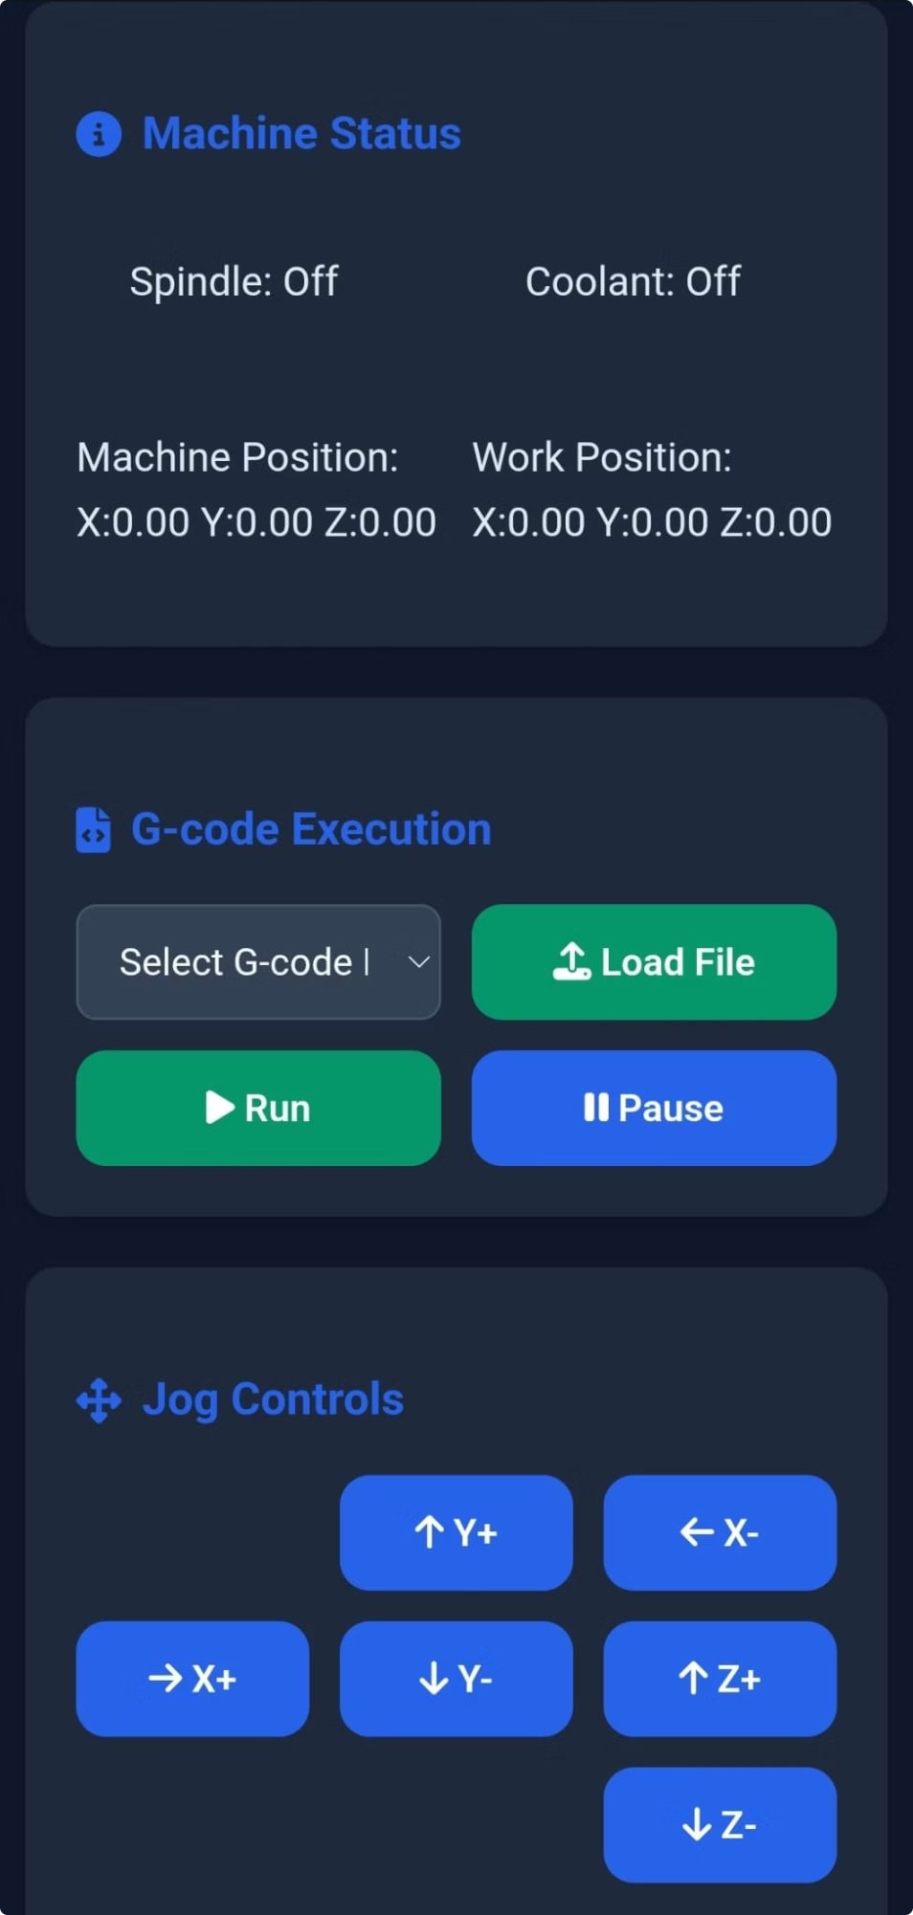
Mobile Communications:
A Flask-based web application provides a responsive mobile interface for remote control from any device on the same Wi-Fi network.
Key Features
Jog the machine
Start and stop jobs
Zero the axes
File uploads (G-code from phone to Raspberry Pi)

Slide 7
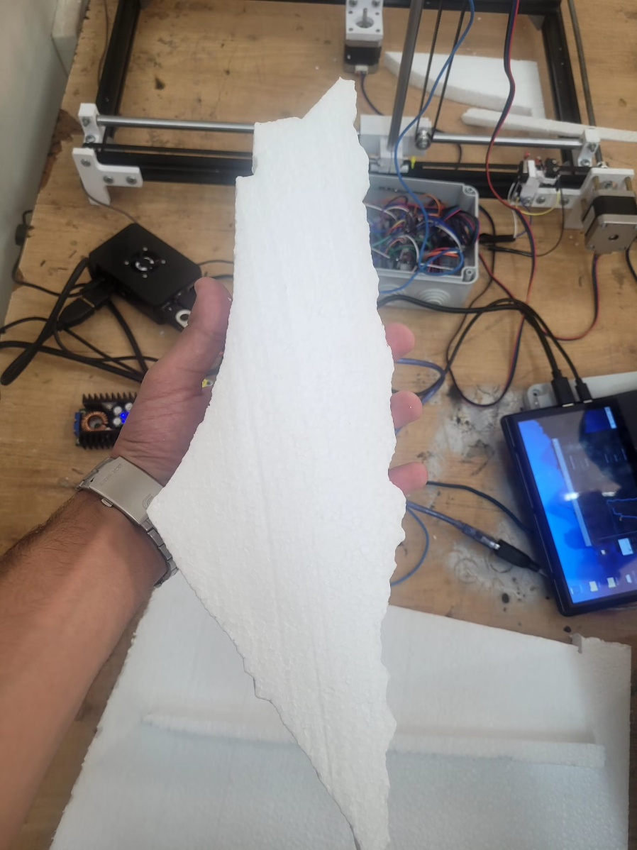
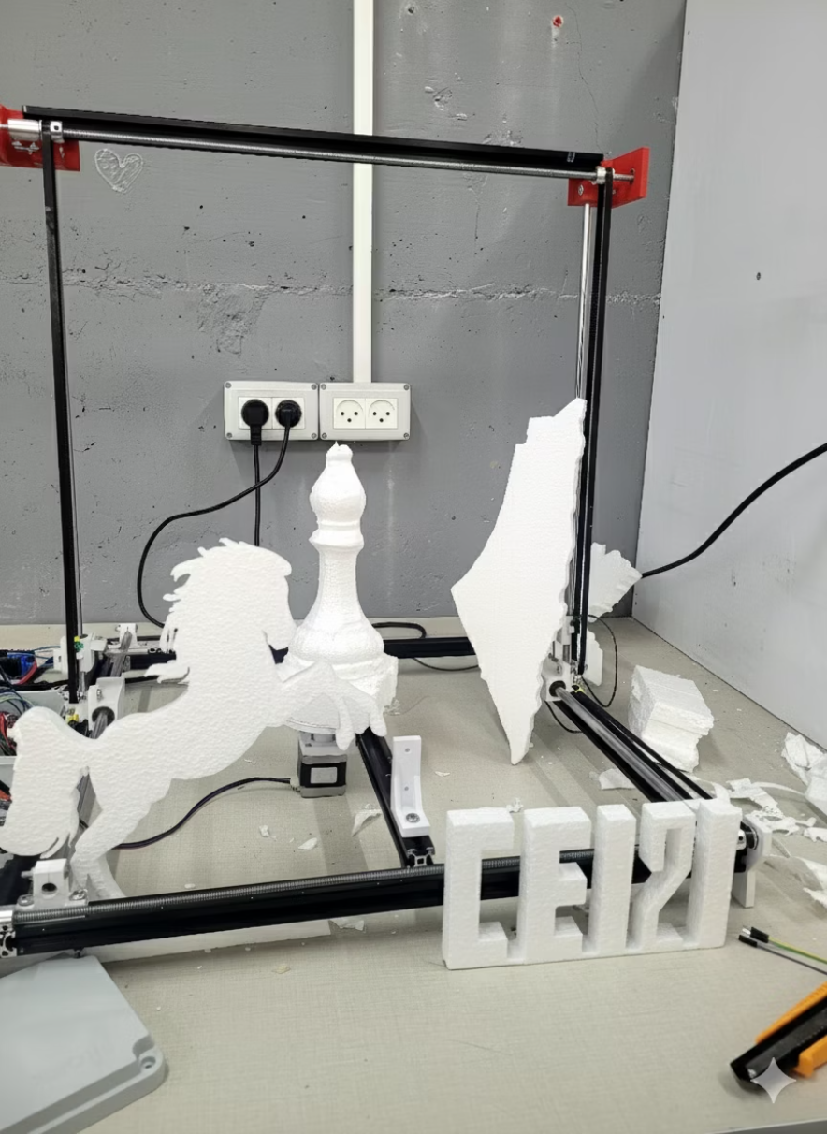
Results:
Our system successfully performed precise and repeatable 2D and 3D cuts on various foam samples.
Both the Raspberry Pi GUI and mobile app functioned flawlessly, confirming our project as a viable, cost-effective alternative to expensive CNC systems.

Slide 8
Challenges & Constraints
Hardware Availability
Fragile Components
Limited local market options caused delays in sourcing components.
3D-printed components frequently broke under operational stress.
Heat Control for the Cutting Wire
Maintaining a stable wire temperature was difficult. Too much current caused wire breakage, while too little made cutting slow or uneven.

Slide 9
Future Work:
Vision System Integration
Automated Material Handling
Material Expansion
Change the material of the wire so it can handle higher voltages and expand the project to other materials like plastic
Implement a camera for real-time monitoring of the cutting process.
Develop systems for automatic loading and unloading of foam.

Slide 10
Conclusion:
Our project successfully demonstrated a cost-effective, portable, and precise CNC foam cutting solution, making manufacturing accessible to a wider audience.
This system offers a powerful tool for students, small workshops, and hobbyists, democratizing access to high-precision cutting technology.

