Slide 1

GRADUATION PROJECT 1
StudentTechShop
Presented By:
Adam Yaesh
Laith Alayyan
Supervisor:
Dr. Asmaa Afeefi

Slide 2
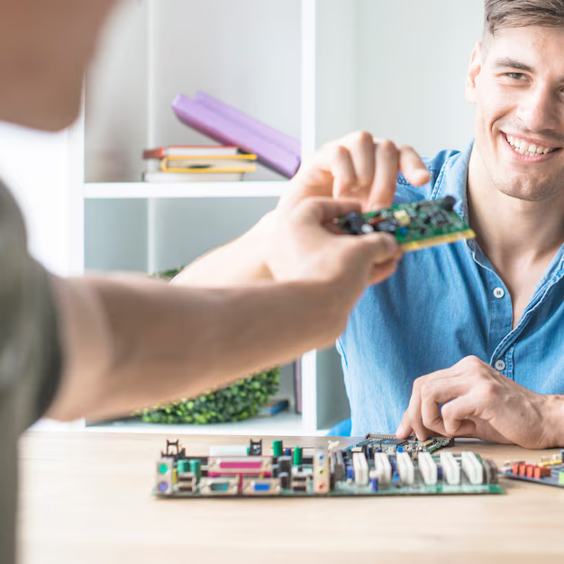
Why StudentTechShop
To assist students in their sale of hardware parts.

Slide 3






Mobile
Application
Website
Backend
SQL Server (Database)

Slide 4
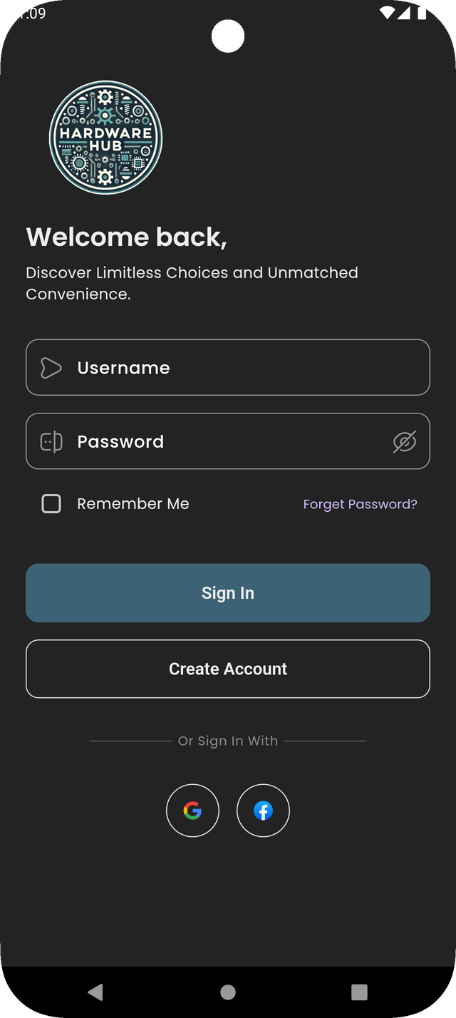
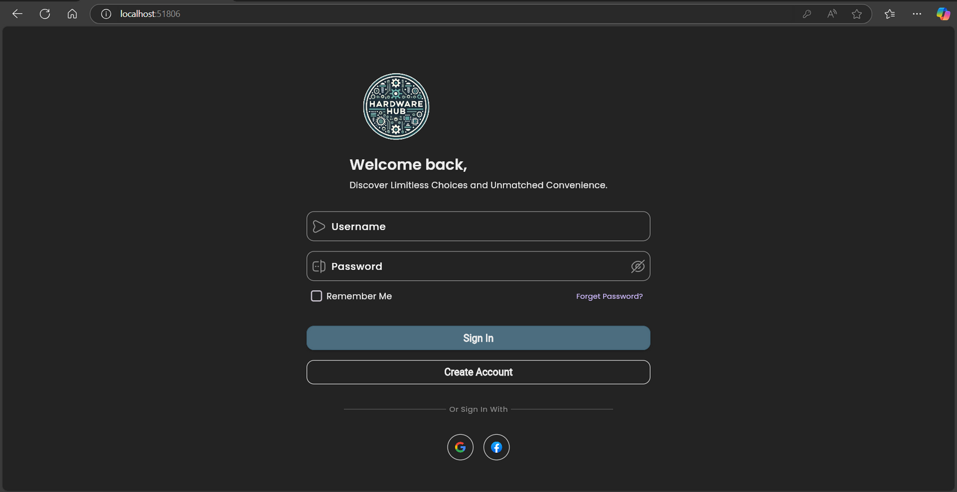
Signup Login
AUTHENTICATION AND SECURITY

Slide 5
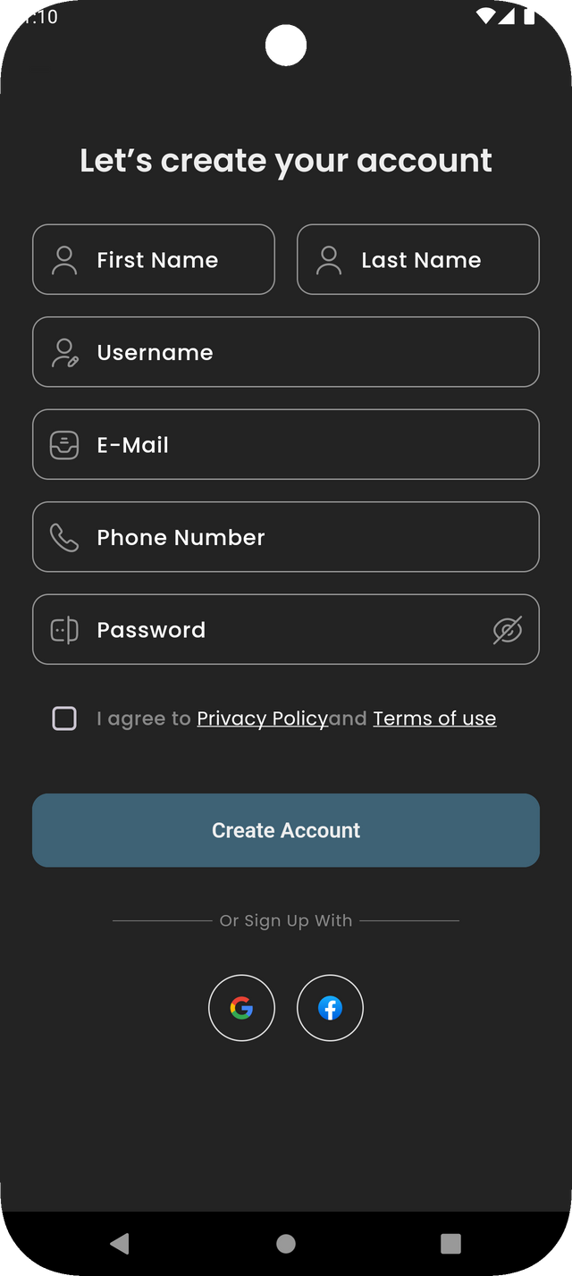
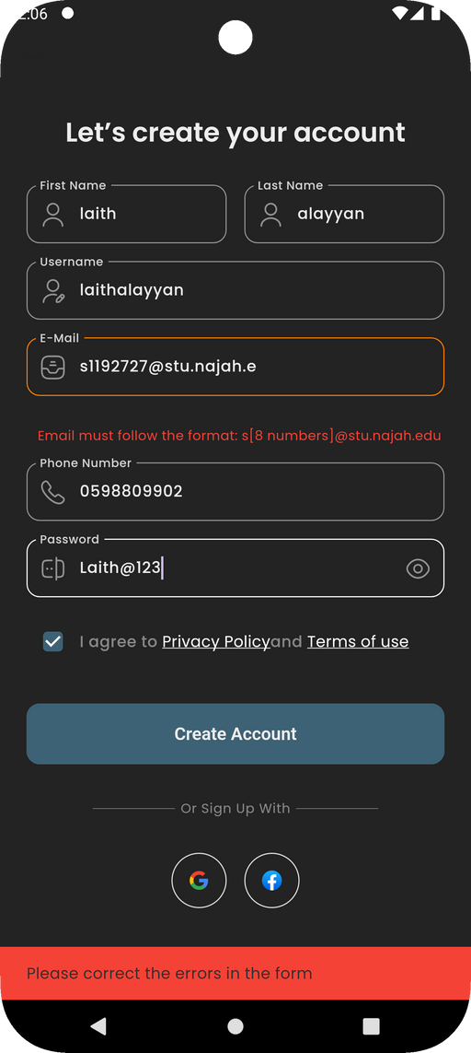
Signup Login
AUTHENTICATION AND SECURITY

Slide 6
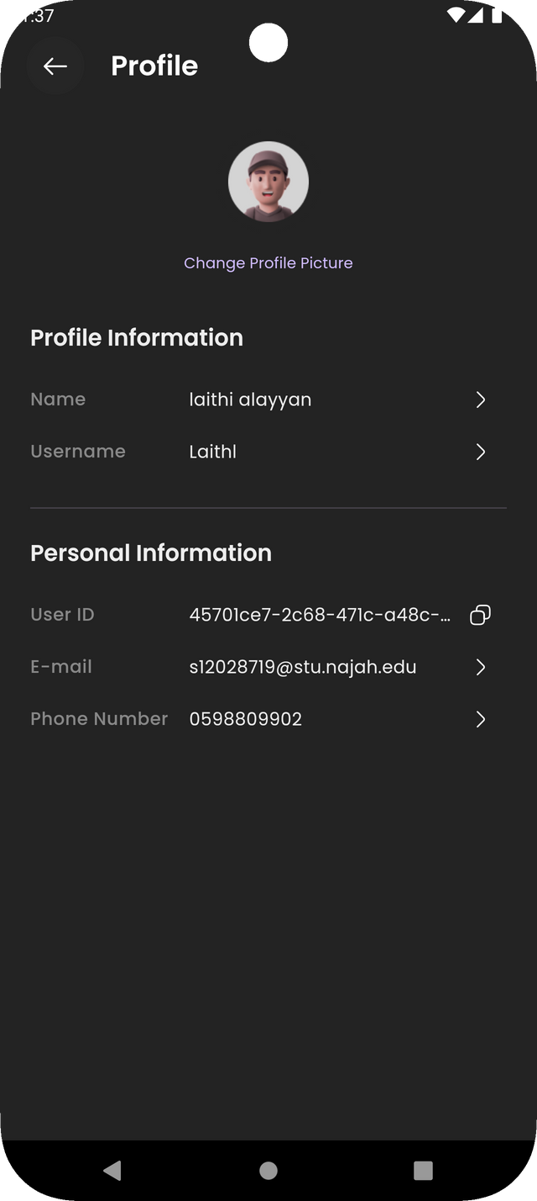
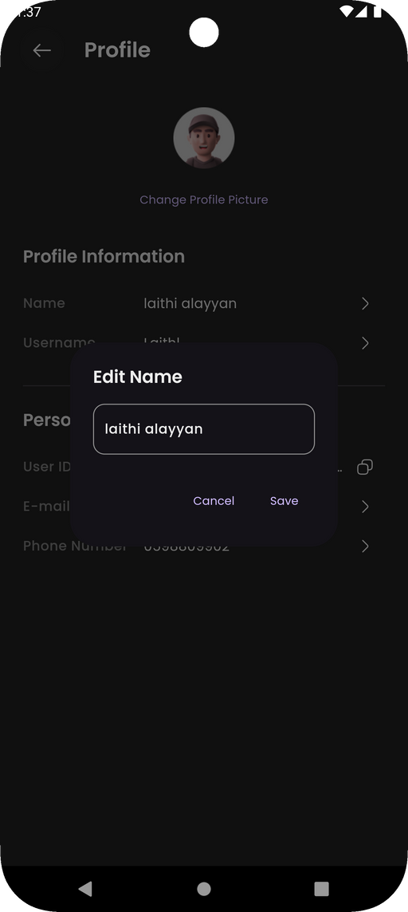
User’s Profile Information

Slide 7
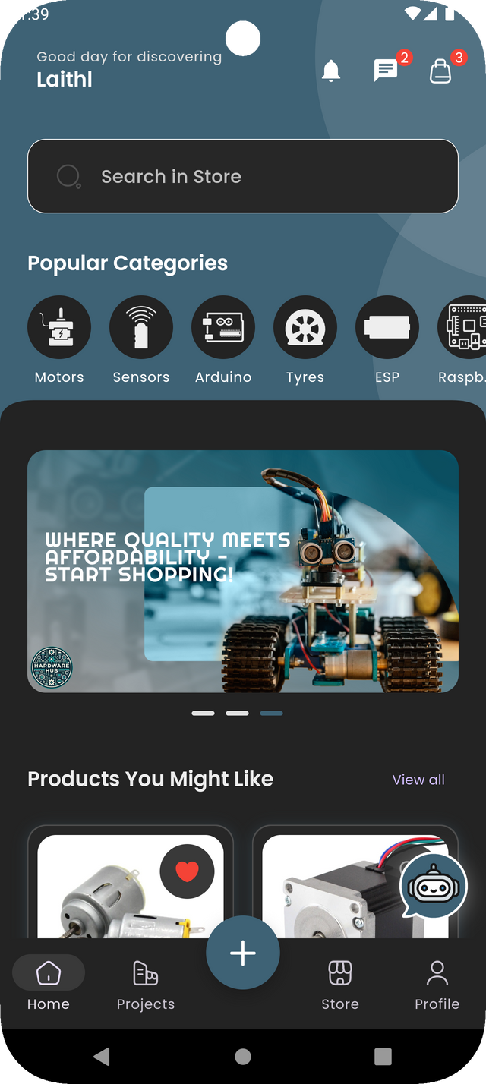
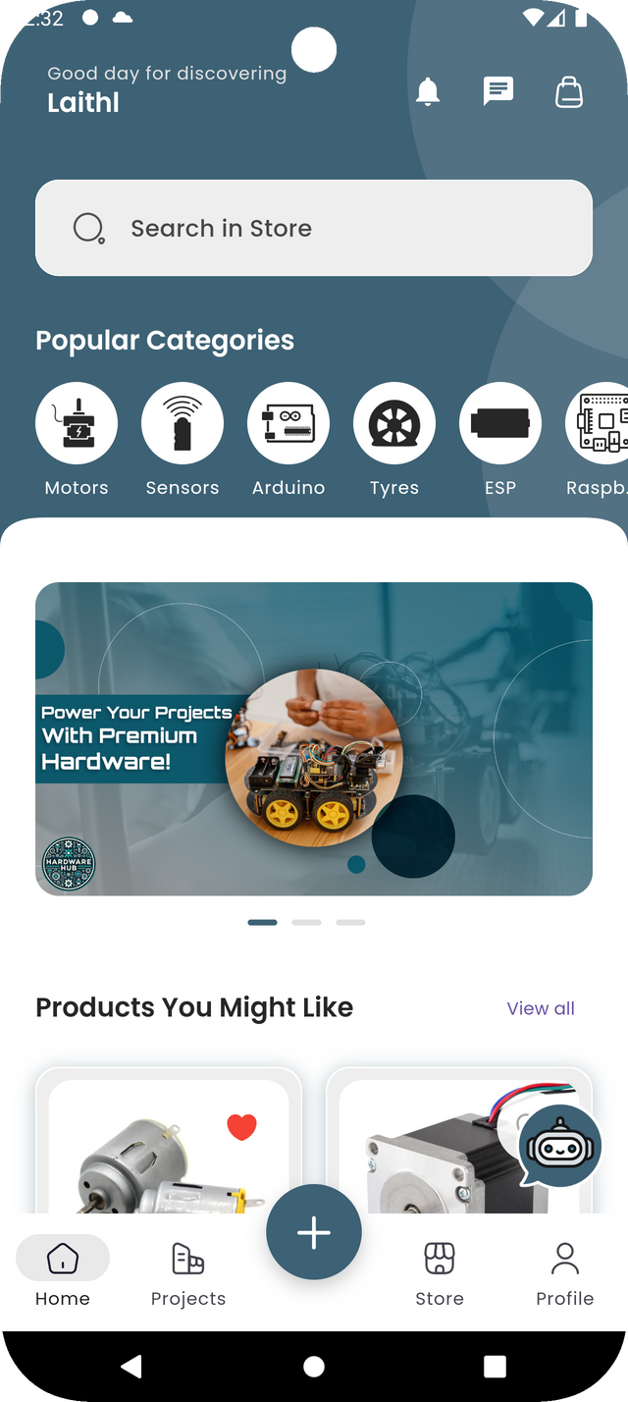
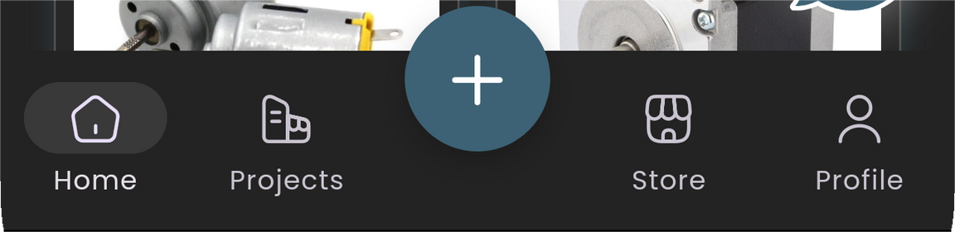
STUDENT TECH SHOP

Slide 8
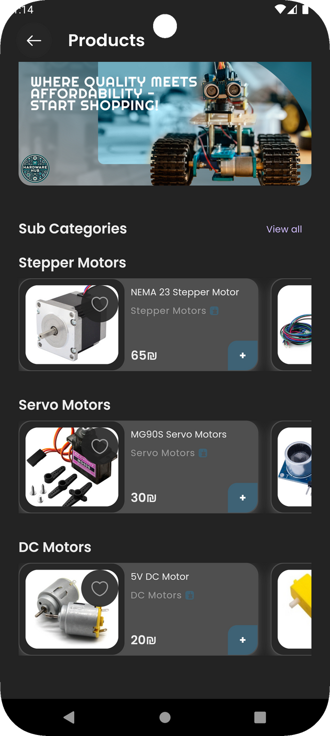
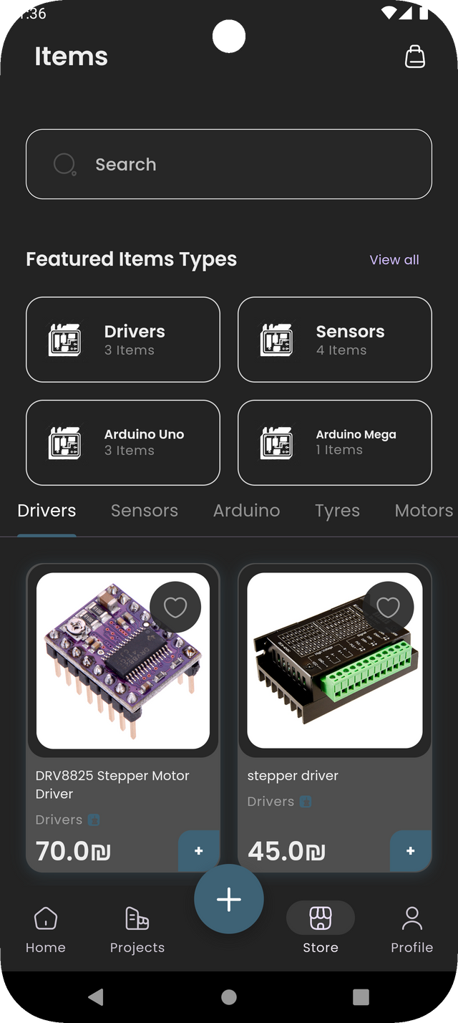
PRODUCTS

Slide 9
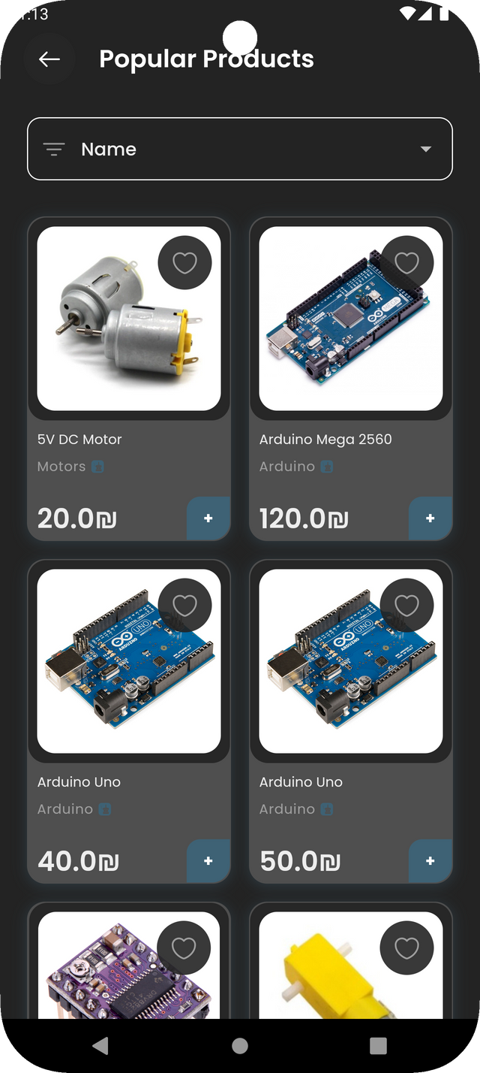
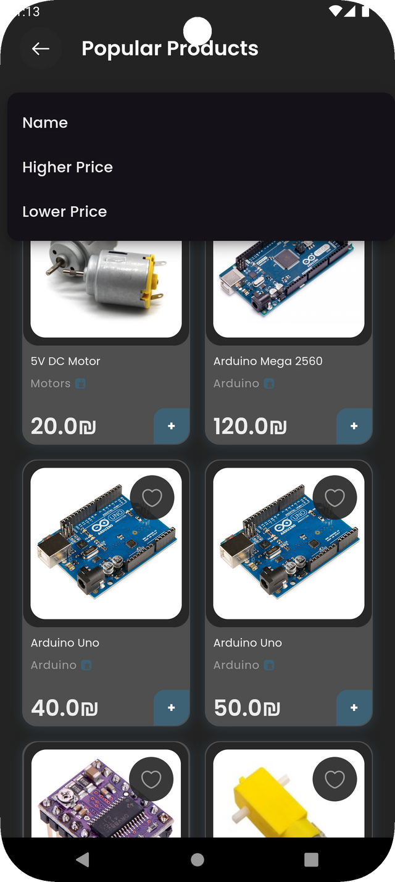
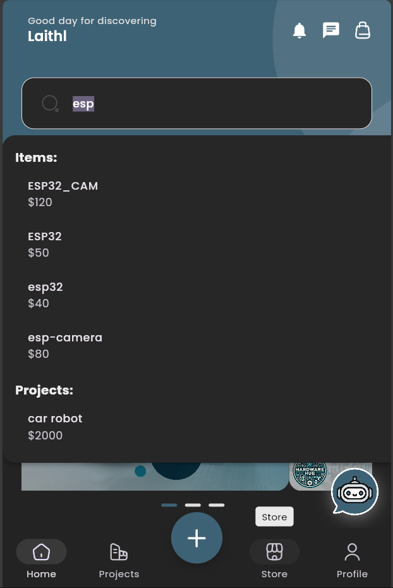
PRODUCTS

Slide 10
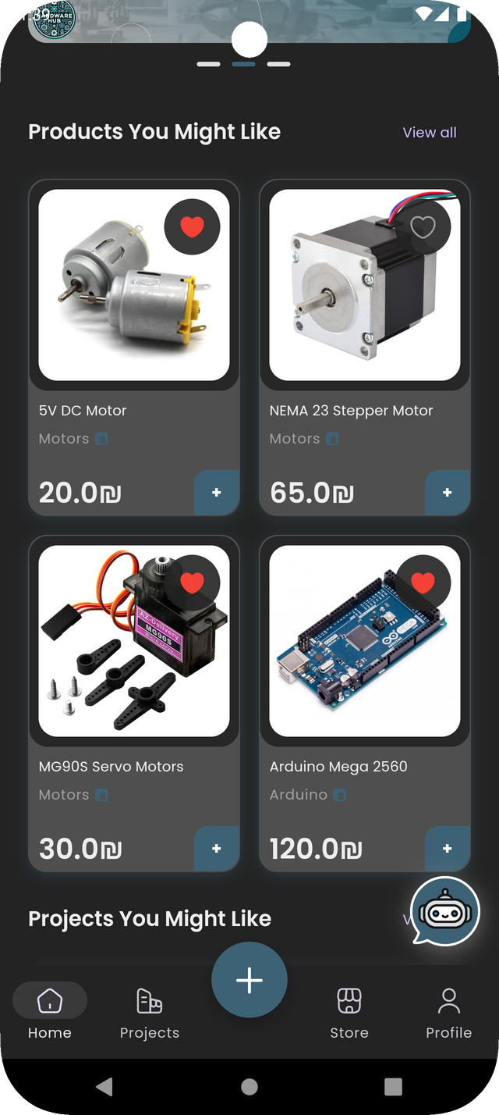
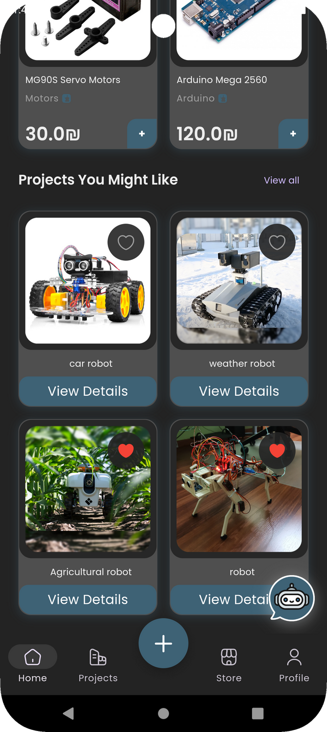
RECOMMENDATIONS

Slide 11
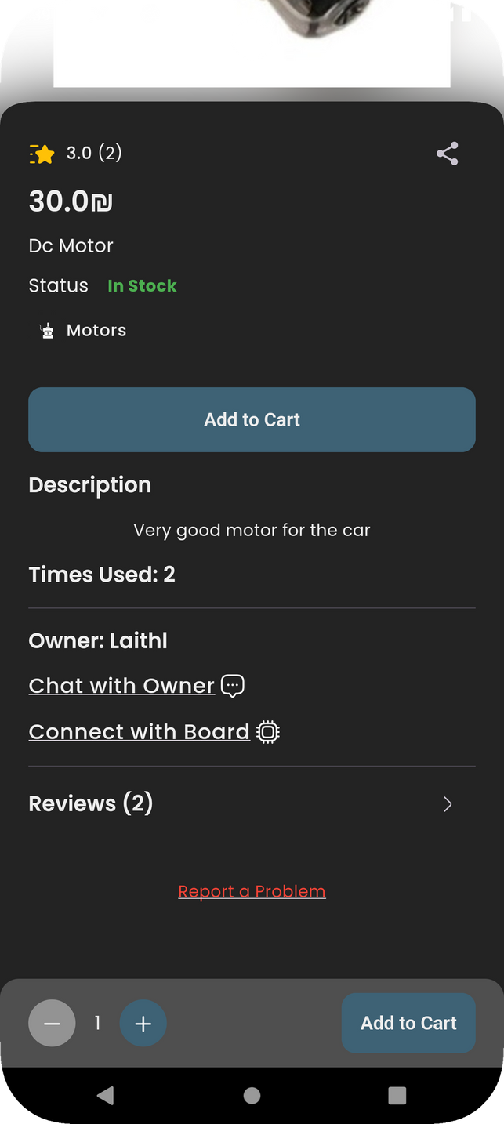
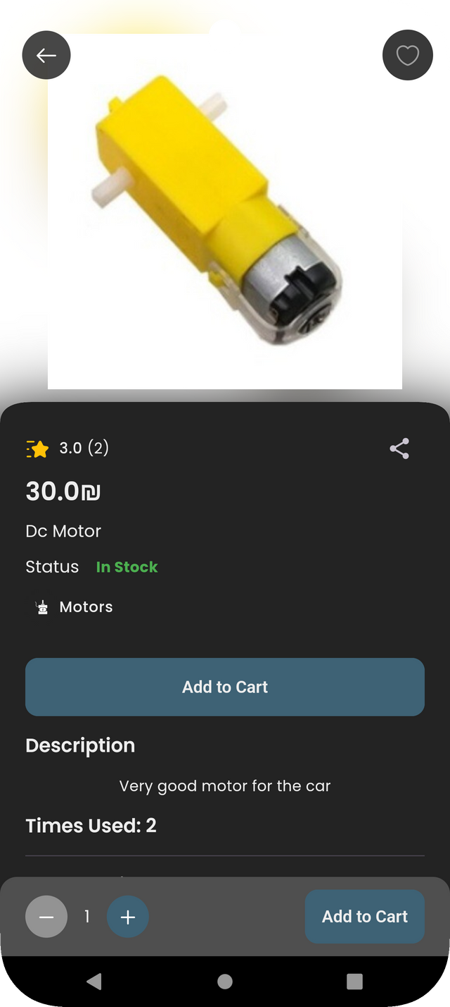
PRODUCTS

Slide 12
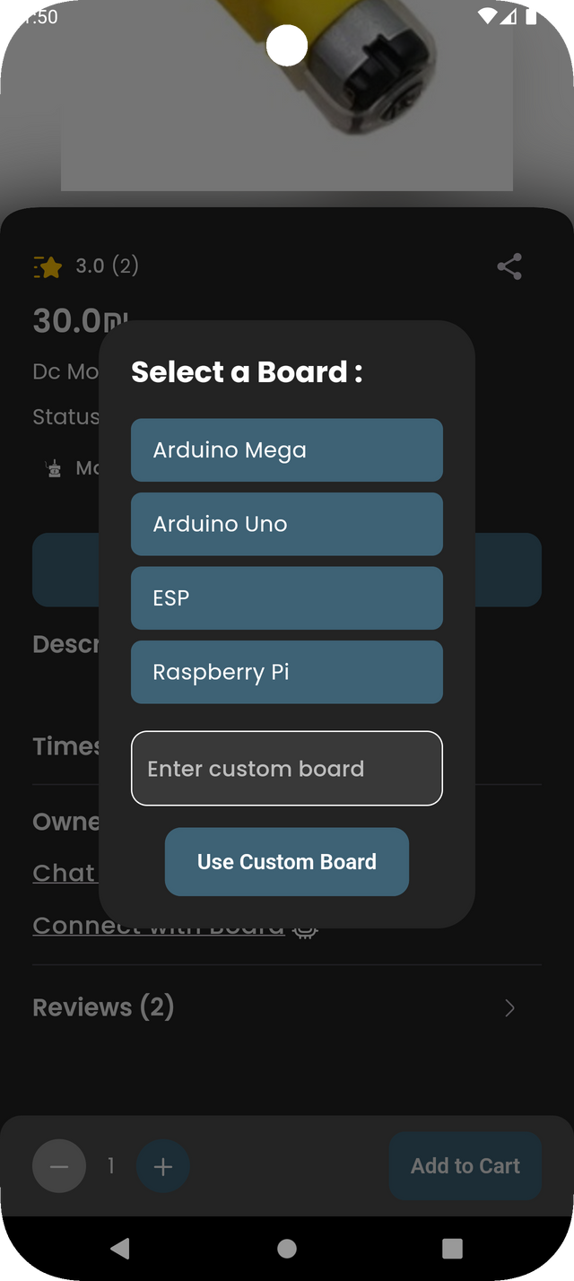
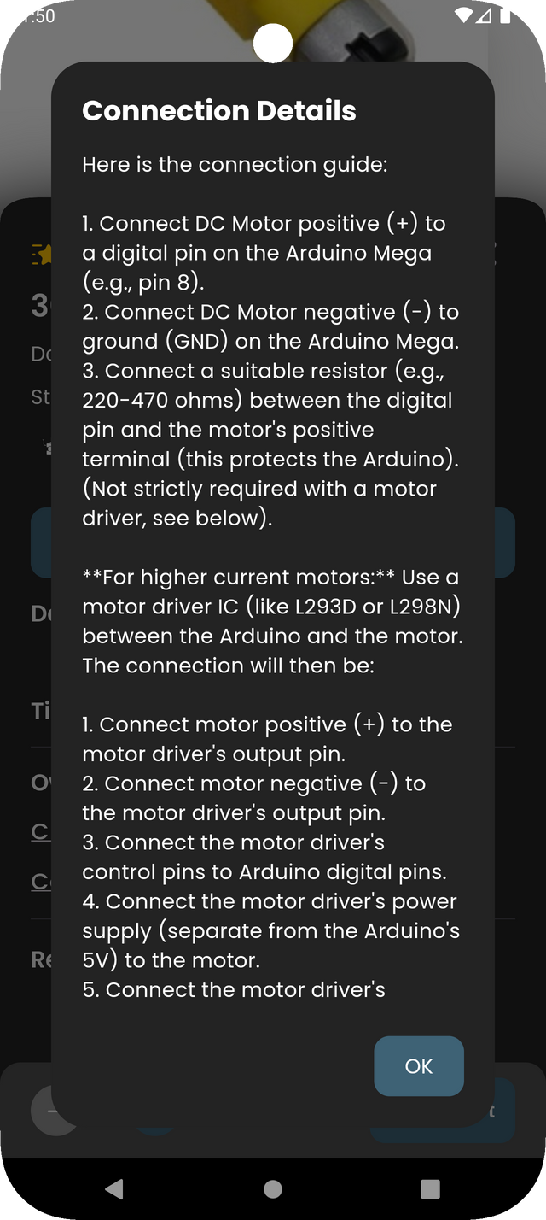
CONNECTION

Slide 13
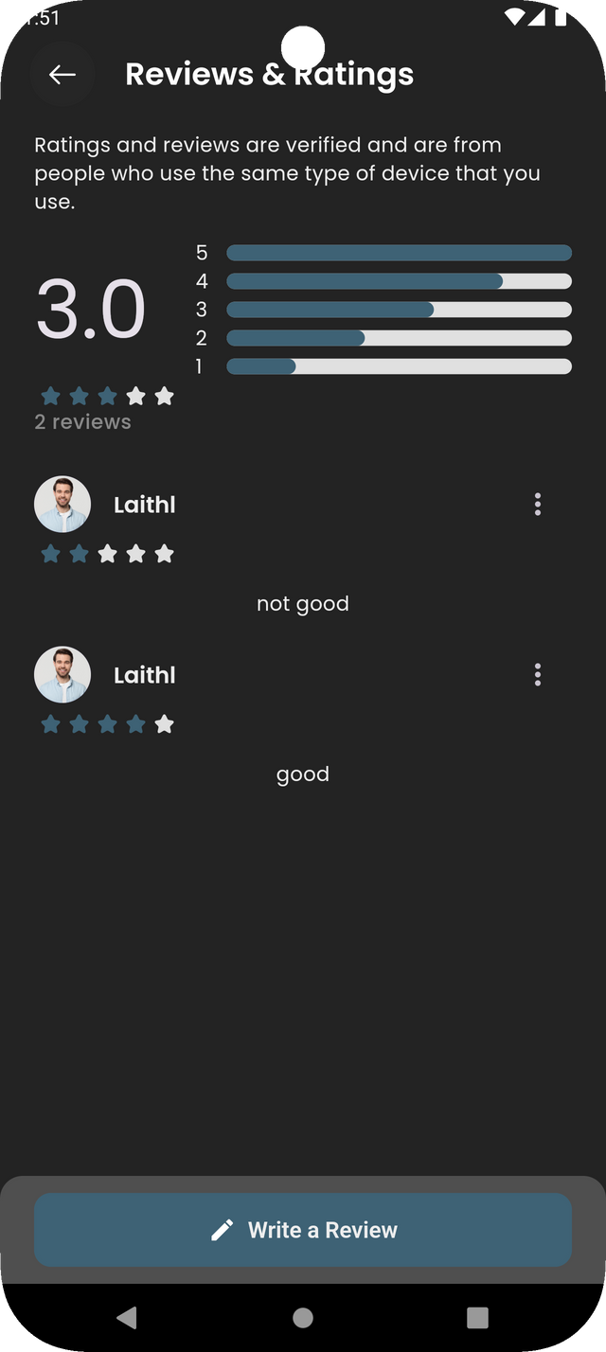
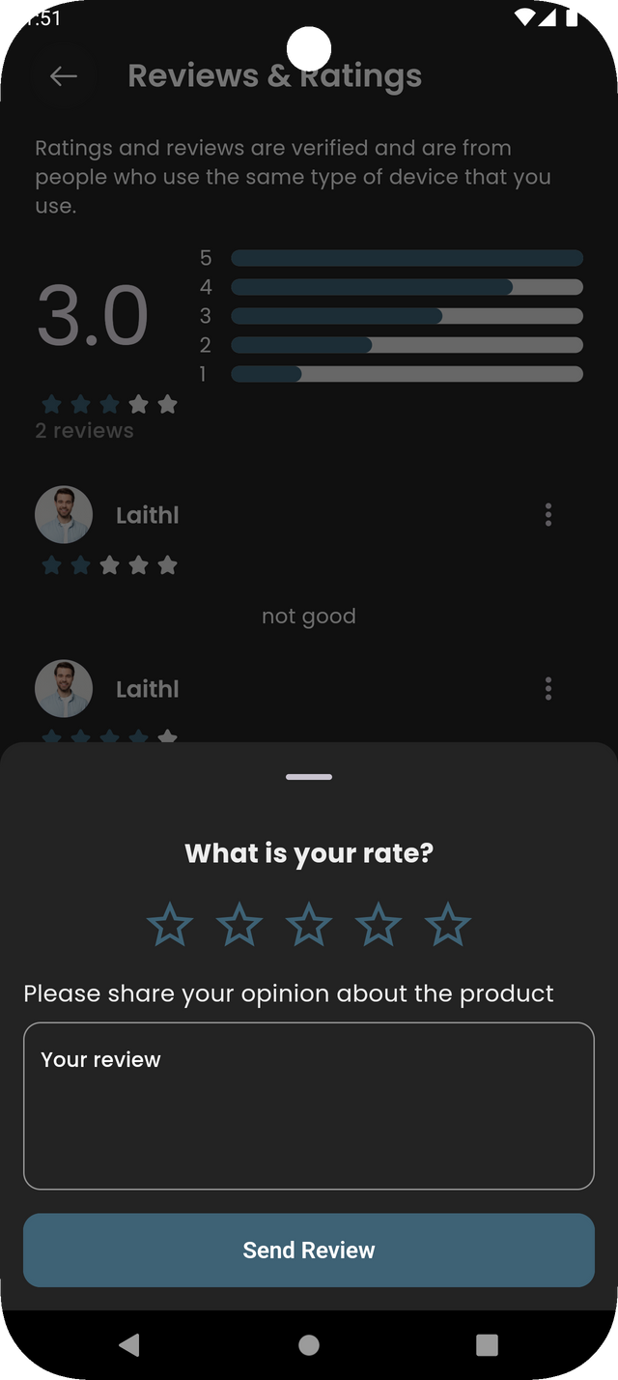
REVIEW

Slide 14
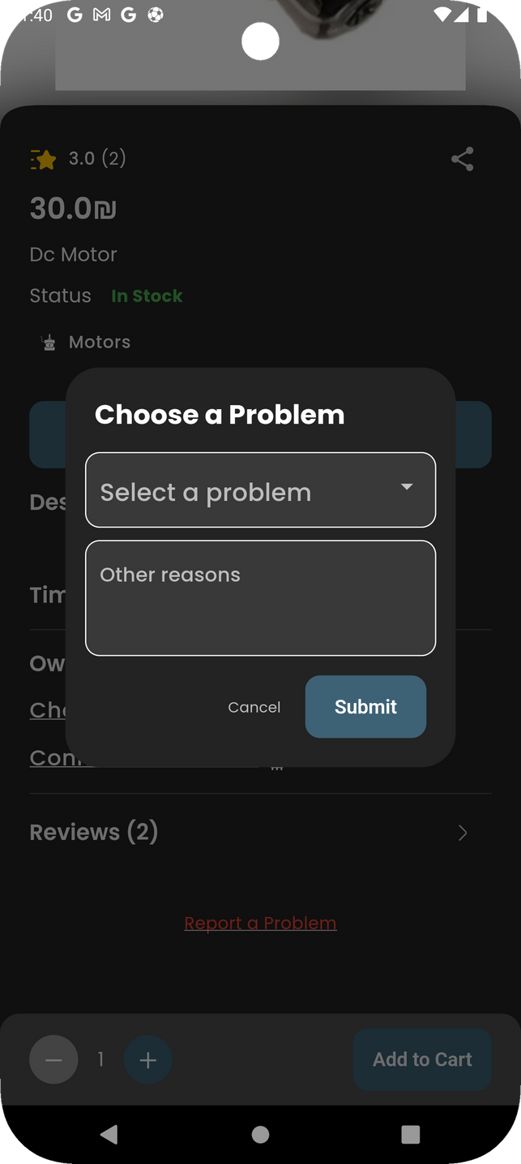
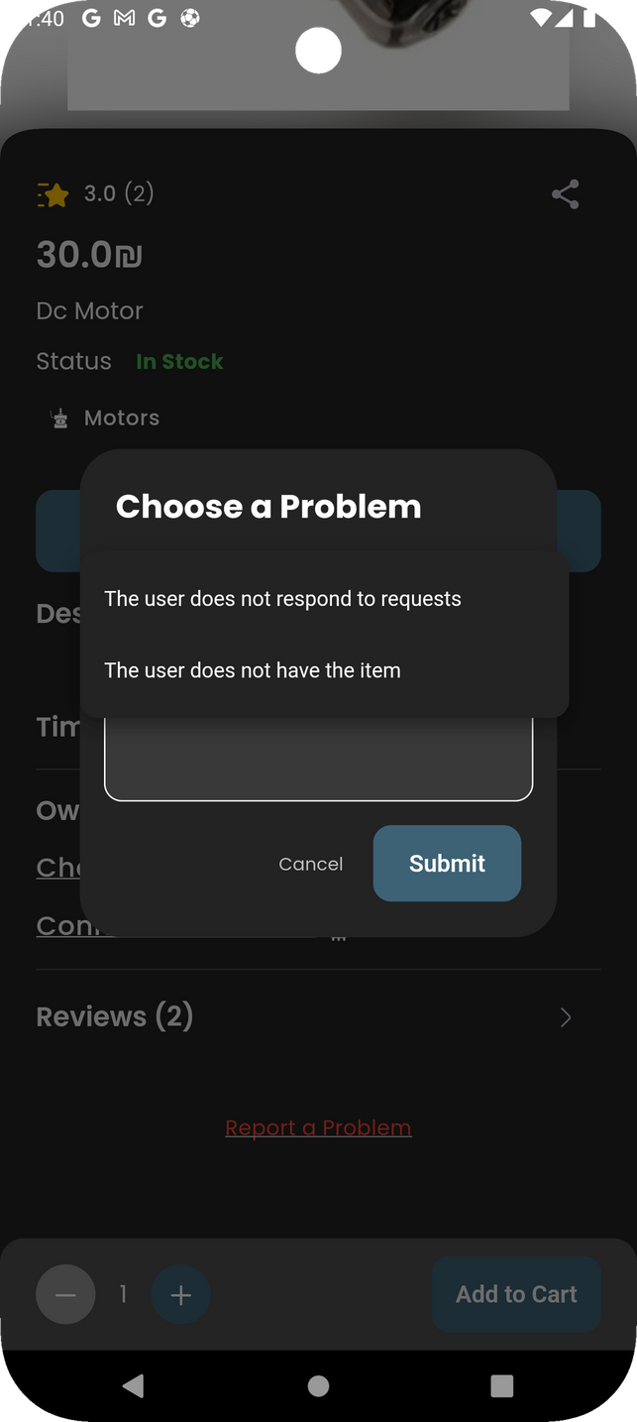
REPORT

Slide 15
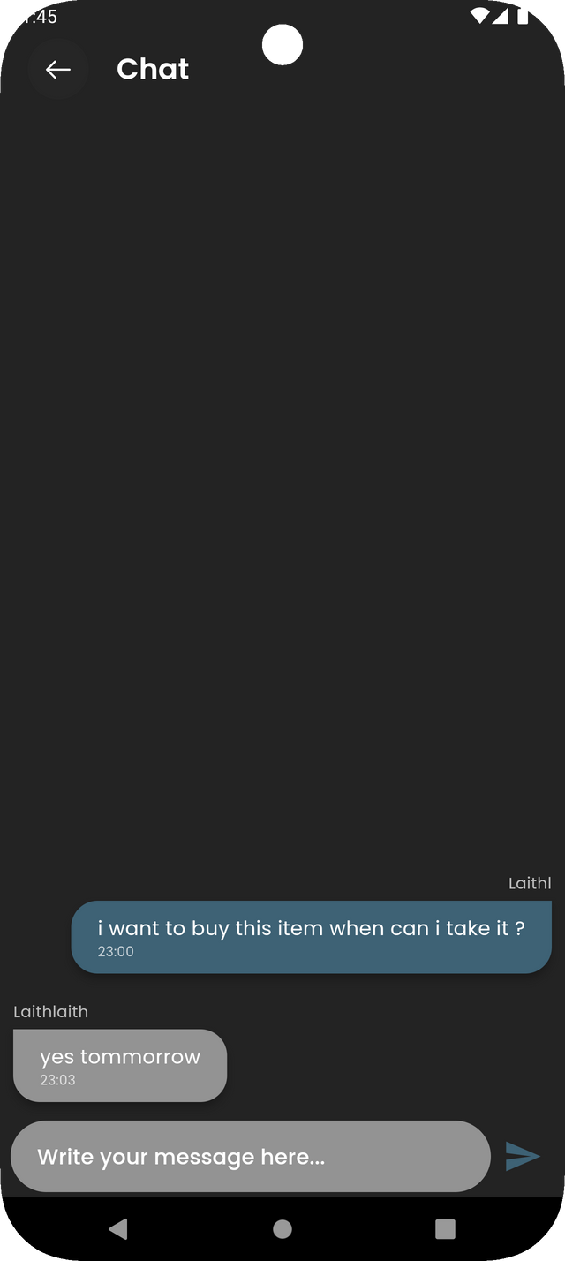
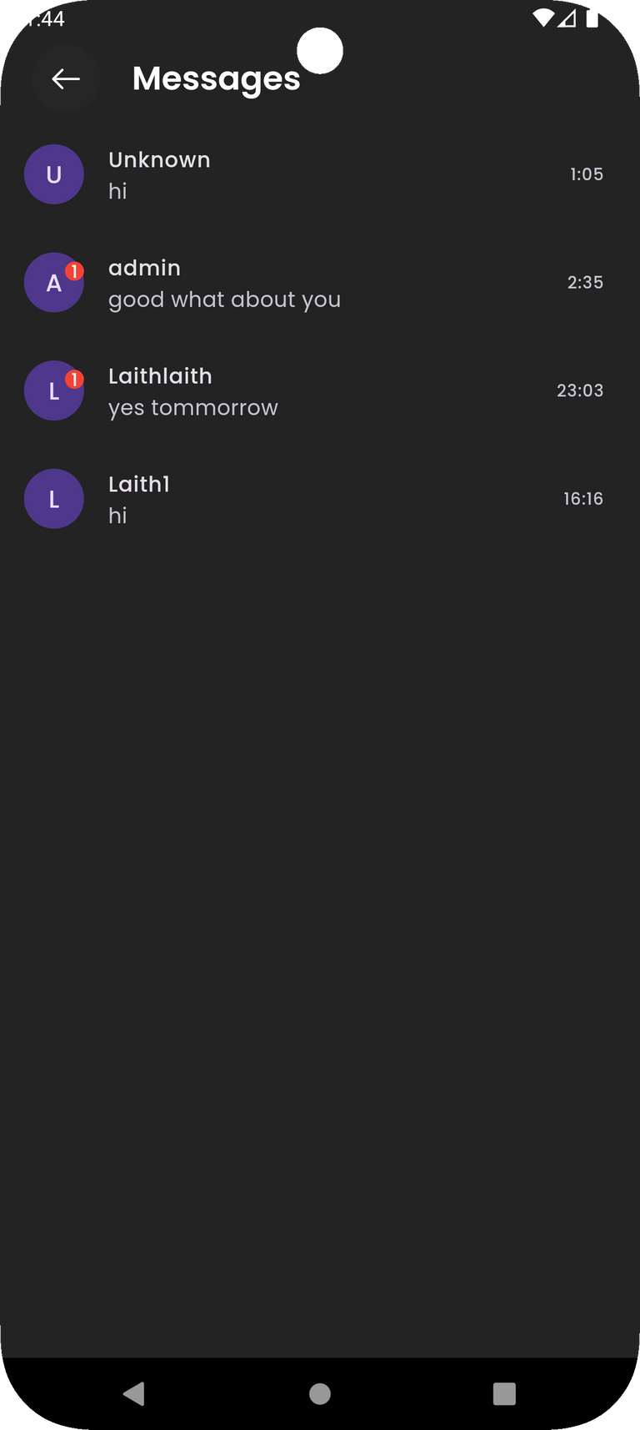
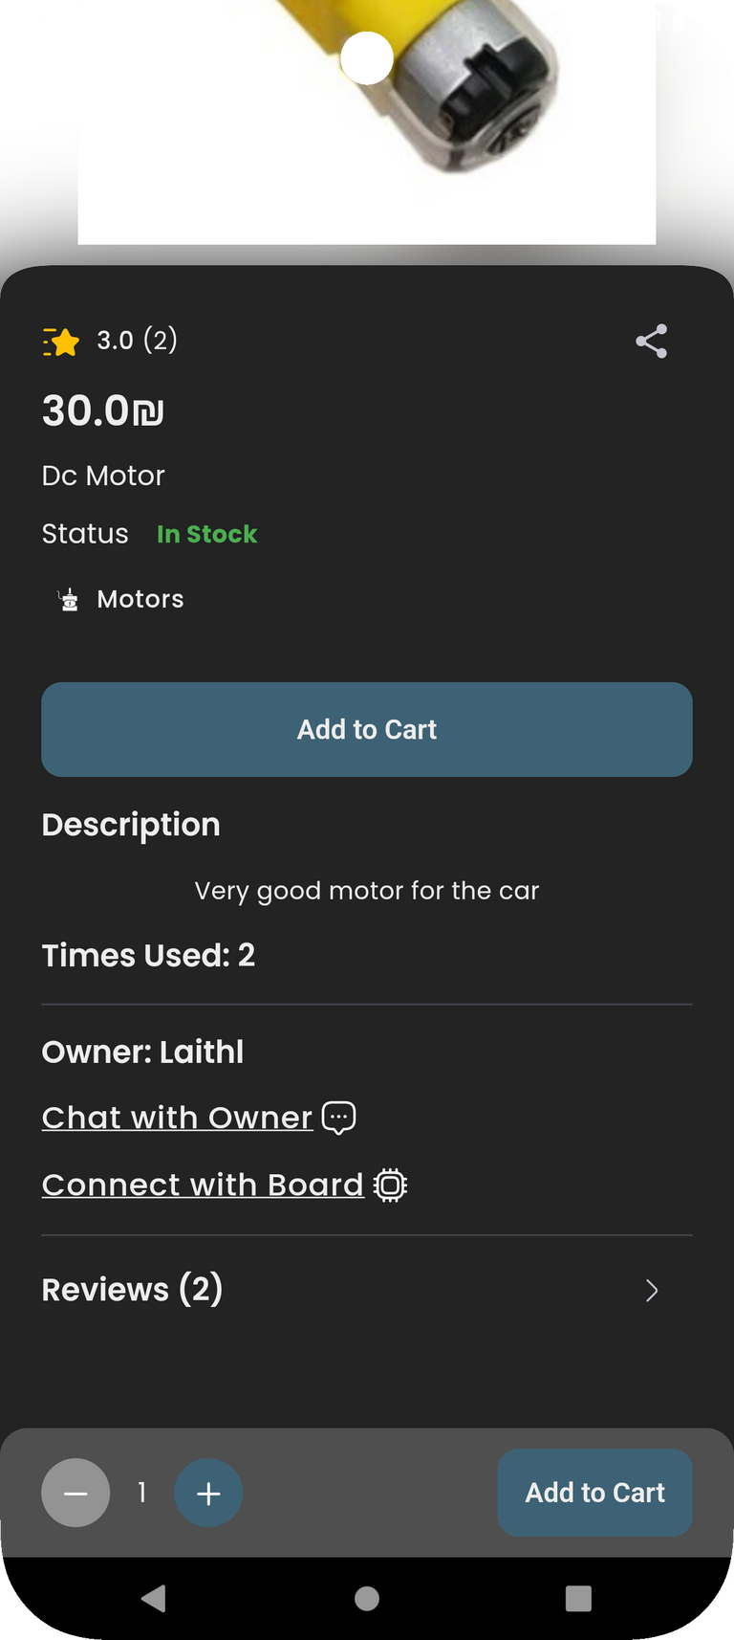
Chatting!

Slide 16
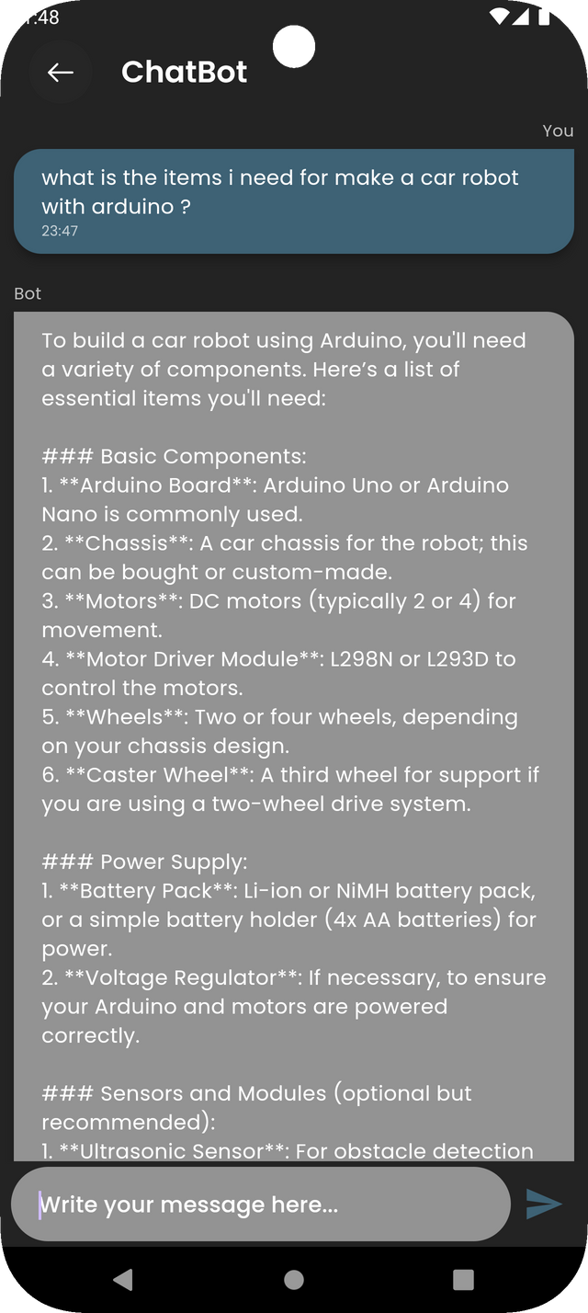
ChatBot!

Slide 17
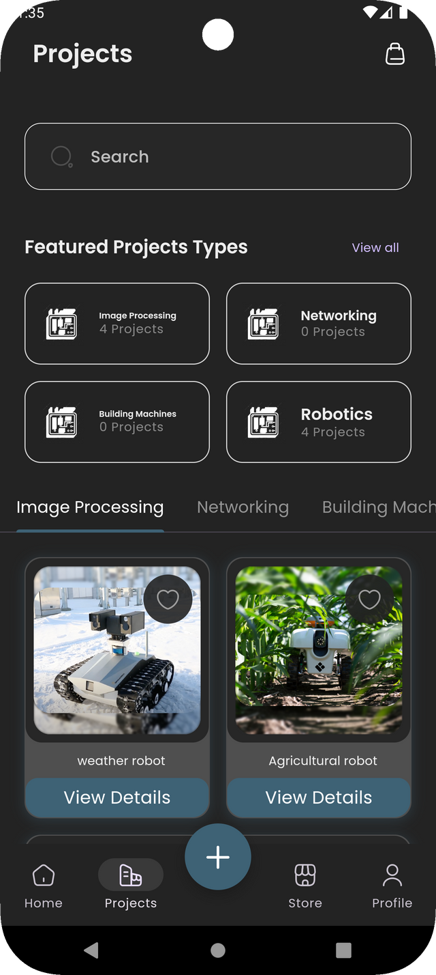
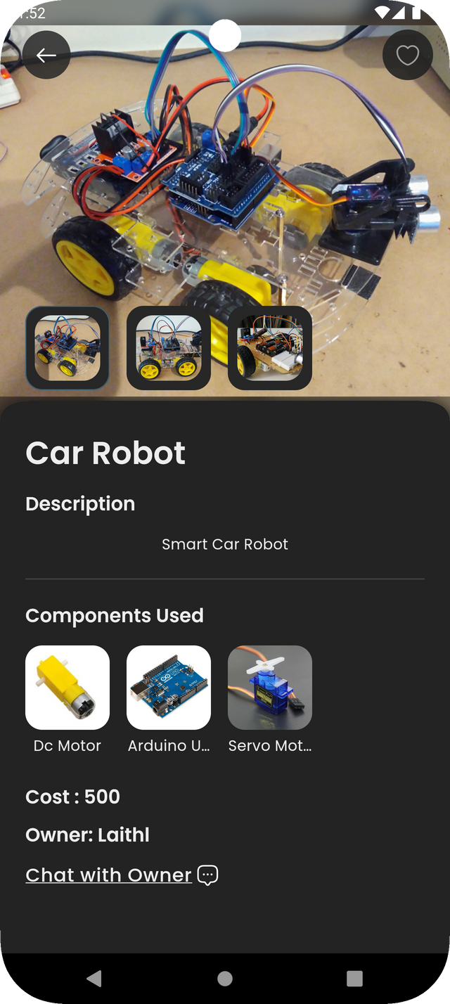
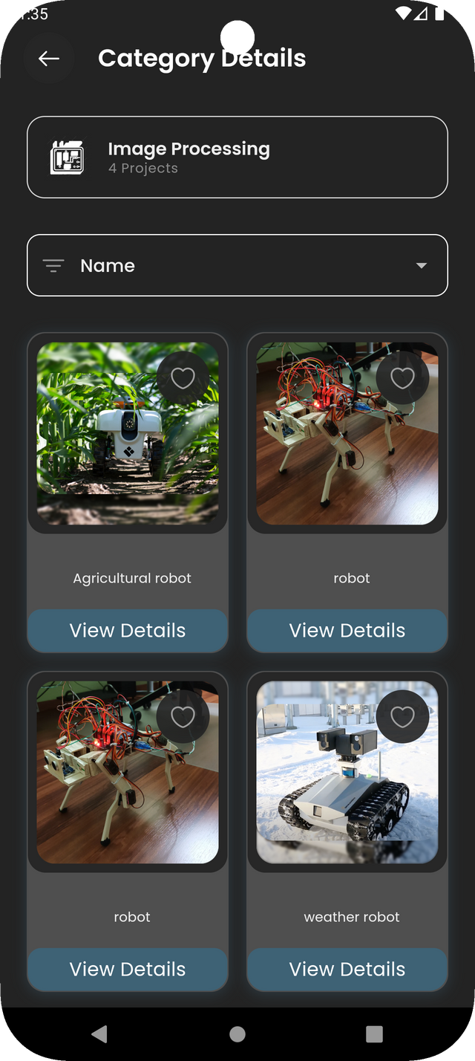
PROJECTS

Slide 18
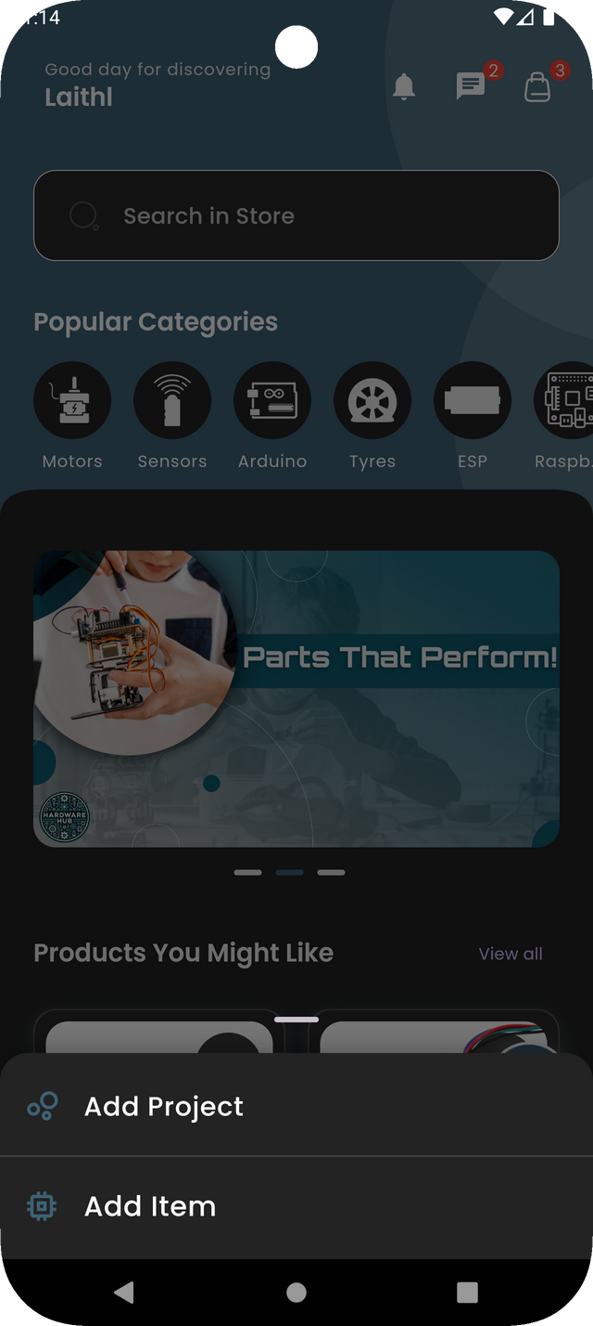
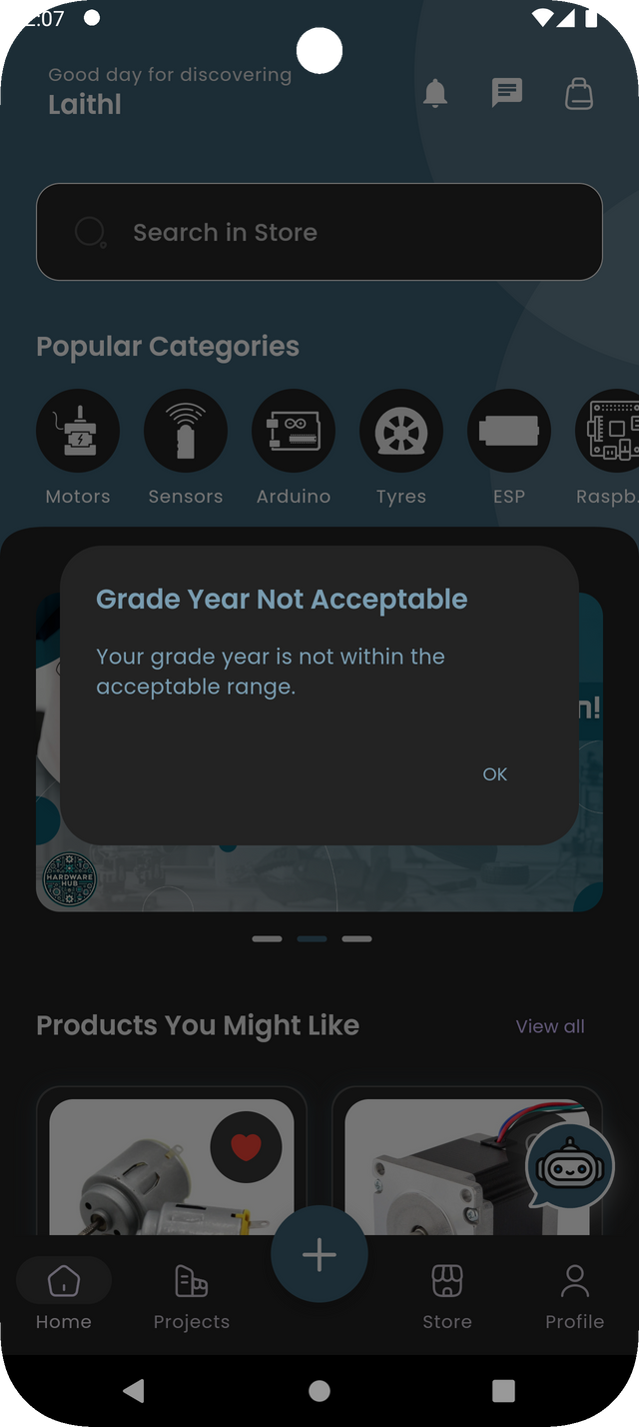
ADD PRODUCT - PROJECT

Slide 19
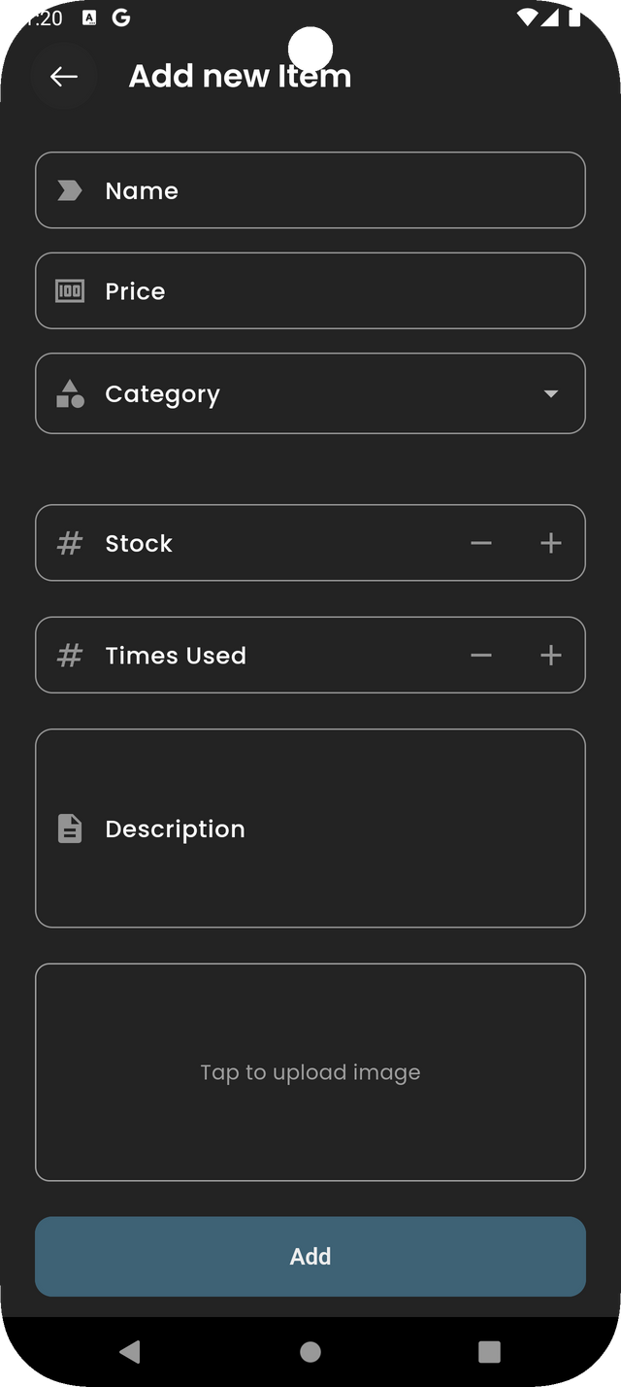
ADD PRODUCT

Slide 20
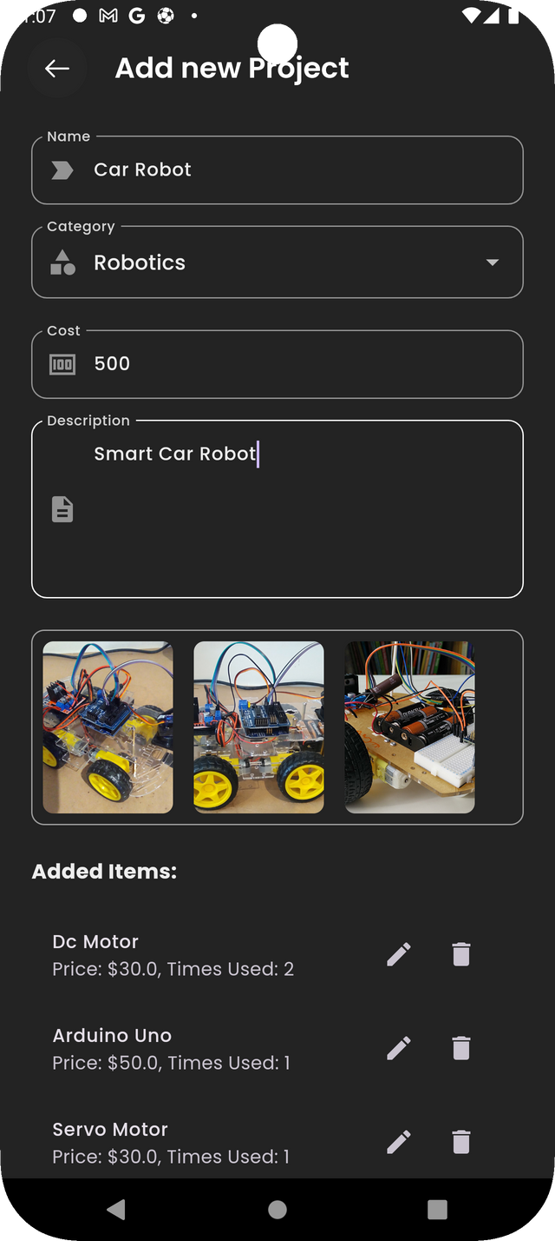
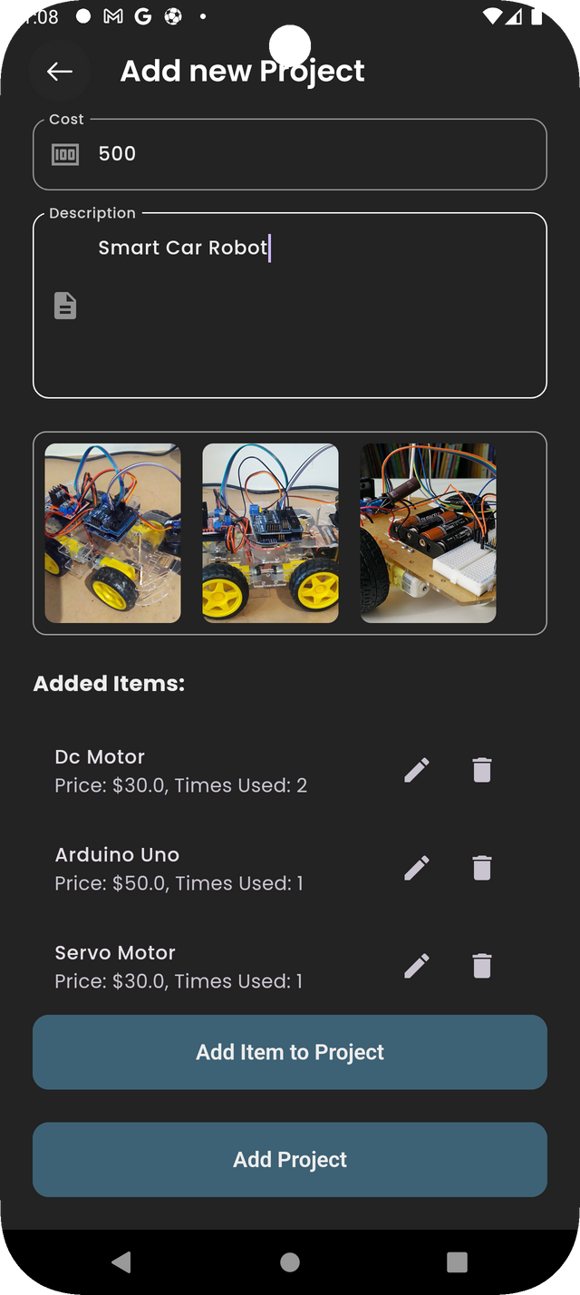
ADD PROJECT

Slide 21
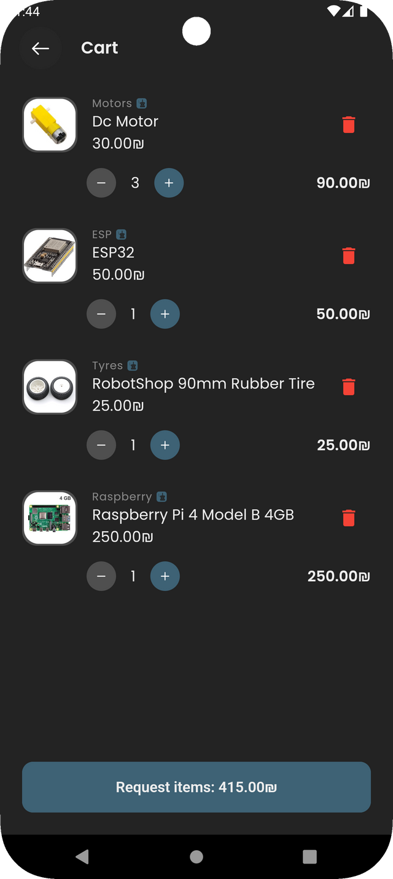
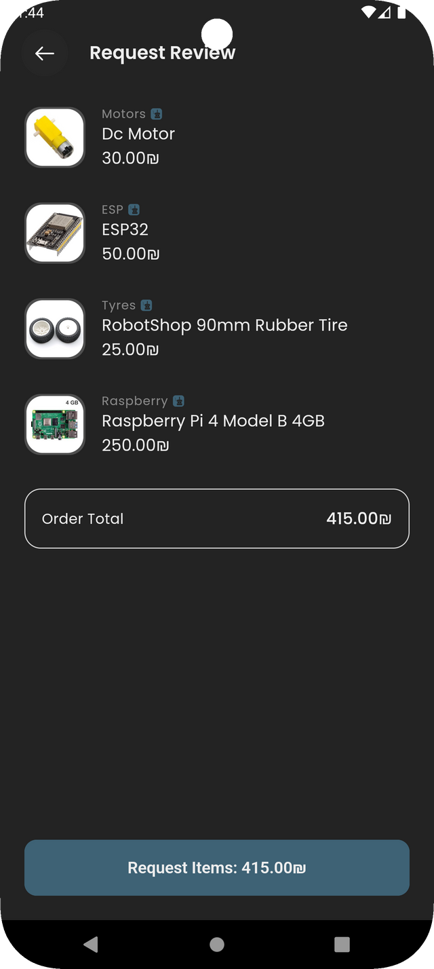
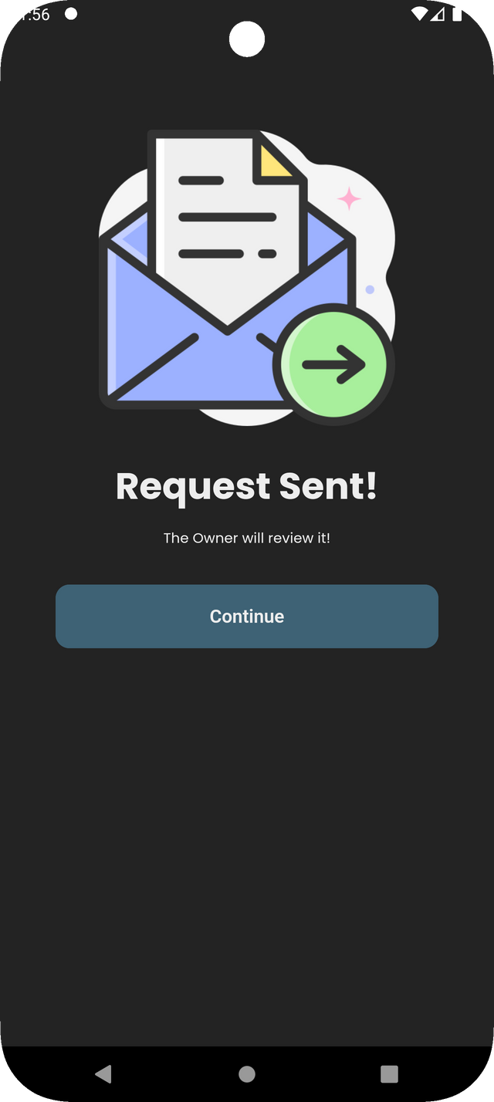
Cart

Slide 22
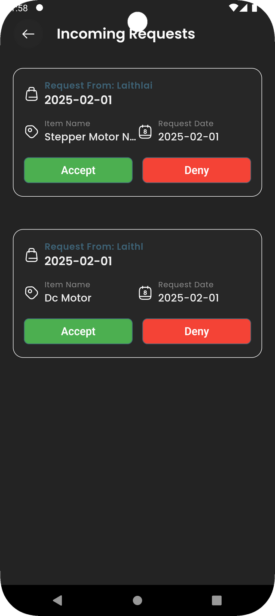
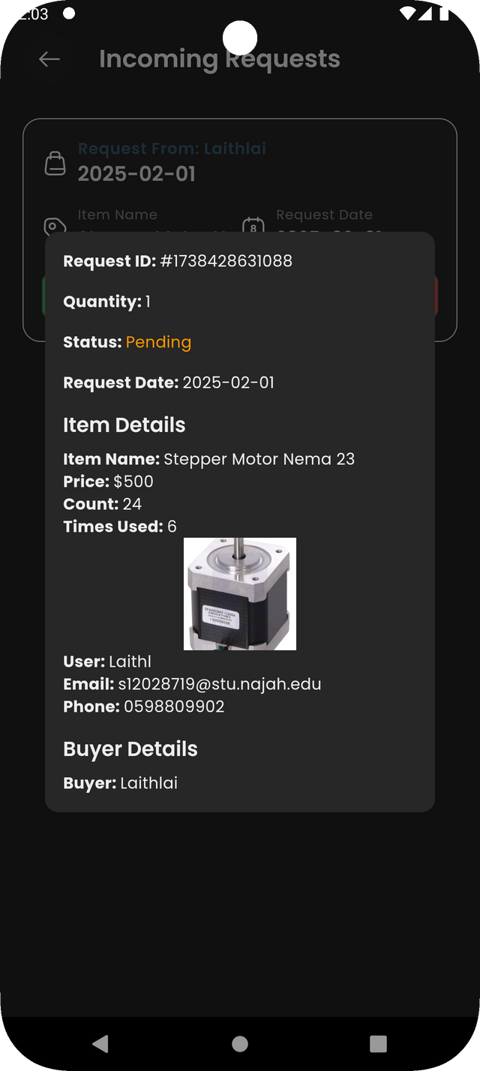
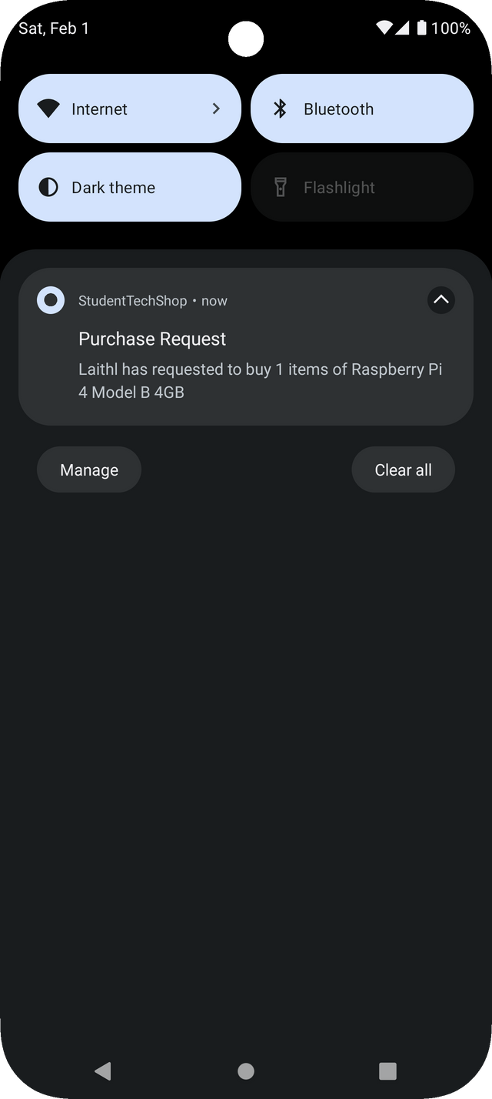
Requests

Slide 23
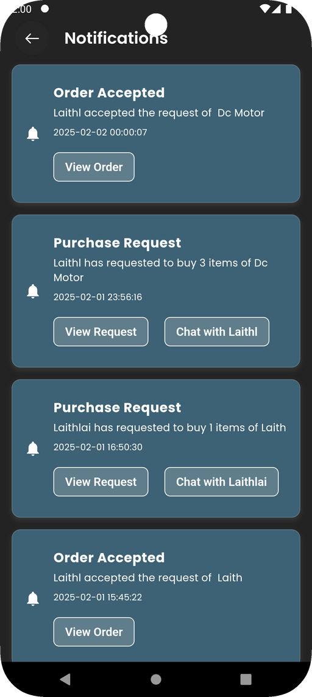

Notifications

Slide 24
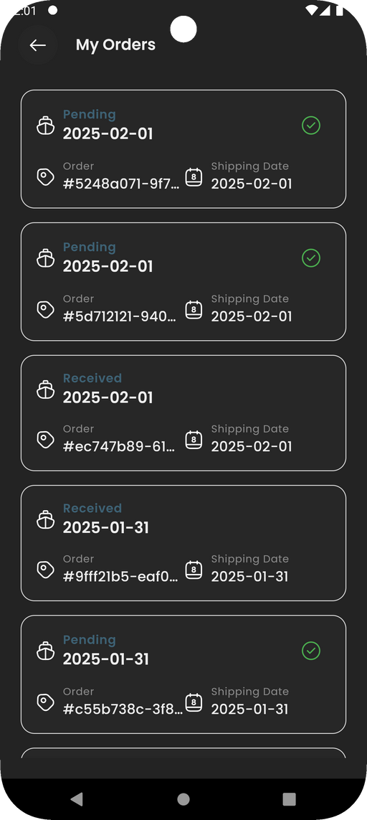
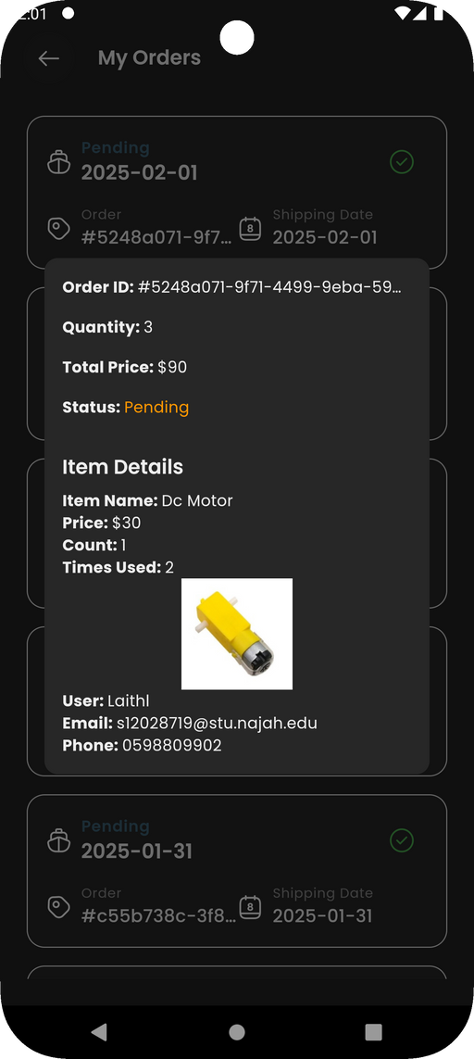
Orders

Slide 25
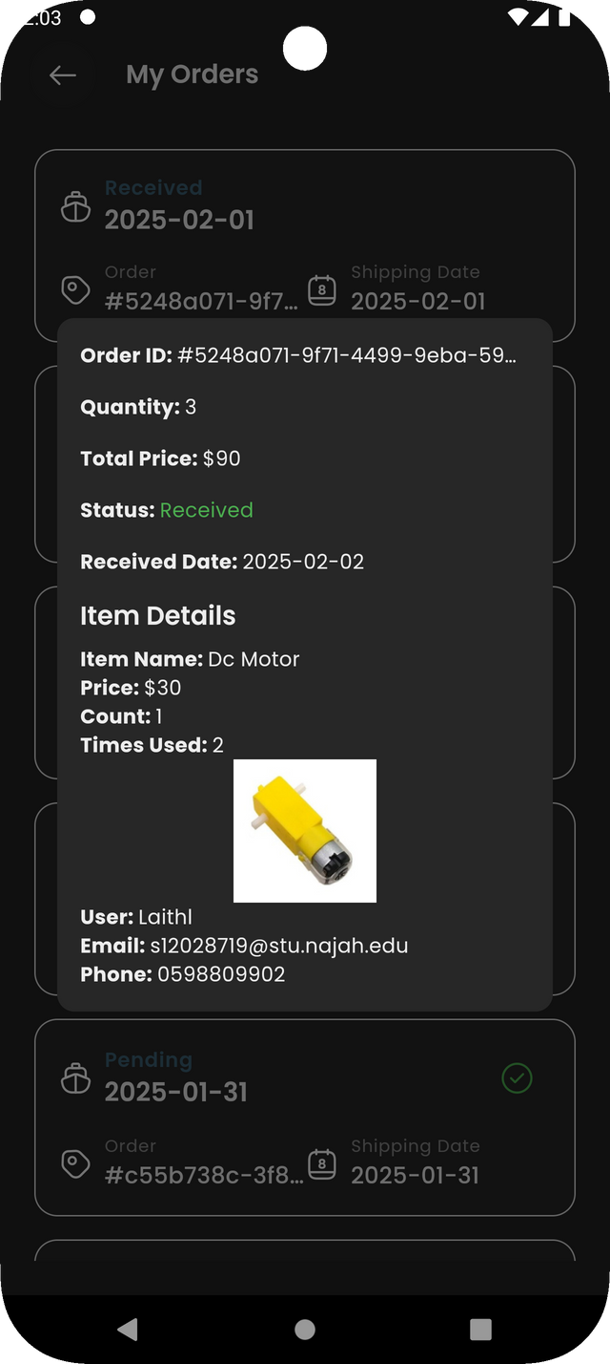
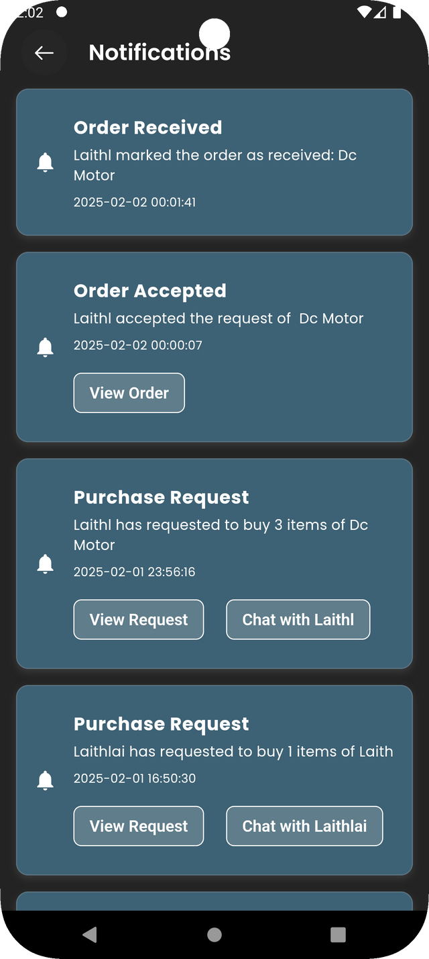

Received & Notifications

Slide 26
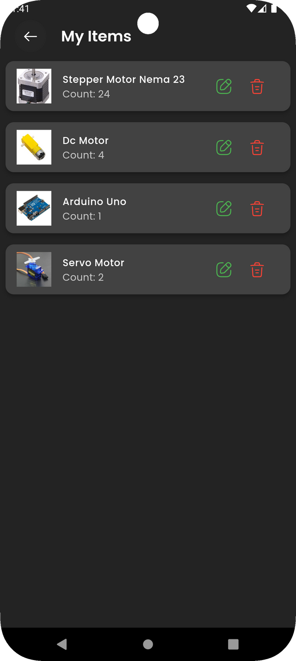
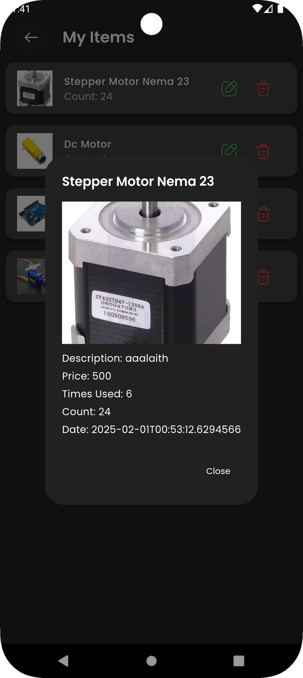

My Products

Slide 27



My Projects

Slide 28


WishList

Slide 29

Administrator powers on the system

Slide 30

Administrator powers on the system

Slide 31


Administrator powers on the system

Slide 32

Administrator powers on the system

Slide 33

Administrator powers on the system

Slide 34


Administrator powers on the system

Slide 35

Administrator powers on the system

Slide 36

Administrator powers on the system

Slide 37

Administrator powers on the system

Slide 38


Administrator powers on the system

Slide 39

Administrator powers on the system

Slide 40


Administrator powers on the system

Slide 41

Administrator powers on the system

Slide 42
Problems Encountered
Some sites required a subscription.
The many things we learned in a short time.

Slide 43
Future Work
1. Agree with a specific company to provide products in
good quantities and prices for students and display
them on the website.
2. Adding delivery service in agreement with the delivery company.

Slide 44
THANK YOU

