Slide 1
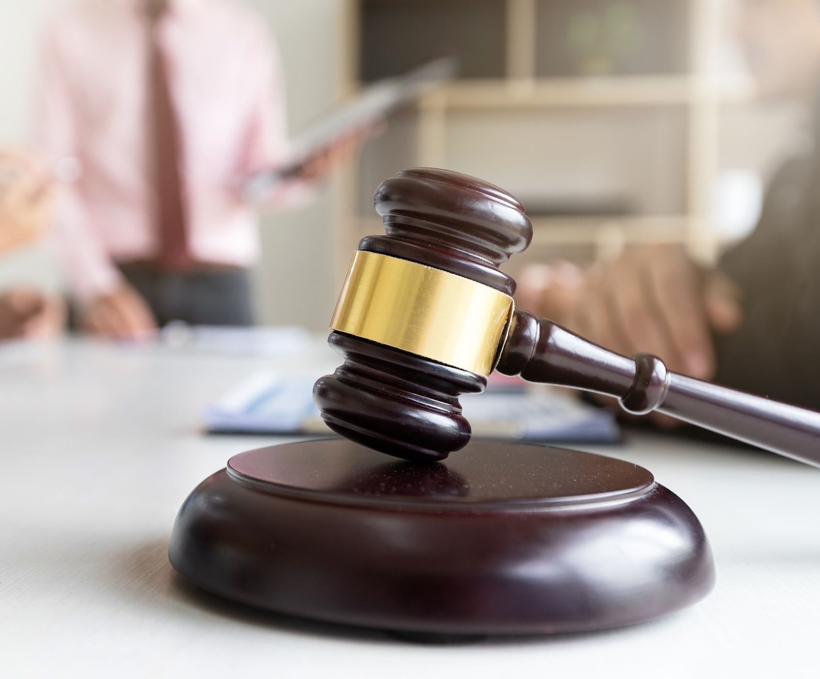
JUSTICE ROOTS
Presented By
Mohammad Bdair
Mohammad Aydi
Supervisors:
Dr. Raed Qadi
Dr. Khalid Daud
www.reallygreatsite.com

Slide 2
CONTENT
01
INTRODUCTION
02
GOALS AND OBJECTIVES
03
TECHNOLOGIES
04
SYSTEM DESIGN
05
ADMINISTRATIVE COMMISION
06
CLIENTS AND LAWYERS
07
CONSTRAINTS
08
FUTURE WORK

Slide 3
OBJECTIVES
Online Courts
Job Opportunities
Statutory Process
Apply the idea of online courts by building a convinient platform
Provide job opportunities for lawyers through the find a lawyer page
Facilitate The people’s life by simplifying the finding a suitable lawyer and eliminate the need for waiting in long queues at courts
Cases Management
Legal Awareness
Judiciary System
Built a reliable and convenient dashboard for judges and employees to help them in managing the courts and their procedures
Improve the legal awareness of people by introducing a community
Provide solution for the tough conditions which any country may go through

Slide 4

TECHNOLOGIES

Slide 5
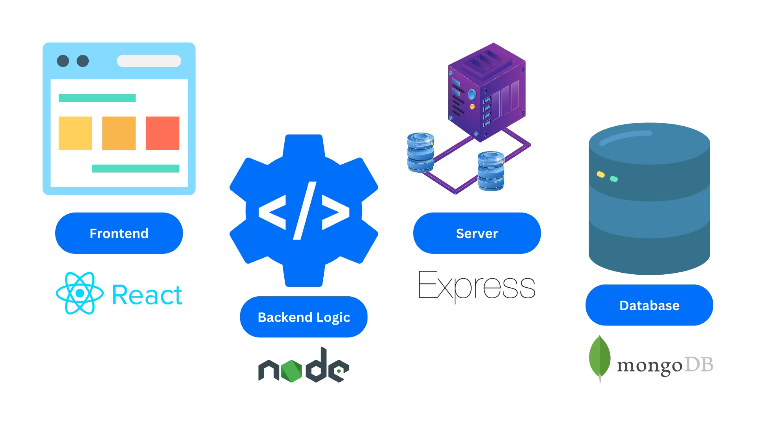
SYSTEM DESIGN

Slide 6
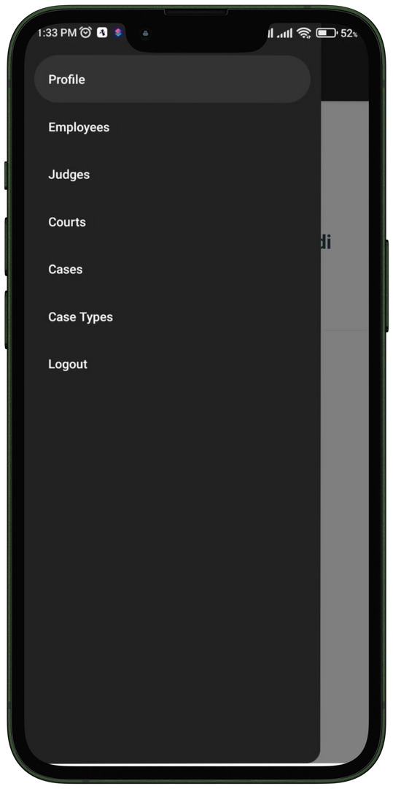


ADMINISTRATIVE COMMISSION

Slide 7
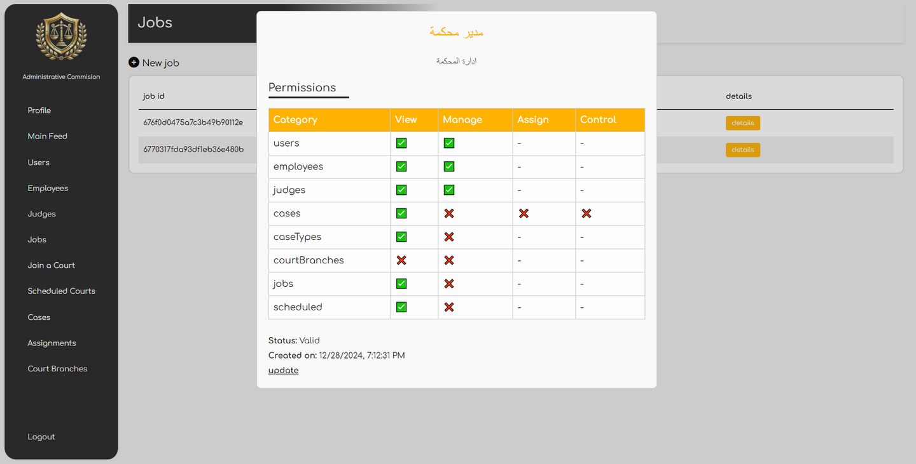
ADMINISTRATIVE COMMISSION

Slide 8
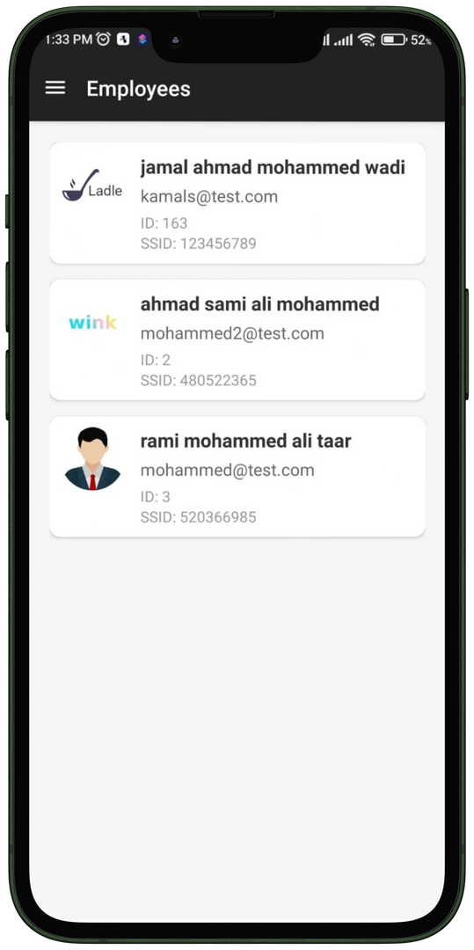
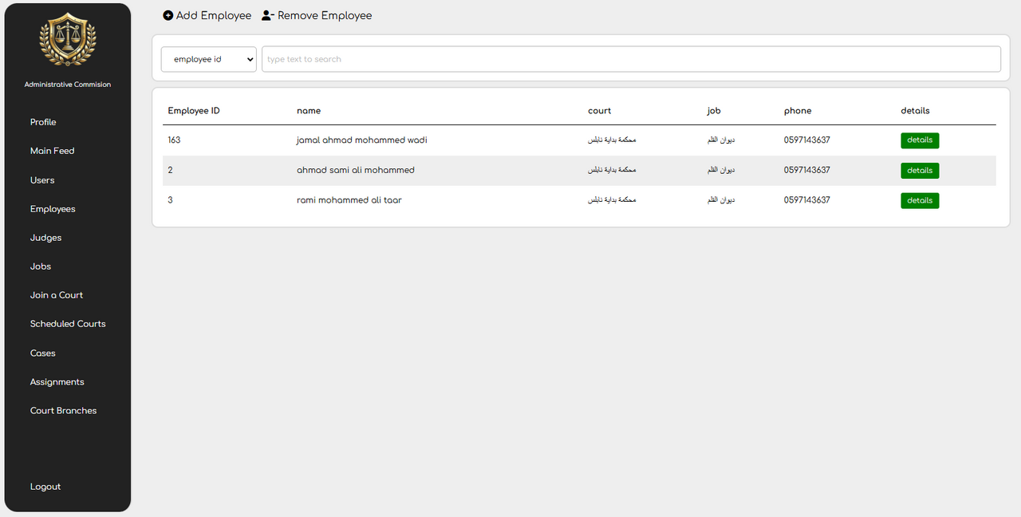
ADMINISTRATIVE COMMISSION

Slide 9
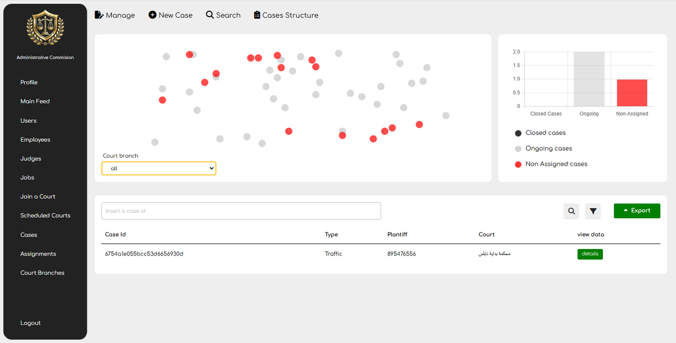
ADMINISTRATIVE COMMISSION

Slide 10
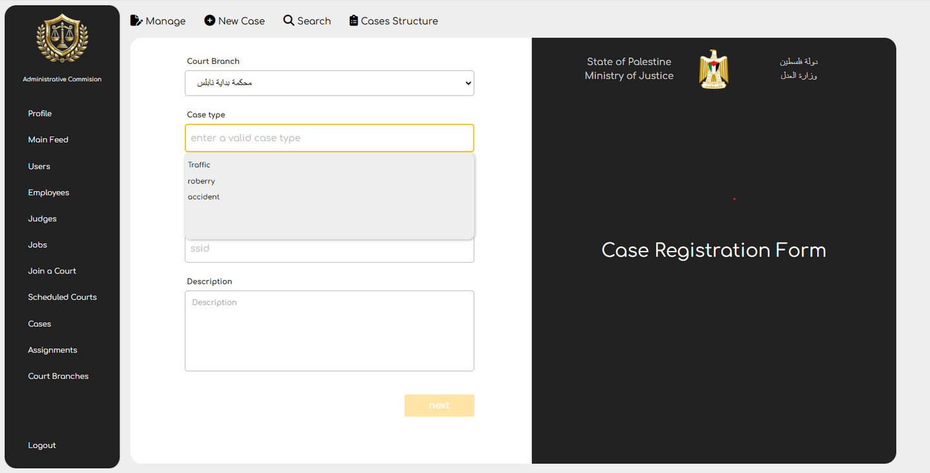
ADMINISTRATIVE COMMISSION

Slide 11
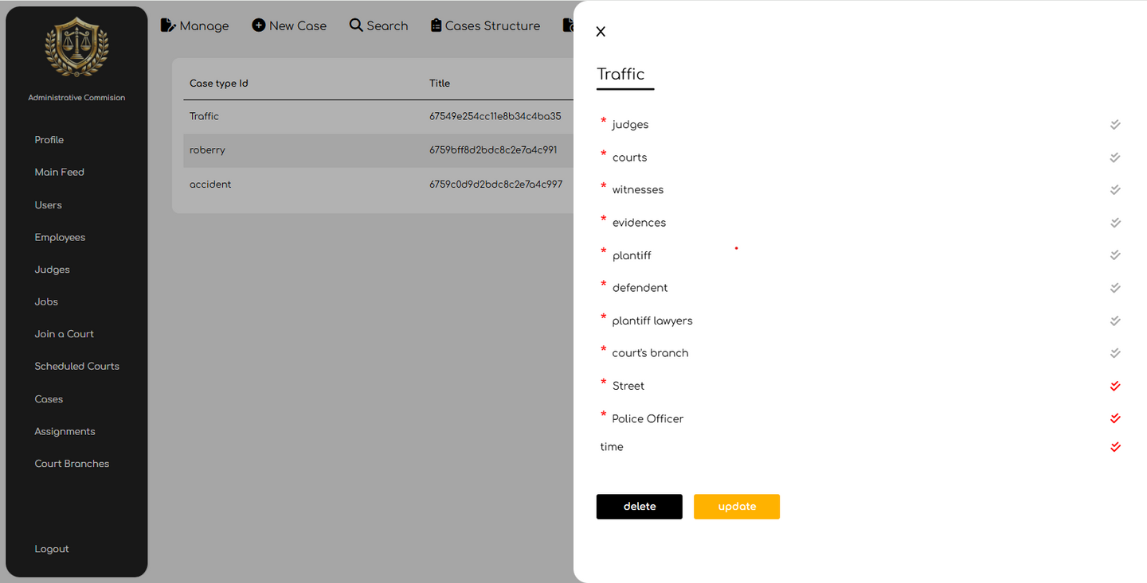
ADMINISTRATIVE COMMISSION

Slide 12
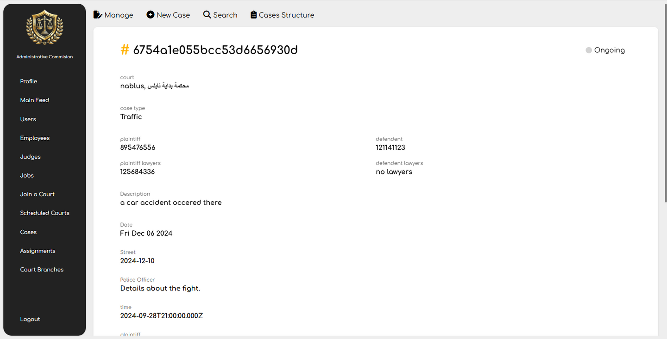
ADMINISTRATIVE COMMISSION

Slide 13
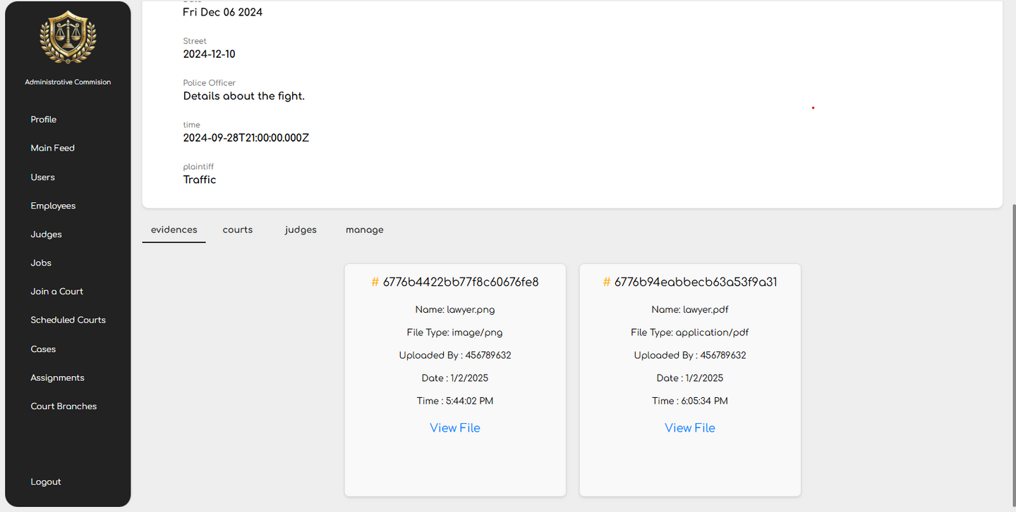
ADMINISTRATIVE COMMISSION

Slide 14
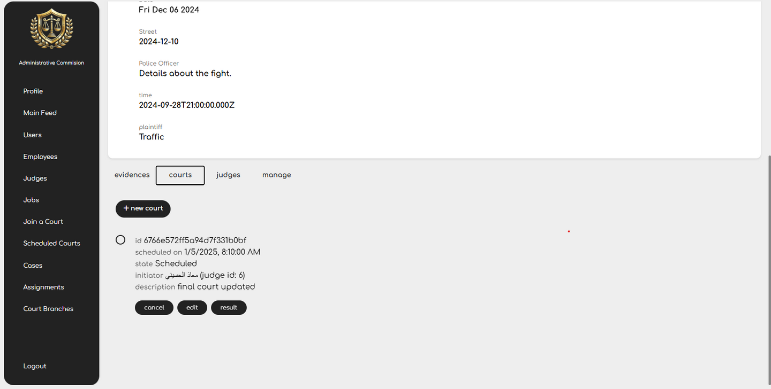
ADMINISTRATIVE COMMISSION

Slide 15
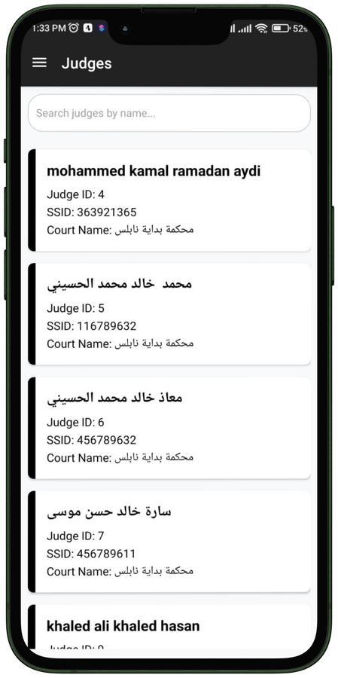
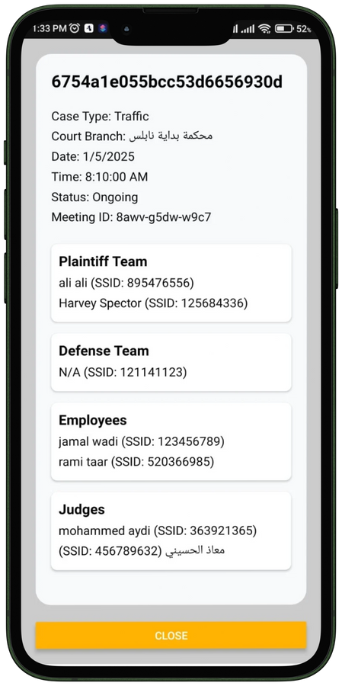
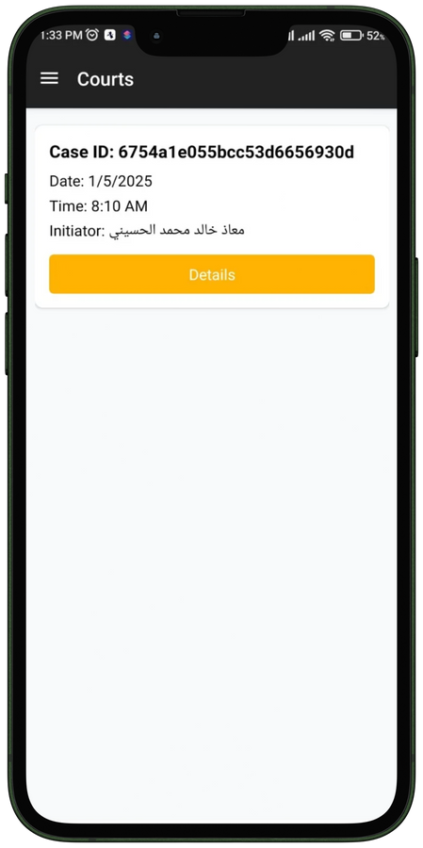
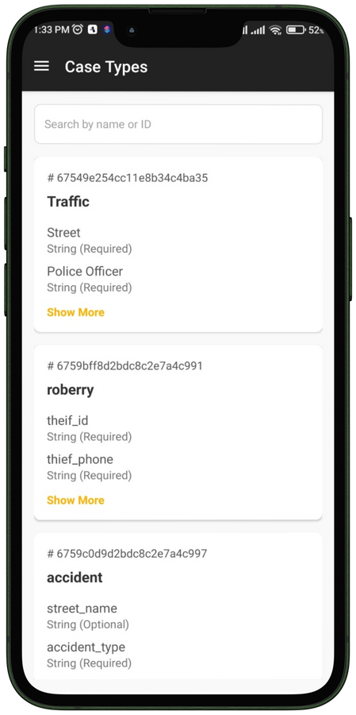
ADMINISTRATIVE COMMISSION
Judges
Court Details
Courts
Case Types

Slide 16
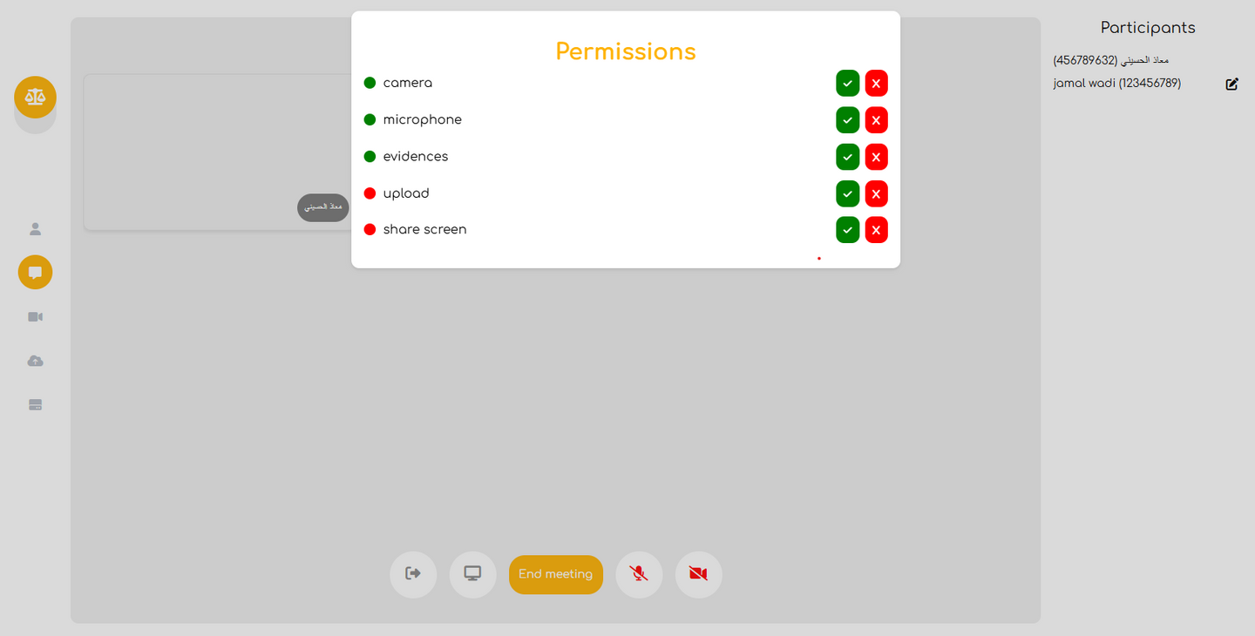
ONLINE COURTS

Slide 17
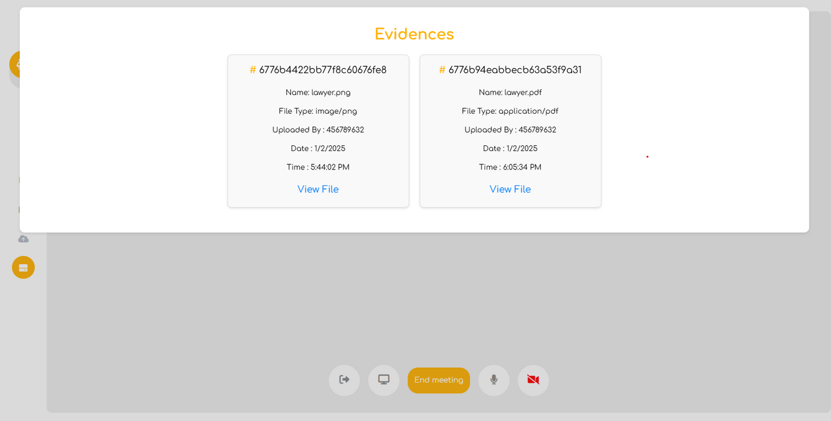
ONLINE COURTS

Slide 18
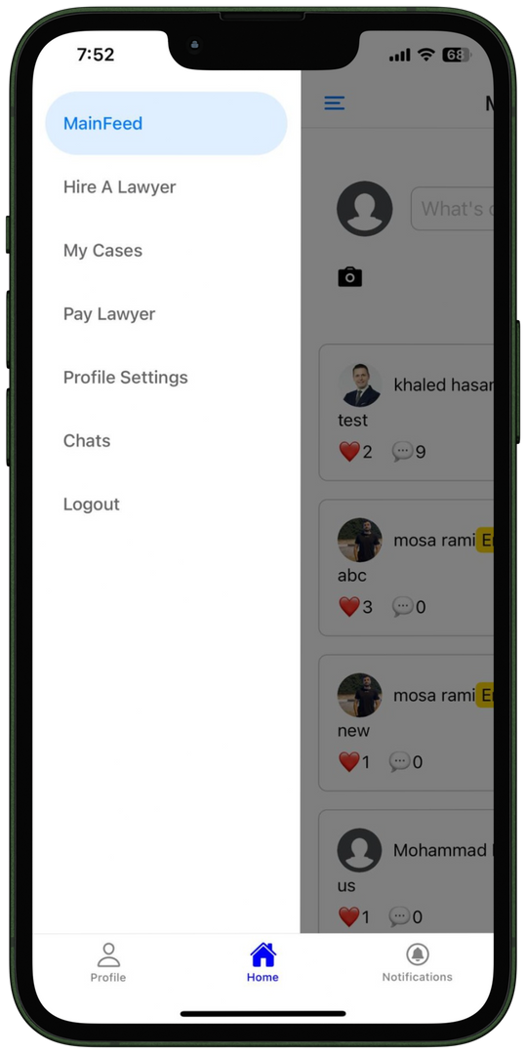
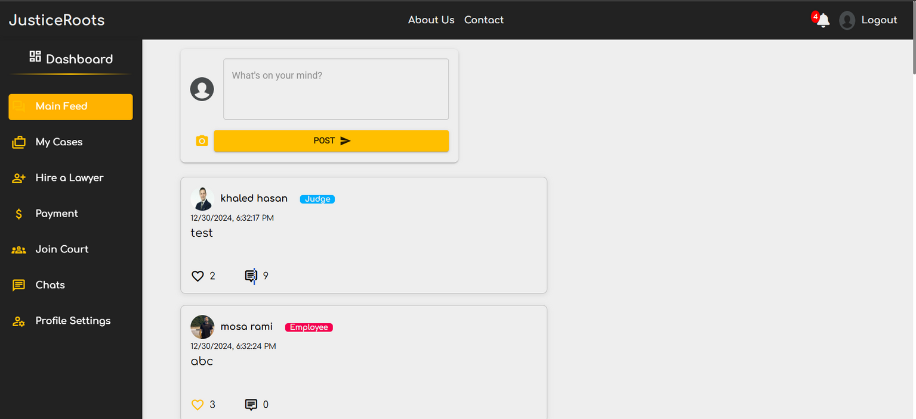
CLIENT
DASHBOARD

Slide 19
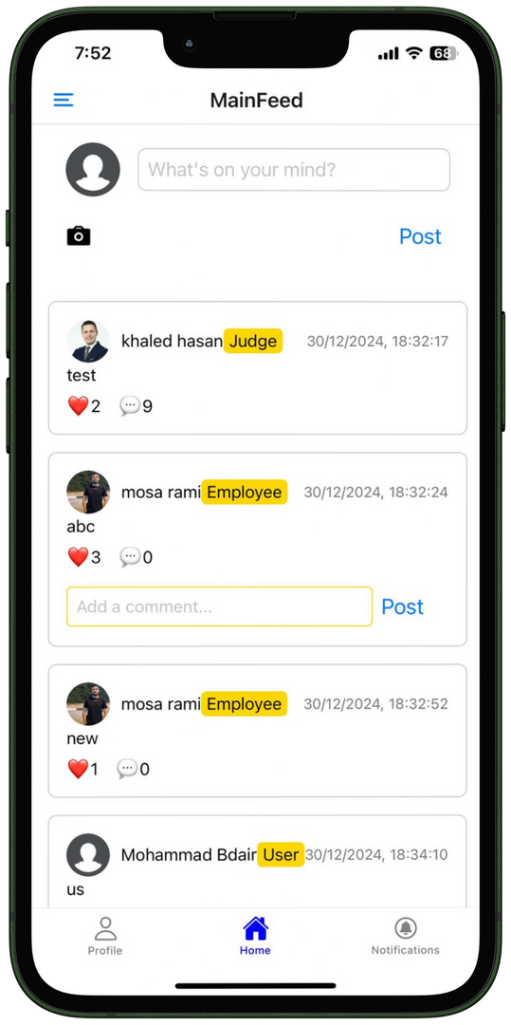
CLIENT
COMMUNITY

Slide 20
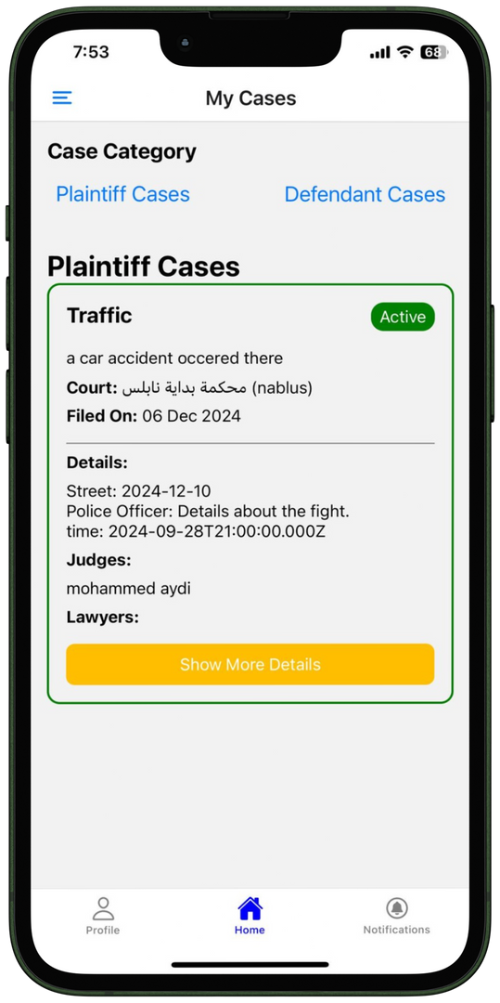
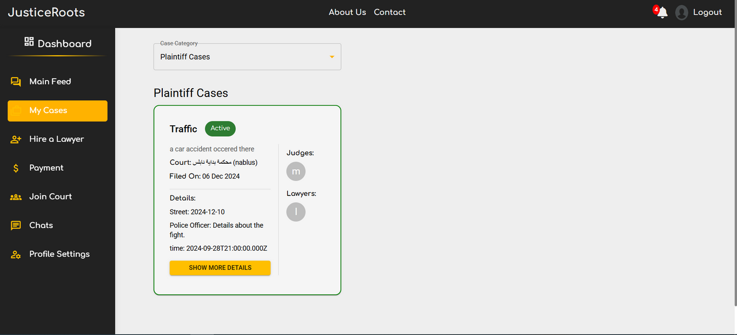
CLIENT
CLIENT CASES

Slide 21
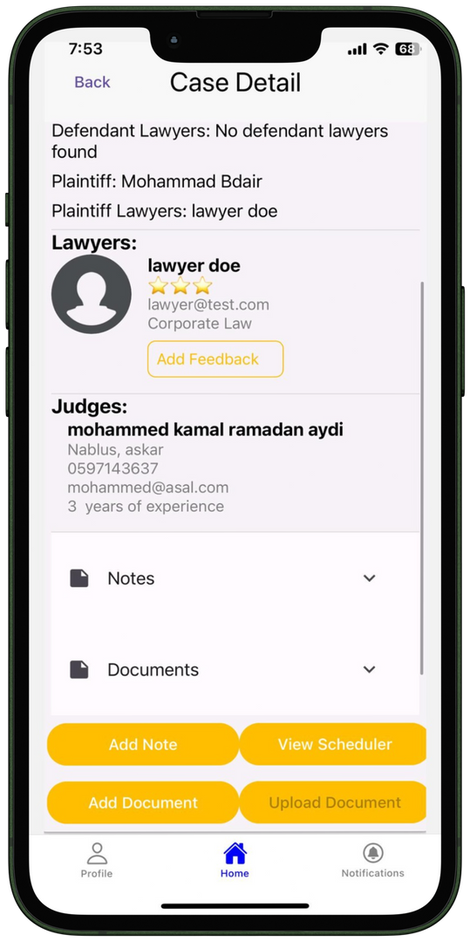
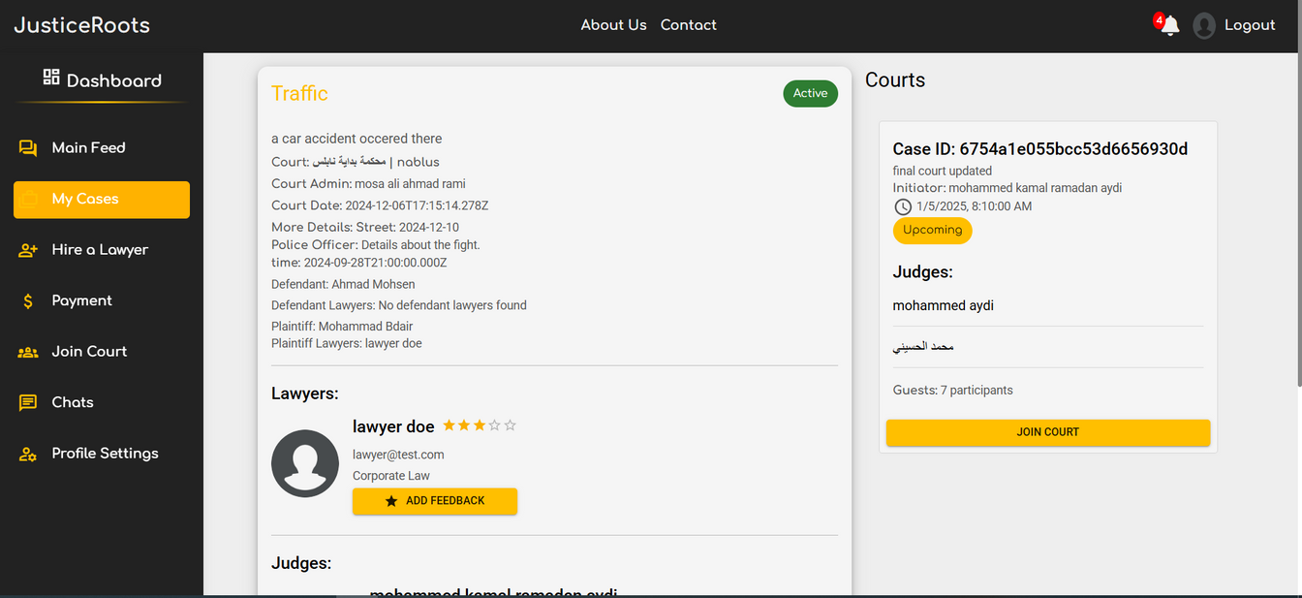
CLIENT
CASE DETAILS

Slide 22
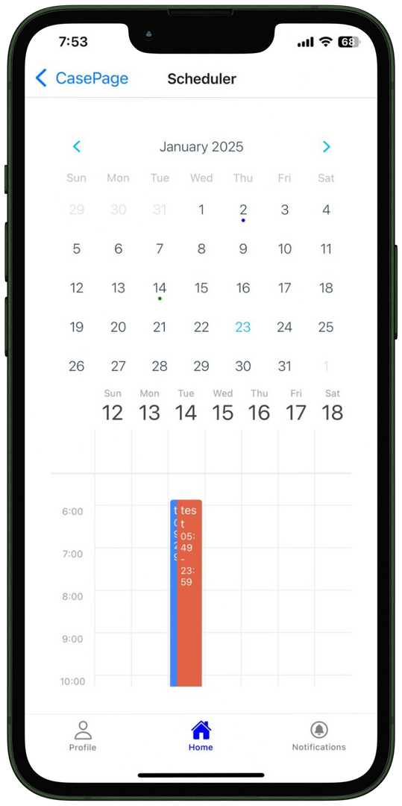
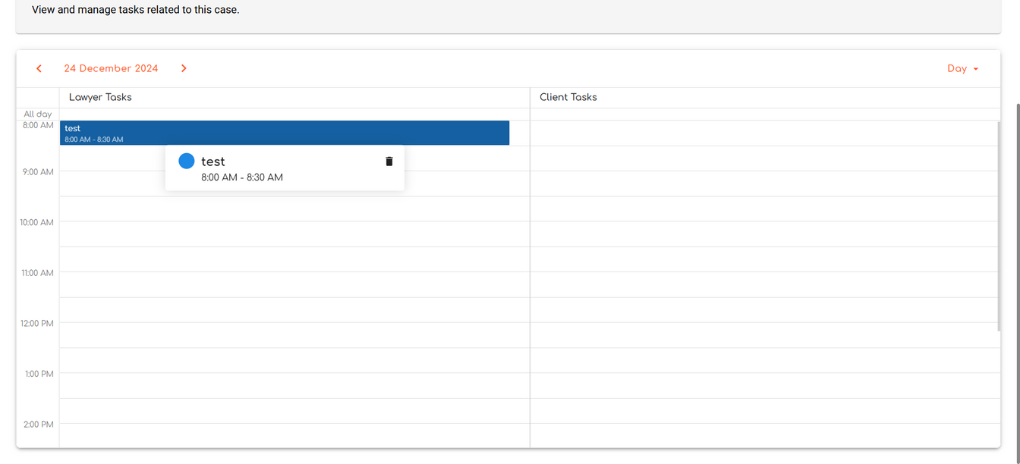
CLIENT
CASE TASKS

Slide 23
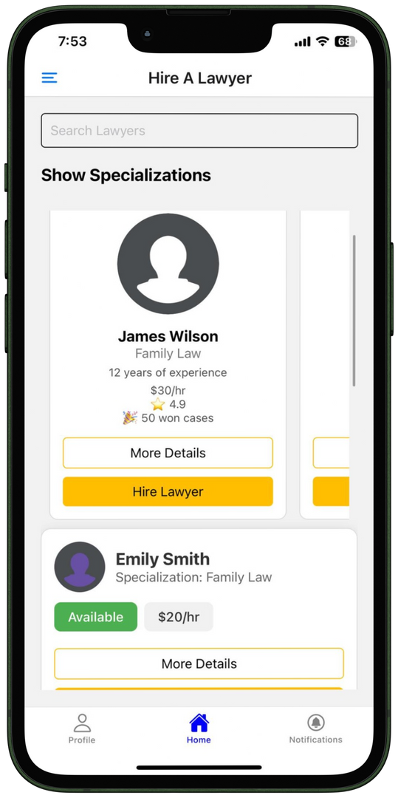
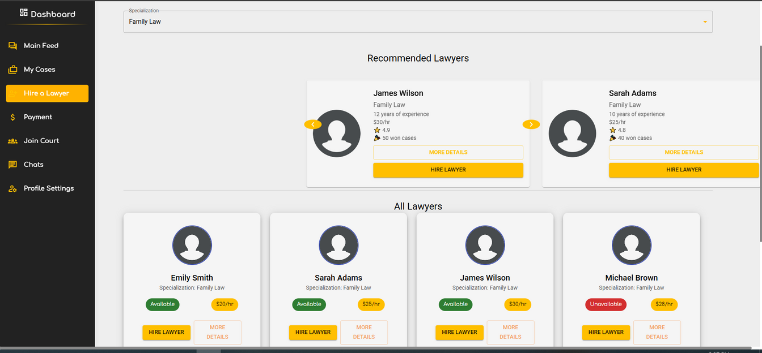
CLIENT
HIRE A LAWYER

Slide 24
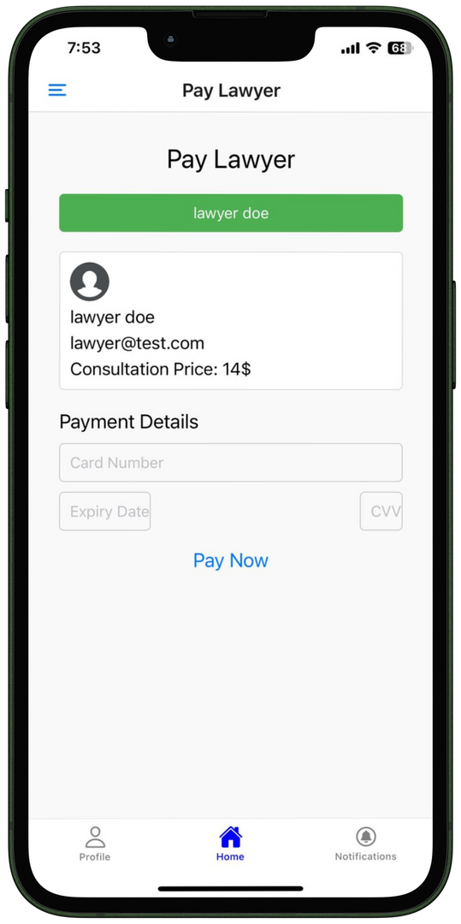
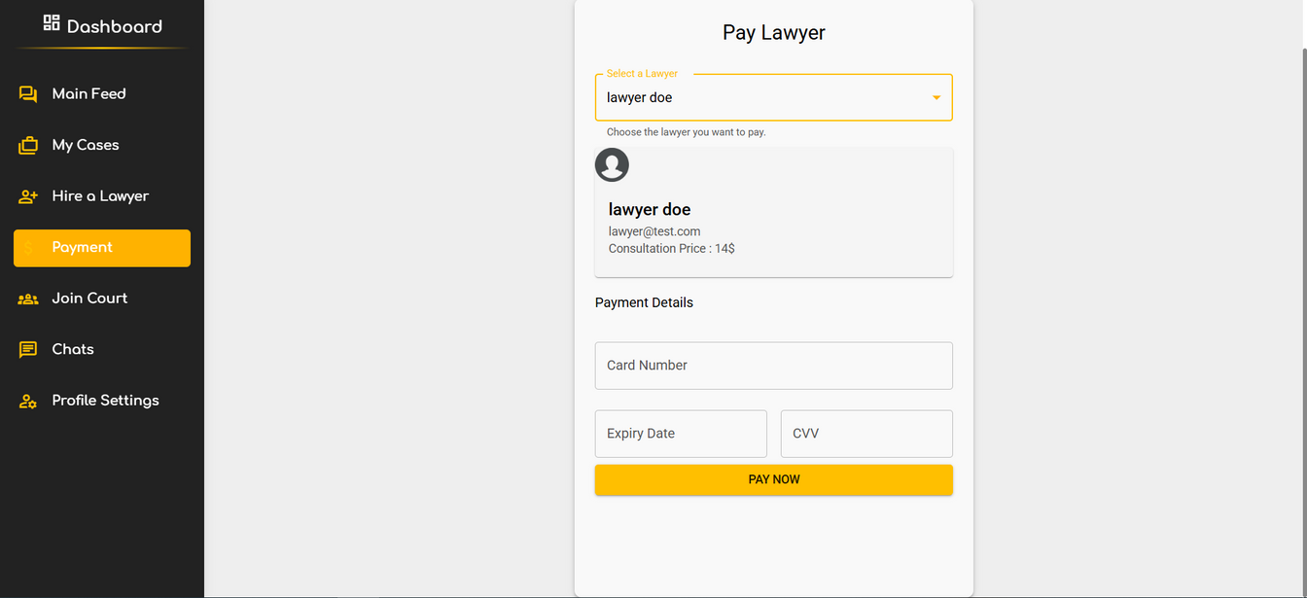
CLIENT
PAY A LAWYER

Slide 25
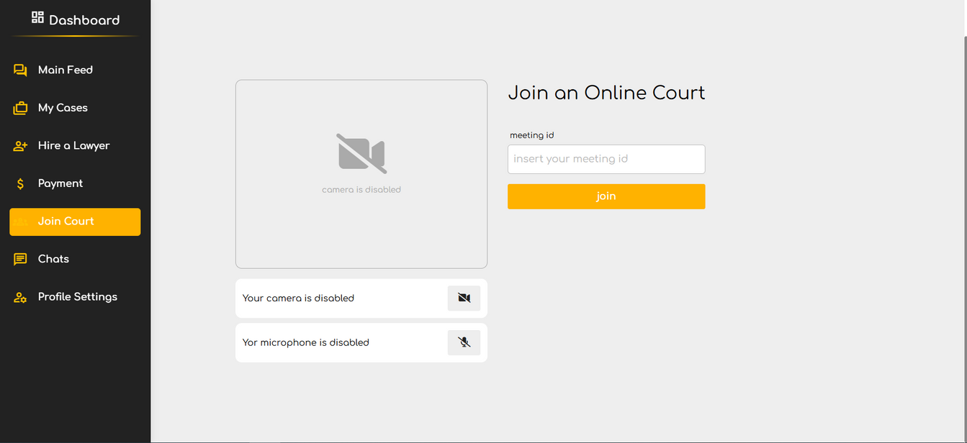
CLIENT
JOIN COURT

Slide 26
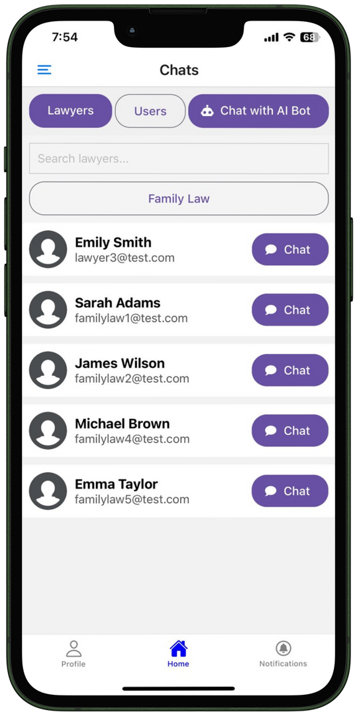
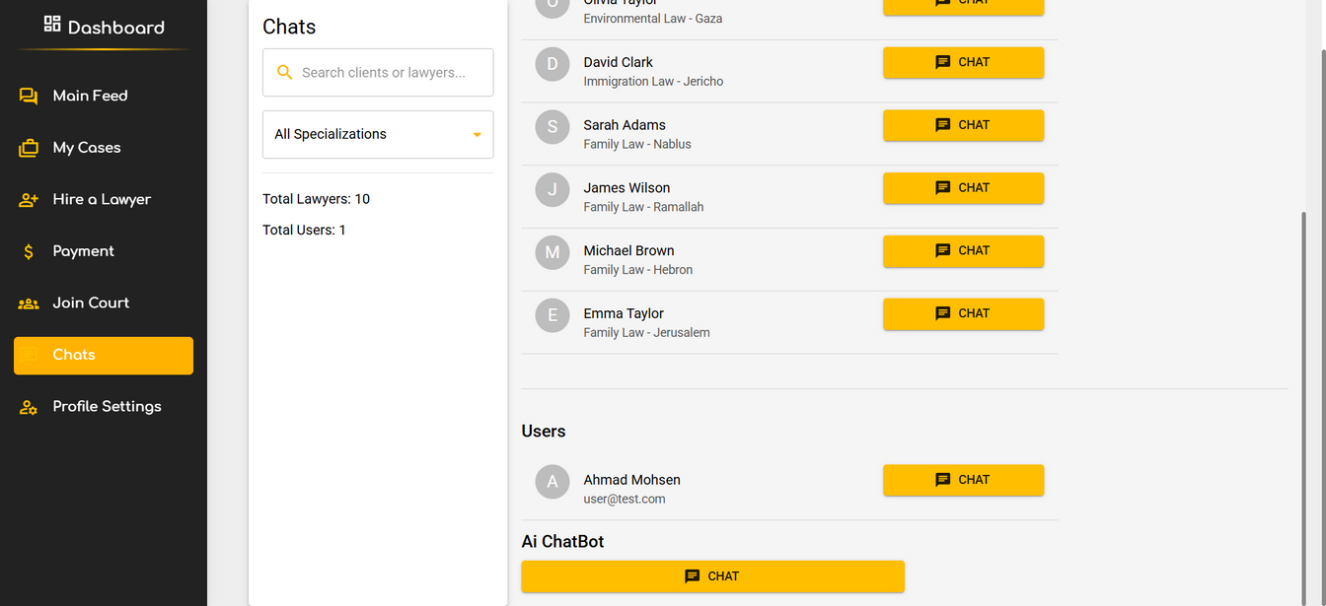
CLIENT
CHATS PAGE

Slide 27
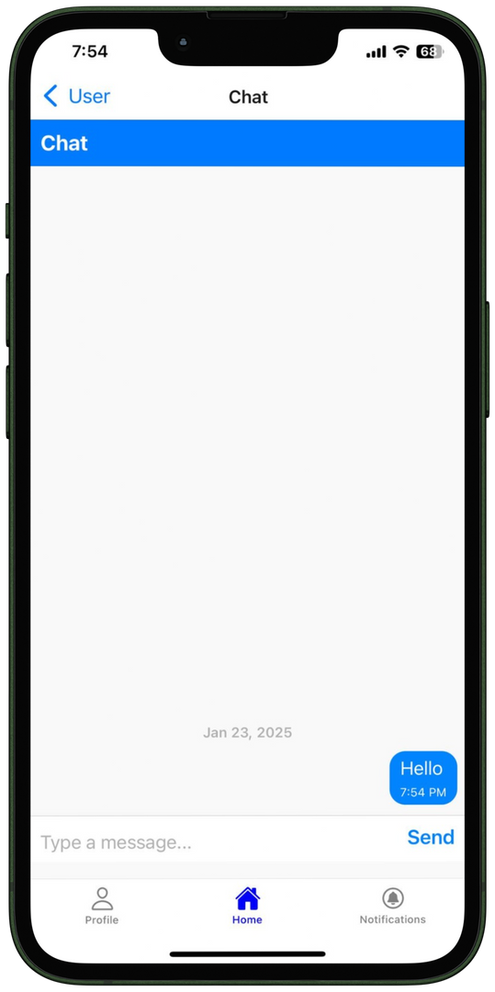
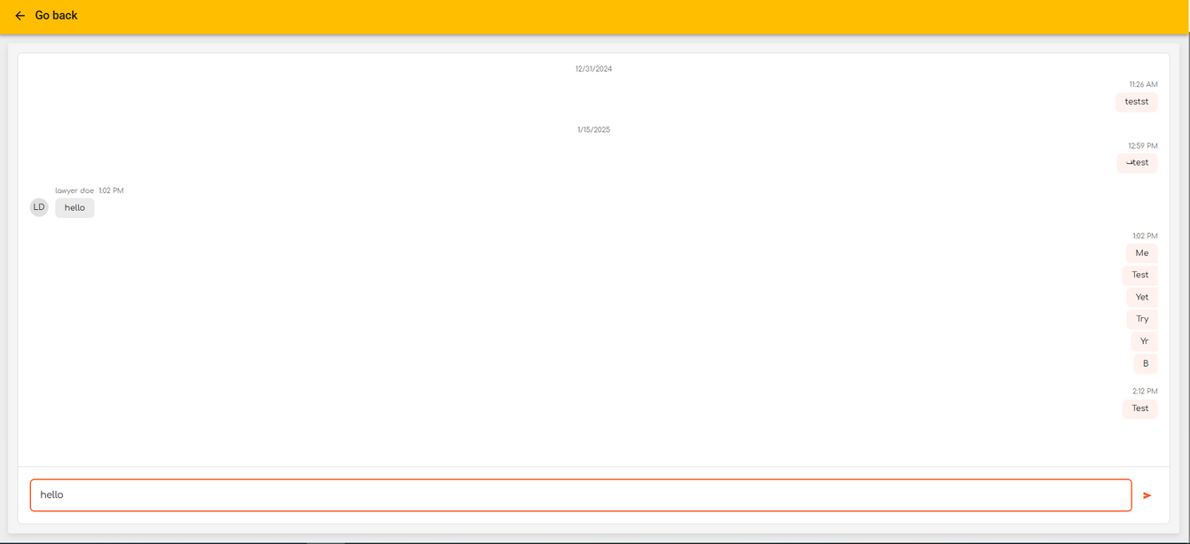
CLIENT
CHAT PAGE

Slide 28
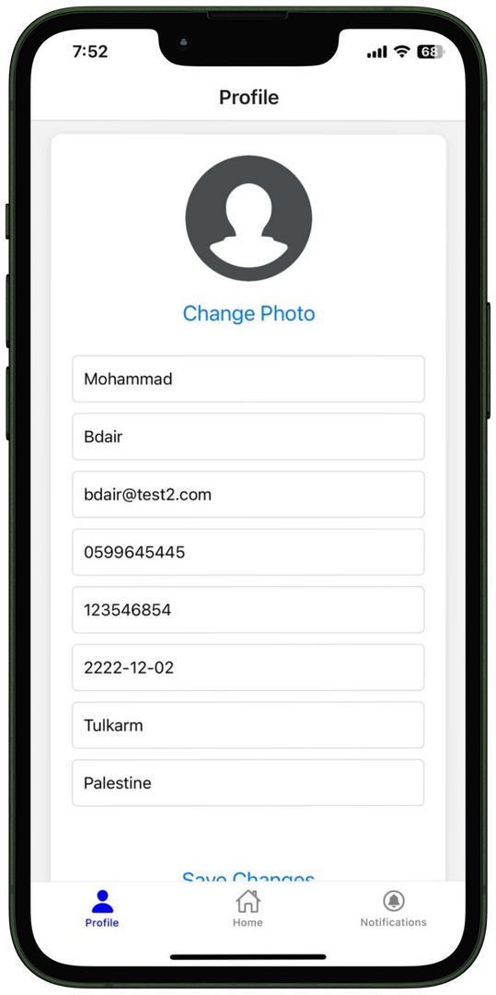
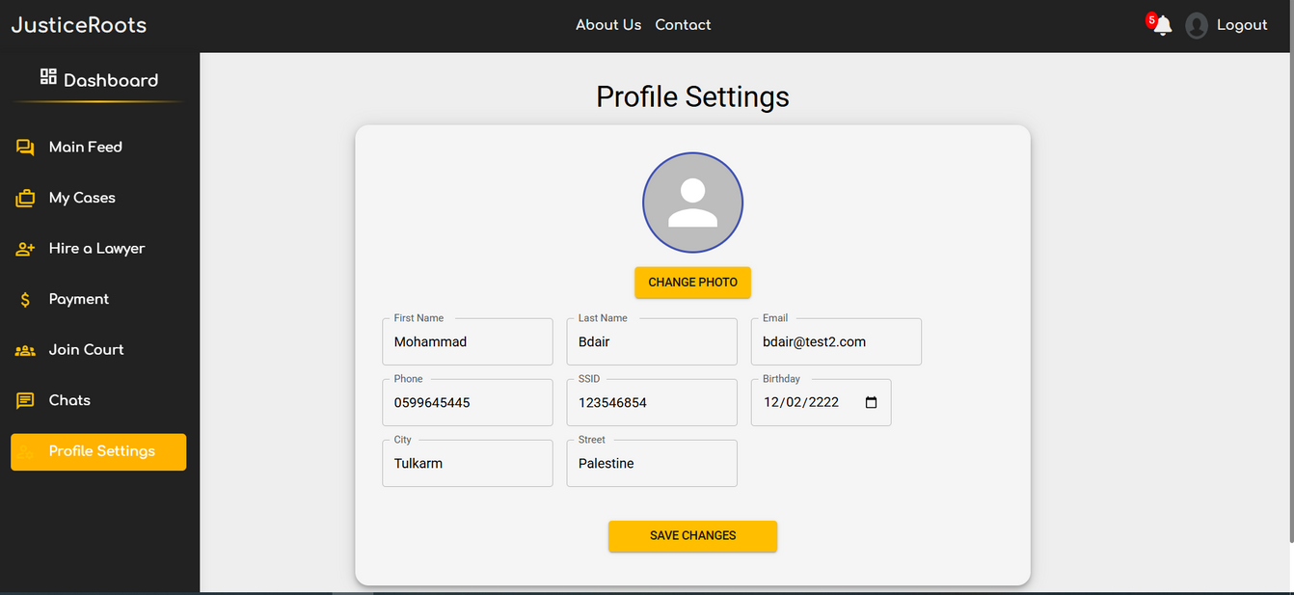
CLIENT
PROFILE SETTINGS

Slide 29
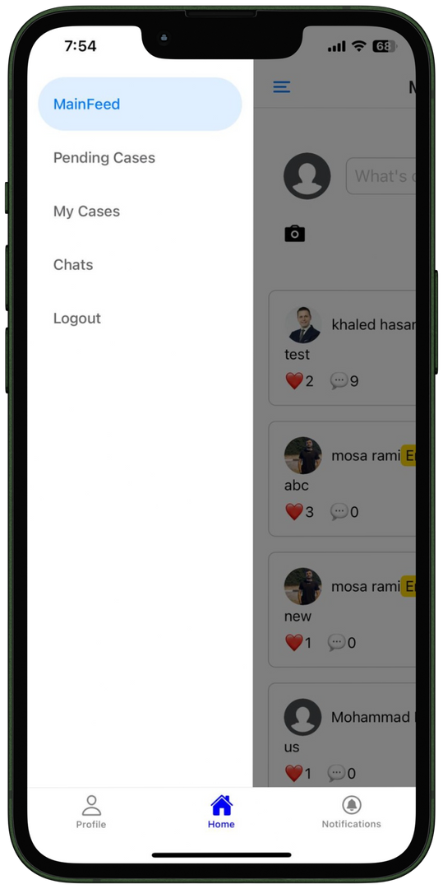
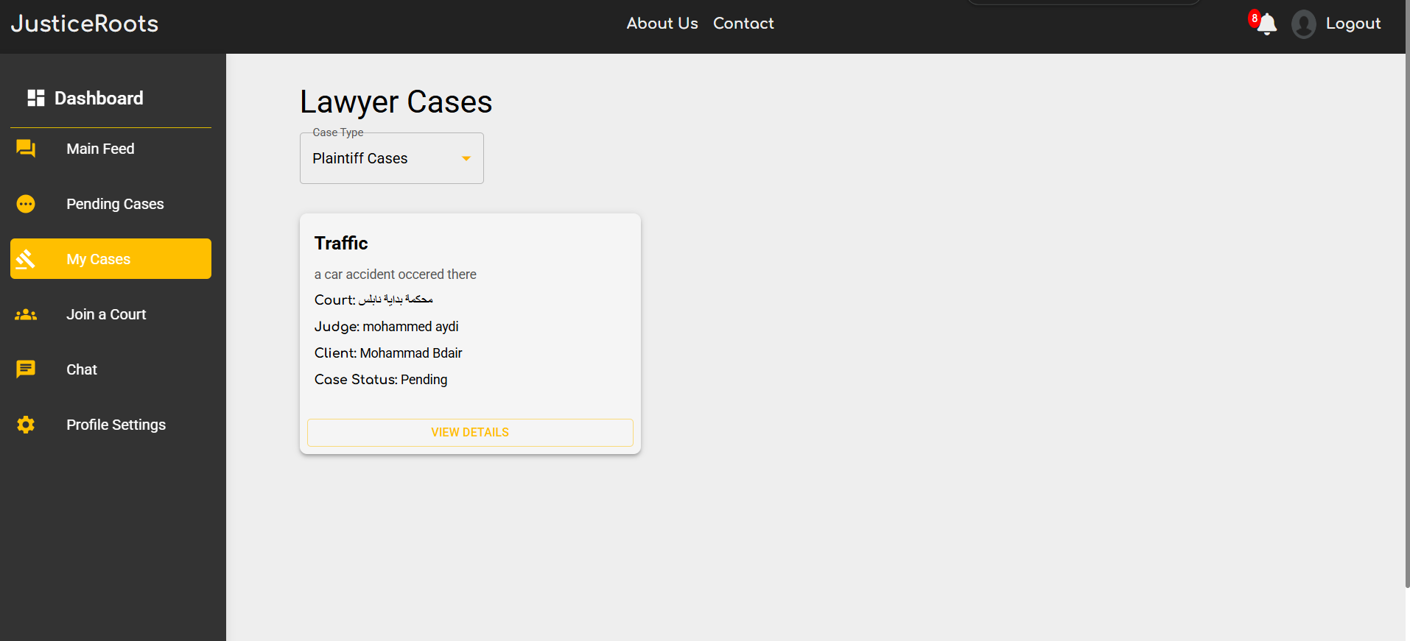
LAWYER
DASHBOARD

Slide 30
LAWYER
MAIN FEED

Slide 31
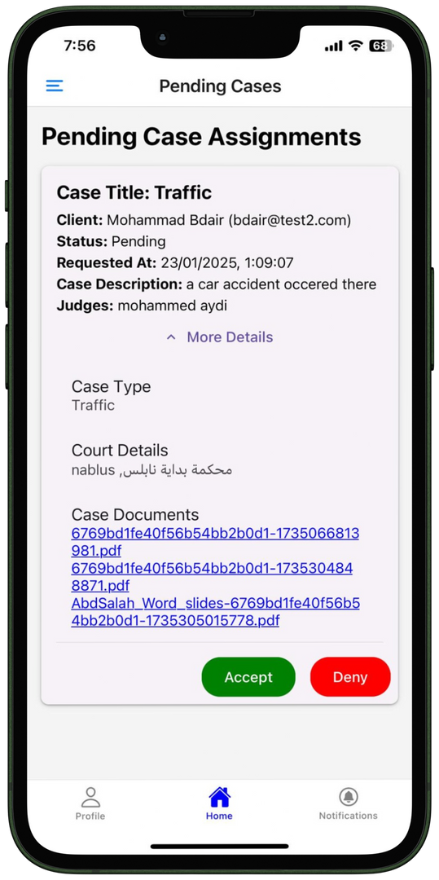
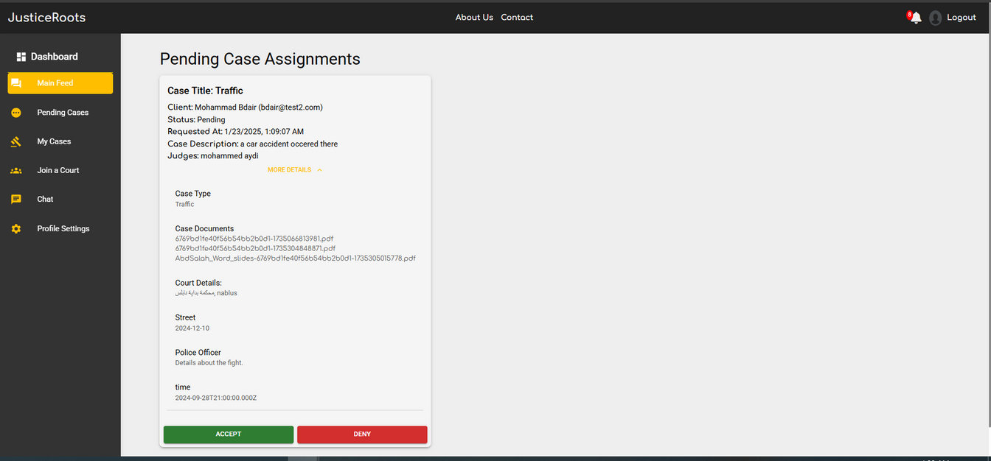
LAWYER
PENDING CASES

Slide 32
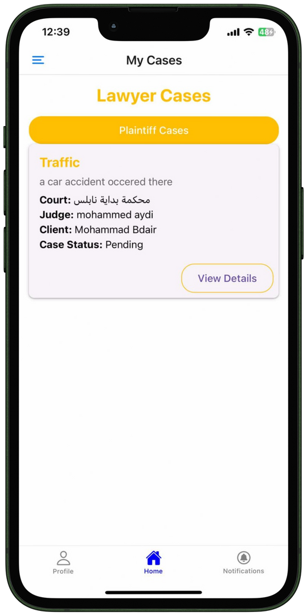
LAWYER
CASES

Slide 33
LAWYER
JOIN COURT

Slide 34
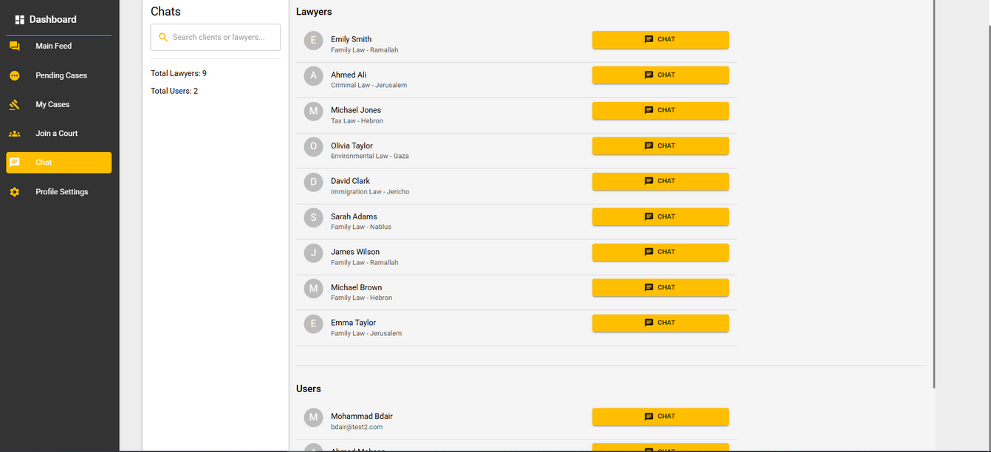
LAWYER
CHATS PAGE

Slide 35
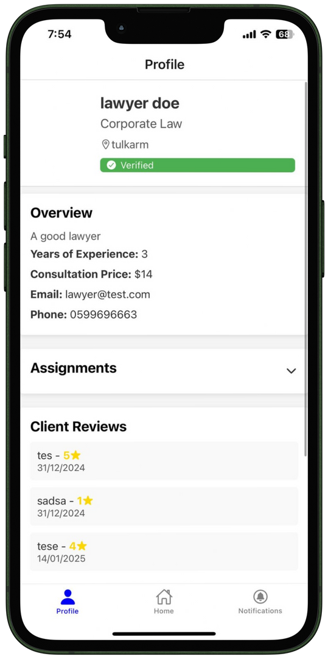
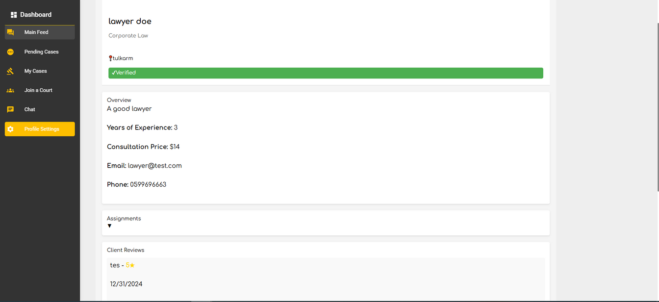
LAWYER
PROFILE

Slide 36
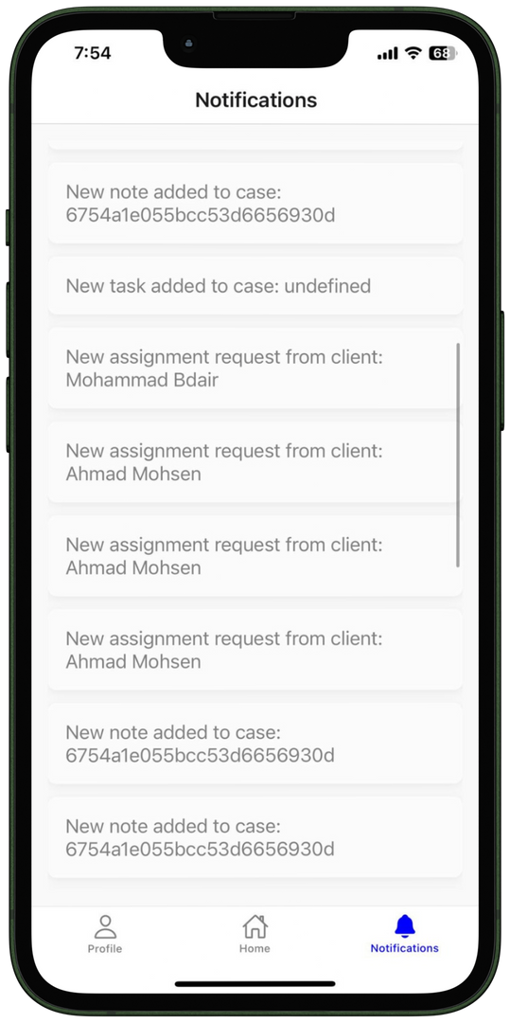
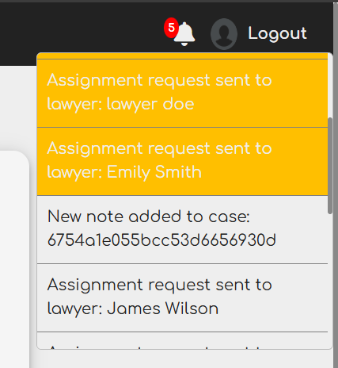
GLOBAL
NOTIFICATIONS

Slide 37


CONSTRAINTS
Legal
Technical
Requirements

Slide 38
FUTURE WORK
make security enhancements on the online court and employees accounts,
change the permisions system to be more detailed and flexible
Try to build our own infrastructure for video calls, and itegrate more features in it
Se
SECURITY
PRIVILIGES
ONLINE COURTS

Slide 39
Thank You

