Slide 1
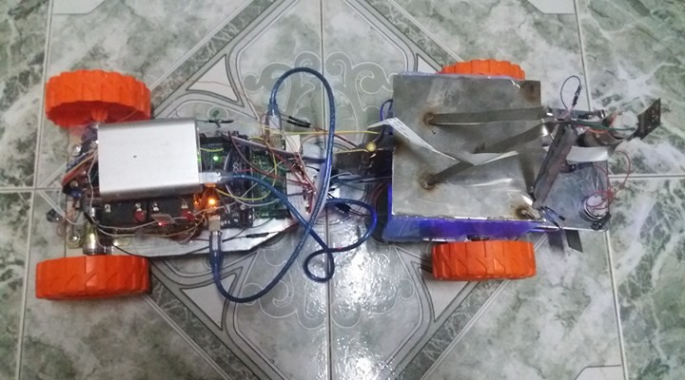
Auto cut grass
prepared by :
Murad Dweikat
Waddah Janajreh

Slide 2
Outline
Objective
defined auto cutting grass
Constraints
Component Used
Problems
Software Part
Image processing using raspberry
Flow Chart OF System
Conclusion
Future work
Demo

Slide 3
Objective
The idea of the project is to make it easier for the person to use the grass cutting machine and the possibility of anyone to use it in addition to not need any specialized person

Slide 4
Defined auto cutting grass
An automatic lawn mower is a device or robot that help human to cut grass automatically. Due to rapid development, many robots have turn into an autonomous robot. In this project, the movement or the path of the automatic lawn mower is based on a path planning technique. Camera Sensors are used to provide feedback from outside world. For this lawn mower, Arduino Mega microcontroller is utilized as the microcontroller. Every action of the lawn mower is monitored by the microcontroller with the help of the sensor. Furthermore.

Slide 5
Defined auto cutting grass
Benefits:
This project can be used by anyone without previous experience in a way easy and interesting as he controls the car remotely.
2. No need to use traditional methods of cleaning the garden of grass where they can use the robot in the grass cut and clean it after cutting directly.

Slide 6
Constraints
Time constraints
Software Constraints:
Image Processing
Hardware Components

Slide 7
Hbridge
Charging Battery
Car Module
USB Cable
Screws
Raspberry Pi 3
Component Used
    Raspberry Pi camera
Bluetooth
Arduino Mega
metal
    wheels

Slide 8
Problem..
Types of problems:
Hardware problem.
Software problem.
Mechanical problem.

Slide 9
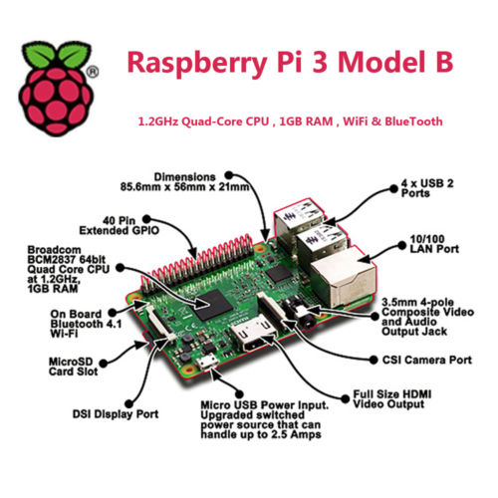
Raspberry Pi 3
boasts improved performance, connectivity and power management with a 64-bit CPU and onboard Wi-Fi and Bluetooth.
Notes:
If not have a google account he or she can create an new one and continue enjoy our application
After that the user should select which account want to log in with and will see his information and the profile picture on his google plus acount

Slide 10
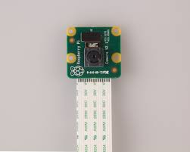
Raspberry Pi camera
It used to take high-definition video, as well as stills photographs.
It’s easy to use for beginners.

Slide 11
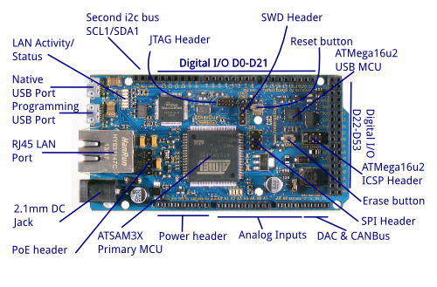
Arduino Mega(2560)
54 digital input/output pins.
16 analog inputs.
4 UARTs (hardware serial ports).
The Arduino IDE(1.6.7 v).

Slide 12
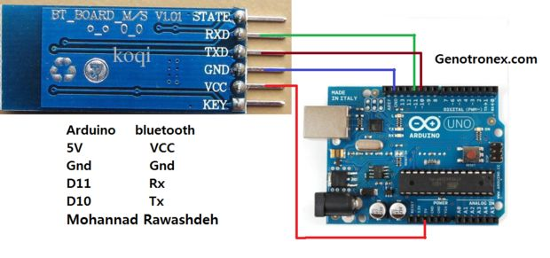
Bluetooth Module HC-06
Serial port Bluetooth, Drop-in replacement for wired serial connections, transparent usage. You can use it simply for a serial port replacement to establish connection between MCU and GPS, PC to your embedded project and

Slide 13
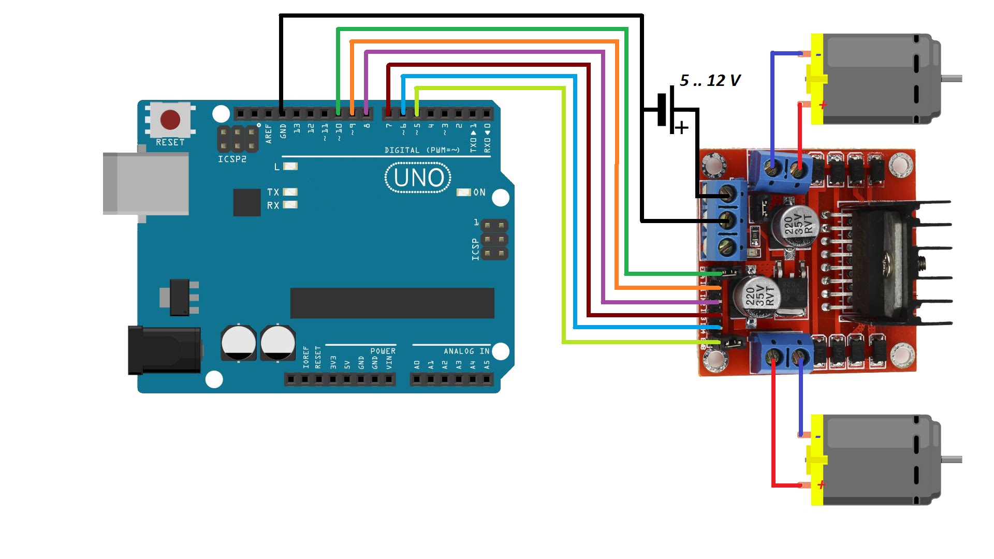
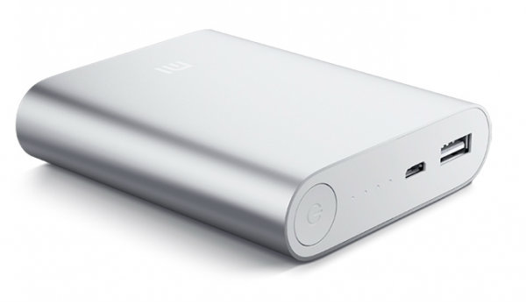
Car Module and Battery Charging
For driving:

Slide 14
Car Module and Battery Charging
For cutting and lever:

Slide 15
Software Part
Image Processing
Software
Streaming Video
Remotely

Slide 16
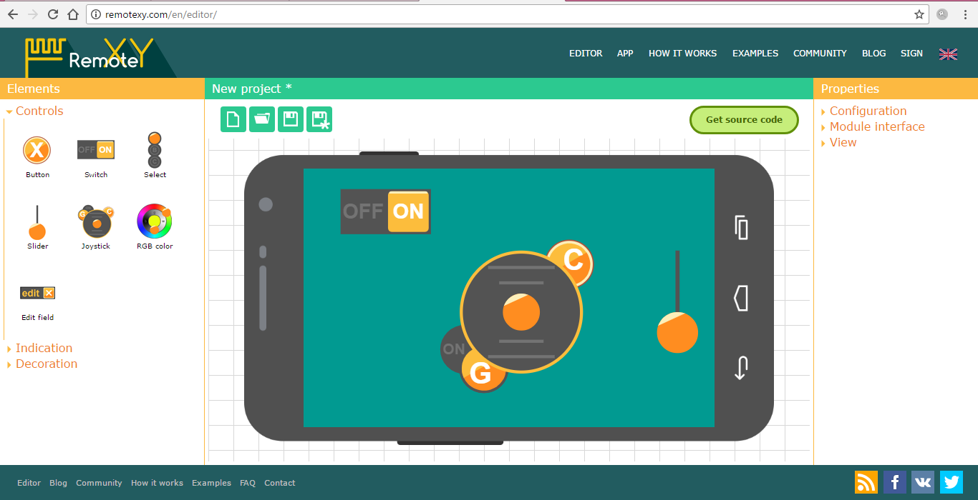
Remotely-XY

Slide 17
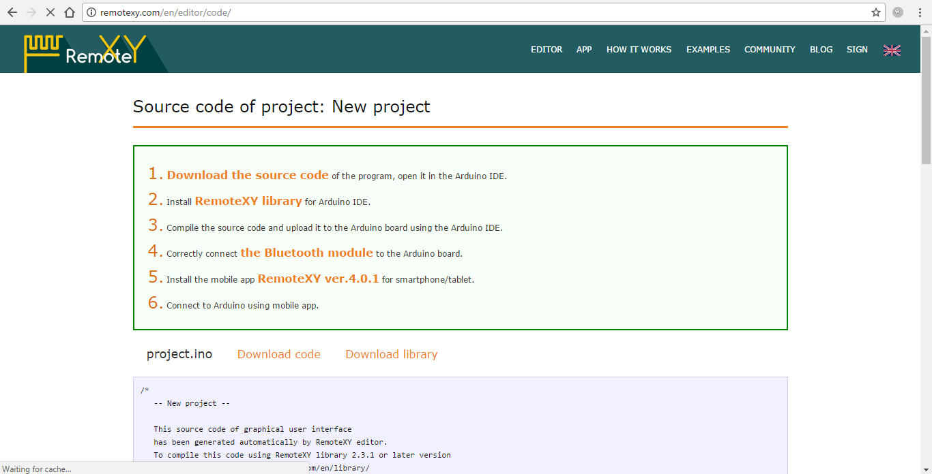
Remotely-XY

Slide 18
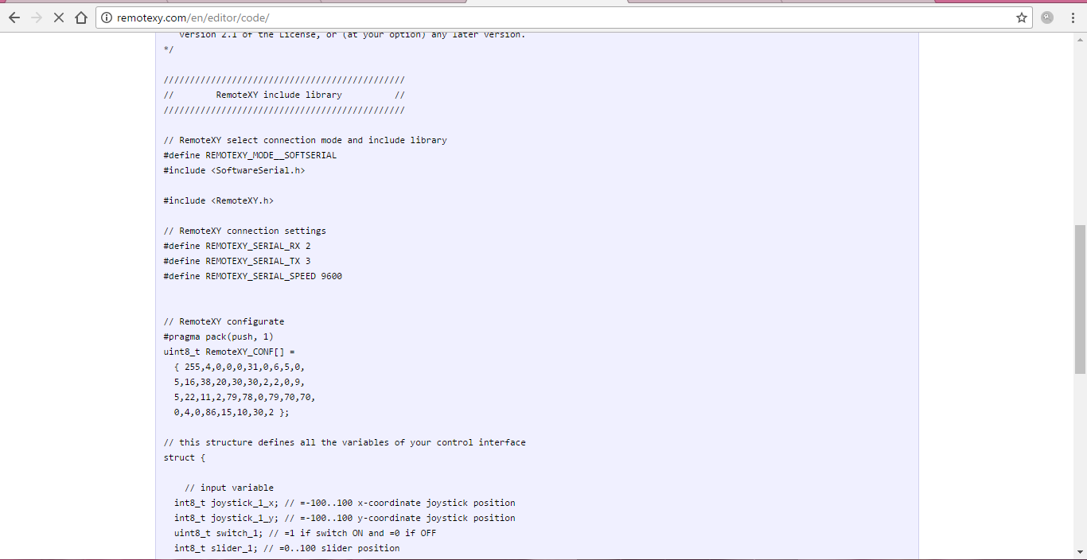
Remotely-XY

Slide 19
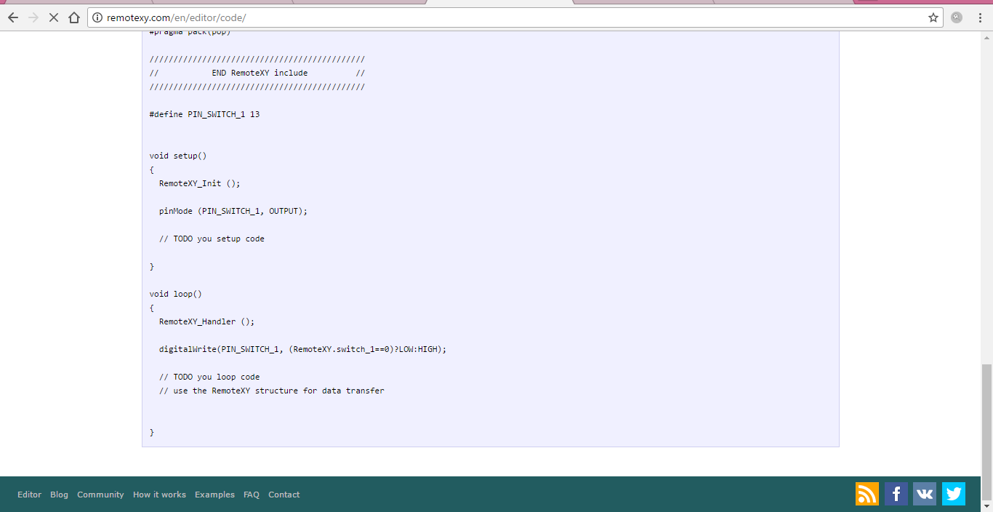
Remotely-XY

Slide 20
Video streamer “live camera”
Use command:
LD_LIBRARY_PATH=./ ./mjpg_streamer -i "input_file.so -f /tmp/stream" -o "output_http.so -w ./www/“
LD_LIBRARY_PATH=./ ./mjpg_streamer -i "input_file.so -f /tmp/stream" -o "output_http.so -w ./www/"&
raspistill -w 840 -h 480 -q 5 -o /tmp/stream/pic.jpg -tl 1 -t 999999 -th 0:0:0

Slide 21
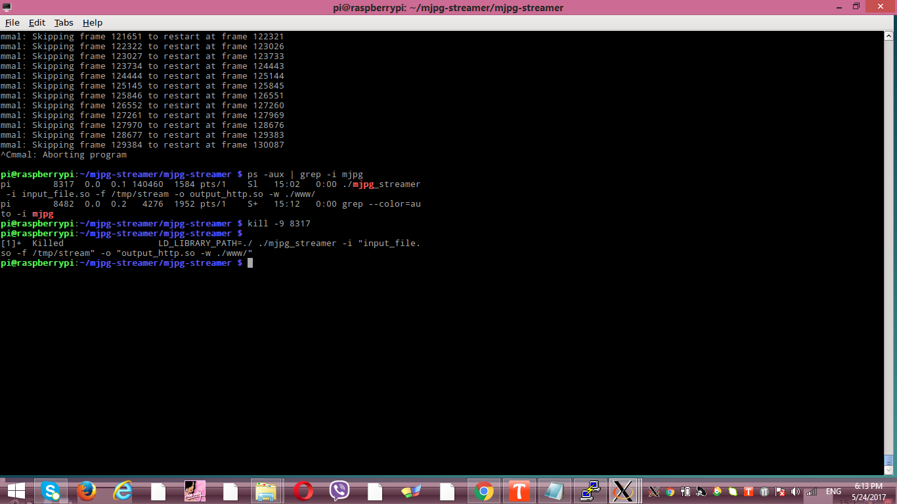
Video streamer “live camera”
Kill live camera:

Slide 22
Image processing using raspberry
Motion Detection
Edge Detection
Color Detection

Slide 23
Motion Detection
Start
Start Video Input
Consecutive frame Subtraction
End
Thresholding
Contour Detection of object
Filtering
Object detection

Slide 24
Color Detection
Start
Video Input in RGB form
Convert RGB to HSV
Apply Threshold of HSV Range for border
End
Display Result

Slide 25
Detection of Garden
Get Frames from Raspberry camera
Start Video Streaming
perform Color and edge algorithm
Start
No
Check for sum of pixel
End
Send 1 to Arduino
yes

Slide 26
Flow Chart OF System
camera
Move car automatic and cutting grass
Check Values from Bluetooth
Start
Bluetooth
Move car ,and cutting grass
End

Slide 27
Conclusion

Slide 28
Future work
Charge battery for machine is automatic.
Add tp-link for machine”WIFI”.
Add more algorithm to get more accurate result of detect border for garden using image processing

Slide 29


Thank you very much

