Slide 1

Wireless Music Player
Wireless Music
Player
Designed By :
Fadi Ne’irat
Mohammad Barham
Fadi Neirat
Mohammad Barham

Slide 2
Content
Introduction
Device parts
Working procedures
Problems
Future Plans

Slide 3
Introduction
Our wireless music player allows the user to listen to uncompressed digital audio streamed over a wireless link.
The music player reads uncompressed audio data from an SD card in an immobile "base station." A pair of Xbee transceiver modules are used to stream data and control signals between the base station and a portable module.

Slide 4
Overview
Why using wireless ?
Wider range : approximately 100 m
Separated Controller
Why use of file with .wav extention

Slide 5
Consist of Tow Parts
Main Station
Portable station

Slide 6
Main Station
Portable Station
Audio Stream
Control Signals

Slide 7
Main Station
Begin
Start SPI
Initialize SD-Card
Initialize FAT file System
Get First File
Chek for and implement file skip request, or stop command
Buffer 2KB of data
Transmit Data
Data Request

Slide 8
Portable Station
Begin
Yes No
No
Yes
Initialize SPI (DAC)
Initialize USART, with receive interrupt
Initialize timer2 with 8Khz interrupt
Buffer low?
Request Data
Button pressed?
Send Command
Halt palyback if pause or stop

Slide 9
Working Procedure

Slide 10


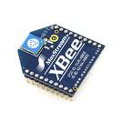

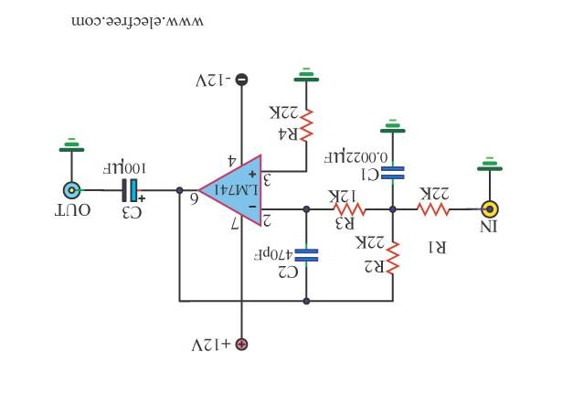
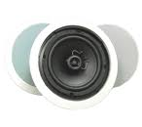
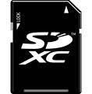

Send Command for play(as example)
This controller must be ready
Processing request and send packets as needed
Initialize
File System
List all files And read first packet from first file(2KB)
Initialize SD-CARD
Read packet and send it to DAC

Slide 11
Problems
SD card Initialization
File System
Sensitivity of XBEE
XBEE communication
DAC output

Slide 12
Future Plans
Develop our project to work on client-server application using PIC
Increase sound resolution to get a sound with better quality

