Slide 1

An-Najah National University
Faculty Of Engineering
Civil Engineering Department
Graduation Project II
Analysis and Redesign of Water network & Design of Wastewater network for Kaferdan village
Prepared By :
Abdallah Bzoor
Kefah Ali
Mohammed Abo Abed
Supervision of Dr. Anan Jayyousi

Slide 2
Outline:
Objectives of the project.
Significance of the work
Study area
Questionnaire analysis
Existing water network
Redesign of water network
Design of wastewater network

Slide 3
Objectives
Analyze the existing water network.
Redesign the water network in the village.
Design a wastewater network.

Slide 4
Significance of the work
To supply water at an adequate pressure and flow.
To transport sewage through KAFERDAN VILLAGE to sewage treatment plants.
To have an economic design as possible for both networks.

Slide 5
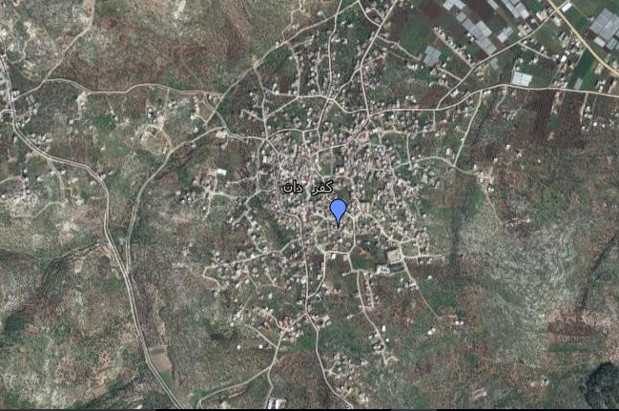
Study area

Slide 6
Area and land use:
The present population is 6400 persons.
The area is approximately 7330 donum
Kaferdan village is a flat land, The ground surface in the village varies from 100 m to 190 m (A.M.S.L).

Slide 7
Data Collection:
Contour, Houses, roads, Boundary, aerial photo and amount of consumption water for each consumer,… etc. manhole, conduits, road contour and outfall for the village.

Slide 8
Questionnaire analysis
avaerage consumption water
Average family size = 5.9 capita
Average consumption = 11.9 m³
So the water consumption = (11.9*1000)/(30*5.9)= 67.2 L/C/day

Slide 9
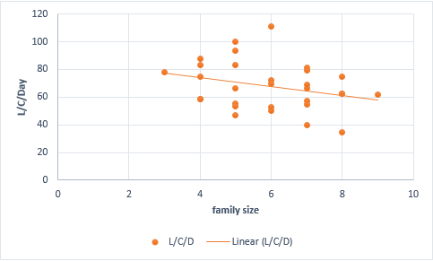

Slide 10
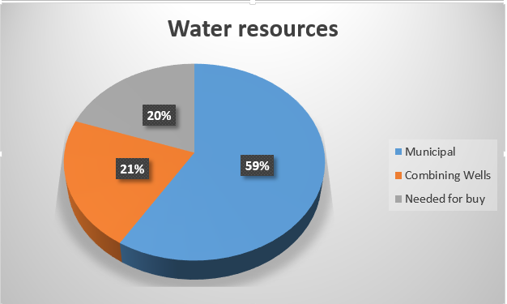

Slide 11
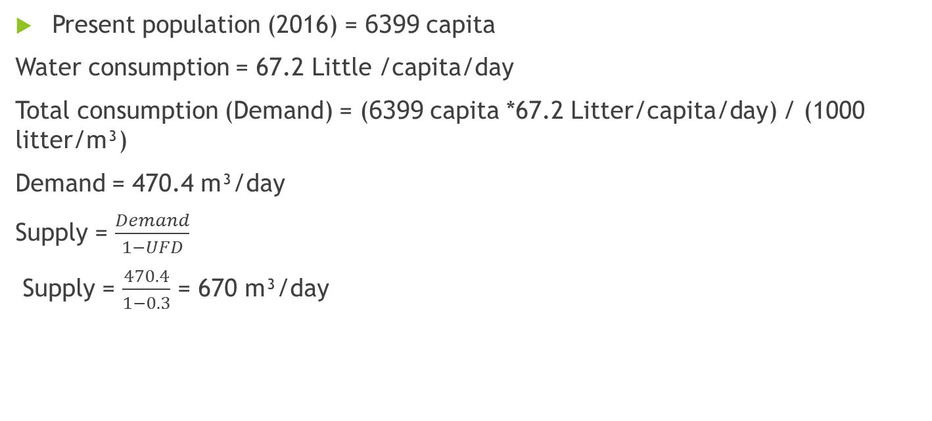
Modeling of WDN
Present population (2016) = 6399 capita
Water consumption = 67.2 Little /capita/day
Total consumption (Demand) = (6399 capita *67.2 Litter/capita/day) / (1000 litter/m³)
Demand = 470.4 m³/day
Supply = $\frac{Demand}{1−UFD}$
Supply = $\frac{470.4}{1−0.3}$ = 670 m³/day

Slide 12
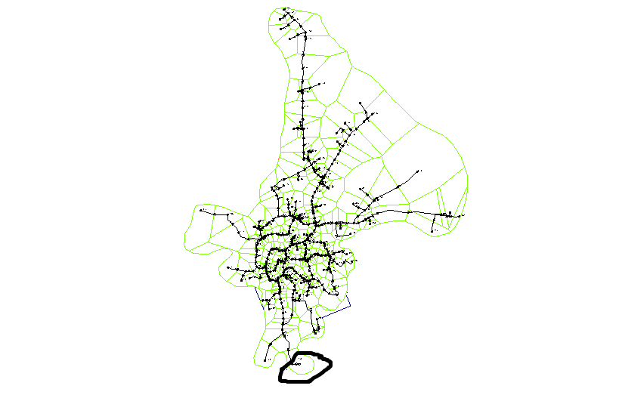
Modeling of WDN

Slide 13
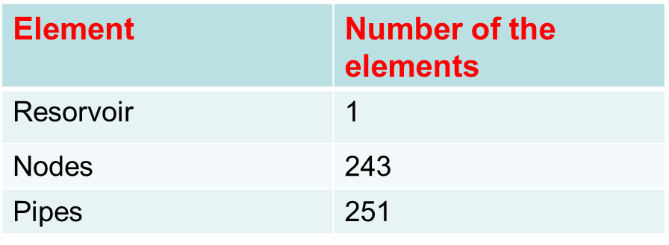
WDN

Slide 14
WDN
Design constraints:
Pressure at junction between (20-100) m.H₂O.
Velocity in pipe (0.3-3.0) m/s.

Slide 15
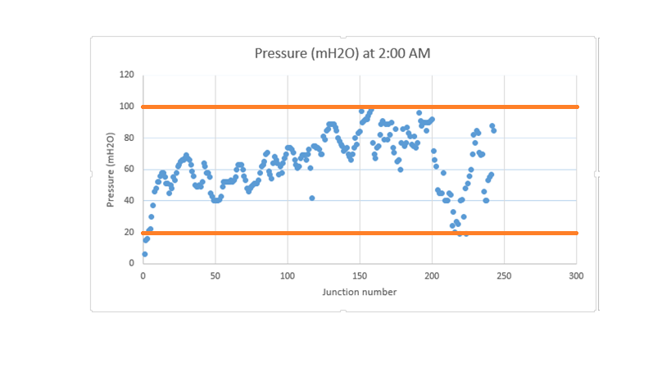
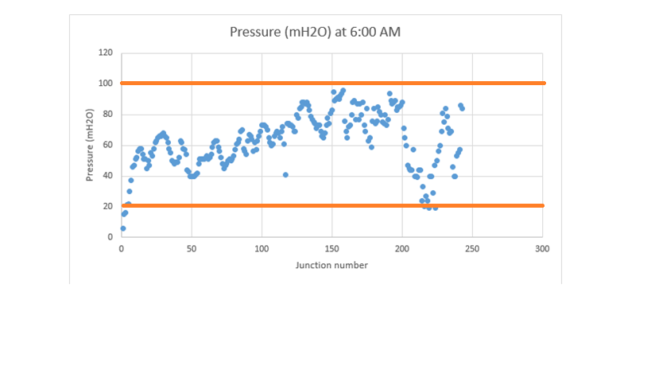
Result of analysis of WDN
Preesure at minimum demand (2:00am) and maximum demand (6:00am)

Slide 16
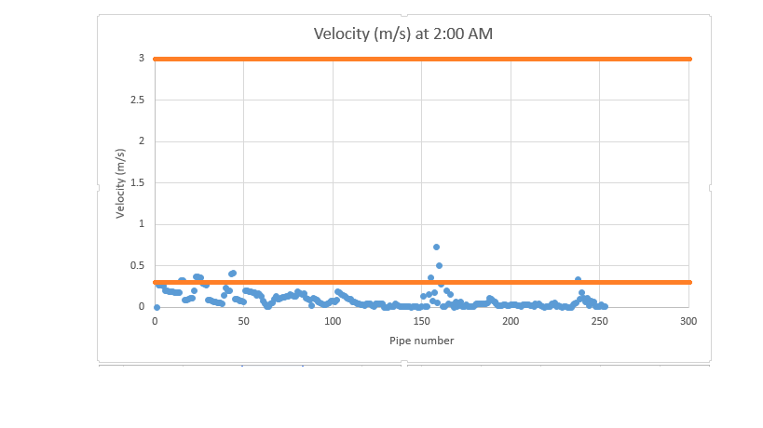
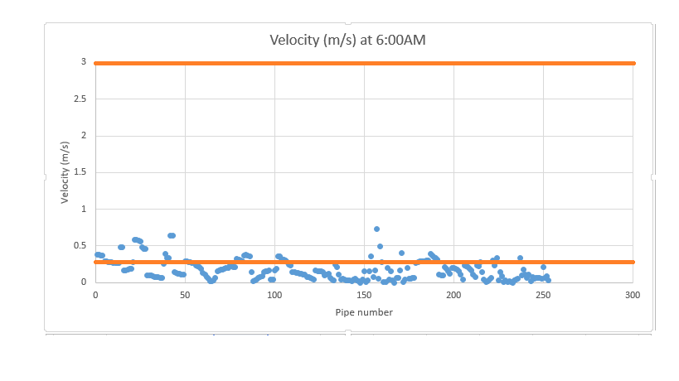
Result of analysis of WDN
Velocities at minimum demand (2:00am) and maximum demand(6:00am)

Slide 17
Redesign of WDN

Slide 18
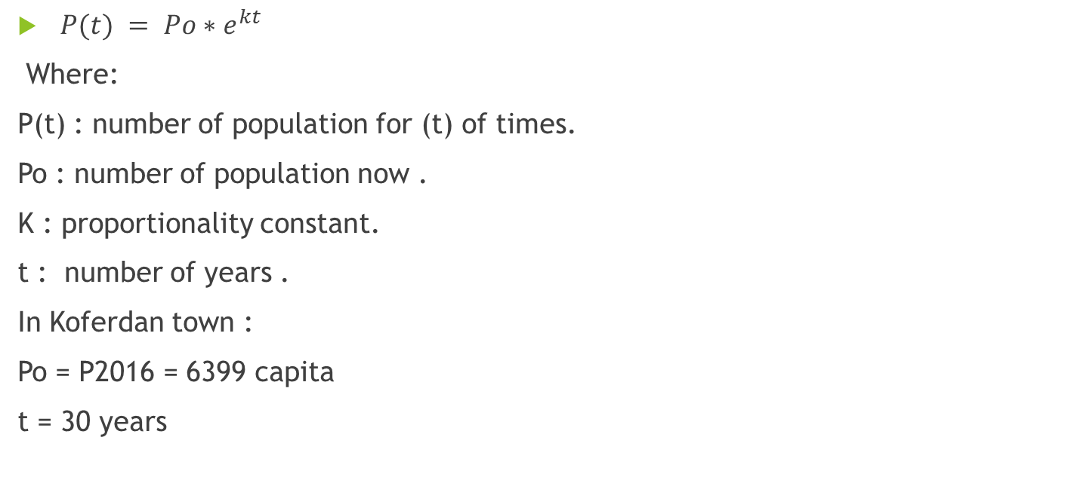
Data of future population
$P(t) = Po{∗e}^{kt}$
Where:
P(t) : number of population for (t) of times.
Po : number of population now .
K : proportionality constant.
t : number of years .
In Koferdan town :
Po = P2016 = 6399 capita
t = 30 years

Slide 19
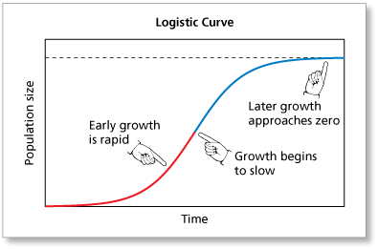

Slide 20
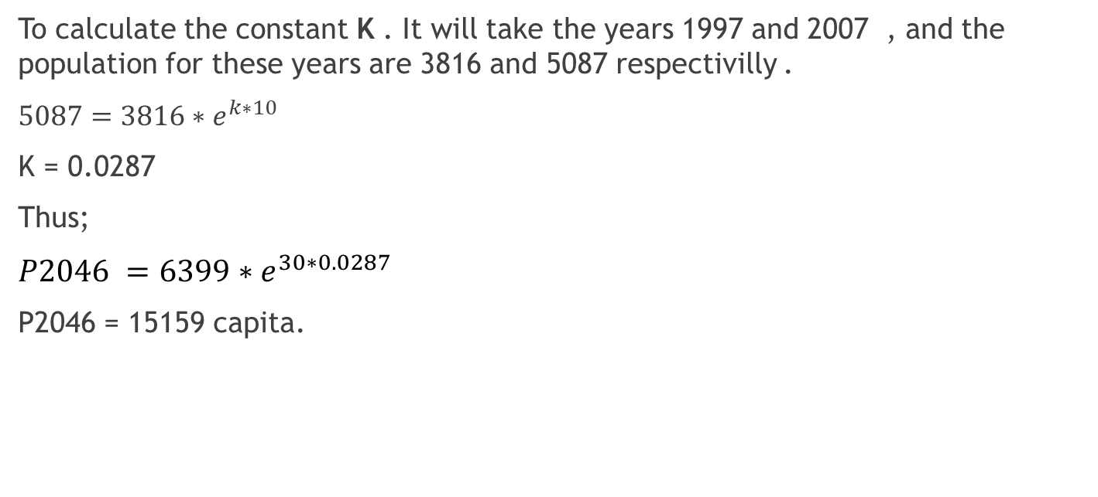
Data of future population
To calculate the constant K . It will take the years 1997 and 2007 , and the population for these years are 3816 and 5087 respectivilly .
$5087=3816{∗e}^{k∗10}$
K = 0.0287
Thus;
$P2046 =6399{∗e}^{30∗0.0287}$
P2046 = 15159 capita.

Slide 21
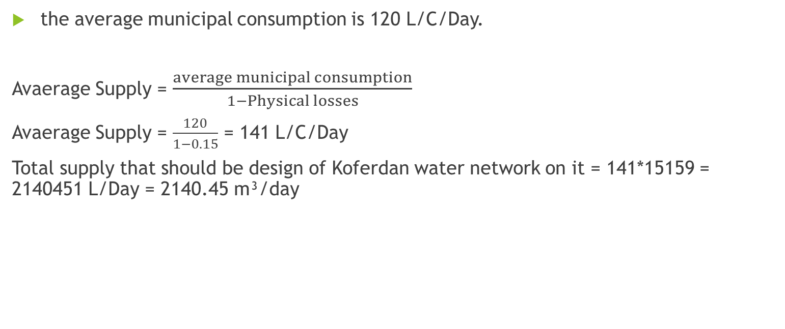
Data of the supply
the average municipal consumption is 120 L/C/Day.
Avaerage Supply = $\frac{average municipal consumption}{1−Physical losses}$
Avaerage Supply = $\frac{120}{1−0.15}$ = 141 L/C/Day
Total supply that should be design of Koferdan water network on it = 141*15159 = 2140451 L/Day = 2140.45 m³/day

Slide 22
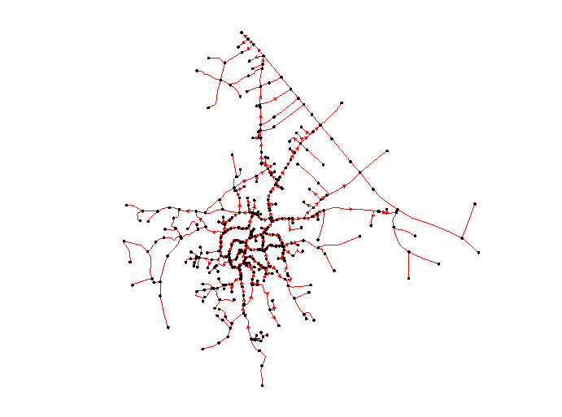
Model of WDN

Slide 23
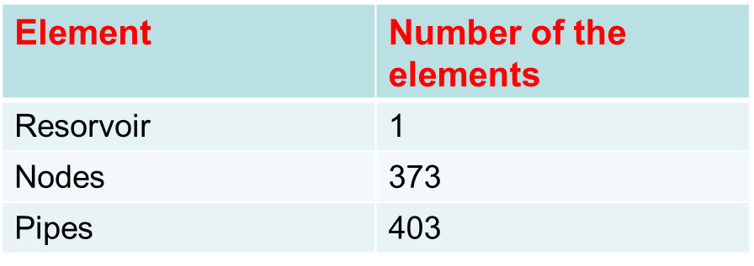
WDN

Slide 24
Design Critera
Type of pipes / Criterea | Pressure(mH2O) | Velocity(m/sec)
Ductile iron | 20-100 | 0.1- 3

Slide 25
Methodology of Design

Slide 26
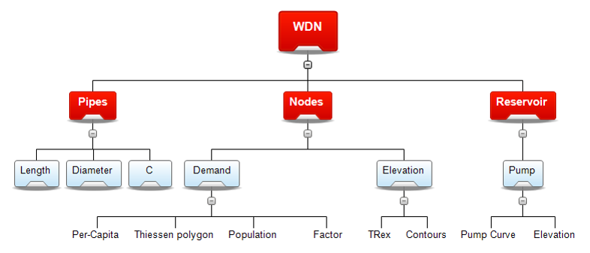

Slide 27
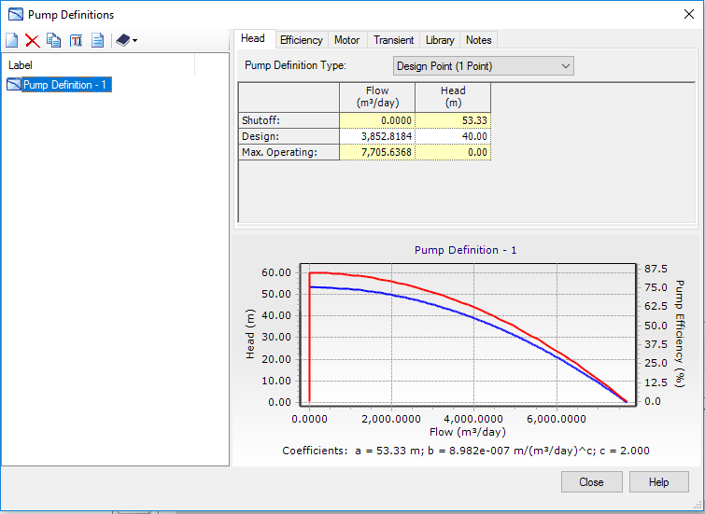
Result of Design
1- Pumps

Slide 28
Result of Design
Pw = ɤQH
Where :
ɤ : Specific weight for water(N/ m³).
Q : Total flow rate that input to pump (m³/sec).
H : Total head that was added by pump (m).
Pw = (9810 N/ m³)*(3852/24*60*60 m³/sec)*(20m) =8747.25 watt.
Pw = 8.74725 Kelowatt = Poutput .
Pinput = Poutput/µ
Where :
µ : The efficiency of the pump (-)
Pinput = 8.74725/0.85 = 10.29 kelowatt.
The power of pump (hp) = 10.29/0.75 = 14 hp

Slide 29
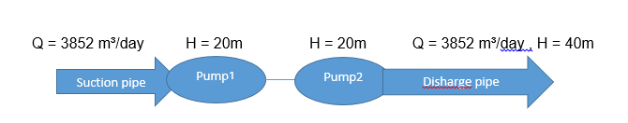
Result of Design
The below drown illustration the method of installation the two pump in series:

Slide 30
Result of Design
2- Preesures
Pressure at maximum demand (6:00am) by using of two pumps

Slide 31
Result of Design
Pressure at minimum demand (2:00am) by using of one pump

Slide 32
Result of Design
3- Velovities
Velocity at maximum demand (6:00am) by using of two pumps

Slide 33
Cost of The design
Total cost = (Ʃ Ci*Li) + Cost of two pumps.
Where :
Total cost ($).
Ci : The cost of diameter i (inch) per meter ($/m).
Li : The length of diameter i (m).
In this network was the estimated total cost was 303262 $ .
Cost of one pump (15hp) = 14000$
The total cost = 303626+28000 = 331626 $

Slide 34
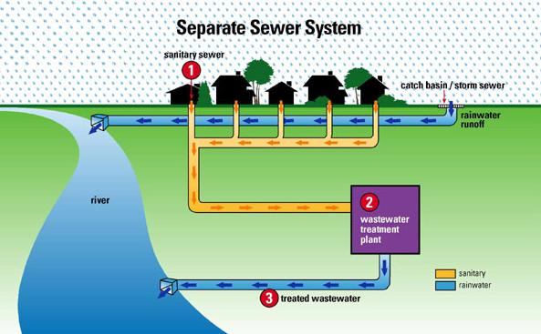
Design of the wastewater network

Slide 35
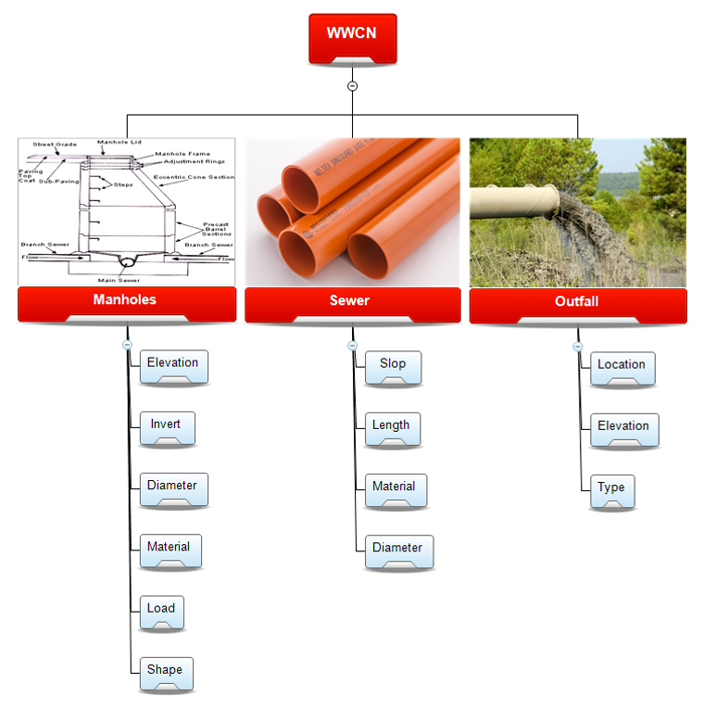

Slide 36
Wastewater generation
Each person in the town will generate about 80% of water consumption(120L/c/day).
Thus , Avaerage wastewater generation = 0.8 * 120 * 15159/ 1000 = 1455.26 m³/day
Peak wastewater generation = Pf * Avaearage wastewater generation
Where :
Pf : Peak factor = 16* {(Population in thousands)^(-1/6)} = 16 * (15159)^(-1/6) = 3.2
Then , Peak wastewater generation for koferdan town = 3 * 1455.26 = 4365.75 m³/day

Slide 37
Design criteria
The velocity : (0.6 – 3 m/sec)
The cover : (1-5m)
The slope : (1-15%)
The distance between manholes are (30-50 m)

Slide 38
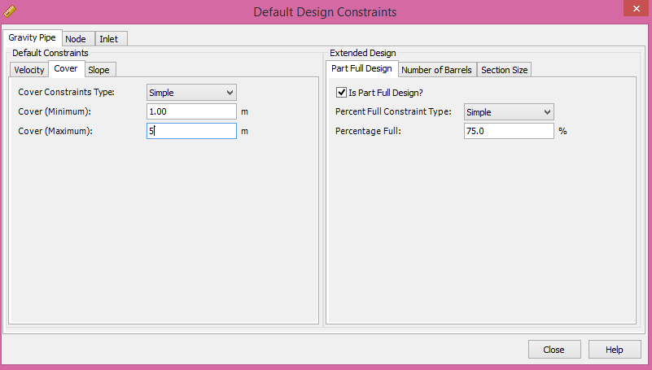
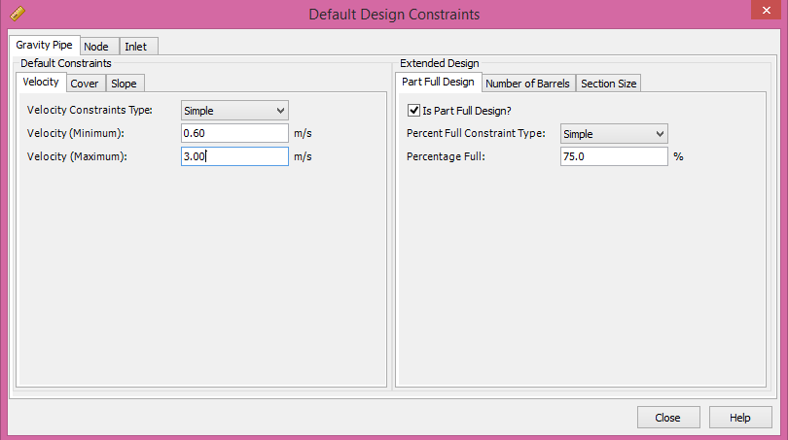
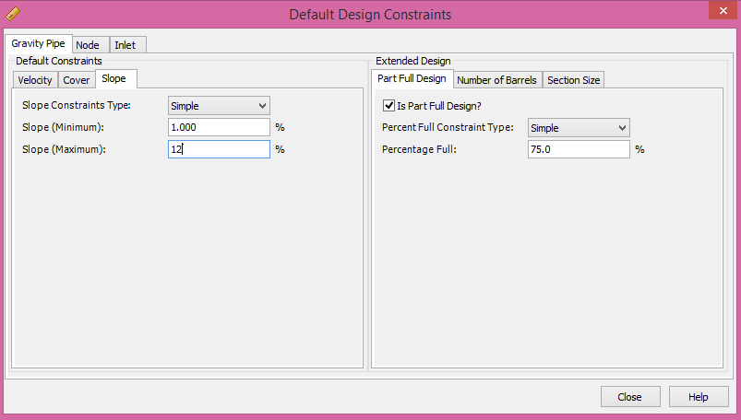
Design constrain

Slide 39
MODELING AND DESIGN

Slide 40
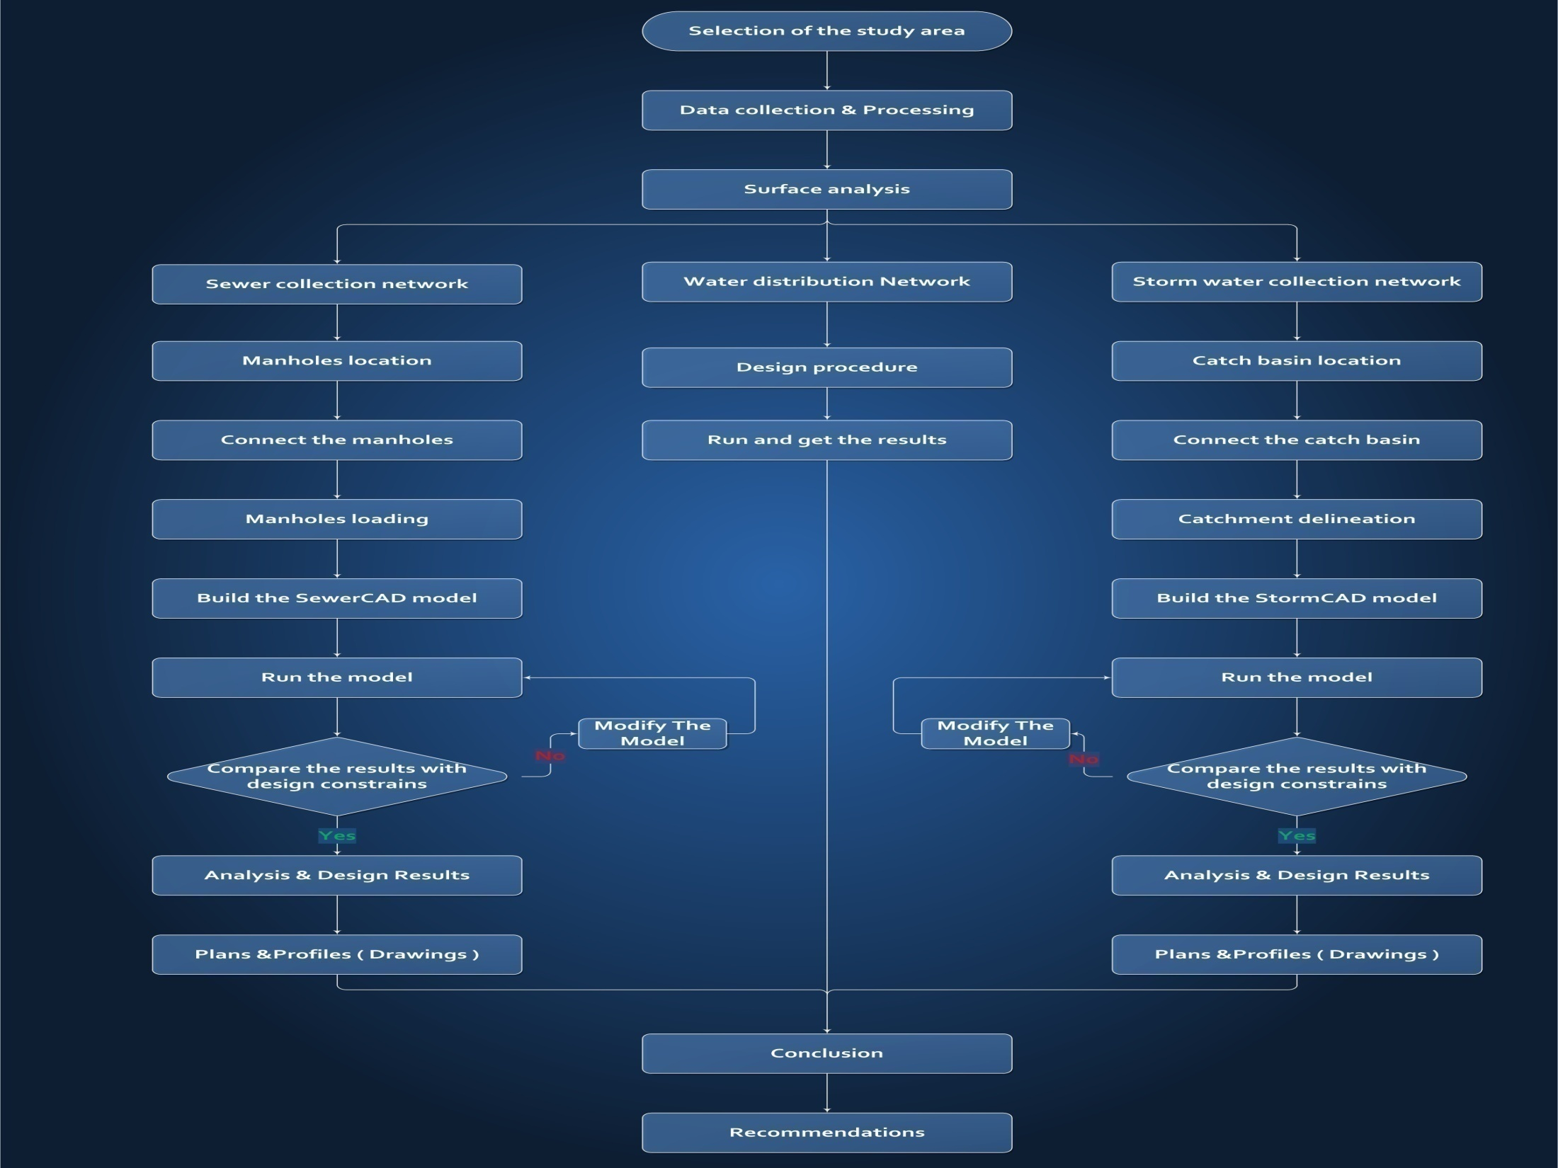
Methodology

Slide 41
Methodology
Location & Connecting Manhole
Before starting the design we should consider that the manholes must be located at the roads networks wherever there is:
1- An intersection.
2- Change in slop.
3- Change in direction.
4- Maximum distance of (30-50) m.

Slide 42

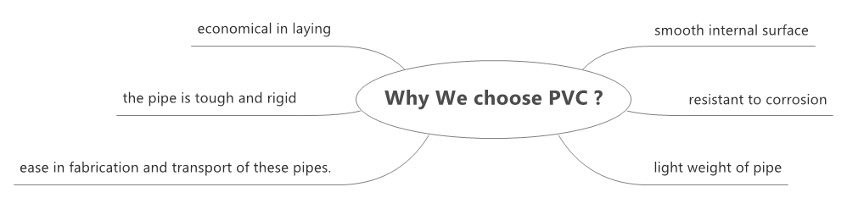
Choosing the PVC conduits

Slide 43
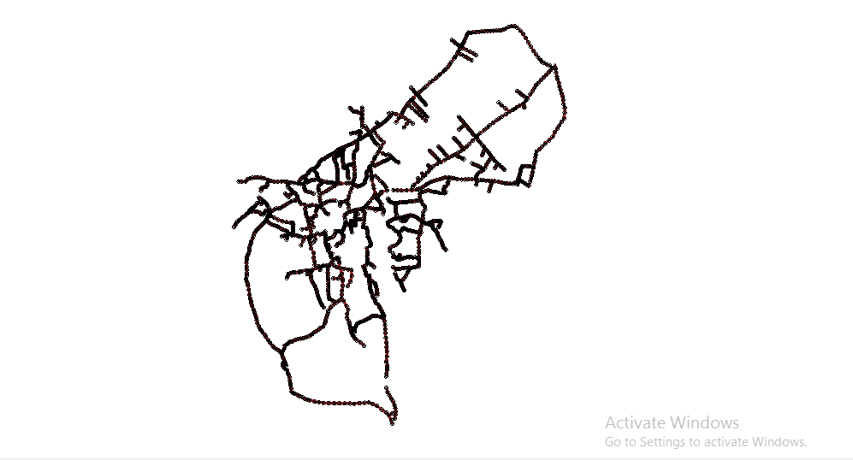
Model of the wastewater network

Slide 44
Loads on manholes
By finding the area of catchment of each manhole using ArcHydro Tool in GIS we can find the load for each manhole as follows:
15159 capita/7328000 m² = 0.002 capita/ m²
0.002* area of each part = number of persons in each part(q˳)
Load was produced from each part = (120L/c/d * q˳* 3 * 0.8) + (120* q˳* 0.8 * 0.2)

Slide 45
Results And Discussion

Slide 46
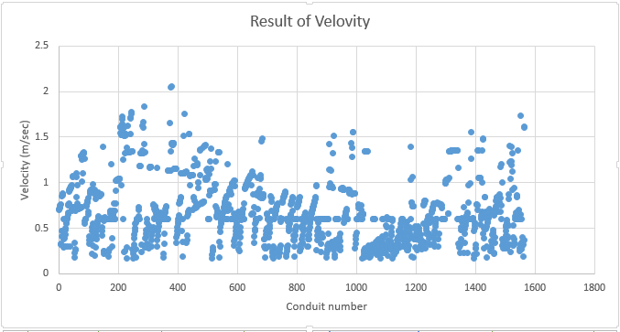
Velocity (m/s)

Slide 47
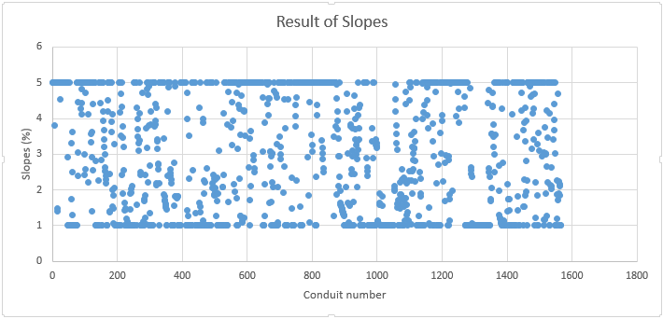
Slope (%)

Slide 48
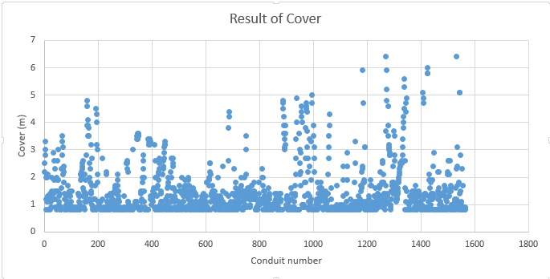
Cover (m)

Slide 49
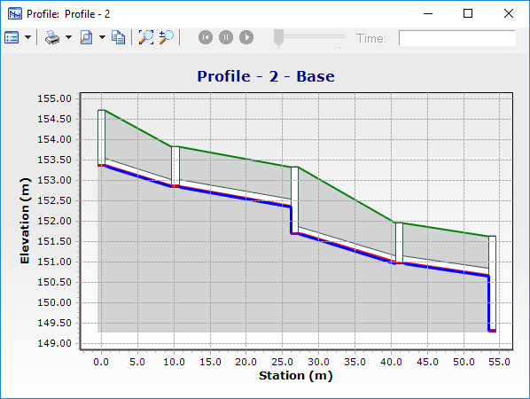
Profile

Slide 50
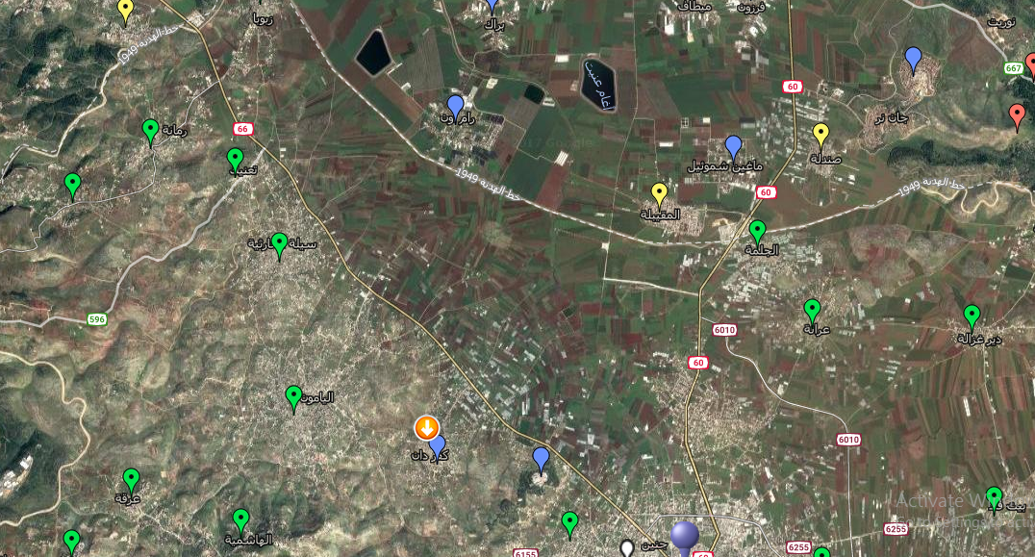
The proposed location for Wastewater Treatment Plant
Location of WWTP

Slide 51

Conclusions
After the end of design process we got the following conclusions:
The majority diameter of water pipes are 1.3, 2,3,4,6 and 8 inch.
The water pipe material is ductile iron.
The sewer conduit material is PVC because it's easy to site.
Most sewer network conduits diameters are 8,10,12 inch.
ArcHydro tools save a lot of time in calculates loads.

Slide 52
Recommendations
A periodic maintenance should be done and the damaged parts should be replaced.
If possible treatment plant is considered as a feasible project.
Suitable space between water pipes and wastewater pipes must be achieved (water pipes must be above wastewater pipes).

Slide 53


