Slide 1

Wedding hall with restaurant
An-Najah National University
Faculty Of Engineering
Building Engineering Department
Graduation Project II
2016 / 2017
Prepared by:
Razan Omar
Aseel Suliman
Maysa Barham
Supervised by:
Dr. Ameer Al-Akeer

Slide 2
Outline :
Introduction
Objectives
Methodology
Project Design
Quantity take off.
Conclusion
Site Analysis
Architectural design.
Structural design
Electromechanical.
Environmental.

Slide 3
Introduction :
Location:
-Burqa village in Nablus
Objective:
to design a qualified
wedding hall with restaurant
that satisfies the standard
requirements

Slide 4
Methodology
Aspect | code | Software prog.
Architectural | Neufurt Time saver | AutoCAD Revit
Structural | * ACI -318-08 for reinforced concrete structural design. * UBC -97 for earthquake load computations. * ASCE for load computations | ETABS
Elctro-Mechanical |  | DIAlux
environmental |  | Ecotic

Slide 5
Project Design
Site analysis
Architectural design
Environmental design
Structural design
Electro –mechanical design

Slide 6
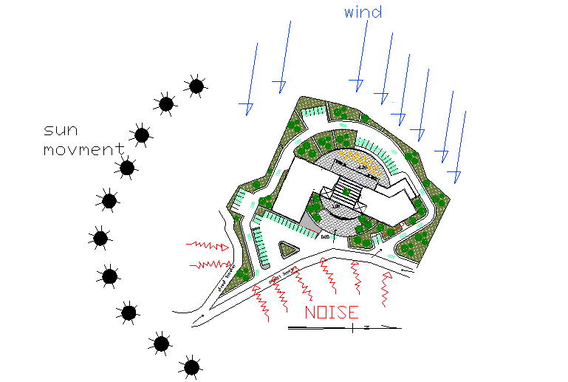
Site Analysis
The area of the site is 3000 m²

Slide 7
Project design
Architectural Design:
1-Site plan
2-The plans
3-Sections
4-Elevations

Slide 8
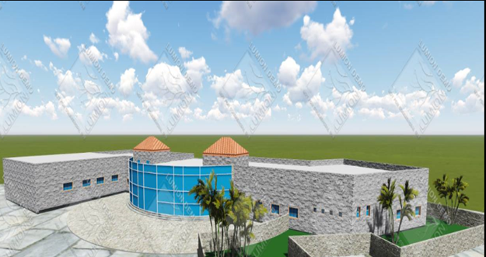
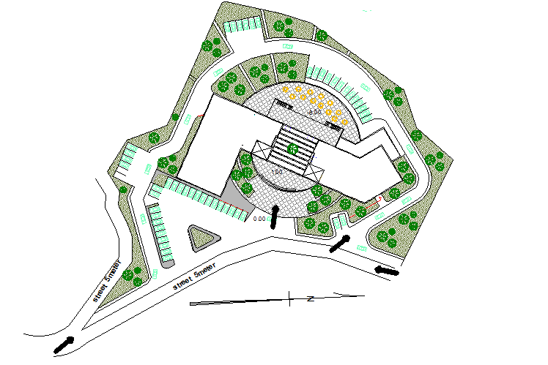
Project design
(Architectural Design):

Slide 9
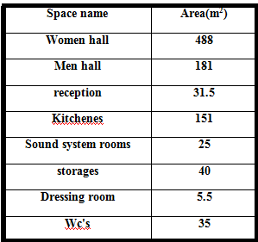
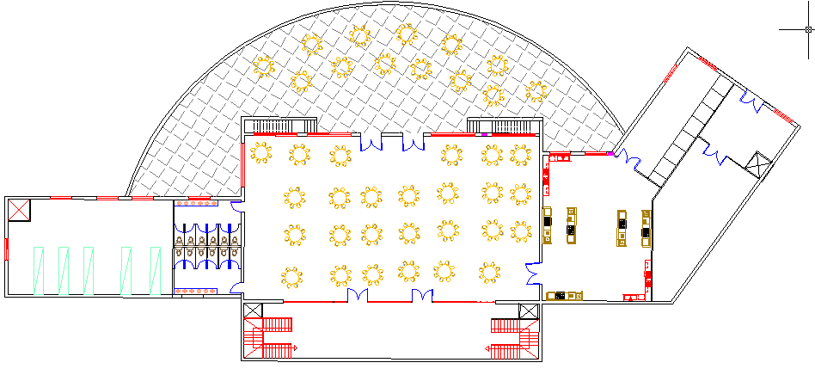
Project design(Architectural Design):
Basement floor(750 m^2)

Slide 10
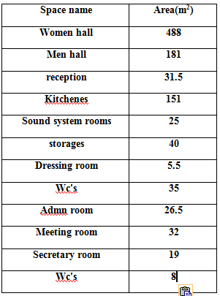
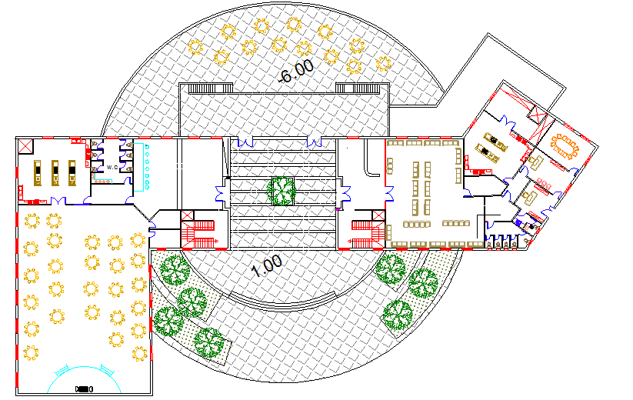
Project design(Architectural Design):
Ground floor(1070m^2)

Slide 11
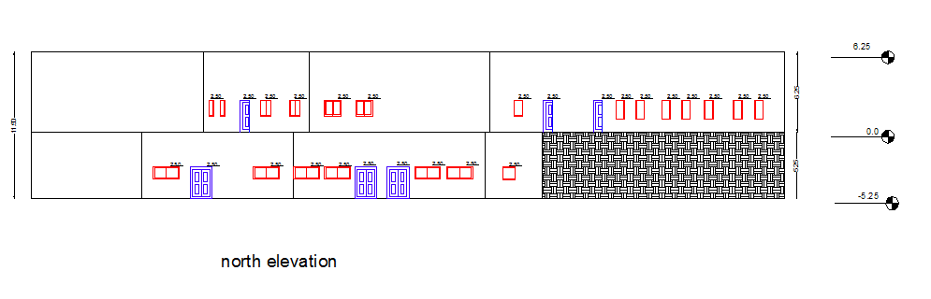

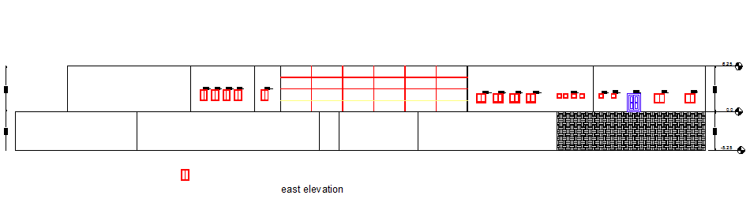
Project design
(Architectural Design):
Elevations
North elevation

Slide 12
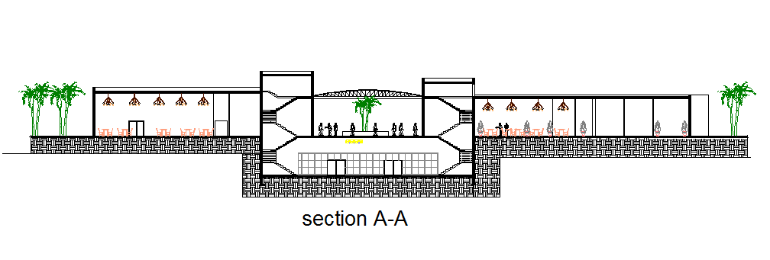
Project design
(Architectural Design):
Sections

Slide 13
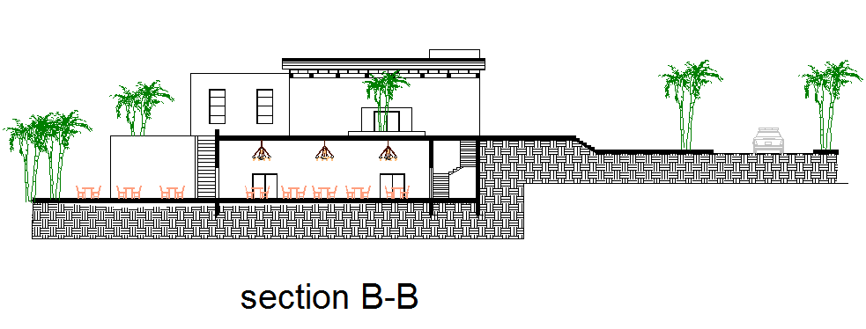
Project design
(Architectural Design):
Sections

Slide 14
Project design
(Environmental Design):
1- The layers for the elements
2-Thermal analysis
3- Daylight factor
4- Shading design
6-Acostical design

Slide 15
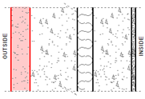


Project design(Environmental Design):
Sample calculation (External Wall Material)

Slide 16
Project design(Environmental Design):
U-values for each element
Element | u-value (w/m².k)
Internal wall | .48
Roof | .39
Ceiling | .43
Floor | .14
Floor exposed to soil | .11
window | 2.41

Slide 17
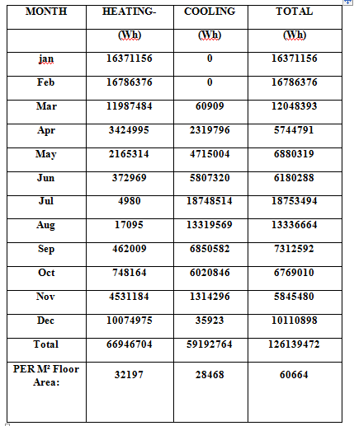
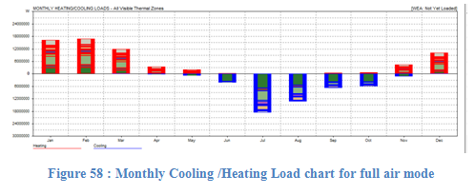
Project design(Environmental Design):
Thermal analysis

Slide 18
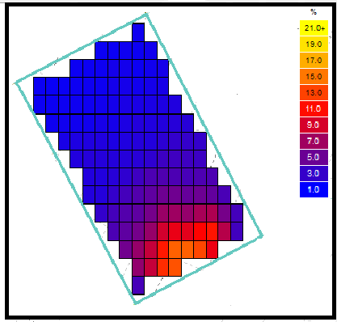
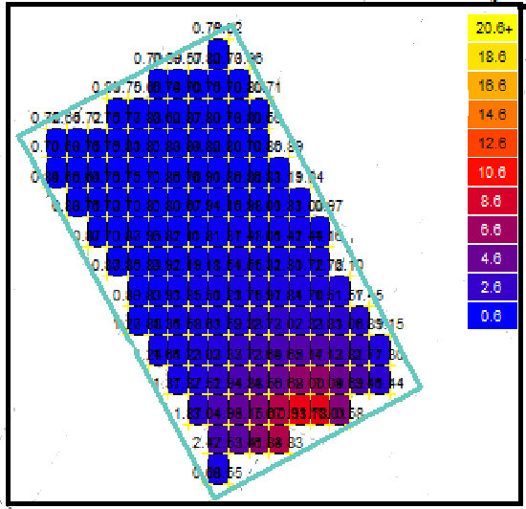
Project design(Environmental Design):
Day light factors(sample calculations):
D.F=1.79 not suitable
Day light map after changing area of glass
Day light map for administration room with original Area of glass with windows has SHGC =.75 and τ=.611
D.F=3.75 OK

Slide 19
Project design(Environmental Design):
Day light factors:
space | D.F (with original area of glass) | (D.F) after changing area of glass
restaurant | 2.65
Meeting hall | 4.75 | 3.44
Kitchen for restaurant | 1.22 | 1.47

Slide 20
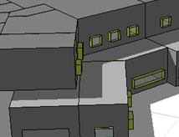

Project design(Environmental Design):
Window shading:

Slide 21
Project design(Environmental Design):
STC and IIC
STC for the external wall =56 db which achieve the standerd
STC for the internal wall =46 db which achieve the standerd
IIC for the ceiling=56db which achieve the standerd

Slide 22
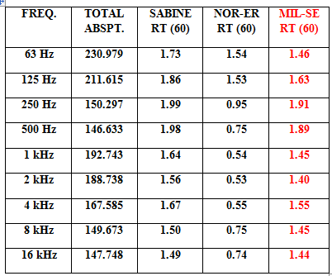
Project design(Environmental Design):
Acoustics Design:
Statistical reverberation time for women hall
For wedding hall shouid be between(1.4-2)sec

Slide 23
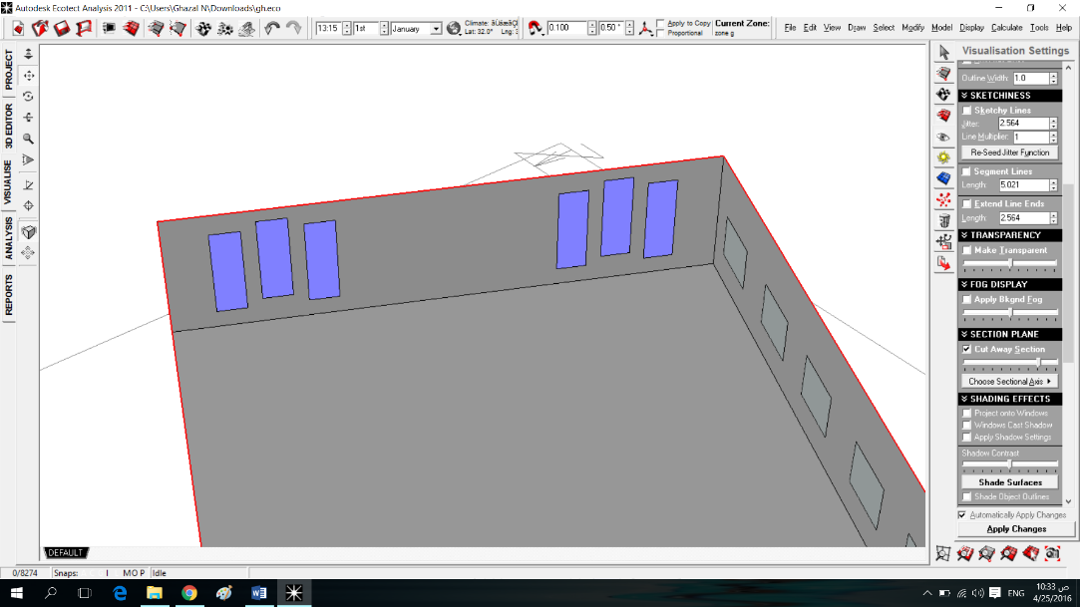
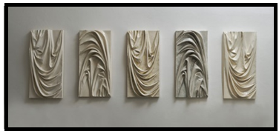
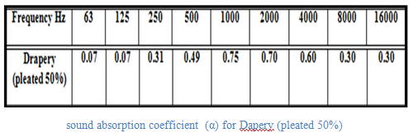
Project design(Environmental Design):
Acoustics Design:
The use of Decorative drapery

Slide 24
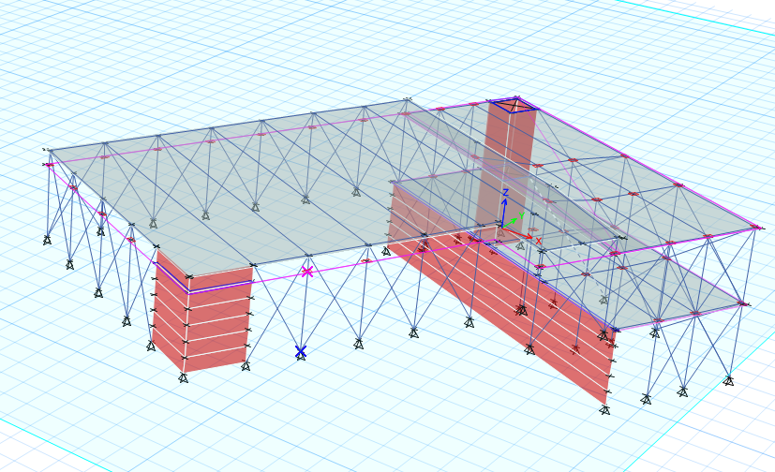
Structure Design:
Design data and Load
3D model and checks
Design stage :
Slab design
Beam design
Column design
Shear wall design
Stair design
Footing design

Slide 25
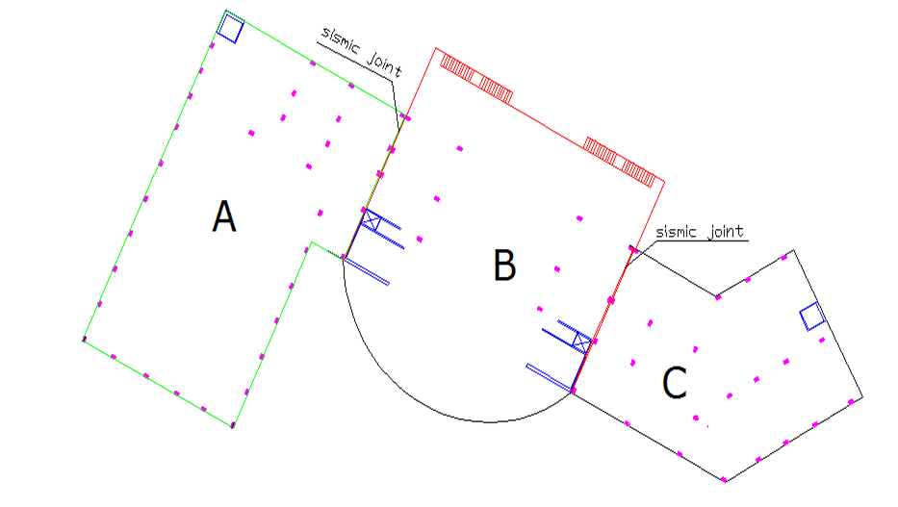
Structure Design:

Slide 26
Structure Design:
Design Data:
Concrete F`c = 28 Mpa
Steel yielding strength Fy = 420 Mpa
Bearing Capacity For Soil 350 KN/m2
Load:
Super imposed dead load = 4 KN/m2
Live load = 3 KN/m2

Slide 27
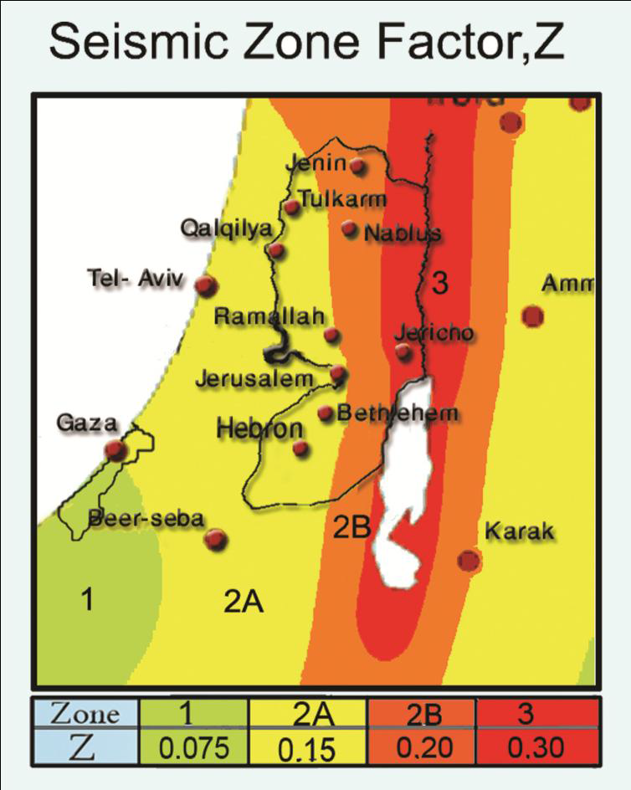
Soil Type Sb
Location:
Nablus → Zone: 2B
→ Z = 0.2
Cv = 0.2
Ca =0.2
I (importance factor) =1
Structure Design:
Seismic Design Data:

Slide 28
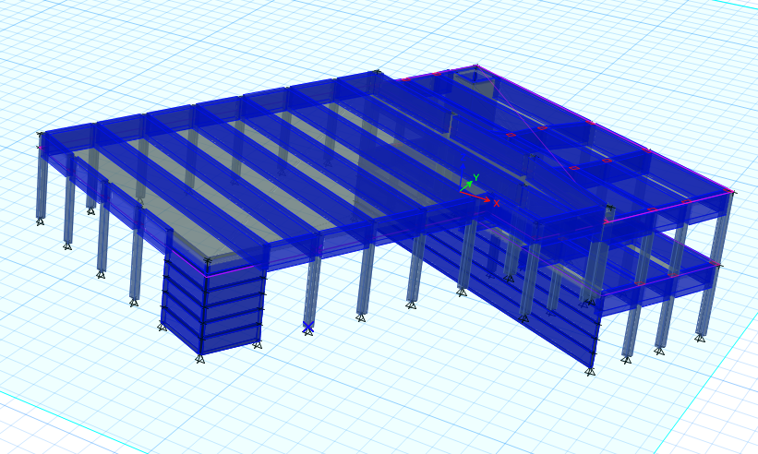
3D – Model :
Structure Design:

Slide 29
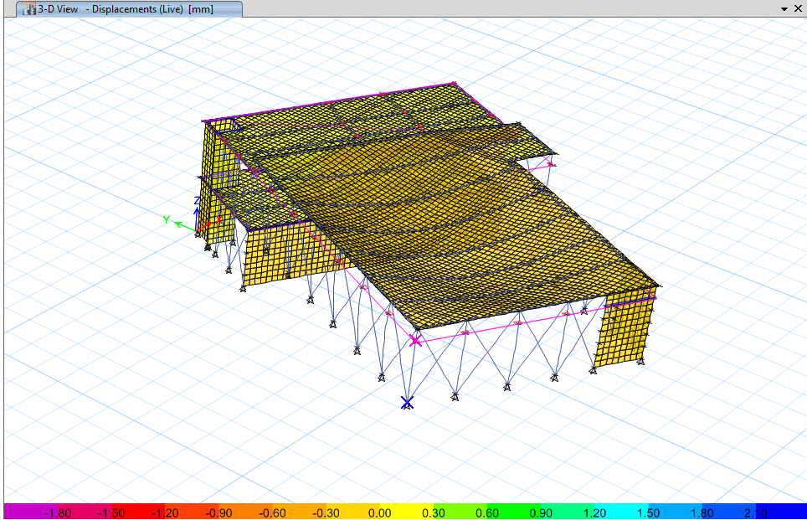
3D Model – Compatibility Check:
Structure Design:

Slide 30
Equilibrium Check:
Structure Design:
Loads | ETABS- Results | Manual Results | Error
Dead Load | 21874.4 KN | 0.11312 KN | 0.1% < 5 %
Live load | 2018.58 KN | 4724.65 KN | 1.3 % < 5 %
SID load | 17156.01 KN | 17856.57 KN | 0.04 % < 5%
Error < 5% …… ok

Slide 31
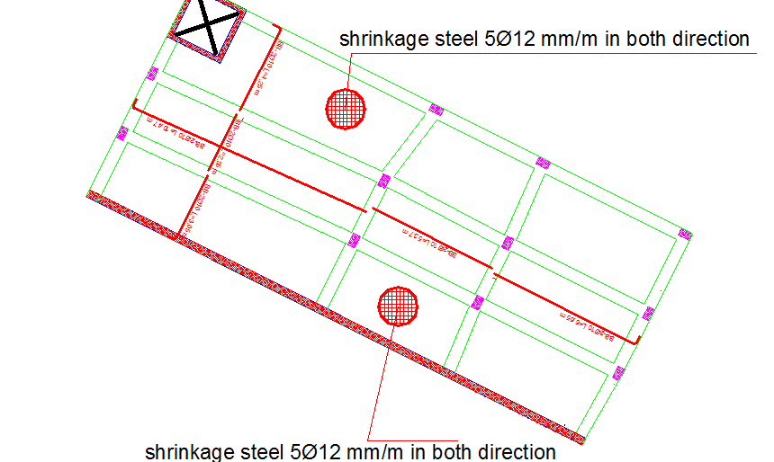
Design Stage:
Structure Design:
Typical Solid Slab Reinforcements in

Slide 32
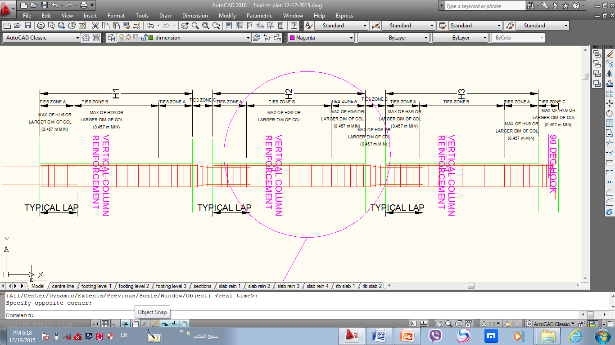
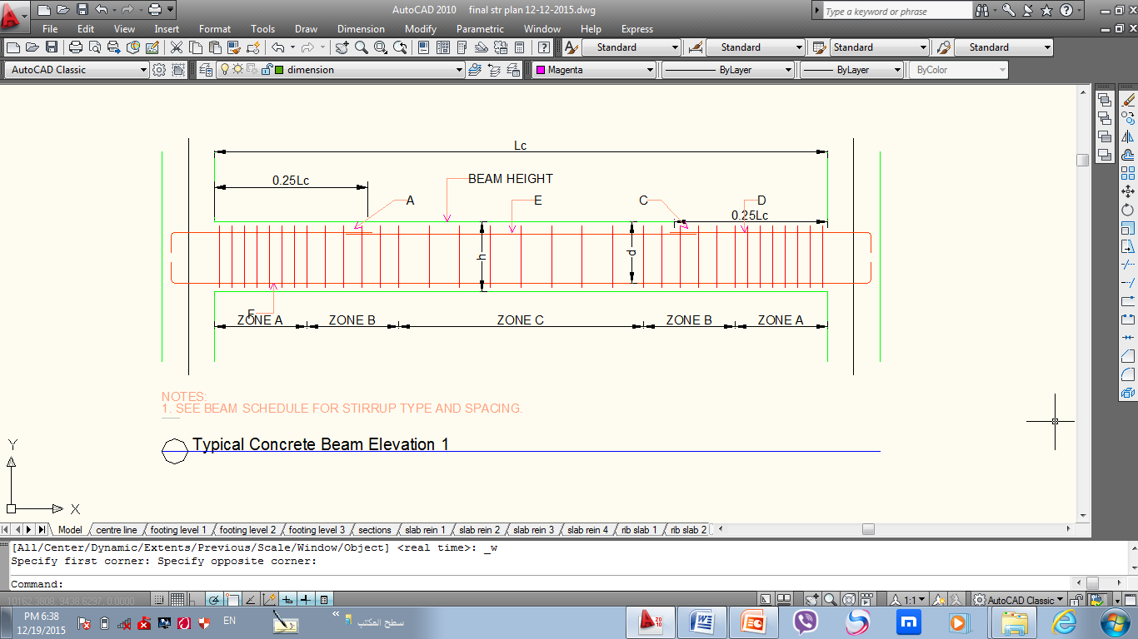
Design Stage:
Structure Design:
Beams and columns Reinforcements:

Slide 33
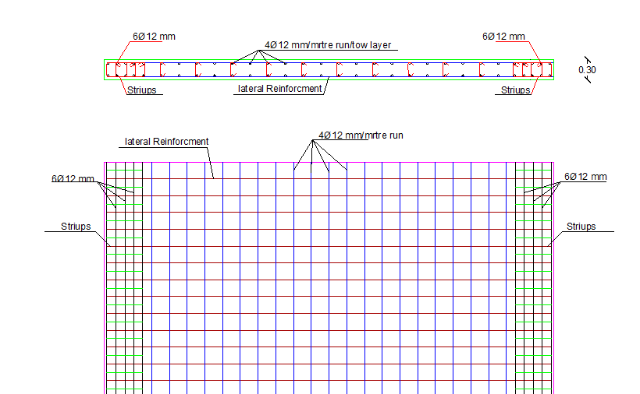
Structure Design:
Shear walls Reinforcements:

Slide 34
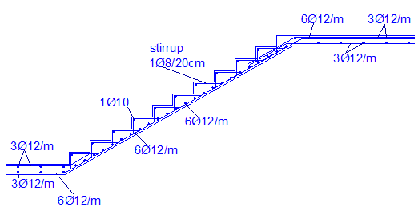
Structure Design:
Stair Design:

Slide 35
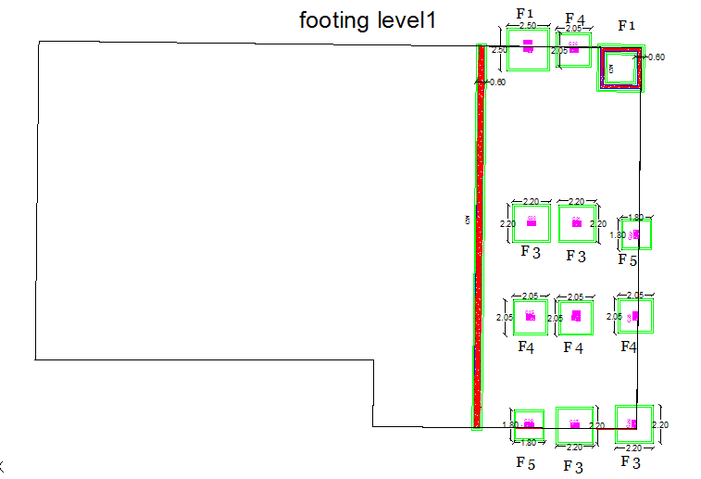
Structure Design:
Footing Plan :

Slide 36
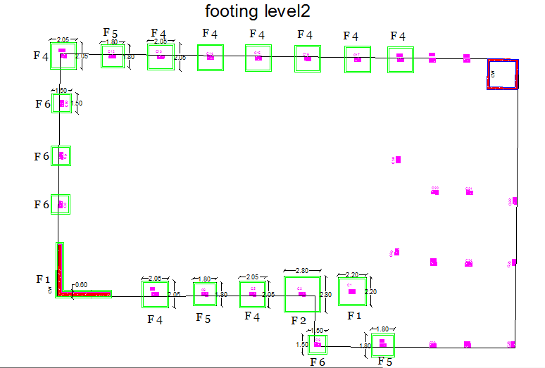
Structure Design:
Footing Plan :

Slide 37
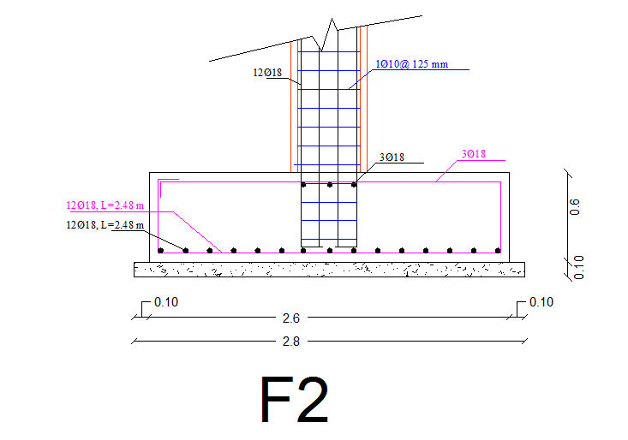
Structure Design:
Isolated Footing Detailing :

Slide 38
Electro-Mechanical Design :
Eelectrical Design
Electrical design of a building involves many aspects Including
Distribution of sockets
Distribution of lighting
Mechanical Design
Mechanical design of a building involves many aspects Including :
1- water supply system
2- Drainage system
3- (VRF) system

Slide 39
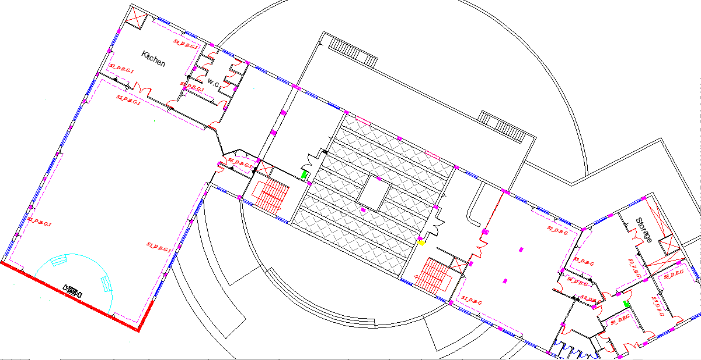
Electrical Design :
Distribution of sockets for ground floor :

Slide 40
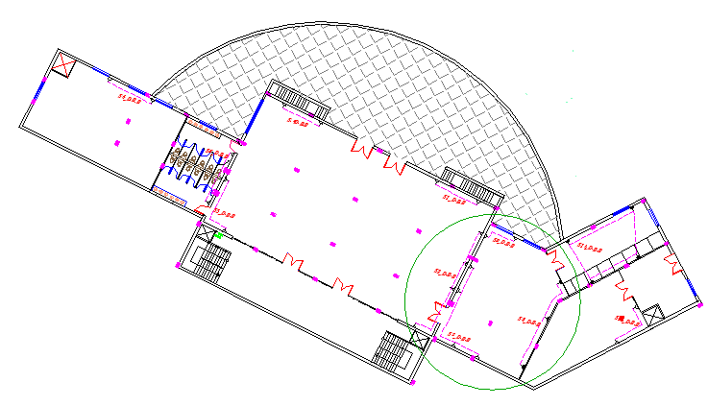
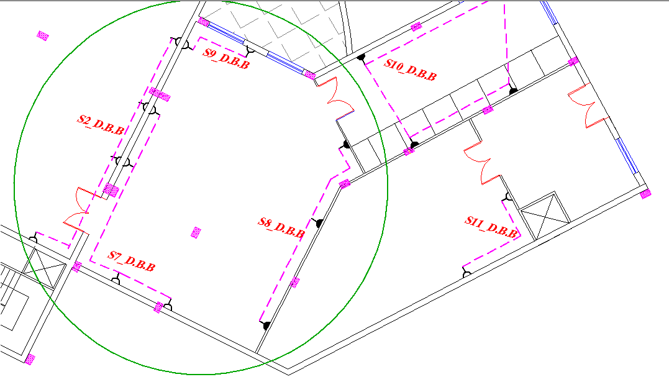
Electrical Design :
Distribution of sockets for bassment floor :

Slide 41
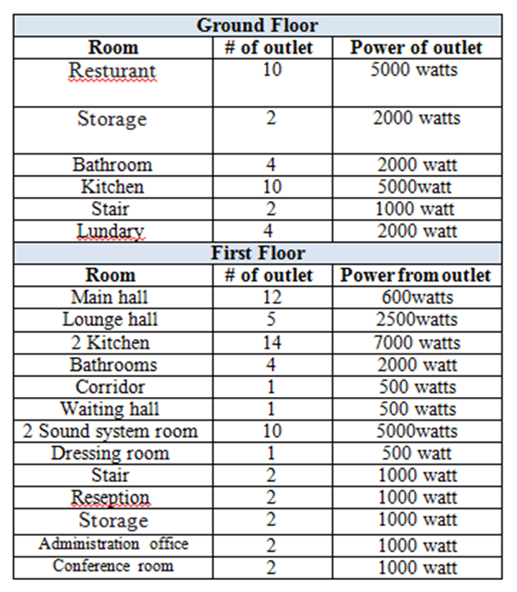
Electrical Design :
Number the Outlets in the building for each space :

Slide 42
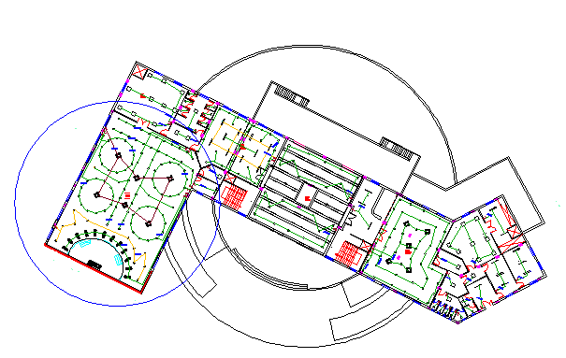
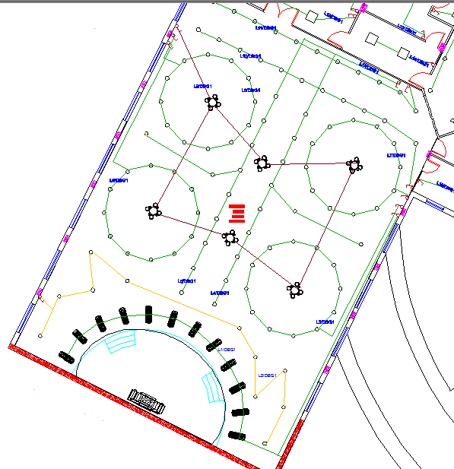
Electrical Design :
Distribution of lighting for main hall:

Slide 43
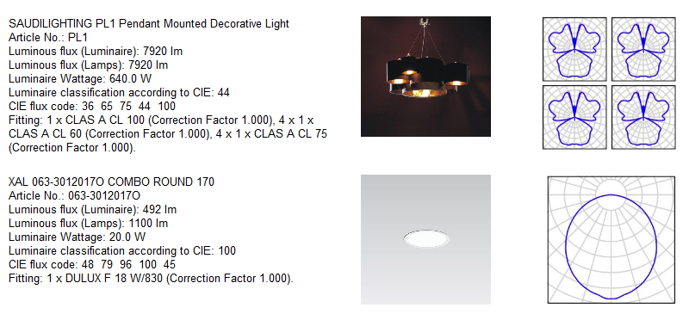
Electrical Design :
There are the types of lamps have been used in

Slide 44
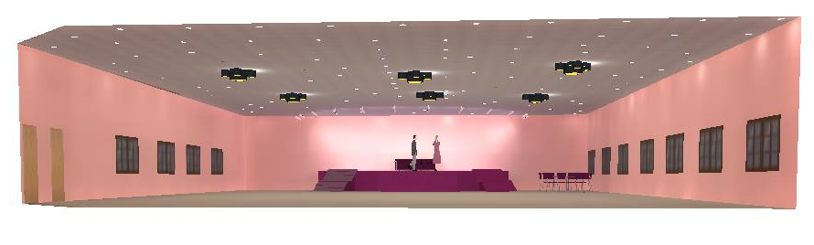
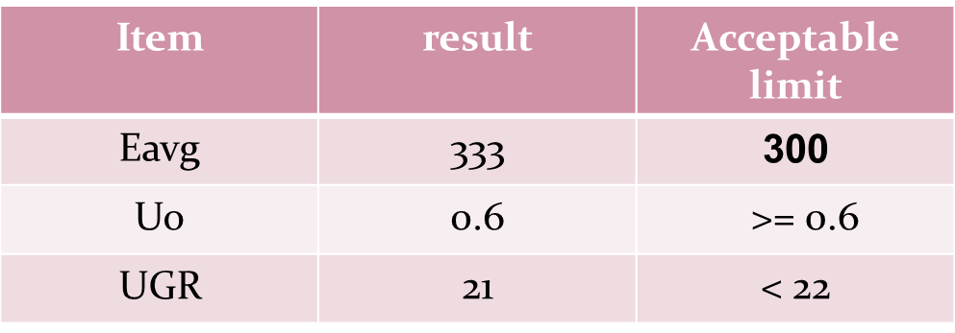
Electrical Design :
Artificial lighting using “Dialux” for main hall

Slide 45
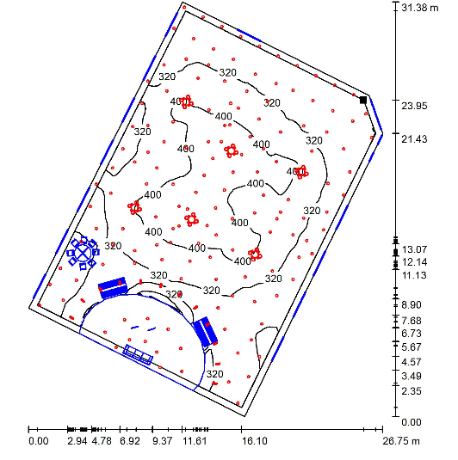
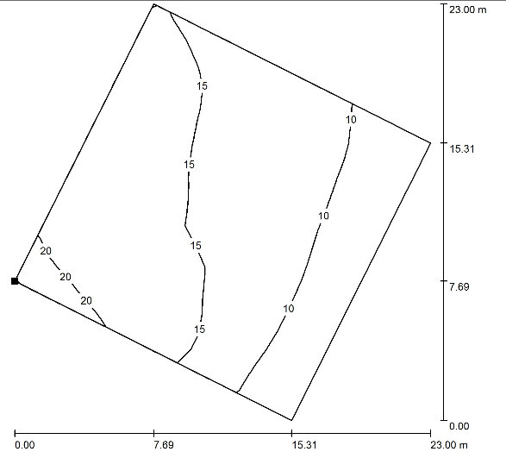
Electrical Design :
Artificial lighting using “Dialux” for main hall
Elluminance isolines
UGR Isolines

Slide 46
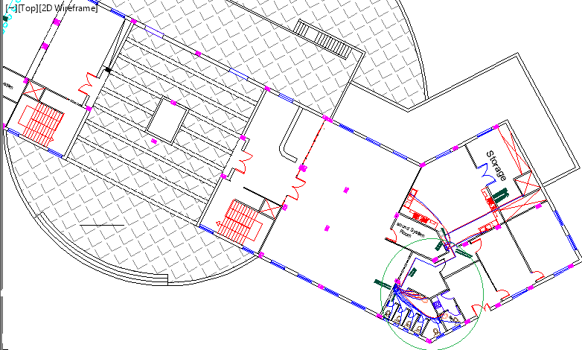
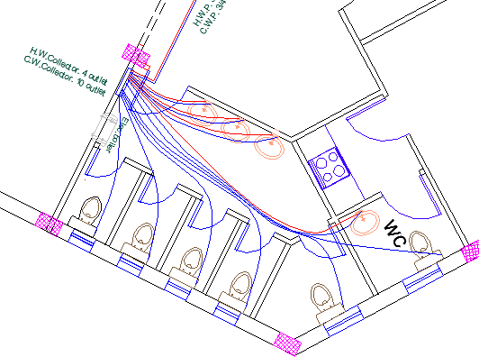
Mechanical Design :
Ground floor water supply

Slide 47
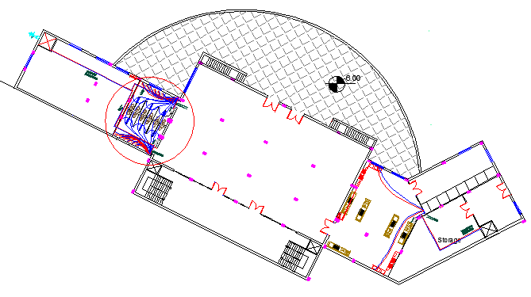
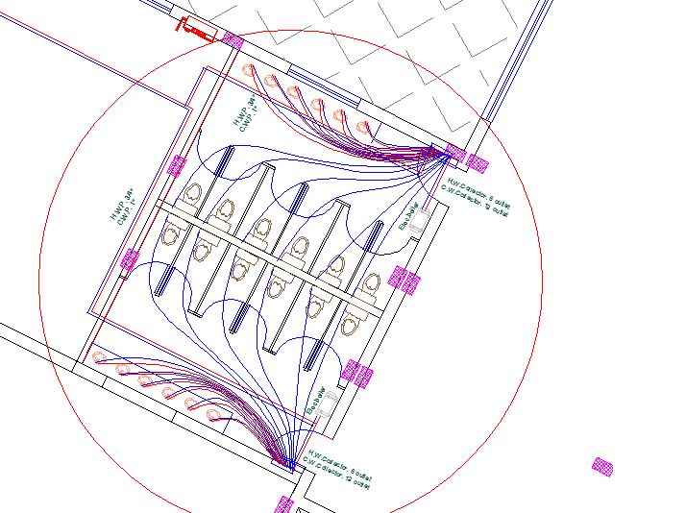
Mechanical Design :
Bassment floor water supply

Slide 48
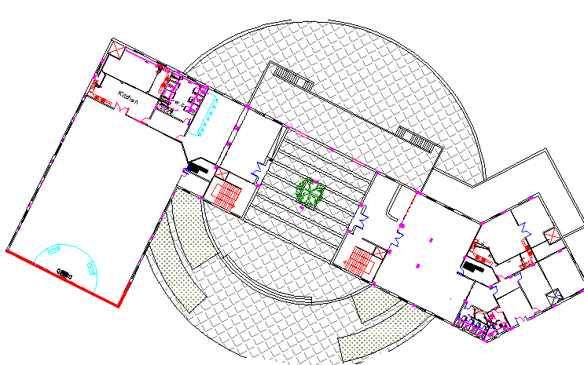

Mechanical Design :
Water drainge system :

Slide 49

Mechanical Design :
Water draing system :
The vertical stack pipe diameter = 4 inch.
The diameter of vent = 4 inch
The main drain pipes (underground pipes) diameter = 6 inch @ 1% slope.

Slide 50


VRF system :
In Main hall :

Slide 51


VRF system :

Slide 52

VRF system :
The unit out door and unit door will use in main hall

Slide 53


Fire system ::

Slide 54
Cost Estimation
Total Cost = 1,228,198 ₪
Cost per meter square = 896.49 ₪/m^2

Slide 55


