Slide 1

Supervision of
Dr. Kamal Irshaid

Slide 2
Table of contents
1- Overview
2- Vision
3- Mission
4- Problems Involved during Website implementation
5- Admin Interface
6- Customer Interface
7- Tools
8- Future outlook

Slide 3
1- Project Overview
Based on the great spread of technology and the great interest in online shopping, we started the idea of our website, Oh My Car, which offers the customer the best parts, whether interior or exterior, in terms of quality and high efficiency in providing service at an affordable price.

Slide 4
2-VIsion Statement
We aim to be the most common, respected, and successful car auto parts website in Palestine

Slide 5
3-Mission Statement
OH MY CAR is dedicated to creating lifetime customers by delivering the highest quality products and treating each customer as if they are a guest in our home.

Slide 6
3- Problems Involved during Website implementation
1- Using JavaScript to build the website and link with the database .
2- Losing part of the practical part (codes) during the implementation process and rewriting the code from the beginning

Slide 7
3- Problems Involved during Website implementation
3- Expensive in terms of time due to synchronization with other courses registered this semester
4-Difficulty transferring information about orders and suppliers to the database
5- Inaccurately and incorrectly printed outputs for entities

Slide 8
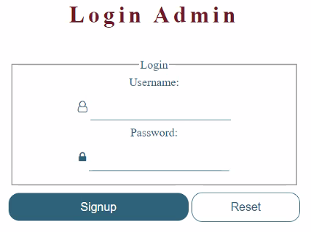
4- Admin Interface

Slide 9
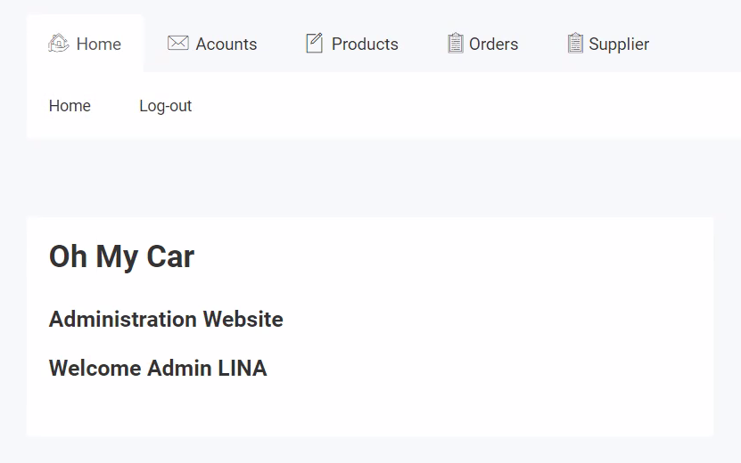
4- Admin Interface

Slide 10
5- Customer Interface

Slide 11



6- Tools
1- PhpStorm
2- Xamp
3- PhpMyAdmin
4- Draw.io
5- Canvas

Slide 12
Future outlook
We will seek to develop this system more and more and put a lot of tasks that we have enough time to put during the required period to complete the project, such as developing a payment mechanism so that payment is made through the site via a credit card and also that this site is converted into an application to be downloaded To the mobile phone and browse in it to be more profitable through it and to provide other services through the website such as car wash service

Slide 13
Thank You
Prepared by
Saeed Hamad , Fatima Khawaled , Lina Abu Dawoud

