Slide 1
UPPER Exoskeletons
Ismaeel Sbeih
Yazan Jawwabreh
SUPERVISOR :
Dr. Salameh Abdelfattah

Slide 2
What is Exoskeletons?

Slide 3
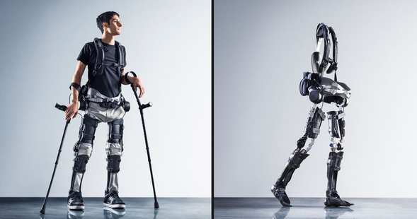
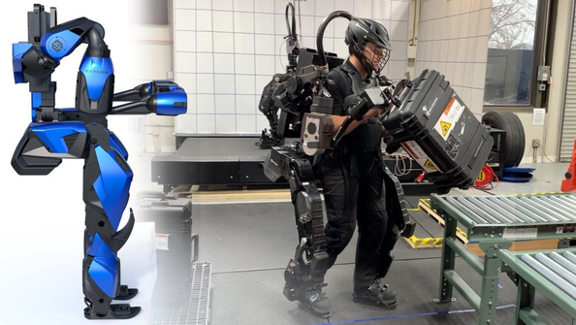


Slide 4
Classifications of Exoskeletons
according to body part
according to use of actuators
according to How it controlled

Slide 5
Classifications of Exoskeletons
according to body part
according to use of actuators
according to How it controlled

Slide 6
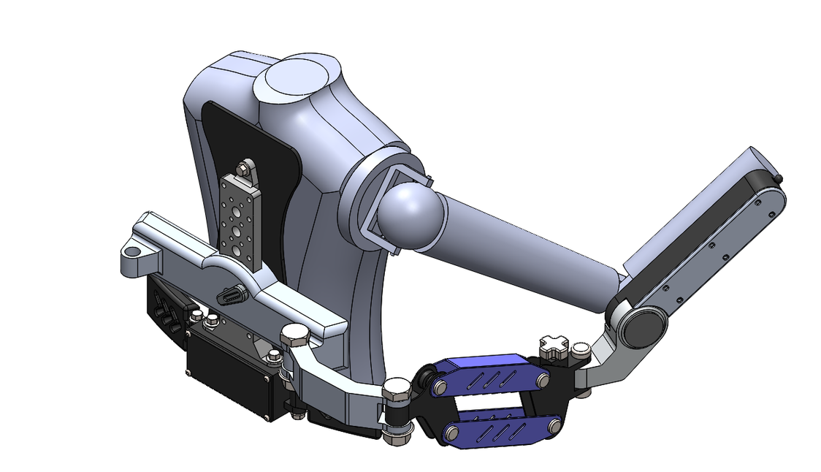
Classification according to body part
Upper exoskeletons

Slide 7
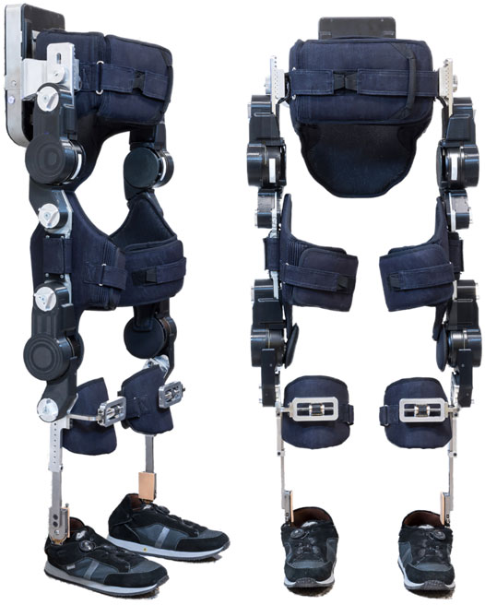
Classification according to body part
Lower exoskeletons

Slide 8
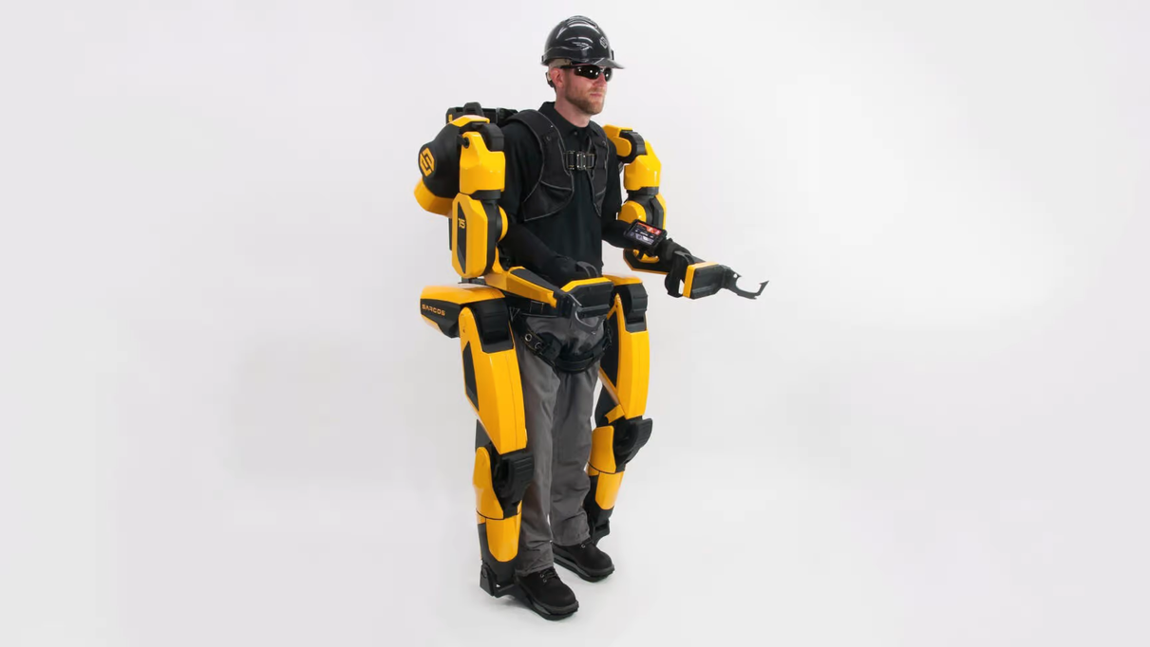
Classification according to body part
Full body exoskeletons

Slide 9
Classifications of Exoskeletons
according to body part
according to use of actuators
according to How it controlled

Slide 10
Classification according to use of actuators
Active Exoskeleton

Slide 11
Classification according to use of actuators
Passive Exoskeleton

Slide 12
Classifications of Exoskeletons
according to body part
according to use of actuators
according to How it controlled

Slide 13
Classification according to How it controlled
joystick
control panels
sensors
no control

Slide 14
Applications of Exoskeleton
Medical
Emergencies
industrial

Slide 15
material of the Exoskeleton

Slide 16
When selecting a material an exoskeleton , there are several factors to consider
Strength
Weight
Environmental factors
Safety

Slide 17
Material Selection
Aluminum
carbon fiber

Slide 18
Design

Slide 19
Segment Dimensions

Slide 21
DEGREE OF FREEDOM

Slide 22
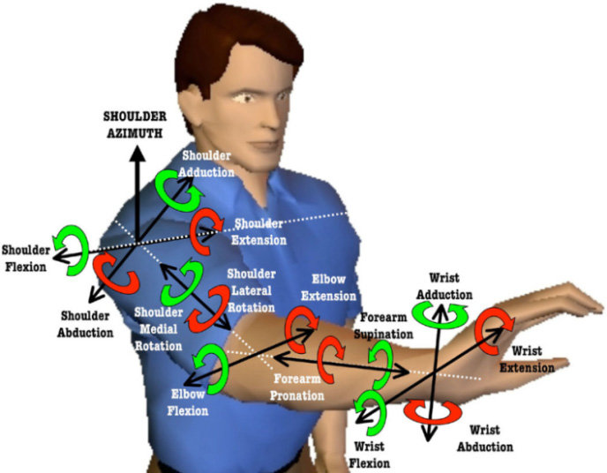

Slide 23
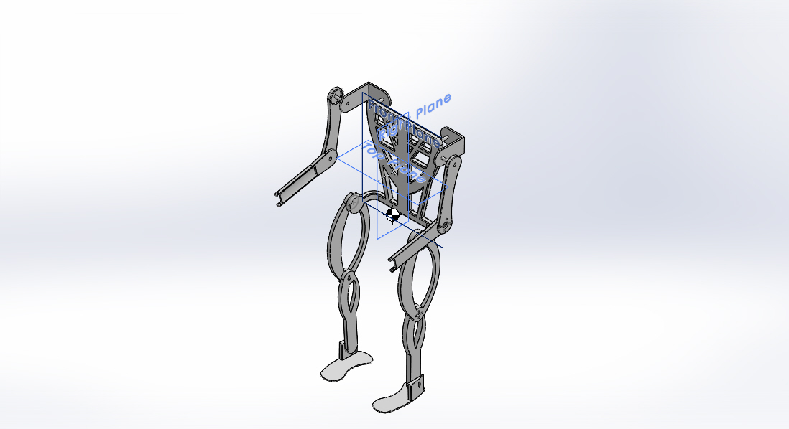

Slide 24
Overview of the project

Slide 25
sensor
SEMG SENSOR
FORCE SENSOR
FLEX SENSOR

Slide 26
motor
Servo motor
position
tourqe
Stepper motor
position

Slide 27
motor
Servo motor
position
tourqe
Stepper motor
position

Slide 28
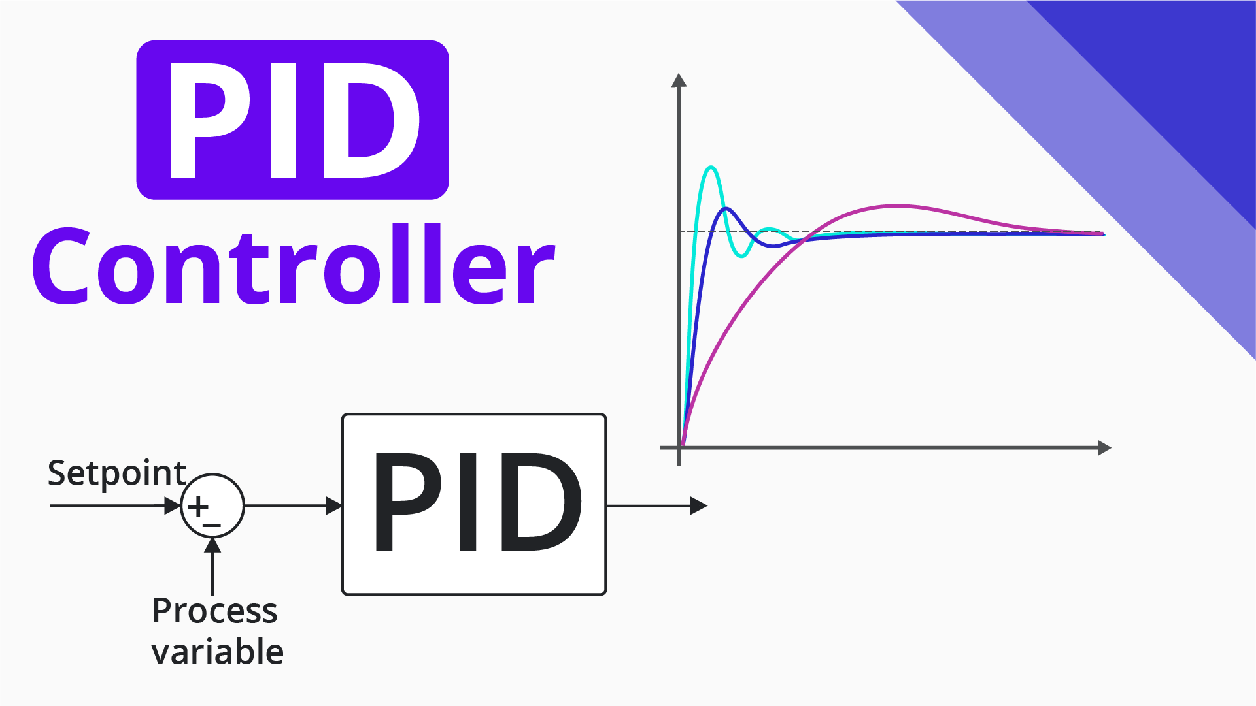

Slide 29
Set point
(position)
Motor
Position error
MOTOR POSITION
∑
PID
MOTOR
MEASURED POSITION
FEEDBACK

Slide 30
Pulse Width Modulation

Slide 31
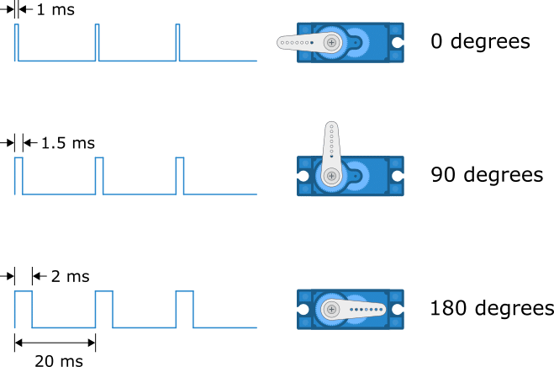

Slide 34
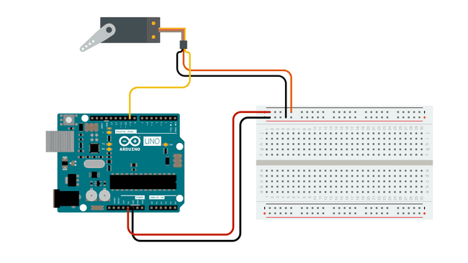

Slide 35
Voltage Divider

Slide 37
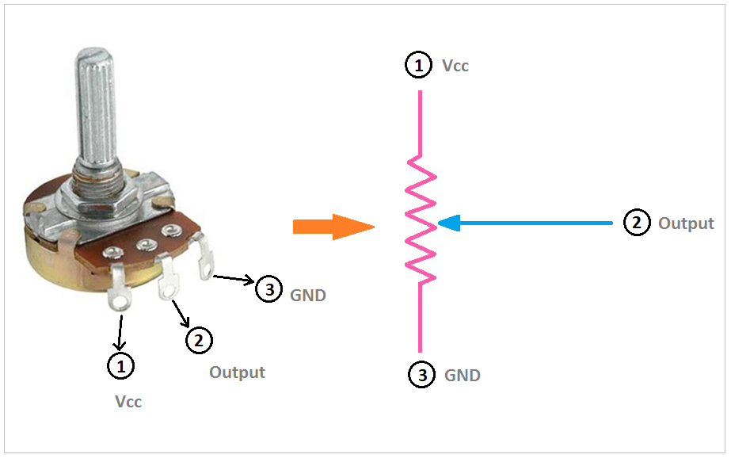

Slide 38
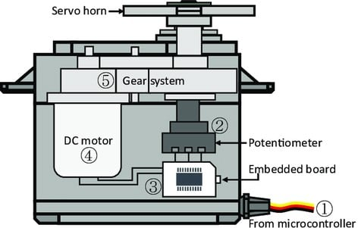

Slide 39
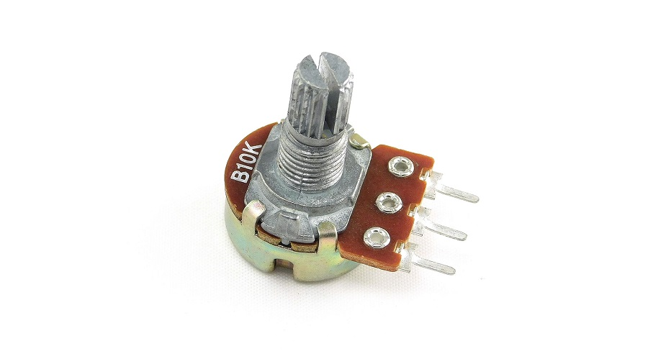

Slide 40
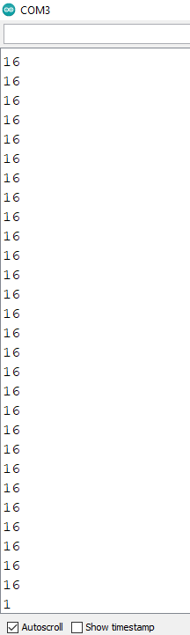

Slide 41
