Slide 1
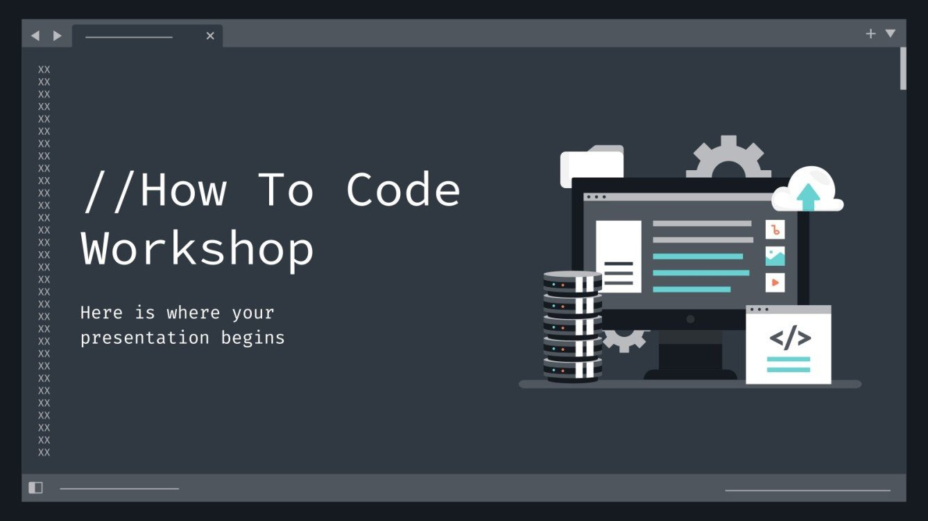


Slide 2
<title> Looming Code </title>
<!-- Supervised by -->
<b> Dr. Mai Abu-Sair </b>
<!-- Presented by: -->
<strong>
Aws Nassar
Ahmad Jaber
Aseel Attili
</strong>

Slide 3
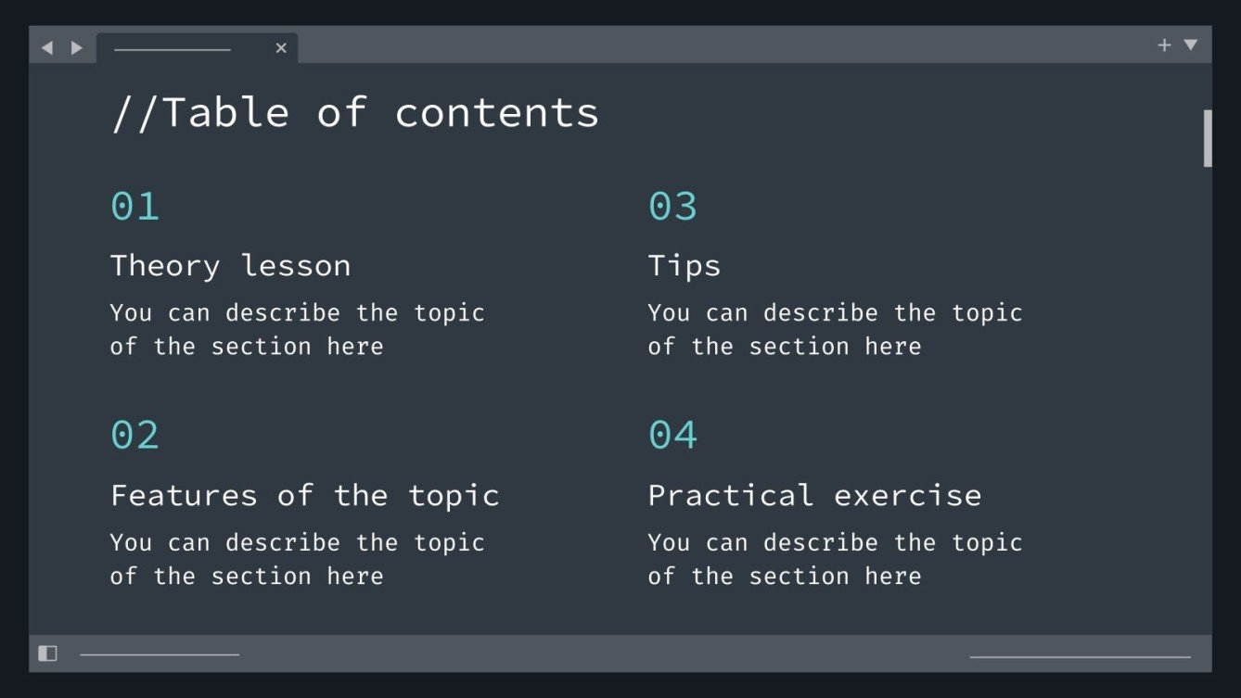
01
Introduction
02
Objectives
03
//Distinguishing features
04
Dynamic website Management
05
Recommender System
06
Helper
System
07
Tools
08
Future Work

Slide 4
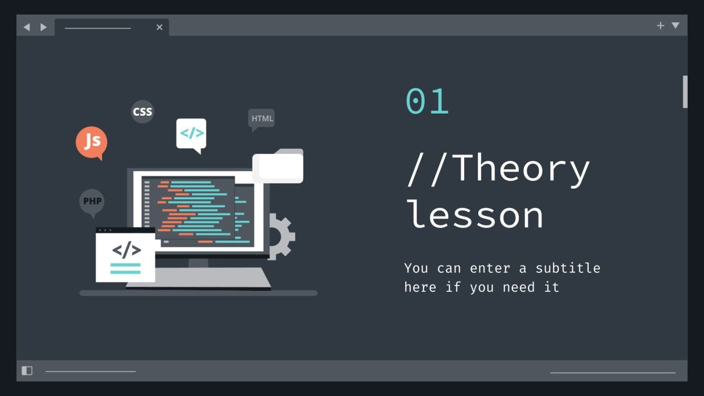
01
// Introduction

Slide 5
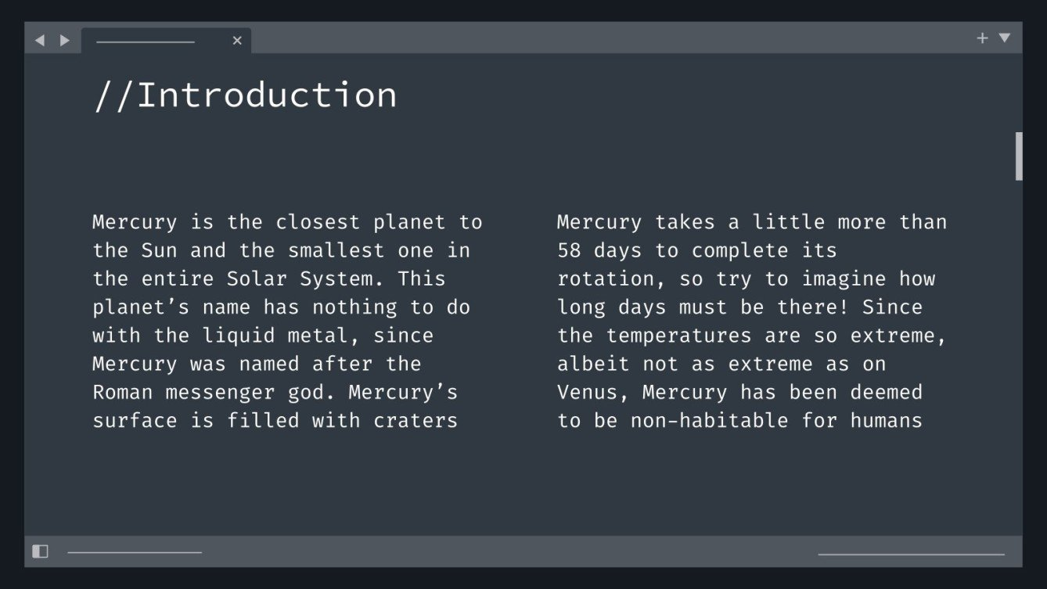
Our graduation project is an educational web-based application designed for learning programming languages and programming concepts. This platform is built to provide a comprehensive and personalized learning experience, catering to learners of all levels.

Slide 6
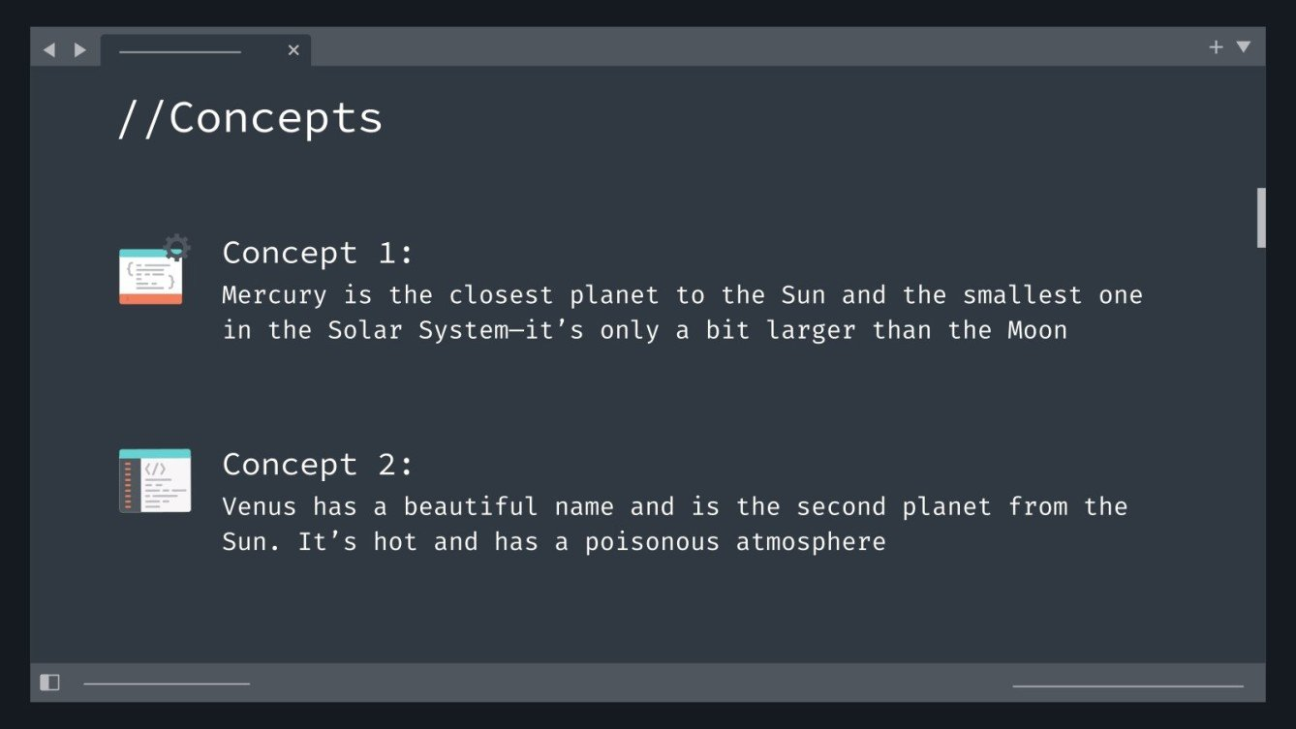
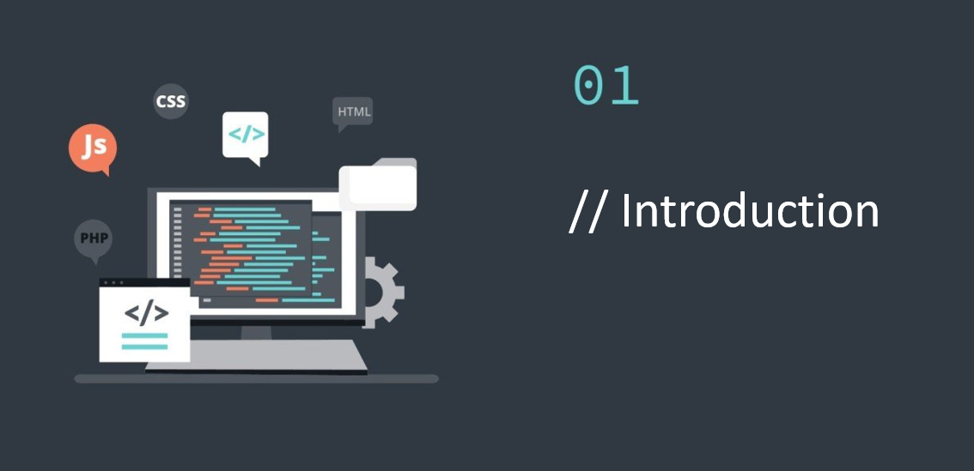
02
02
// Objectives

Slide 7
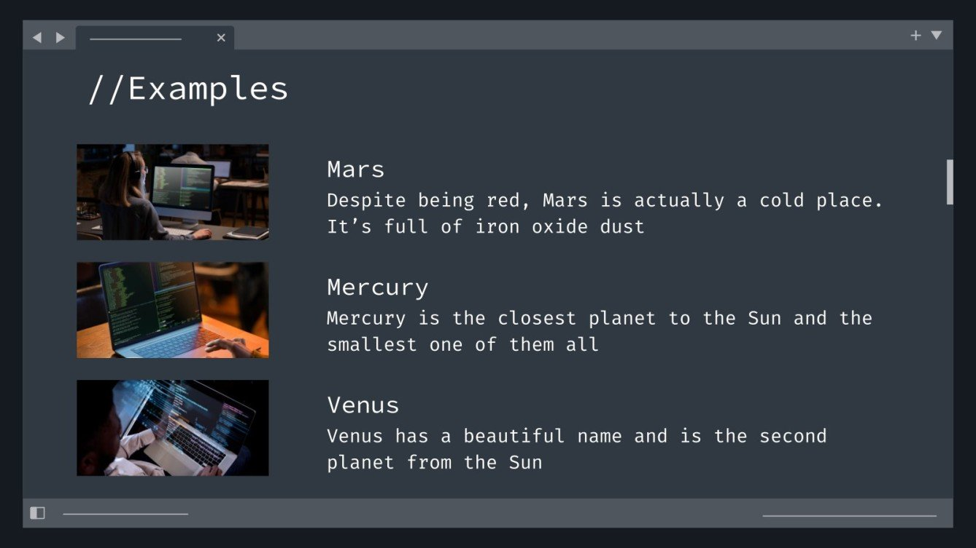
// Objectives
Enhance Programming Education
  comprehensive platform for all skill levels
Prioritize User Experience Through Recommender and Helper Systems.
  Implement a sophisticated recommender system to provide personalized course suggestions tailored to individual learner preferences.
  Develop an intelligent helper system to guide learners to the most suitable starting chapters based on their current knowledge and skills, ensuring an optimized learning experience.

Slide 8
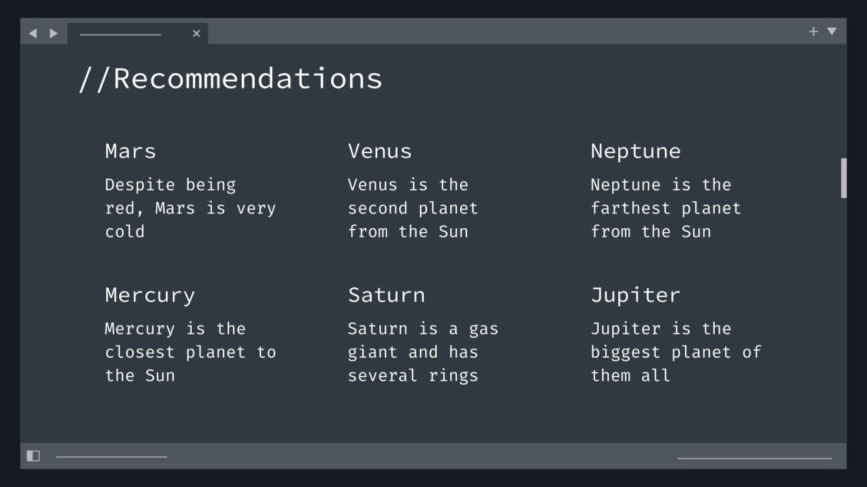
03
// Distinguishing features

Slide 9
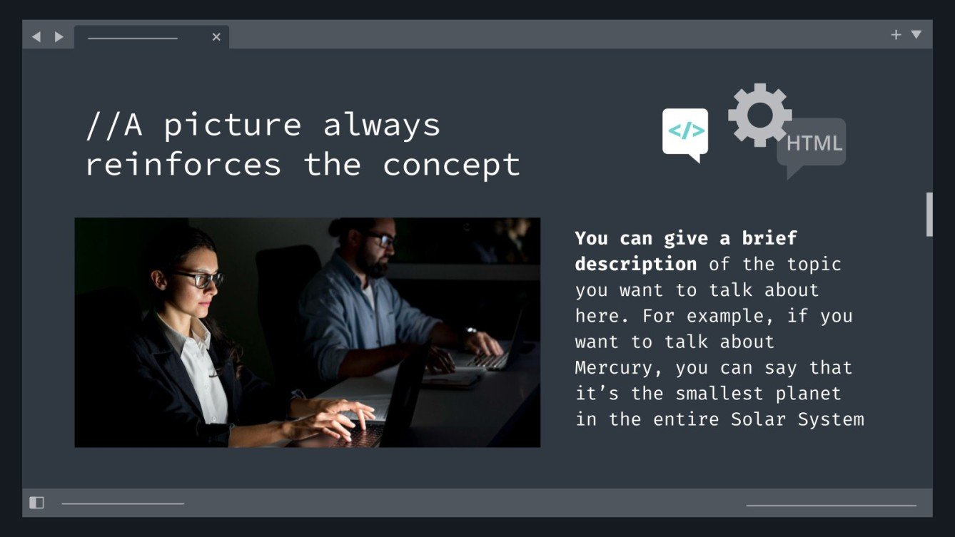
// Distinguishing features
Dynamic Website Management:
Enable easy add, edit, and delete courses and quizzes, eliminating the need for coding and streamlining operations to save time.
Helper System:
An intelligent feature that recommends the most suitable starting chapters, for each learner based on their current understanding and levels.
Recommender System:
content based recommender system that suggests course/s that align with the learner's preferences, previous knowledge, and learning style.

Slide 10
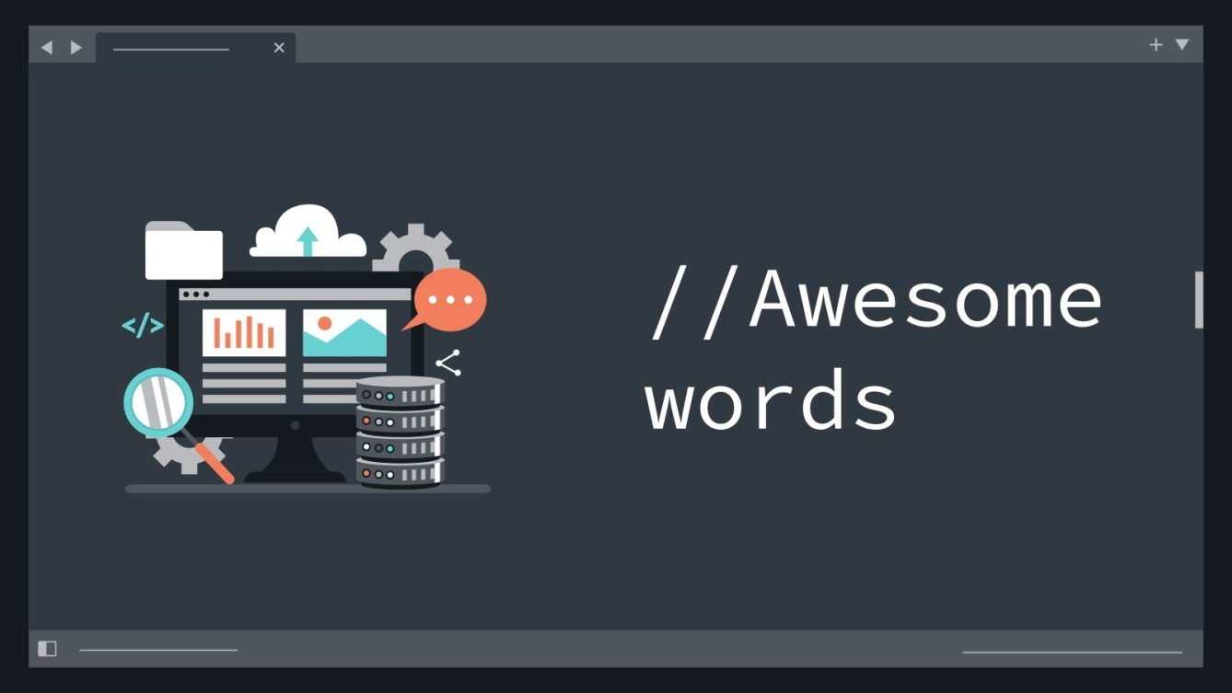
04
// Dynamic website
Management

Slide 11
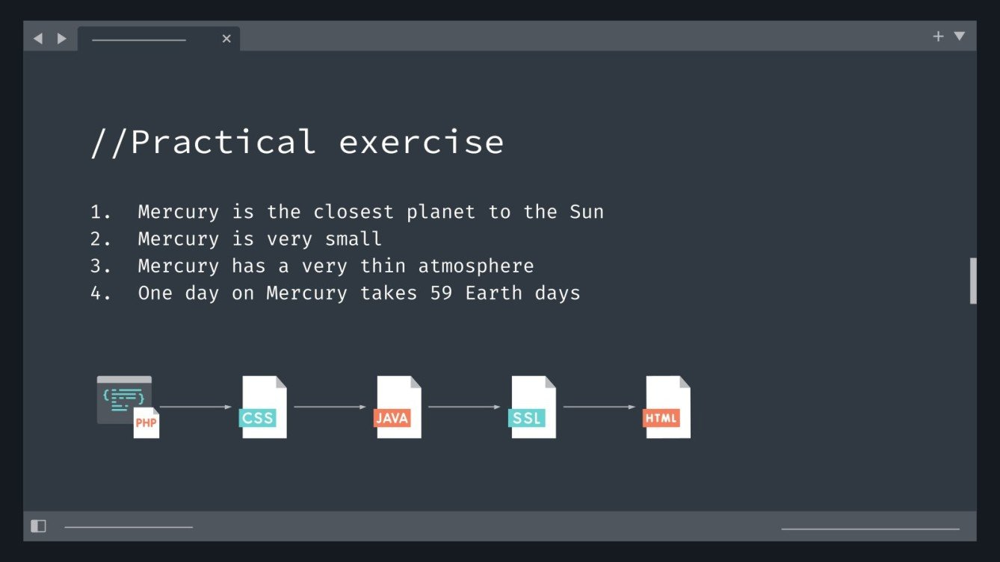
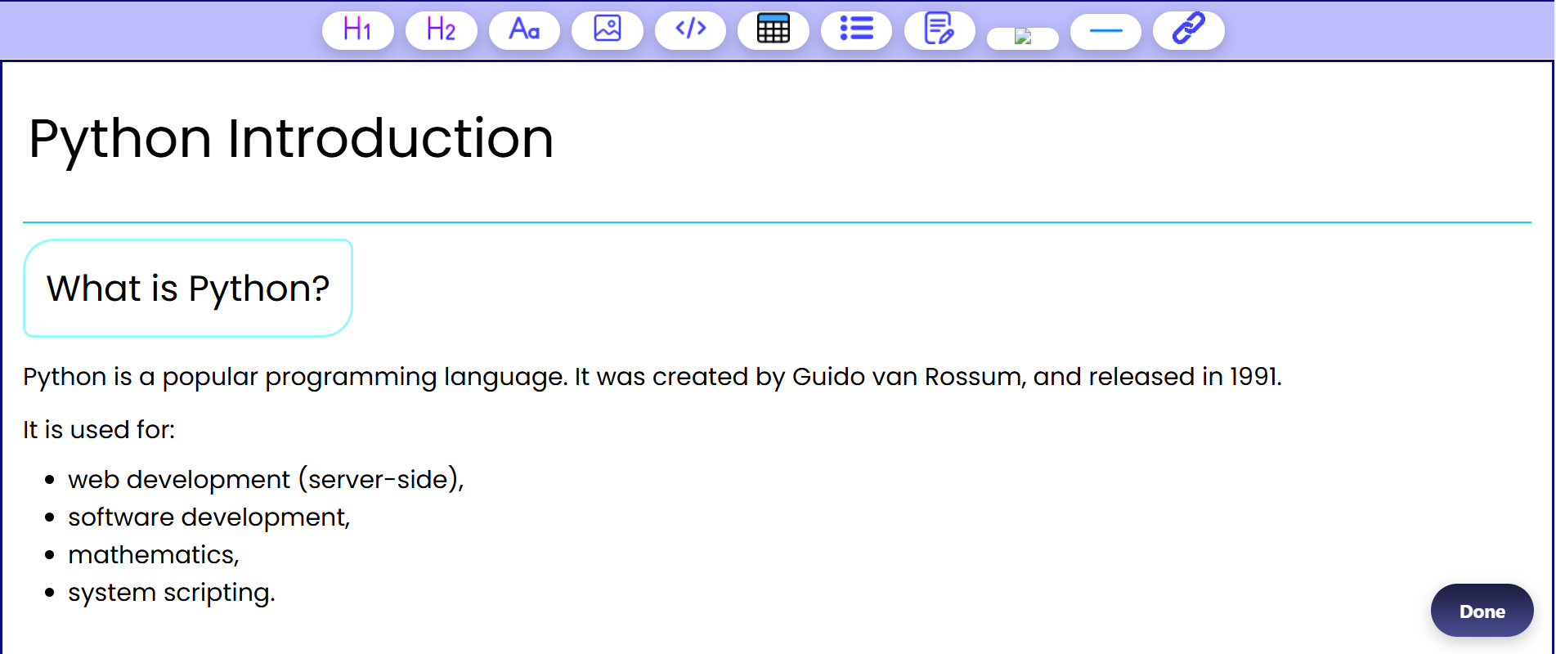
// Dynamic website Management

Slide 12
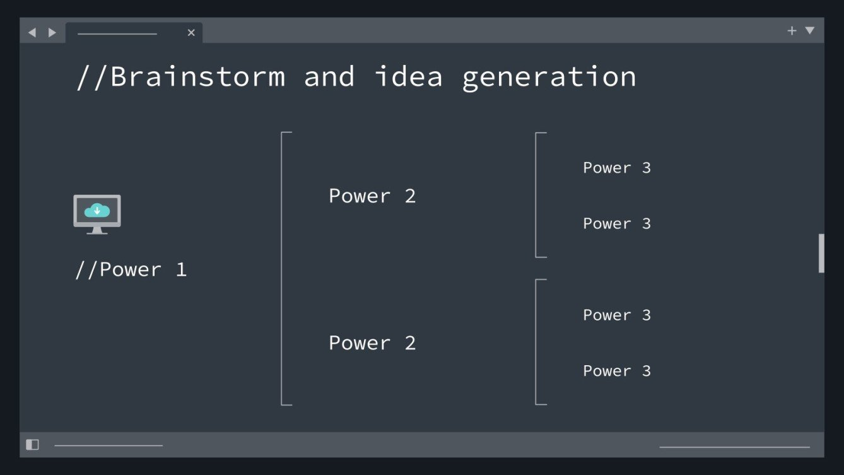
05
// Recommender
System

Slide 13
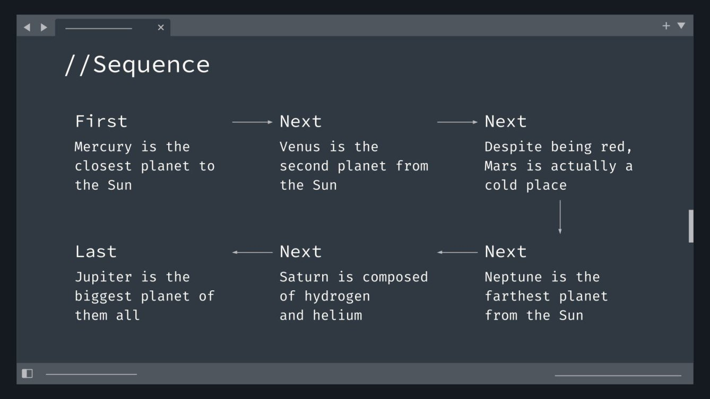
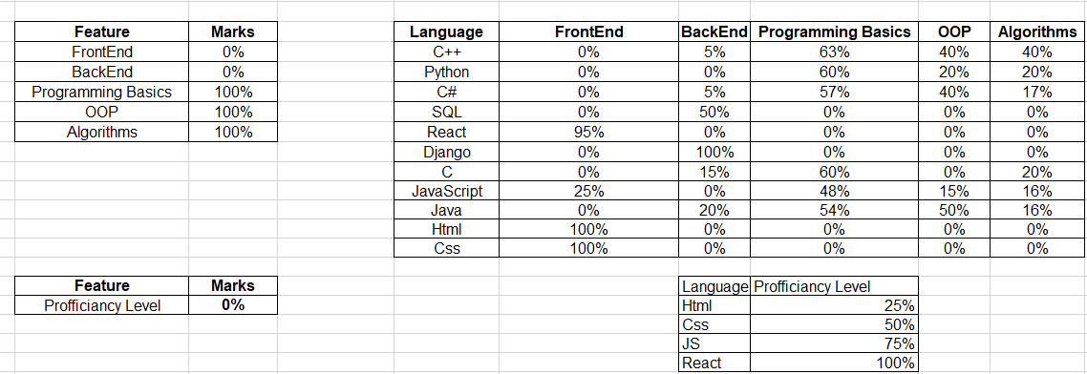
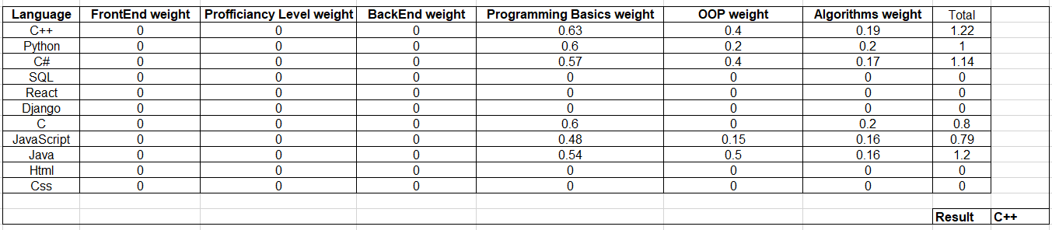
// Recommender System

Slide 14
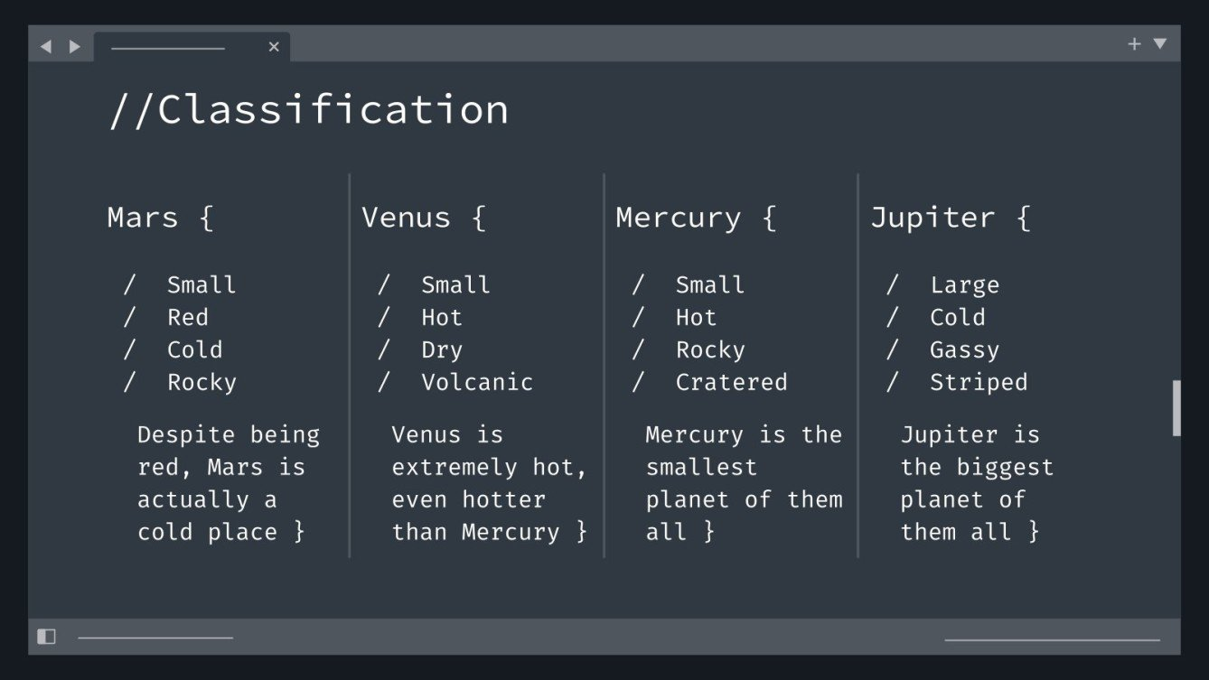
06
// Helper System

Slide 15
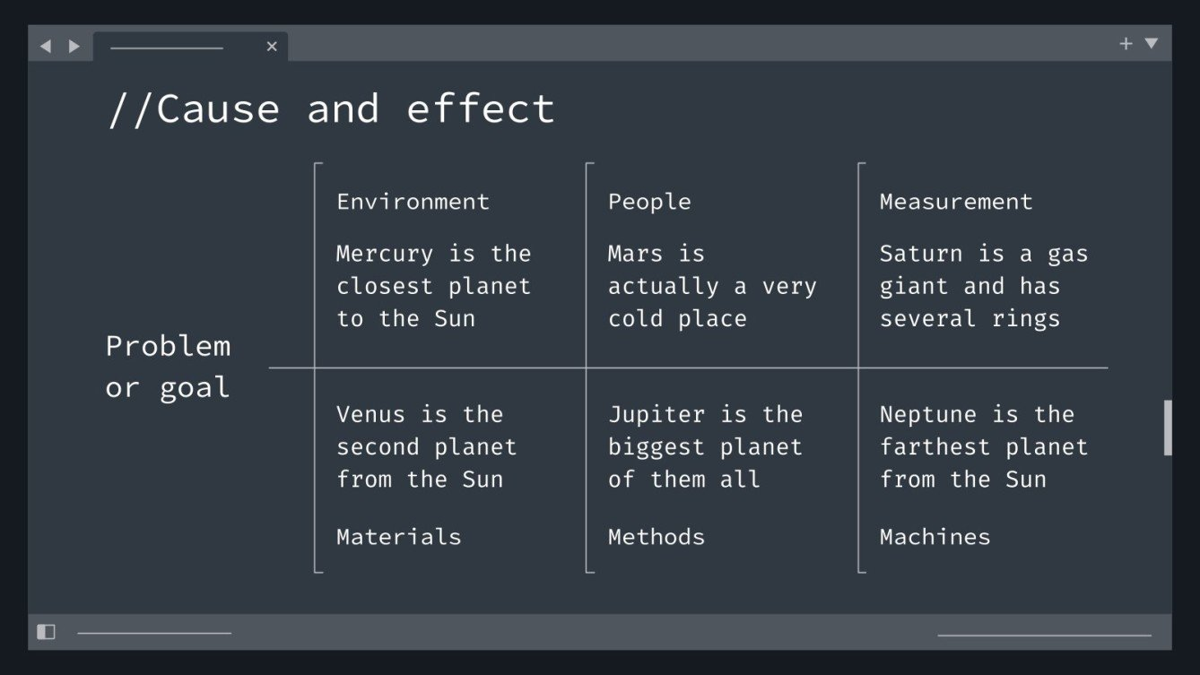
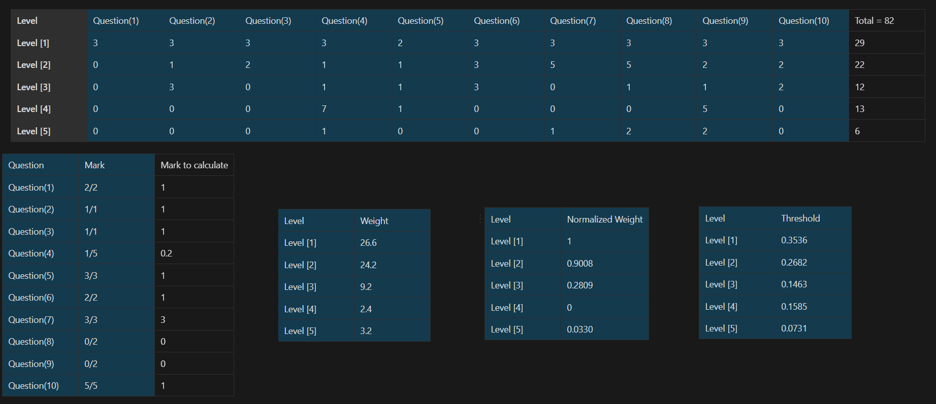
// Helper System

Slide 16
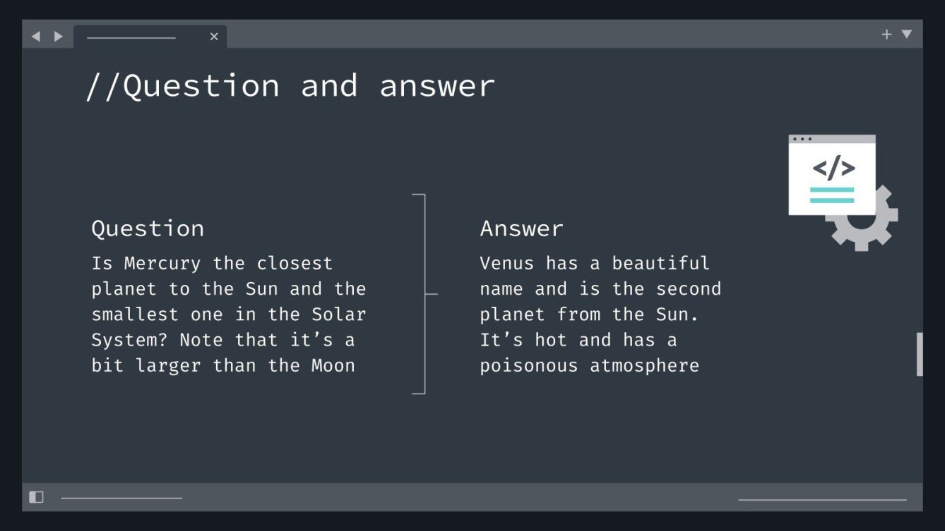
07
// Tools

Slide 17
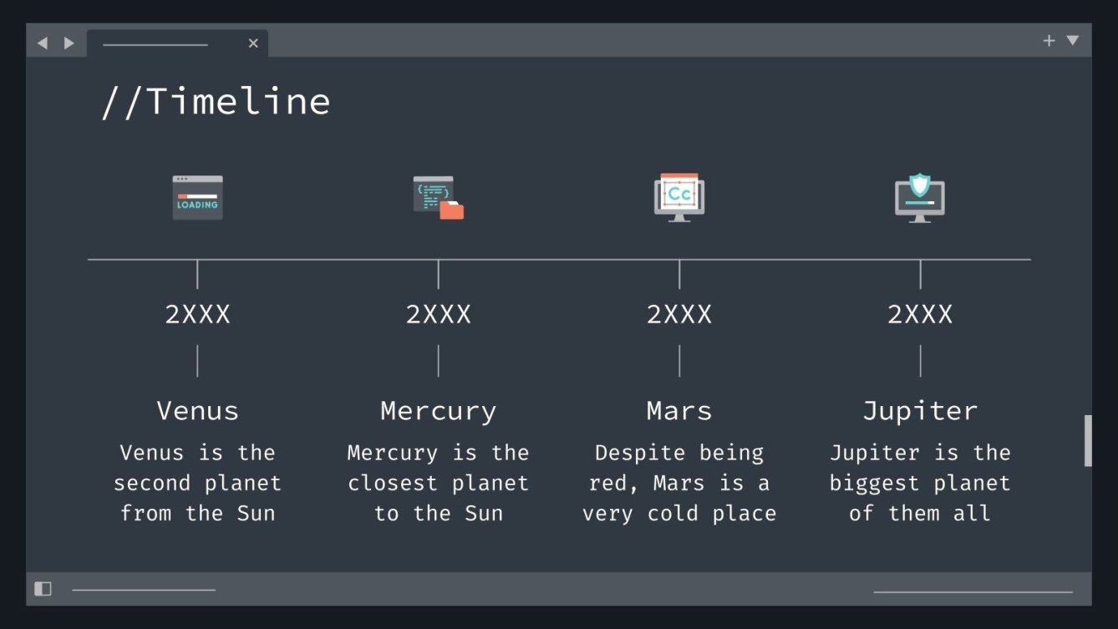





// Tools

Slide 18
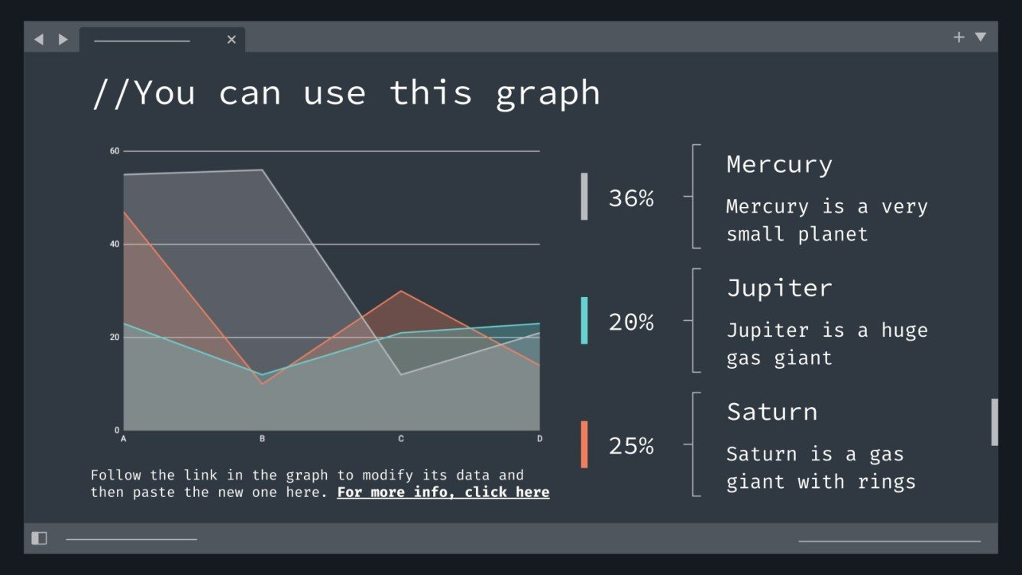
08
// Future Work

Slide 19
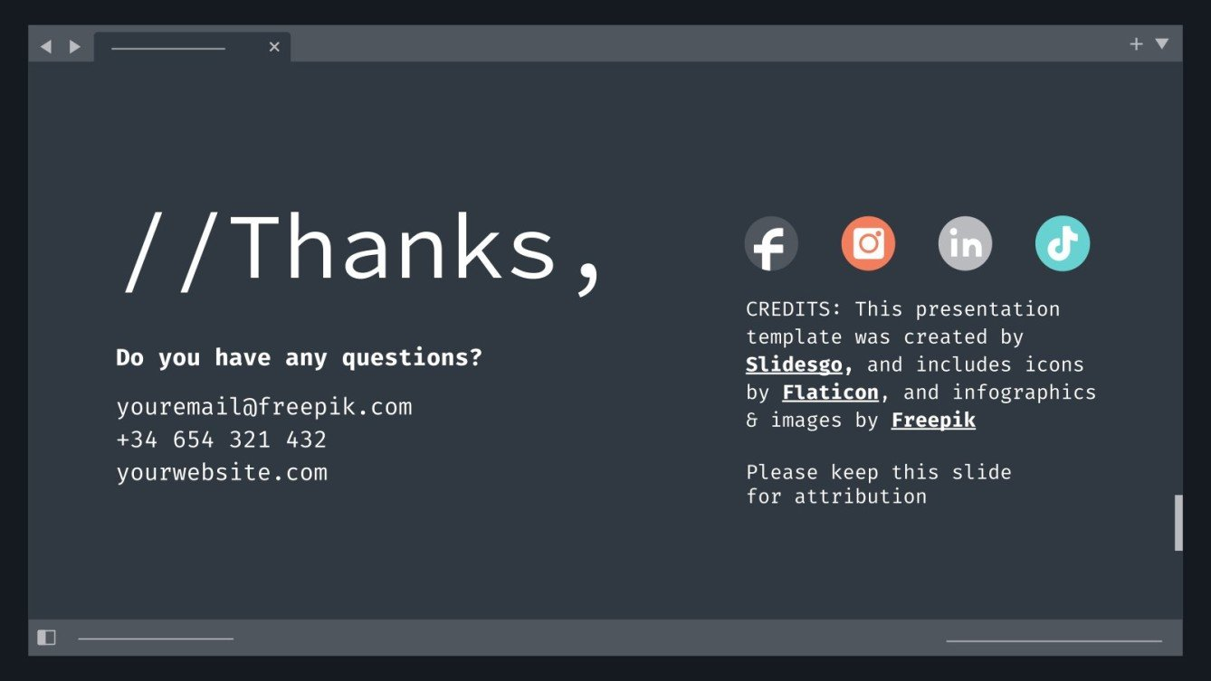
// Future Work
Enhanced Recommender System
- Rating Feature.
- Detailed Course Features.
Custom Learning Paths
- Use quiz performance data to dynamically generate personalized learning paths, guiding learners through topics based on their proficiency levels.
Integration of Chatbot
- Introduce a chatbot feature to assist learners in navigating the website.
Compiler and Code Execution Environment
- Integrate a compiler and code execution environment directly into the platform

Slide 20



