Slide 1

Graduation Project 2
Analysis and Improvement of
Hazardous Traffic Locations (Black Spots) in Nablus Governorate.
By : Lama Majdi Odeh
Mira Ra’ed Hijjawi
Tareq Ayman Nazzal
Under supervision of : Prof. Khalid Al-Sahili

Slide 2
Introduction
Definition of Black spots
Black spots : the sites or areas where traffic crashes occur frequently, whether or not these crashes result in human death or physical injury, or are limited to material damage to public and private property.

Slide 3
Statistics
1.3 million
20-50 million
12829 crash
13165
crash
Globally
Palestine

Slide 4
Importance of Identifying Black Spots
Ensure traffic safety
Reduce financial costs
Minimize traffic crashes

Slide 5
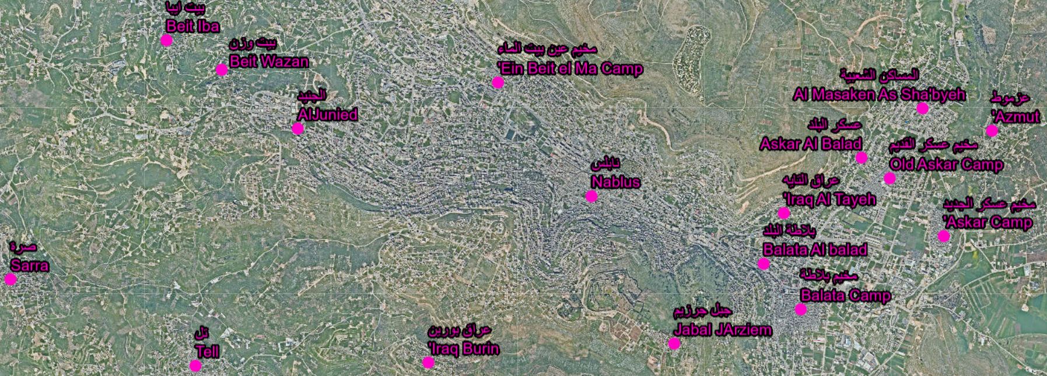
MPWH provided us with a list of Black spots: AL Basateen Intersection, Deir Al Hatab, Azmout and Salem intersection, Hewara Street, Tell- Street, Qusin- Sarra (Qalqilya street), Qusin (Village entrance), An Najah Hospital Intersection, Al Bathan-Serafi, Nablus –Jenin Road Intersection, Bizzaria Intersection, and Nablus –Jenin Road Intersection-Sabastia Intersection.
Study Area

Slide 6
Literature Review
Palestine
Jordan
India
Ethiopia

Slide 7
Results
Constraints
The team faced one major constraint, which is lack of data related to traffic volumes, AADT.
But, the team managed to use the existing data to continue working.

Slide 8
Methodology
A visit to Nablus Police Directorate
Site visits
Data collection
1
2
3
3
Application of MPWH Formula
4
5
6
7
Provide initial recommendations and possible countermeasures
Application of Indian, Jordanian and Ethiopian.
Suggesting modified formula and classification

Slide 9
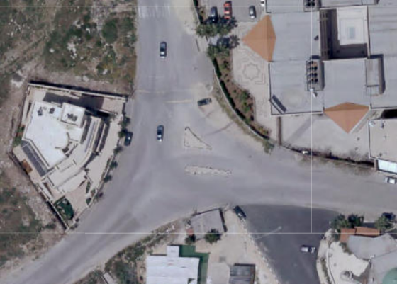
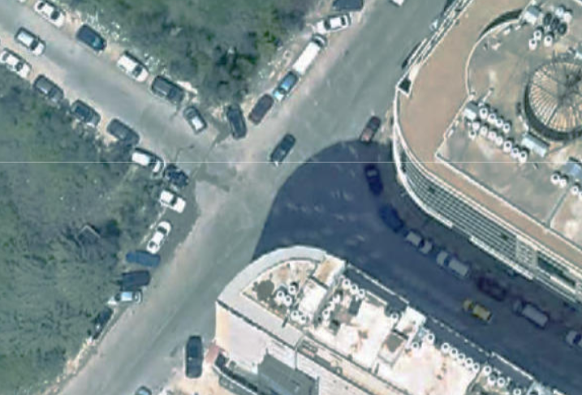
Description
NNU-Hospital Intersection
Al-Basateen Street Intersection

Slide 10
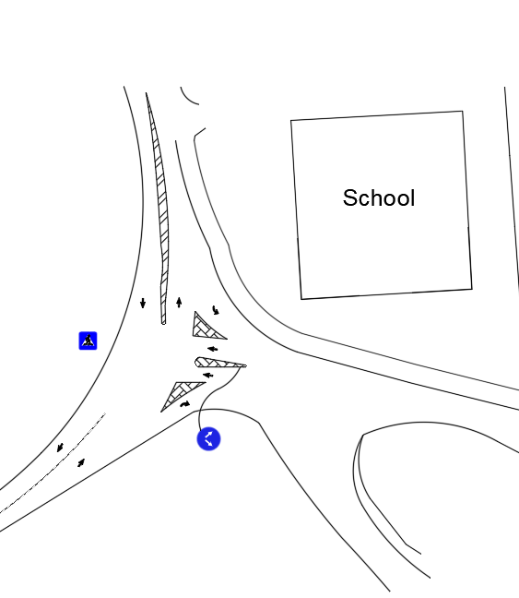
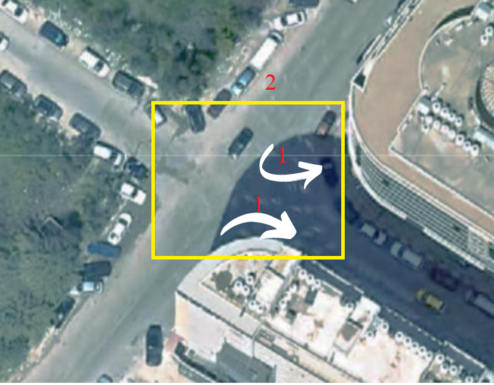
Countermeasures
NNU-Hospital Intersection
Al-Basateen Street Intersection

Slide 11
Analysis and Calculations

Slide 12
Analysis and Calculations
The data needed was collected from police excel datasheet.
The excel sheet contains all the crashes that happened for 3 years and 9 months (From 2019 to September 2022) 3.75 years.
Each location has the numbers of accidents every year and according to police classification.
Property | Physical | Location
86 | 54 | NNU-Hospital Intersection
4 | 9 | Sabastia Intersection
0 | 28 | Azmout-Saleem Intersection
445 | 325 | Hewara Street
77 | 41 | Tell-Street
110 | 85 | Al-Basateen
50 | 166 | Al-Bathan
22 | 61 | Bizzaria Intersection
62 | 96 | Qusin-Surra(Qalqilya Street)
34 | 45 | Qusin Intersection
890 | 910 | Total-Each Type
1800 |  | Total

Slide 13
Analysis
MPWH Method
Severity Index (SI) = 20 x number of fatalities +10 x number of serious injuries + 2 x number of moderate injuries + 1number of slight injuries.
The rating/severity of black spots is described as:
1.High: SI is 50 or more.
2.Medium: SI is between 25-50.
3.Low: SI is less than or equal 25.
In 2018, the General Police Directorate considered a section of a road or an intersection as a black spot if the site is 1000m long and has 8 or more crashes (MPWH, 2020).

Slide 14
Analysis
Table: Application of (MPWH) for Average of Years.
Location | Average SI | Severity
NNU-Hospital Intersection | 14 | L
Sabastia Intersection | 2 | L
Azmout, Salem Intersection | 8 | L
Hewara Street | 103 | H
Tell-Street | 14 | L
Al-Basateen | 23 | L
Al-Bathan | 81 | H
Bizzaria Intersection | 17 | L
Qusin-Surra(Qalqilia Street) | 32 | M
Qusin Intersection | 12 | L

Slide 15
Analysis
India Method
Accident Severity Index (ASI) = N_{f} x 6 + N_{s} x 3 + N_{m} x 1
N_{f}: number of fatalities.
N_{S}: number of serious injuries.
N_{m}: number of medium to slight injuries.
Ethiopia Method
S=(15*F) + (8*S) +(3*L) + (1*P)
F: Number of Fatalities.
S: Number of serious injuries.
L: Number of light injuries.
P: Number of property damage.
Jordan Method
Weighted Severity Index (ASI) = 3 x W + I +1/3 x A
W: Number of fatalities.
I: Number of injuries.
A: Number of property damage.

Slide 16
Application of International Methods
2019
Location | Jordan | India | Ethiopia
 | SI | SI | SI
NNU-Hospital Intersection | 34 | 27 | 102
Sabastia Intersection | 2 | 2 | 6
Azmout, Saleem Intersection | 6 | 6 | 15
Hewara Street | 157 | 125 | 479
Tell-Street | 12 | 9 | 34
Al-Basateen | 29 | 17 | 86
Al-Bathan | 94 | 102 | 286
Bizzaria Intersection | 18 | 16 | 52
Qusin-Surra(Qalqilia Street) | 36 | 29 | 107
Qusin Intersection | 8 | 6 | 24
2020
Location | Jordan | India | Ethiopia
 | SI | SI | SI
NNU-Hospital Intersection | 13 | 6 | 38
Sabastia Intersection | 1 | 0 | 4
Azmout, Saleem Intersection | 12 | 12 | 36
Hewara Street | 124 | 81 | 370
Tell-Street | 18 | 13 | 55
Al-Basateen | 45 | 33 | 134
Al-Bathan | 18 | 15 | 59
Bizzaria Intersection | 27 | 25 | 82
Qusin-Surra(Qalqilia Street) | 37 | 34 | 109
Qusin Intersection | 10 | 8 | 31

Slide 17
Application of International Methods
2021
Location | Jordan | India | Ethiopia
 | SI | SI | SI
NNU-Hospital Intersection | 15 | 10 | 46
Sabastia Intersection | 4 | 4 | 12
Azmout, Saleem Intersection | 4 | 4 | 12
Hewara Street | 123 | 93 | 366
Tell-Street | 21 | 12 | 62
Al-Basateen | 26 | 20 | 79
Al-Bathan | 50 | 53 | 136
Bizzaria Intersection | 10 | 7 | 29
Qusin-Surra(Qalqilia Street) | 17 | 17 | 52
Qusin Intersection | 16 | 15 | 49
2022
Location | Jordan | India | Ethiopia
 | SI | SI | SI
NNU-Hospital Intersection | 21 | 11 | 62
Sabastia Intersection | 3 | 3 | 9
Azmout, Saleem Intersection | 6 | 6 | 18
Hewara Street | 71 | 39 | 219
Tell-Street | 15 | 9 | 48
Al-Basateen | 22 | 15 | 63
Al-Bathan | 28 | 25 | 82
Bizzaria Intersection | 13 | 13 | 39
Qusin-Surra(Qalqilia Street) | 28 | 21 | 82
Qusin Intersection | 22 | 16 | 65

Slide 18
Analysis
Property Damage (New Term)
Property/Total | Total | Property | Physical | Location
0.6 | 140 | 86 | 54 | NNU-Hospital Intersection
0.3 | 13 | 4 | 9 | Sabastia Intersection
0.0 | 28 | 0 | 28 | Azmout-Salem Intersection
0.6 | 770 | 445 | 325 | Hewara Street
0.7 | 118 | 77 | 41 | Tell-Street
0.6 | 195 | 110 | 85 | Al-Basateen
0.2 | 216 | 50 | 166 | Al-Bathan
0.3 | 83 | 22 | 61 | Bizzaria Intersection
0.4 | 158 | 62 | 96 | Qusin-Surra(Qalqilya Street)
0.4 | 79 | 34 | 45 | Qusin Intersection
0.4
 |  | 890 | 910 | Total-Each Type
 |  | 1800 |  | Total

Slide 19
Results
Suggested Formula
Severity index (SI) = 20 x number of deaths + 10 x number of serious injuries + number of moderate injuries + 1 x number of slight injuries + 0.5 x property damage.
The rating/severity of black spots is described as
Low: 0 < S < 50
Medium: 50 < S < 100
High: more than 100

Slide 20
Results
Table: Application of (MPWH) for Average of Years.
Location | Average SI | Severity
NNU-Hospital Intersection | 26 | L
Sabastia Intersection | 3 | L
Azmout, Salem Intersection | 7 | L
Hewara Street | 161 | H
Tell-Street | 24 | L
Al-Basateen | 37 | L
Al-Bathan | 83 | M
Bizzaria Intersection | 19 | L
Qusin-Surra(Qalqilia Street) | 39 | L
Qusin Intersection | 17 | L

Slide 21
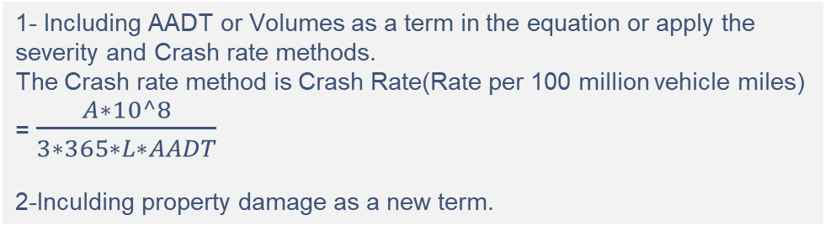
Critical Considerations
1- Including AADT or Volumes as a term in the equation or apply the severity and Crash rate methods.
The Crash rate method is Crash Rate(Rate per 100 million vehicle miles) = $\frac{A∗10^8}{3∗365∗L∗AADT}$
2-Inculding property damage as a new term.

Slide 22
Recommendations
Nablus Municipality
MPWH & MOT
Police Directorate
Continuous follow up for the inventory.
Keep up to date with MOT & MPWH
Traffic volumes studies should be done properly
Spreading awareness since most of the crashes occur due to drivers’ misbehavior.
Traffic volumes studies should be done properly.
Improving archiving process and use GPS application.

