Slide 1

VR Earthquake Simulator
An-Najah National University
Electrical and Telecommunications Engineering Departments
Students Name:
Ro’ya Al-aqraa
Ahmad Ghabbish
Supervisor:
Prof. Allam Mousa

Slide 2
Introduction
In recent years, virtual reality technology has been rapidly advancing, making it possible to create immersive experiences that can simulate virtually any scenario. One such application of this technology is in disaster preparedness training. By utilizing virtual reality, individuals can be trained on how to handle various emergency situations without putting themselves in danger. This is where my project comes in: designing a virtual reality application using Unity and uploading it to the Oculus Quest 2 to simulate an actual earthquake and teach users how to behave during this catastrophe.
Virtual reality (VR) has emerged as a breakthrough technology over the last few years. The ability to create a simulated environment that mimics real-life scenarios creates an opportunity to learn and experience circumstances that may not be safe or feasible in reality.
Our project aims to discuss the design of a VR application using Unity that simulates an earthquake disaster. The application will be uploaded to Oculus Quest 2, the leading wireless VR platform, for an immersive experience that will help users comprehend how to handle such a catastrophe and behave during it.

Slide 3

Objectives
Simulate VR earthquake and try it on oculus quest2 wireless .
Enhance the imagination with realistic life to add any thing into project .
Dealing with new software and devices such as unity and oculus .

Slide 4


Software
In our project we used tow software such as Autodesk 3D MAX for show final design of the house and Unity Hup to create a environment

Slide 5
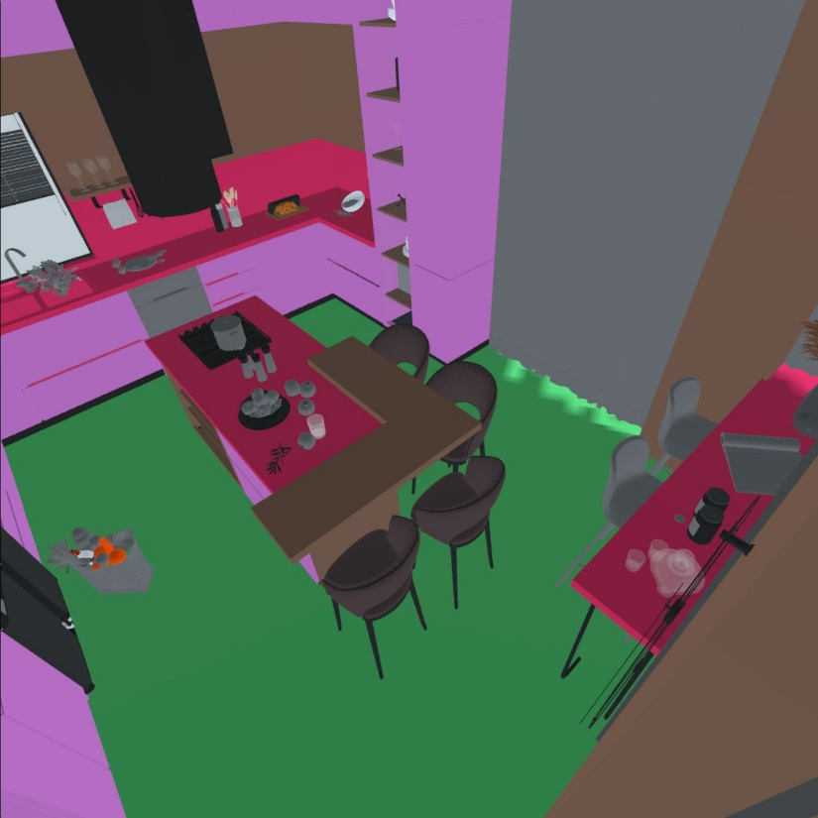
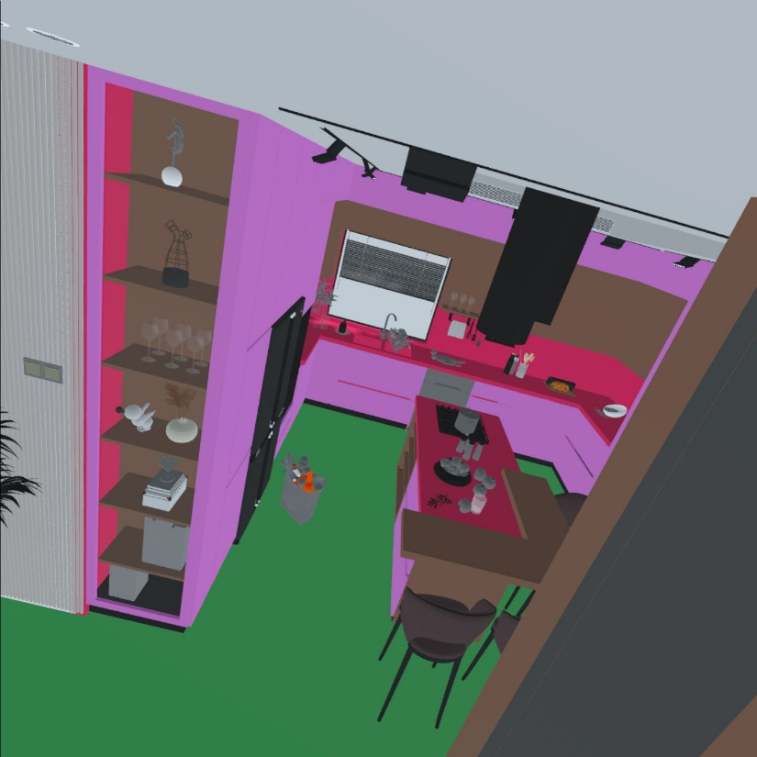

Our virtual environment Design

Slide 6
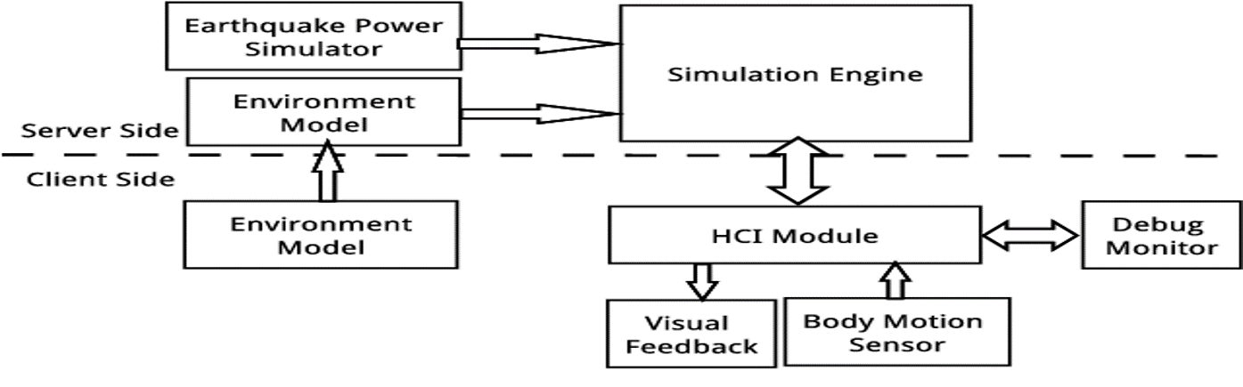
System Architecture Of The Simulation System

Slide 7
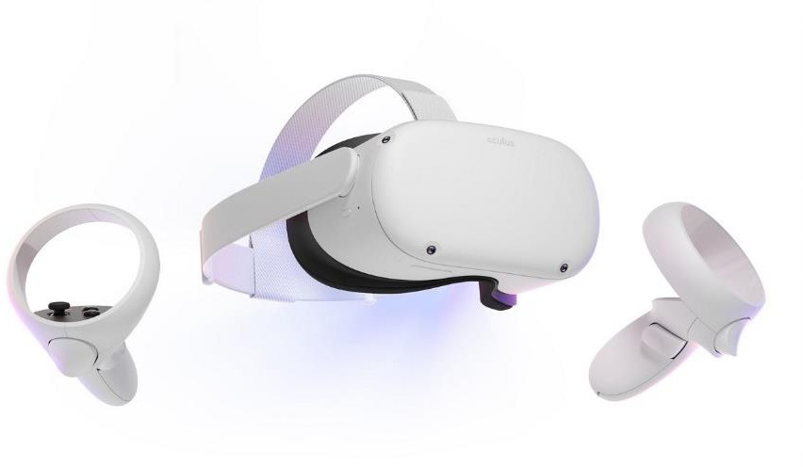
Methods & Materials
Developing process:
The development process contain dealing with different devices such as mobile phone , oculus quest 2, Pc device , and to make the development process compatible with all devices , there is many things to study about it .
And the following diagram show the development process details.

Slide 8
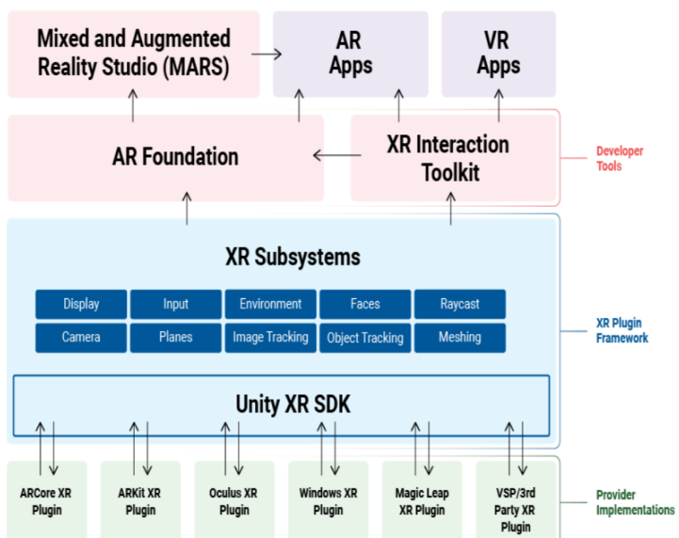
Here is the interaction system from followed to create VR or AR experience

Slide 9
RESULTS
Dealing with XR interaction toolkit .
XR rig setup to attach the input action (controller) .
Configuring , Optimizing the project for oculus quest 2 build .
Installing APK files to oculus quest 2 .
The final expected result is to make VR earthquake simulator and put scenario to escape from this room and to avoid harmful injures.
Design traditional home using 3d max application with many details , and the following pictures shows the home from different location , and unity environment witch is a software specialist in gaming production and application , in addition it supports different operation systems (IOS , Android , etc…) , and many developing mode (VR , AR , 2D , 3d )

Slide 10
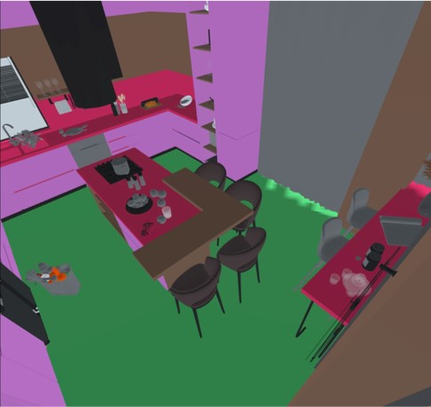
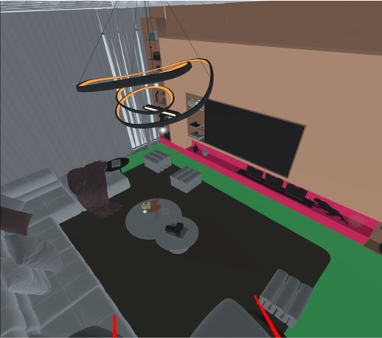
VIEW 2 FROM OCULUS
VIEW 1 FROM OCULUS

Slide 11
CONCLUSION:
The VR development consider as part of android developing, because the operation system for oculus is android, let’s considering oculus quest as android mobile phone with lenses and controllers.
it includes dealing with different things at same time and make synchronization between mobile phone, oculus device, computer device.

Slide 12
Thank you!

