Slide 1

Design of Wastewater Collection Network for Aqqaba Village
Prepared by:
1. Lama Abu Safat
2. Ruba Ghannam
Under supervision of: Dr. Abdel-Haleem Khader

Slide 2
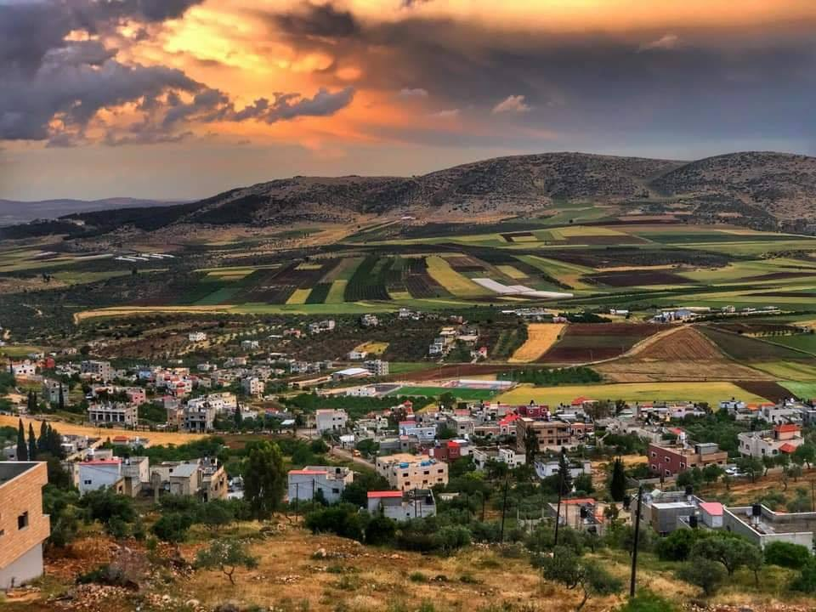
Introduction
Aqqaba village lies in the northern Westbank, located between Jenin and Nablus.
Aqqaba has a total area of about 8,223 donums .
Elevations in the village vary significantly from one place to another with maximum and minimum values of 675 m and 415 m AMSL.
Aqqaba is shown in the Figure.

Slide 3
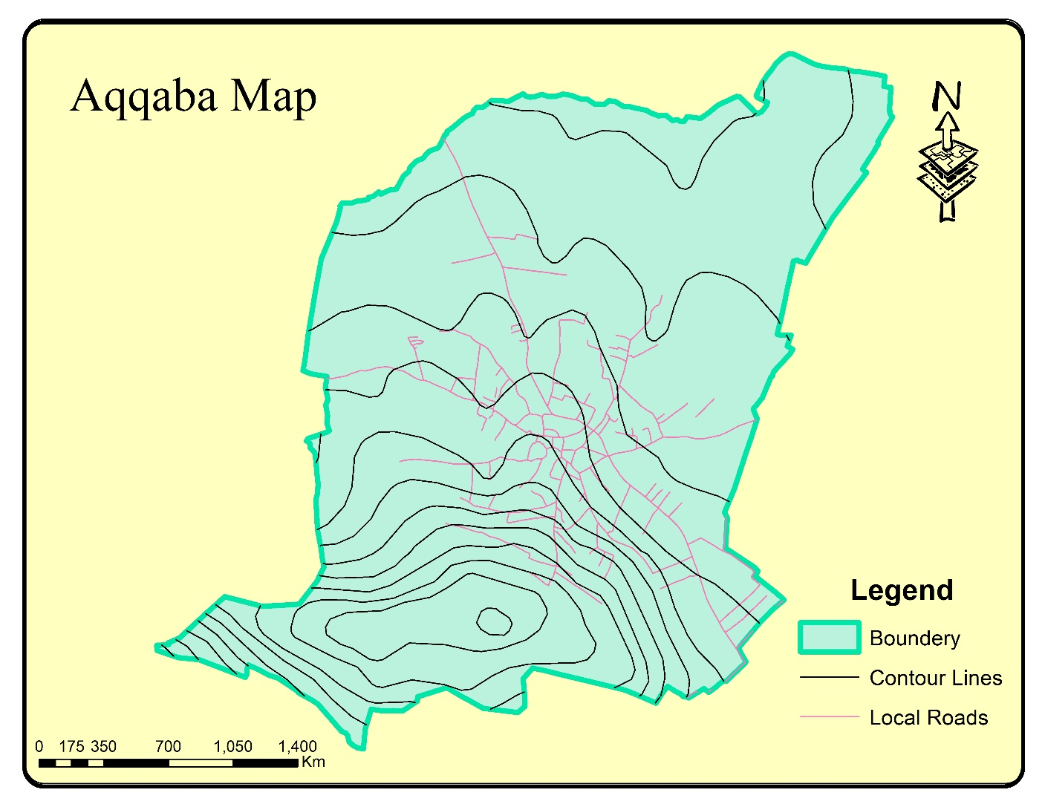

Slide 4
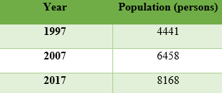
Introduction
Aqqaba village isn’t serviced by a complete WWCN, cesspits are the only available way of wastewater disposal in the village as an alternative solution..
The objective is to design a WWCN for Aqqaba village to serve for the next 30 years.
In the West Bank, more than 60% of local communities are not serviced by WWCNs.
The population of Aqqaba was obtained from the PCBS for the census years of 1997, 2007 and 2017 are as presented.

Slide 5
Standards & Specifications
Water consumption is 120 l/c. d.
return flow of 85% of the consumption.
infiltration rate of 20% of the flow.
Manholes: minimum diametr 60 cm.
Length of conduit: 50m max.
Material: PVC pipes.
Pipe sizes: minimum 8 inches (200 mm).
Full flow: 75% of the cross section.
Peak Factor (PF): The peak factor used is 2.5.
Velocity: 0.6-3 m/s.
Cover: 0.8-4.5 m.
Slope: 0.5-15%.

Slide 6
Project constraints and limitations
Nature and topography of the study area: the village has difficult terrain and high slopes which affect the design.
Location of streets: The issue here is that some areas of the village are not serviced with streets.
Location of buildings: urban plans are not up to date and do not describe the real situation.

Slide 7
Design methodology
GIS shapefiles.
SewerCAD: exporting shapefiles to SewerCAD, and sketching the WWCN.
Load allocation: Assuming that all manholes receive the same load.
Defining different parameters: defining the elevations using TRex tool in SewerCAD.
Running the model: running the developed WWCN model and by applying the trial-and-error procedure, proper design was obtained.

Slide 8
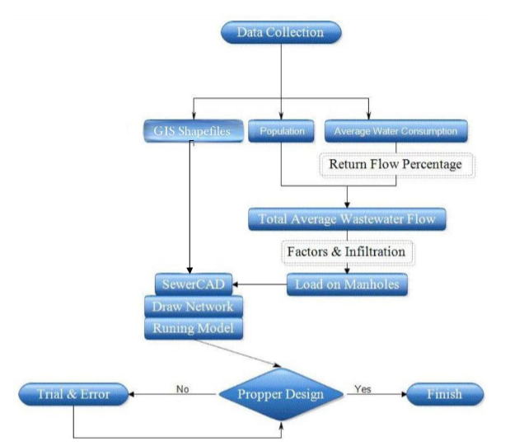

Slide 9
Population and growth rate
P1997 = 4,441, P2017 =8,168.
Growth rate:
P_2017 = P_1997 (1+r)^{n}
8,168 = 4,441 (1+r)²⁰
r = 0.0309 = 3.09%
Population after 30 years:
P_2050 = P_2017 (1+r)^{n}
P_2050 = 8,168 (1+0.0309)³³ = 22,297 persons

Slide 10
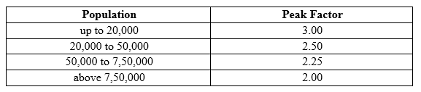
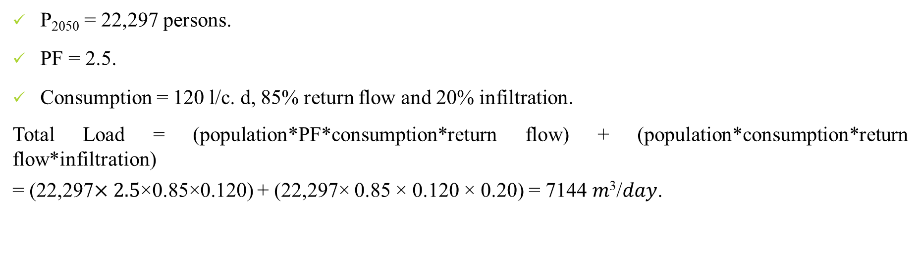
Total load
P₂₀₅₀ = 22,297 persons.
PF = 2.5.
Consumption = 120 l/c. d, 85% return flow and 20% infiltration.
Total Load = (population*PF*consumption*return flow) + (population*consumption*return flow*infiltration)
= (22,297$×2.5$×0.85×0.120) + (22,297× 0.85 × 0.120 × 0.20) = 7144 𝑚³/𝑑𝑎𝑦.

Slide 11
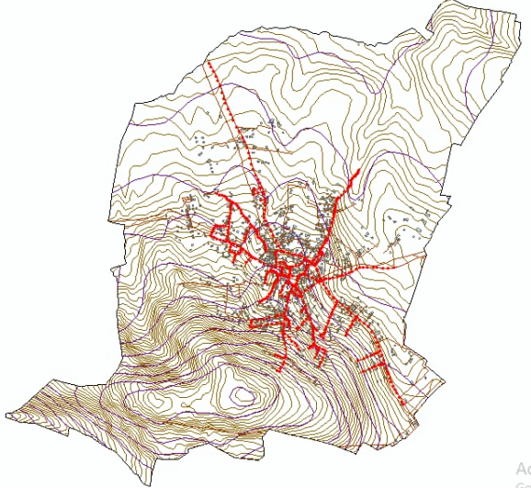
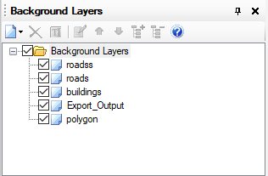
Modeling, analysis and design of WWCN
Adding Shapefiles to SewerCAD.
Drawing the Manholes: In this step the manholes are drawn with consideration to changes in direction, grade, or pipe size or at intersections of collection sewers.

Slide 12
Modeling, analysis and design of WWCN
The next step is to add the elevations using the TRex tool in SewerCAD.
After adding the elevations, the conduits are drawn with respect to the manholes as shown.

Slide 13
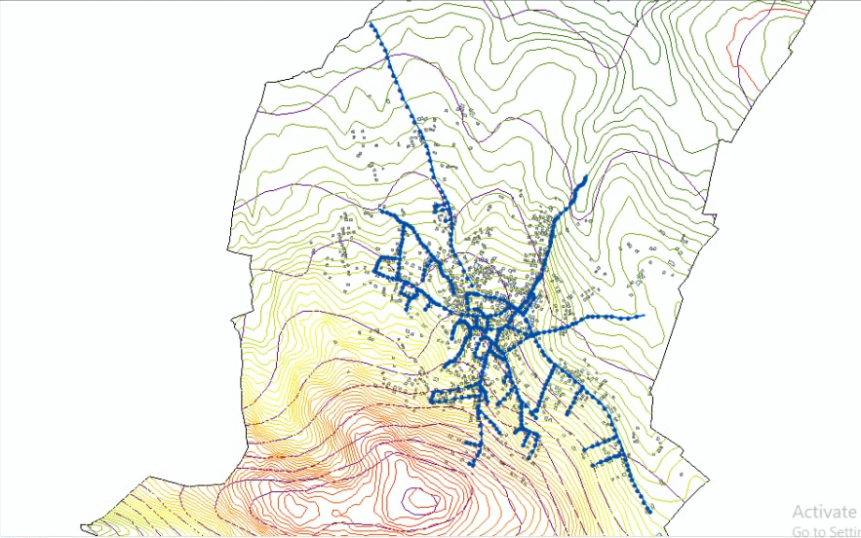

Slide 14
Modeling, analysis and design of WWCN
The following step is to define the conduits from conduit catalog.
Then, the design constraints are defined.
Manhole loads are now calculated on the basis that all manholes carry the same load.
Load on each manhole = totoal load / number of manholes
= 7144 𝑚3/𝑑𝑎𝑦 / 535
= 20 𝑚3/𝑑𝑎𝑦.

Slide 15
Design of the WWCN
the solver calculation options in SewerCAD are set to steady state time analysis and design calculation type, the conduit type is set to catalog conduit.
Trial and Error:
High cover-starts were solved by using more manholes in the same area drop manholes, or decreasing the conduit length between such manholes.
Zero-slope streets which create very high cover after a long line of manholes, were solved by changing the direction of conduit paths of such manholes.
Negative-slope streets were treated by rotating the line such that the slope becomes positive.

Slide 16
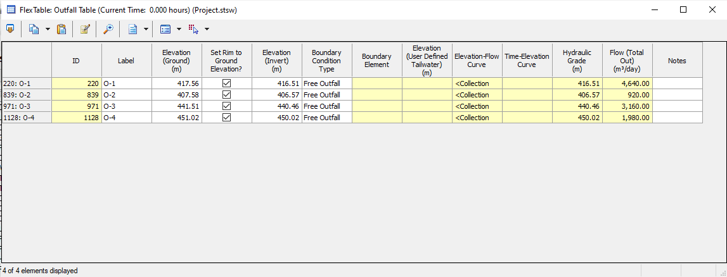
Results
The results of the design are a WWCN with 535 manholes, 535 conduits and Four outfalls having an elevation of 418 m,408 m, 442m and 452m AMSL as shown.

Slide 17
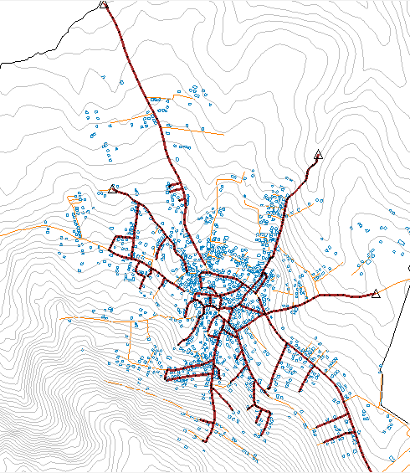

Slide 18
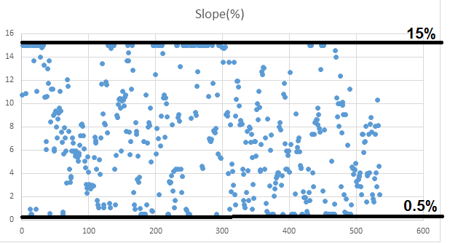
Slopes

Slide 19
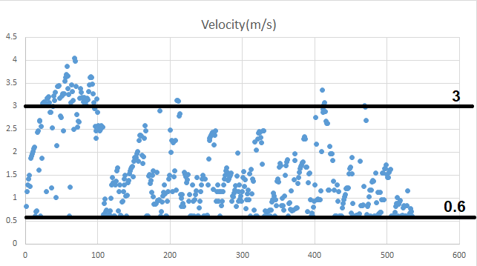
Velocities

Slide 20
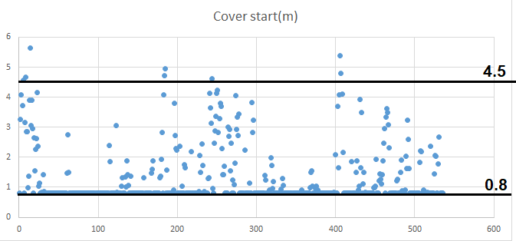
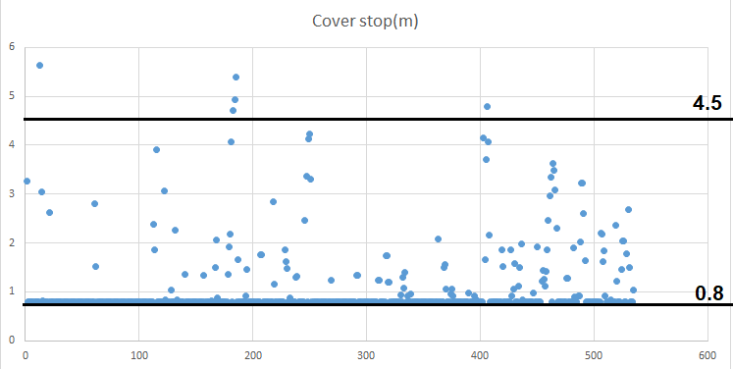
Cover (start and stop)

Slide 21
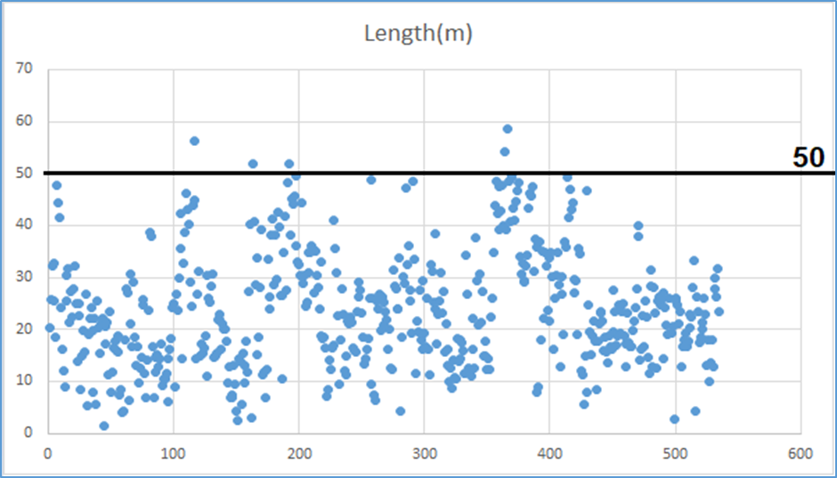
Lengths

Slide 22
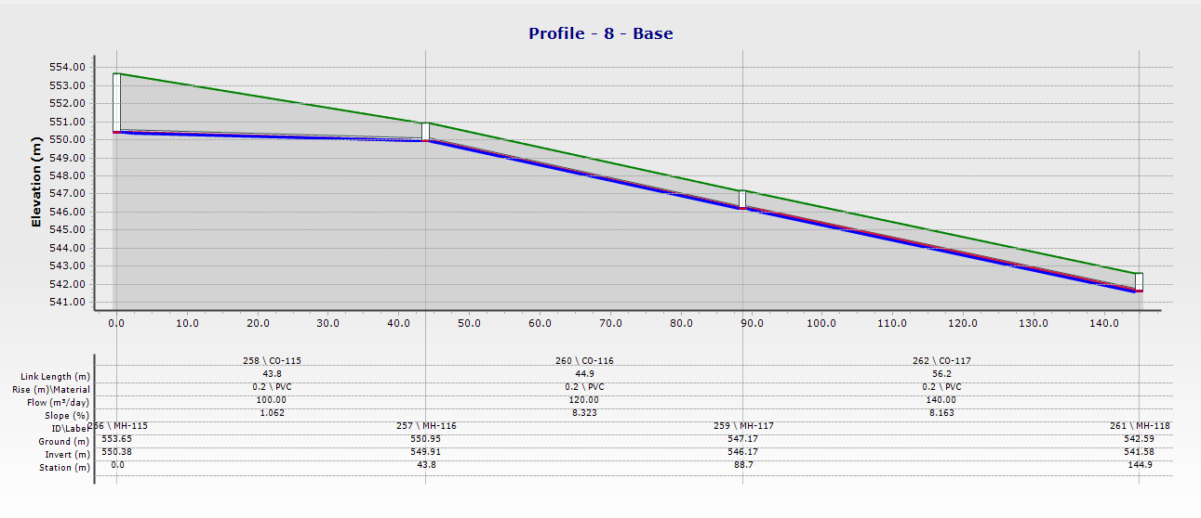
Profiles

Slide 23
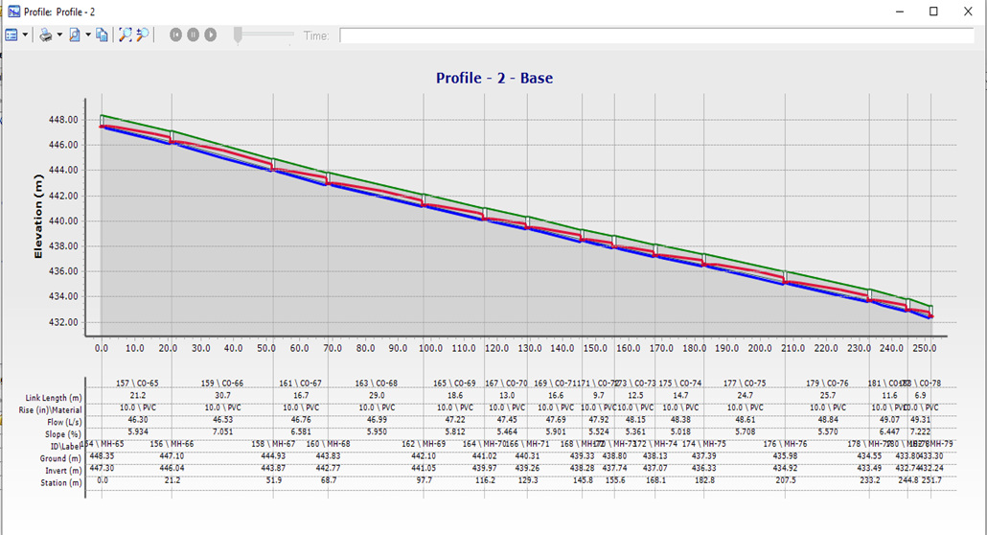
Profiles

Slide 24
Discussion
Slopes: All values of slopes of conduits are within the specified range of 0.5% -15%.
Velocities in conduits: Generally, the values of velocities in the conduits are within the specified range of 0.6-3 m/s. There are a few values over. .
Cover (start and stop): Overall, the values of covers are within the specified range of 0.8-4.5 m. There are only 6-7 values over the constraint but they are acceptable since there is only 6-7 out 535 and it’s not significantly higher than the constraint.
Diameters: all diameters are 8 inches since the flow inside them doesn’t even reach a 75% so there is no need for larger conduits.
Lengths: allmost values of lengths are all below maximum 50 m.

Slide 25
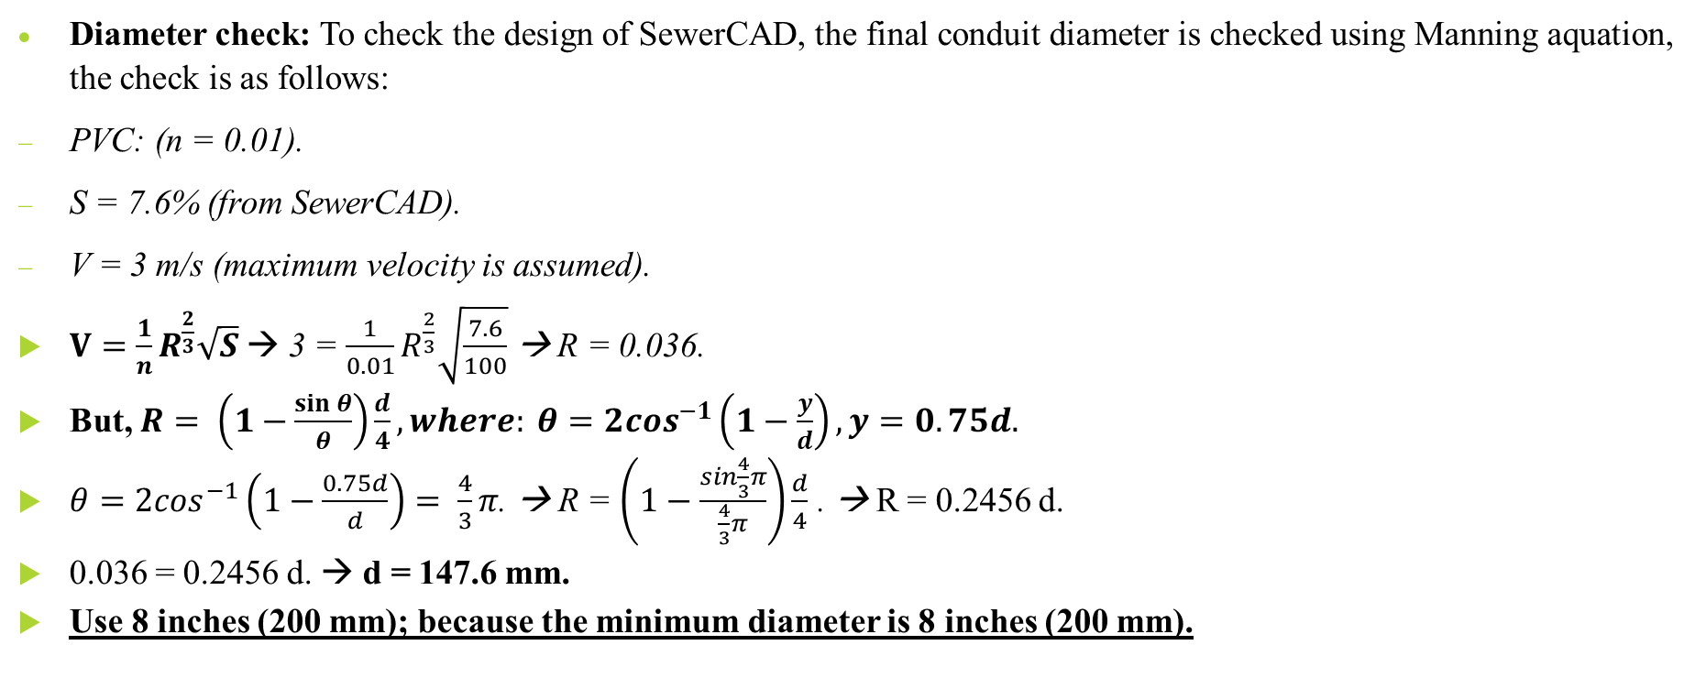
Diameter check
Diameter check: To check the design of SewerCAD, the final conduit diameter is checked using Manning aquation, the check is as follows:
PVC: (n = 0.01).
S = 7.6% (from SewerCAD).
V = 3 m/s (maximum velocity is assumed).
$V=\frac{1}{n}R^{\frac{2}{3}}\sqrt{S}$→ 3 = $\frac{1}{0.01}R^{\frac{2}{3}}\sqrt{\frac{7.6}{100}}$ → R = 0.036.
But, $R= \left(1−\frac{\sin{θ}}{θ}\right)\frac{d}{4}, where: θ=2\cos^{−1}\left(1−\frac{y}{d}\right), y=0.75d.$
$θ=2\cos^{−1}\left(1−\frac{0.75d}{d}\right)= \frac{4}{3}π$. → R = $\left(1−\frac{\sin{\frac{4}{3}π}}{\frac{4}{3}π}\right)\frac{d}{4}$ . → R = 0.2456 d.
0.036 = 0.2456 d. → d = 147.6 mm.
Use 8 inches (200 mm); because the minimum diameter is 8 inches (200 mm).

Slide 26
Conclusions and recommendations
It can be concluded that:
A WWCN is designed to accommodate Aqqaba village’s current and future wastewater disposal needs.
The use of the designed WWCN will create a much healthier environment (groundwater) than the used cesspits.
There is four outfalls in the lowest possible areas of the village. These outfalls can have their own wastewater treatment plant (WWTP) having collected in some way, or they can be connected to a nearby village wastewater treatment plant in the future.

Slide 27
Thank you for listening

