Slide 1

An-Najah National University
Computer engineering department
Hunger Station
Prepared by:
Aseel Hamdan
Supervised by:
Eng.Asmaa Afeefi

Slide 2
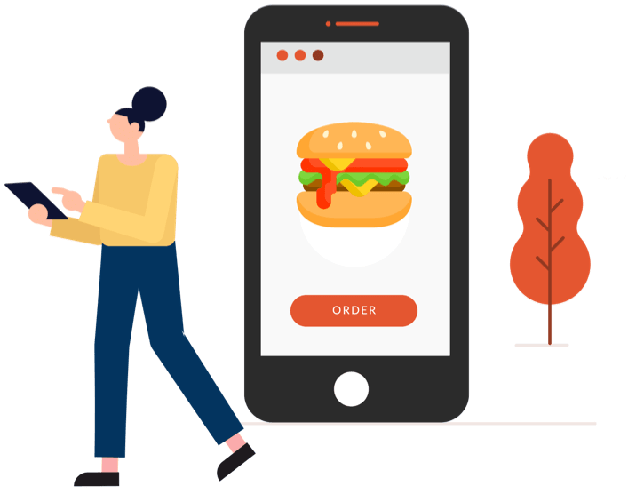
Introduction
why Hunger Station?
Hunger Station is a food delivery mobile app created for many Palestinian restaurants that provides its customers with good hearty meals, snacks, drinks and sweets ,aims to ease order food process and make it simple as much as possible.

Slide 3
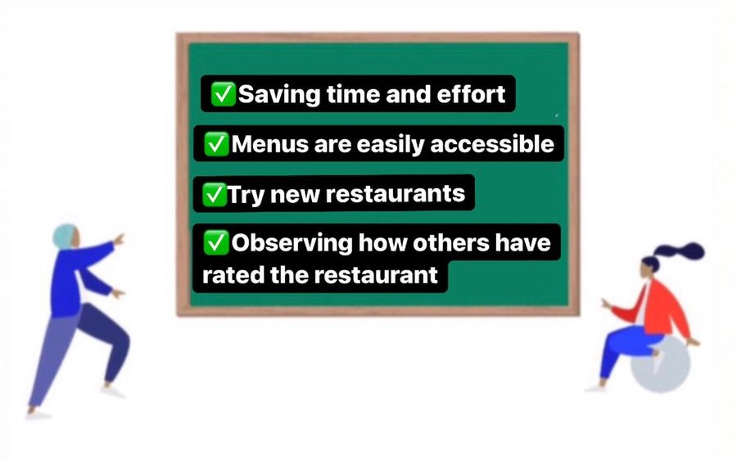
The Advantages of Hunger Station App:

Slide 4
Types of application users
Restaurant
Admin
Customer

Slide 5
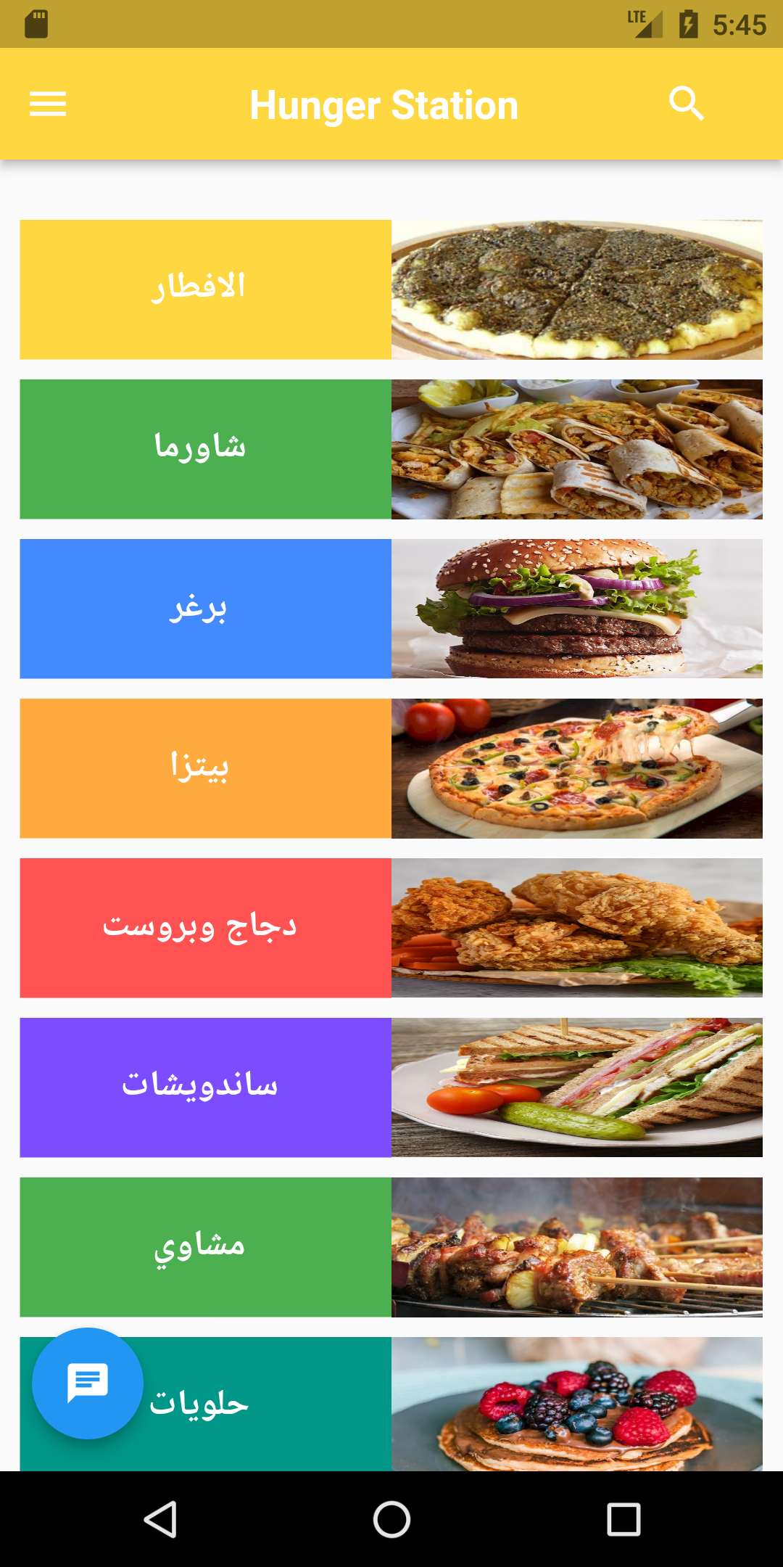
Customer side
Customer can :
selects one of food types, and a list of restaurants that come under that type appears.
look for a certain restaurant.
Question the chat-bot about menus in the app.
Create order.
Review the restaurant.
Customer home page

Slide 6
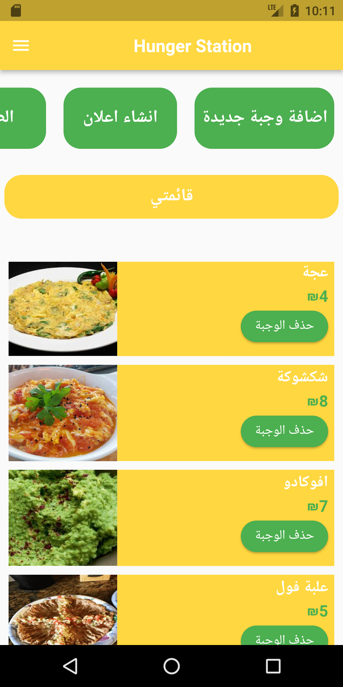
Restaurant side
Restaurant can :
add a new meal to his list
Delete a meal from his list
Approval of customer requests
AL homsani restaurant home page

Slide 7
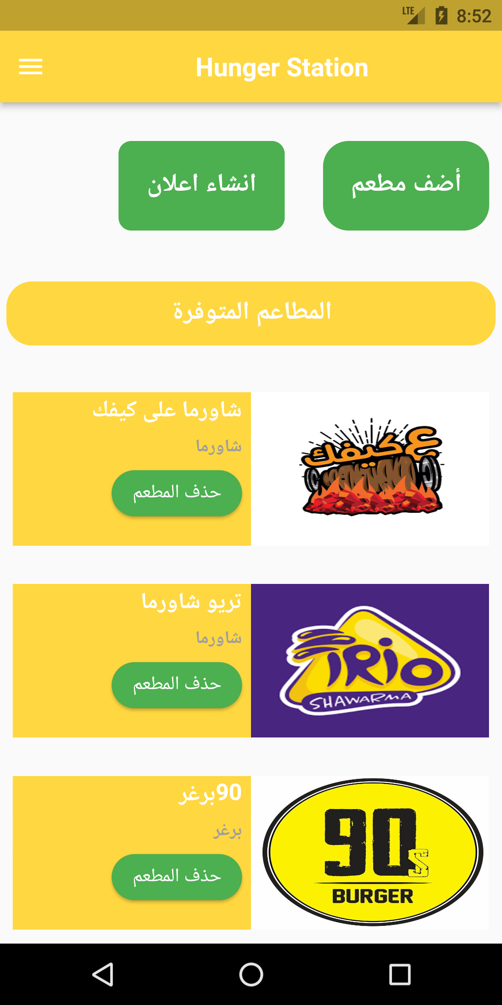
Admin side
Admin can :
Add Restaurant to the App
Delete Restaurant from the App
create adverts to encourage people to open the app
Admin home page

Slide 8
Problems
Because the chat bot was built using Google Dialog flow, which does not support Arabic, the chat is in English but the app is in Arabic.
A simulator was used to test the app, which is less efficient than the actual device and does not support Arabic.
Android Studio and simulator consumes huge amount RAM, which causes performance issues.

Slide 9

Future Work
In addition to the app, website could be implemented.
Make a map-based tracking system for ordering.
Create a recommendation system that displays the restaurants that the consumer most frequently visits.
Expand the application to include supermarkets as well.

Slide 10
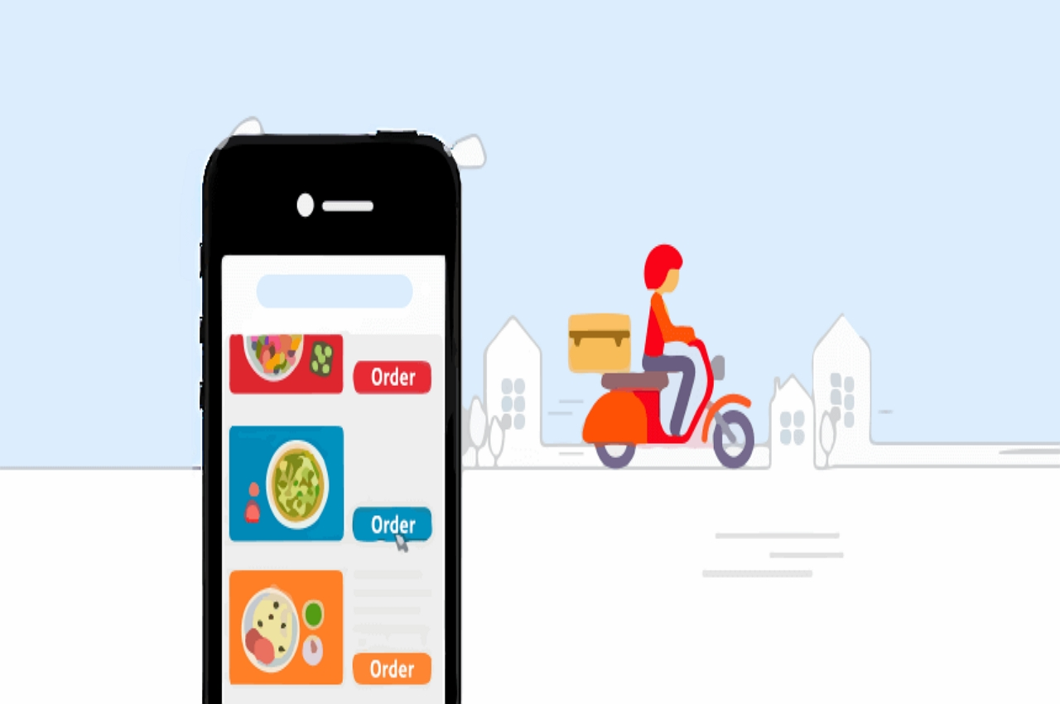
Conclusion
The design I created was successful in achieving the targeted aims. The app is simple to use and provides a simple ordering experience to save the customer time and effort.

