Slide 1

بسم الله الرحمن الرحيم
AN-NAJAH NATIONAL UNIVERSITY
ENGINEERING COLLEGE
Civil Engineering Department
Graduation project
" Alreehan Tower design"
Prepared By
Motamad hijjawi
Ali Hamidi
Instructor
Dr.Monther Dyab

Slide 2
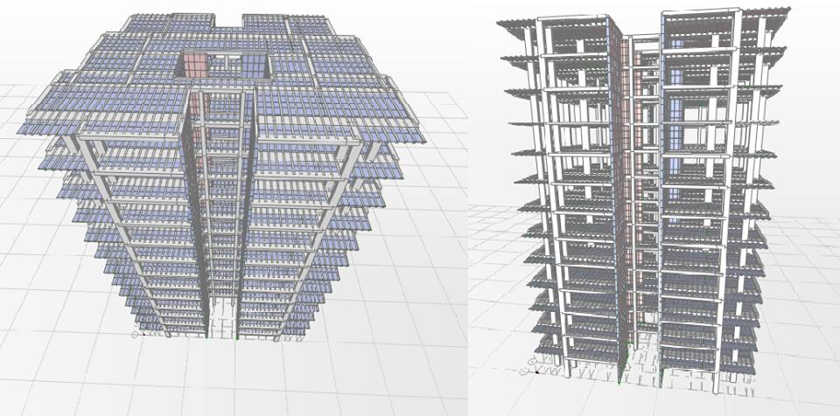
3D of the building

Slide 3
Abstract
The main aims of the project are to analyze and design all parts of the structure and determine the right and economical ways to solve the
Problems facing the process.

Slide 4
our project is alreehan tower, 12 stories:
We choose:
*The frame structure as a structural system to design according it
Because we just have beams, columns and slabs which distributes symmetrically with no inclined ones.
* The concrete and reinforced concrete as a material for building, this is the available material we can use in state of our available technology here in Palestine

Slide 5
a mass active topology in order to have a high capability to resist high bending and positive and negative pressure of compression to be insitue preferable
.
* The form of 2D & 3D and curves of zero elastic ones to use it in application of beams and floors

Slide 6
Overview
Al-reehan towers it is two building with the same foundation , we redesign just one of these
This project is a design of an residential building which located in Ramallah city. This building is consisted of twelve stories.
The building designed under a static load by SAP 2000 v.14 program

Slide 7
Contents
Chapter One: Introduction
1-1 About the project
1-2 Philosophy of analysis & design
1-3 Materials
1-4 Loads
1-5 Codes
Chapter Two: Design of floor system
2-1 Slab systems
2-2 Floor system
2-3 Thickness of the slab
2-4 Design of rib
2-5 Shear design of rib

Slide 8
Contents
Chapter Three: Beams
3-1 Beams system
3-2 Shear design of beams
Chapter Four: Columns
4-1 Column system
4-2 Groups design

Slide 9
Contents
Chapter Five : Foundations
5-1 footing system
5-2 design of mat foundation
5-3 footing thickness & design for flexure
Chapter Six: Shear walls
6-1 Walls system
6-2 walls reinforcement

Slide 10
INTRODUCTION
About the project:
The building located in Ramallah, is a residential building consists of twelve floors having approximately the same area (448m2) and height(3.1m).
Philosophy of analysis & design:
-The building is considered as reinforced concrete structure with walls all around. In this project, the structure will be analyzed and designed using software SAP2000 version 14.
-Ultimate design method is used to design the building.

Slide 11
INTRODUCTION
Materials of construction:
Reinforced concrete:
unit weight= 25 KN/m³
f’c = 28 MPa
Fy =420 MPa
Block density = 12 KN/m³
Stone density =18 KN/m³

Slide 12
INTRODUCTION
loads:
Its gravity load consist of:
Live load: it comes from the people, machines and any moveable objects in the building. The amount of live load depends on the type of building or structure.
In this project the live load is (3kN/m²) for all floors.
Dead load: Owen weight=(Calculated By SAP)

Slide 13
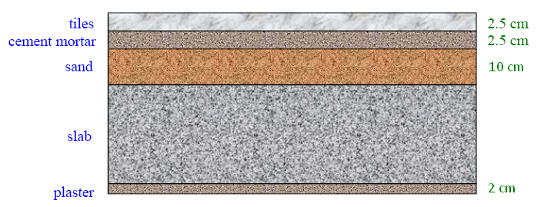
Superimposed Load: This weight per unit area depends on the type of finishing which is usually made of
Tiles (2.5cm thick) =0.025×24 = 0.6 kN/m2
Cement mortar (2.5cm thick) =0.025×23 = 0.575 kN/m2
Sand fill (10 cm thick) =0.1×18 = 1.8 kN/m2
Plaster (2 cm thick) =0.02×23 = 0.46 kN/m2
Equivalent partition weight = 1KN/m2
Superimposed Load =4.5KN/m2

Slide 14
INTRODUCTION
Code Used:
American Concrete Institute Code (ACI 318-05)
Combination:
Ultimate load= 1.2D+1.6L

Slide 15
SLAB
One-way slabs:
When the ratio of the longer to the shorter side (L/ B) of
the slab is at least equal to 2.0, it is called one-way slab
One-way ribbed slabs:
If the ribs are provided in one direction only, the slab is classified as being one-way, regardless of the ratio of longer to shorter panel dimensions.

Slide 16
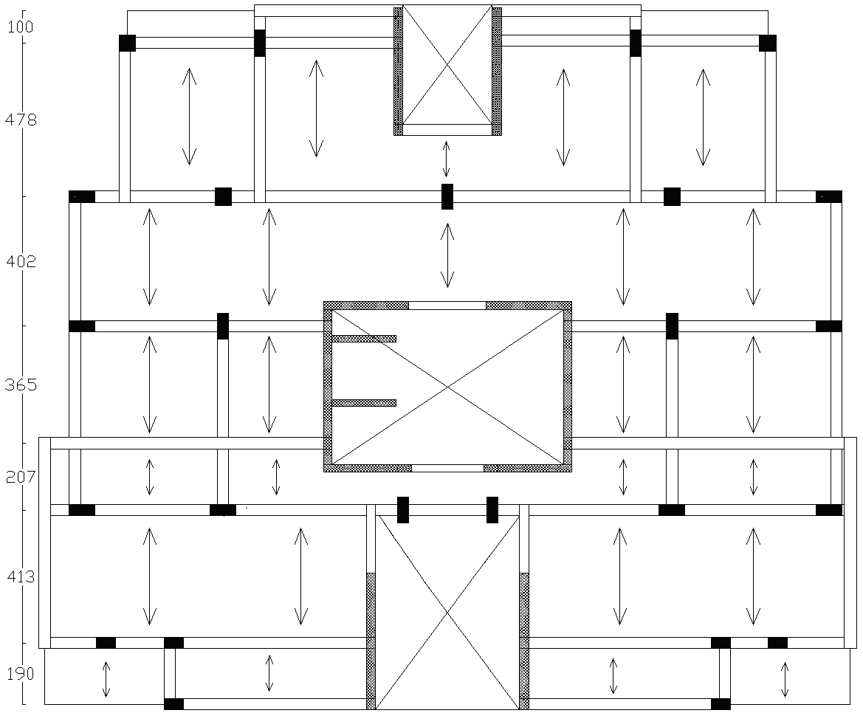
One way ribbed slab is used only in this structure :

Slide 17
SLAB
To control deflection, ACI Code specifies minimum thickness values for one-way ribbed slabs
For this project thickness of slab: hmin = Ln/18.5 =4.78/18.5=22.76 cm
but h not good for shear resistance and for the design of hidden beams
Use h=30cm.

Slide 18
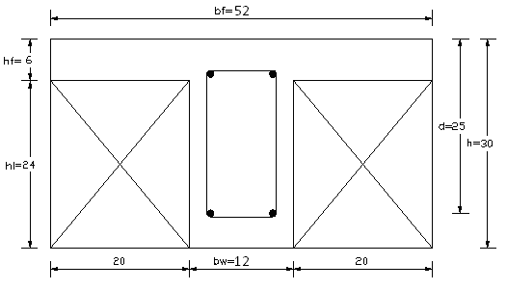
cross section in ribbed slab

Slide 19

Shear resistance:
According to ACI Code shear strength provided by rib concrete Vc may be taken 10% greater than those for beams.
= 21.8KN

Slide 20
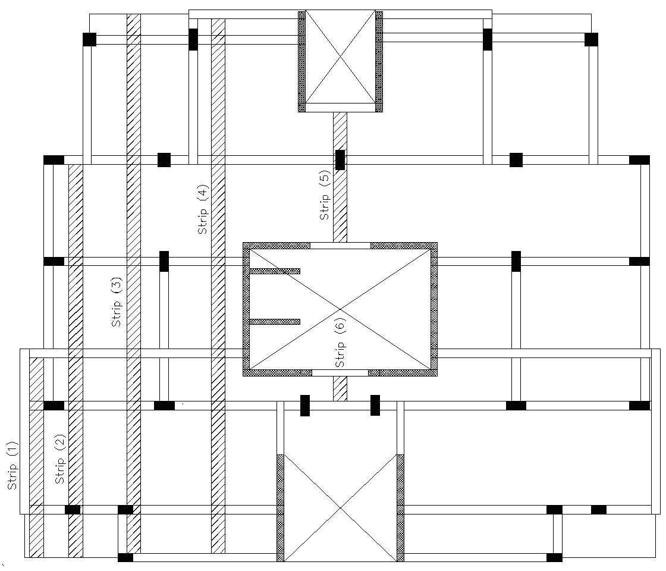
Design of rib :
There are six groups of rib in the floor plan as shown in figure

Slide 21
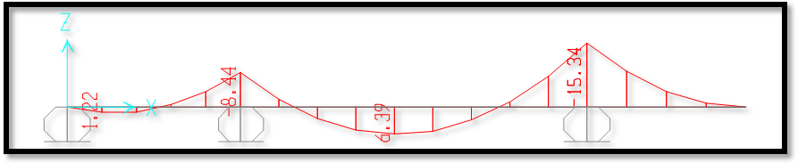
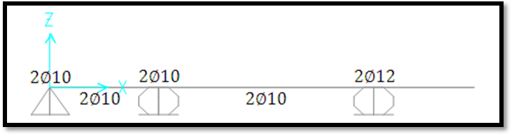
SLAB
Design of Slab :
Rib 1 :

Slide 22


ρ
Negative moment design for Rip 1.
Mu (KN.m) | d (mm) | b (mm) | P | As (mm2) | Asmin (mm2) | since | use As (mm2) | n | db
0 | 250 | 120 | 0 | 0 | 100 | As<Asmin | 100 | 2 | 10
8.44 | 250 | 120 | 0.0031 | 91.6 | 100 | As<Asmin | 100 | 2 | 10
15.34 | 250 | 120 | 0.0057 | 170.6 | 100 | As>Asmin | 170.618 | 2 | 12
Positive moment design for Rip 1.
Mu (KN.m) | d (mm) | b (mm) | p | As (mm2) | Asmin (mm2) | since | use As (mm2) | n | db
1.22 | 250 | 520 | 1E-04 | 12.70 | 100 | As<Asmin | 100 | 2 | 10
6.39 | 250 | 520 | 0.0005 | 67.81 | 100 | As<Asmin | 100 | 2 | 10

Slide 23
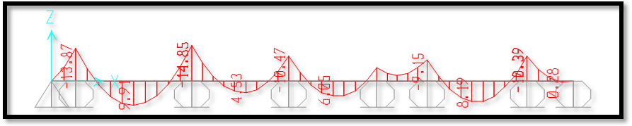
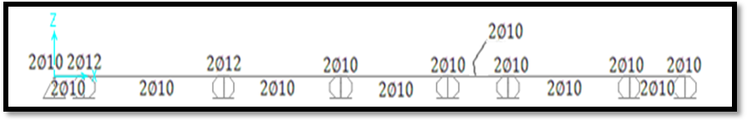
SLAB
Design of Slab :
Rib 4 :

Slide 24
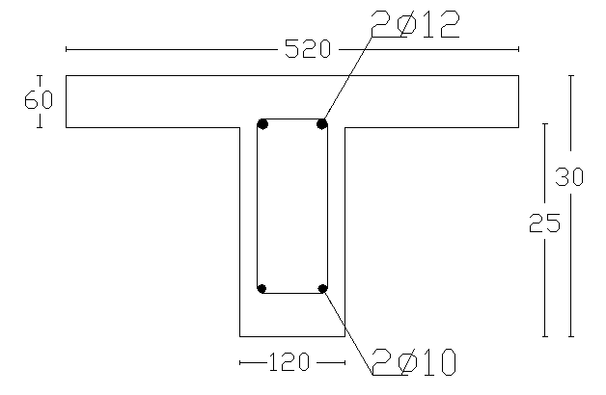
Most ribs have steel bar 2ᶲ12 in upper and steel bar 2ᶲ10 in bottom

Slide 25
BEAMS
Beams are usually designed to carry the following loads:
- Their own weight
-Weights of partitions applied directly on them
-Floor loads
Beams in this part of the project will be designed using Tributary area method. All of beams are hidden

Slide 26
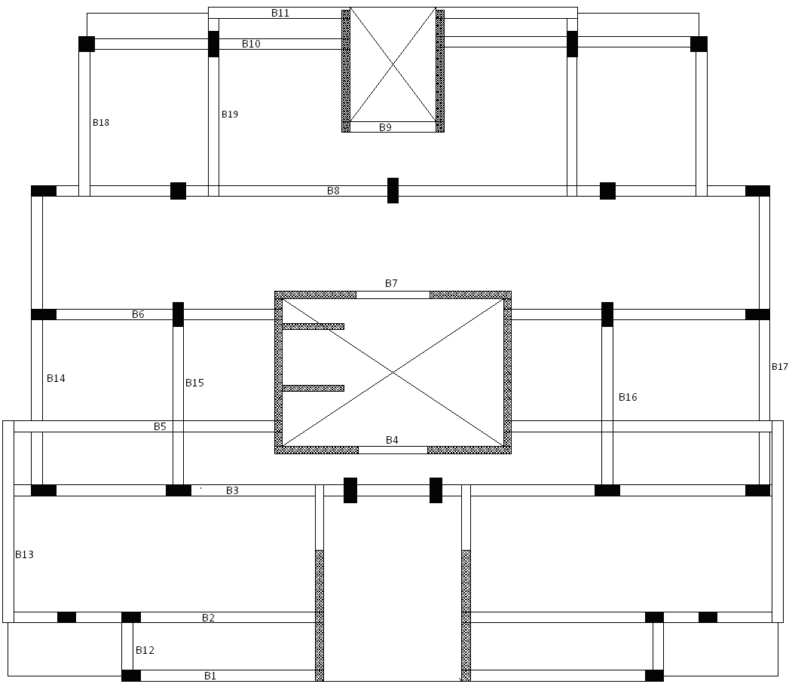
Design of the floor:
There is many beams are used to carry slab as shown in figure

Slide 27
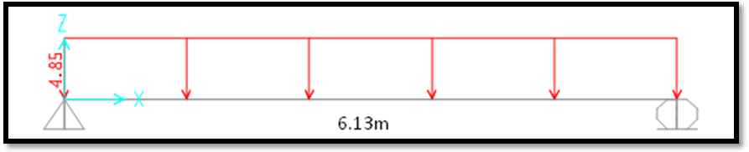
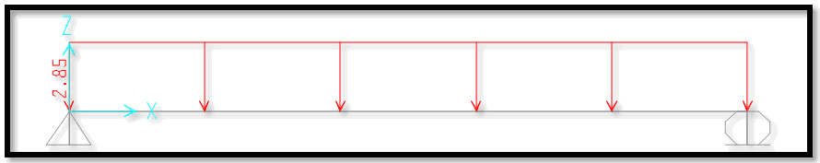
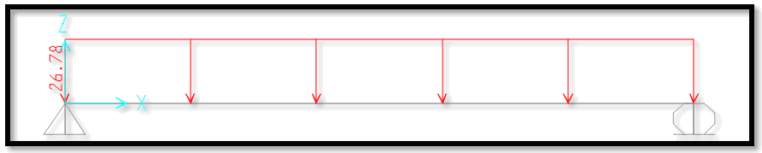
BEAMS
Design of beam 1:
D.L= ×5.1=4.85KN/m
D.L(KN/m)
L.L= ×3=2.85KN/m
L.L(KN/m)
S.D.L= ×4.5+22.5=26.78KN/m
S.D.L(KN/m)

Slide 28
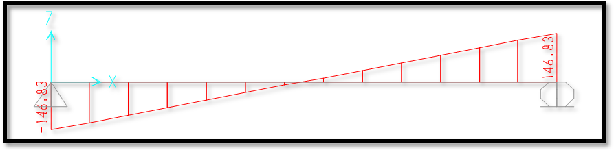
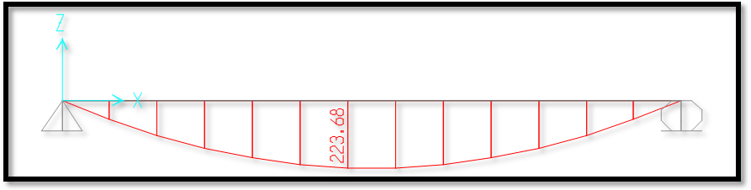
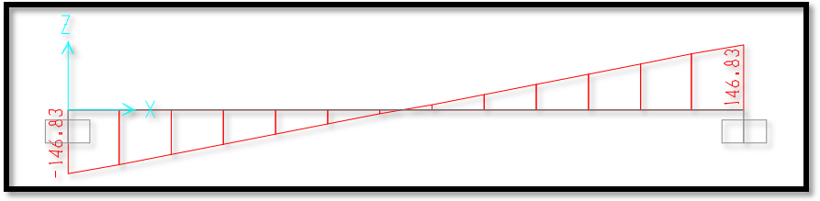
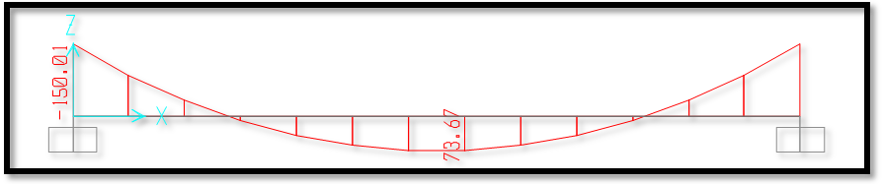
In order to get efficient results two models are considered to represent the existing condition, which are the fixed and hinged cases at the ends.
Hinged case at the end:
S.F.D (KN)
B.M.D (KN.m)
Fixed case at the end:
S.F.D (KN)
B.M.D (KN.m)

Slide 29
Positive moment design for beam (b1).
Mu fixed (KN.m) | Mu hinged (KN.m) | Mu average (KN.m) | d (mm) | b (mm) | P | As (mm2) | Asmin (mm2) | Since | use As (mm2) | select
73.67 | 223.68 | 148.68 | 240 | 600 | 0.0128 | 1845 | 480 | As>Asmin | 1845 | 6Ф 20
Negative moment design for beam (b1).
Mu fixed (KN.m) | Mu hinged (KN.m) | Mu average (KN.m) | d (mm) | b (mm) | P | As (mm2) | Asmin (mm2) | since | use As (mm2) | select
150.01 | 0 | 75.005 | 240 | 600 | 0.0061 | 872 | 480 | As>Asmin | 872 | 4Ф 18
Shear design for beam (b1):
Ultimate shear at the critical section (at distance d from the face of support) is equal to:
Vu = 135.33 KN.
Vn = (Vu/ 0.75) = 180.44 KN.
Vc = (1/6)(fc)^{0.5} *bw *d = 127 KN.
Vs = Vn – Vc = 53.44 KN.
Vs max = 4(Vc) = 508 KN Vs ≤ Vs max --------------------- OK
(Av/S) = 0.53
(Av/S) min = 0.5
(Av/S) ≥ (Av/S) min ------------------- OK
Use 8 mm diameter stirrups:
S = 189.55 mm, here Vs ≤ 2 Vc, so S max. = min. (600mm & d/2)
Use S = 120 mm

Slide 30
The other Beams have been working in the same way as in the last

Slide 31
COLUMNS

Slide 32
We will design the column of this structure against earthquake
There are three methods to perform analysis and design of earthquake:
1-Time history.
2-Response spectrum.
3-Equivalent static.
In this project dynamic analysis and design will be done using the Response spectrum method

Slide 33
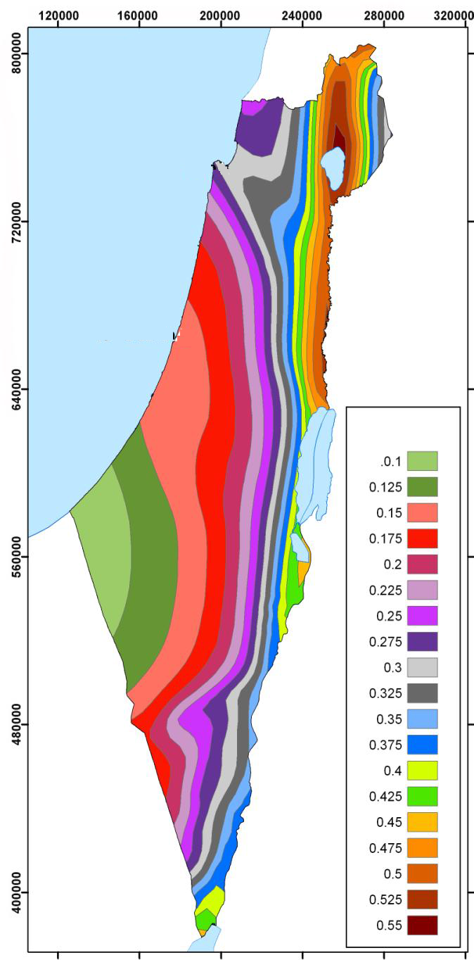
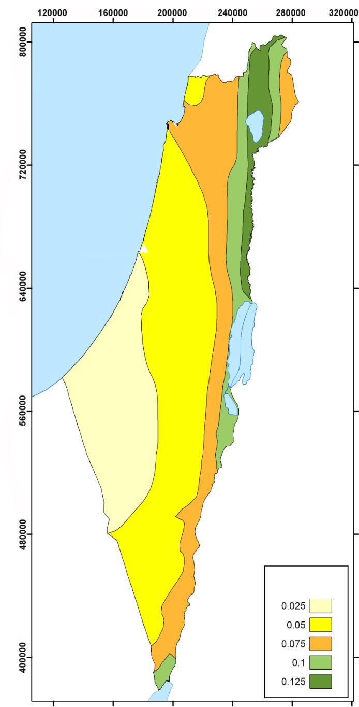
From the map the response spectral Values Ss, S1 are found for Ramallah City as Approximately 27 and 7 percent
Figure1 Hazard map of Palestine in terms of earthquake response spectral acceleration in g, for 475 years return period and damping ratio of 5% computed for periods: a) 0.2 sec; and b) 1 sec

Slide 34
I: seismic factor (importance factor) = 1.25
The approximate parameter Ct and x are 0.02 and 0.75 for this structural system
The Site class can found as B for rock soil profile
This all information will put in sap 2000 for analysis and design

Slide 35
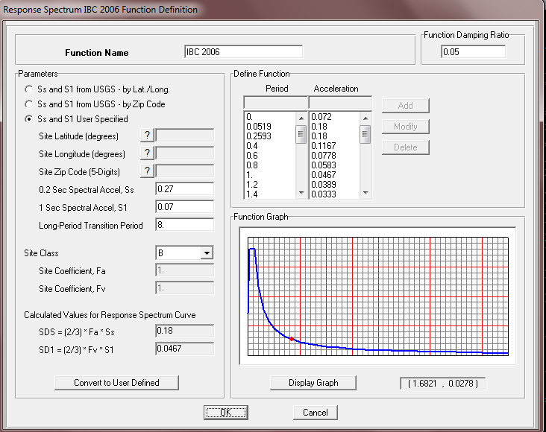
Dynamic Design

Slide 36
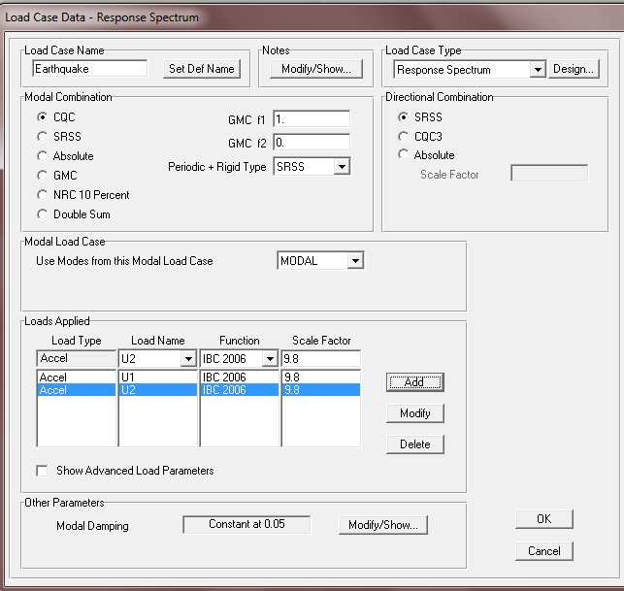

Slide 37
Load combination
1. added default design combination by sap
the concrete frame design
2. taking the envelope of the combinations

Slide 38
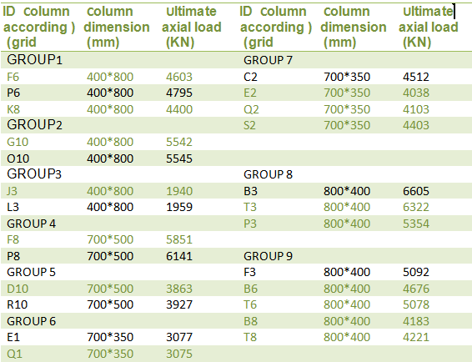
Columns grouping

Slide 39
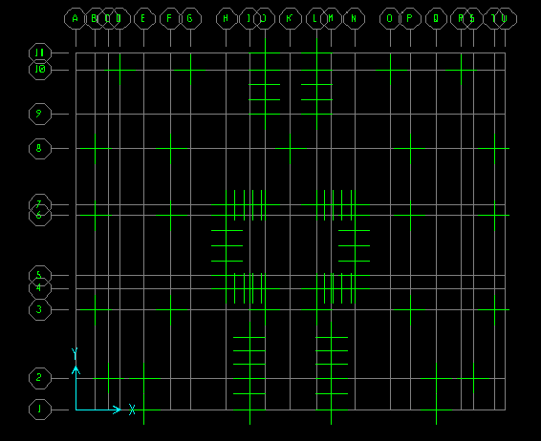
ID from grid

Slide 40
Columns dimensions
We have two design dimensions:
First one: given by architectural engineer
These dimensions are preliminary and it have some
problems that we cant put the area of steel(bars) in
these dimensions as specified in ACI code and it have
high value of percent of steel

Slide 41
The second:we assume other dimensions
We increase the dimensions of columns in order to make it possible to distribute bars with spacing within ACI code limits
&
Decrease the values of steel percentage to be nearby the economical percent

Slide 42
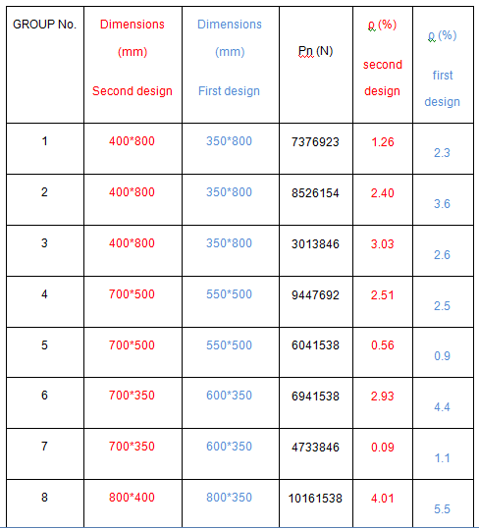
Two designs comparison

Slide 43
Groups design
4.2.1 Design column in group 1:
P_{u} = 4795 KN
P_{n} max = ( 4795/0.65 ) = 7377 KN
P_{n} max = 0.8 [ 0.85*f_{c}~*(Ag – As ) + Fy*As )
7377*1000 = 0.8 [ 0.85 * 28 *( 400*800 - As ) + 420*As
As = 4052 mm²
ρ= As/Ag = ( 4052)/(400*800) = 1.26 % > ρ_{min}=1% ………………. OK
Use 14Ф20mm (As=4396mm²)

Slide 44
Check for buckling
* check buckling:
Check if column is short or long
[(K*Lu)/r] < [34 – 12(M1/M2)] ………… for short column
K = 0.75 , Lu = (3.1 – 0.06) , r = 0.3h = 0.3*0.8 = 0.24 , M1 = M2
(0.75 * 3.04)/ 0.24= 9.5 , 34-12(1)=22
So , [(K*Lu)/r] < [34 – 12(M1/M2)] ………………… OK
P_{cr} = π² EI / (KL)²
EI = (0.4 * E_{C} * I_{g} ) / (1 + B_{d} )
B_{d} = (1.2D_{L} / P_{u}) = 3676 / 4795 = 0.767
E_{c} = 4700 ( 28 )^{0.5} = 24870 MPa
I_{g} = ( bh³)/12 = ( 400*800³)/12 = 1.71*10¹⁰ mm⁴
EI = 9.61*10¹³
P_{cr} = π² (9.61*10¹³) / ( ( 0.75 * 3100 )² * 1000 ) = 175288 KN
0.75 P_{cr} = 131466 KN > P_{u} …………………. Ok ( no buckling )

Slide 45
* Spaces between ties :-
16 Db = 16 * 20 = 320mm
Or
48 Ds = 48 * 10 = 480mm
Or
Least column dimension = 400mm
Take the smaller ………………………….. S = 320 mm

Slide 46
Choice of the Type of Foundation
The allowable bearing capacity of the soil =300KN/m2 ,The Summation of service load equal 127677KN
The area of all footing larger than 50% of the base area of structure So the footing will design as mat foundation
Mat foundation provided when the soil is having very low bearing capacity and or when columns loads are heavy, the required footing area becomes very large (more than 50 percent of the area) and uneconomical

Slide 47
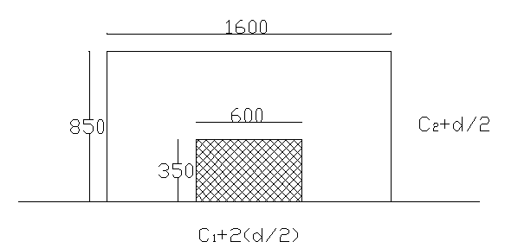
Assume the mat depth =1.1m,the effective depth =1m
For column 1:-
bo=600+2×(1000/2)+2×(350+1000/2)=3300mm
ᶲVcp=(0.75/3)×√28×3300×1000/1000=4365.5KN
Pu from sap=2838.6KN
ᶲVcp>Pu ok
Critical section in column 1

Slide 48
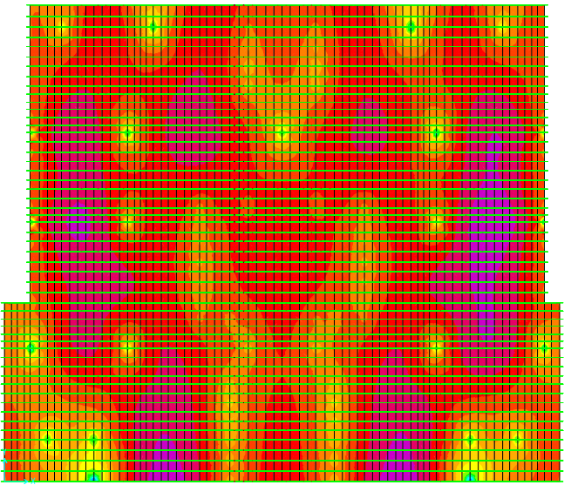
Moment distribution in X-direction

Slide 49
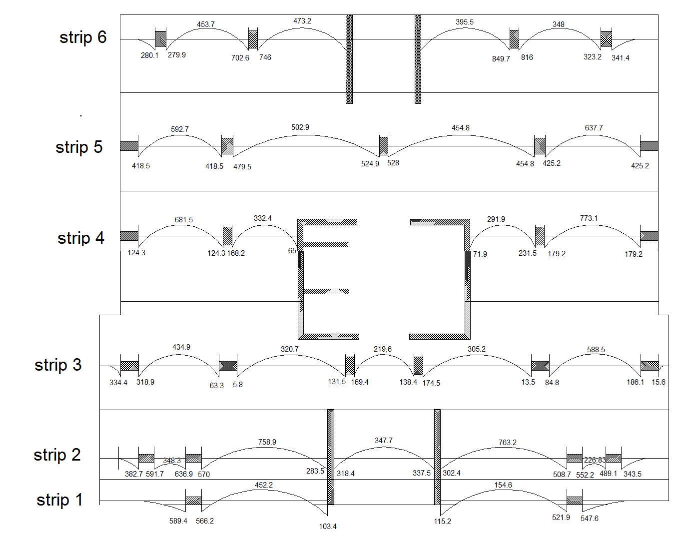
There are six groups of strip in the mat as shown in figure

Slide 50
1_The maximum positive moment 849.7KN.m/m
Area of steel =2290mm2 <Asmin
use As min 3333.3mm2
9ᶲ22/m
2_The maximum negative moment773.1KN.m/m
Area of steel =2079mm2<Asmin
use As min 3333.3mm2
9ᶲ22/m
The values of moment in y-direction
1_The maximum positive moment from sap 2000 equal 558.1KN.m/m
Area of steel =1493mm2<Asmin
use As min 3333.3mm2
9ᶲ22/m
2_The maximum negative moment from sap 2000 equal 601KN.m/m
Area of steel =1610mm2<Asmin
use As min 3333.3mm2
9ᶲ22/m

Slide 51
SHEAR WALLS

Slide 52
The ultimate axial load on this walls is from the loads from adjoining slab (dead & live ) , reactions of beams, in addition to own weight of walls
According to ACI code (14.5):
ФP_{nw} = 0.55Фf_{c}/Ag [ 1 – (KL_{c} / 32h )²]
ФP_{nw} : nominal axial load strength of wall.
Ag: gross area of section.
h: overall thickness of member.
K: effective length factor, which less than 1 , conservatively we will consider that K=1.
Lc: vertical distance between supports.
Ф: strength reduction factor which equal (0.7).
We will design for one meter run of wall, so:
Ф=0.7 , Ag=250mm X 1000mm , Lc= 3100mm , h= 250mm , K= 1 .

Slide 53
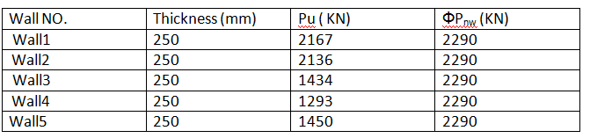
NOTE:-
We notice from this table that ФP_{nw} > Pu for all walls ……. So its safe.

Slide 54
Wall reinforcement:
Vertical reinforcement
According to ACI code (14.3.2): minimum ratio of vertical reinforcement area to gross concrete area shall be 0.0012
As = 0.0012 x Ag = 0.0012 x 250 x 1000 = 300mm²
USE Ф12mm / 300mm

Slide 55
Horizontal reinforcement
According to ACI code (14.3.3) minimum ratio of horizontal reinforcement area to gross concrete area
shall be 0.002
As = 0.002 x Ag = 0.002 x 250 x 1000 = 500mm²
USE Ф12mm / 200mm

Slide 56
THANK YOU

