Slide 1
Mobile App. For Hospital Management System
Presented by:
Eman Hamayel
Rana Abumazen
Supervisor:
Dr.Emad Al Natsheh
Dr.Aladdin Almasri

Slide 2
Outline :
Introduction.
Motivation.
Features.
How does it work.
Technologies.
Methods & Techniques.
Constraints.
Future work & recommendations

Slide 3
Introduction :
It’s a cross-platform mobile application that helps both patient and doctor save time and effort on each .

Slide 4
Motivation :
Patients sometimes have difficulties in
booking appointments with a particular
doctor, and appointments may be erroneous.
Instead of waiting for several hours in the laboratory to obtain the results of the examination, the application can get results through the pdf.

Slide 5
Features :
The patient selects the material to be used by the required doctor. If this appointment is not available, the available dates will be shown and to ensure that he is serious about booking. The secretary will contact him to confirm his reservation.
The patient can view his reports as a file (pdf ) and this saves a lot of time.
Our application provides notification to the patient so that when the patient remains on one hour, a notification is sent to remind him of the appointment.

Slide 7
How the system works ?
Log in the application
There is an addict who sets up doctors' tables and can add or delete a doctor
There are 3 users of the system
The patient records his entry and makes an appointment and is able to view the results of his analysis as a file (pdf)
There is a notification system to remind you of the appointment, and it is possible to talk to doctors

Slide 8
As for the doctor can also log on to the system and see the patient's reports as a file (pdf) and to establish a conversation with doctors or patients.
The secretary is able to check the schedules of doctors and also can confirm the dates of patients and intervene in emergencies.

Slide 9

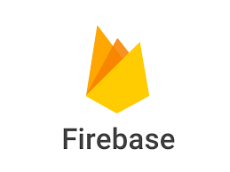
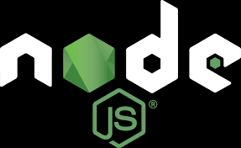


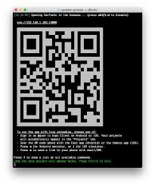
Technologies :

Slide 10
React-Native :
JavaScript framework for writing native mobile applications for iOS and Android.
React Native applications are written using JSX.
React Native Apps will render using mobile components.

Slide 11
It’s one of the top mobile JavaScript frameworks among the developers.
React-Native is all about the UI.
Apply React Native UI components to an existing app’s code.

Slide 12
NodeJs :
Platform built on Chrome's JavaScript runtime for easily building fast, scalable network applications.
Node.js uses an event-driven model that makes it lightweight and efficient

Slide 13
Firebase :
Firebase Real-time Database is a cloud-hosted database.
Data is stored as JSON and synchronized in real-time to every connected client.
It stores and syncs data with our NoSQL cloud database.
Data is synced across all clients in real-time, andremains available when our app goesoffline.

Slide 14
Methods & Techniques :
Registration .
Home page & Navigation.
Reservation system.
Database.

Slide 15
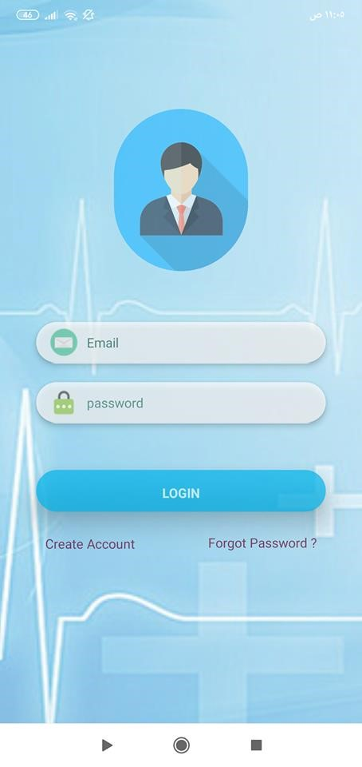
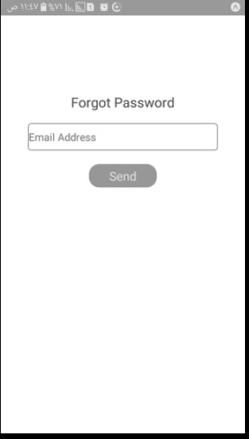
Registration :

Slide 16
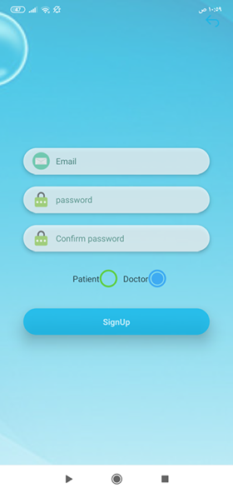

Slide 17
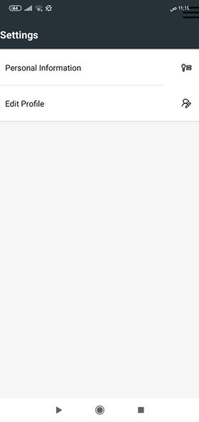
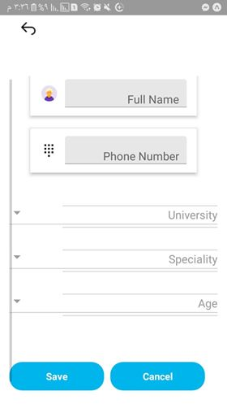
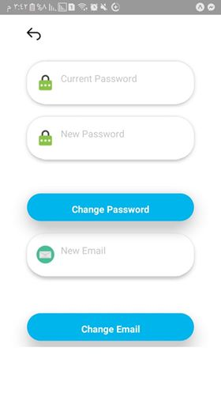

Slide 18
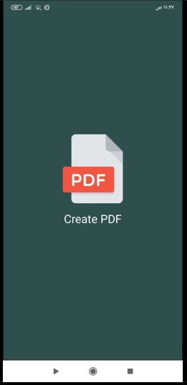
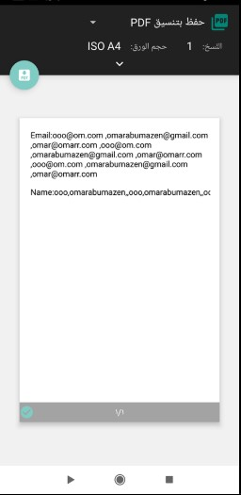
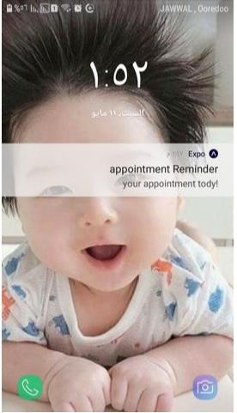

Slide 19
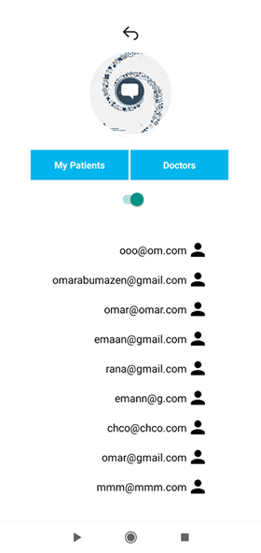
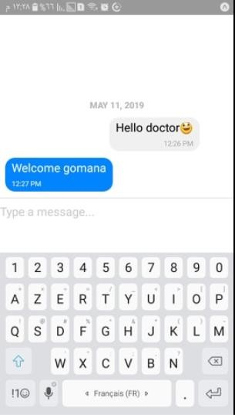
Chatting with patient or doctor

Slide 20
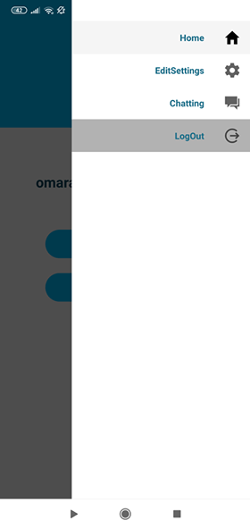
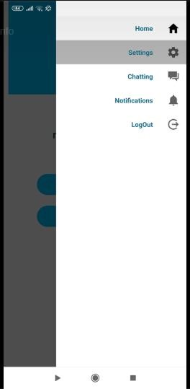
Profile’s Dr.
Profile’s Patient

Slide 23
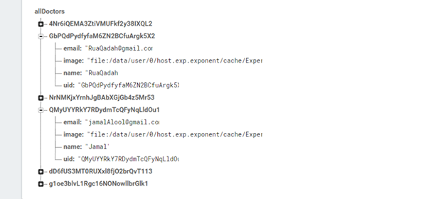
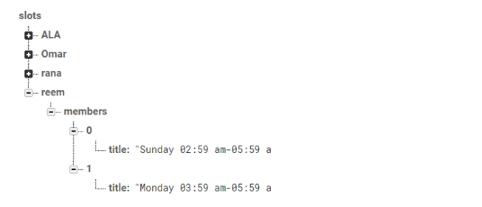
Database

Slide 24
Constraints :
Shortage of Time.
Limited resources.
React Native setup is tedious and annoying.
Documentations: documentations about the basic of react native and how to deal with expo so it was difficult to search about notifications and creating pdf files.
A lot of things we needed to learn:
Nodejs.
Expo.
ES6: We only have basic familiarity with the JavaScript syntax.

Slide 25
Future Work:
Find out if the patient wants treatment on insurance or use his own account where each transaction differs from the other. When a user searches for a location, it is attached to a map because it may be outside the country in which the centre is located. It may not be an idea to link the centre to the blood bank so that the centre requests the blood groups of the bank available at that time and when the donation, the bank will send a notification to the centre.

Slide 26


